Slide 1
Chapter 6: Seasonality
Many economic variable exhibit some form of cyclicality: “seasonality”, like flower sales, Christmas sales (impact of retail trade), airplane ticket sales. Seasonality has an impact on the series total variance. If you goal is to forecast, seasonality should be taken into account.
The dependence on the past tends to occur most strongly at multiples of some seasonal lag (s) when there is evidence of seasonal fluctuations.
Ignoring seasonality is a misspecification of the model problem.
Seasonality can have different lengths: weekly, monthly, quarterly frequency.
The ACF and PACFs can help us to determine the periodicity in the series. The correlation between some specific quarters or months will be shown in the correlogram. We can see from the ACF of Male Unemployment (on first difference) that 36th month is correlated with the 24th month, that is correlated with the 12th month.

Slide 2
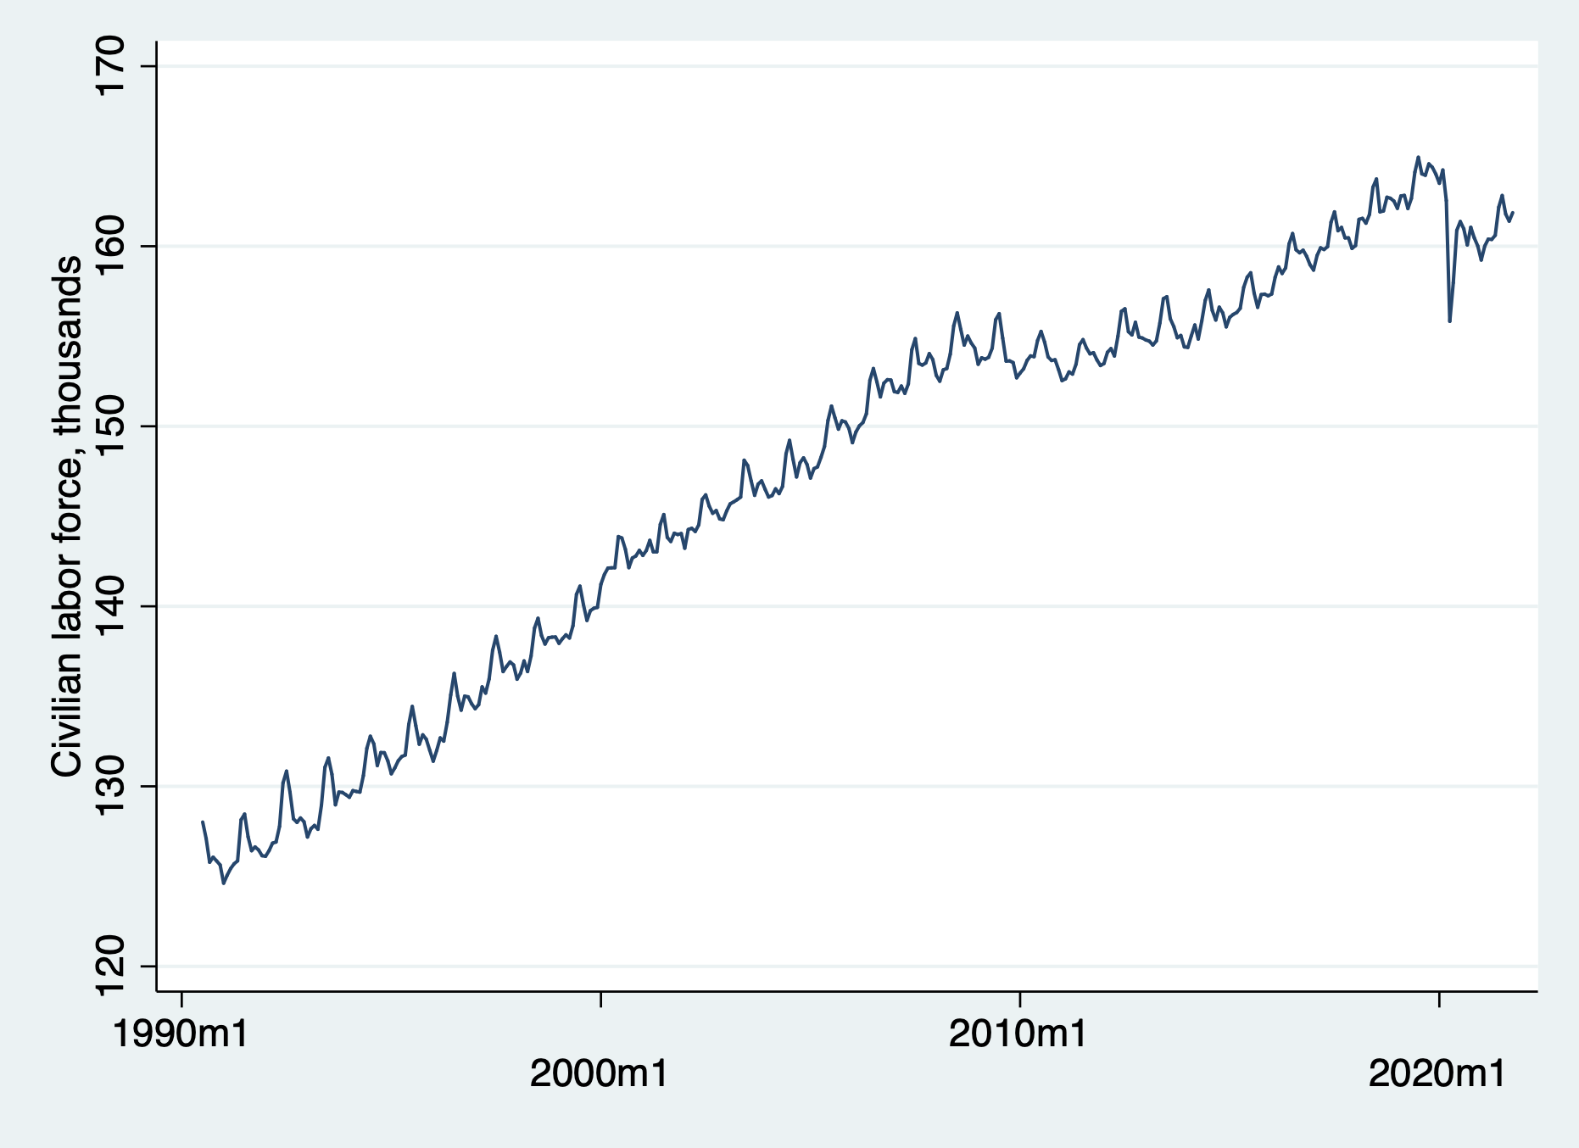

Slide 3
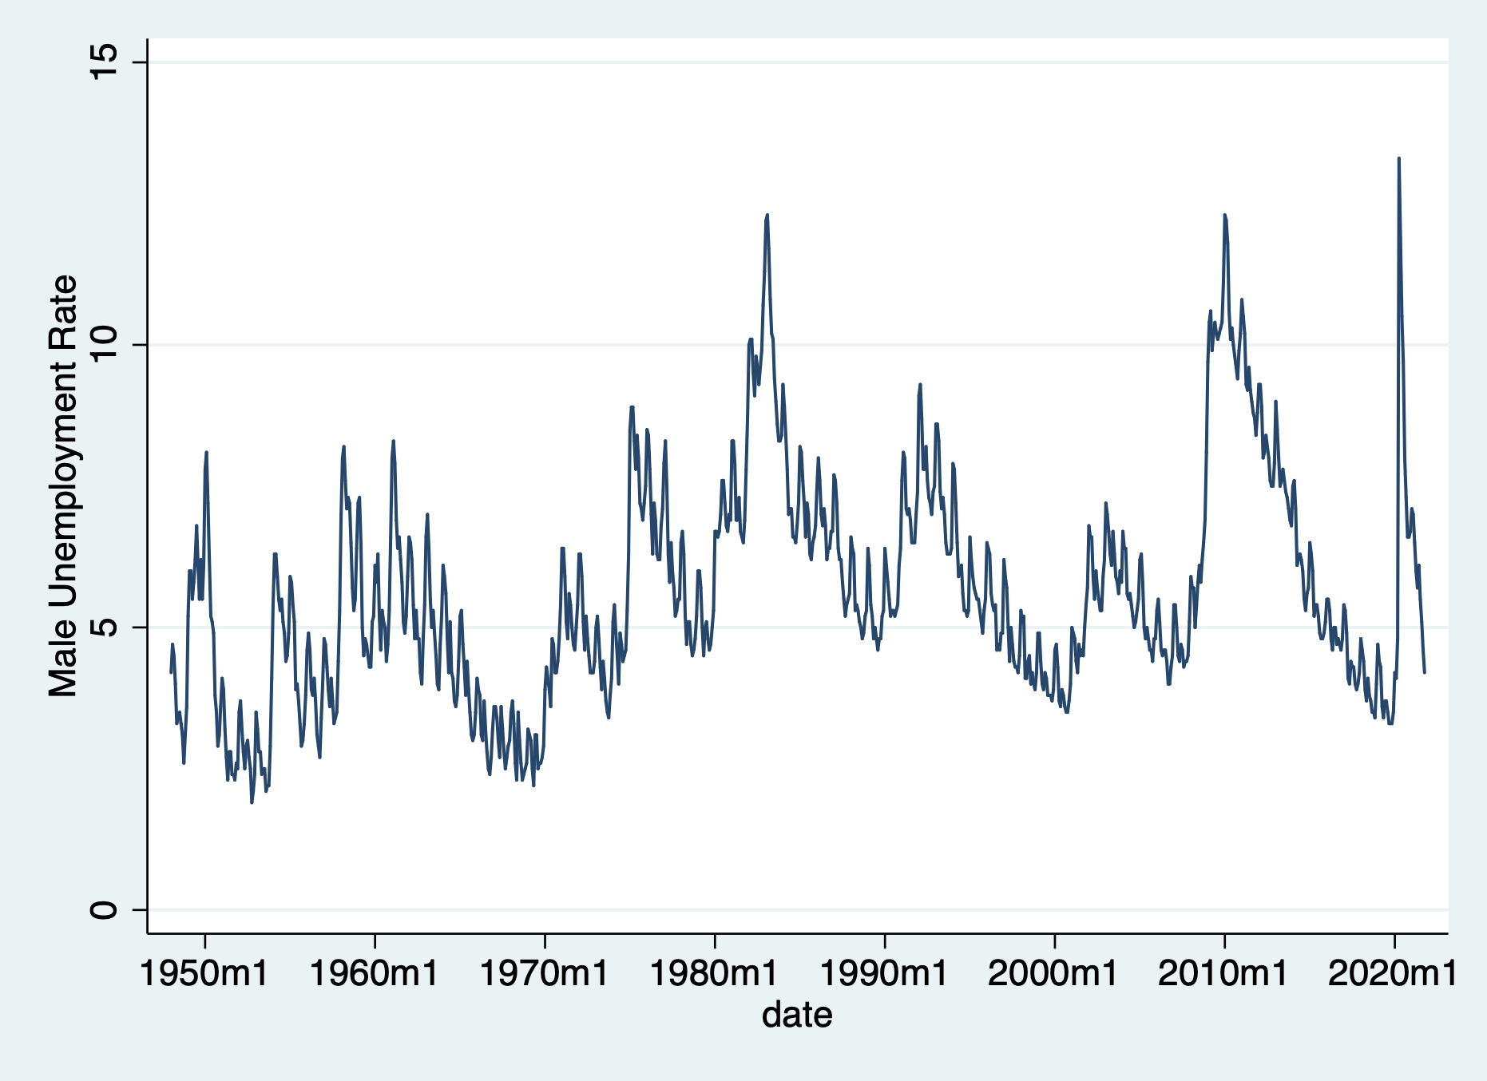

Slide 4
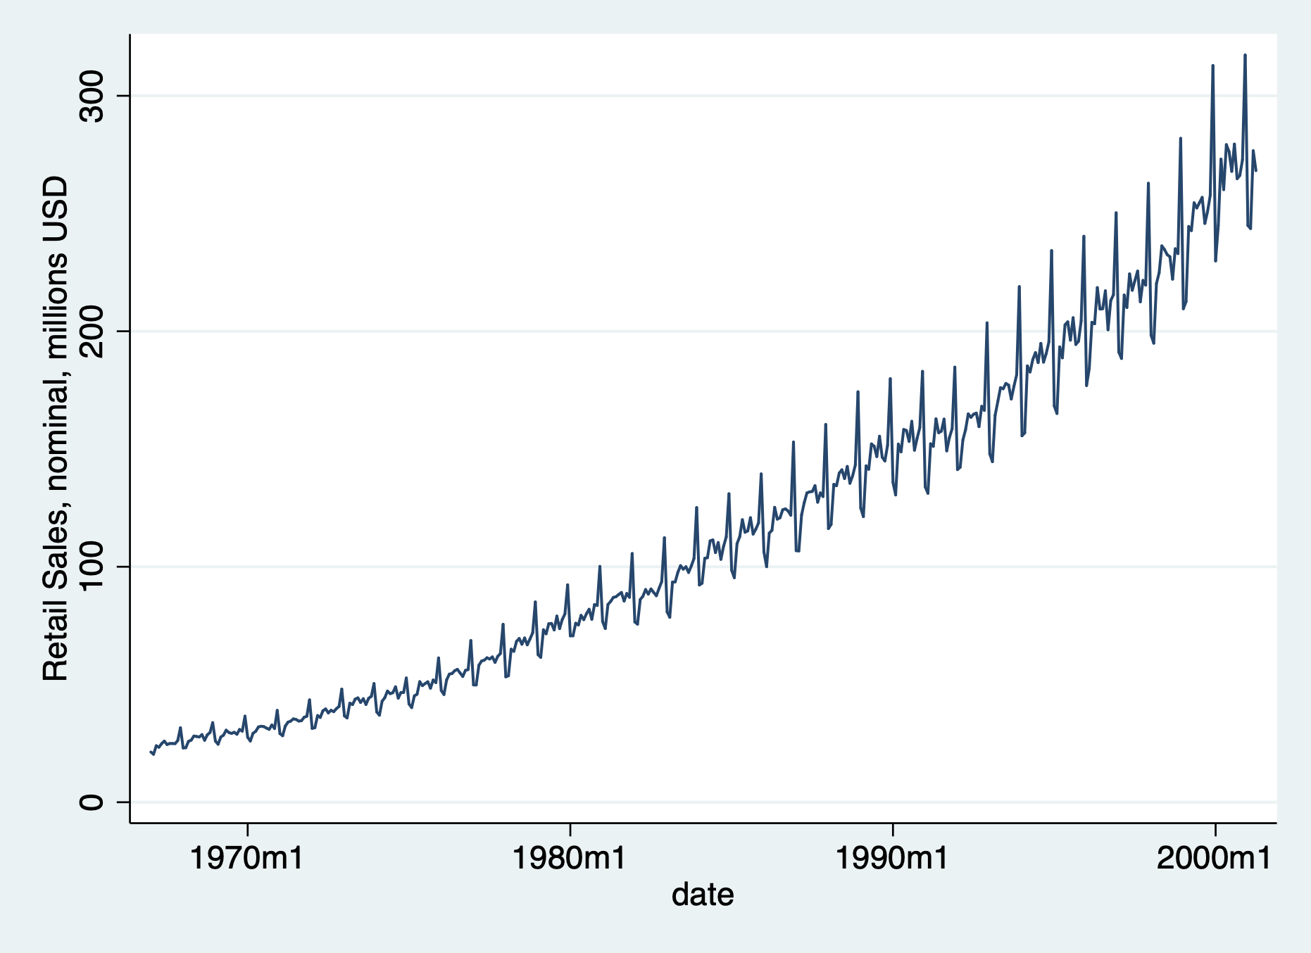

Slide 5
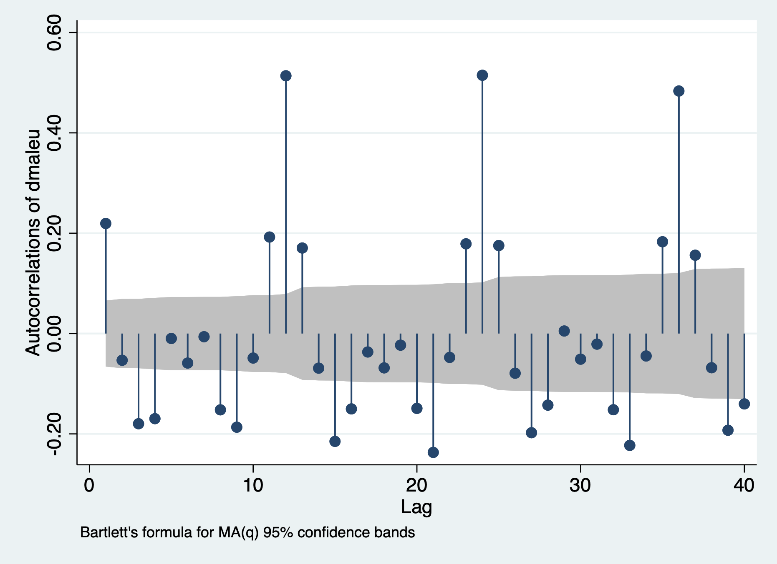

Slide 6
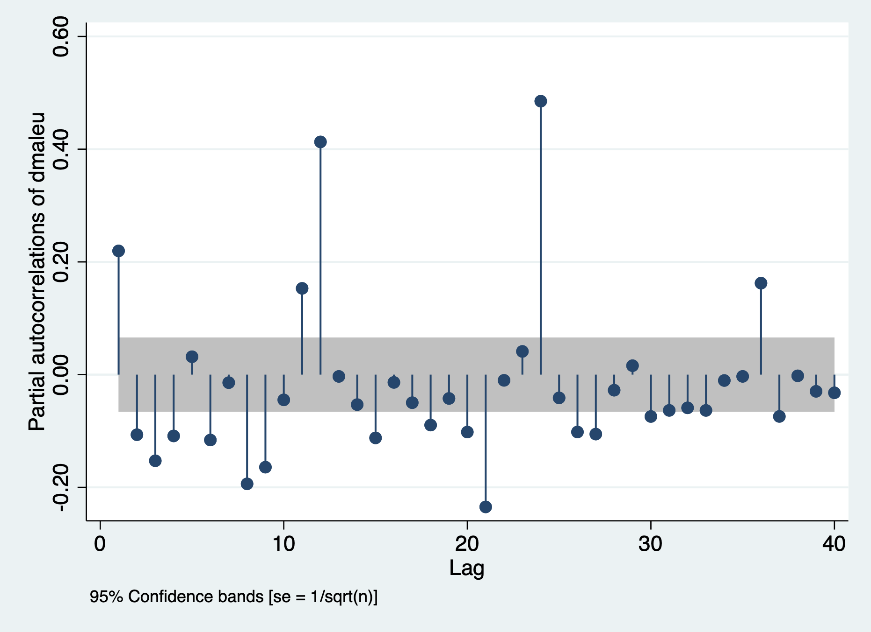

Slide 7
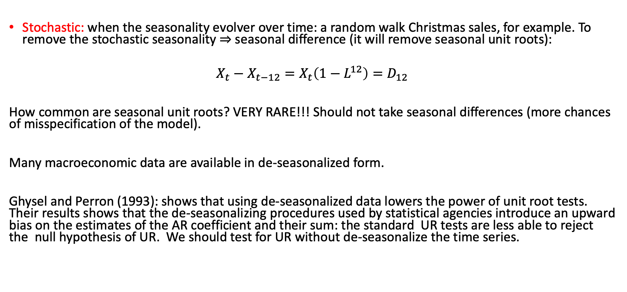
Type of Seasonality: Stochastic and Deterministic
Stochastic: when the seasonality evolver over time: a random walk Christmas sales, for example. To remove the stochastic seasonality $⇒$ seasonal difference (it will remove seasonal unit roots):
$$X_{t}−X_{t−12}=X_{t}\left(1−L^{12}\right)=D_{12}$$
How common are seasonal unit roots? VERY RARE!!! Should not take seasonal differences (more chances of misspecification of the model).
Many macroeconomic data are available in de-seasonalized form.
Ghysel and Perron (1993): shows that using de-seasonalized data lowers the power of unit root tests. Their results shows that the de-seasonalizing procedures used by statistical agencies introduce an upward bias on the estimates of the AR coefficient and their sum: the standard UR tests are less able to reject the null hypothesis of UR. We should test for UR without de-seasonalize the time series.

Slide 8
Deterministic Seasonality
Deterministic: Deterministic seasonality occurs when the pattern (same amount or same percentage) is the same each year. It is bet captured by seasonal dummies. If the variable is in level, the dummies will capture level shifts; if the variable is in logarithm, then the dummies capture percentage changes.
Deterministic seasonality is more than adequate to account for seasonality.
Example: Christmas shopping show a spike of approximately 20% growth every winter.
How to remove deterministic seasonality: as we “detrend” a trend-stationary process, we “de-seasonalize” a process that shows seasonality, by including seasonal dummies.

Slide 9
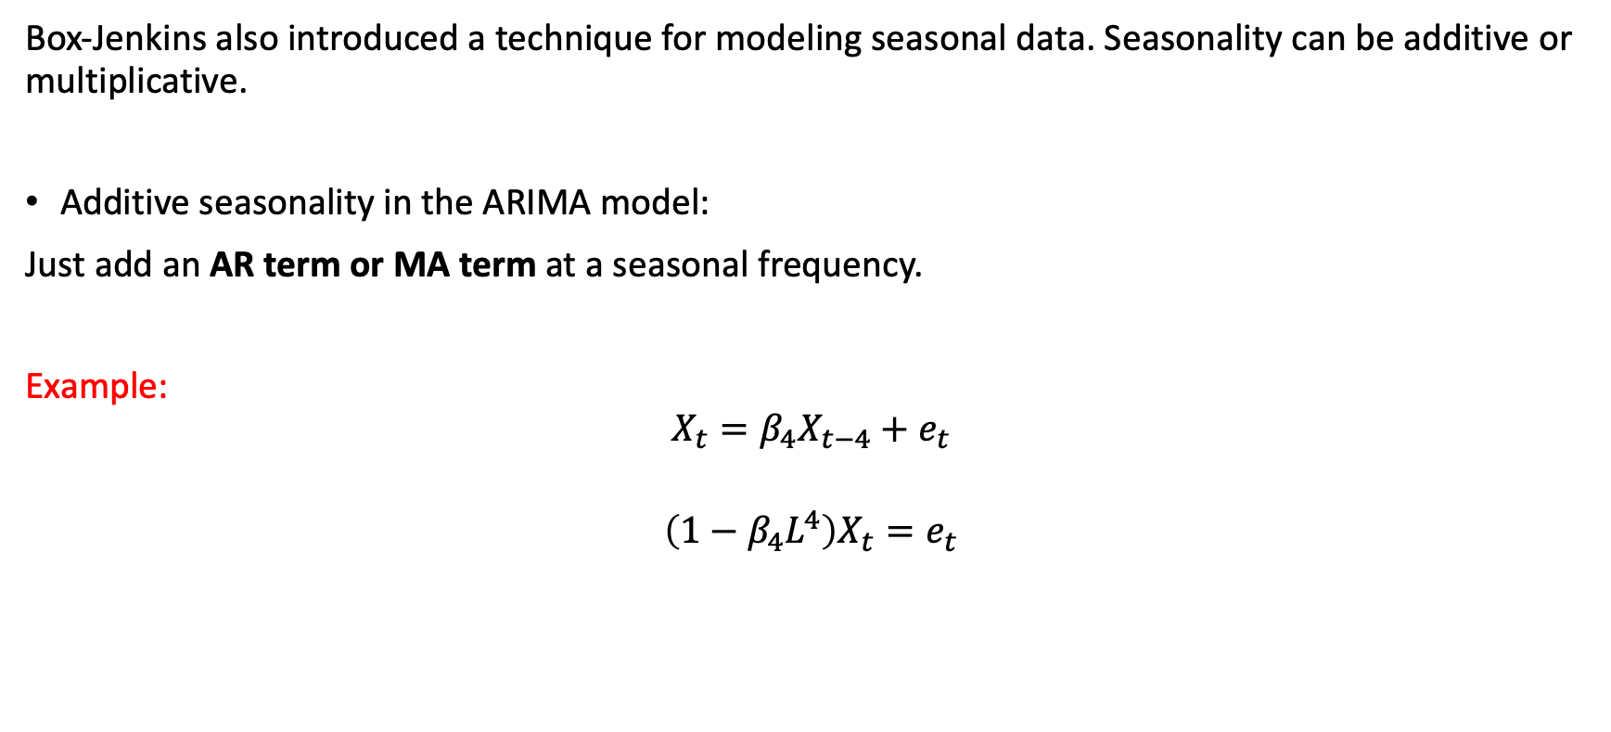
Modeling Seasonal Data: additive seasonality
Box-Jenkins also introduced a technique for modeling seasonal data. Seasonality can be additive or multiplicative.
Additive seasonality in the ARIMA model:
Just add an AR term or MA term at a seasonal frequency.
Example:
$$X_{t}=β_{4}X_{t−4}+e_{t}$$
$${\left(1−β_{4}L^{4}\right)X}_{t}=e_{t}$$

Slide 10
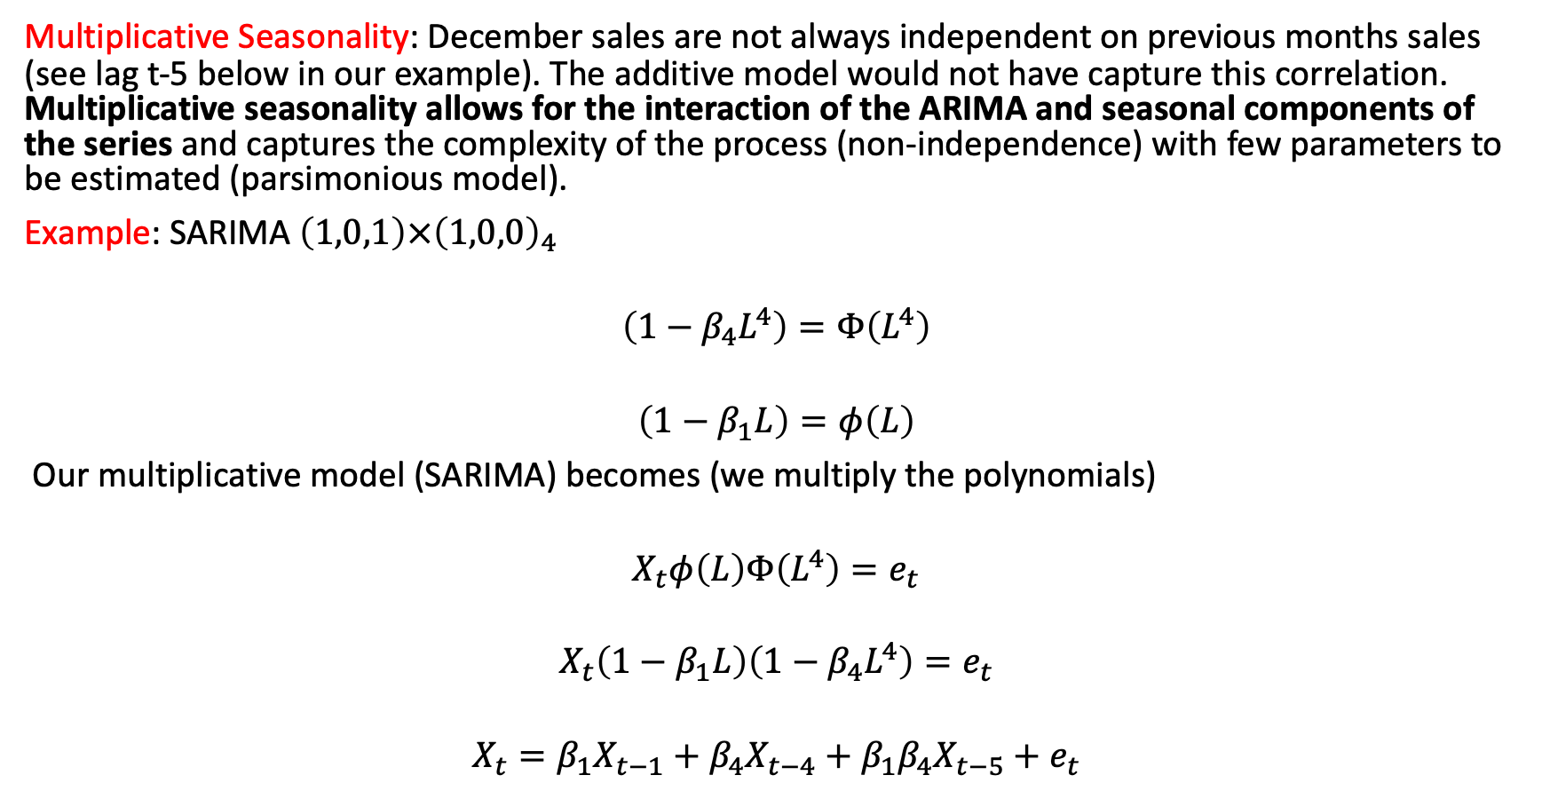
Modeling Seasonal Data: SARIMA models
Multiplicative Seasonality: December sales are not always independent on previous months sales (see lag t-5 below in our example). The additive model would not have capture this correlation. Multiplicative seasonality allows for the interaction of the ARIMA and seasonal components of the series and captures the complexity of the process (non-independence) with few parameters to be estimated (parsimonious model).
Example: SARIMA $\left(1,0,1\right)×{\left(1,0,0\right)}_{4}$
$$\left(1−β_{4}L^{4}\right)=Φ\left(L^{4}\right)$$
$$\left(1−β_{1}L\right)=φ\left(L\right)$$
Our multiplicative model (SARIMA) becomes (we multiply the polynomials)
$$X_{t}φ\left(L\right)Φ\left(L^{4}\right)=e_{t}$$
$$X_{t}\left(1−β_{1}L\right)\left(1−β_{4}L^{4}\right)=e_{t}$$
$$X_{t}=β_{1}X_{t−1}+β_{4}X_{t−4}+β_{1}β_{4}X_{t−5}+e_{t}$$

Slide 11
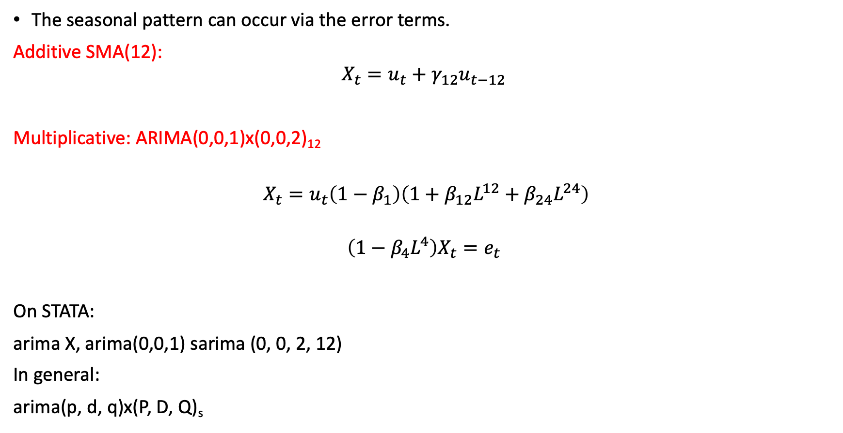
MA Seasonality: additive and multiplicative
The seasonal pattern can occur via the error terms.
Additive SMA(12):
$$X_{t}=u_{t}+γ_{12}u_{t−12}$$
Multiplicative: ARIMA(0,0,1)x(0,0,2)₁₂
$X_{t}=u_{t}\left(1−β_{1}\right)\left(1+β_{12}L^{12}+β_{24}L^{24}\right)$
$${\left(1−β_{4}L^{4}\right)X}_{t}=e_{t}$$
On STATA:
arima X, arima(0,0,1) sarima (0, 0, 2, 12)
In general:
arima(p, d, q)x(P, D, Q)_{s}

Slide 12

SARIMA(P, D, Q) IDENTIFICATION: ACFs and PACFs
Computing the ACF - example: SAR(4)
$$X_{t}=0.5X_{t−4}+e_{t}$$
$$Corr\left(X_{t},X_{t−1}\right)=0$$
$$Corr\left(X_{t},X_{t−2}\right)=0$$
$$Corr\left(X_{t},X_{t−3}\right)=0$$
$$Corr\left(X_{t},X_{t−4}\right)=0.5$$
$$Corr\left(X_{t},X_{t−5}\right)=0$$
$$Corr\left(X_{t},X_{t−6}\right)=0$$
$$Corr\left(X_{t},X_{t−7}\right)=0$$
$$Corr\left(X_{t},X_{t−8}\right)={0.5}^{2}=0.25$$

Slide 13
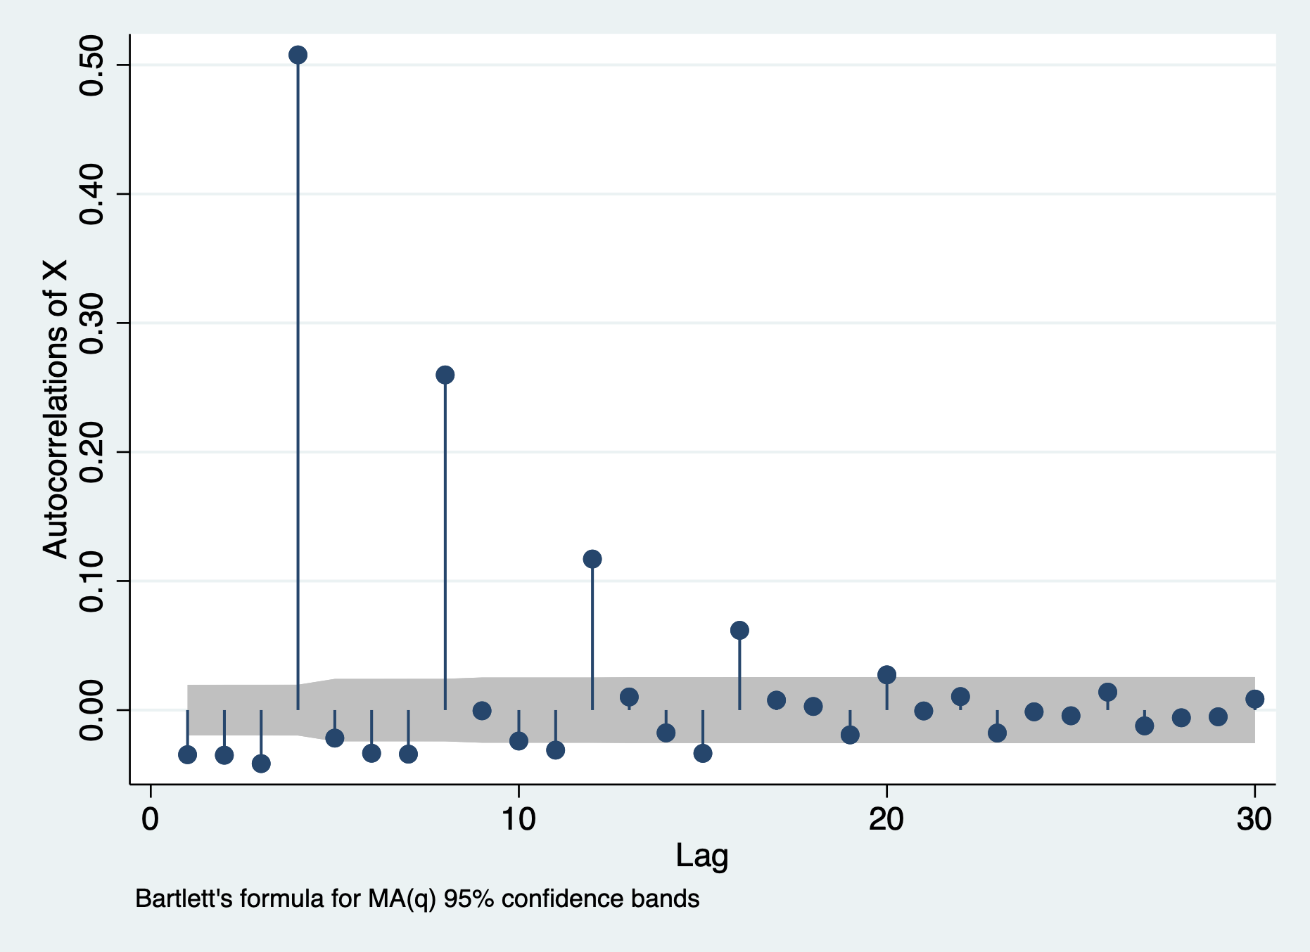

Slide 14
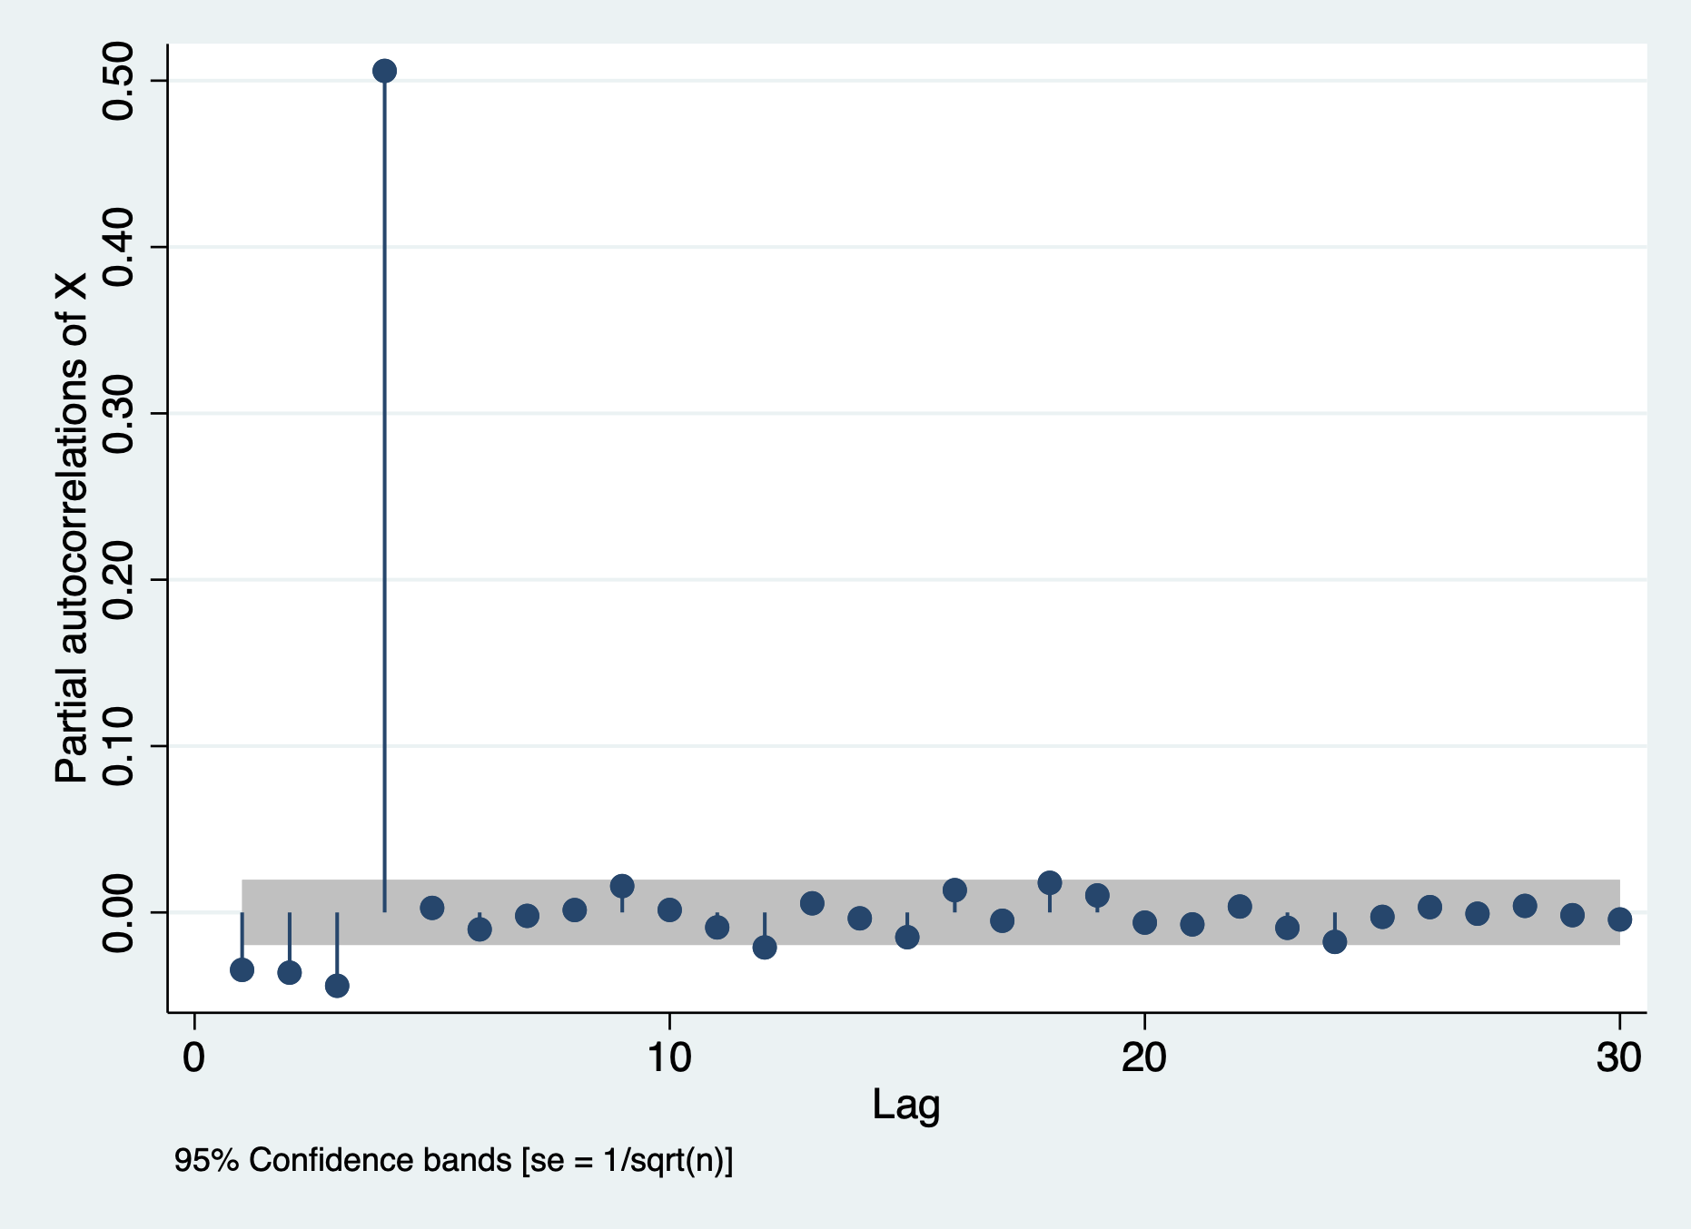

Slide 15

SARIMA(P, D, Q) IDENTIFICATION: ACFs and PACFs
Computing the ACF - example:
$$X_{t}=0.5e_{t−4}+e_{t}$$
$$Corr\left(X_{t},X_{t−1}\right)=0$$
$$Corr\left(X_{t},X_{t−2}\right)=0$$
$$Corr\left(X_{t},X_{t−3}\right)=0$$
$$Corr\left(X_{t},X_{t−4}\right)=0$$
$$Corr\left(X_{t},X_{t−5}\right)=0$$
$$Corr\left(X_{t},X_{t−6}\right)=0$$
$$Corr\left(X_{t},X_{t−7}\right)=0$$
$$Corr\left(X_{t},X_{t−12}\right)=0.5$$

Slide 16
Autocorrelation: Additive SMA(12)

Slide 17
Partial Autocorrelation: Additive SMA(12)

Slide 18
Autocorrelation: Multiplicative ARIMA(0,0,1)(0,0,12)

Slide 19
Partial Autocorrelation: Multiplicative ARIMA(0,0,1)(0,0,12)

Slide 20
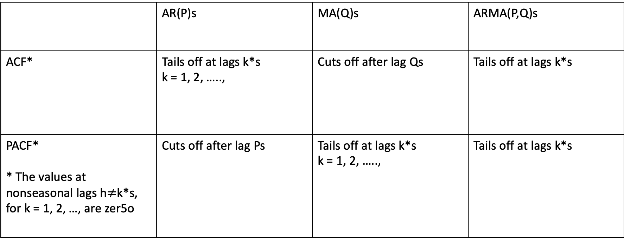
Behavior of the ACF and PACF for pure SARIMA model
 | AR(P)s | MA(Q)s | ARMA(P,Q)s
ACF* | Tails off at lags k*s k = 1, 2, ….., | Cuts off after lag Qs | Tails off at lags k*s
PACF* * The values at nonseasonal lags h$≠$k*s, for k = 1, 2, …, are zer5o | Cuts off after lag Ps | Tails off at lags k*s k = 1, 2, ….., | Tails off at lags k*s

Slide 21
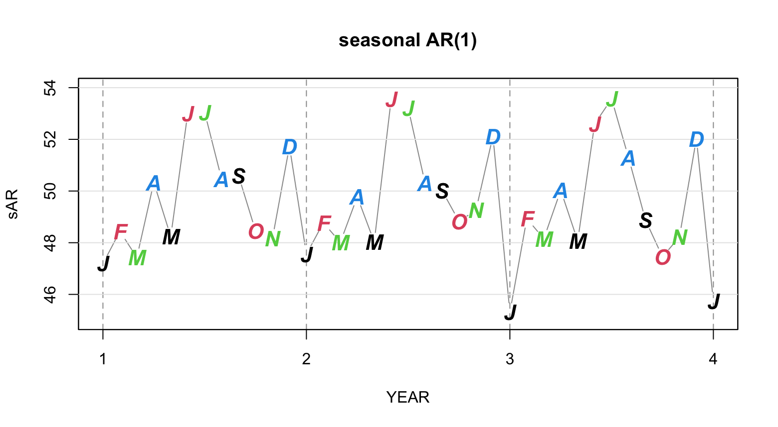

Slide 22
Normally the seasonal pattern will interact with the non-seasonal pattern in the data, complicating the identification of the model .

Slide 23
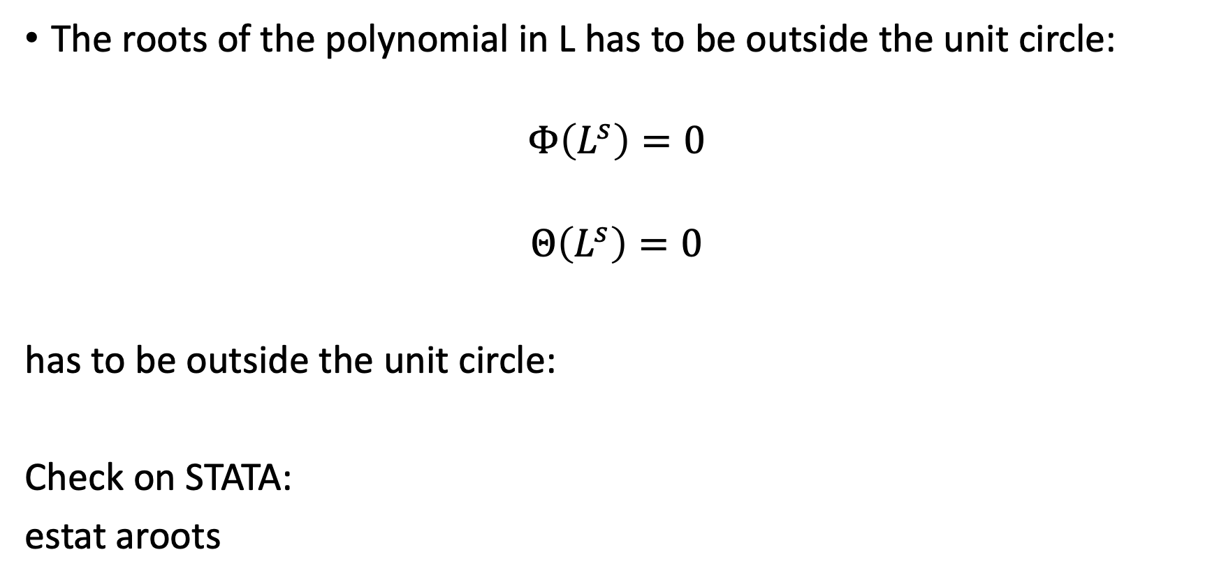
Invertibility and Stability of seasonal models
The roots of the polynomial in L has to be outside the unit circle:
$$Φ\left(L^{s}\right)=0$$
$$Θ\left(L^{s}\right)=0$$
has to be outside the unit circle:
Check on STATA:
estat aroots

