Slide 1
Chapter 2
Instructions : Language of the Computer

Slide 2
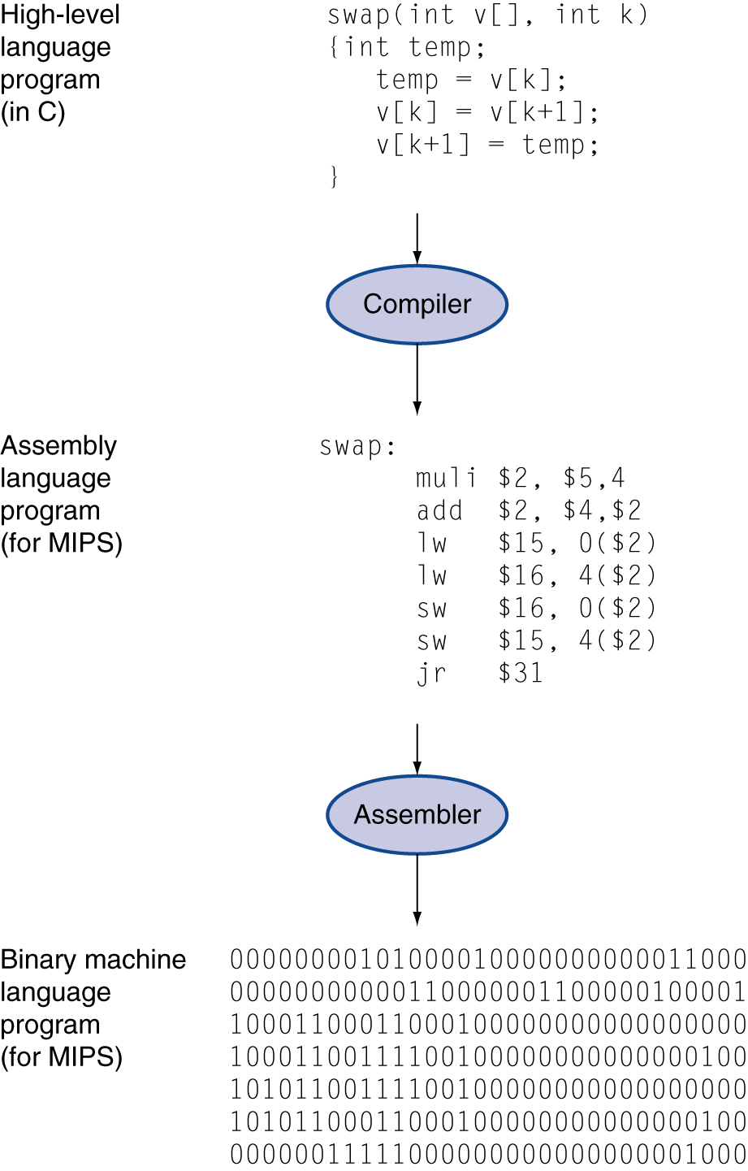
Representation of a Program
High-level language
Level of abstraction closer to problem domain
Provides for productivity and portability
Assembly language
Textual representation of instructions
Hardware representation
Binary digits (bits)
Encoded instructions and data

Slide 3
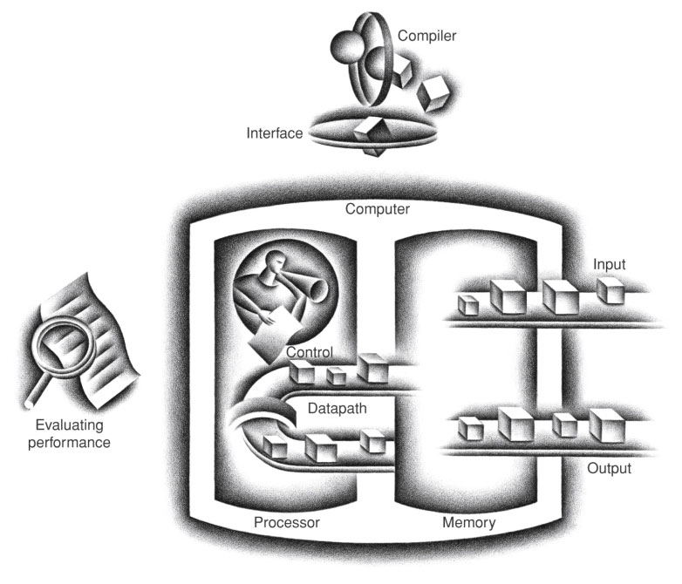
17번 방의 값과
18번 방의 값을
더해서 8번 방에 써라.
00000010001100100100000000100000₂
FIGURE 1.5 The organization of a computer, showing the five classic components. The processor gets instructions and data from memory. Input writes data to memory, and output reads data from memory. Control sends the signals that determine the operations of the datapath, memory, input, and output.
Copyright © 2014 Elsevier Inc. All rights reserved.

Slide 4
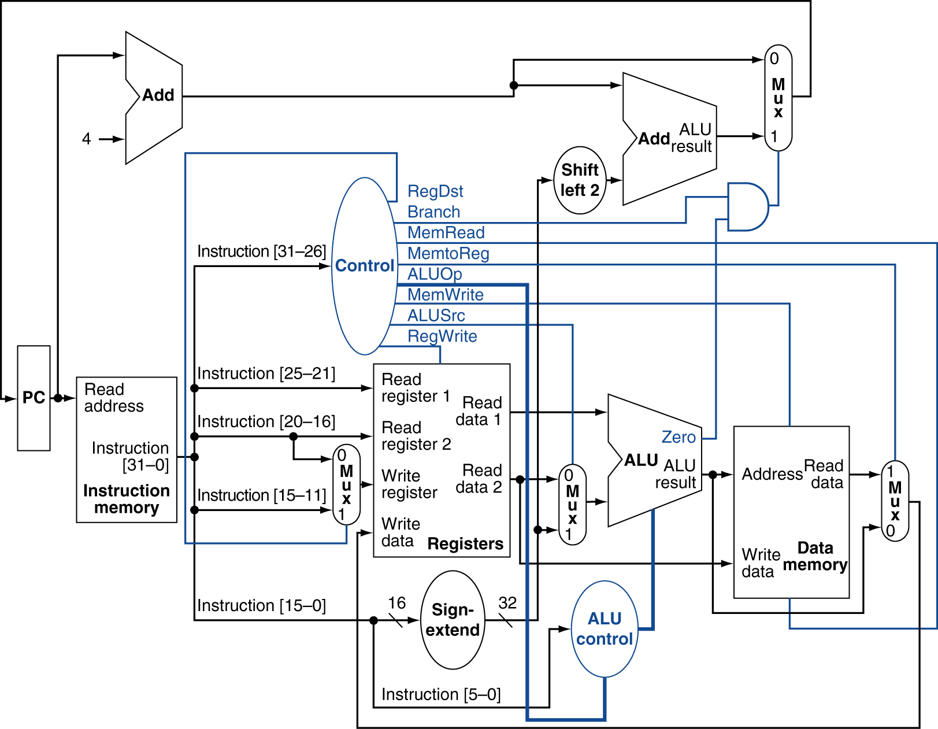
Logic Diagram of a Processor

Slide 5
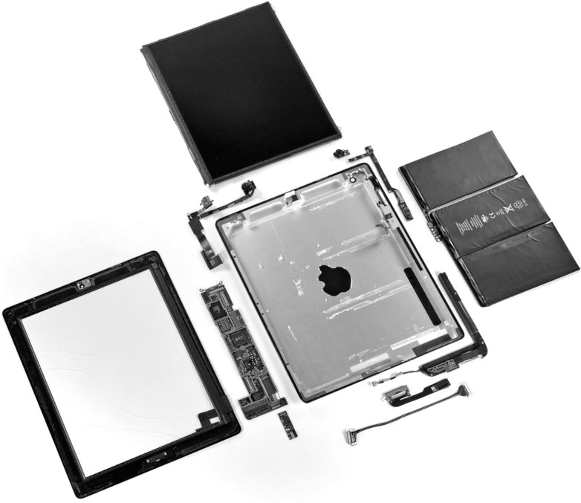
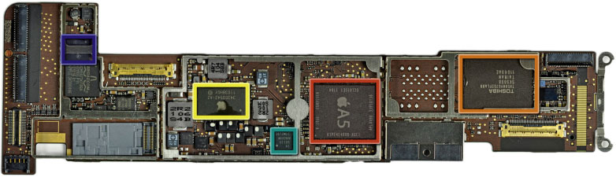
inside iPad 2
FIGURE 1.8 The logic board of Apple iPad 2 in Figure 1.7. The photo highlights five integrated circuits. The large integrated circuit in the middle is the Apple A5 chip, which contains a dual ARM processor cores that run at 1 GHz as well as 512 MB of main memory inside the package. Figure 1.9 shows a photograph of the processor chip inside the A5 package. The similar sized chip to the left is the 32 GB flash memory chip for non-volatile storage. There is an empty space between the two chips where a second flash chip can be installed to double storage capacity of the iPad. The chips to the right of the A5 include power controller and I/O controller chips. (Courtesy iFixit, www.ifixit.com)
5
Copyright © 2014 Elsevier Inc. All rights reserved.

Slide 6
Instruction Set Architecture (ISA)
§2.1 Introduction
컴퓨터 (프로세서) 에서 사용되는 명령어들의 집합 및 그 정의
Different computers (processors) have different ISAs
But with many aspects in common
Many modern computers have simple instruction sets
그 중에서 MIPS ISA 를 배울 것임.

Slide 7
The MIPS Instruction Set
Used as the example throughout the book
Stanford MIPS commercialized by MIPS Technologies (www.mips.com)
Large share of embedded core market
Applications in consumer electronics, network/storage equipment, cameras, printers, …
Typical of many modern ISAs
See MIPS Reference Data tear-out card, and Appendix A.10

Slide 8
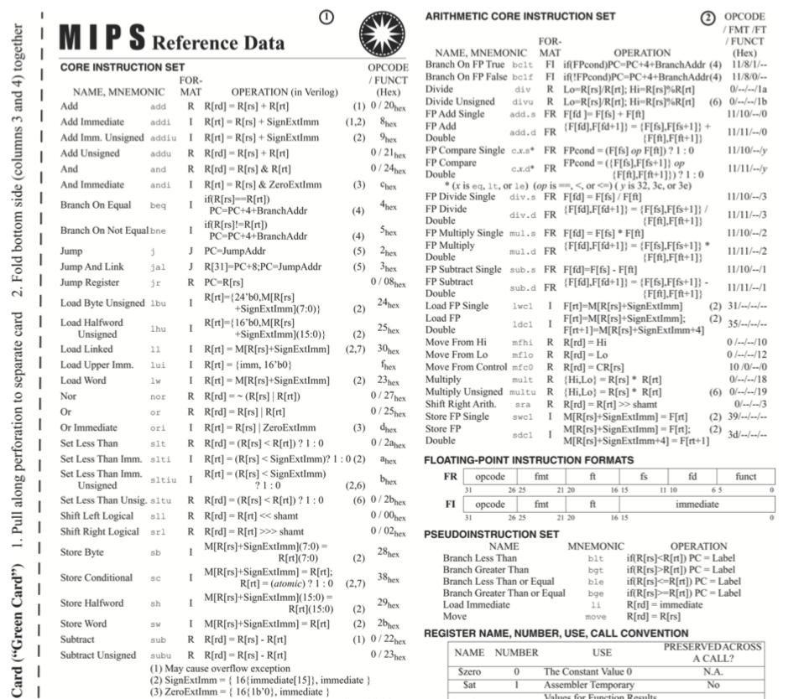

Slide 9
Types of Instructions
Arithmetic / Logic instructions 연산 명령어
= ALU operations
Data transfer instructions 메모리 접근 명령어
= Load/Store instructions
Branch instructions 분기 명령어
= Control transfer instructions

Slide 10
1. MIPS
Arithmetic Instructions

Slide 11
1) MIPS Arithmetic Instructions
덧셈, 뺄셈, 곱셈, 나눗셈 등의 산술 논리 연산 명령어들
add a, b, c # a gets b + c
operation source operands
destination operand comments
§2.2 Operations of the Computer Hardware
instruction

Slide 12
MIPS Arithmetic
C code:
f = g + h;
Compiled MIPS code:
add f, g, h # f = g + h

Slide 13
Operands of Arithmetic Instructions
3 operands : 1 destination, 2 sources
Arithmetic instructions use only register operands
§2.3 Operands of the Computer Hardware

Slide 14
Registers
레지스터 : 프로세서 내부에 있는, 작고 빠른 임시의 메모리
MIPS has a 32 × 32-bit register file ($0 ~ $31)
Use for frequently accessed data
Numbered 0 to 31
32-bit data called a “word”
Design Principle : Smaller is faster
c.f. main memory: millions of locations

Slide 15
Registers vs. Memory
register
FIGURE 1.5 The organization of a computer, showing the five classic components. The processor gets instructions and data from memory. Input writes data to memory, and output reads data from memory. Control sends the signals that determine the operations of the datapath, memory, input, and output.
Copyright © 2014 Elsevier Inc. All rights reserved.

Slide 16
MIPS Arithmetic Instructions : revisited
add a, b, c # a gets b + c
operation source operands
destination operand comments
§2.2 Operations of the Computer Hardware

Slide 17
MIPS Arithmetic
C code:
f = g + h;
Compiled MIPS code:
add $3, $4, $5

Slide 18
MIPS Arithmetic
C code:
f = (g + h) - (i + j);
Compiled MIPS code:
(가정: f in $2, g in $3, h in $4, i in $5, j in $6)
add $7, $3, $4 # $7 = g + h add $8, $5, $6 # $8 = i + j sub $2, $7, $8 # f = $7 - $8

Slide 19
1-1. MIPS
Immediate Arithmetic/Logic Instructions

Slide 20
MIPS Immediate Arithmetic Instructions
C code:
f = g + 10;
Compiled MIPS code:
(가정: f in $2, g in $3)
addi $2, $3, 10 # 3rd operand 만 상수

Slide 21
The Constant Zero
MIPS register 0 ($zero or $0) 의 값은 항상 0 이다.
바뀌지 않는다.
Useful for common operations
E.g., move between registers
add $5, $4, $zero

Slide 22
Exercise
.text
.globl main
main:
addi $8, $0, 10 # Q1 : 이 명령어를 실행한 후 8번 레지스터의 값은 얼마인가? (십진수과 16진수로 쓰시오.)
addi $9, $0, 16 # Q2 : 이 명령어를 실행한 후 9번 레지스터의 값은 얼마인가? (십진수과 16진수로 쓰시오.)
add $10, $8, $9 # Q3 : 이 명령어를 실행한 후 10번 레지스터의 값은 얼마인가? (십진수과 16진수로 쓰시오.)
십진수 10을 32bit 16진수로 쓰면 0x0000 000A
이진수로는 0000 0000 0000 0000 0000 0000 0000 1010
* 십진수 16을 32bit 16진수로 쓰면 0x0000 0010
이진수로는 0000 0000 0000 0000 0000 0000 0001 0000

Slide 23
Hexadecimal Numbers (16진수)
Base 16
Compact representation of bit strings
4 bits per hex digit
0 | 0000 | 4 | 0100 | 8 | 1000 | c | 1100
1 | 0001 | 5 | 0101 | 9 | 1001 | d | 1101
2 | 0010 | 6 | 0110 | a | 1010 | e | 1110
3 | 0011 | 7 | 0111 | b | 1011 | f | 1111
Example: 0xeca8 6420
1110 1100 1010 1000 0110 0100 0010 0000

Slide 24
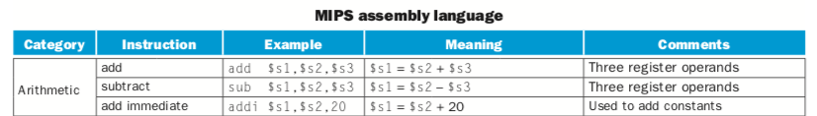

Slide 25
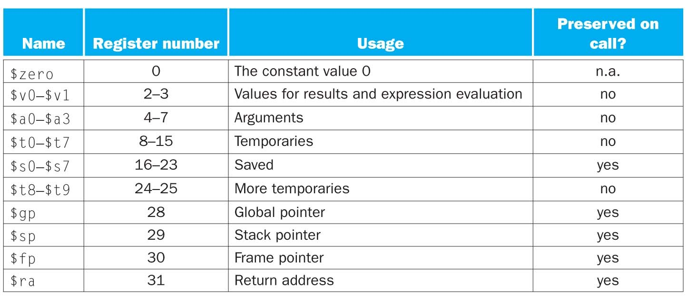
MIPS Register Aliases

