Slide 1
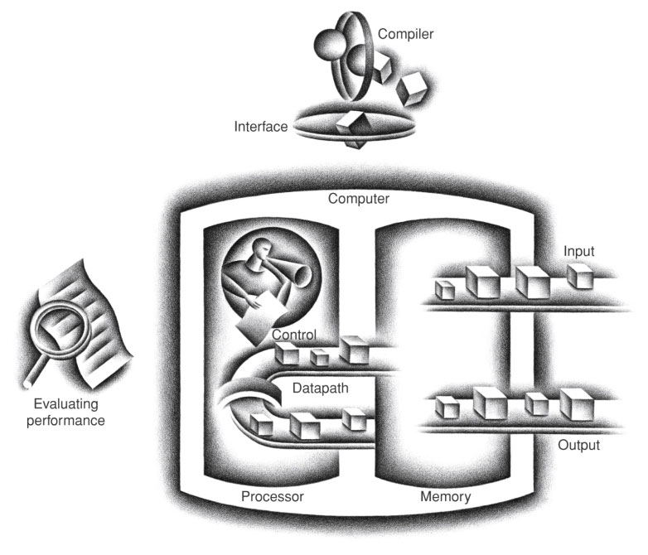
00000000000000000000000000000000₂
register
FIGURE 1.5 The organization of a computer, showing the five classic components. The processor gets instructions and data from memory. Input writes data to memory, and output reads data from memory. Control sends the signals that determine the operations of the datapath, memory, input, and output.
Copyright © 2014 Elsevier Inc. All rights reserved.

Slide 2
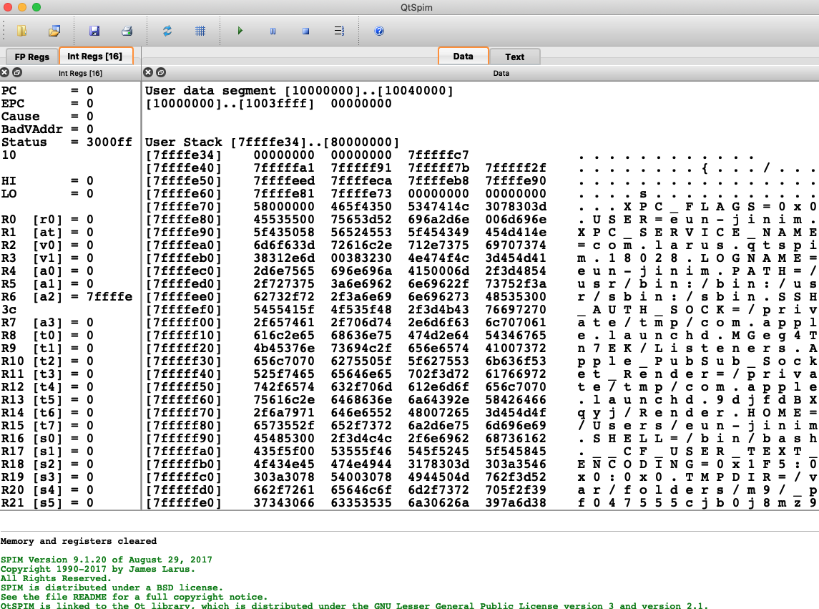
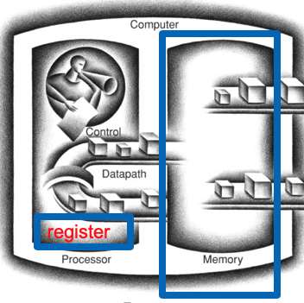
00000000000000000000000000000000₂
Load
Store

Slide 4
2) MIPS Data Transfer Operations
store instruction : register -> memory
sw $4, 8($5)
“store word” offset
operation memory address = R[$5] + 8
source operand in register
base register
§2.2 Operations of the Computer Hardware

Slide 5
load instruction : memory -> register
lw $4, 8($5)
“load word” offset
operation memory address = R[$5] + 8
destination operand in register
base register
§2.2 Operations of the Computer Hardware

Slide 6
다음 코드 수행 결과 $4, $5, $6 의 값은?
.text
.globl main
main:
lui $5, 0x1000
lui $4, 0x789A
ori $4, $4, 0xBCDE
sw $4, 8($5)
lw $6, 8($5)

Slide 7
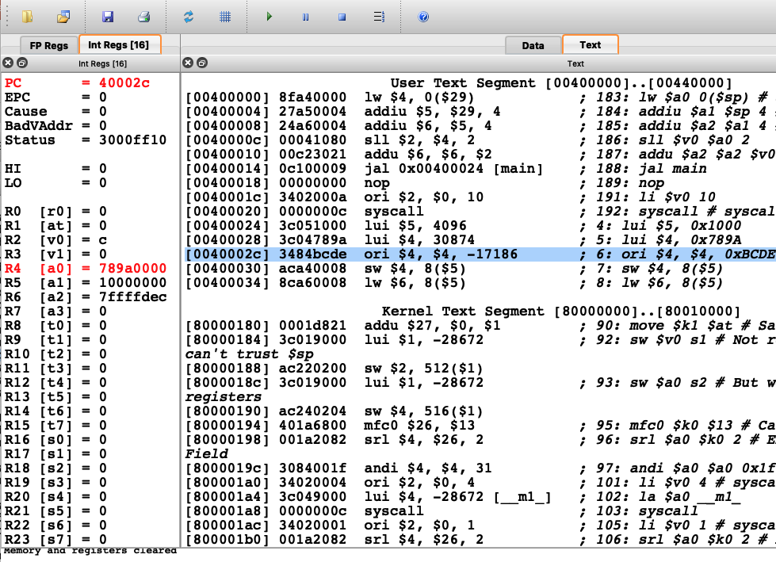

Slide 8
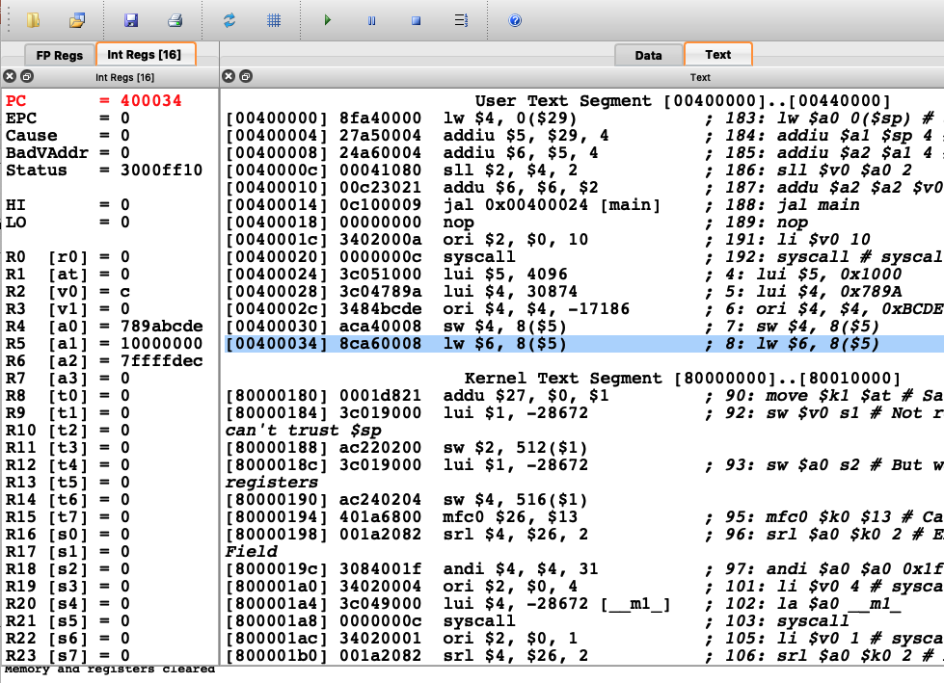

Slide 9
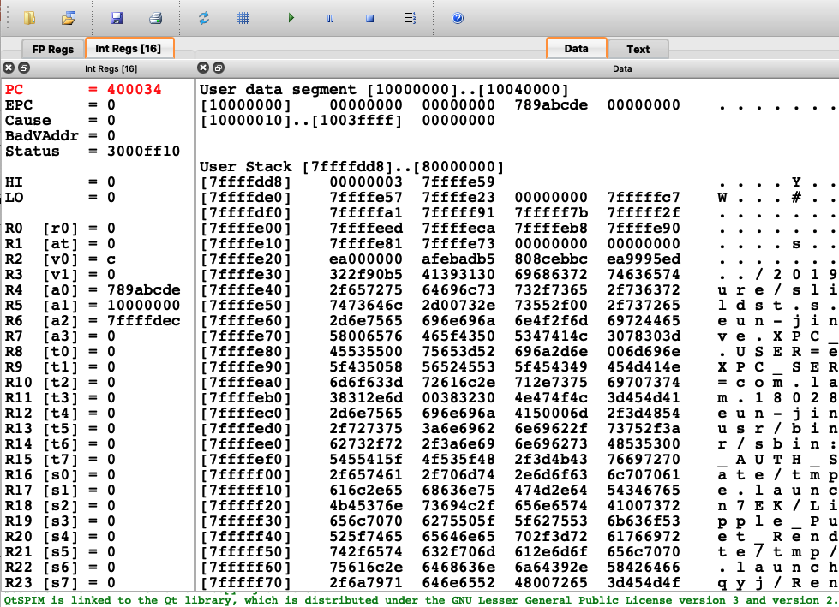
[0x10000008]

Slide 10
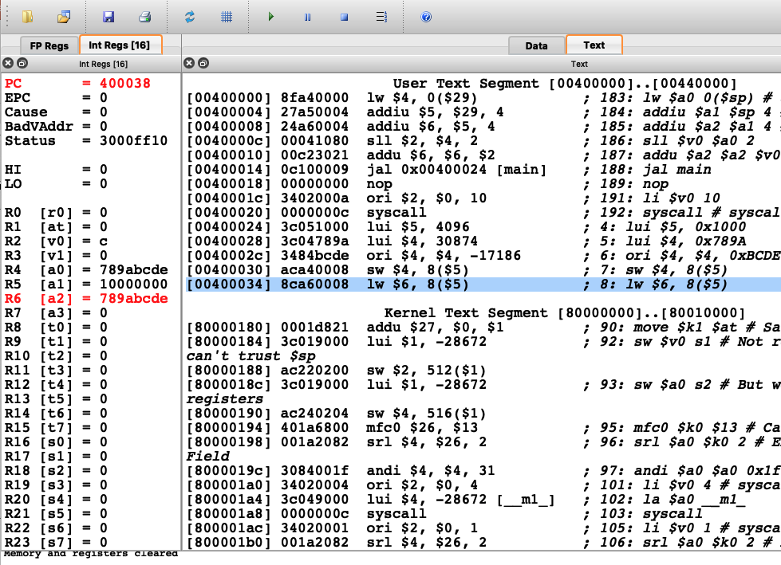

Slide 11
Representing data transfer instructions
sw $4, 8($5)
lw $4, 8($5)

Slide 12
MIPS I-format Instructions
op
rs
rt
constant or address
6 bits
5 bits
5 bits
16 bits
Immediate arithmetic and load/store instructions
rt: destination or source register number
Constant: –2¹⁵ ~ (+2¹⁵ – 1)
Address: offset added to base address stored in rs register

Slide 13
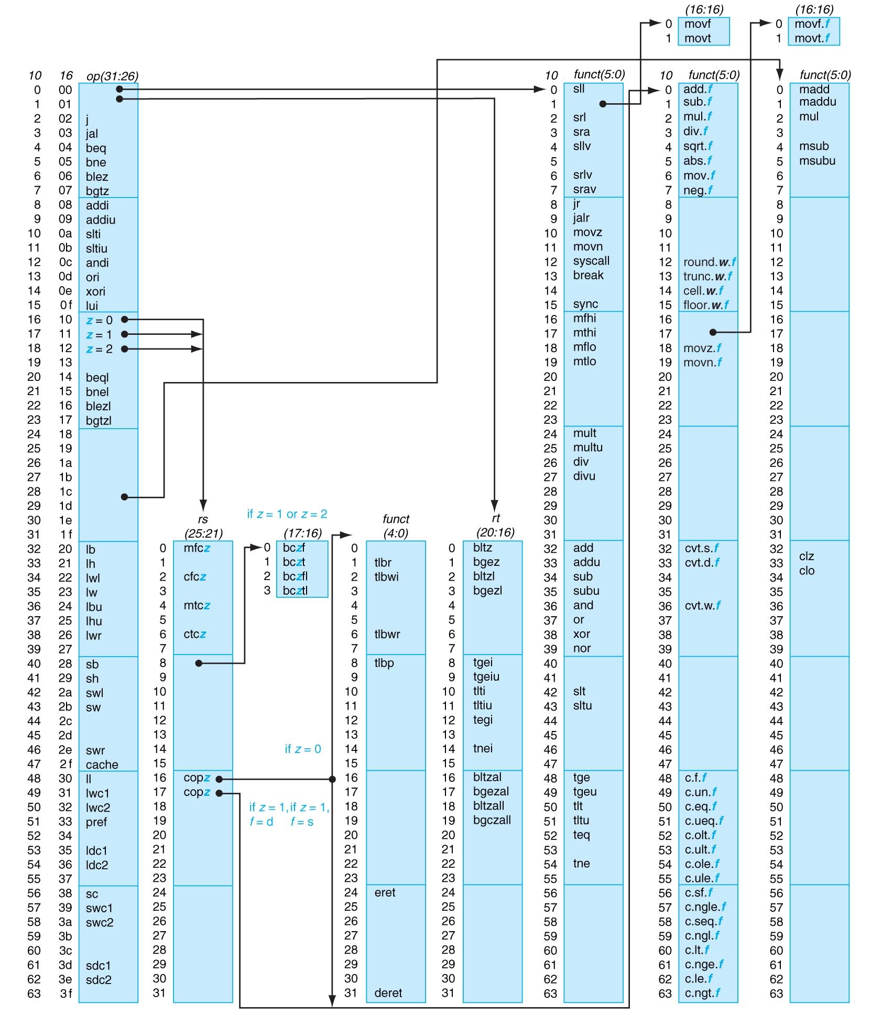
MIPS opcode map
Appendix A-50

Slide 14
sw $4, 8($5)
101011
00101
00100
0000 0000 0000 1000
6 bits
5 bits
5 bits
16 bits
1010 1100 1010 0100 0000 0000 0000 1000
= 0xaca40008

Slide 16
dissassemble 0x8ca60008
=1000 1100 1010 0110 0000 0000 0000 1000
lw $4, 8($5)
100011
00101
00110
0000 0000 0000 1000
6 bits
5 bits
5 bits
16 bits

Slide 17
MIPS assembler features
Comments
Labels
Numbers are base 10, Hexadecimals are prefixed with 0x
Strings are enclosed with “ and “
Special characters : \n, \t and \”
Assembler directives :
.ascii, .asciiz “some string”
.space n
.byte, .half, .word, .float, .double d1, d2, … dn
.data <addr>
.text <addr>
.globl symbol

Slide 18
Initializing Data Segment
[0x10010000]
[0x10010001]
[0x10010002]
[0x10010003]
[0x10010004]
[0x10010005]
0x01
0xfe
0x00
0x00
0x00
0x73
.data
.byte 1
.byte -2
.space 3
.byte ‘s’
in C,
char a[] = {1,-2, 0, 0, 0, 0x73};
// 0x73 는 ‘s’ 의 ASCII code

Slide 19
Initializing Data Segment
[0x10020000]
[0x10020001]
[0x10020002]
[0x10020003]
[0x10020004]
[0x10020005]
[0x10020006]
[0x10020007]
[0x10020008]
[0x10020009]
[0x1002000a]
[0x1002000b]
[0x1002000c]
[0x1002000d]
[0x1002000e]
[0x1002000f]
0x00000001
0xffffffff
0xabcdef12
0x0000ffff
.data 0x10020000
w1: .word 1
.word -1
.word 0xabcdef12
.word 0xffff
.text
.globl main
main : lui $5, 0x1002
lui $4, 0x789a
sw $4, 8($5)
in C,
int w1[4] = {1,-1, 0xabcdef12, 0xffff} ;
int main(){
w1[2] = 0x789a0000;
}
label

Slide 20
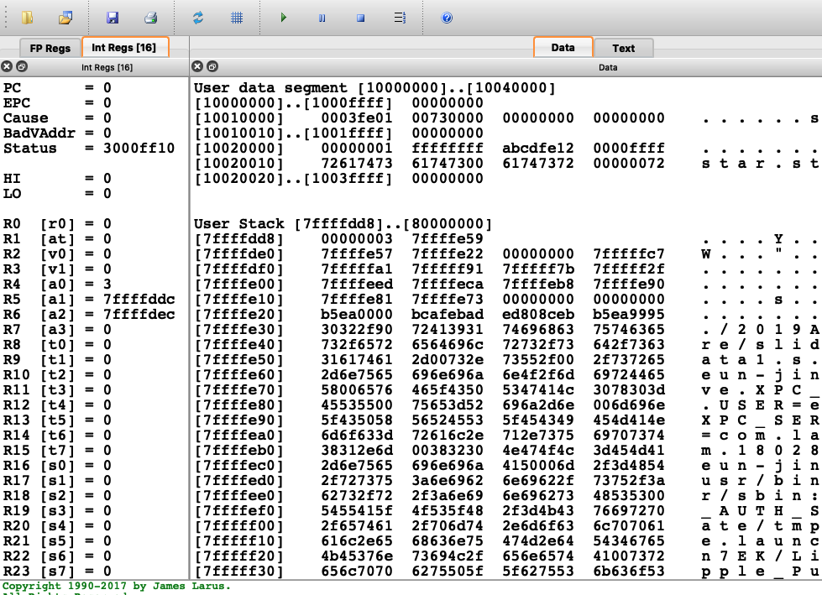

Slide 21
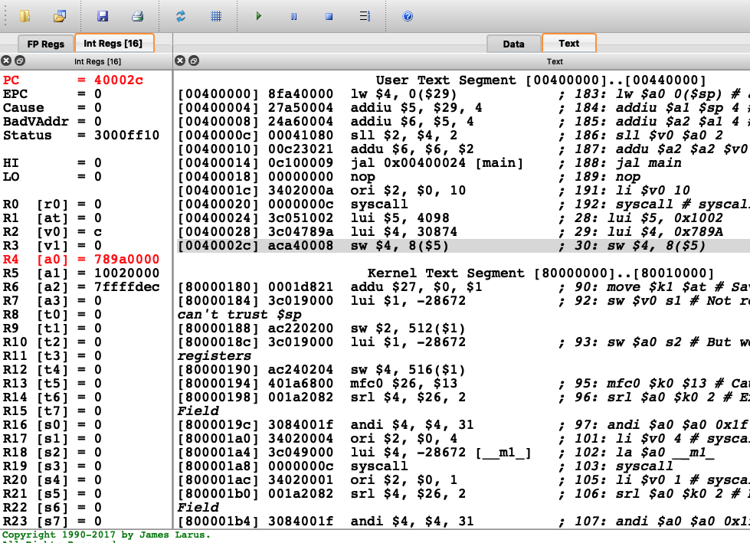

Slide 22
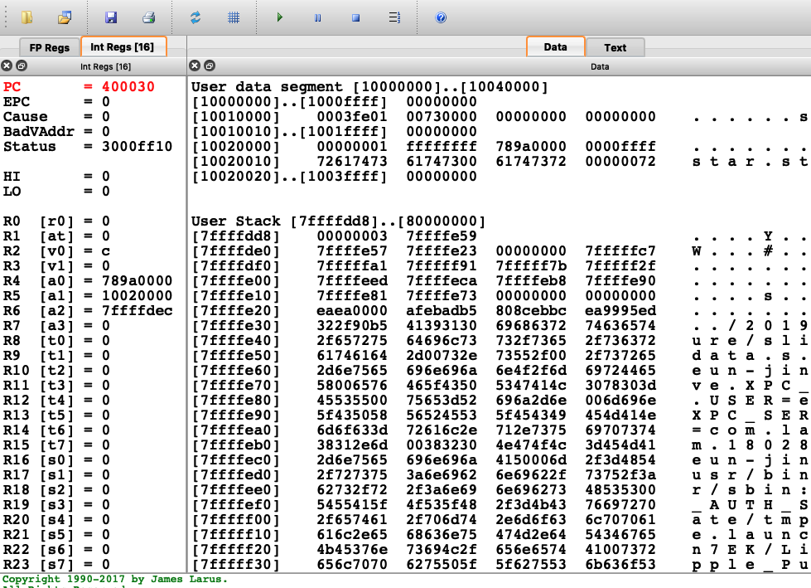

Slide 23
Initializing Data Segment
[0x10030000]
[0x10030001]
[0x10030002]
[0x10030003]
[0x10030004]
[0x10030005]
[0x10030006]
[0x10030007]
[0x10030008]
[0x10030009]
[0x1003000a]
[0x1003000b]
[0x1003000c]
[0x1003000d]
0x73
0x74
0x61
0x72
0x00
0x73
0x74
0x61
0x72
0x73
0x74
0x61
0x72
0x00
.data 0x10030000
str1: .byte ‘s’
.byte ‘t’
.byte ‘a’
.byte ‘r’
.byte 0
str2: .ascii “star”
str3:
.asciiz “star”
in C,
char str1[] = {‘s’,’t’,’a’,’r’,’\0’};
char str2[] = {‘s’,’t’,’a’,’r’};
char str3[] = “star”; // = {‘s’,’t’,’a’,’r’,’\0’};

Slide 24

글자를 모아 단어를 만들 때
한국어,영어는 왼쪽에서 오른쪽으로 쓴다.
STAR
아랍어는 오른쪽에서 왼쪽으로 쓴다.
왜? 규칙이니까.

Slide 25
4개의 byte 를 모아 word 를 만들 때도 2가지 방향이 가능
[0x10020000]
[0x10020001]
[0x10020002]
[0x10020003]
[0x10020004]
[0x10020005]
[0x10020006]
[0x10020007]
[0x10020008]
[0x10020009]
[0x1002000a]
[0x1002000b]
[0x1002000c]
[0x1002000d]
[0x1002000e]
[0x1002000f]
0x00000001
0xffffffff
0xabcdef12
0x0000ffff
0xab
0xcd
0xef
0x12
0x12
0xef
0xcd
0xab
Little endian
byte order
big endian
byte order

Slide 26


Byte order : Little endian vs. Big endian
[10010000]
0x01
.data 0x10010000
.byte 1
.byte 2
.byte 3
.byte 4
Little endian : intel
Big endian : SPARC, Motorola
MIPS : can be configured to either one
[10010001]
0x02
[10010002]
0x03
[10010003]
0x04
a word at 10010000 = 0x04030201
a word at 10010000 = 0x01020304

Slide 27
0x10010000 ~ 0x10010003 에 저장된 내용을 word 로 읽으면?
[0x10010000]
[0x10010001]
[0x10010002]
[0x10010003]
[0x10010004]
[0x10010005]
0x01
0xfe
0x00
0x00
0x00
0x73
.data
.byte 1
.byte -2
.space 3
.byte ‘s’
in C,
char a[] = {1,-2, 0, 0, 0, 0x73};
// 0x73 는 ‘s’ 의 ASCII code
0x01fe0000 ?
(big endian)
0x0000fe01 ?
(little endian)

Slide 28
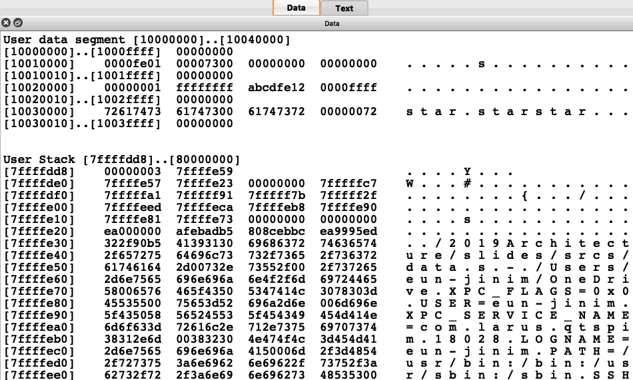
SPIM 에서 memory 내용을 보여줄 때 word 단위로 보여줌

Slide 29
Little endian byte order
[0x10020000]
[0x10020001]
[0x10020002]
[0x10020003]
[0x10020004]
[0x10020005]
[0x10020006]
[0x10020007]
[0x10020008]
[0x10020009]
[0x1002000a]
[0x1002000b]
[0x1002000c]
[0x1002000d]
[0x1002000e]
[0x1002000f]
0x00000001
0xffffffff
0xabcdef12
0x0000ffff
0x01
0x00
0x00
0x00
0xff
0xff
0xff
0xff
0x12
0xef
0xcd
0xab
0xff
0xff
0x00
0x00
.data 0x10020000
w1: .word 1
.word -1
.word 0xabcdef12
.word 0xffff
.text
.globl main
main : lui $5, 0x1002
lui $4, 0x789a
sw $4, 8($5)
in C,
int w1[4] = {1,-1, 0xabcdef12, 0xffff} ;
int main(){
w1[2] = 0x789a0000;
}
label

Slide 31
[0x10030000]
[0x10030001]
[0x10030002]
[0x10030003]
[0x10030004]
[0x10030005]
[0x10030006]
[0x10030007]
[0x10030008]
[0x10030009]
[0x1003000a]
[0x1003000b]
[0x1003000c]
[0x1003000d]
0x73
0x74
0x61
0x72
0x00
0x73
0x74
0x61
0x72
0x73
0x74
0x61
0x72
0x00
.data 0x10030000
str1: .byte ‘s’
.byte ‘t’
.byte ‘a’
.byte ‘r’
.byte 0
str2: .ascii “star”
str3:
.asciiz “star”
in C,
char str1[] = {‘s’,’t’,’a’,’r’,’\0’};
char str2[] = {‘s’,’t’,’a’,’r’};
char str3[] = “star”; // = {‘s’,’t’,’a’,’r’,’\0’};
0x72617473
0x61747300
0x61747372

Slide 32
SPIM 에서 이 부분은 byte 단위로 보여줌

Slide 33
word alignment
[0x10010000]
[0x10010001]
[0x10010002]
[0x10010003]
[0x10010004]
[0x10010005]
[0x10010006]
[0x10010007]
[0x10010008]
[0x10010009]
[0x1001000a]
[0x1001000b]
[0x1001000c]
[0x1001000d]
[0x1001000e]
[0x1001000f]
0x01
0xfe
0x00
0x00
0x00
0x73
0x01
0x00
0x00
0x00
.data 0x10010000
a: # 0x10010000
.byte 1
.byte -2
.space 3
.byte 's' # 0x10010005
w1: # 0x10010008
.word 1
.word -1
.word 0xabcdfe12
.word 0xffff
.text
.globl main
main:
la $5, a # pseudoinstruction
la $6, w1
lw $4, 0($6)
for word alignment
0x00000001

Slide 34
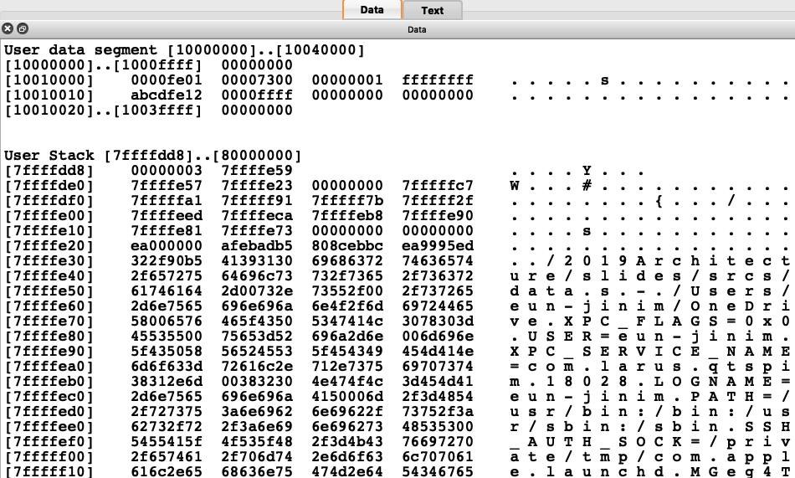

Slide 35
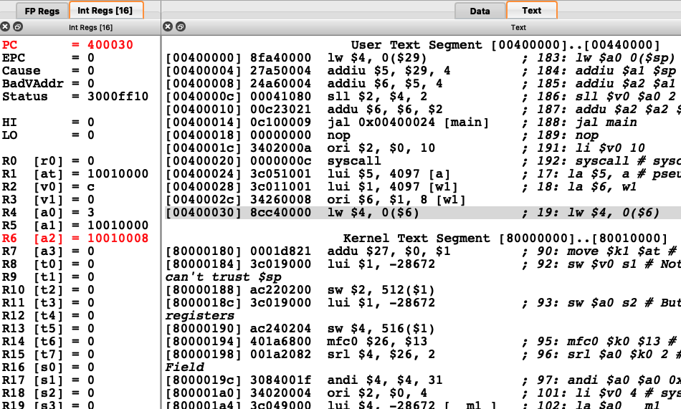
la (load address) pseudoinstruction 에서 label 의 사용

Slide 37
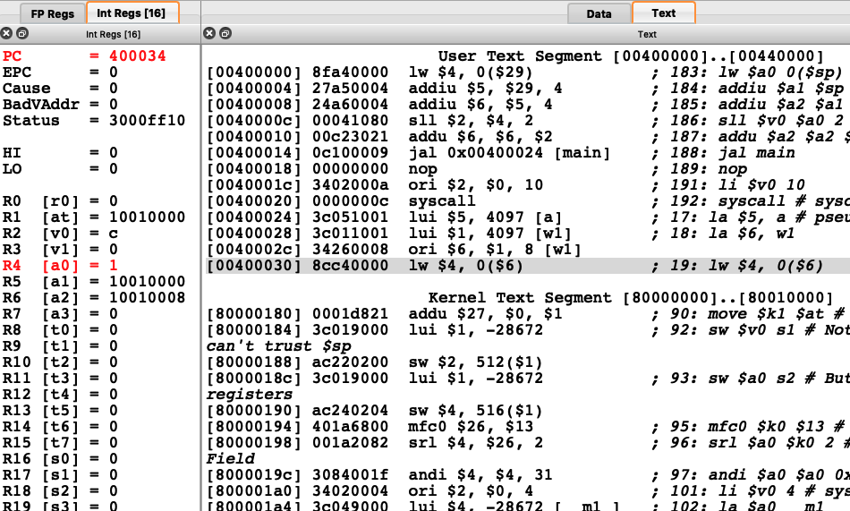

Slide 38
Memory Operands
변수들은 Main memory 에 저장됨
Arrays, structures, dynamic data
산술 연산을 하려면
메모리에 있는 변수 값을 먼저 레지스터로 Load
연산을 수행
레지스터에 있는 연산 결과를 메모리에 Store
Memory is byte addressed
8-bit byte 마다 주소가 있음
Words (= 4 bytes) are aligned in memory
워드 주소는 4의 배수
MIPS is Big Endian
Most-significant byte at least address of a word
c.f. Little Endian: least-significant byte at least address

Slide 39
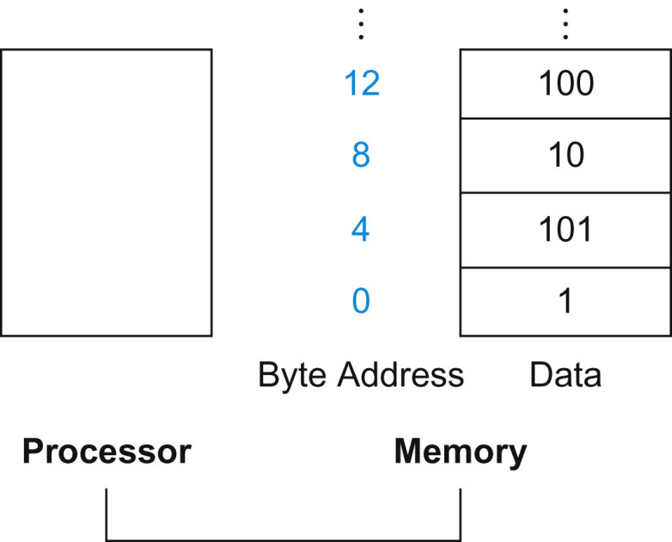
Byte addressing
4bytes
FIGURE 2.3 Actual MIPS memory addresses and contents of memory for those words. The changed addresses are highlighted to contrast with Figure 2.2. Since MIPS addresses each byte, word addresses are multiples of 4: there are 4 bytes in a word.
Copyright © 2014 Elsevier Inc. All rights reserved.

Slide 40
Memory Operand Example 1
C code:
int g,h,A[100];
g = h + A[8];
g in $s1, h in $s2, base address of A in $s3
Compiled MIPS code:
Index 8 requires offset of 32
4 bytes per word
lw $t0, 32($s3) # load word add $s1, $s2, $t0
offset
base register

Slide 41
Memory Operand Example 2
C code:
A[12] = h + A[8];
h in $s2, base address of A in $s3
Compiled MIPS code:
Index 8 requires offset of 32
lw $t0, 32($s3) # load word add $t0, $s2, $t0 sw $t0, 48($s3) # store word
processor
memory
$s2
3
h
1032
20
A[8]
$s3
1000
&A[0]
$t0
?
1048
23
A[12]

Slide 42
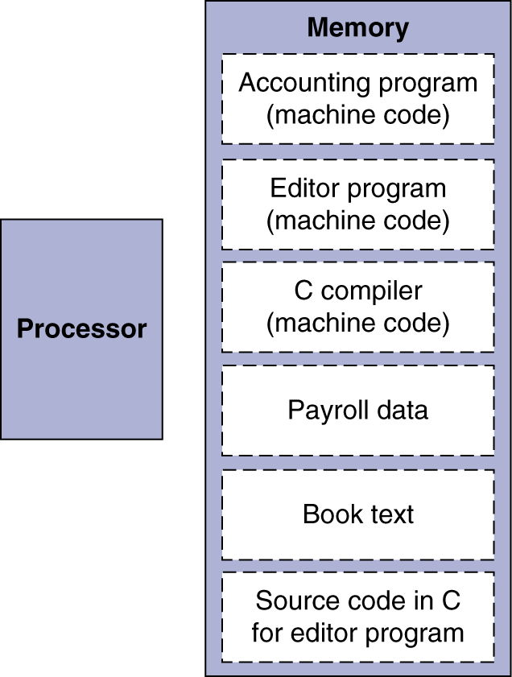
Stored Program Computers
The BIG Picture
Instructions represented in binary, just like data
Instructions and data stored in memory
Programs can operate on programs
e.g., compilers, linkers, …
Program is a sequence of instructions
Processor fetches and executes instructions from memory in sequence.

