Slide 1
Chapter 4
The Processor

Slide 2
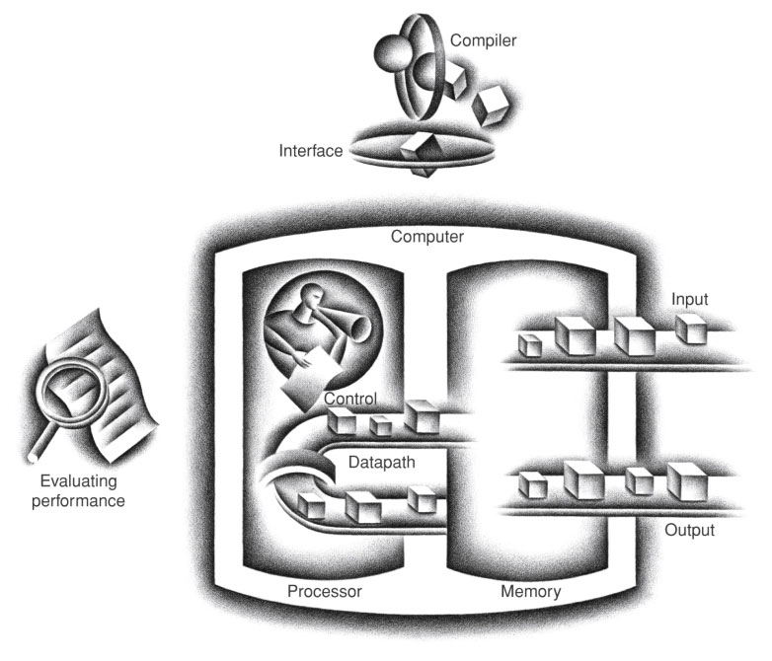
FIGURE 1.5 The organization of a computer, showing the five classic components. The processor gets instructions and data from memory. Input writes data to memory, and output reads data from memory. Control sends the signals that determine the operations of the datapath, memory, input, and output.
Copyright © 2014 Elsevier Inc. All rights reserved.

Slide 3
In this chapter,
§4.1 Introduction
We will examine two MIPS implementations in logic gate level.
first, a simplified version
second, a more realistic pipelined version
Our implementation will execute a simple subset of MIPS instructions.
Memory reference instructions: lw, sw
Arithmetic/logical instructions: add, sub, and, or, slt
Branch instructions: beq, j

Slide 4
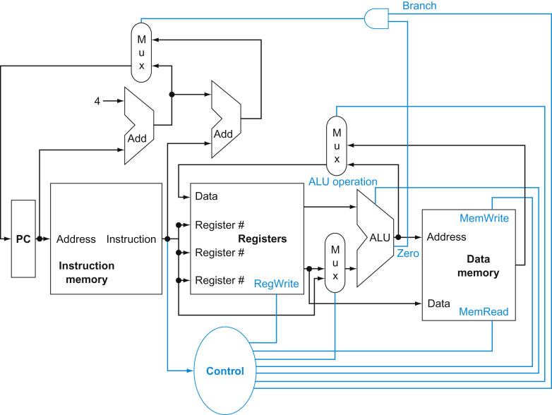

Slide 5


논리곱 $⋀$
논리합 $⋁$

Slide 6
Logic Design Basics (Appendix B)
Information encoded in binary
Low voltage = 0, High voltage = 1
One wire per bit
Multi-bit data encoded on multi-wire buses
Combinational element (조합회로)
입력 데이타를 연산해서 새로운 값을 만드는데 사용된다.
Output = f (current input)
State (sequential) elements (순차회로)
연산된 데이타를 저장해 두었다가 나중에 읽어내기 위해 사용된다.
Output = f (current input, previous input)
§4.2 Logic Design Conventions

Slide 7
Combinational circuit 은 진리표만 주어지면 만들 수 있다.

Slide 8
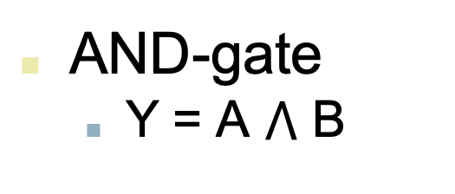
Combinational Elements
AND-gate
Y = A $⋀$ B
Adder
Y = A + B
A
+
Y
B
A
Y
B
Arithmetic/Logic Unit
Y = F(A, B)
Multiplexer
Y = S ? I1 : I0
A
I0
M u x
Y
Y
ALU
I1
B
S
F
control

Slide 9
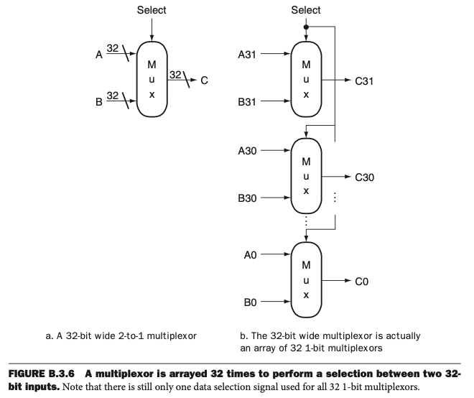
32-bit 2-to-1 MUX
=

Slide 10
Sequential Elements
Register: stores data in a circuit
Uses a clock signal to determine when to update the stored value
Edge-triggered: update when Clk changes from 0 to 1
Clk
D
Q
D
Clk
Q

Slide 11
Sequential Elements
Register with write control (no read control)
Only updates on clock edge when write control input is 1
Used when stored value is required later
Clk
D
Q
Write
Write
Clk
D
Q

Slide 12
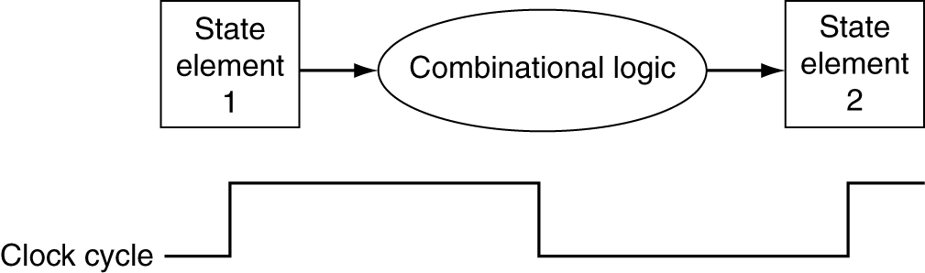
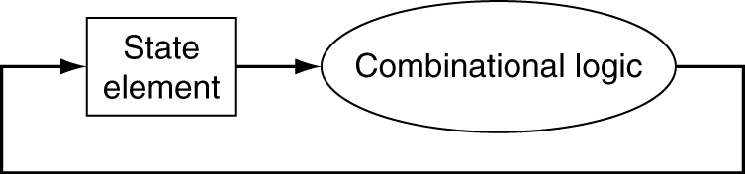
Digital 회로의 동작
클락 사이클 동안(Between clock edges) 에 Combinational 회로에서 입력 신호에 대한 출력 신호를 만든다
combinational 회로의 input은 state elements의 output이다.
combinational 회로의 output은 state elements의 input이다.
clock period (clock edge 간의 간격) 은 combinational 회로의 longest delay 에 의해 정해진다.

Slide 13
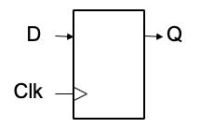
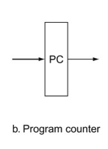

Sequential Circuit : Register (clock signal 은 생략)
a 32-bit register = 1-bit D flip flop x 32
- write signal 이 없으면 write signal 은 항상 1
- clock signal 도 있지만 (그림에서) 생략
31
31
30
30
Write = 1
=
32
32
…
CLK
1
1
0
0

Slide 14
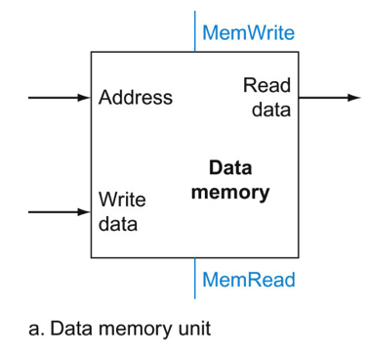
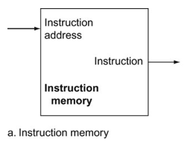
Sequential Circuit : Memory (clock signal 은 생략)
Instruction memory is read-only in this implementation
32
32
32
32
32

Slide 15
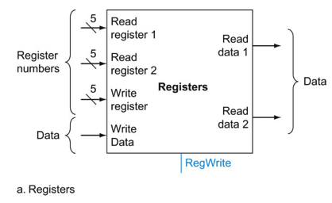
Sequential Circuit : Register File (clock signal 은 생략)
32 x 32-bit registers
RegWrite =1 일 때만 레지스터의 값이 바뀌고
RegRead signal 이 없는 것은 항상 (매 클럭마다) 레지스터가 읽혀져 출력값이 된다는 뜻임
32
32
32

Slide 16
1) Build a datapath first and 2) add a control
add, sub, and, or, slt
lw, sw
beq, j
FIGURE 1.5 The organization of a computer, showing the five classic components. The processor gets instructions and data from memory. Input writes data to memory, and output reads data from memory. Control sends the signals that determine the operations of the datapath, memory, input, and output.
Copyright © 2014 Elsevier Inc. All rights reserved.

Slide 17
Building a Datapath
Datapath
Elements that process data and addresses in the CPU
Registers, ALUs, mux’s, memories, …
§4.3 Building a Datapath
Each datapath element can only do one function at a time
Hence, we need separate instruction and data memories
Use multiplexers where alternate data sources are used for different instructions

Slide 18
How instructions are executed in a processor
1) Fetch instruction : instruction memory 중 PC가 가리키는 주소에서 수행할 instruction 을 프로세서로 읽어온다.
(PC 는 4만큼 자동 증가)
2) Execute instruction : 그 명령어를 수행한다.
2-1)명령어를 해석하는 동시에 Register file 에서 레지스터 값을 읽는다.
2-2) 명령어 종류에 따라 다음을 실행한다.
Arithmetic/Logic 연산 -> 결과를 레지스터에 쓴다.
Memory 주소 계산 -> data memory 에 쓴다.
-> data memory 를 읽는다 -> 결과를 레지스터에 쓴다.
Branch target address 계산 -> BTA 를 PC 에 쓰거나 쓰지 않는다.
add, sub,
and, or, slt
sw
lw
beq, j
add $8, $3, $4
lw $9, 4($7)
sw $10, 8($11)
beq $5, $6, L
j FN

Slide 19
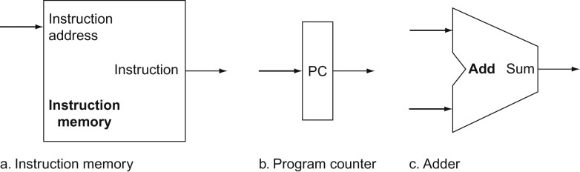
FIGURE 4.5 Two state elements are needed to store and access instructions, and an adder is needed to compute the next instruction address. The state elements are the instruction memory and the program counter. The instruction memory need only provide read access because the datapath does not write instructions. Since the instruction memory only reads, we treat it as combinational logic: the output at any time reflects the contents of the location specified by the address input, and no read control signal is needed. (We will need to write the instruction memory when we load the program; this is not hard to add, and we ignore it for simplicity.) The program counter is a 32-bit register that is written at the end of every clock cycle and thus does not need a write control signal. The adder is an ALU wired to always add its two 32-bit inputs and place the sum on its output.
19
Copyright © 2014 Elsevier Inc. All rights reserved.

Slide 20
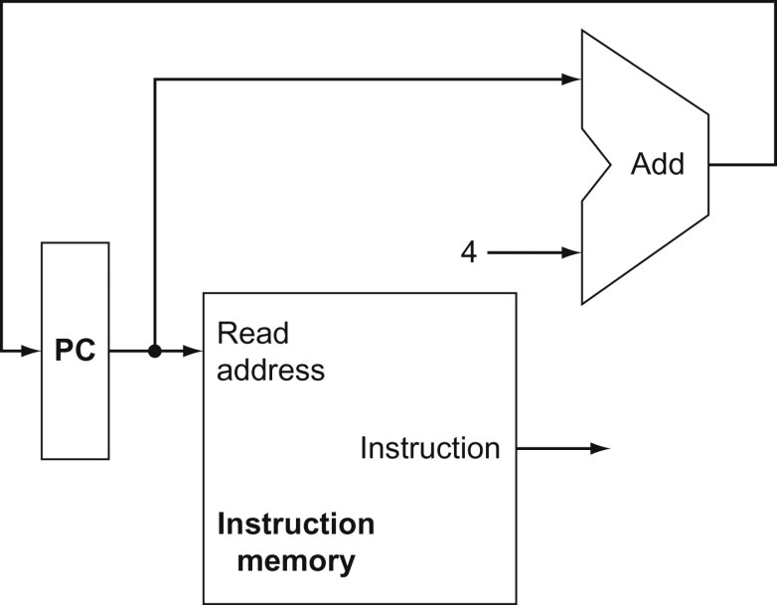
1) Instruction Fetch
FIGURE 4.6 A portion of the datapath used for fetching instructions and incrementing the program counter. The fetched instruction is used by other parts of the datapath.
20
Copyright © 2014 Elsevier Inc. All rights reserved.

Slide 21
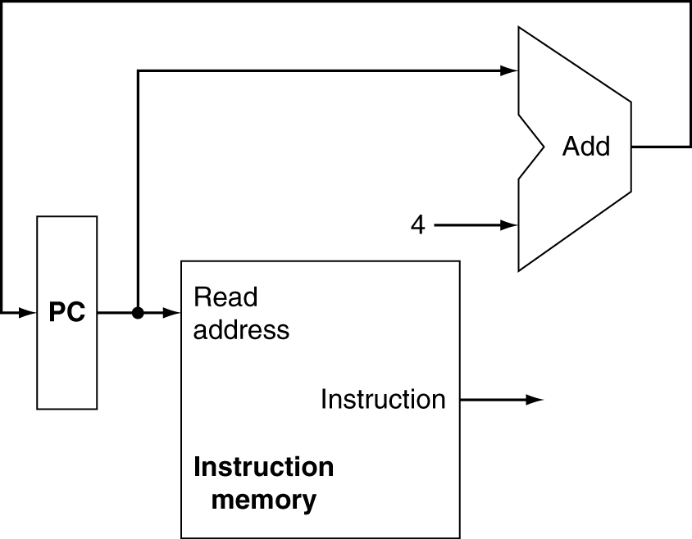
Instruction Fetch(datapath part 1)
A portion of datapath used for fetching instruction and incrementing PC
[0x00401000] add $2, $8,$9 000000 01000 01001 00010 00000 100000
0x00401004
0x00401000
Increment by 4 for next instruction
000000 01000 01001 00010 00000 100000
32-bit register

Slide 22
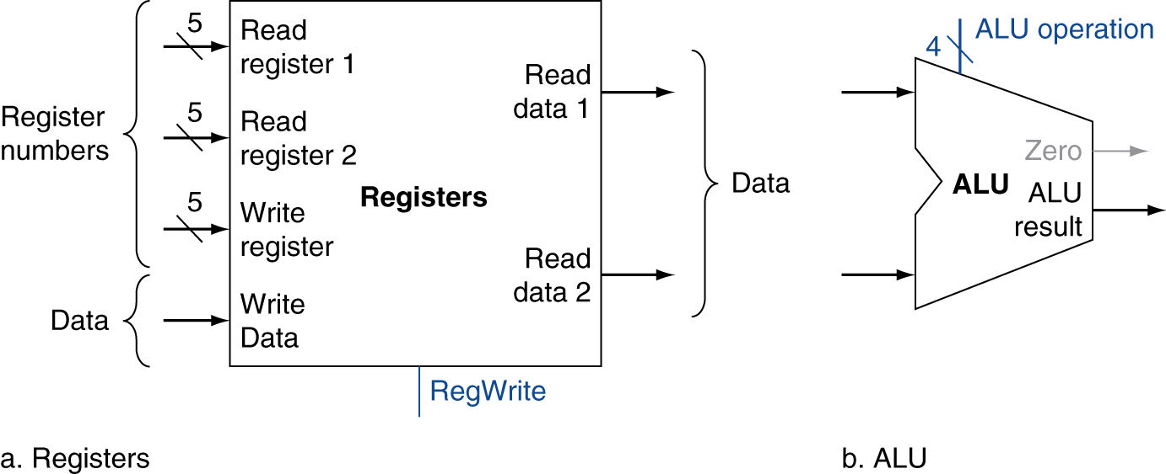
2) Execution of Arithmetic/Logic Instructions
add $2, $8, $9
Read two register operands
Perform arithmetic/logical operation
Write a result into a destination register

Slide 23
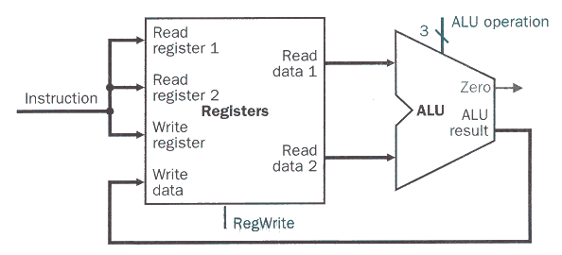
Datapath part 2: Execution of A/L Instructions
add $2, $8,$9 000000 01000 01001 00010 00000 100000
0010
5
01000
$0
$8
$9
00000000
…
00000005
00000001
…
0x00000005
5
01001
0
000000 01000 01001 00010 00000 100000
32
5
0x00000006
00010
0x00000001
1

Slide 24
ALU Control
ALU used for
Load/Store: F = add
Branch: F = subtract
R-type: F depends on funct field
§4.4 A Simple Implementation Scheme
ALU control | Function
0000 | AND
0001 | OR
0010 | add
0110 | subtract
0111 | set-on-less-than
1100 | NOR

Slide 25
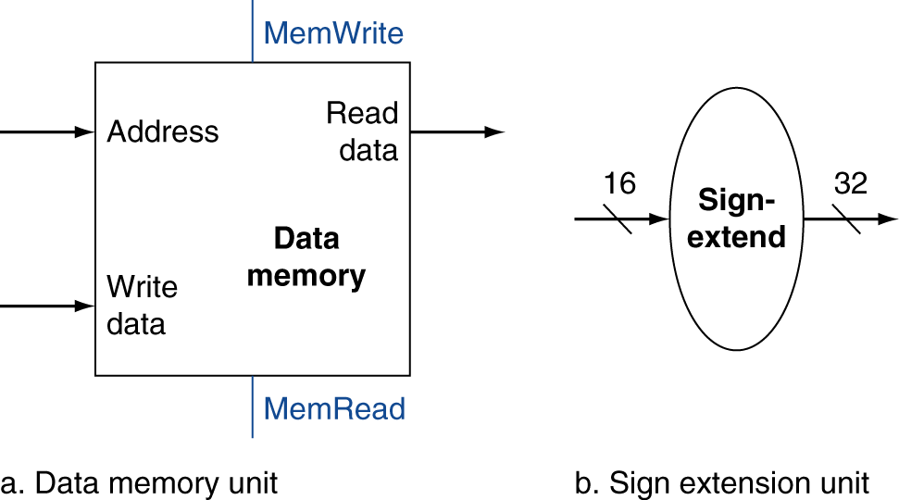
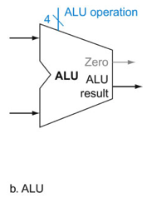
3) Execution of Load/Store Instructions
lw $2, 4($8)
Read register operands
Calculate address using 16-bit offset
Use ALU, but sign-extend offset
Load: Read memory and update register
Store: Write register value to memory

Slide 26
Part 1: Instruction Fetch
[0x00402000] lw $2, 4($8) 100011 01000 00010 0000 0000 0000 0100
0x00402004
0x00402000
Increment by 4 for next instruction
100011 01000 00010 0000 0000 0000 0100
32-bit register

Slide 27
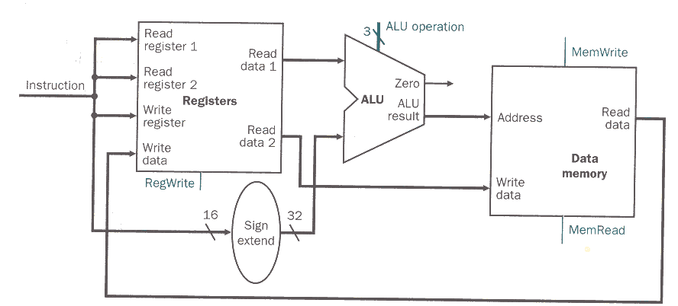
Datapath part 3: Execution of Data Transfer Instructions
A portion of datapath used for register access, followed by a memory address calculation, then a read or write from memory, and a write into the register file if the instruction is a load.
lw $2, 4($8) 100011 01000 00010 0000 0000 0000 0100
0010
01000
4
0
00010
10011 01000 00010 0000 0000 0000 0100
1
0000 0000 0000 0100
1

Slide 28
part 2
4

Slide 29
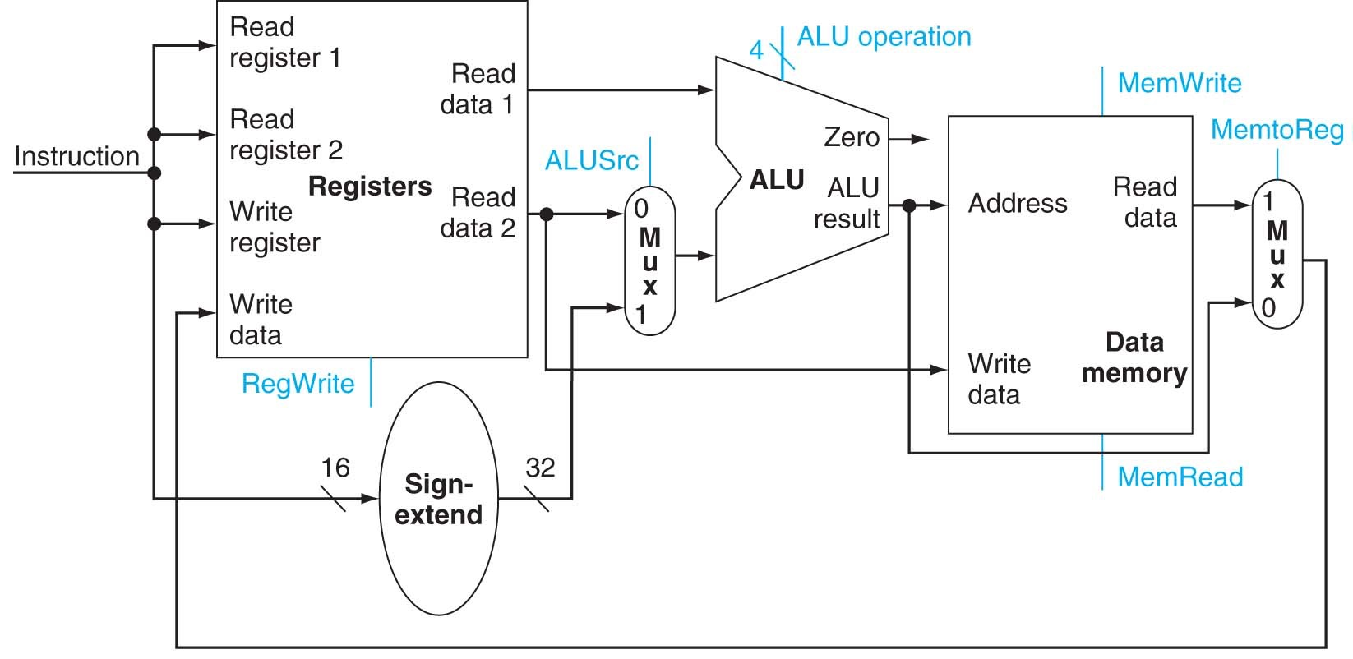
Combining part 2 and 3

Slide 30
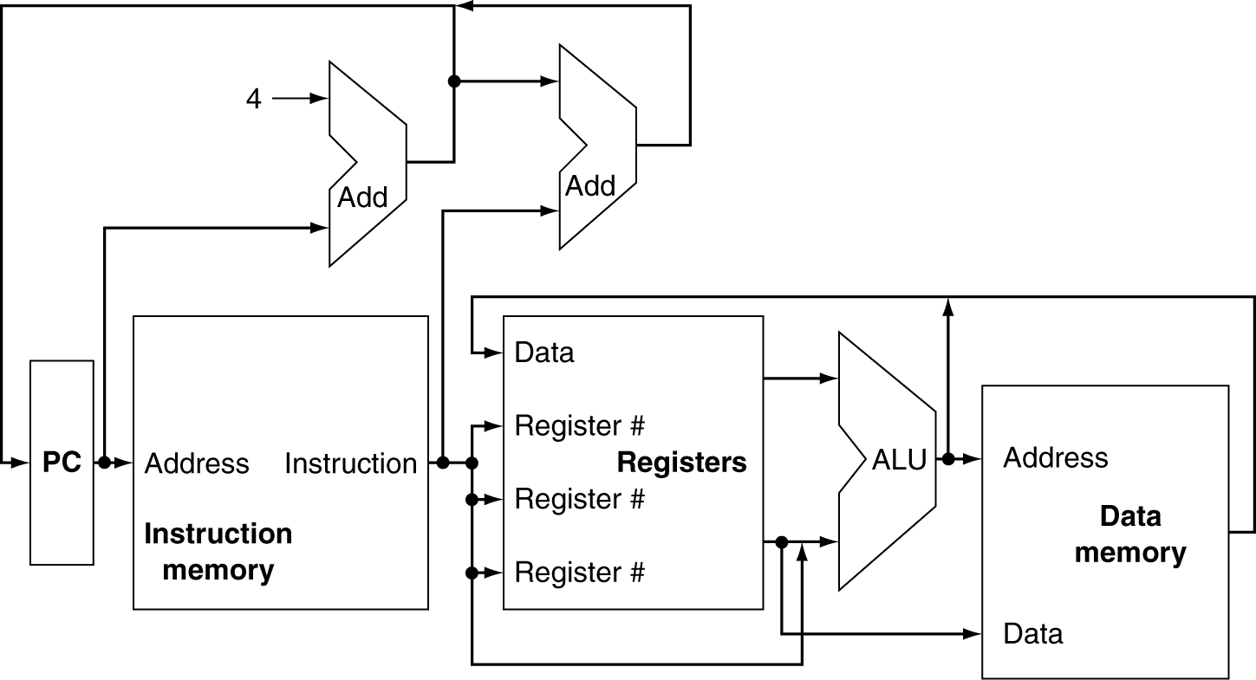
Role of Multiplexers
Can’t just join wires together
Use multiplexers

Slide 31
Part 1: Instruction Fetch

Slide 32
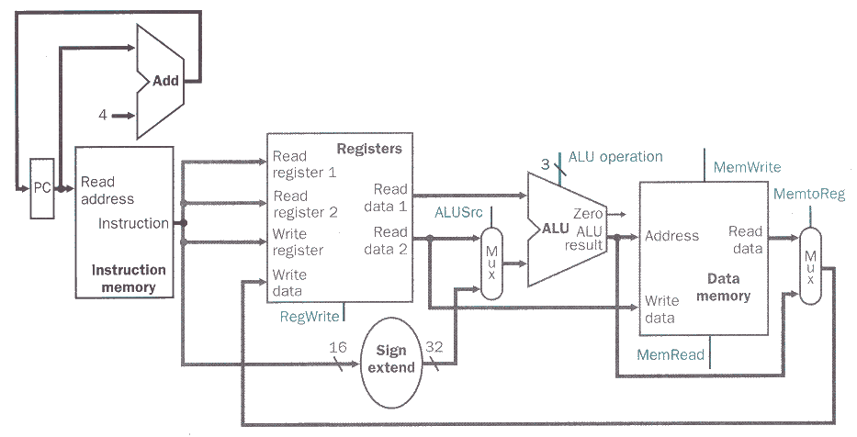
Adding part 1
4

Slide 33
4) Execution of Branch Instructions
beq $3, $4, L
Read register operands
Compare operands
Use ALU, subtract and check Zero output
Calculate target address
Sign-extend displacement
Shift left 2 places (word displacement)
Add to (PC + 4)

Slide 34
Fetching beq instruction
[0x00403000] beq $3, $4, L 000100 00011 00100 0000 0000 0000 0010
0x00403004
0x00403000
4
000100 00011 00100 0000 0000 0000 0010

Slide 35
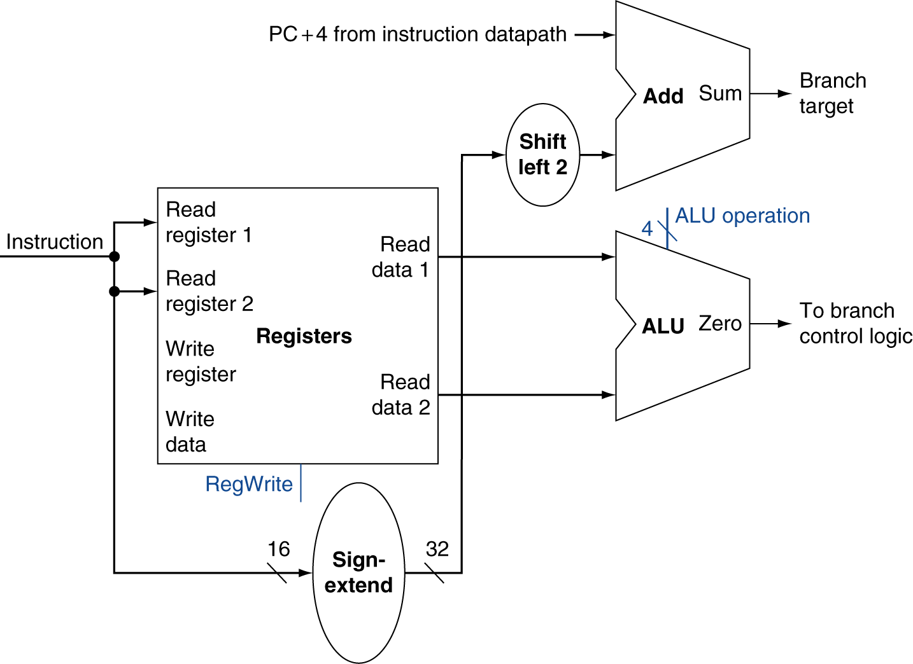
part 4: Branch Instructions
A portion of datapath used for evaluating a branch condition and computing branch target address
beq $3, $4, L 000100 00011 00100 0000 0000 0000 0010
Just re-routes wires
0x00403004
0x0040300C
Register File
0000 0000 0000 0000 0000 0000 0000 1000
00011
$0
$3
$4
00000000
…
00000005
00000005
00000001
…
0x00000005
0110
00100
000100 00011 00100 0000 0000 0000 0010
1
0x00000005
0x00000000
0
0000 0000 0000 0010
0000 0000 0000 0000 0000 0000 0000 0010
Sign-bit wire replicated

Slide 36
ALU Control
ALU used for
Load/Store: F = add
Branch: F = subtract
R-type: F depends on funct field
§4.4 A Simple Implementation Scheme
ALU control | Function
0000 | AND
0001 | OR
0010 | add
0110 | subtract
0111 | set-on-less-than
1100 | NOR

Slide 37
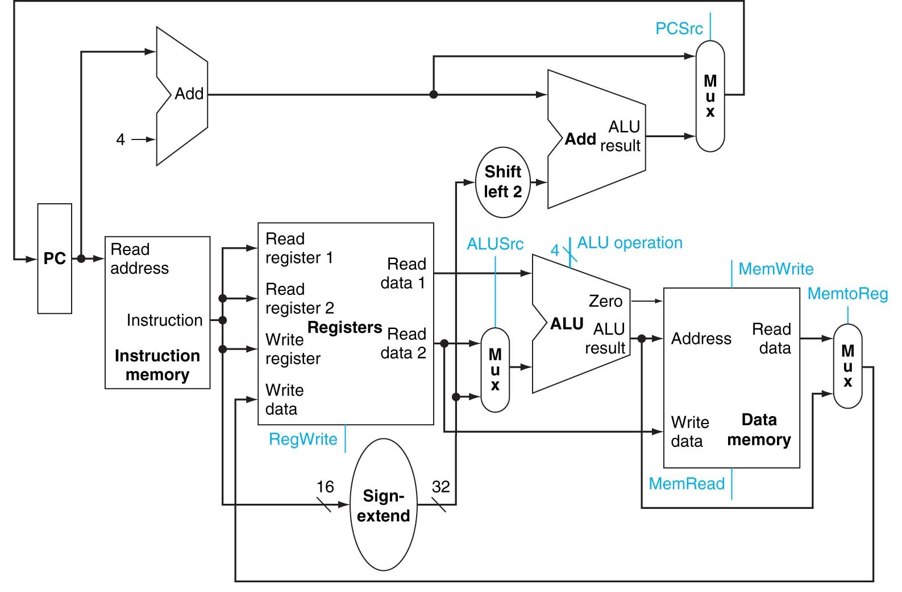
Adding part 4
?

Slide 38
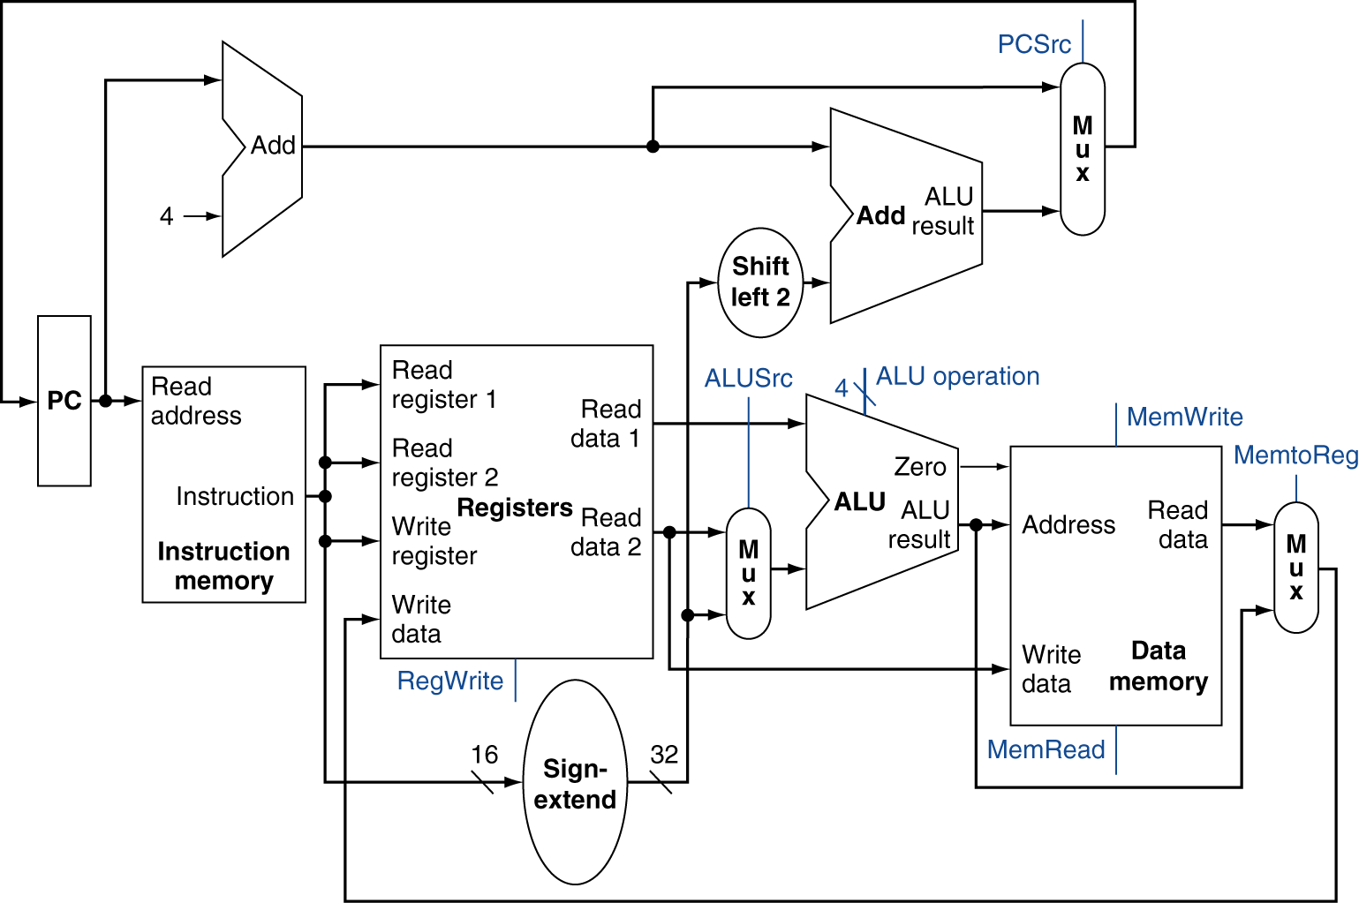
Full Datapath

Slide 39
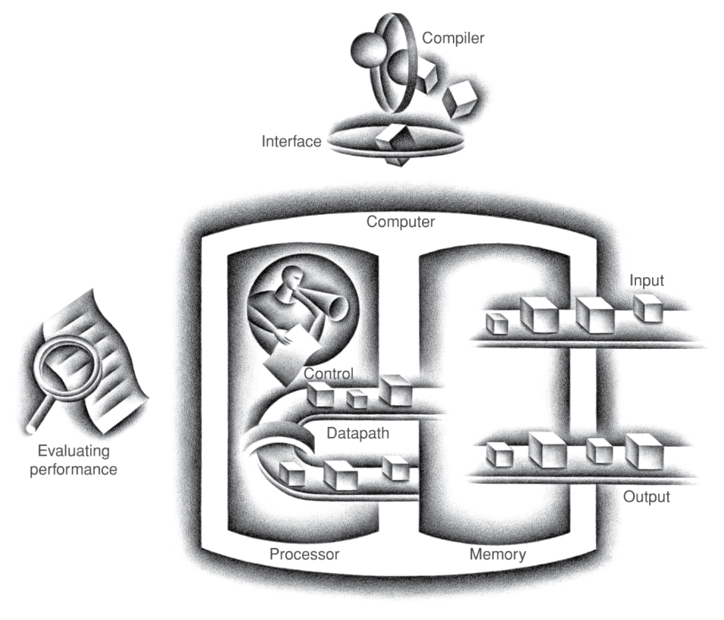
CPU Overview
Processor
Memory

Slide 40
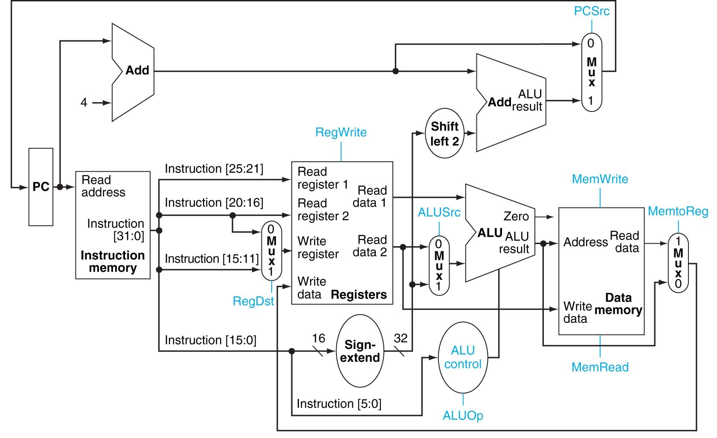
Datapath
Use multiplexors to stitch them together

Slide 41
Datapath part 2: Execution of A/L Instructions
add $2, $8,$9 000000 01000 01001 00010 00000 100000
0010
5
01000
$0
$8
$9
00000000
…
00000005
00000001
…
0x00000005
5
01001
1
000000 01000 01001 00010 00000 100000
32
5
0x00000006
00010
0x00000001
1

Slide 42
Datapath part 3: Execution of Data Transfer Instructions
lw $2, 4($8) 100011 01000 00010 0000 0000 0000 0100
0010
01000
4
0
00010
10011 01000 00010 0000 0000 0000 0100
1
0000 0000 0000 0100
1

Slide 43
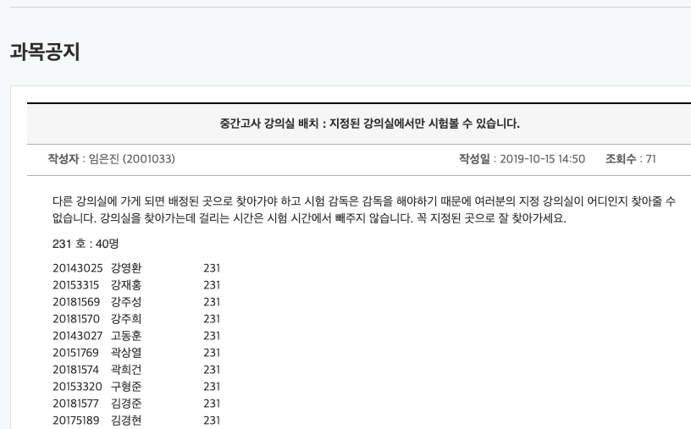
중간고사
10/23 수 오후 8-9pm 시
강의실 배정은 공지사항에서 각자 확인할 것

Slide 44
중간 수업 평가 해주세요. 주관식
종합정보시스템에서 온라인 입력 주관식 1문항
10/17 목 10:00 ~ 10/27 일 24:00
강의 개선에 활용합니다.

