Slide 1
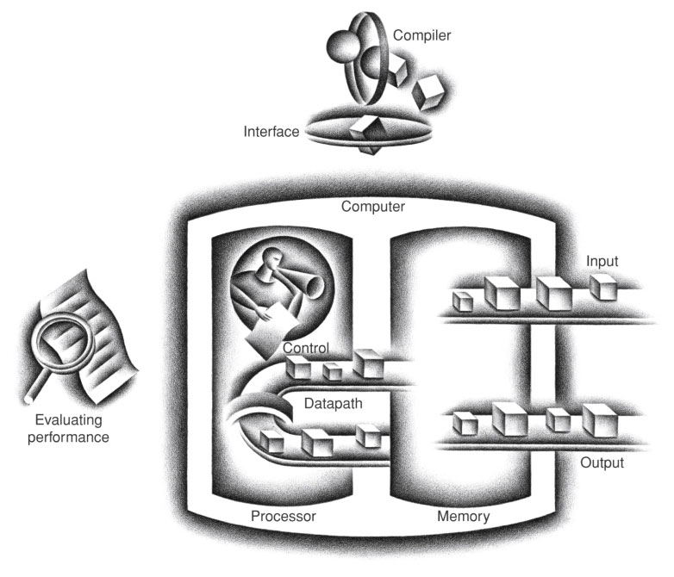
FIGURE 1.5 The organization of a computer, showing the five classic components. The processor gets instructions and data from memory. Input writes data to memory, and output reads data from memory. Control sends the signals that determine the operations of the datapath, memory, input, and output.
Copyright © 2014 Elsevier Inc. All rights reserved.

Slide 2
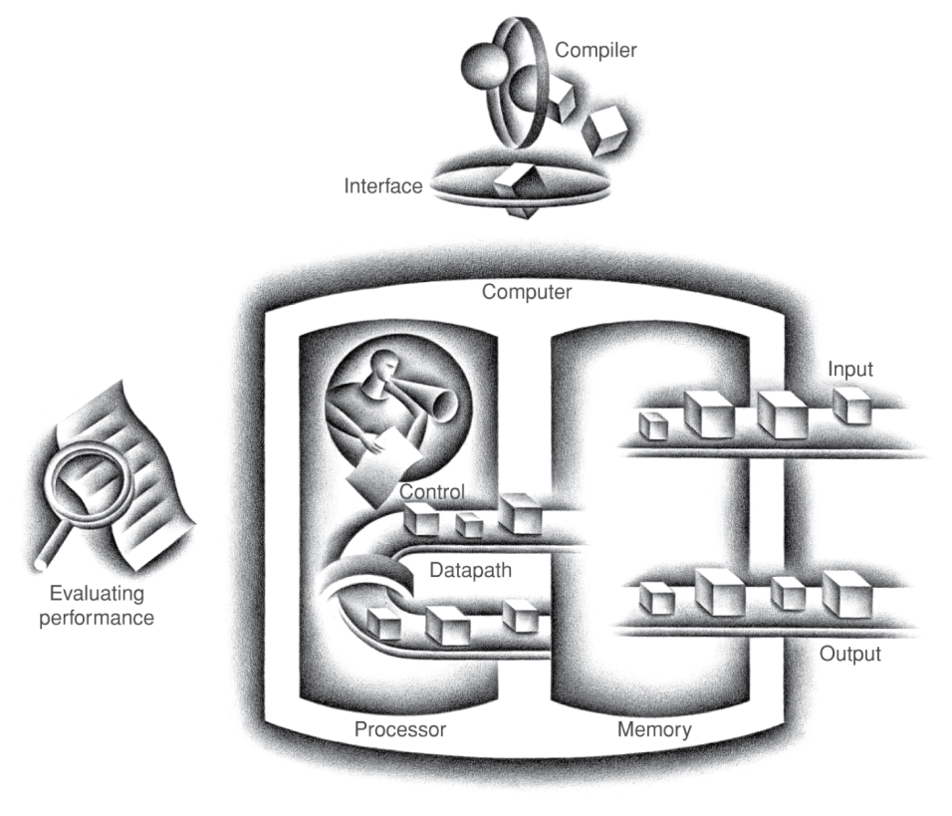
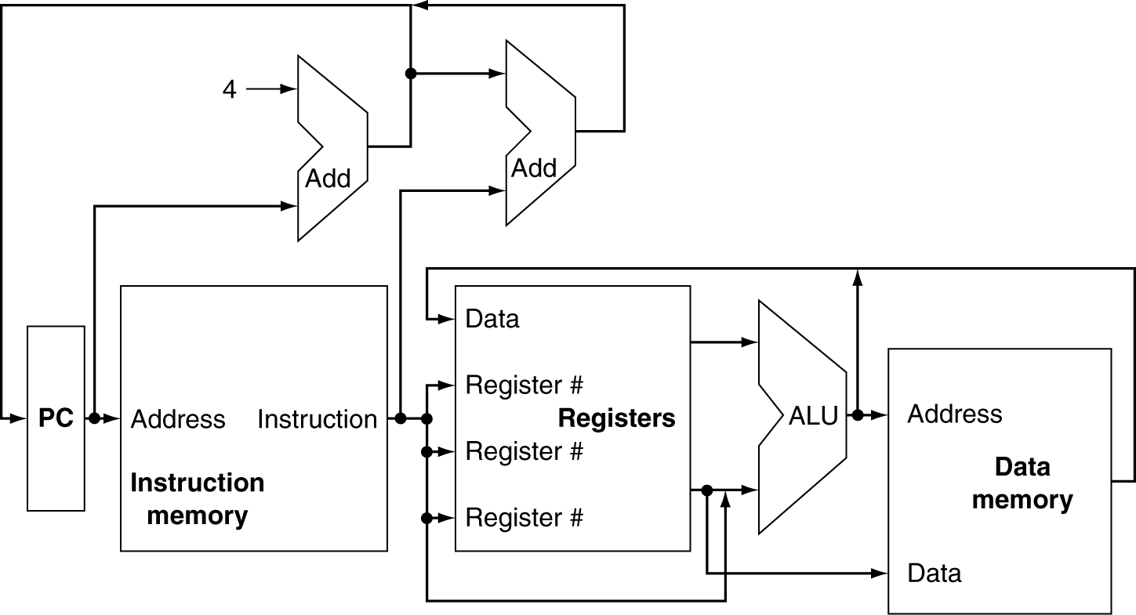
CPU Overview
Processor
Memory

Slide 3
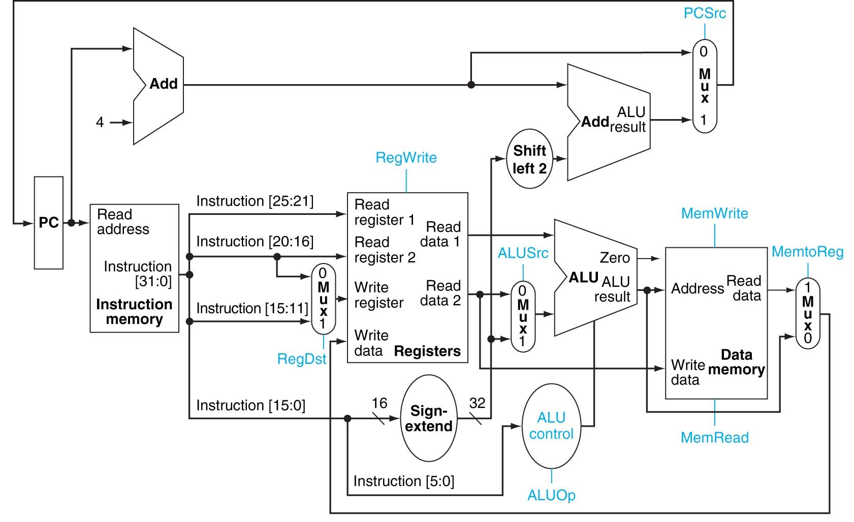
Datapath

Slide 4
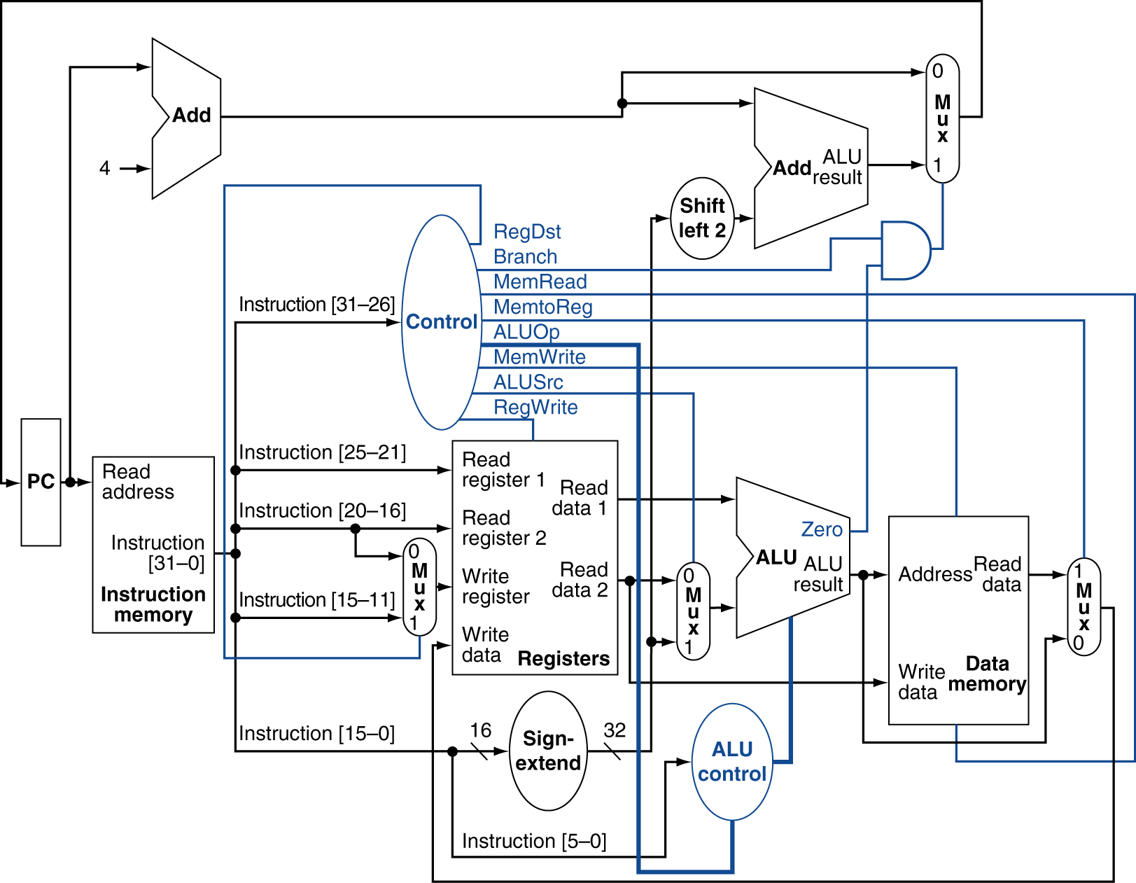
Datapath With Control

Slide 5
Processor
Memory

Slide 6
Harvard Architecture vs. Von Neumann Architecture
• von Neumann Architecture
• Same memory holds data, instructions.
• A single set of address/data buses between CPU and memory
• Harvard Architecture
• Separate memories for data and instructions.
• Two sets of address/data buses between CPU and memory

Slide 7
Roles of Instruction Fields
Control signals derived from instruction
R-type
0
rs
rt
rd
shamt
funct
31:26
25:21
20:16
15:11
10:6
5:0
Load/ Store
35 or 43
rs
rt
address
31:26
25:21
20:16
15:0
Branch
4
rs
rt
address
31:26
25:21
20:16
15:0
opcode
always read
read, except for load
write for R-type and load
sign-extend and add

Slide 8
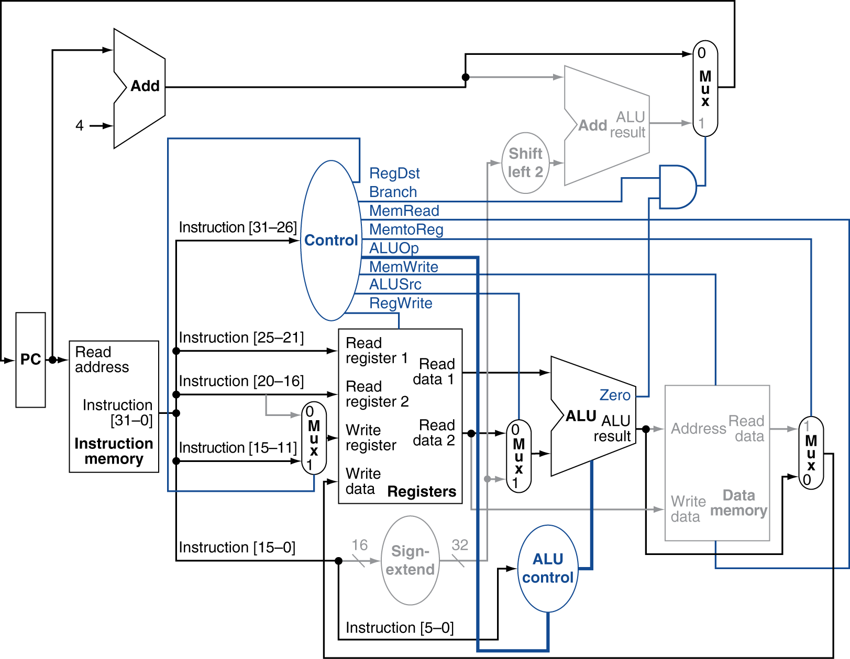

Execution of Arithmetic/Logic Instructions

Slide 9
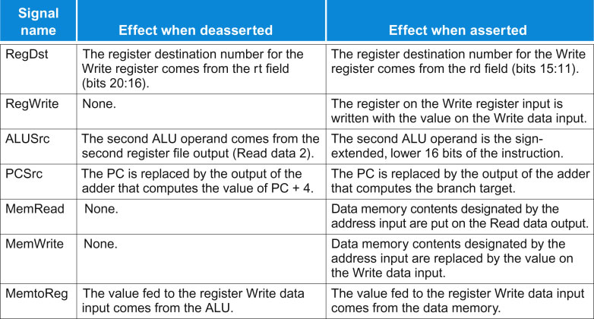
Meaning of Control Signals
FIGURE 4.16 The effect of each of the seven control signals. When the 1-bit control to a two-way multiplexor is asserted, the multiplexor selects the input corresponding to 1. Otherwise, if the control is deasserted, the multiplexor selects the 0 input. Remember that the state elements all have the clock as an implicit input and that the clock is used in controlling writes. Gating the clock externally to a state element can create timing problems. (See Appendix B for further discussion of this problem.)
Copyright © 2014 Elsevier Inc. All rights reserved.

Slide 10
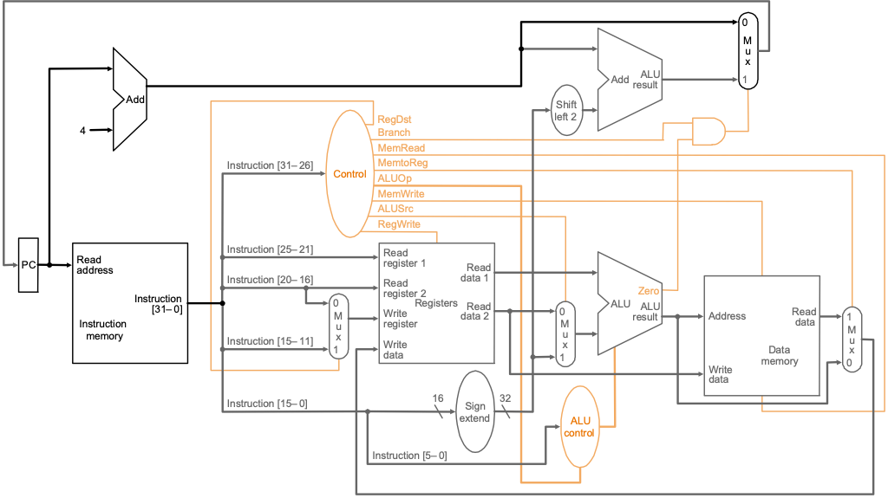
Execution of R-type (Arithmetic/Logic) instruction
0
0
000000
10
01000
1
0
01001
0
0
00010
1
0010
(+)
0
100000
add $2, $8,$9 000000 01000 01001 00010 00000 100000

Slide 11
ALU Control
ALU used for
R-type: F depends on funct field
Load/Store: F = add
Branch: F = subtract
§4.4 A Simple Implementation Scheme
ALU control | Function
0000 | AND
0001 | OR
0010 | add
0110 | subtract
0111 | set-on-less-than
1100 | NOR

Slide 12
2단계로 ALU control 을 구현
Assume 2-bit ALUOp derived from opcode
Combinational logic derives ALU control
instruction 으로부터의 input
control 회로에서 만들어지는 output
opcode | ALUOp | Operation | funct | ALU function | ALU control
lw(0x23) | 00 | load word | XXXXXX | add | 0010
sw(0x2b) | 00 | store word | XXXXXX | add | 0010
beq(0x04) | 01 | branch equal | XXXXXX | subtract | 0110
R-type (0x00) | 10 | add | 100000 | add | 0010
 |  | subtract | 100010 | subtract | 0110
 |  | AND | 100100 | AND | 0000
 |  | OR | 100101 | OR | 0001
 |  | set-on-less-than | 101010 | set-on-less-than | 0111

Slide 13
2단계로 ALU control 을 구현
Assume 2-bit ALUOp derived from opcode
Combinational logic derives ALU control
instruction 으로부터의 input
control 회로에서 만들어지는 output
opcode | ALUOp | Operation | funct | ALU function | ALU control
lw(0x23) | 00 | load word | XXXXXX | add | 0010
sw(0x2b) | 00 | store word | XXXXXX | add | 0010
beq(0x04) | 01 | branch equal | XXXXXX | subtract | 0110
R-type (0x00) | 10 | add | 100000 | add | 0010
 |  | subtract | 100010 | subtract | 0110
 |  | AND | 100100 | AND | 0000
 |  | OR | 100101 | OR | 0001
 |  | set-on-less-than | 101010 | set-on-less-than | 0111

Slide 14
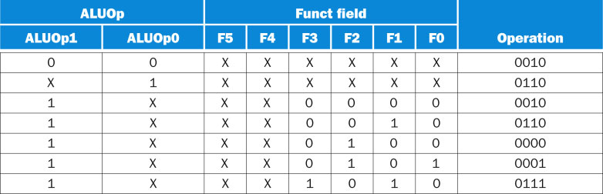
FIGURE 4.13 The truth table for the 4 ALU control bits (called Operation). The inputs are the ALUOp and function code field. Only the entries for which the ALU control is asserted are shown. Some don’t-care entries have been added. For example, the ALUOp does not use the encoding 11, so the truth table can contain entries 1X and X1, rather than 10 and 01. Note that when the function field is used, the first 2 bits (F5 and F4) of these instructions are always 10, so they are don’t-care terms and are replaced with XX in the truth table.
Copyright © 2014 Elsevier Inc. All rights reserved.

Slide 15
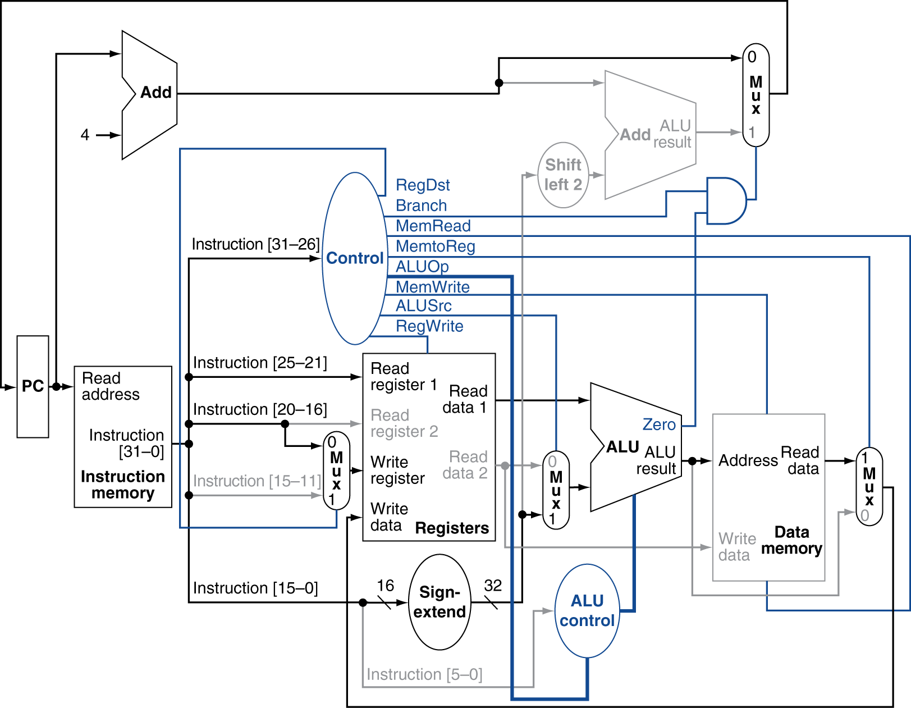
Load Instruction

Slide 16
Execution of lw instruction
0
0
100011
01000
1
0
00010
1
1
0010
(+)
0
0x00000004
0000 0000 0000 0100
1
00
lw $2, 4($8) 100011 01000 00010 0000 0000 0000 0100

Slide 17
2단계로 ALU control 을 구현
Assume 2-bit ALUOp derived from opcode
Combinational logic derives ALU control
instruction 으로부터의 input
control 회로에서 만들어지는 output
opcode | ALUOp | Operation | funct | ALU function | ALU control
lw(0x23) | 00 | load word | XXXXXX | add | 0010
sw(0x2b) | 00 | store word | XXXXXX | add | 0010
beq(0x04) | 01 | branch equal | XXXXXX | subtract | 0110
R-type (0x00) | 10 | add | 100000 | add | 0010
 |  | subtract | 100010 | subtract | 0110
 |  | AND | 100100 | AND | 0000
 |  | OR | 100101 | OR | 0001
 |  | set-on-less-than | 101010 | set-on-less-than | 0111

Slide 18
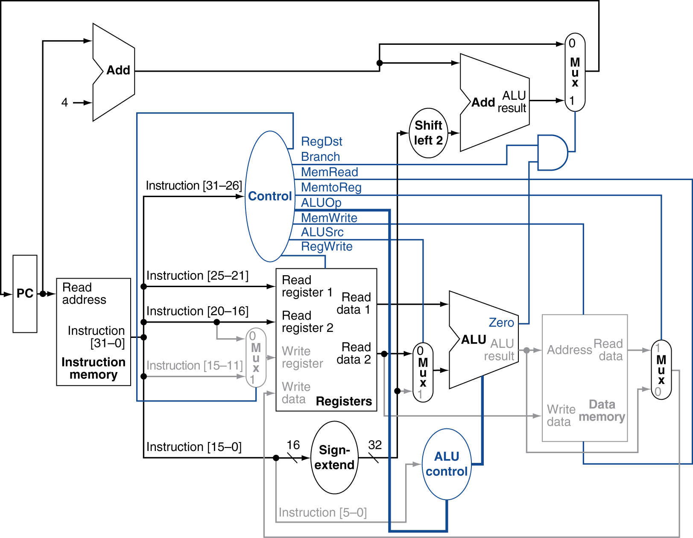
Branch-on-Equal Instruction

Slide 19
Execution of branch instruction
PC+4
BTA
1
0/1
0x00000008
000100
0/1
0x00000002
00011
0
0
00100
0
X
0110
(-)
X
X
0000 0000 0000 0010
X(0)
01
beq $3, $4, L 000100 00011 00100 0000 0000 0000 0010

Slide 20
2단계로 ALU control 을 구현
Assume 2-bit ALUOp derived from opcode
Combinational logic derives ALU control
instruction 으로부터의 input
control 회로에서 만들어지는 output
opcode | ALUOp | Operation | funct | ALU function | ALU control
lw(0x23) | 00 | load word | XXXXXX | add | 0010
sw(0x2b) | 00 | store word | XXXXXX | add | 0010
beq(0x04) | 01 | branch equal | XXXXXX | subtract | 0110
R-type (0x00) | 10 | add | 100000 | add | 0010
 |  | subtract | 100010 | subtract | 0110
 |  | AND | 100100 | AND | 0000
 |  | OR | 100101 | OR | 0001
 |  | set-on-less-than | 101010 | set-on-less-than | 0111

Slide 21
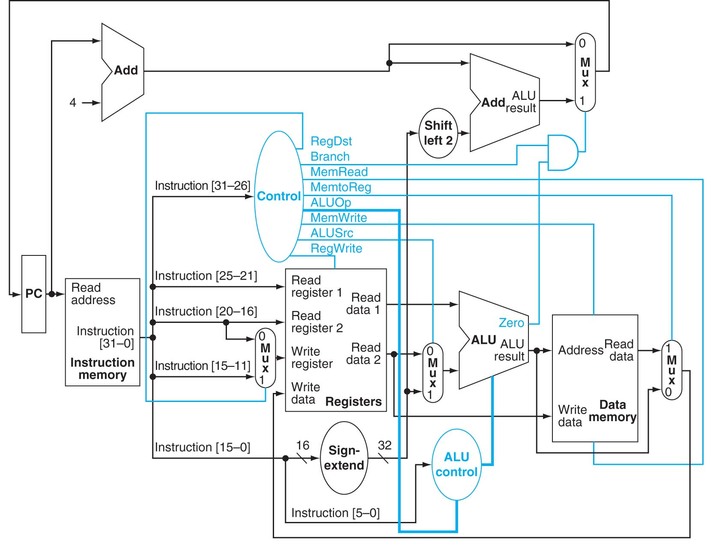
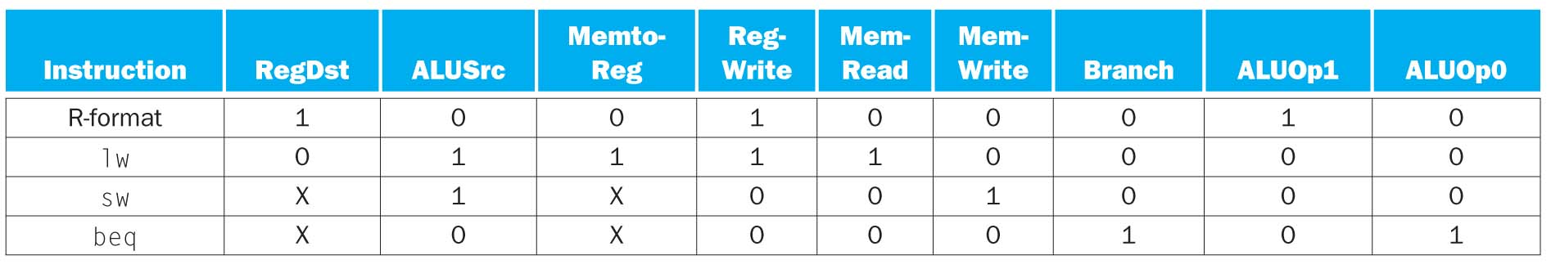
Control Signals

Slide 22
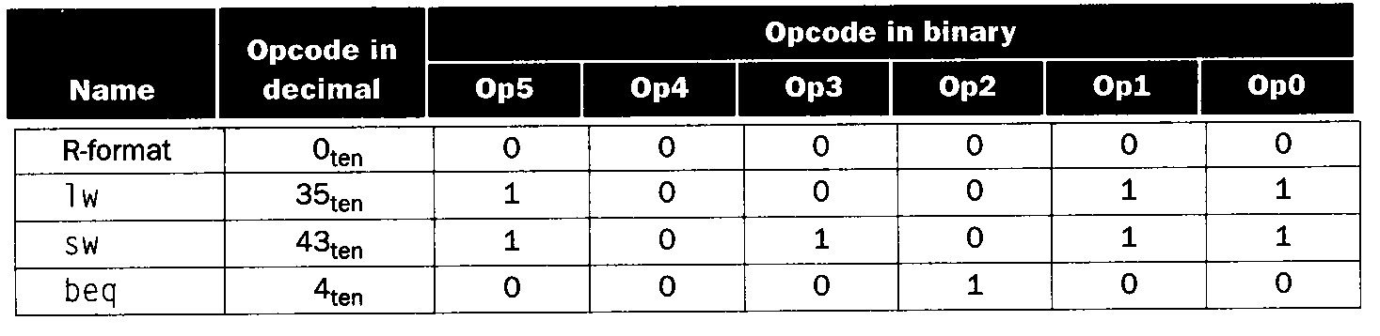
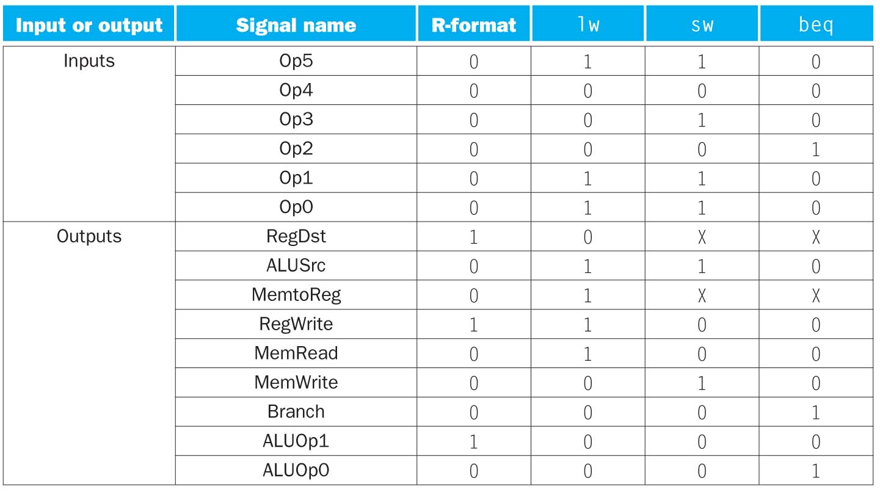
Truth table for the control
Input
Output

Slide 23
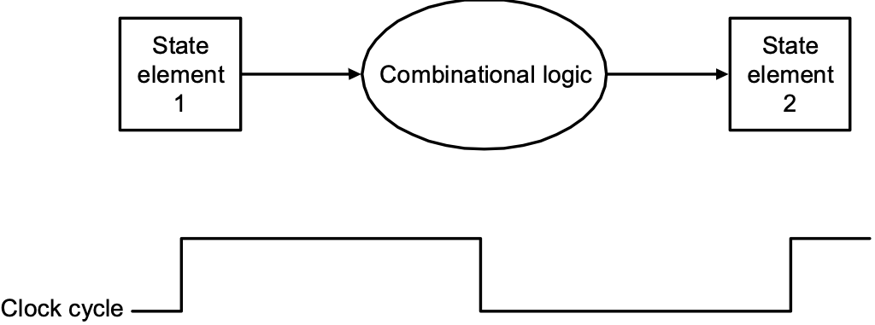
Our Simple Control Structure
All of the control logic is combinational
We wait for everything to settle down, and the right thing to be done
ALU might not produce right answer right away
we use write signals along with clock to determine when to write
(registers and memory are written at the end of the cycle)
Cycle time determined by length of the longest path

Slide 24
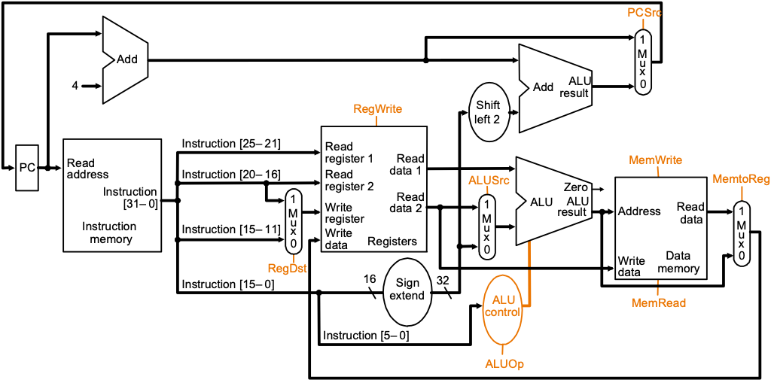
Performance of Single Cycle Machines
Calculate the minimum cycle time assuming negligible delays except:
memory (200ps), ALU and adders (100ps), register file access (50ps)

Slide 25
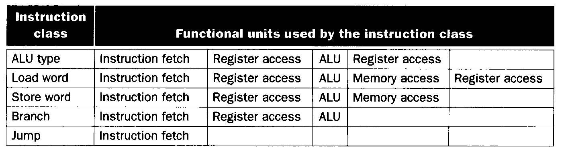
Instruction class | Inst. memory | Register read | ALU operation | Data memory | Register write | total
ALU type | 200 | 50 | 100 | 0 | 50 | 400ps
Lw | 200 | 50 | 100 | 200 | 50 | 600ps
Sw | 200 | 50 | 100 | 200 |  | 550ps
Branch | 200 | 50 | 100 |  |  | 350ps
Jump | 200 |  |  |  |  | 200ps
Clock rate :

Slide 26
Performance Issues
Longest delay determines clock period
Critical path: load instruction
Instruction memory → register file → ALU → data memory → register file
Not feasible to vary period for different instructions
We will improve performance by pipelining

