Slide 1
Pipeline Hazards
Situations that prevent starting the next instruction in the next cycle
Structural hazards
A required resource is busy
Data hazard
Need to wait for previous instruction to complete its data read/write
Control hazard
Deciding on control action depends on previous instruction

Slide 2
Structural Hazards
Conflict for use of a resource
In MIPS pipeline with a single memory
Load/store requires data access
Instruction fetch would have to stall for that cycle
Would cause a pipeline “bubble”
Hence, pipelined datapaths require separate instruction/data memories
Or separate instruction/data caches

Slide 3
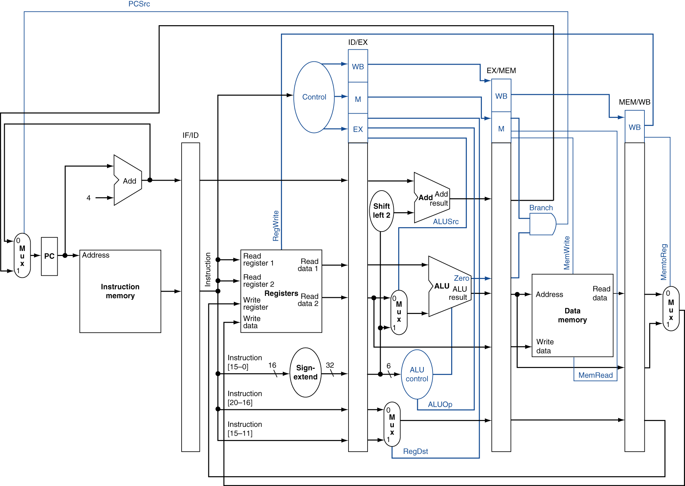
Solution to Structural Hazards

Slide 4
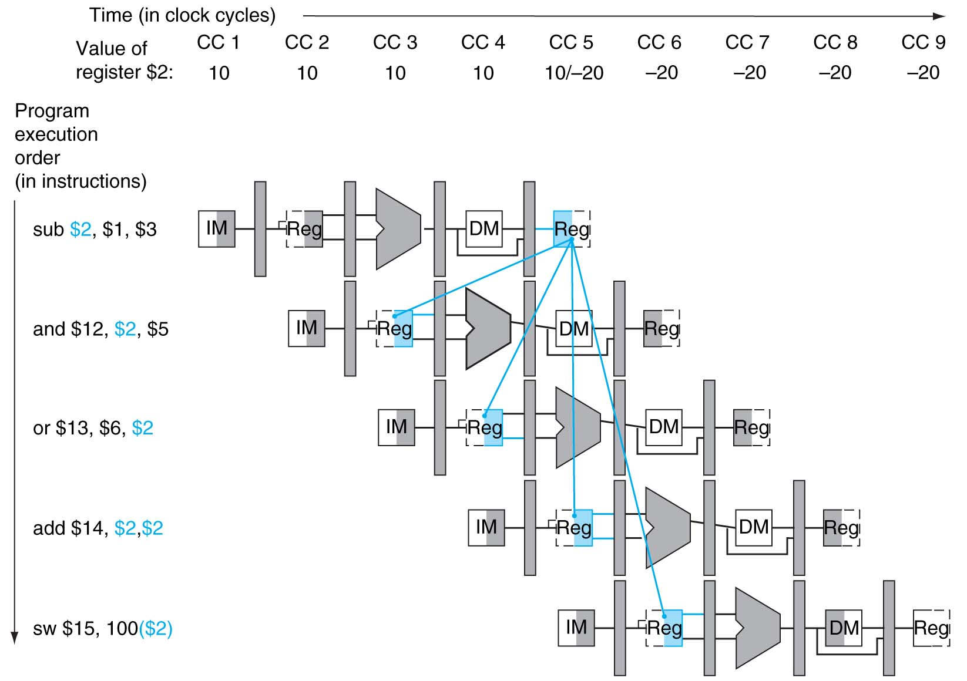
Dependencies

Slide 5
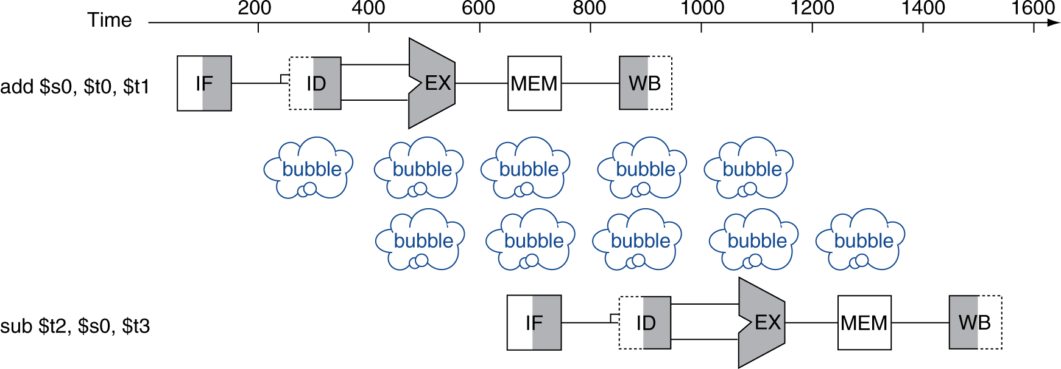
Data Hazards
An instruction depends on completion of data access by a previous instruction
add $s0, $t0, $t1 sub $t2, $s0, $t3
pipeline stall

Slide 6
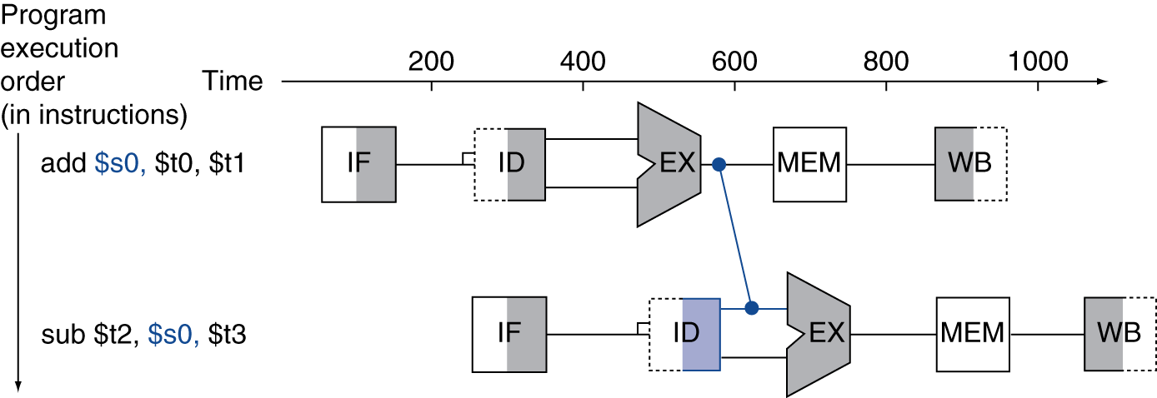
Forwarding (aka Bypassing)
Use result when it is computed
Don’t wait for it to be stored in a register
Requires extra connections in the datapath

Slide 7
Data Hazards in ALU Instructions
Consider this sequence:
sub $2, $1,$3 and $12,$2,$5 or $13,$6,$2 add $14,$2,$2 sw $15,100($2)
We can resolve hazards with forwarding
How do we detect when to forward?
§4.7 Data Hazards: Forwarding vs. Stalling

Slide 8
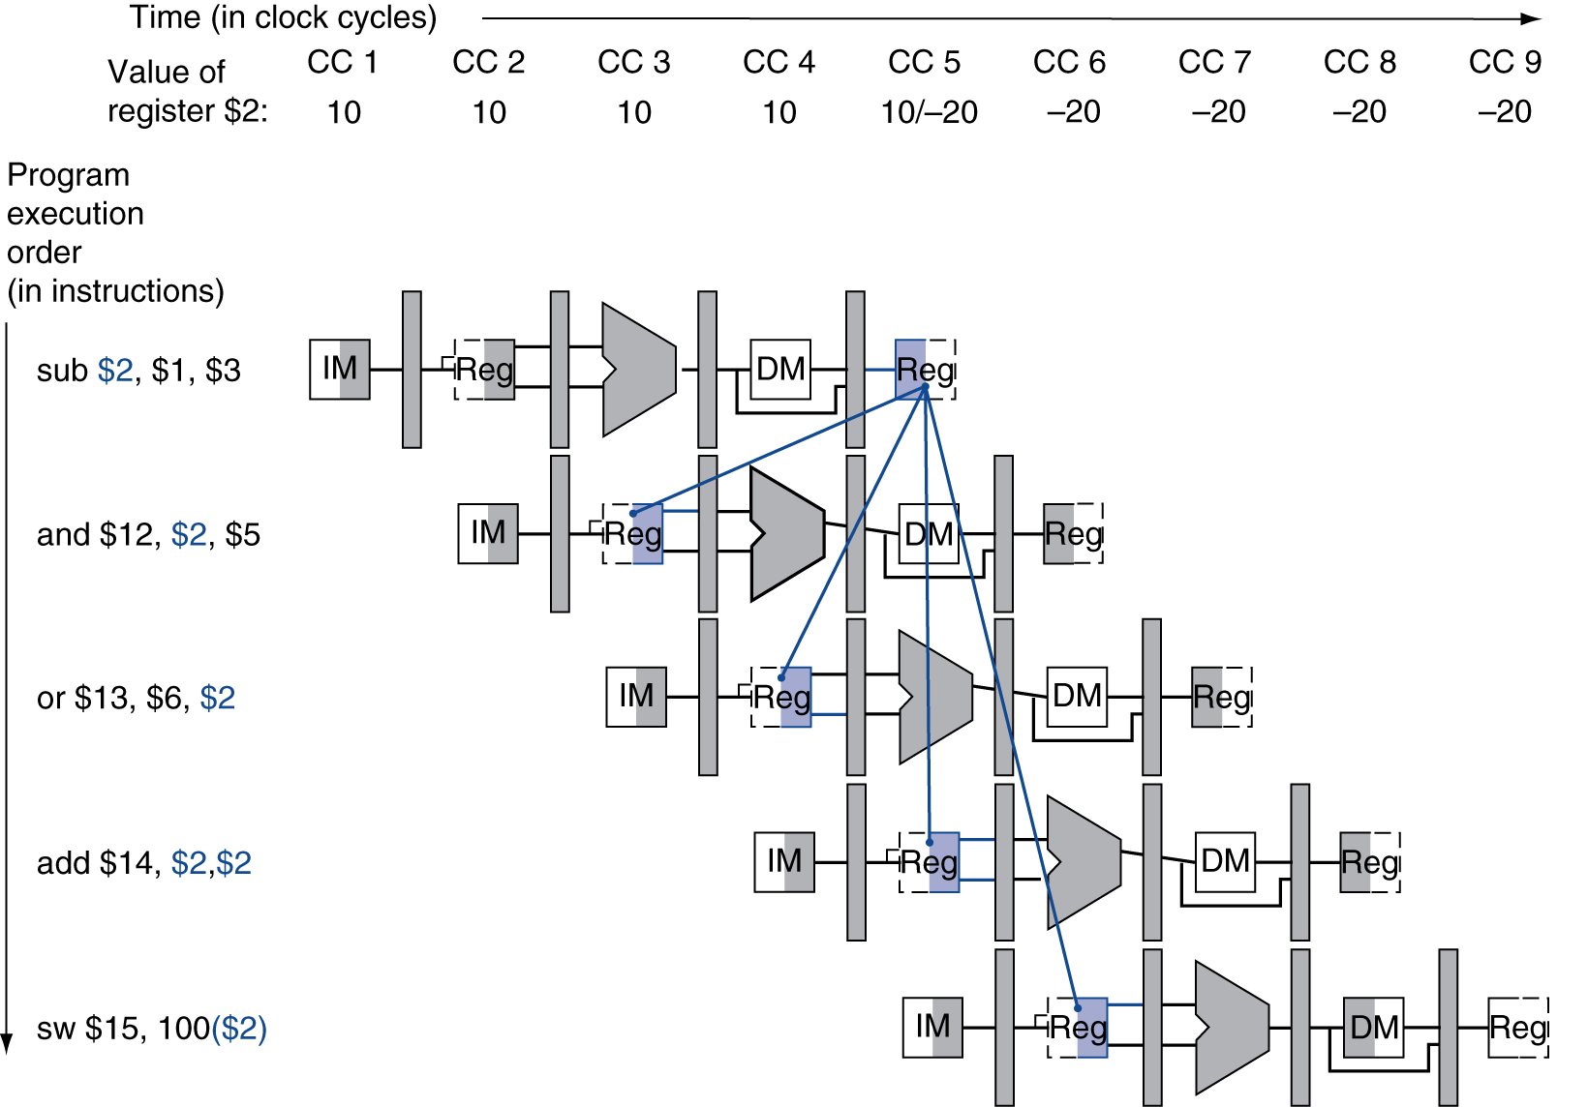
Dependencies & Forwarding
Chapter 4 — The Processor — 8

Slide 9
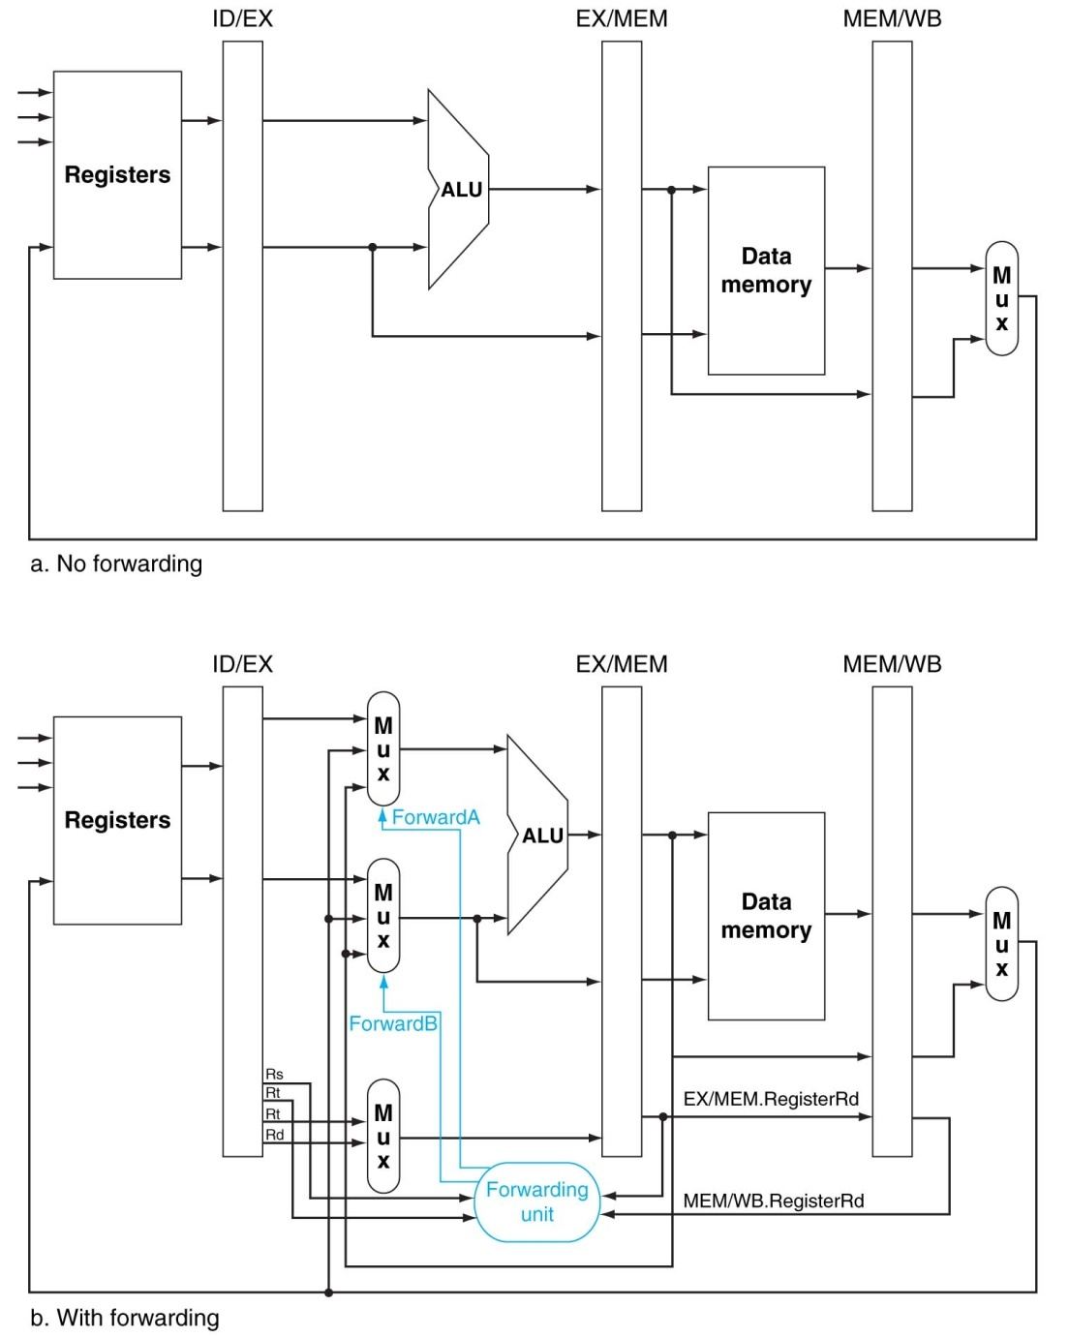
Modification to the pipeline datapath

Slide 10
Detecting the Need to Forward (1)
Pass register numbers along pipeline
e.g., ID/EX.RegisterRs = register number for Rs sitting in ID/EX pipeline register
ALU operand register numbers in EX stage are given by
ID/EX.RegisterRs, ID/EX.RegisterRt
Data hazards when
1a. EX/MEM.RegisterRd = ID/EX.RegisterRs
1b. EX/MEM.RegisterRd = ID/EX.RegisterRt
2a. MEM/WB.RegisterRd = ID/EX.RegisterRs
2b. MEM/WB.RegisterRd = ID/EX.RegisterRt
Fwd from EX/MEM pipeline reg
Fwd from MEM/WB pipeline reg
Chapter 4 — The Processor — 9

Slide 11
Detecting the Need to Forward (2)
But only if forwarding instruction will write to a register!
EX/MEM.RegWrite, MEM/WB.RegWrite
And only if Rd for that instruction is not $zero
EX/MEM.RegisterRd ≠ 0, MEM/WB.RegisterRd ≠ 0
Chapter 4 — The Processor — 10

Slide 12
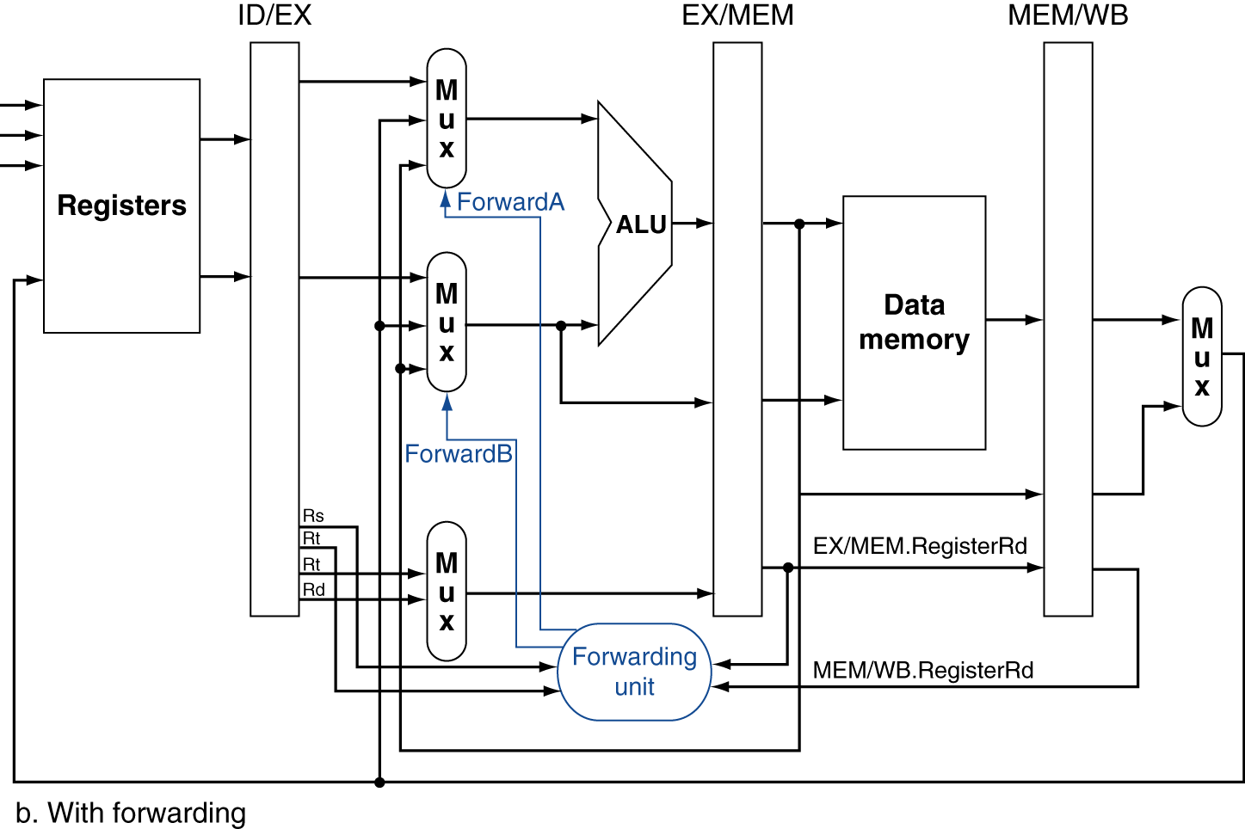
Forwarding Paths

Slide 13
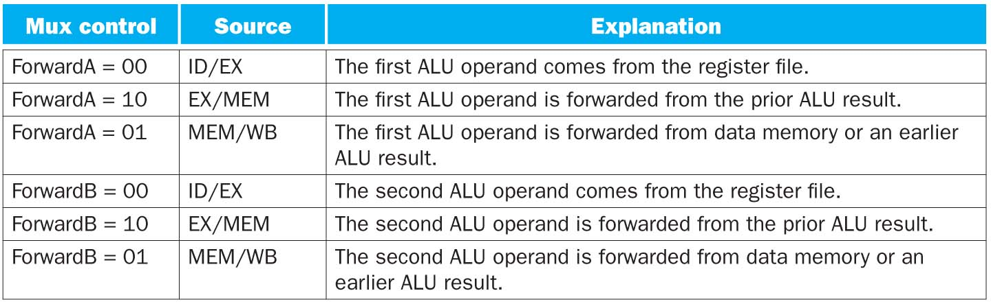
Meaning of ForwardA/B control signals

Slide 14
Forwarding Conditions
add $4, $x, $x
sub $x, $4, $x
EX hazard
if (EX/MEM.RegWrite and (EX/MEM.RegisterRd ≠ 0) and (EX/MEM.RegisterRd = ID/EX.RegisterRs)) ForwardA = 10
if (EX/MEM.RegWrite and (EX/MEM.RegisterRd ≠ 0) and (EX/MEM.RegisterRd = ID/EX.RegisterRt)) ForwardB = 10
MEM hazard
if (MEM/WB.RegWrite and (MEM/WB.RegisterRd ≠ 0) and (MEM/WB.RegisterRd = ID/EX.RegisterRs)) ForwardA = 01
if (MEM/WB.RegWrite and (MEM/WB.RegisterRd ≠ 0) and (MEM/WB.RegisterRd = ID/EX.RegisterRt)) ForwardB = 01
add $4, $x, $x
sub $x, $x, $4
add $4, $x, $x
xxx xx, xx, xx
sub $x, $4, $x
add $4, $x, $x
xxx xx, xx, xx
sub $x, $x, $4

Slide 15
Double Data Hazard
Consider the sequence:
add $10,$11,$12 and $10,$16,$13 sub $15,$10,$14
Forward from which stage?
the most recent value
Revise MEM hazard condition
Only forward if EX hazard condition isn’t true
ForwardA = 01
ForwardA = 10
EX hazard
if (EX/MEM.RegWrite and (EX/MEM.RegisterRd ≠ 0) and (EX/MEM.RegisterRd = ID/EX.RegisterRs)) ForwardA = 10
MEM hazard
if (MEM/WB.RegWrite and (MEM/WB.RegisterRd ≠ 0) and (MEM/WB.RegisterRd = ID/EX.RegisterRs)) ForwardA = 01

Slide 16
Truth table of Forwarding Unit
input
output
EX/MEM.RegWrite | EX/MEM.rd=ID/EX.rs | MEM/WB.RegWrite | MEM/WB.rd=ID/EX.rs | ForwardA | Source
1 | 1 | X | X | 10 | EX/MEM
X | 0 | 1 | 1 | 01 | MEM/WB
0 | X | 1 | 1 | 01 | MEM/WB
Otherwise |  |  |  | 00 | ID/EX
EX/MEM.RegWrite | EX/MEM.rd=ID/EX.rt | MEM/WB.RegWrite | MEM/WB.rd=ID/EX.rt | ForwardB | Source
1 | 1 | X | X | 10 | EX/MEM
X | 0 | 1 | 1 | 01 | MEM/WB
0 | X | 1 | 1 | 01 | MEM/WB
Otherwise |  |  |  | 00 | ID/EX

Slide 17
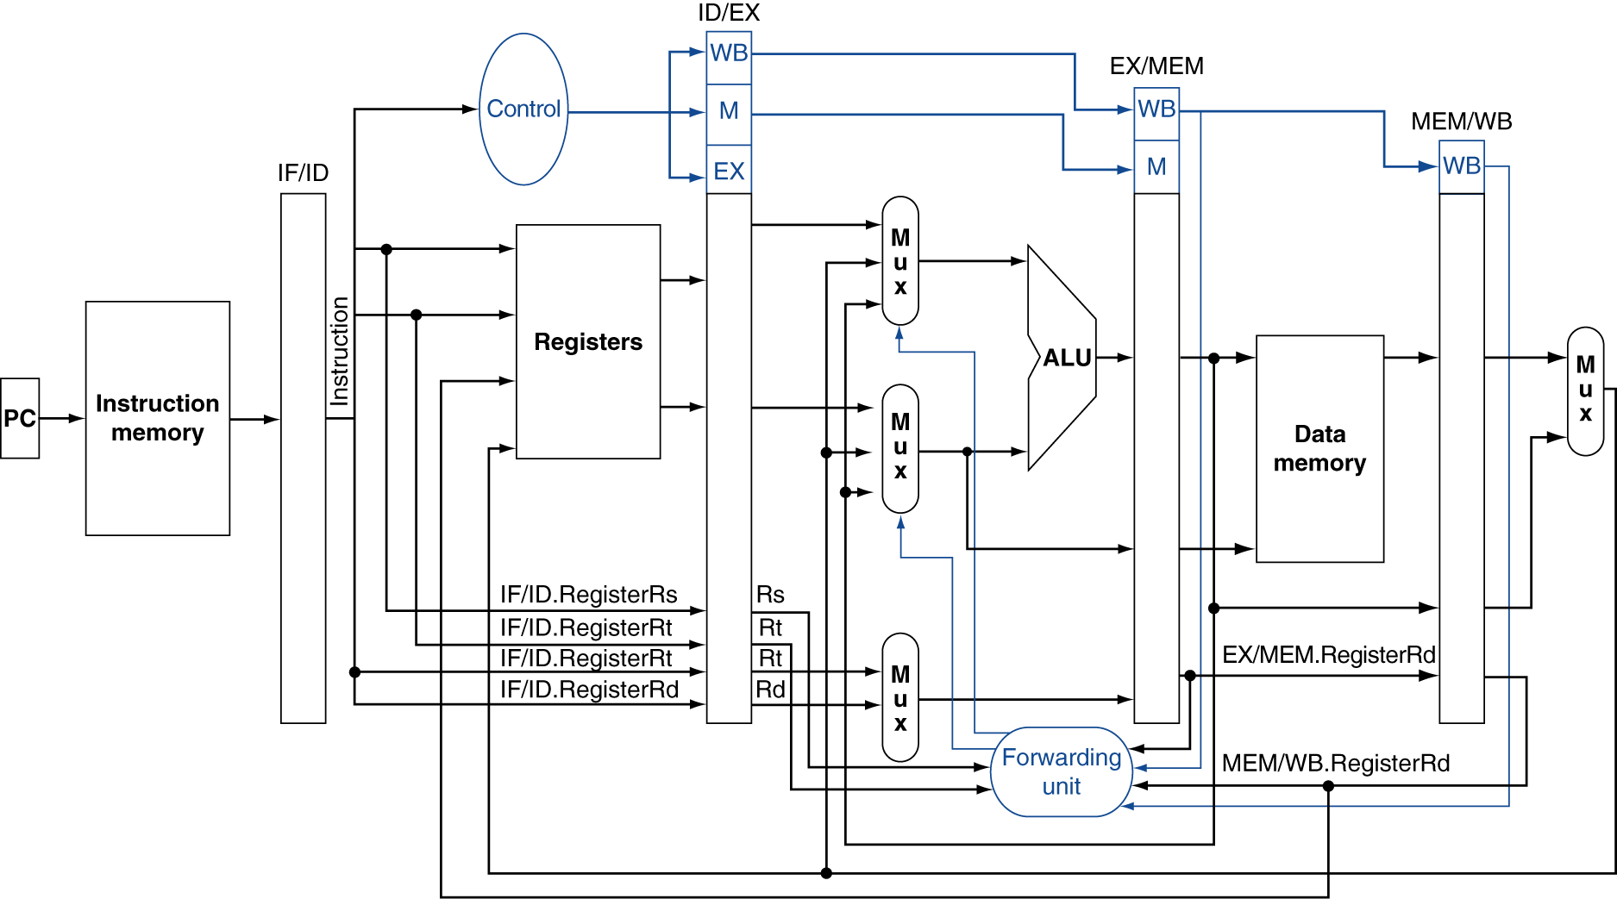
Datapath with Forwarding

Slide 18
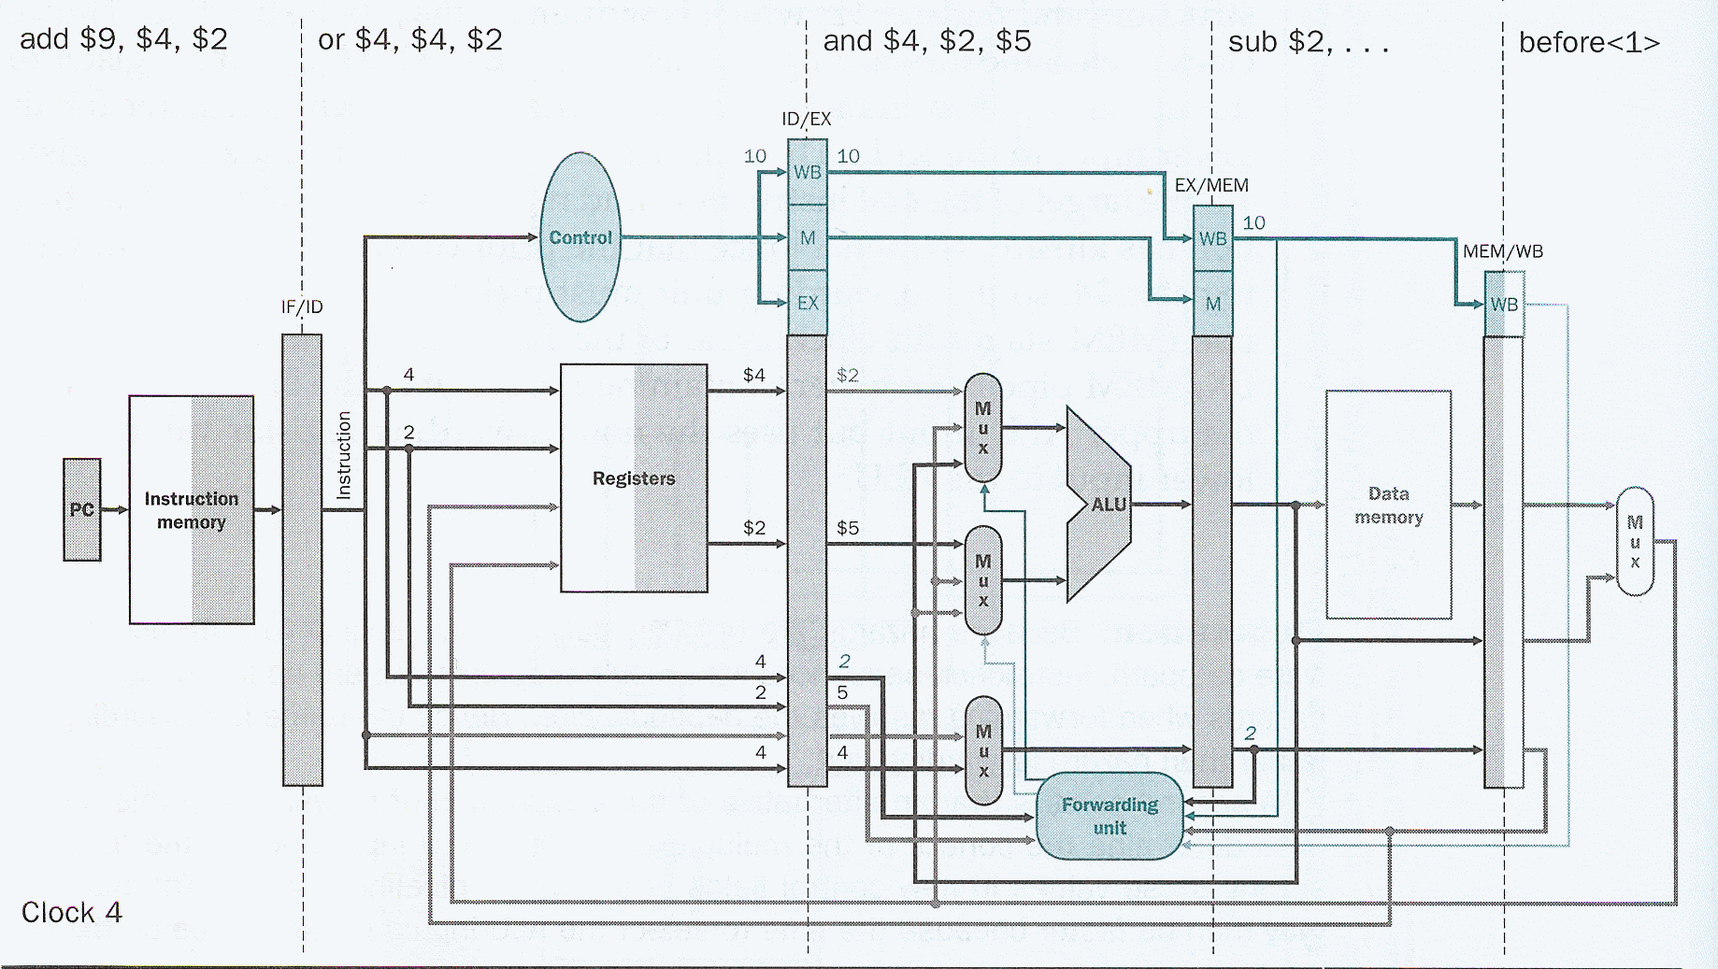
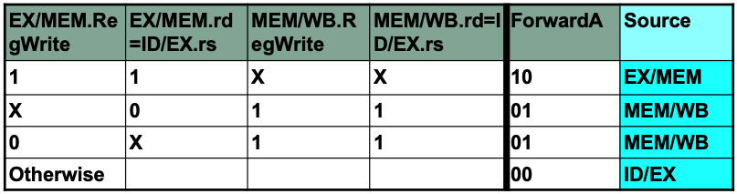
Solving Hazard b/w SUB & AND instructions (CC4)

Slide 19
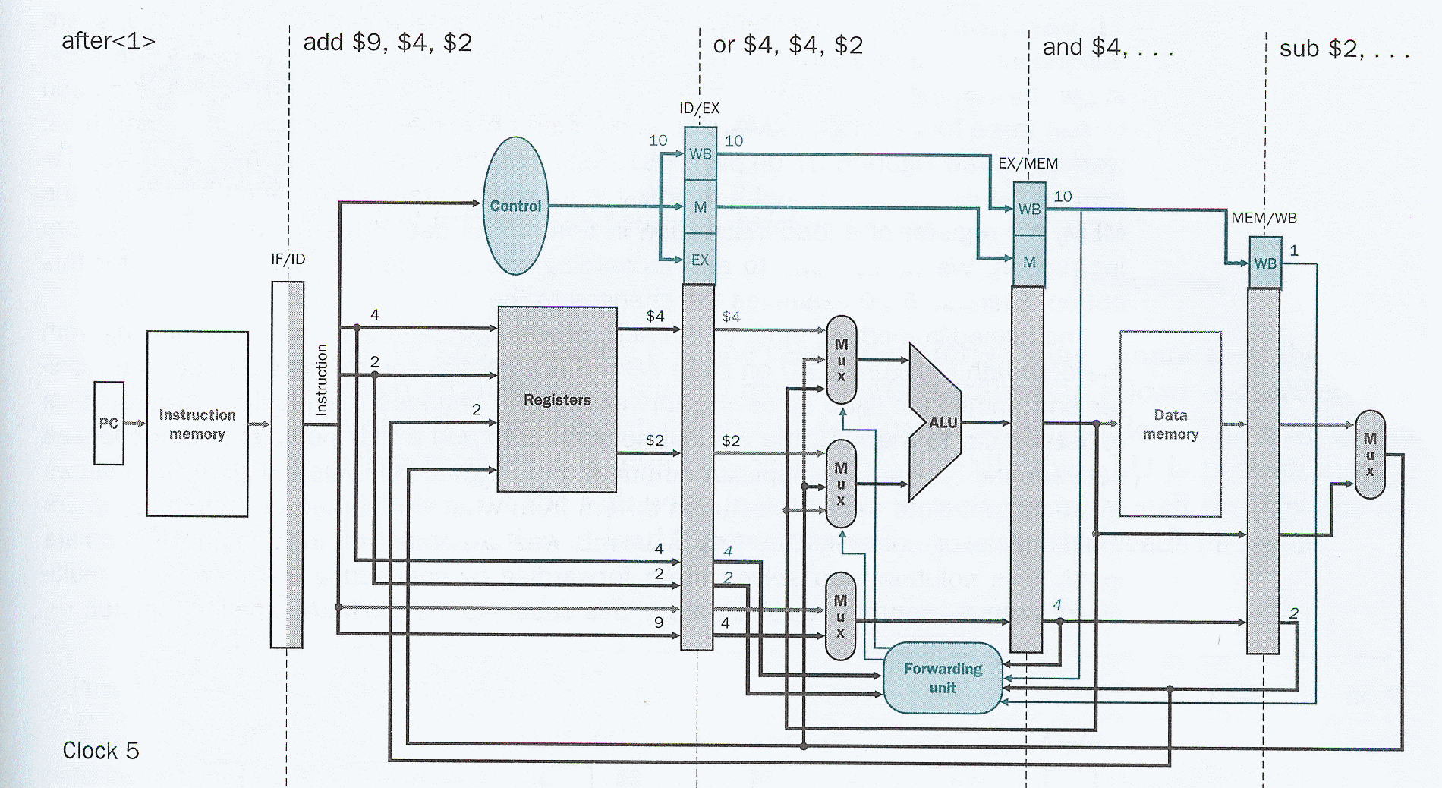
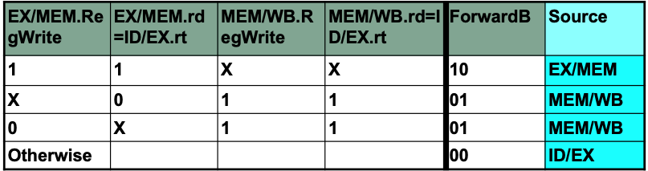
Solving Hazard b/w SUB,AND & OR instructions (CC5)

Slide 20
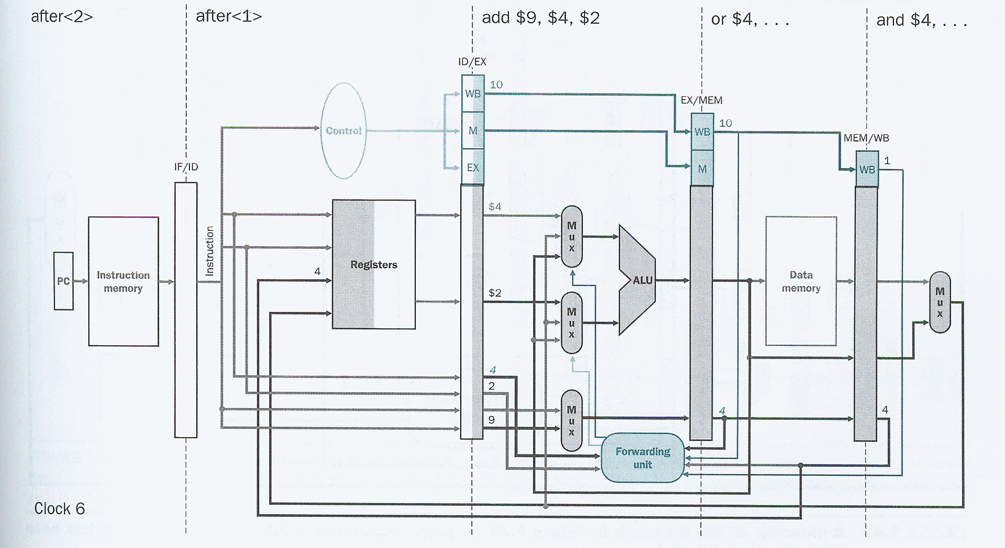
Solving Hazard b/w AND,OR & ADD instructions (CC6)

Slide 21
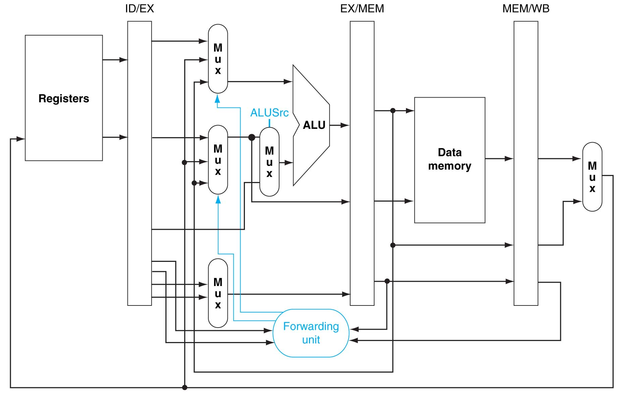
2 Multiplexors to the 2nd input of ALU

Slide 22
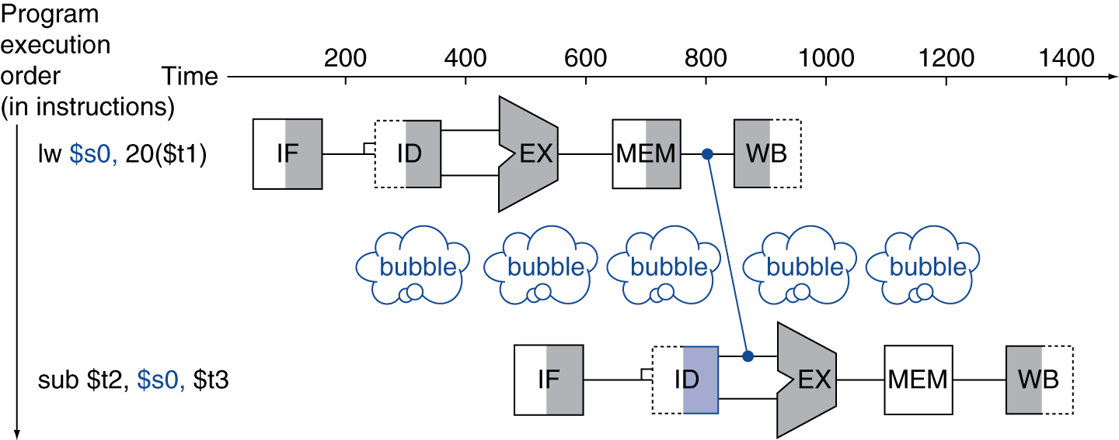
Load-Use Data Hazard
Can’t always avoid stalls by forwarding
If value is not computed when needed

Slide 23
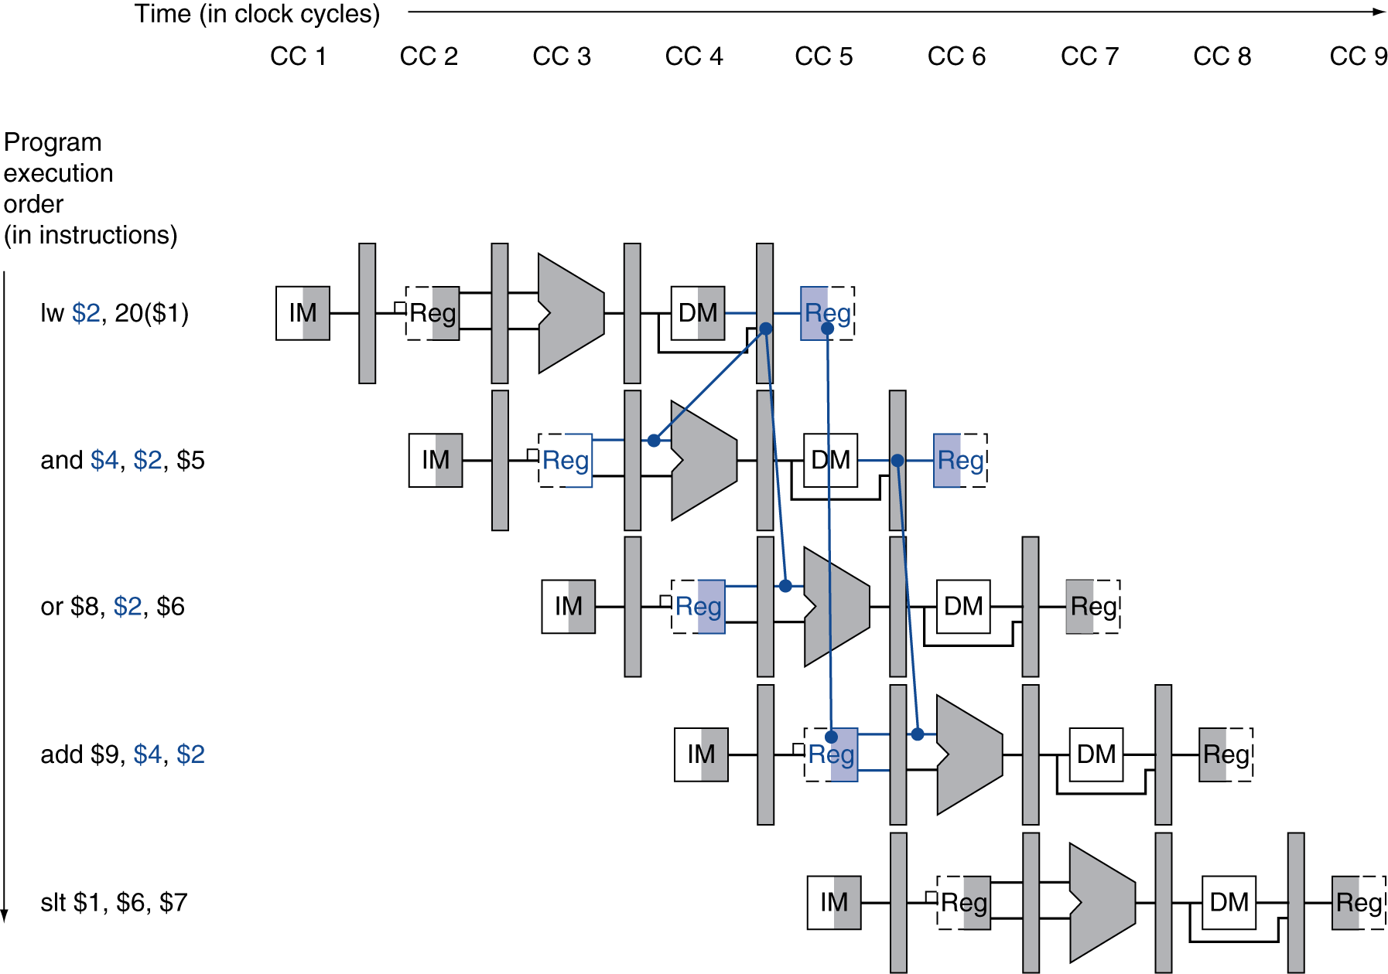
Load-Use Data Hazard
Need to stall for one cycle

Slide 24
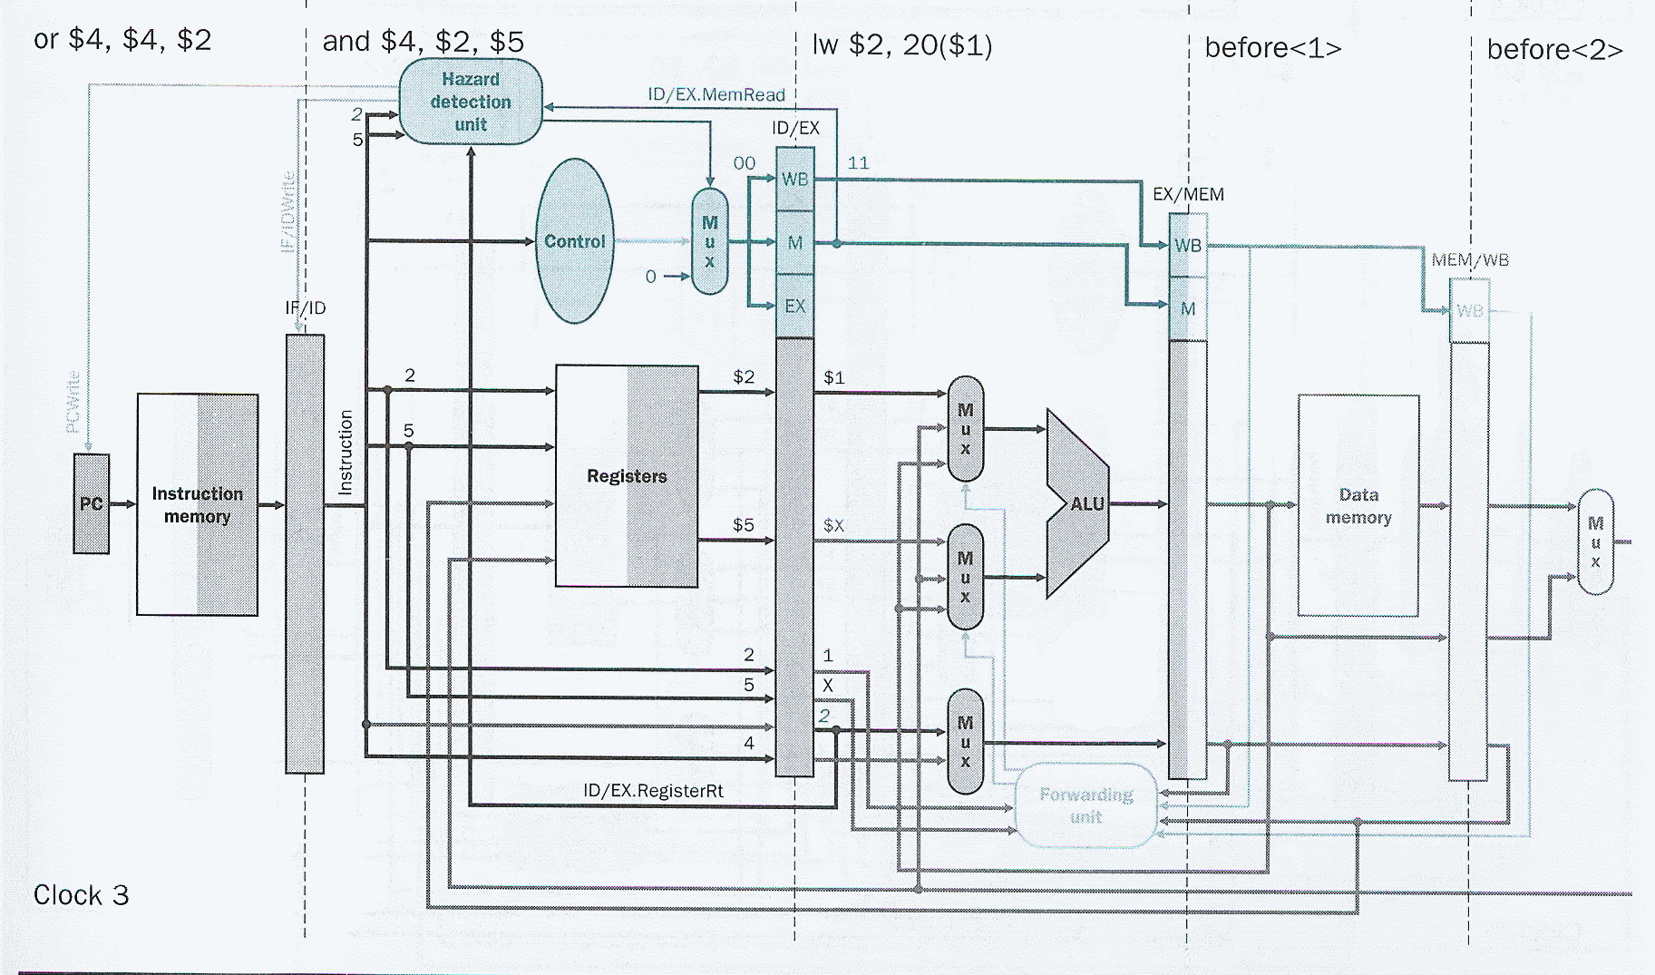
Load-Use Hazard Detection
Check when an instruction is decoded in ID stage
ALU operand register numbers in ID stage are given by
IF/ID.RegisterRs, IF/ID.RegisterRt
Load-use hazard when
ID/EX.MemRead and ((ID/EX.RegisterRt = IF/ID.RegisterRs) or (ID/EX.RegisterRt = IF/ID.RegisterRt))
If detected, stall and insert bubble
lw $2, 20($1)
and $4, $2, $5

Slide 25
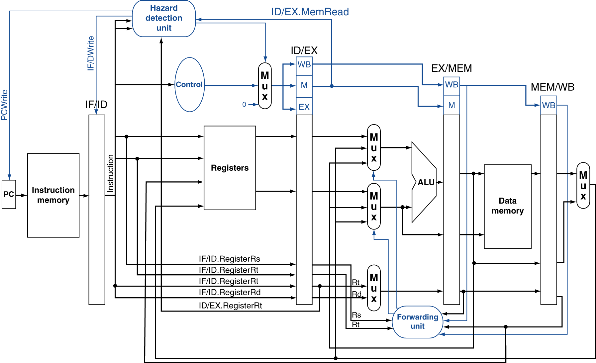
Datapath with Hazard Detection
Rs
Rt

Slide 26
How to Stall the Pipeline
Force control values in ID/EX register to 0
EX, MEM and WB do nop (no-operation)
Prevent update of PC and IF/ID register
또 한 번 같은 명령어를 decode
또 한 번 같은 명령어를 fetch
1-cycle stall allows MEM to read data for lw
Can subsequently forward to EX stage

Slide 27
Truth table of Hazard Detection Unit
ID/EX.MemRead | ID/EX.rt = IF/ID.rs | ID/EX.rt = IF/ID.rt | PCWrite | IF/IDWrite | Control MUX
1 | 1 | X | 0 | 0 | 0
1 | X | 1 | 0 | 0 | 0
Otherwise |  |  | 1 | 1 | 1
0
0
0
lw $2, 20($1)
and $4, $2, $5

Slide 28
Detecting Hazard at clock 3
0
0
0

Slide 29
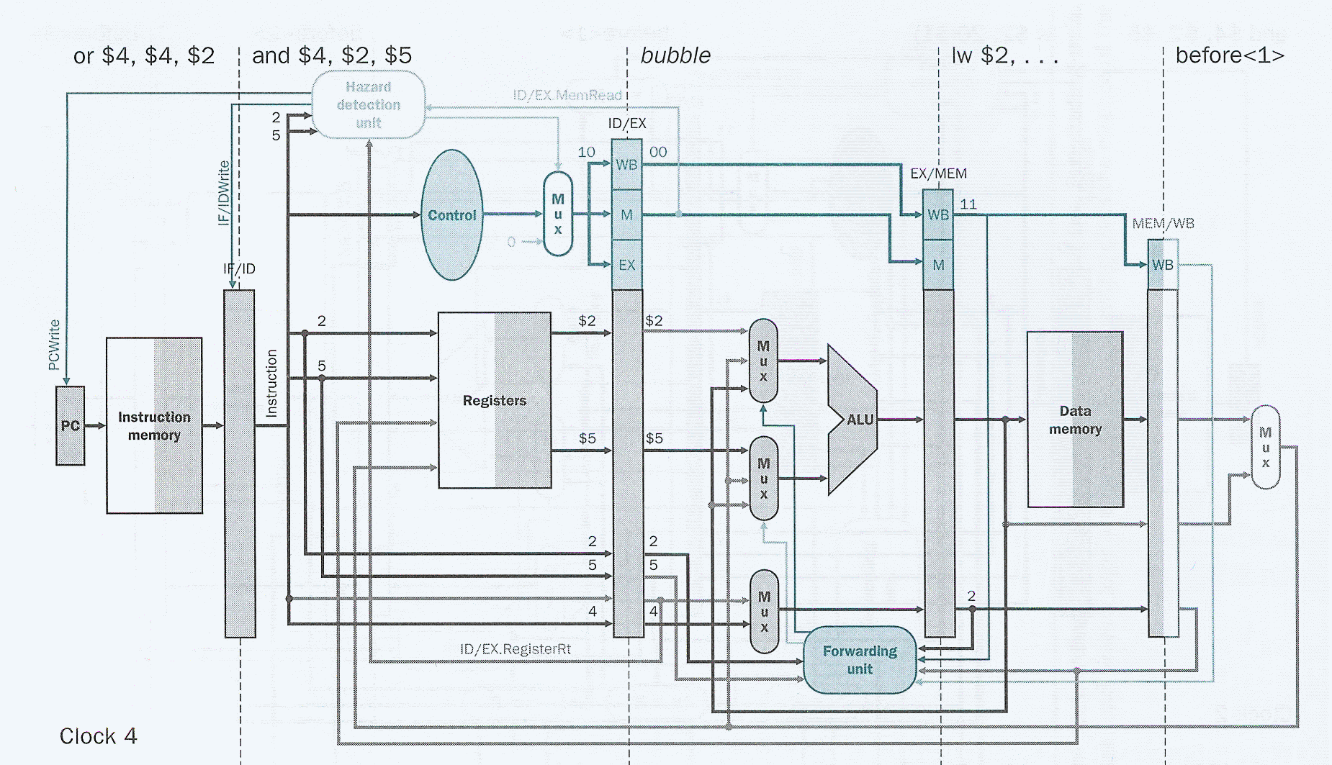
Bubble at EX stage at clock 4

Slide 30
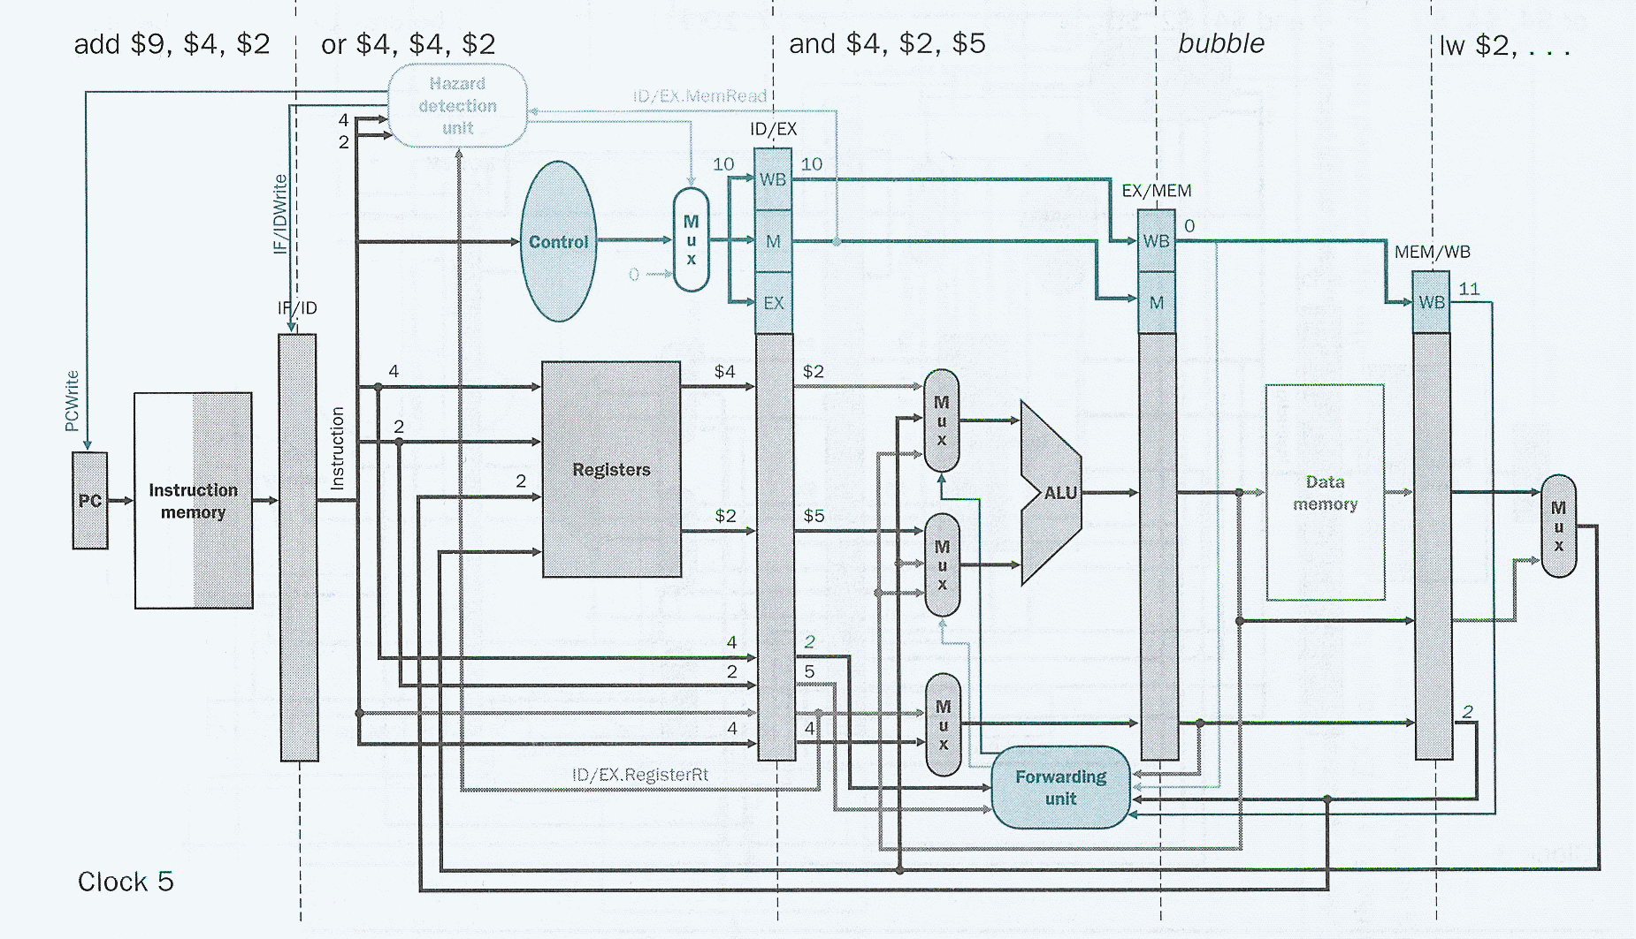
Bubble at MEM stage at clock 5…
01

Slide 31
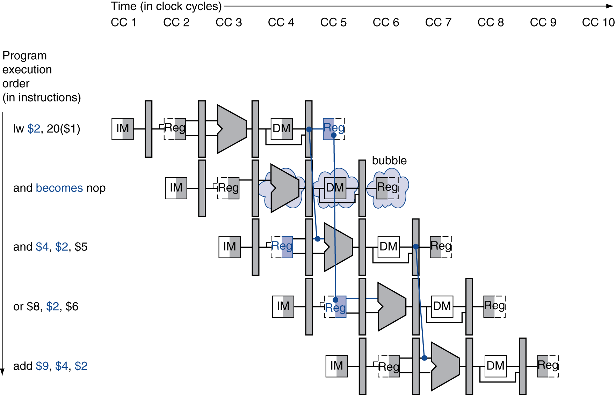
Stall/Bubble in the Pipeline
Stall inserted here

Slide 32
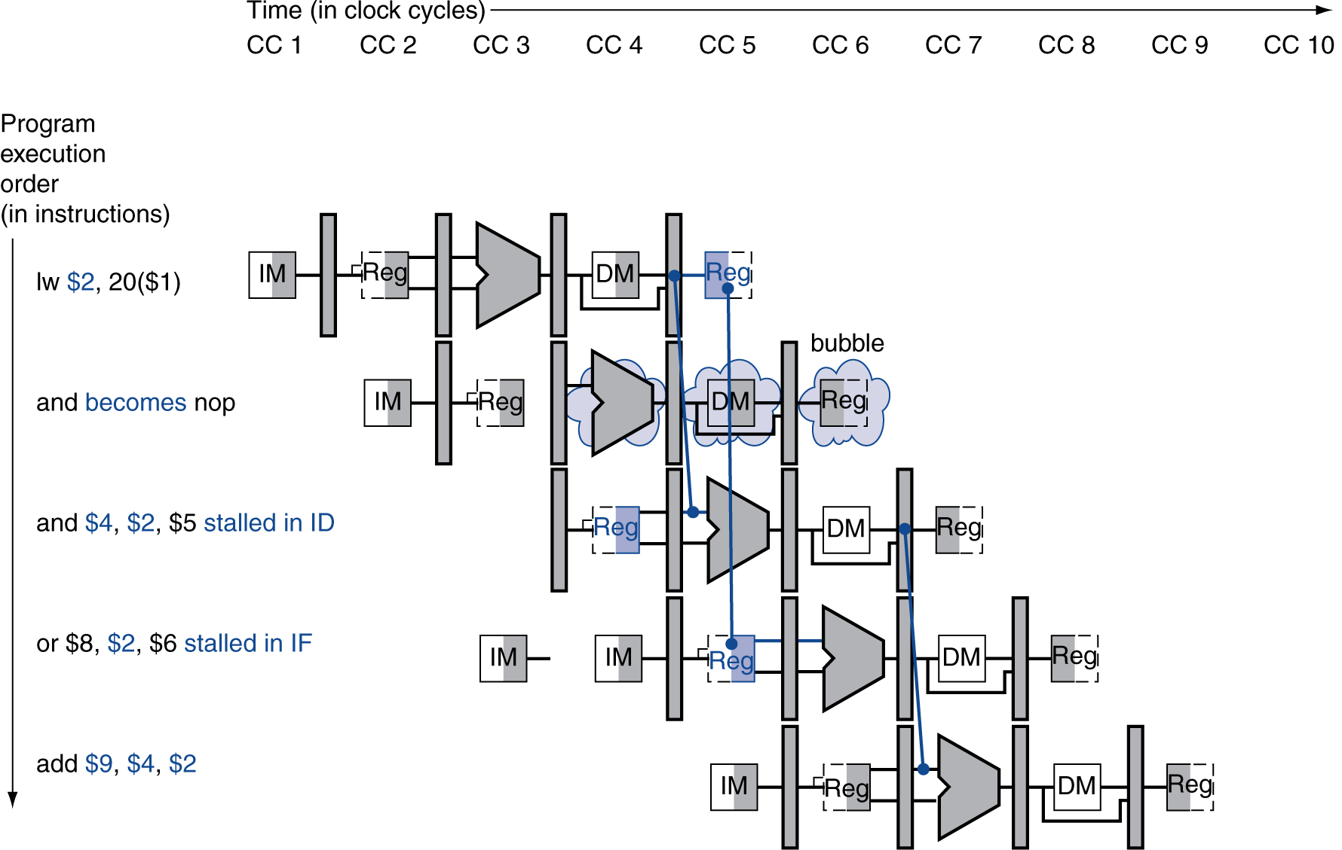
Stall/Bubble in the Pipeline
Or, more accurately…

Slide 33
Datapath with Hazard Detection

Slide 34
Code Scheduling to Avoid Stalls
Reorder code to avoid use of load result in the next instruction
C code for A = B + E; C = B + F;
lw $t1, 0($t0)
lw $t2, 4($t0)
add $t3, $t1, $t2
sw $t3, 12($t0)
lw $t4, 8($t0)
add $t5, $t1, $t4
sw $t5, 16($t0)
lw $t1, 0($t0)
lw $t2, 4($t0)
lw $t4, 8($t0)
add $t3, $t1, $t2
sw $t3, 12($t0)
add $t5, $t1, $t4
sw $t5, 16($t0)
stall
stall
13 cycles
11 cycles

Slide 35
Stalls and Performance
The BIG Picture
Stalls reduce performance
But are required to get correct results
Compiler can arrange code to avoid hazards and stalls
Requires knowledge of the pipeline structure

