Slide 1
Control (Branch) Hazards
Branch 명령은 flow of control 을 변경한다.
Fetch 할 다음 명령어의 주소는 branch 조건에 따라 달라진다.
Solution to branch hazard
pipeline stall
branch prediction
static
as taken
as not taken
상황에 따라
dynamic

Slide 2
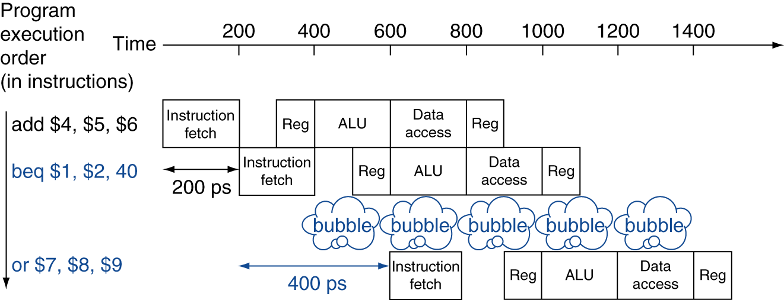
Pipeline Stall on Branch Instr.
Wait until branch outcome determined before fetching next instruction

Slide 3
Branch Prediction
Longer pipelines can’t readily determine branch outcome early
Stall penalty becomes unacceptable
Predict outcome of branch
Only stall if the prediction is wrong
In MIPS pipeline
predict branches as not taken

Slide 4
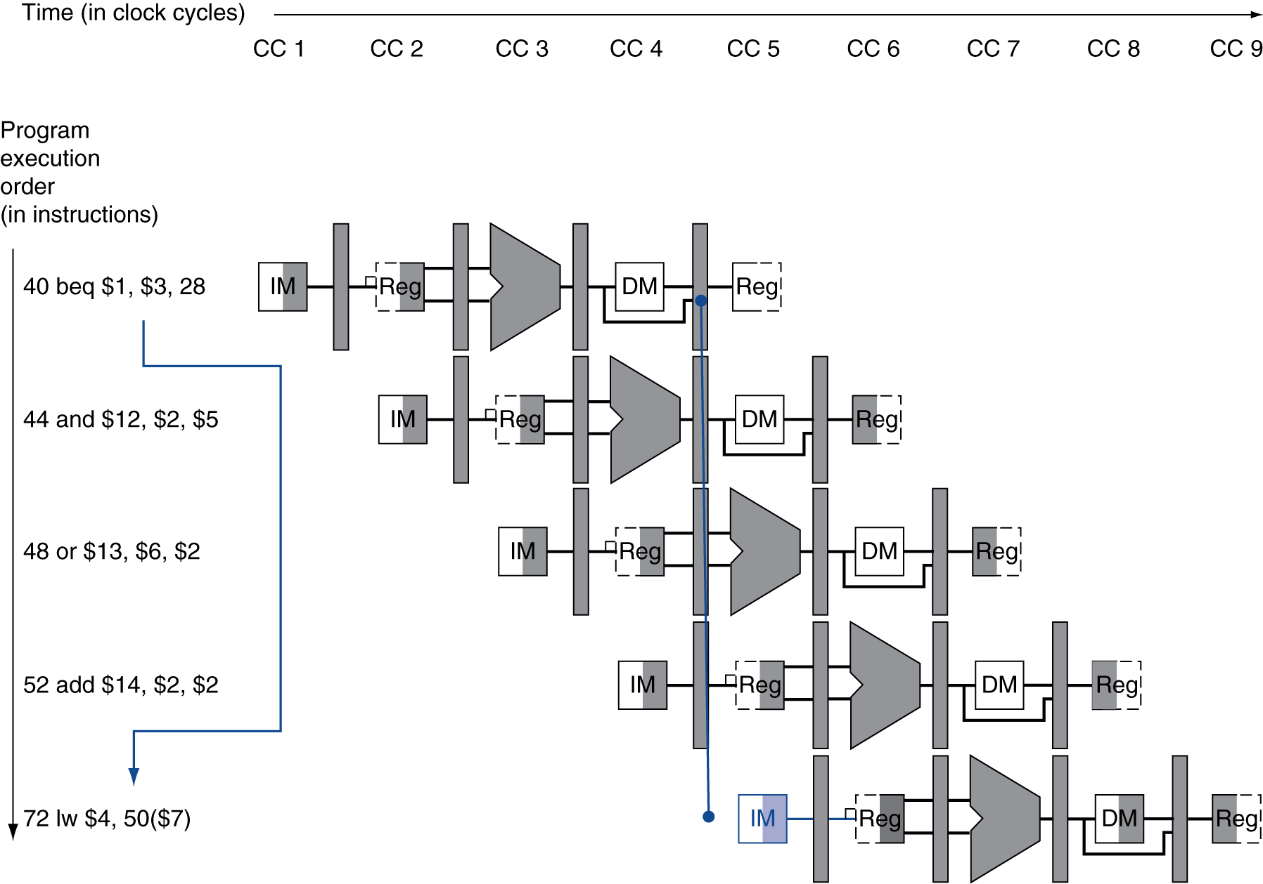
Branch Hazards
§4.8 Control Hazards
If branch outcome determined in MEM
Flush these instructions
(Set control values to 0)
PC

Slide 5
Reducing Branch Delay
Modification of the hardware
Target address adder in ID stage
Register comparator in ID stage
Example: branch taken
36: sub $10, $4, $8 40: beq $1, $3, 7 44: and $12, $2, $5 48: or $13, $2, $6 52: add $14, $4, $2 56: slt $15, $6, $7 ... 72: lw $4, 50($7)
← immediate field 에 저장된 offset value
44 + 7 x 4

Slide 6
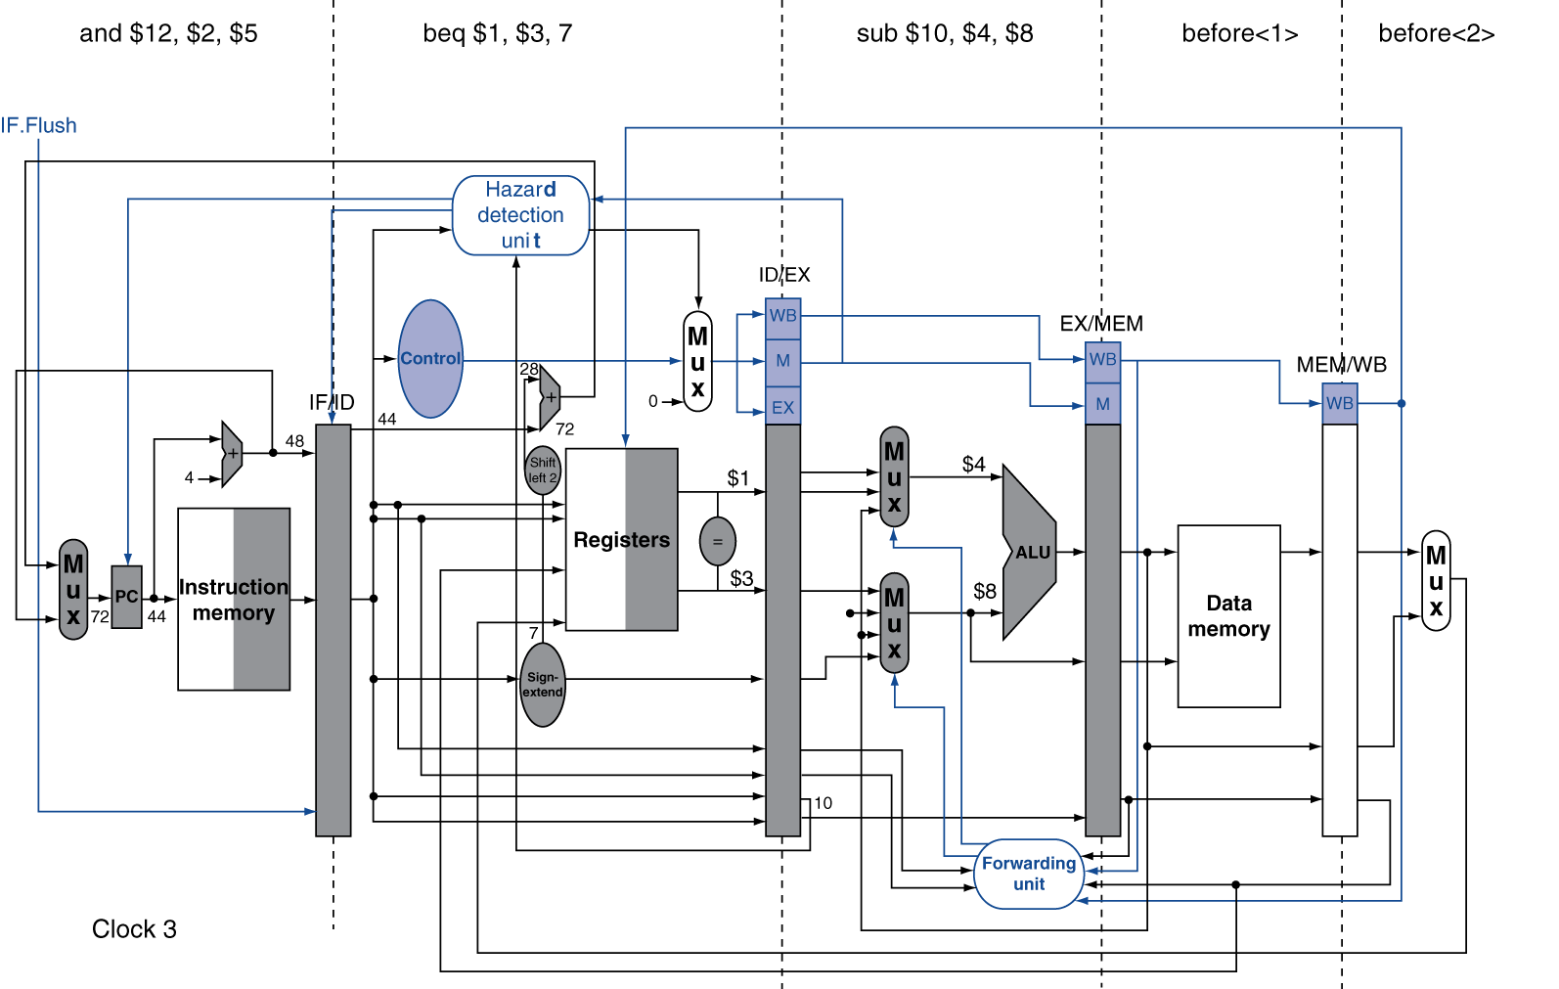

Example: Branch Taken (CC3)
IF.Flush 가 1이면 IF/ID 의 instruction 부분에 0x00000000 (nop) 이 써짐
Branch
zero

Slide 7
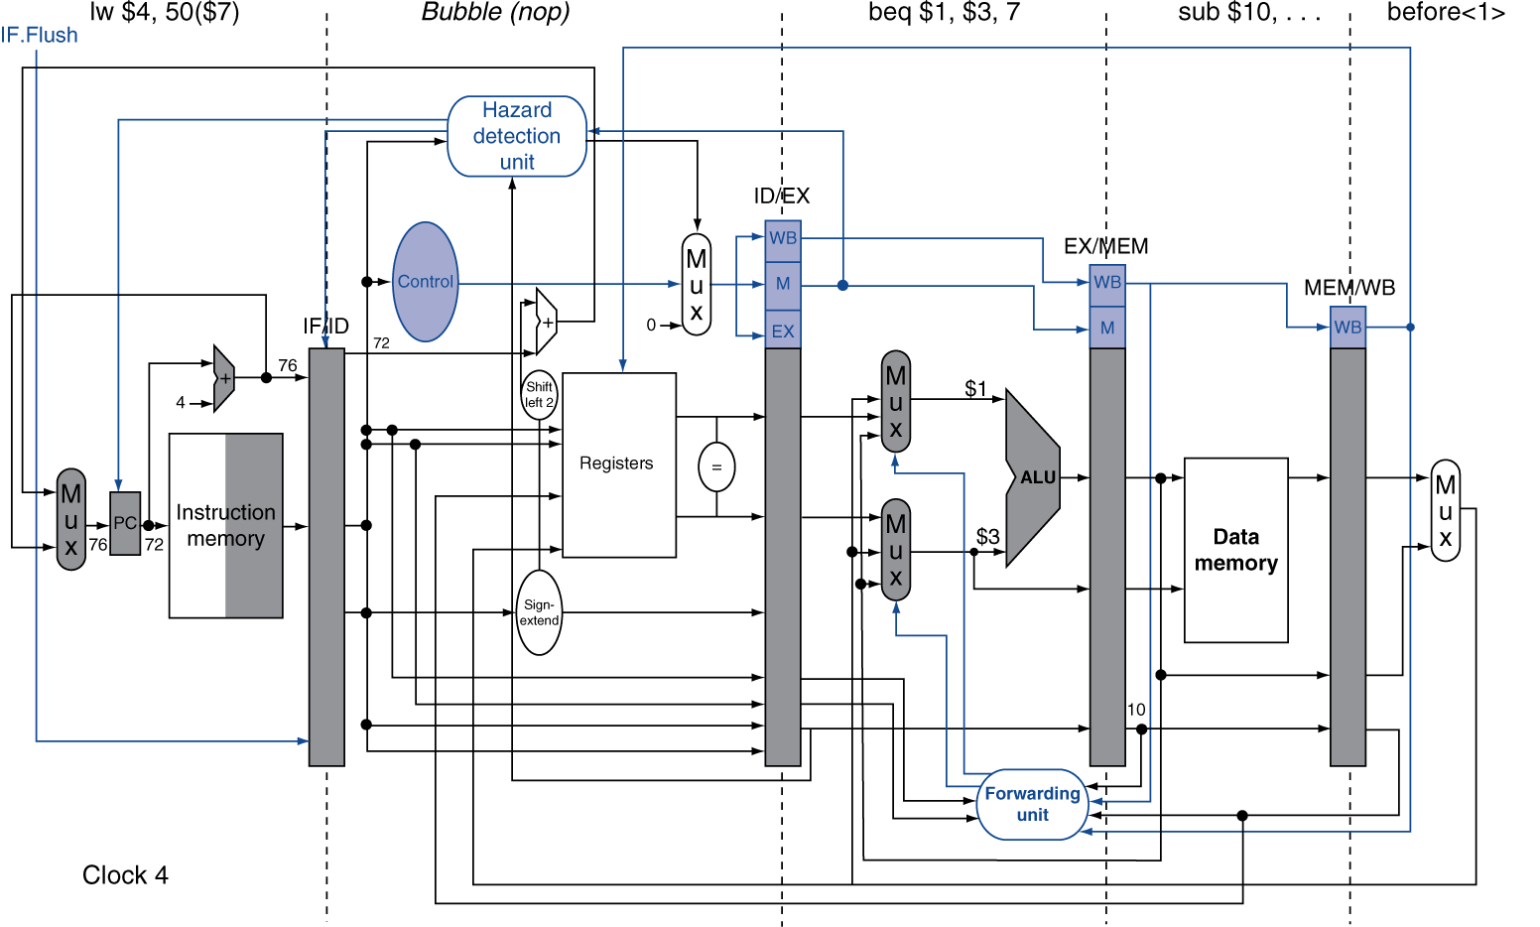
Example: Branch Taken (CC4)

Slide 8
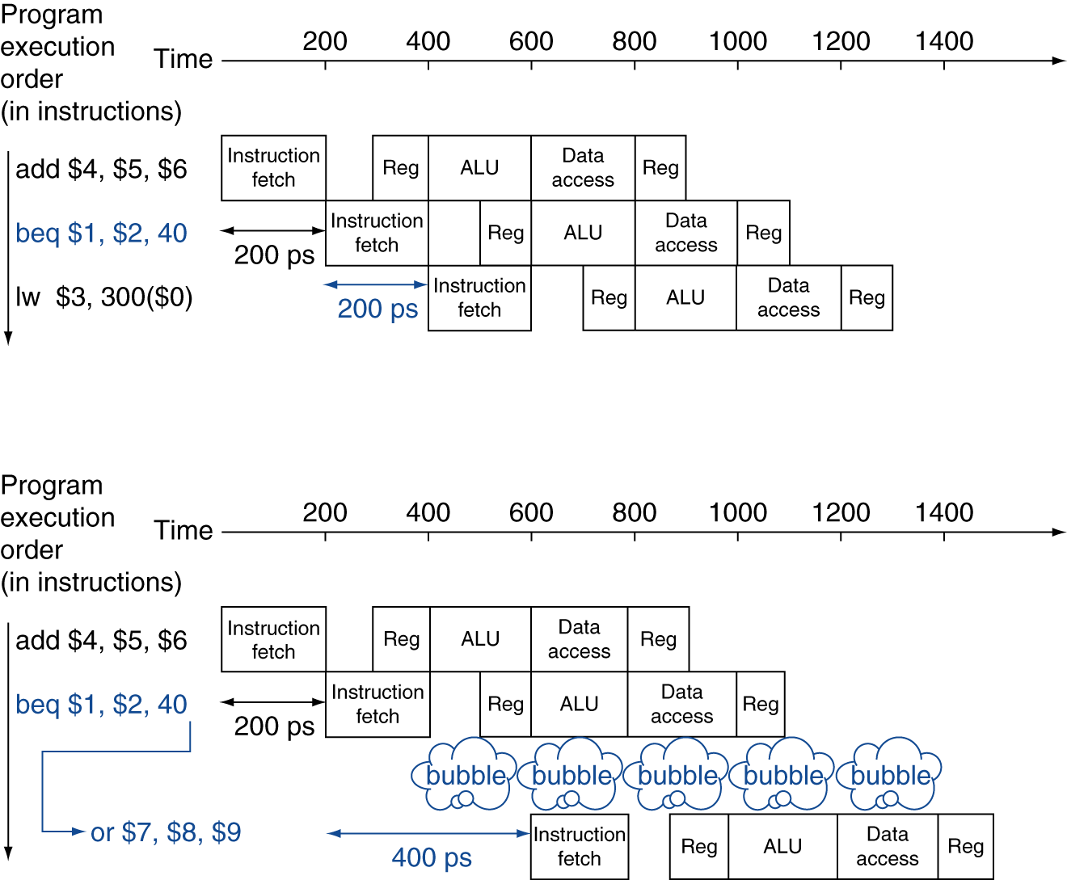
MIPS with Predict Not Taken
Prediction correct
branch not taken
Prediction incorrect
one cycle stall

Slide 9
More-Realistic Branch Prediction
Static branch prediction
Based on typical branch behavior
Example: loop and if-statement branches
Predict backward branches taken
Predict forward branches not taken
Dynamic branch prediction
Hardware measures actual branch behavior
e.g., record recent history of each branch
Assume future behavior will continue the trend
When wrong, stall while re-fetching, and update history

Slide 10
Pipeline Summary
The BIG Picture
Pipelining improves performance by increasing instruction throughput
Executes multiple instructions in parallel
Each instruction has the same latency
Subject to hazards
Structure, data, control
Instruction set design affects complexity of pipeline implementation

