Slide 1
1.6 Performance

Slide 2

Which of these airplanes has the best performance?
Airplane Passengers Range (mi) Speed (mph)
Boeing 777 375 4630 610
Boeing 747 470 4150 610
BAC/Sud Concorde 132 4000 1350
Douglas DC-8-50 146 8720 544
Which is fastest?
In transporting a single passenger
In transporting 450 passengers
In transporting 130 passengers 8000 miles away

Slide 3
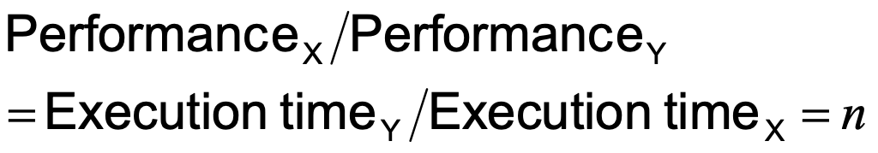
Relative Performance
Define Performance = 1/Execution Time
“X is n time faster than Y”
Example: time taken to run a program
10s on A, 15s on B
Execution Time_{B} / Execution Time_{A} = 15s / 10s = 1.5
So A is 1.5 times faster than B

Slide 4
Execution Time
Elapsed Time (or wall-clock time, response time)
counts everything (disk and memory accesses, I/O , etc.)
a useful number, but often not good for comparison purposes
CPU time
doesn't count I/O or time spent running other programs
can be broken up into system time, and user time
Unix command :
%time ls
90.7u 12.9s 2:39 65%
Our focus: user CPU time
time spent executing the lines of code that are "in" our program
user+system time
-------------------------
elapsed time
user CPU time
system CPU time
elapsed time

Slide 5
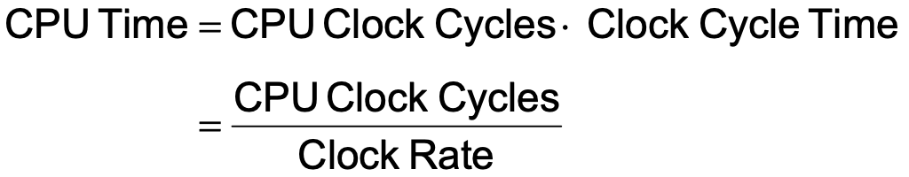
CPU Time
Performance improved by
Reducing number of clock cycles
Increasing clock rate
Hardware designer must often trade off clock rate against cycle count

Slide 6
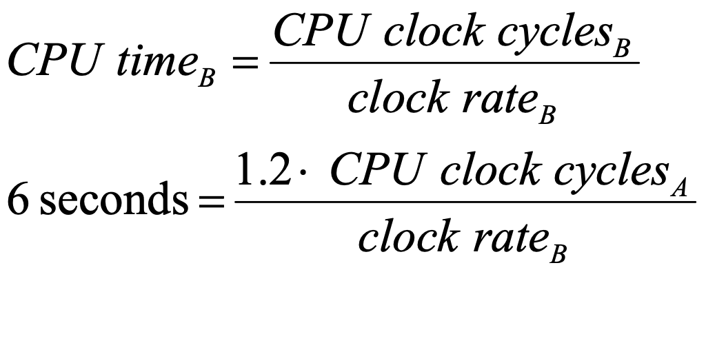
Example
2 GHz 클럭의 컴퓨터 A 에서 10초에 수행되는 프로그램이 있다.
이 프로그램을 6초에 수행하는 컴퓨터를 설계하고자 한다.
클럭 속도는 얼마든지 빠르게 만들 수 있는데 이렇게 하면 CPU 다른 부분의 설계에 영향을 미쳐 같은 프로그램에 대해 A보다 1.2 배 많은 클럭 사이클이 필요하게 된다고 한다.
컴퓨터 B의 클럭 속도는 얼마로 해야 하겠는가?
→

Slide 7
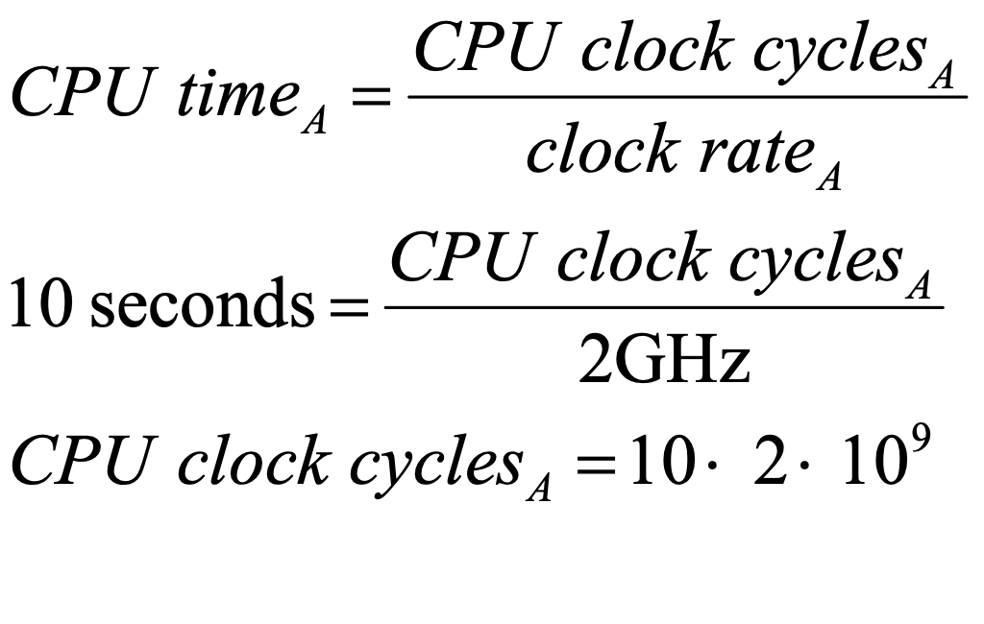
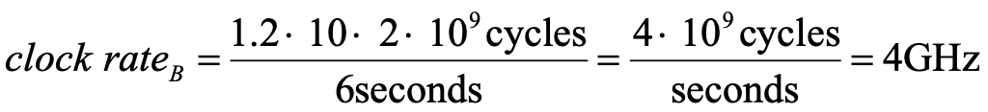
Example: solution

Slide 8
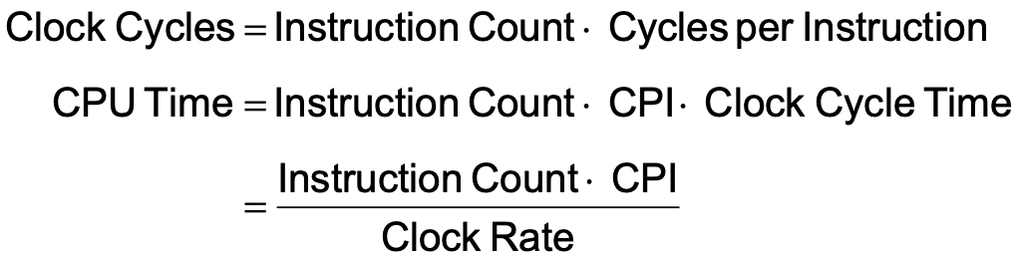
Instruction Count and CPI
Instruction Count for a program
Determined by program, ISA and compiler
Average cycles per instruction
Determined by CPU hardware
If different instructions have different CPI
Average CPI affected by instruction mix

Slide 9
# of Instructions Example
A compiler designer is trying to decide between two code sequences for a particular machine. Based on the hardware implementation, there are three different classes of instructions: Class A, Class B, and Class C, and they require one, two, and three cycles (respectively). The first code sequence has 5 instructions: 2 of A, 1 of B, and 2 of C The second sequence has 6 instructions: 4 of A, 1 of B, and 1 of C. Which sequence will be faster? How much? What is the CPI for each sequence?

Slide 10
CPI Example
Alternative compiled code sequences using instructions in classes A, B, C
Class | A | B | C
CPI for class | 1 | 2 | 3
IC in sequence 1 | 2 | 1 | 2
IC in sequence 2 | 4 | 1 | 1
Sequence 1: IC = 5
Clock Cycles = 2×1 + 1×2 + 2×3 = 10
Avg. CPI = 10/5 = 2.0
Sequence 2: IC = 6
Clock Cycles = 4×1 + 1×2 + 1×3 = 9
Avg. CPI = 9/6 = 1.5

Slide 11
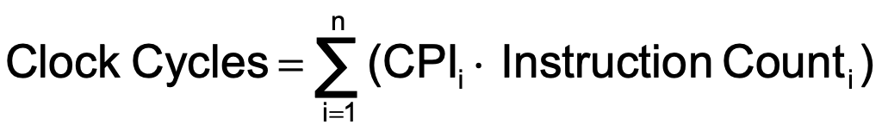
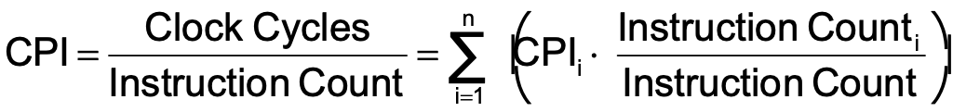
CPI in More Detail
If different instruction classes take different numbers of cycles
Weighted average CPI
Relative frequency

Slide 12
CPI Example
Suppose we have two implementations of the same instruction set architecture (ISA). For some program, Machine A has a clock cycle time of 250 ps. and a CPI of 2.0 Machine B has a clock cycle time of 500 ps. and a CPI of 1.2 What machine is faster for this program, and by how much?
If two machines have the same ISA which of our quantities (e.g., clock rate, CPI, execution time, # of instructions, MIPS) will always be identical?

Slide 13
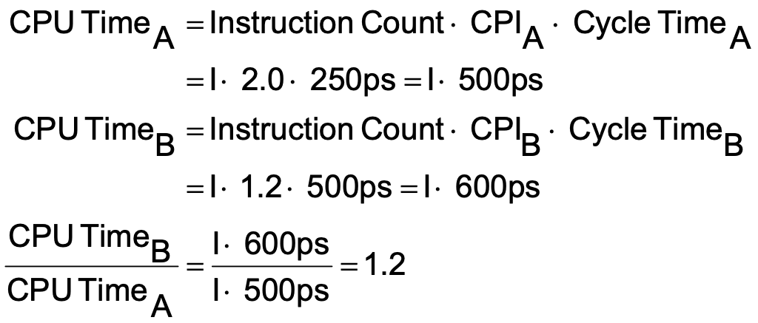
CPI Example
Computer A: Cycle Time = 250ps, CPI = 2.0
Computer B: Cycle Time = 500ps, CPI = 1.2
Same ISA
Which is faster, and by how much?
A is faster…
…by this much

Slide 14

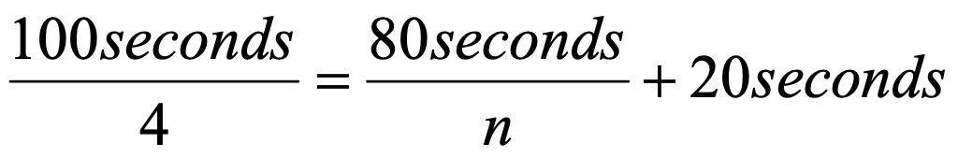
Amdahl's Law
Example:
"Suppose a program runs in 100 seconds on a machine, with multiply responsible for 80 seconds of this time. How much do we have to improve the speed of multiplication if we want the program to run 4 times faster?" How about making it 5 times faster?
Principle: Make the common case fast

Slide 15
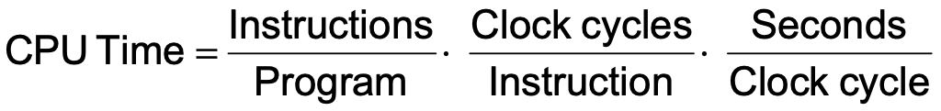
Performance Summary
The BIG Picture
Performance depends on
Algorithm: affects IC, possibly CPI
Programming language: affects IC, CPI
Compiler: affects IC, CPI
Instruction set architecture: affects IC, CPI, T_{c}

Slide 16
Effect of Compiler Optimization
Compiled with gcc for Pentium 4 under Linux

