Slide 1
ILP (section 4.10)

Slide 2
Instruction-Level Parallelism (ILP)
Pipelining: executing multiple instructions in parallel
To increase ILP
Deeper pipeline
Less work per stage ⇒ shorter clock cycle
Multiple issue
Replicate pipeline stages ⇒ multiple pipelines
Start multiple instructions per clock cycle
CPI < 1, so use Instructions Per Cycle (IPC)
E.g., 4GHz 4-way multiple-issue
16 BIPS, peak CPI = 0.25, peak IPC = 4
But dependencies reduce this in practice
§4.10 Parallelism via Instructions
Chapter 4 — The Processor — 2

Slide 3
Multiple Issue
Static multiple issue
Compiler groups instructions to be issued together
Packages them into “issue slots”
Compiler detects and avoids hazards
Dynamic multiple issue
CPU examines instruction stream and chooses instructions to issue each cycle
Compiler can help by reordering instructions
CPU resolves hazards using advanced techniques at runtime
Chapter 4 — The Processor — 3

Slide 4
Static Multiple Issue
Compiler groups instructions into “issue packets”
Group of instructions that can be issued on a single cycle
Determined by pipeline resources required
Think of an issue packet as a very long instruction
Specifies multiple concurrent operations
⇒ Very Long Instruction Word (VLIW)
Chapter 4 — The Processor — 4

Slide 5
Scheduling Static Multiple Issue
Compiler must remove some/all hazards
Reorder instructions into issue packets
No dependencies with a packet
Possibly some dependencies between packets
Varies between ISAs; compiler must know!
Pad with nop if necessary
Chapter 4 — The Processor — 5

Slide 6
MIPS with Static Dual Issue
Two-issue packets
One ALU/branch instruction
One load/store instruction
64-bit aligned
ALU/branch, then load/store
Pad an unused instruction with nop
Address | Instruction type | Pipeline Stages
n | ALU/branch | IF | ID | EX | MEM | WB
n + 4 | Load/store | IF | ID | EX | MEM | WB
n + 8 | ALU/branch |  | IF | ID | EX | MEM | WB
n + 12 | Load/store |  | IF | ID | EX | MEM | WB
n + 16 | ALU/branch |  |  | IF | ID | EX | MEM | WB
n + 20 | Load/store |  |  | IF | ID | EX | MEM | WB
Chapter 4 — The Processor — 6

Slide 7
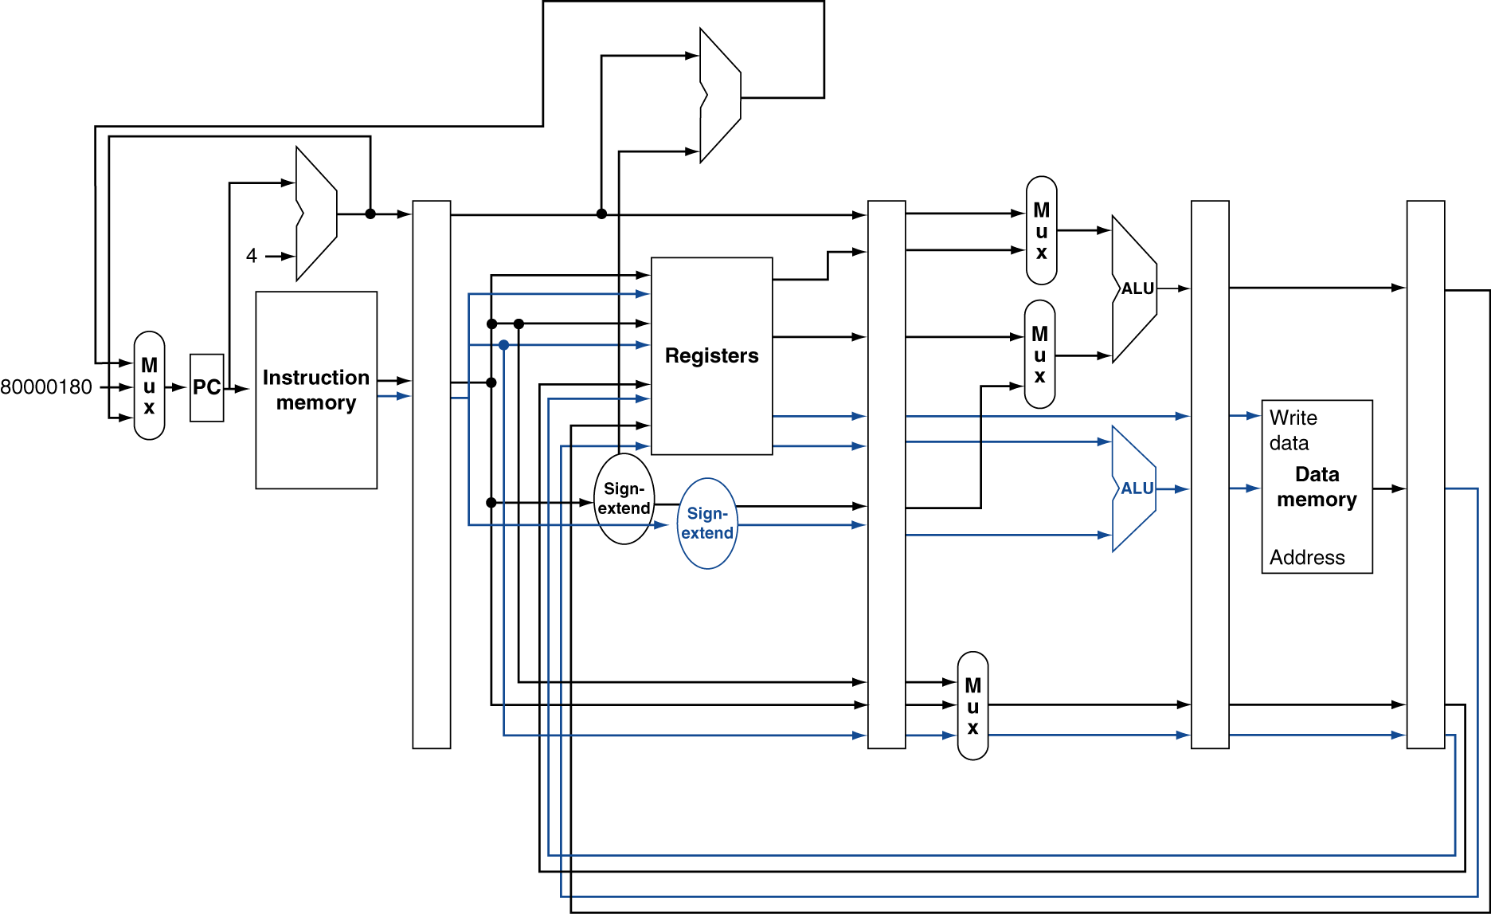
MIPS with Static Dual Issue
Chapter 4 — The Processor — 7

Slide 8
Dynamic Multiple Issue
“Superscalar” processors
CPU decides whether to issue 0, 1, 2, … each cycle
Avoiding structural and data hazards
Avoids the need for compiler scheduling
Though it may still help
Code semantics ensured by the CPU
Chapter 4 — The Processor — 12

Slide 9
Dynamic Pipeline Scheduling
Allow the CPU to execute instructions out of order to avoid stalls
But commit result to registers in order
Example
lw $t0, 20($s2) addu $t1, $t0, $t2 sub $s4, $s4, $t3 slti $t5, $s4, 20
Can start sub while addu is waiting for lw
Chapter 4 — The Processor — 13

Slide 10
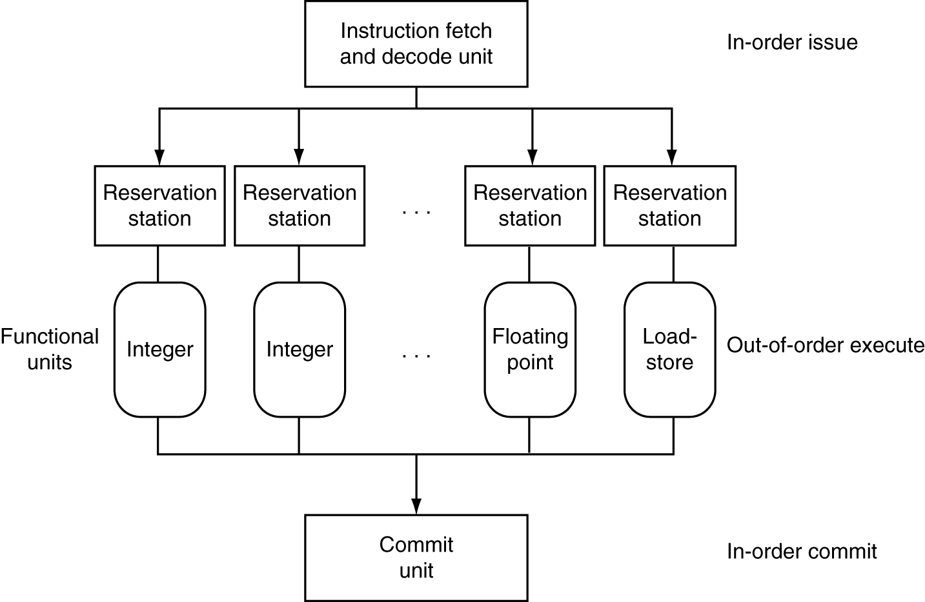
Dynamically Scheduled CPU
Preserves dependencies
Hold pending operands
Results also sent to any waiting reservation stations
Reorders buffer for register writes
Can supply operands for issued instructions
Chapter 4 — The Processor — 14

Slide 11
Speculation
“Guess” what to do with an instruction
Start operation as soon as possible
Check whether guess was right
If so, complete the operation
If not, roll-back and do the right thing
Common to static and dynamic multiple issue
Examples
Speculate on branch outcome
Roll back if path taken is different
Speculate on load
Roll back if location is updated
Chapter 4 — The Processor — 16

Slide 12
Power Efficiency
Complexity of dynamic scheduling and speculations requires power
Multiple simpler cores may be better
Microprocessor | Year | Clock Rate | Pipeline Stages | Issue width | Out-of-order/ Speculation | Cores | Power
i486 | 1989 | 25MHz | 5 | 1 | No | 1 | 5W
Pentium | 1993 | 66MHz | 5 | 2 | No | 1 | 10W
Pentium Pro | 1997 | 200MHz | 10 | 3 | Yes | 1 | 29W
P4 Willamette | 2001 | 2000MHz | 22 | 3 | Yes | 1 | 75W
P4 Prescott | 2004 | 3600MHz | 31 | 3 | Yes | 1 | 103W
Core | 2006 | 2930MHz | 14 | 4 | Yes | 2 | 75W
UltraSparc III | 2003 | 1950MHz | 14 | 4 | No | 1 | 90W
UltraSparc T1 | 2005 | 1200MHz | 6 | 1 | No | 8 | 70W
Chapter 4 — The Processor — 20

Slide 13
Cortex A8 and Intel i7
Processor | ARM A8 | Intel Core i7 920
Market | Personal Mobile Device | Server, cloud
Thermal design power | 2 Watts | 130 Watts
Clock rate | 1 GHz | 2.66 GHz
Cores/Chip | 1 | 4
Floating point? | No | Yes
Multiple issue? | Dynamic | Dynamic
Peak instructions/clock cycle | 2 | 4
Pipeline stages | 14 | 14
Pipeline schedule | Static in-order | Dynamic out-of-order with speculation
Branch prediction | 2-level | 2-level
1st level caches/core | 32 KiB I, 32 KiB D | 32 KiB I, 32 KiB D
2nd level caches/core | 128-1024 KiB | 256 KiB
3rd level caches (shared) | - | 2- 8 MB
§4.11 Real Stuff: The ARM Cortex-A8 and Intel Core i7 Pipelines
Chapter 4 — The Processor — 21

Slide 14
Concluding Remarks
ISA influences design of datapath and control
Datapath and control influence design of ISA
Pipelining improves instruction throughput using parallelism
More instructions completed per second
Latency for each instruction not reduced
Hazards: structural, data, control
Multiple issue and dynamic scheduling (ILP)
Dependencies limit achievable parallelism
Complexity leads to the power wall
§4.14 Concluding Remarks
Chapter 4 — The Processor — 26

Slide 15
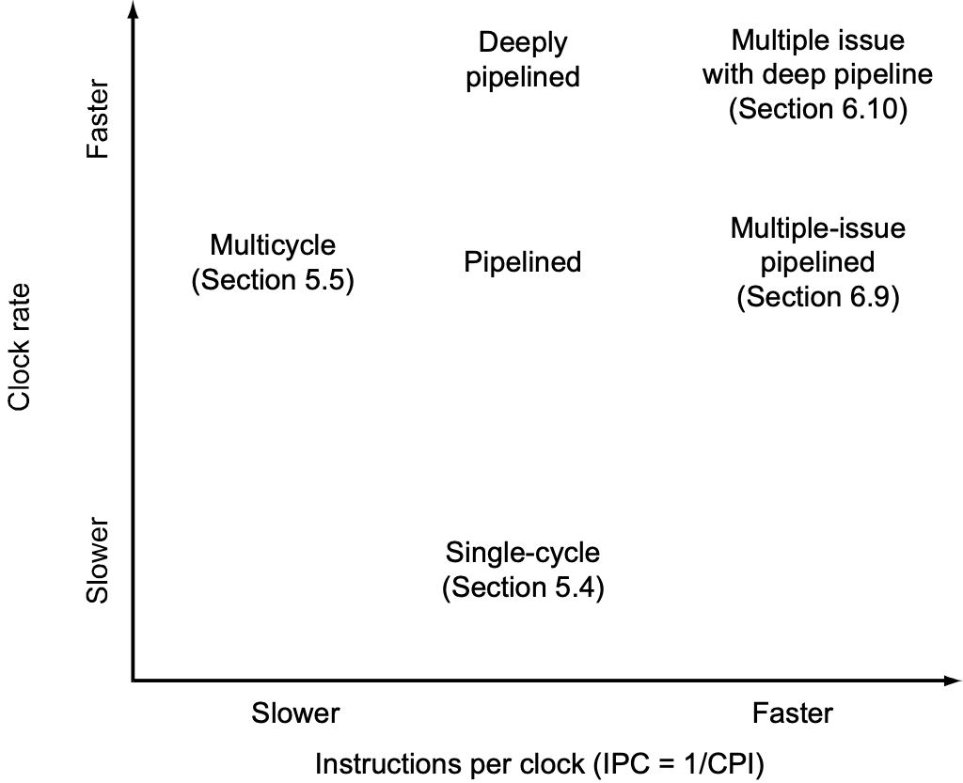
Summary
Pipelining does not improve latency, but does improve throughput

