Slide 1
3.5 Floating Point Numbers

Slide 2
기말고사 일정
12/10,12,17,19

Slide 3
Floating Point Numbers
§3.5 Floating Point
Representation for non-integral numbers
Including very small and very large numbers
Scientific notation
–2.34 × 10⁵⁶
+0.002 × 10^{–4}
+987.02 × 10⁹
In binary
±1.xxxxxxx₂ × 2^{yyyy}
Types float and double in C
normalized
not normalized

Slide 4
Floating Point Standard
Defined by IEEE Std 754-1985
Developed in response to divergence of representations
Portability issues for scientific code
Now almost universally adopted
Two representations
Single precision (32-bit)
Double precision (64-bit)

Slide 5
IEEE Floating-Point Format
single: 8 bits double: 11 bits
single: 23 bits double: 52 bits
S
Exponent
Fraction
S: sign bit (0 ⇒ non-negative, 1 ⇒ negative)
Normalize significand: 1.0 ≤ |significand| < 2.0
Always has a leading pre-binary-point 1 bit, so no need to represent it explicitly (hidden bit)
Significand is Fraction with the “1.” restored
Exponent: excess representation: actual exponent + Bias
Ensures exponent is unsigned
Single: Bias = 127; Double: Bias = 1023

Slide 6
Single-Precision Range
Exponents 00000000 and 11111111 reserved
Smallest value
Exponent: 00000001 ⇒ actual exponent = 1 – 127 = –126
Fraction: 000…00 ⇒ significand = 1.0
±1.0 × 2^{–126} ≈ ±1.2 × 10^{–38}
Largest value
exponent: 11111110 ⇒ actual exponent = 254 – 127 = +127
Fraction: 111…11 ⇒ significand ≈ 2.0
±2.0 × 2⁺¹²⁷ ≈ ±3.4 × 10⁺³⁸

Slide 7
Double-Precision Range
Exponents 0000…00 and 1111…11 reserved
Smallest value
Exponent: 00000000001 ⇒ actual exponent = 1 – 1023 = –1022
Fraction: 000…00 ⇒ significand = 1.0
±1.0 × 2^{–1022} ≈ ±2.2 × 10^{–308}
Largest value
Exponent: 11111111110 ⇒ actual exponent = 2046 – 1023 = +1023
Fraction: 111…11 ⇒ significand ≈ 2.0
±2.0 × 2⁺¹⁰²³ ≈ ±1.8 × 10⁺³⁰⁸

Slide 8
Floating-Point Precision
Relative precision
all fraction bits are significant
Single: approx 2^{–23}
Equivalent to 23 × log₁₀2 ≈ 23 × 0.3 ≈ 6 decimal digits of precision
Double: approx 2^{–52}
Equivalent to 52 × log₁₀2 ≈ 52 × 0.3 ≈ 16 decimal digits of precision

Slide 9
Floating-Point Example
Represent –0.75
–0.75 = (–1)¹ × 1.1₂ × 2^{–1}
S = 1
Fraction = 1000…00₂
Exponent = –1 + Bias
Single: –1 + 127 = 126 = 01111110₂
Double: –1 + 1023 = 1022 = 01111111110₂
Single: 1011111101000…00
Double: 1011111111101000…00

Slide 10
Floating-Point Example
What number is represented by the single-precision float
11000000101000…00
S = 1
Fraction = 01000…00₂
Exponent = 10000001₂ = 129
x = (–1)¹ × (1 + 01₂) × 2^{(129 – 127)}
= (–1) × 1.01 × 2²
= –5.0

Slide 11
Comparison of floating point numbers
Comparison of floating point numbers:
Compare signs
Compare remaining part as an unsigned integer
Example : 0.75 vs. 3.45
(How do we compare unsigned integers?)

Slide 12
Example : Decimal → Binary
0.75
decimal: .75 = -3/4 = -3/2²
binary: .11 = -1.1 x 2⁻¹
floating point: exponent = 126 = 01111110
IEEE single precision:
0 01111110 100 0000 0000 0000 0000 0000
3.45
= (-1)⁰x(1.101110011001100…)x2¹
0 10000000 101 1100 1100 1100 1100 1101

Slide 13
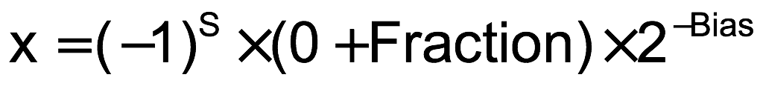
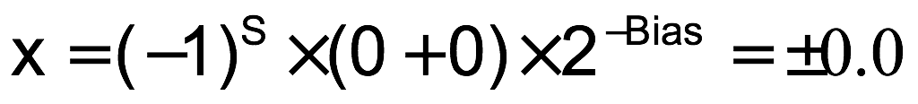
Denormal Numbers
Exponent = 000...0 ⇒ hidden bit is 0
Smaller than normal numbers
allow for gradual underflow, with diminishing precision
Denormal with fraction = 000...0
Two representations of 0.0!

Slide 14
Infinities and NaNs
Exponent = 111...1, Fraction = 000...0
±Infinity
Can be used in subsequent calculations, avoiding need for overflow check
Exponent = 111...1, Fraction ≠ 000...0
Not-a-Number (NaN)
Indicates illegal or undefined result
e.g., 0.0 / 0.0
Can be used in subsequent calculations

Slide 15
Floating-Point Addition
Consider a 4-digit decimal example
9.999 × 10¹ + 1.610 × 10^{–1}
1. Align decimal points
Shift number with smaller exponent
9.999 × 10¹ + 0.016 × 10¹
2. Add significands
9.999 × 10¹ + 0.016 × 10¹ = 10.015 × 10¹
3. Normalize result & check for over/underflow
1.0015 × 10²
4. Round and renormalize if necessary
1.002 × 10²

Slide 16
Floating-Point Addition
Now consider a 4-digit binary example
1.000₂ × 2^{–1} + –1.110₂ × 2^{–2} (0.5 + –0.4375)
1. Align binary points
Shift number with smaller exponent
1.000₂ × 2^{–1} + –0.111₂ × 2^{–1}
2. Add significands
1.000₂ × 2^{–1} + –0.111₂ × 2–1 = 0.001₂ × 2^{–1}
3. Normalize result & check for over/underflow
1.000₂ × 2^{–4}, with no over/underflow
4. Round and renormalize if necessary
1.000₂ × 2^{–4} (no change) = 0.0625

Slide 17
FP Adder Hardware
Much more complex than integer adder
Doing it in one clock cycle would take too long
Much longer than integer operations
Slower clock would penalize all instructions
FP adder usually takes several cycles
Can be pipelined

Slide 18
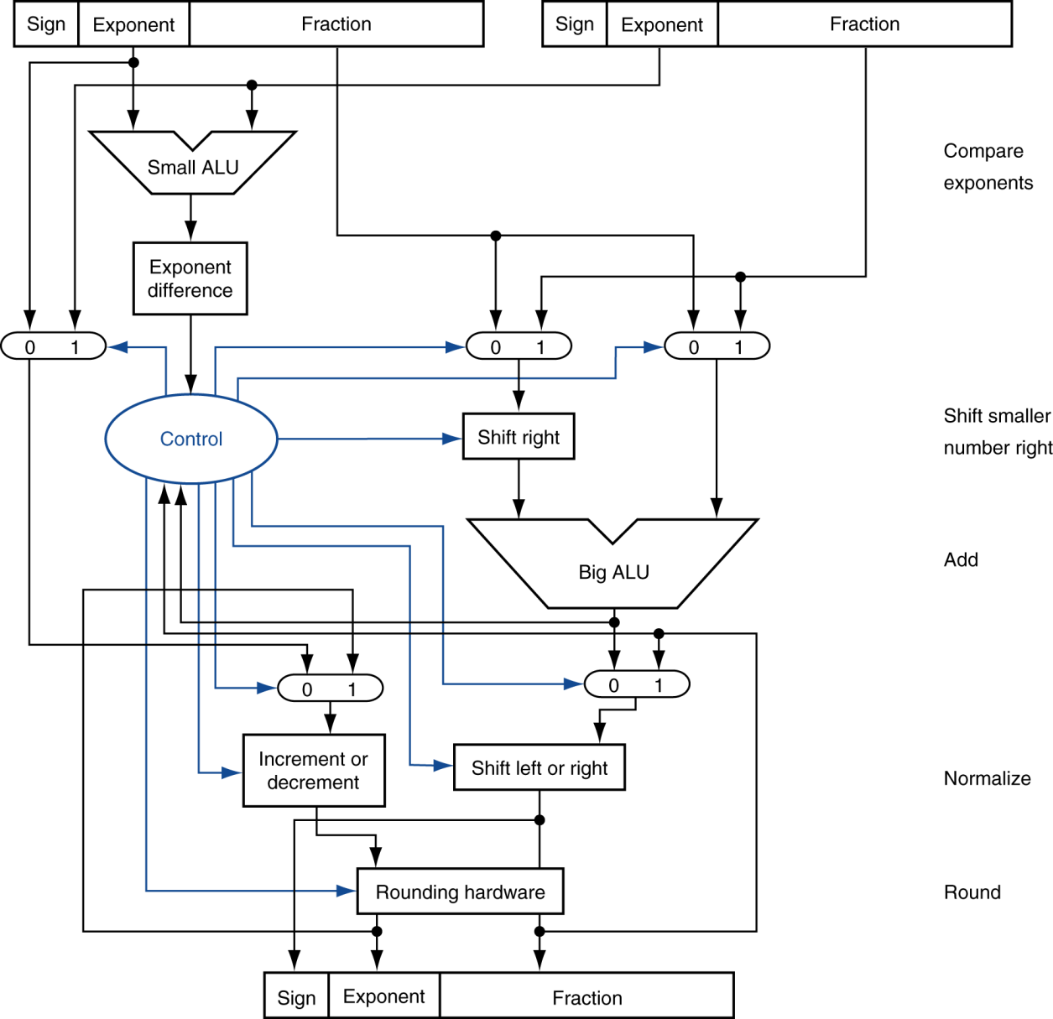
FP Adder Hardware
Step 1
Step 2
Step 3
Step 4

Slide 19
Floating-Point Multiplication
Consider a 4-digit decimal example
1.110 × 10¹⁰ × 9.200 × 10^{–5}
1. Add exponents
For biased exponents, subtract bias from sum
New exponent = 10 + –5 = 5
2. Multiply significands
1.110 × 9.200 = 10.212 ⇒ 10.212 × 10⁵
3. Normalize result & check for over/underflow
1.0212 × 10⁶
4. Round and renormalize if necessary
1.021 × 10⁶
5. Determine sign of result from signs of operands
+1.021 × 10⁶

Slide 20
Floating-Point Multiplication
Now consider a 4-digit binary example
1.000₂ × 2^{–1} × –1.110₂ × 2^{–2} (0.5 × –0.4375)
1. Add exponents
Unbiased: –1 + –2 = –3
Biased: (–1 + 127) + (–2 + 127) = –3 + 254 – 127 = –3 + 127
2. Multiply significands
1.000₂ × 1.110₂ = 1.110 ⇒ 1.110₂ × 2^{–3}
3. Normalize result & check for over/underflow
1.110₂ × 2^{–3} (no change) with no over/underflow
4. Round and renormalize if necessary
1.110₂ × 2^{–3} (no change)
5. Determine sign: +ve × –ve ⇒ –ve
–1.110₂ × 2^{–3} = –0.21875

Slide 21
FP Arithmetic Hardware
FP multiplier is of similar complexity to FP adder
But uses a multiplier for significands instead of an adder
FP arithmetic hardware usually does
Addition, subtraction, multiplication, division, reciprocal, square-root
FP ↔ integer conversion
Operations usually takes several cycles
Can be pipelined

Slide 22
FP Instructions in MIPS
FP hardware is coprocessor 1
Adjunct processor that extends the ISA
Separate FP registers
32 single-precision: $f0, $f1, … $f31
Paired for double-precision: $f0/$f1, $f2/$f3, …
Release 2 of MIPs ISA supports 32 × 64-bit FP reg’s
FP instructions operate only on FP registers
Programs generally don’t do integer ops on FP data, or vice versa
More registers with minimal code-size impact
FP load and store instructions
lwc1, ldc1, swc1, sdc1
(pseudoinstructions l.s, l.d, s.s, s.d)
e.g., ldc1 $f8, 32($sp)

Slide 23
FP Instructions in MIPS
Single-precision arithmetic
add.s, sub.s, mul.s, div.s
e.g., add.s $f0, $f1, $f6
Double-precision arithmetic
add.d, sub.d, mul.d, div.d
e.g., mul.d $f4, $f4, $f6
Single- and double-precision comparison
c.xx.s, c.xx.d (xx is eq, lt, le)
Sets or clears FP condition bit
e.g. c.lt.s $f3, $f4
Branch on FP condition code true or false
bc1t, bc1f
e.g., bc1t TargetLabel

Slide 24
FP Example: °F to °C
C code:
float f2c (float fahr) { return ((5.0/9.0)*(fahr - 32.0)); }
fahr in $f12, result in $f0, literals in global memory space
Compiled MIPS code:
f2c: lwc1 $f16, 0($gp) lwc2 $f17, 4($gp) div.s $f16, $f16, $f17 lwc1 $f17, 8($gp) sub.s $f17, $f12, $f17 mul.s $f0, $f16, $f17 jr $ra

Slide 25
.data 0x10008000
f5: .float 5.0
.float 9.0
.float 32.0
.float 70.0
.text
.globl main
main:
addi $sp, $sp, -4
sw $ra, 0($sp)
lwc1 $f12, 12($gp)
jal f2c
lw $ra, 0($sp)
addi $sp, $sp, 4
jr $ra
f2c:
lwc1 $f16, 0($gp)
lwc1 $f17, 4($gp)
div.s $f16, $f16, $f17
lwc1 $f17, 8($gp)
sub.s $f17, $f12, $f17
mul.s $f0, $f16, $f17
jr $ra

Slide 26
Accurate Arithmetic
IEEE Std 754 specifies additional rounding control
Extra bits of precision (guard, round, sticky)
Choice of rounding modes
Allows programmer to fine-tune numerical behavior of a computation
Not all FP units implement all options
Most programming languages and FP libraries just use defaults
Trade-off between hardware complexity, performance, and market requirements

Slide 27
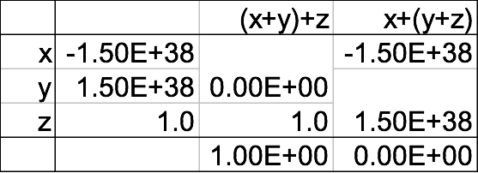
Associativity
Parallel programs may interleave operations in unexpected orders
Assumptions of associativity may fail
Need to validate parallel programs under varying degrees of parallelism

