Slide 1
Large and Fast : Exploiting Memory Hierarchy (Chapter 5)

Slide 2
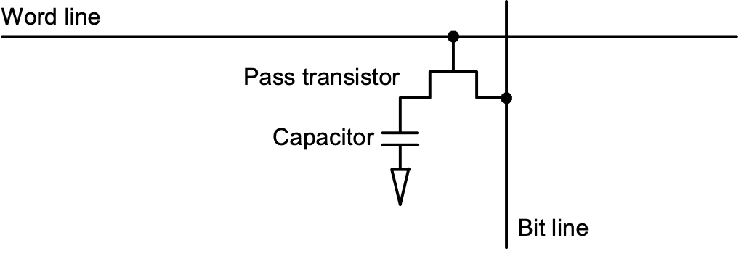
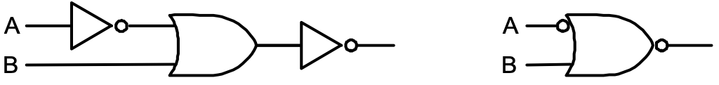
Memory Technology
SRAM:
value is stored on a pair of inverting gates
very fast but takes up more space than DRAM (4 to 6 transistors)
DRAM:
value is stored as a charge on capacitor (must be refreshed)
very small but slower than SRAM (factor of 5 to 10)

Slide 3
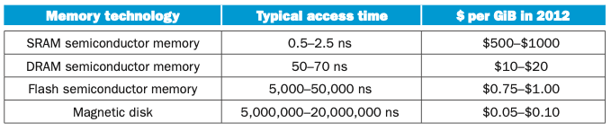
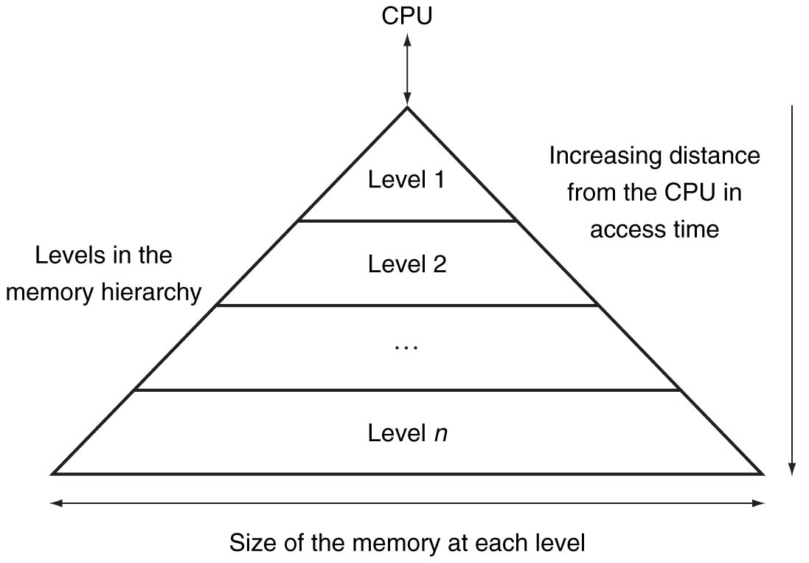
Exploiting Memory Hierarchy

Slide 4
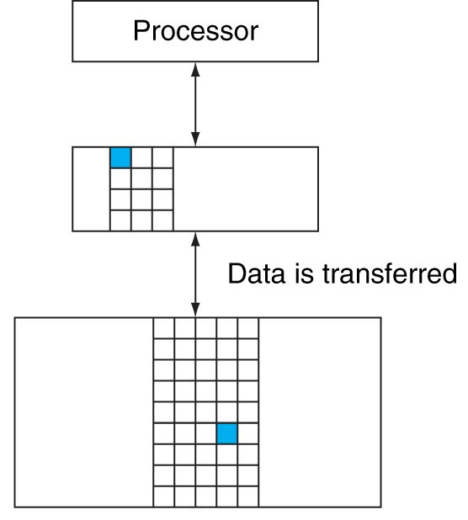
Two levels of memory
Our initial focus: two levels (upper, lower)
block: minimum unit of data
hit: data requested is in the upper level
miss: data requested is not in the upper level

Slide 5
Principle of Locality
If an item is referenced, temporal locality (시간적 지역성): it will tend to be referenced again soon
spatial locality(공간적 지역성): nearby items will tend to be referenced soon.
A principle that makes having a memory hierarchy a good idea
Why does code have locality?

Slide 6
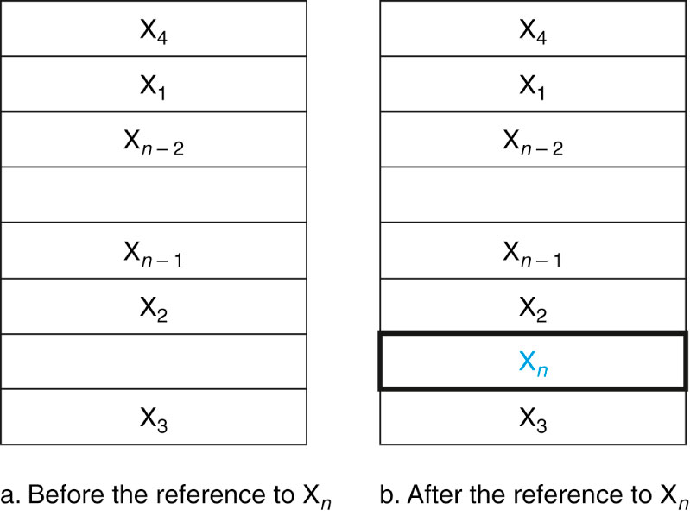
Basics of Cache

Slide 7
Cache
Two issues:
How do we know if a data item is in the cache?
If it is, how do we find it?
Our first example:
block size is one word of data
"direct mapped"
For each item of data at the lower level,
there is exactly one location in the cache where it might be.
e.g., lots of items at the lower level share locations in the upper level

Slide 8
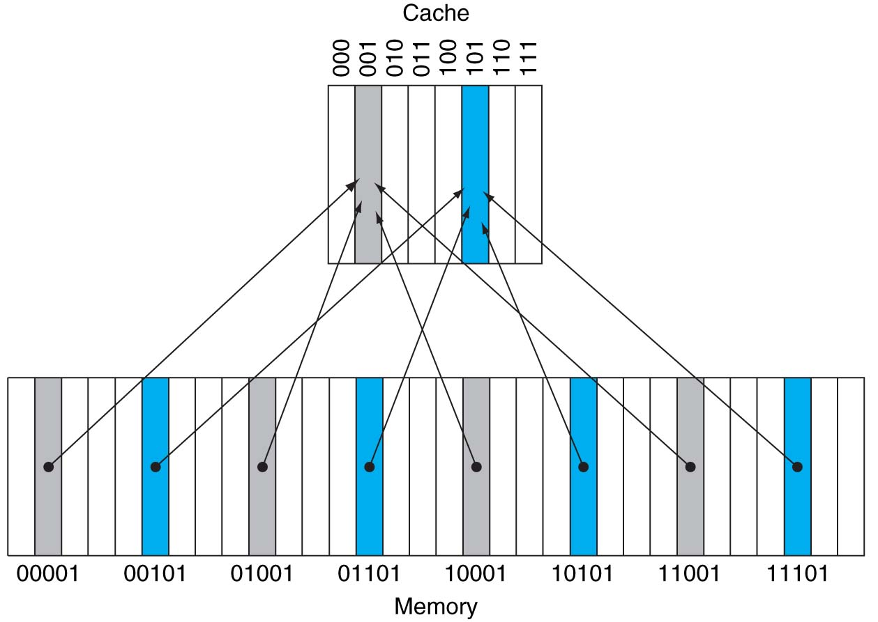
Direct Mapped Cache (word addressing, 1 word/block)
cache index = memory address % the number of blocks in the cache
tag 가 필요해!

Slide 9
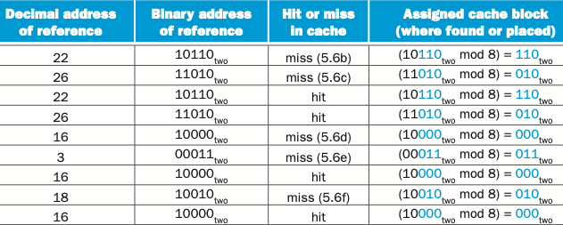
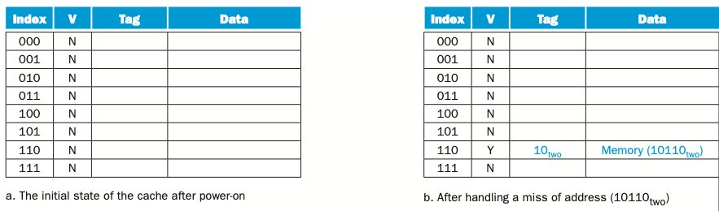
Direct Mapped Cache : An example (word addressing)
memory reference
sequence
cache contents

Slide 10
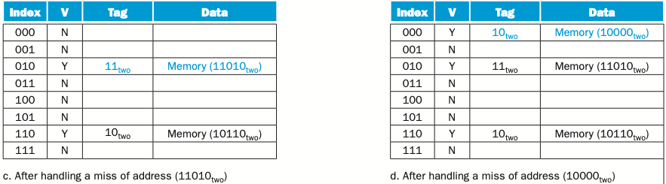
Direct Mapped Cache : An example (word addressing)

Slide 11
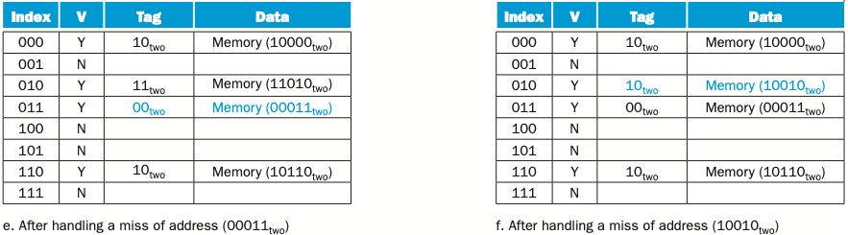
Direct Mapped Cache : An example (word addressing)
Cache conflict at 18 (f)
Compulsory misses at 22,26,16,3 and 18
Conflict miss at 26 in the future reference

Slide 12
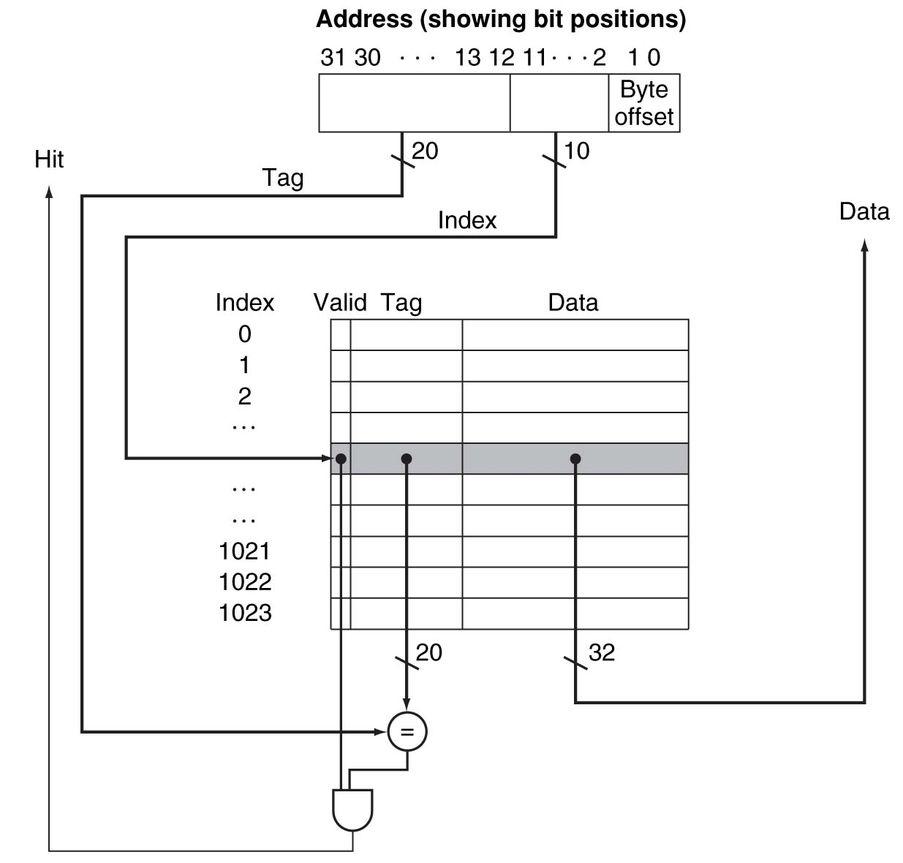
Direct Mapped Cache (byte addressing, 1 word/block)
0001 0000 0000 0000 0000 0000 0001 00 00 0001 0000 0000 0000 0000 0000 0001 00 01
0001 0000 0000 0000 0000 0000 0001 00 10
0001 0000 0000 0000 0000 0000 0001 00 11
[메모리 주소]
What kind of locality are we taking advantage of?
이 주소에 저장된 8 bit value

Slide 13
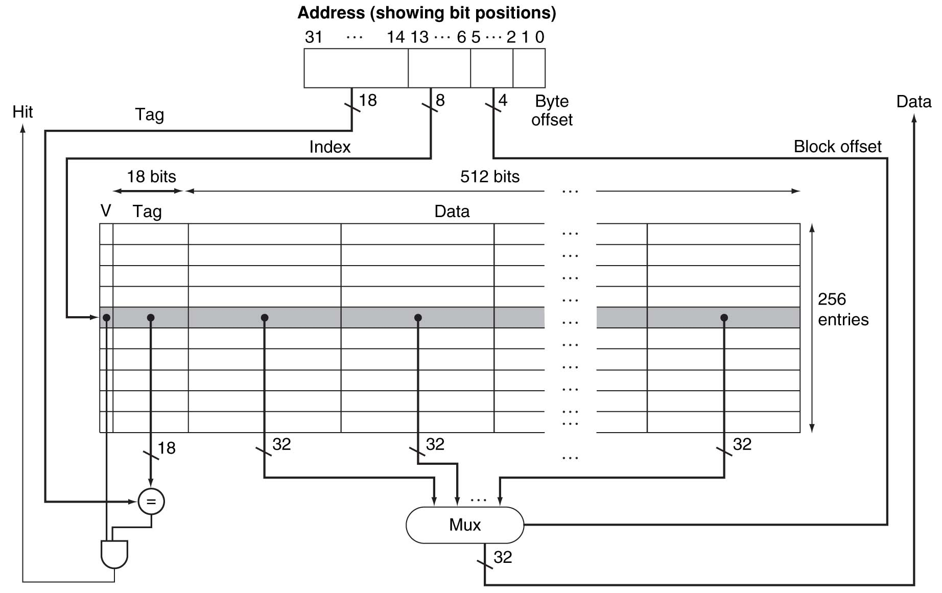
Direct Mapped Cache (byte addressing, 16 words/block)
0001 0000 0000 0000 00 00 0001 00 00 00 00 0001 0000 0000 0000 00 00 0001 00 00 00 01
0001 0000 0000 0000 00 00 0001 00 00 00 10
0001 0000 0000 0000 00 00 0001 00 00 00 11
......
0001 0000 0000 0000 00 00 0001 00 01 00 00 0001 0000 0000 0000 00 00 0001 00 01 00 01
0001 0000 0000 0000 00 00 0001 00 01 00 10
0001 0000 0000 0000 00 00 0001 00 01 00 11
......
0001 0000 0000 0000 00 00 0001 00 11 11 00 0001 0000 0000 0000 00 00 0001 00 11 11 01
0001 0000 0000 0000 00 00 0001 00 11 11 10
0001 0000 0000 0000 00 00 0001 00 11 11 11
Taking advantage of spatial locality:
16 words
= 64 bytes
Notes:
Ex: Accessing 0x40 and 0x48

Slide 14
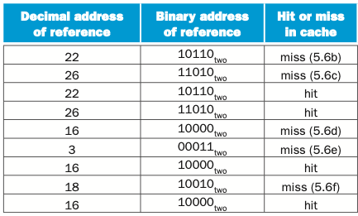
앞의 cache 에서 Byte addressing 이라고 가정하면
22 = 0000 0000 0000 0000 00 00 0000 00 01 01 10
26 = 0000 0000 0000 0000 00 00 0000 00 01 10 10
16 = 0000 0000 0000 0000 00 00 0000 00 01 00 00
3 = 0000 0000 0000 0000 00 00 0000 00 00 00 11
18 = 0000 0000 0000 0000 00 00 0000 00 01 00 10
miss
hit
hit
hit
hit
hit
hit
hit
hit

Slide 15
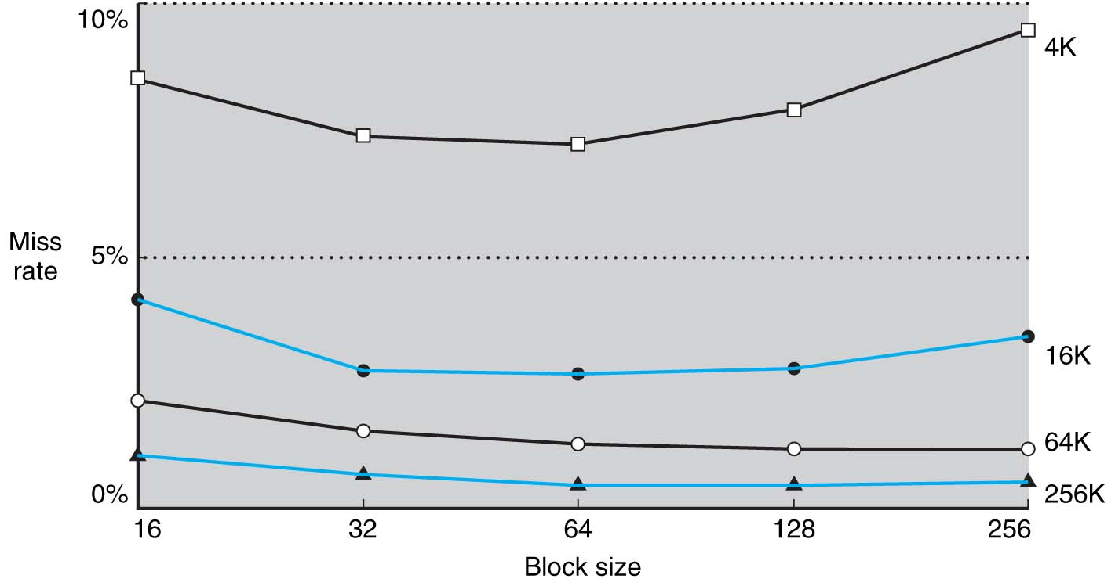
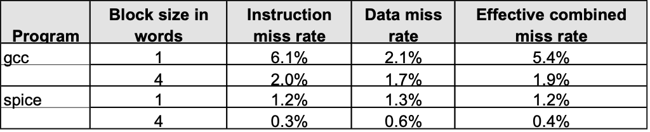
miss rate vs. block size
Increasing the block size tends to decrease miss rate:
Use split caches because there is more spatial locality in code:
Increased
cache conflict

Slide 16
Hits vs. Misses
Read hits
this is what we want!
Read misses
stall the CPU, fetch block from memory, deliver to cache, restart
Write hits: -> cache consistency problem
can replace data in cache and memory (write-through)
write the data only into the cache (write-back the cache later)
Write misses:
read the entire block into the cache, then write the word

Slide 17
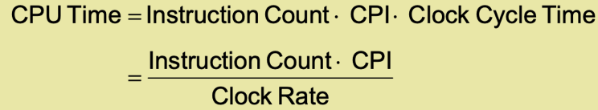
Performance
Simplified model: execution time = (execution cycles + stall cycles) × cycle time stall cycles = # of instructions × miss ratio × miss penalty
Two ways of improving performance:
decreasing the miss ratio
decreasing the miss penalty
What happens if we increase block size?

Slide 18
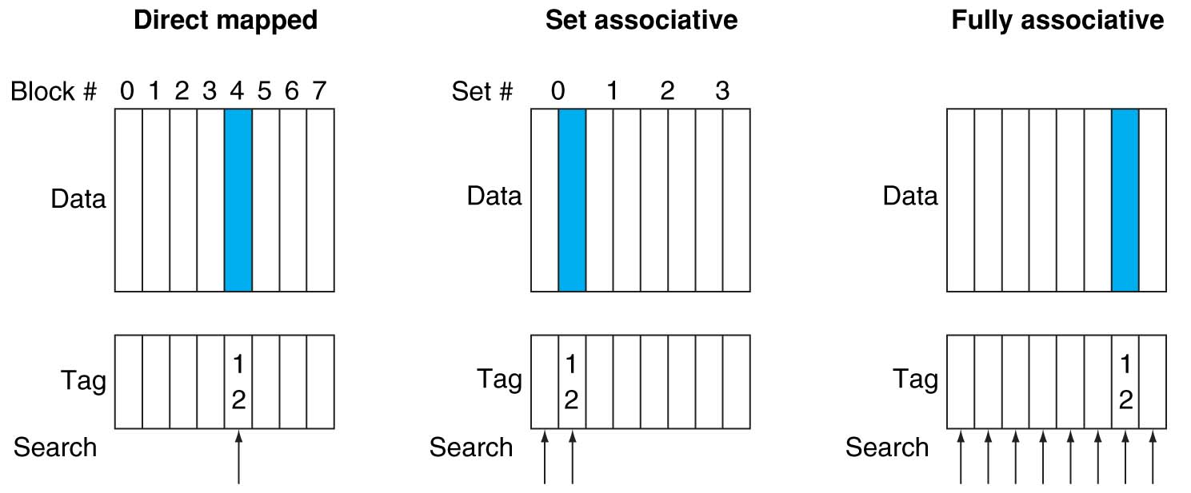
Decreasing miss ratio with associativity
1 word/ block, word addressing
main memory
main memory
main memory

Slide 19
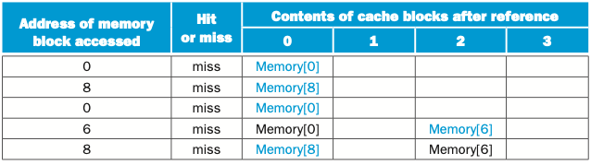
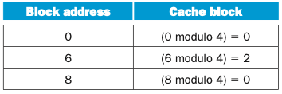
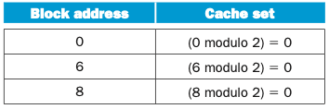
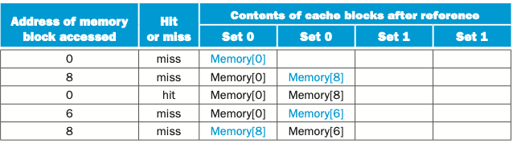
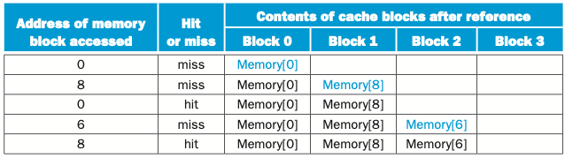
Cache behavior example
Access sequence 0,8,0,6,8
Direct mapped cache
2-way set associative cache
Fully associative cache

Slide 20
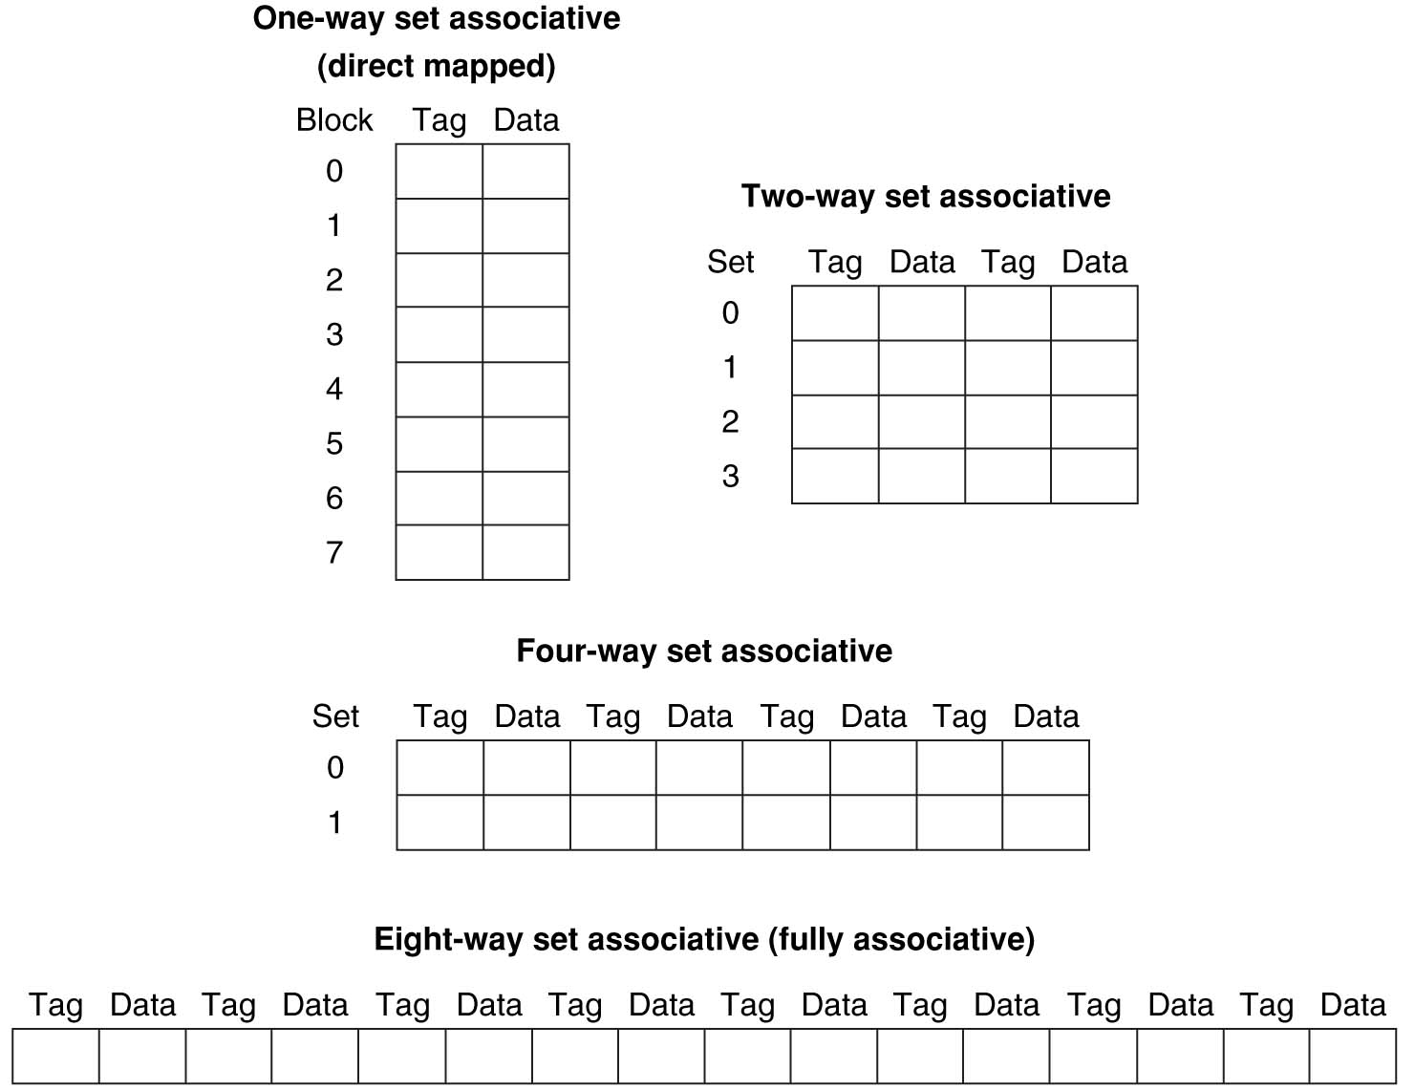
Set associativity
least recently used (LRU) replacement strategy
Notes:
0,8,0,8…
0,4,8,0,4,8…

Slide 21
FIGURE 5.16 The three portions of an address in a set-associative or direct-mapped cache. The index is used to select the set, then the tag is used to choose the block by comparison with the blocks in the selected set. The block offset is the address of the desired data within the block. Copyright © 2009 Elsevier, Inc. All rights reserved.

Slide 22
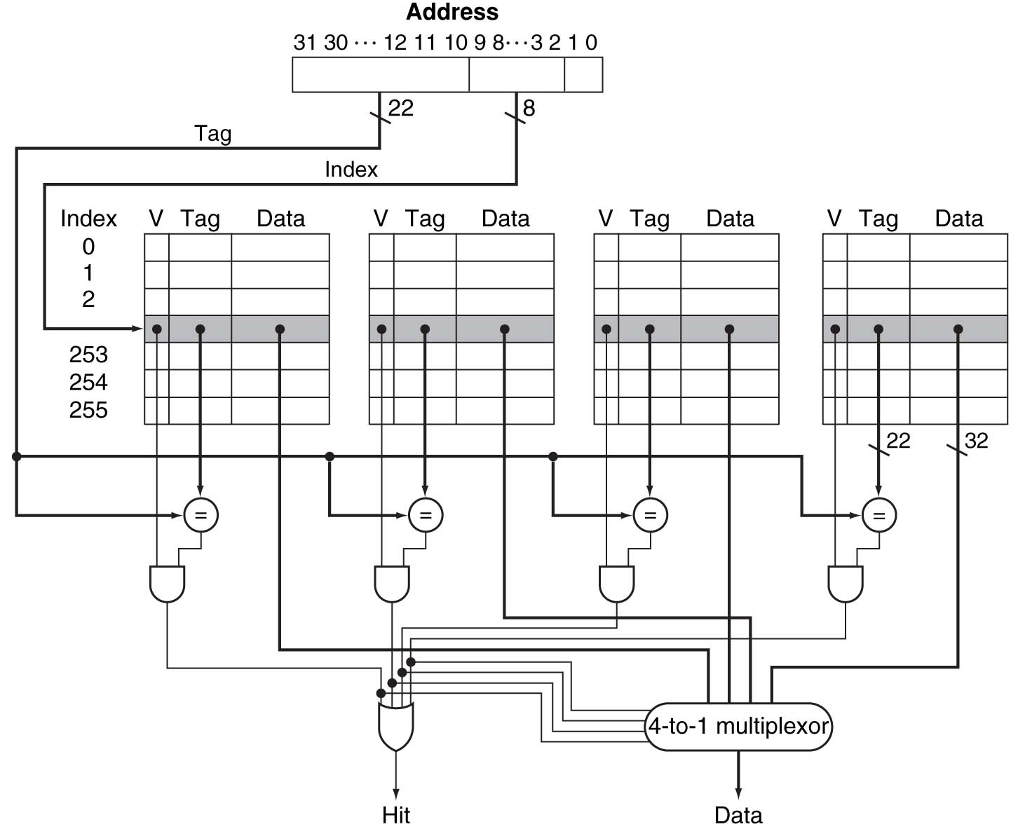
An implementation of 4-way set associative cache
1 word/block, byte addressing
0001 0000 0000 0000 0000 00 00 0000 11 00 0001 0000 0000 0000 0000 00 00 0000 11 01
0001 0000 0000 0000 0000 00 00 0000 11 10
0001 0000 0000 0000 0000 00 00 0000 11 11
0010 0000 0000 0010 0000 11 00 0000 11 00 0010 0000 0000 0010 0000 11 00 0000 11 01
0010 0000 0000 0010 0000 11 00 0000 11 10
0010 0000 0000 0010 0000 11 00 0000 11 11
0100 0000 0100 0000 0000 00 00 0000 11 00 0100 0000 0100 0000 0000 00 00 0000 11 01
0100 0000 0100 0000 0000 00 00 0000 11 10
0100 0000 0100 0000 0000 00 00 0000 11 11
1001 0000 1000 0000 0000 10 00 0000 11 00 1001 0000 1000 0000 0000 10 00 0000 11 01
1001 0000 1000 0000 0000 10 00 0000 11 10
1001 0000 1000 0000 0000 10 00 0000 11 11
Notes:
0xc, 0x80c, …

Slide 23
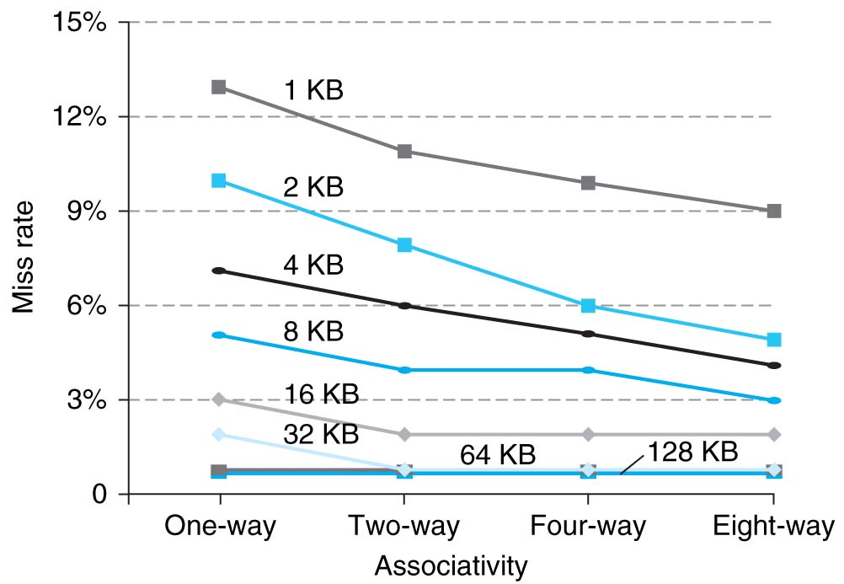
Cache Performance as a function of associativity

Slide 24
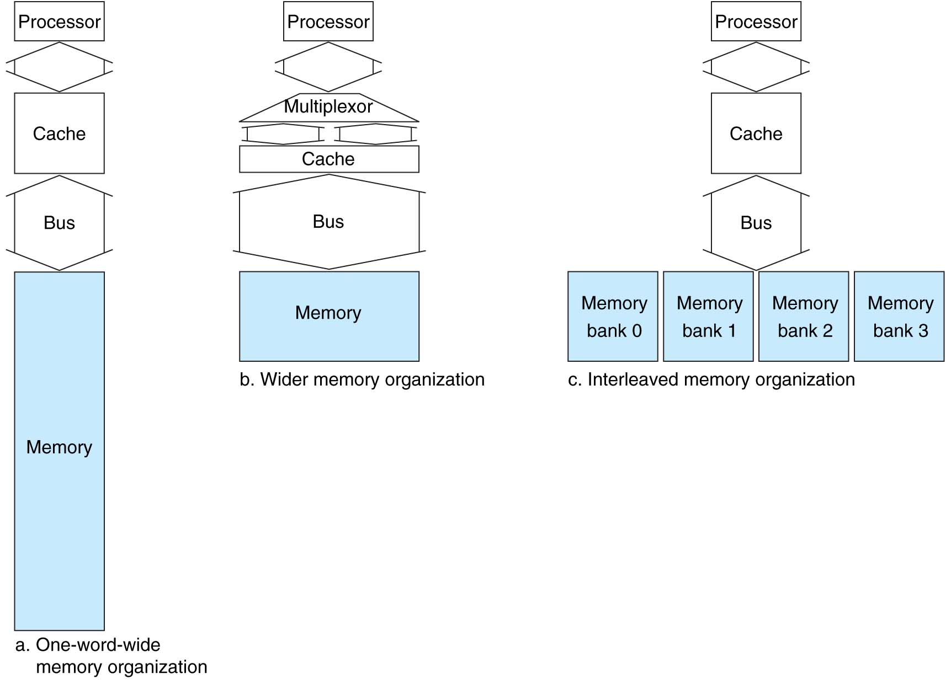
Decreasing miss penalty by memory interleaving
Make reading multiple words easier by using banks of memory
1 clock cycle to send the address
15 clock cycles for each DRAM access initiated
1 clock cycle to send a word of data
Notes:
1+4*(15+1)=65 vs. 1+15+1=17 vs. 1+15+4=20

Slide 25
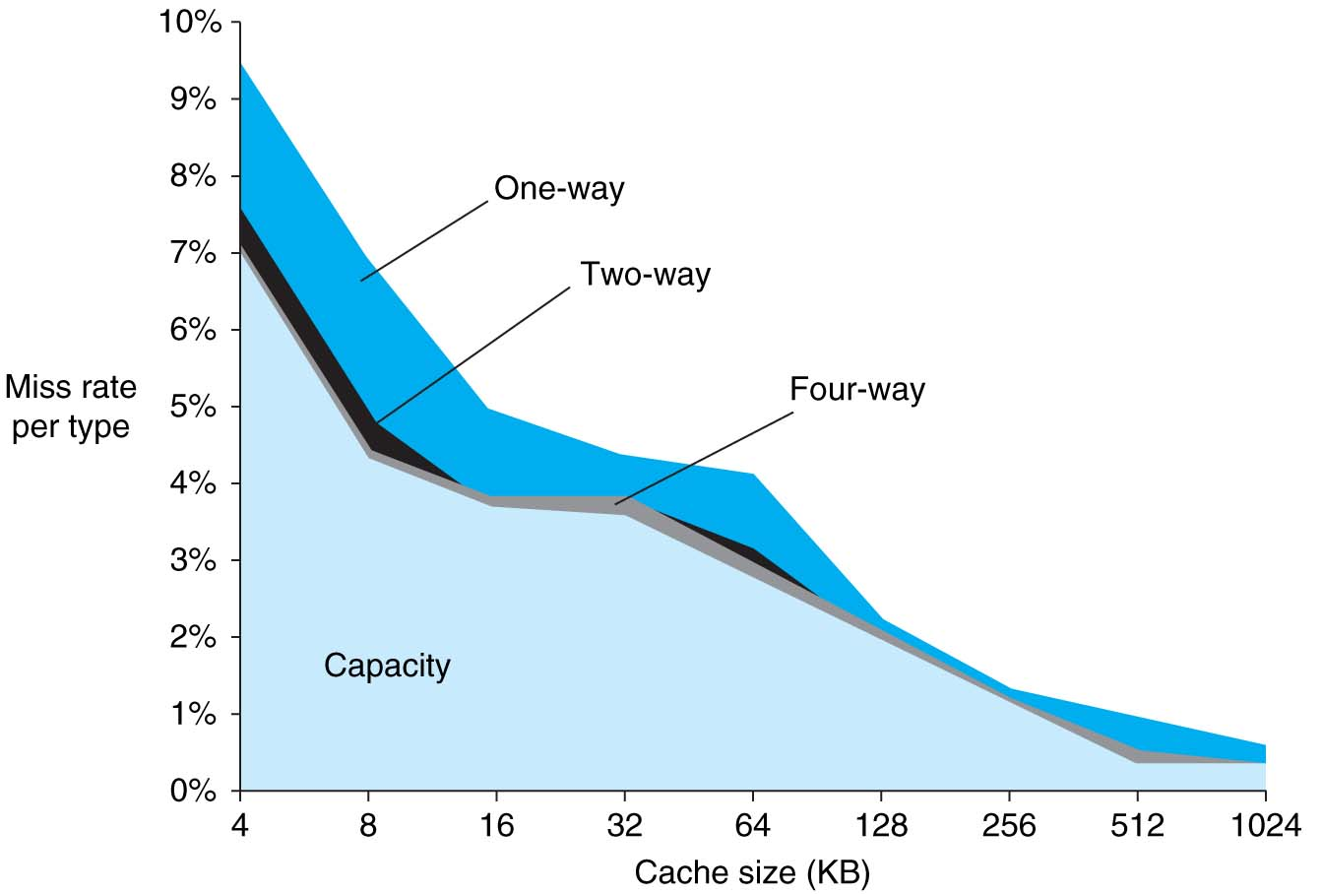
Cache misses
Compulsory misses
Capacity misses
Conflict misses
Design Change | Effect on miss rate | Possible negative performance effect
Increase cache size | Decrease capacity misses | May increase access time
Increase set associativity | Decrease miss rate due to conflict misses | May increase access time
Increase block size | Decrease miss rate for a wide range of block sized due to spatial locality | Increase miss penalty. Very large block could increase miss rate

Slide 26
Improving performance with cache
Reducing cache miss rate
Increasing cache size
Increasing cache block size
Increasing set associativity
Reducing miss penalty
Memory interleaving
Adding 2nd level cache

