Slide 1
Virtual Memory

Slide 2
Analogy between cache and VM
 | Cache | VM
Upper level memory | Cache | Main memory
Lower level memory | Main memory | Secondary Storage
Unit of transfer | Block (32~128B) | Page (4~16 KB)
Upper level memory organization | Direct-mapped or set-associative | Fully associative
Replacement scheme | Random | LRU
Write scheme | Write-through or write-back | Write-back
Miss penalty | Relatively low | Relatively large

Slide 3
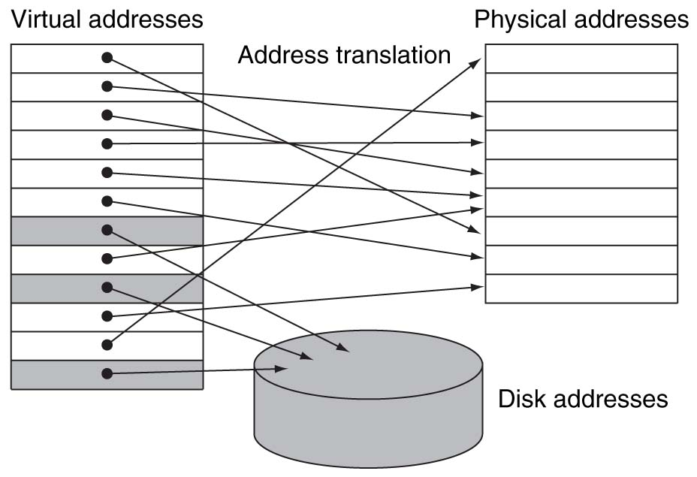
Virtual Memory
Main memory can act as a cache for the secondary storage (disk)
Advantages:
illusion of having more physical memory
program relocation
protection
program uses
virtual address
upper level
memory
lower level
memory

Slide 4
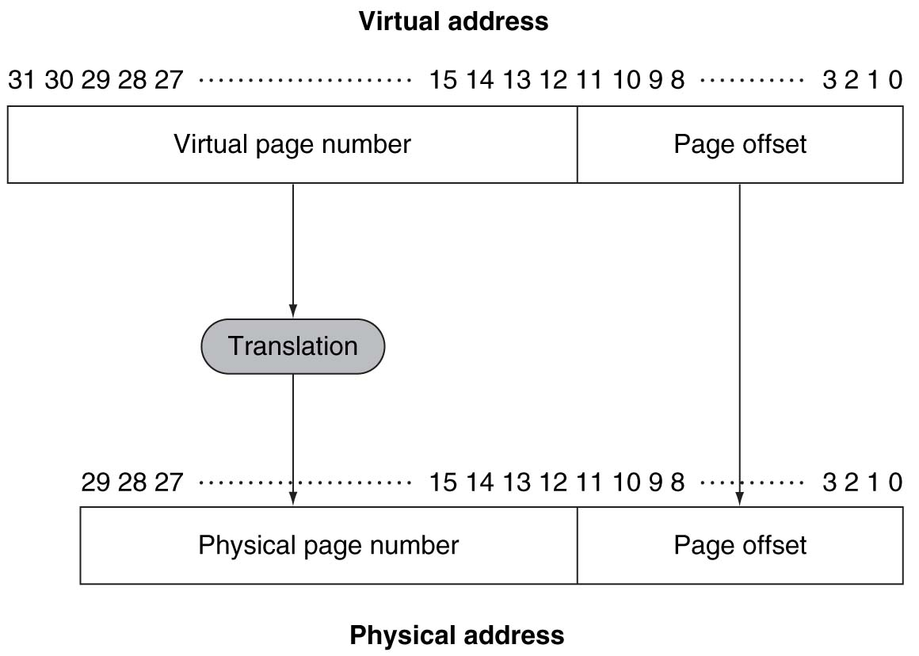
Pages: virtual memory blocks
Page faults: the data is not in memory, retrieve it from disk
huge miss penalty, thus pages should be fairly large (e.g., 4~16KB)
reducing page faults is important (LRU is worth the price)
can handle the faults in software instead of hardware
using write-through is too expensive so we use writeback
address translation

Slide 5
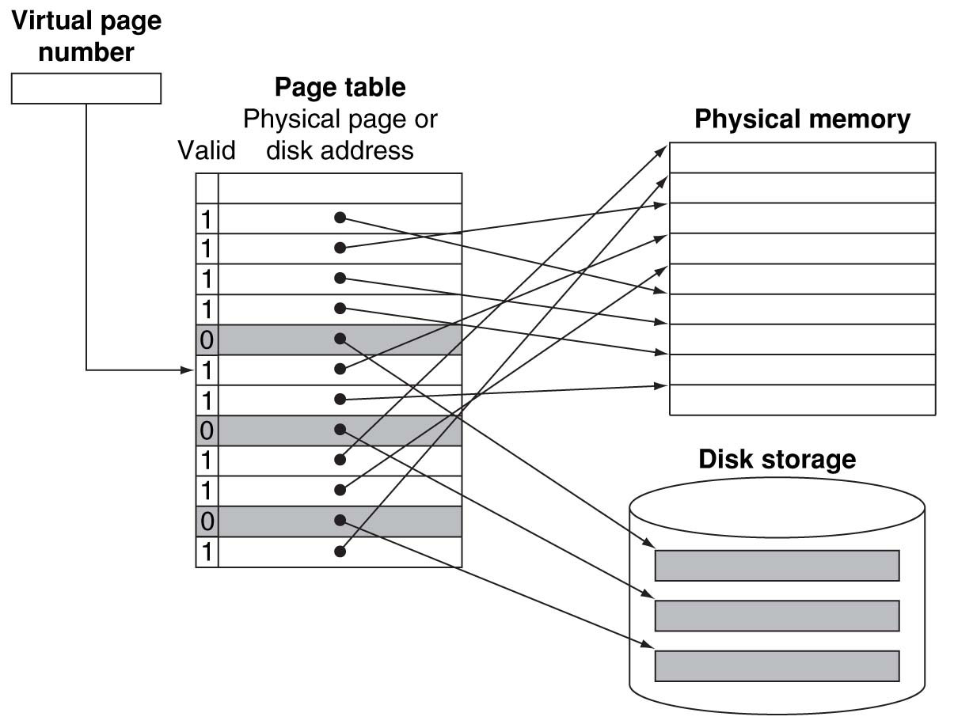
Page Tables :
: direct-mapped
: fully associative

Slide 6
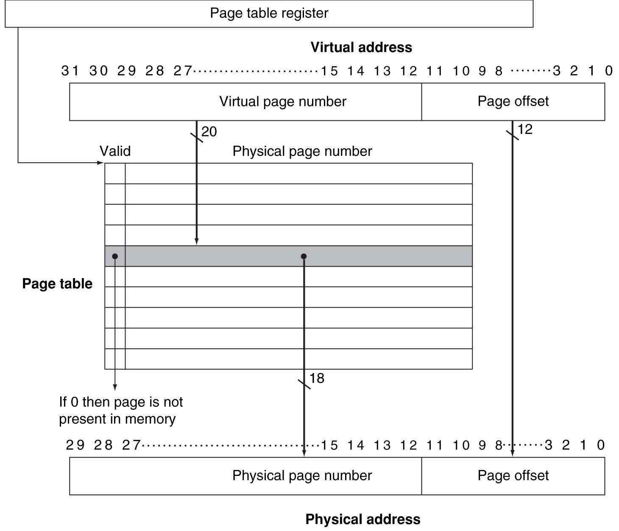
Address translation
0000 0000 0000 0000 0100 0000 0000 1000
Where is the page table?
4
01 0000 0000 0000 0000
01 0000 0000 0000 0000 0000 0000 1000

Slide 7
What is memory address?
메모리에 저장된 것은 2진수 형태의 data 들 (bit 들의 모임) 이고,
이 수많은 bits 중 특정한 bits 를 지칭하기 위한 일련번호가 주소이며
다시 말하지만, 주소(index)는 메모리(cache)에 저장된 것이 아닙니다!!!
byte addressing
word addressing
8B=64bits memory
000
001
010
011
100
101
110
111
0
00100000
01011100
10111110
00001100
01001111
00000000
10101101
11110000
1
Mem[111₂]

Slide 8
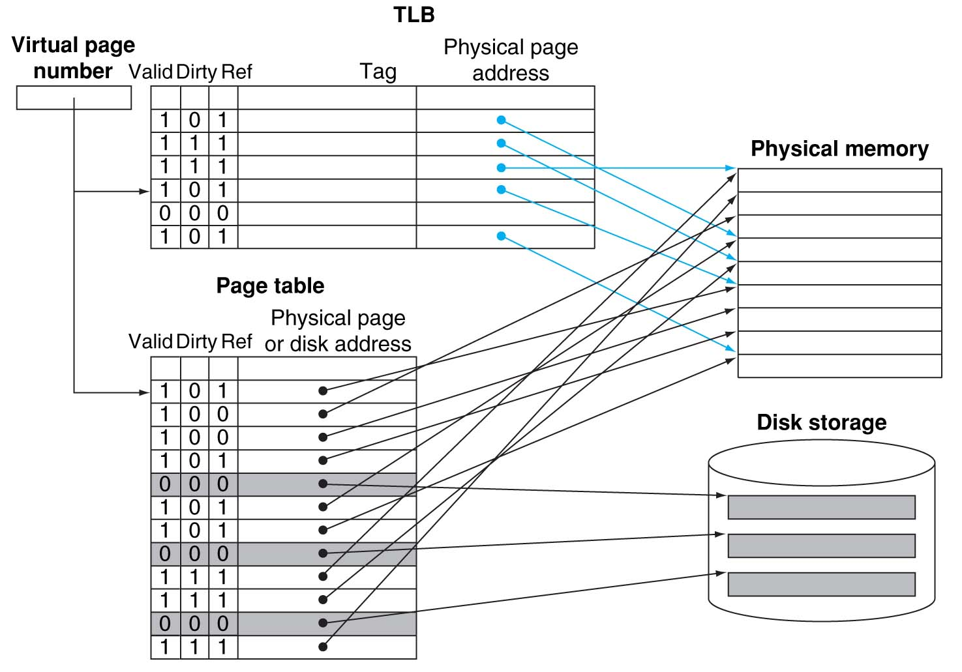
Making Address Translation Fast
virtual address : 0000 0000 0000 0000 0001 0000 0000 1000
A cache for address translations: translation lookaside buffer (TLB)
physical address :
0000 0000 0000 0000 0101 0000 0000 1000
0000 0000 0000 0000 0001
0000 0000 0000 0000 0001
0000 0000 0000 0000 0101
1
0000 0000 0000 0000 0101
Typical values: 16-512 entries,
miss-rate: 0.01% - 1%
miss-penalty: 10 – 100 cycles

Slide 9
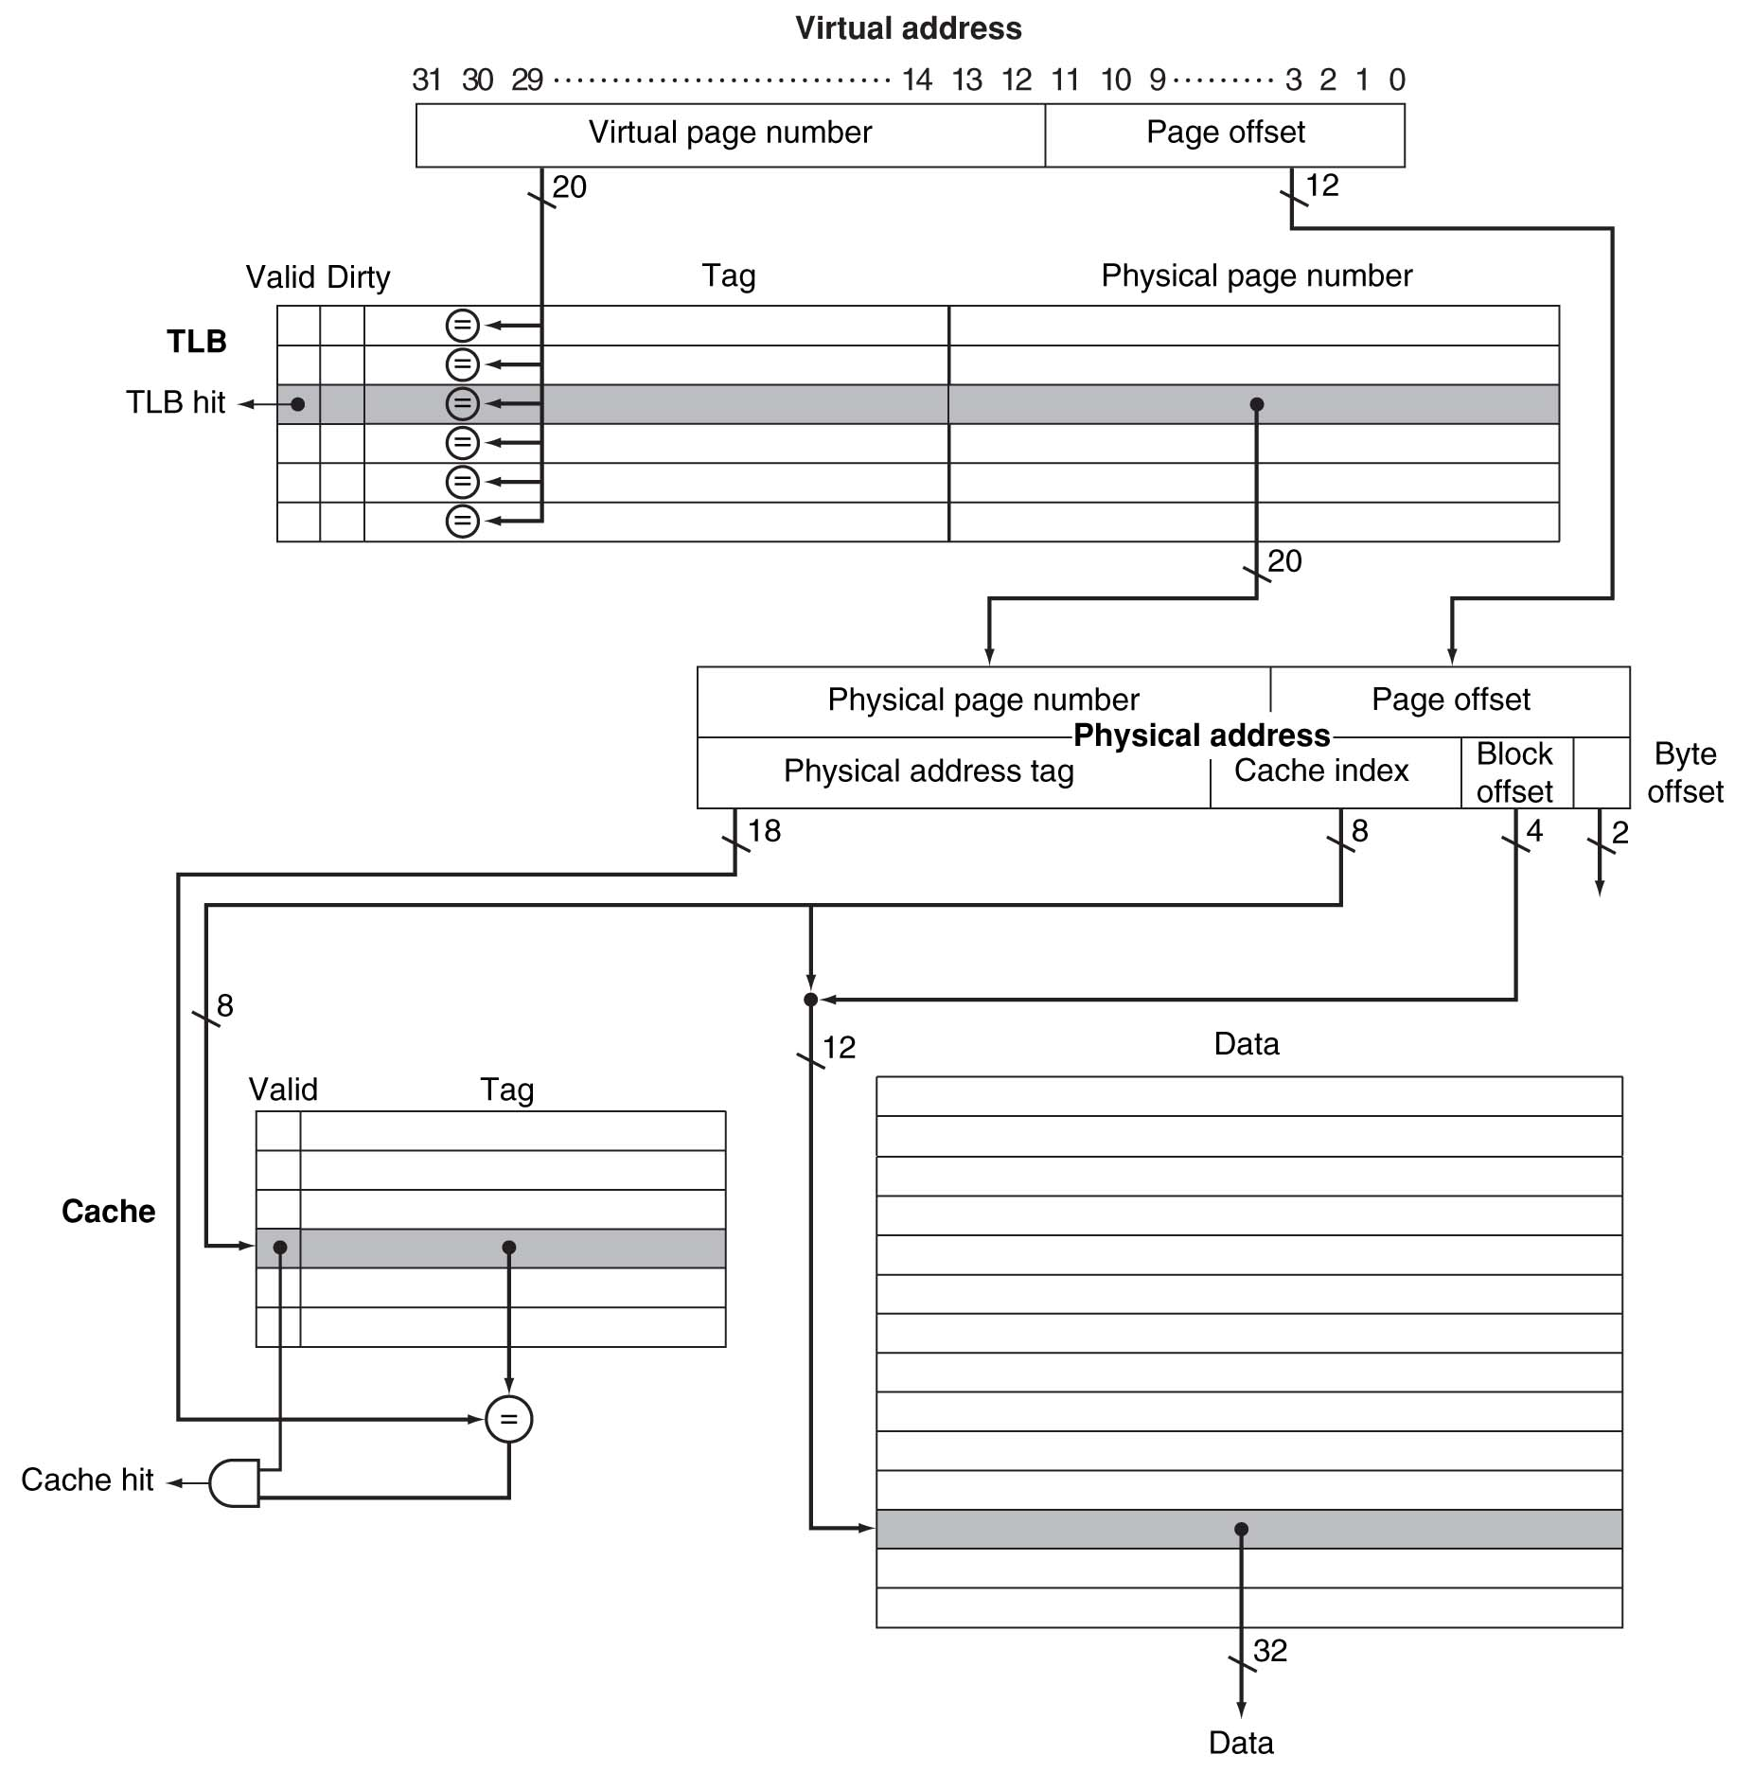
Virtual memory + cache example
0000 0011 0000 0000 0001 0000 1100 0100
page table
0000 0011 0000 0000 0001 0000 1000 0000 1000
0000 1000 0000 0000 1000 0000 1100 0100
0000 1000 0000 0000 10 00 0000 11 00 01 00
main memory
3
0000 1000 0000 0000 10
0x030
0x031
0x032
secondary storage
0x03F

