Slide 1
Memory Hierarchy Question
In the figure shown in next page,
what is the organization of cache (i.e., xx words/block, n-way set associative) ?
What is the page size and how large is a page table ?
Show the contents of cache, TLB, page table, pages in main memory when the memory reference sequence is listed in the figure. (Assume byte addressing, and no page is in memory initially.)
State cache miss/hit, TLB miss/hit, page fault/not for each reference in c.

Slide 2
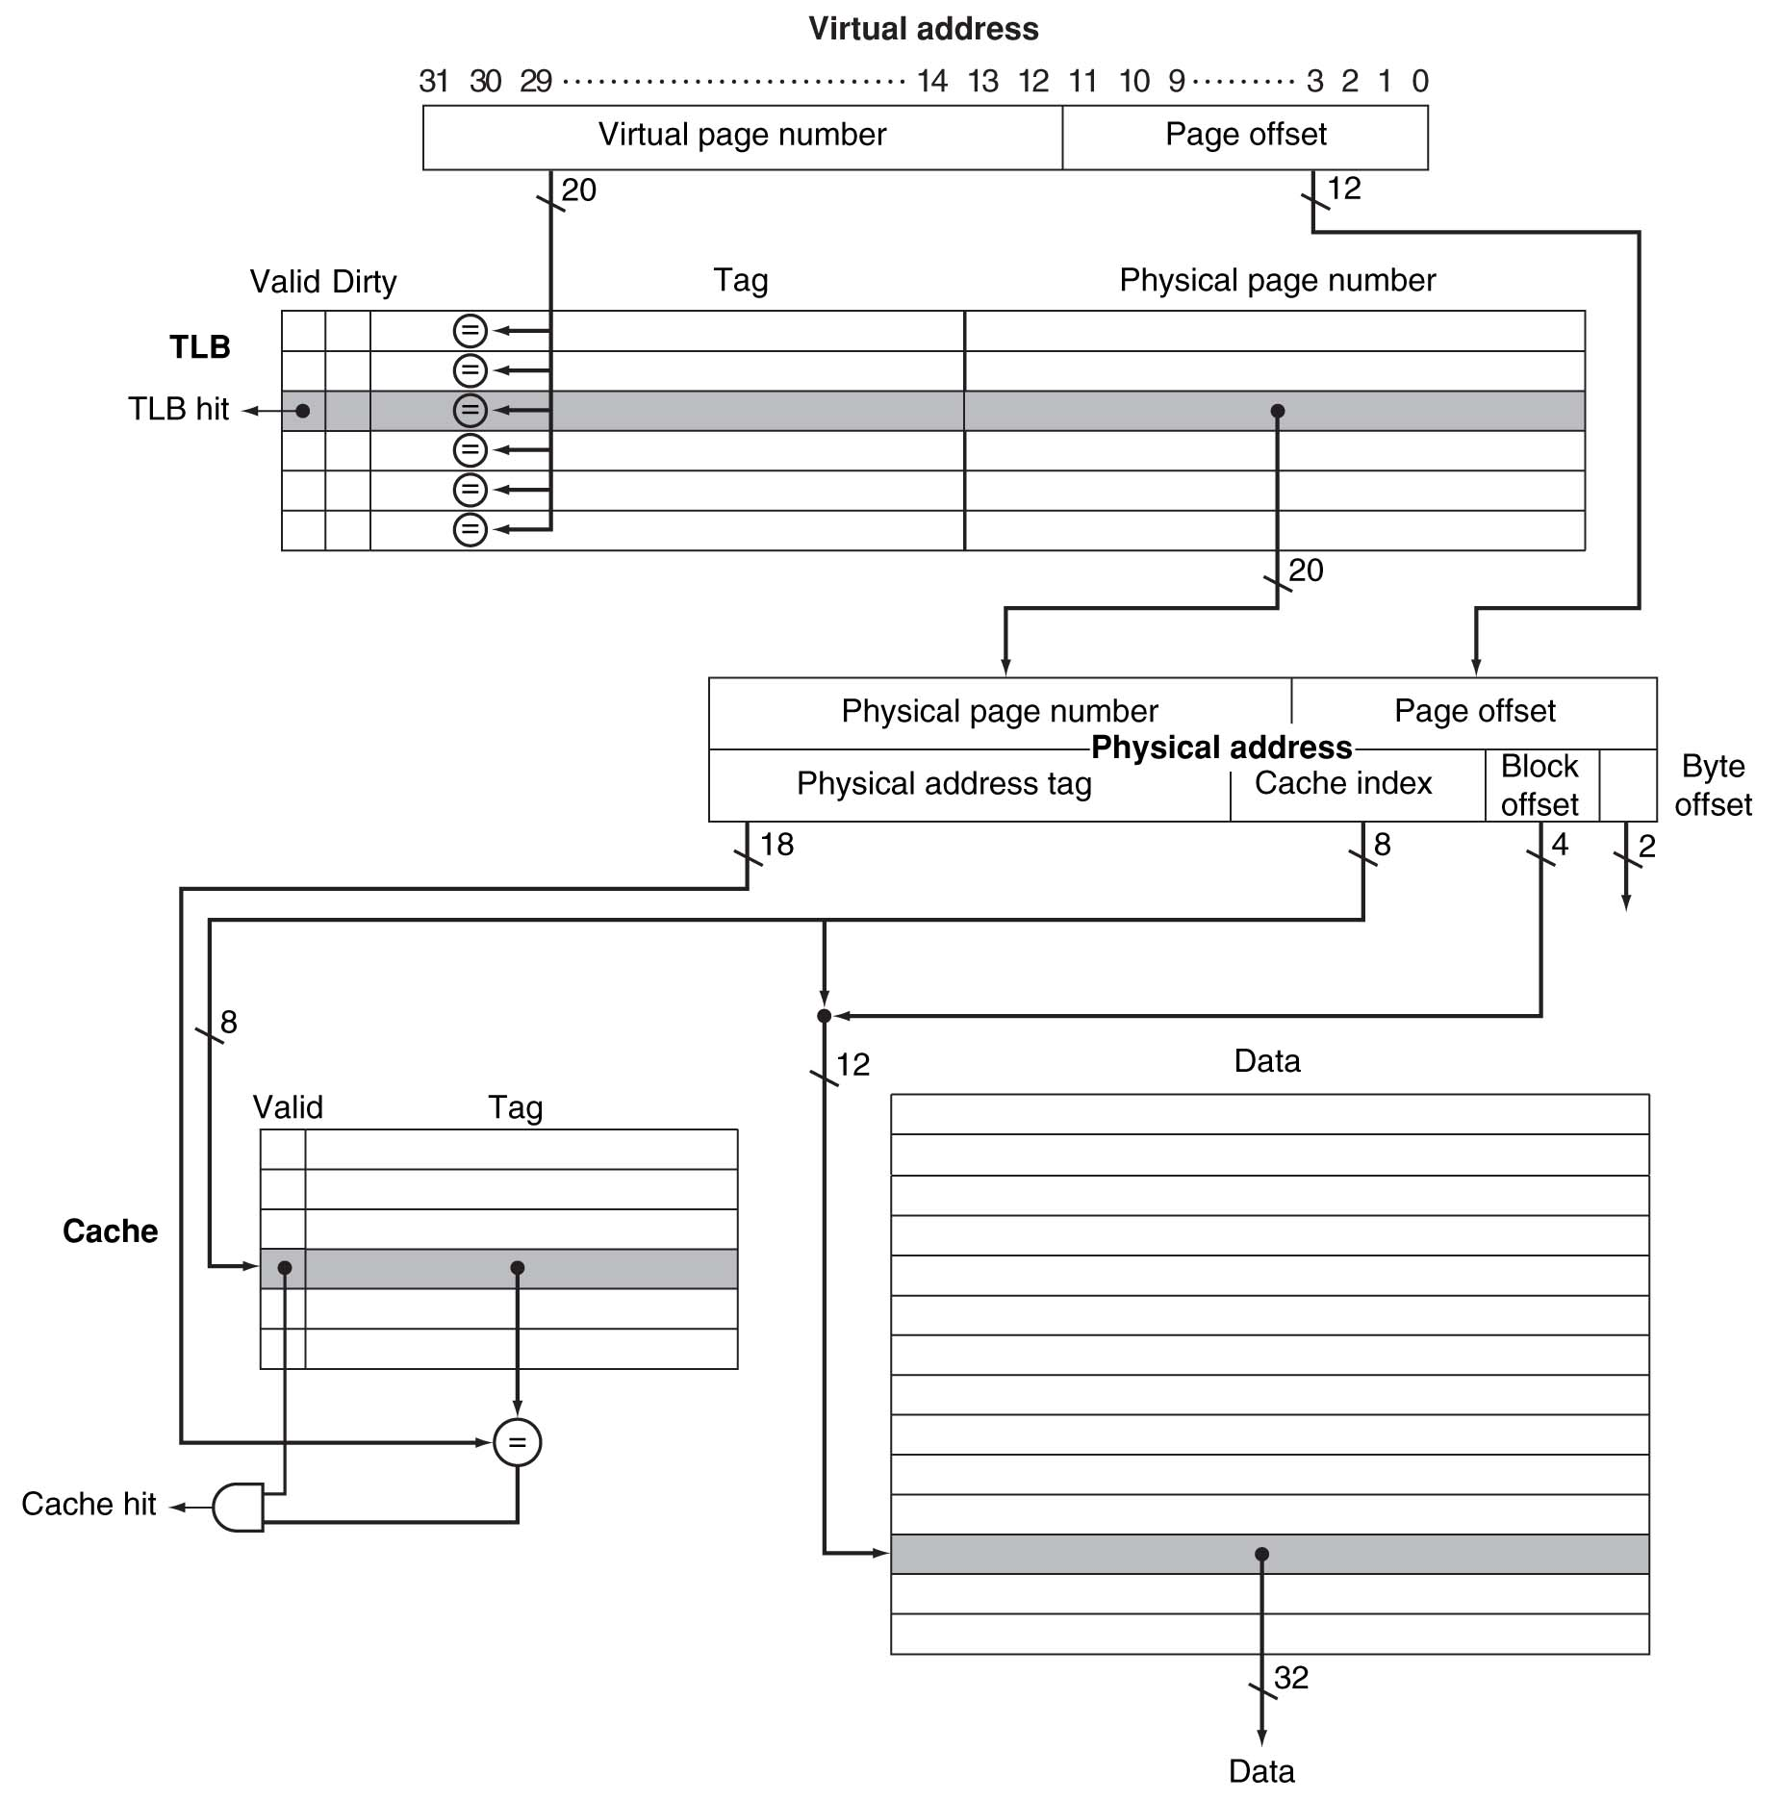
0x00004000
0x00004008
0x00004100
0x00002010
0xFFFFF000
0x00001000
0x00005000
0x00004000
0x00002000

Slide 3
Initial States of TLB, cache, page table and main memory
 | TLB | page | Cache
0x00004000
0x00004008
0x00004100
0x00002010
0xFFFFF000
0x00001000
0x00005000
0x00004000
0x00002000
Index (8b) | V | Tag (18b) | Data (64 bytes) Physical address
0x00 | 0
0x01 | 0
0x02 | 0
0x03 | 0
0x04 | 0
:
0x08 | 0
:
: | 0
:
: | 0
:
: | 0
:
0xFF | 0
TLB
V | Tag (20b) | Physical page # (20b)
0
0
0
0
cache
Page table
Index (20b) | V | Physical page # (20b)
0x00000 | 0
0x00001 | 0
0x00002 | 0
0x00003 | 0
0x00004 | 0
0x00005 | 0
0x00006 | 0
:
0xFFFFF | 0
Main Memory
Page (20b) | Data (4 Kbytes) virtual address
:
0x01000
0x01001
0x01002
0x01003
0x01004
0x01005
:
Address translation :
0x00004000 → ???

Slide 4
Address breakup
Virtual address breakup
Physical address breakup
Virtual page # (20) | page offset (12)
Physical page # (20) |  | page offset (12)
Tag (18) | cache index(8) |  | 4 | 2
Block offset Byte offset

Slide 5
States of TLB, cache, page table and main memory (1)
 | TLB | page | Cache
0x00004000 | Miss | Fault | Miss
0x00004008
0x00004100
Index (8b) | V | Tag (18b) | Data (64 bytes) Physical address
0x00 | 0
0x01 | 0
0x02 | 0
0x03 | 0
0x04 | 0
:
0x08 | 0
:
: | 0
:
: | 0
:
: | 0
:
0xFF | 0
TLB
V | Tag (20b) | Physical page # (20b)
1 | 0x00004 | 0x01000
0
0
0
cache
Page table
Index (20b) | V | Physical page # (20b)
0x00000 | 0
0x00001 | 0
0x00002 | 0
0x00003 | 0
0x00004 | 1 | 0x01000
0x00005 | 0
0x00006 | 0
:
0xFFFFF | 0
Main Memory
Page (20b) | Data (4 Kbytes) virtual address
:
0x01000 | Mem[0x00004000 ~ 0x00004FFF]
0x01001
0x01002
0x01003
0x01004
0x01005
:
Address translation :
0x00004000 → 0x01000000
(0000 0001 0000 0000 0000 0000 0000 0000)

Slide 6
States of TLB, cache, page table and main memory (1)
 | TLB | page | Cache
0x00004000 | Miss | Fault | Miss
0x00004008
0x00004100
Index (8b) | V | Tag (18b) | Data (64 bytes) Physical address
0x00 | 1 | 0x01000 | Mem[0x01000000~0x01000003F]
0x01 | 0
0x02 | 0
0x03 | 0
0x04 | 0
:
0x08 | 0
:
: | 0
:
: | 0
:
: | 0
:
0xFF | 0
TLB
V | Tag (20b) | Physical page # (20b)
1 | 0x00004 | 0x01000
0
0
0
cache
Page table
Index (20b) | V | Physical page # (20b)
0x00000 | 0
0x00001 | 0
0x00002 | 0
0x00003 | 0
0x00004 | 1 | 0x01000
0x00005 | 0
0x00006 | 0
:
0xFFFFF | 0
Main Memory
Page (20b) | Data (4 Kbytes) virtual address
:
0x01000 | Mem[0x00004000 ~ 0x00004FFF]
0x01001
0x01002
0x01003
0x01004
0x01005
:
Address translation :
0x00004000 → 0x01000000
(0000 0001 0000 0000 0000 0000 0000 0000)

Slide 7
States of TLB, cache, page table and main memory (2)
 | TLB | page | Cache
0x00004000 | Miss | Fault | Miss
0x00004008 | Hit |  | Hit
0x00004100
Index (8b) | V | Tag (18b) | Data (64 bytes) Physical address
0x00 | 1 | 0x01000 | Mem[0x01000000~0x01000003F]
0x01 | 0
0x02 | 0
0x03 | 0
0x04 | 0
:
0x08 | 0
:
: | 0
:
: | 0
:
: | 0
:
0xFF | 0
TLB
V | Tag (20b) | Physical page # (20b)
1 | 0x00004 | 0x01000
0
0
0
cache
Page table
Index (20b) | V | Physical page # (20b)
0x00000 | 0
0x00001 | 0
0x00002 | 0
0x00003 | 0
0x00004 | 1 | 0x01000
0x00005 | 0
0x00006 | 0
:
0xFFFFF | 0
Main Memory
Page (20b) | Data (4 Kbytes) virtual address
:
0x01000 | Mem[0x00004000 ~ 0x00004FFF]
0x01001
0x01002
0x01003
0x01004
0x01005
:
Address translation :
0x00004008 → 0x01000008
(0000 0001 0000 0000 0000 0000 0000 1000)

Slide 8
States of TLB, cache, page table and main memory (3)
 | TLB | page | Cache
0x00004000 | Miss | Fault | Miss
0x00004008 | Hit |  | Hit
0x00004100 | Hit |  | Miss
0x00002010
Index (8b) | V | Tag (18b) | Data (64 bytes) Physical address
0x00 | 1 | 0x01000 | Mem[0x01000000~0x01000003F]
0x01 | 0
0x02 | 0
0x03 | 0
0x04 | 0
:
0x40 | 0
:
: | 0
:
: | 0
:
: | 0
:
0xFF | 0
TLB
V | Tag (20b) | Physical page # (20b)
1 | 0x00004 | 0x01000
0
0
0
cache
Page table
Index (20b) | V | Physical page # (20b)
0x00000 | 0
0x00001 | 0
0x00002 | 0
0x00003 | 0
0x00004 | 1 | 0x01000
0x00005 | 0
0x00006 | 0
:
0xFFFFF | 0
Main Memory
Page (20b) | Data (4 Kbytes) virtual address
:
0x01000 | Mem[0x00004000 ~ 0x00004FFF]
0x01001
0x01002
0x01003
0x01004
0x01005
:
Address translation :
0x00004100 → 0x01000100
(0000 0001 0000 0000 0000 0001 0000 0000)

Slide 9
States of TLB, cache, page table and main memory (3)
 | TLB | page | Cache
0x00004000 | Miss | Fault | Miss
0x00004008 | Hit |  | Hit
0x00004100 | Hit |  | Miss
0x00002010
Index (8b) | V | Tag (18b) | Data (64 bytes) Physical address
0x00 | 1 | 0x01000 | Mem[0x01000000~0x01000003F]
0x01 | 0
0x02 | 0
0x03 | 0
0x04 | 1 | 0x01000 | Mem[0x01000100~0x01000013F]
:
0x40 | 0
:
: | 0
:
: | 0
:
: | 0
:
0xFF | 0
TLB
V | Tag (20b) | Physical page # (20b)
1 | 0x00004 | 0x01000
0
0
0
cache
Page table
Index (20b) | V | Physical page # (20b)
0x00000 | 0
0x00001 | 0
0x00002 | 0
0x00003 | 0
0x00004 | 1 | 0x01000
0x00005 | 0
0x00006 | 0
:
0xFFFFF | 0
Main Memory
Page (20b) | Data (4 Kbytes) virtual address
:
0x01000 | Mem[0x00004000 ~ 0x00004FFF]
0x01001
0x01002
0x01003
0x01004
0x01005
:
Address translation :
0x00004100 → 0x01000100
(0000 0001 0000 0000 0000 0001 0000 0000)

Slide 10
States of TLB, cache, page table and main memory (4)
 | TLB | page | Cache
0x00004000 | Miss | Fault | Miss
0x00004008 | Hit |  | Hit
0x00004100 | Hit |  | Miss
0x00002010 | Miss | Fault | Miss
0xFFFFF000
Index (8b) | V | Tag (18b) | Data (64 bytes) Physical address
0x00 | 1 | 0x01000 | Mem[0x01000000~0x01000003F]
0x01 | 0
0x02 | 0
0x03 | 0
0x04 | 1 | 0x01000 | Mem[0x01000100~0x01000013F]
:
0x40 | 0
:
: | 0
:
: | 0
:
: | 0
:
0xFF | 0
TLB
V | Tag (20b) | Physical page # (20b)
1 | 0x00004 | 0x01000
1 | 0x00002 | 0x01001
0
0
cache
Page table
Index (20b) | V | Physical page # (20b)
0x00000 | 0
0x00001 | 0
0x00002 | 1 | 0x01001
0x00003 | 0
0x00004 | 1 | 0x01000
0x00005 | 0
0x00006 | 0
:
0xFFFFF | 0
Main Memory
Page (20b) | Data (4 Kbytes) virtual address
:
0x01000 | Mem[0x00004000 ~ 0x00004FFF]
0x01001 | Mem[0x00002000 ~ 0x00002FFF]
0x01002
0x01003
0x01004
0x01005
:
Address translation :
0x00002010 → 0x01001010
(0000 0001 0000 0000 0001 0000 0001 0000)

Slide 11
States of TLB, cache, page table and main memory (4)
 | TLB | page | Cache
0x00004000 | Miss | Fault | Miss
0x00004008 | Hit |  | Hit
0x00004100 | Hit |  | Miss
0x00002010 | Miss | Fault | Miss
0xFFFFF000
Index (8b) | V | Tag (18b) | Data (64 bytes) Physical address
0x00 | 1 | 0x01000 | Mem[0x01000000~0x01000003F]
0x01 | 0
0x02 | 0
0x03 | 0
0x04 | 1 | 0x01000 | Mem[0x01000100~0x01000013F]
:
0x40 | 1 | 0x01000 | Mem[0x01001000~0x0100103F]
:
: | 0
:
: | 0
:
: | 0
:
0xFF | 0
TLB
V | Tag (20b) | Physical page # (20b)
1 | 0x00004 | 0x01000
1 | 0x00002 | 0x01001
0
0
cache
Page table
Index (20b) | V | Physical page # (20b)
0x00000 | 0
0x00001 | 0
0x00002 | 1 | 0x01001
0x00003 | 0
0x00004 | 1 | 0x01000
0x00005 | 0
0x00006 | 0
:
0xFFFFF | 0
Main Memory
Page (20b) | Data (4 Kbytes) virtual address
:
0x01000 | Mem[0x00004000 ~ 0x00004FFF]
0x01001 | Mem[0x00002000 ~ 0x00002FFF]
0x01002
0x01003
0x01004
0x01005
:
Address translation :
0x00002010 → 0x01001010
(0000 0001 0000 0000 0001 0000 0001 0000)

Slide 12
States of TLB, cache, page table and main memory (5)
 | TLB | page | Cache
0x00004000 | Miss | Fault | Miss
0x00004008 | Hit |  | Hit
0x00004100 | Hit |  | Miss
0x00002010 | Miss | Fault | Miss
0xFFFFF000 | Miss | Fault | Miss
0x00001000
Index (8b) | V | Tag (18b) | Data (64 bytes) Physical address
0x00 | 1 | 0x01000 | Mem[0x01000000~0x01000003F]
0x01 | 0
0x02 | 0
0x03 | 0
0x04 | 1 | 0x01000 | Mem[0x01000100~0x01000013F]
:
0x40 | 1 | 0x01000 | Mem[0x01001000~0x0100103F]
:
0x80 | 0
:
: | 0
:
: | 0
:
0xFF | 0
TLB
V | Tag (20b) | Physical page # (20b)
1 | 0x00004 | 0x01000
1 | 0x00002 | 0x01001
1 | 0xFFFFF | 0x01002
1
cache
Page table
Index (20b) | V | Physical page # (20b)
0x00000 | 0
0x00001 | 0
0x00002 | 1 | 0x01001
0x00003 | 0
0x00004 | 1 | 0x01000
0x00005 | 0
0x00006 | 0
:
0xFFFFF | 1 | 0x01002
Main Memory
Page (20b) | Data (4 Kbytes) virtual address
:
0x01000 | Mem[0x00004000 ~ 0x00004FFF]
0x01001 | Mem[0x00002000 ~ 0x00002FFF]
0x01002 | Mem[0xfffff000 ~ 0xfffffFFF]
0x01003
0x01004
0x01005
:
Address translation :
0xfffff000 → 0x01002000
(0000 0001 0000 0000 0010 0000 0000 0000)

Slide 13
States of TLB, cache, page table and main memory (5)
 | TLB | page | Cache
0x00004000 | Miss | Fault | Miss
0x00004008 | Hit |  | Hit
0x00004100 | Hit |  | Miss
0x00002010 | Miss | Fault | Miss
0xFFFFF000 | Miss | Fault | Miss
0x00001000
Index (8b) | V | Tag (18b) | Data (64 bytes) Physical address
0x00 | 1 | 0x01000 | Mem[0x01000000~0x01000003F]
0x01 | 0
0x02 | 0
0x03 | 0
0x04 | 1 | 0x01000 | Mem[0x01000100~0x01000013F]
:
0x40 | 1 | 0x01000 | Mem[0x01001000~0x0100103F]
:
0x80 | 1 | 0x01000 | Mem[0x01002000~0x0100203F]
:
: | 0
:
: | 0
:
0xFF | 0
TLB
V | Tag (20b) | Physical page # (20b)
1 | 0x00004 | 0x01000
1 | 0x00002 | 0x01001
1 | 0xFFFFF | 0x01002
1
cache
Page table
Index (20b) | V | Physical page # (20b)
0x00000 | 0
0x00001 | 0
0x00002 | 1 | 0x01001
0x00003 | 0
0x00004 | 1 | 0x01000
0x00005 | 0
0x00006 | 0
:
0xFFFFF | 1 | 0x01002
Main Memory
Page (20b) | Data (4 Kbytes) virtual address
:
0x01000 | Mem[0x00004000 ~ 0x00004FFF]
0x01001 | Mem[0x00002000 ~ 0x00002FFF]
0x01002 | Mem[0xfffff000 ~ 0xfffffFFF]
0x01003
0x01004
0x01005
:
Address translation :
0xfffff000 → 0x01002000
(0000 0001 0000 0000 0010 0000 0000 0000)

Slide 14
States of TLB, cache, page table and main memory (6)
 | TLB | page | Cache
0x00004000 | Miss | Fault | Miss
0x00004008 | Hit |  | Hit
0x00004100 | Hit |  | Miss
0x00002010 | Miss | Fault | Miss
0xFFFFF000 | Miss | Fault | Miss
0x00001000 | Miss | Fault | Miss
0x00005000
Index (8b) | V | Tag (18b) | Data (64 bytes) Physical address
0x00 | 1 | 0x01000 | Mem[0x01000000~0x01000003F]
0x01 | 0
0x02 | 0
0x03 | 0
0x04 | 1 | 0x01000 | Mem[0x01000100~0x01000013F]
:
0x40 | 1 | 0x01000 | Mem[0x01001000~0x0100103F]
:
0x80 | 1 | 0x01000 | Mem[0x01002000~0x0100203F]
:
0xC0 | 0
:
: | 0
:
0xFF | 0
TLB
V | Tag (20b) | Physical page # (20b)
1 | 0x00004 | 0x01000
1 | 0x00002 | 0x01001
1 | 0xFFFFF | 0x01002
1 | 0x00001 | 0x01003
cache
Page table
Index (20b) | V | Physical page # (20b)
0x00000 | 0
0x00001 | 1 | 0x01003
0x00002 | 1 | 0x01001
0x00003 | 0
0x00004 | 1 | 0x01000
0x00005 | 0
0x00006 | 0
:
0xFFFFF | 1 | 0x01002
Main Memory
Page (20b) | Data (4 Kbytes) virtual address
:
0x01000 | Mem[0x00004000 ~ 0x00004FFF]
0x01001 | Mem[0x00002000 ~ 0x00002FFF]
0x01002 | Mem[0xfffff000 ~ 0xfffffFFF]
0x01003 | Mem[0x00001000 ~ 0x00001FFF]
0x01004
0x01005
:
Address translation :
0x00001000 → 0x01003000
(0000 0001 0000 0000 0011 0000 0000 0000)

Slide 15
States of TLB, cache, page table and main memory (6)
 | TLB | page | Cache
0x00004000 | Miss | Fault | Miss
0x00004008 | Hit |  | Hit
0x00004100 | Hit |  | Miss
0x00002010 | Miss | Fault | Miss
0xFFFFF000 | Miss | Fault | Miss
0x00001000 | Miss | Fault | Miss
0x00005000
Index (8b) | V | Tag (18b) | Data (64 bytes) Physical address
0x00 | 1 | 0x01000 | Mem[0x01000000~0x01000003F]
0x01 | 0
0x02 | 0
0x03 | 0
0x04 | 1 | 0x01000 | Mem[0x01000100~0x01000013F]
:
0x40 | 1 | 0x01000 | Mem[0x01001000~0x0100103F]
:
0x80 | 1 | 0x01000 | Mem[0x01002000~0x0100203F]
:
0xC0 | 1 | 0x01000 | Mem[0x01003000~ 0x0100303F]
:
: | 0
:
0xFF | 0
TLB
V | Tag (20b) | Physical page # (20b)
1 | 0x00004 | 0x01000
1 | 0x00002 | 0x01001
1 | 0xFFFFF | 0x01002
1 | 0x00001 | 0x01003
cache
Page table
Index (20b) | V | Physical page # (20b)
0x00000 | 0
0x00001 | 1 | 0x01003
0x00002 | 1 | 0x01001
0x00003 | 0
0x00004 | 1 | 0x01000
0x00005 | 0
0x00006 | 0
:
0xFFFFF | 1 | 0x01002
Main Memory
Page (20b) | Data (4 Kbytes) virtual address
:
0x01000 | Mem[0x00004000 ~ 0x00004FFF]
0x01001 | Mem[0x00002000 ~ 0x00002FFF]
0x01002 | Mem[0xfffff000 ~ 0xfffffFFF]
0x01003 | Mem[0x00001000 ~ 0x00001FFF]
0x01004
0x01005
:
Address translation :
0x00001000 → 0x01003000
(0000 0001 0000 0000 0011 0000 0000 0000)

Slide 16
States of TLB, cache, page table and main memory (7)
 | TLB | page | Cache
0x00004000 | Miss | Fault | Miss
0x00004008 | Hit |  | Hit
0x00004100 | Hit |  | Miss
0x00002010 | Miss | Fault | Miss
0xFFFFF000 | Miss | Fault | Miss
0x00001000 | Miss | Fault | Miss
0x00005000 | Miss | Fault | Miss
0x00004000
Index (8b) | V | Tag (18b) | Data (64 bytes) Physical address
0x00 | 1 | 0x01000 | Mem[0x01000000~0x01000003F]
0x01 | 0
0x02 | 0
0x03 | 0
0x04 | 1 | 0x01000 | Mem[0x01000100~0x01000013F]
:
0x40 | 1 | 0x01000 | Mem[0x01001000~0x0100103F]
:
0x80 | 1 | 0x01000 | Mem[0x01002000~0x0100203F]
:
0xC0 | 1 | 0x01000 | Mem[0x01003000~ 0x0100303F]
:
0xFF | 0
TLB
V | Tag (20b) | Physical page # (20b)
1 | 0x00005 | 0x01004
1 | 0x00002 | 0x01001
1 | 0xFFFFF | 0x01002
1 | 0x00001 | 0x01003
cache
Page table
Index (20b) | V | Physical page # (20b)
0x00000 | 0
0x00001 | 1 | 0x01003
0x00002 | 1 | 0x01001
0x00003 | 0
0x00004 | 1 | 0x01000
0x00005 | 1 | 0x01004
0x00006 | 0
:
0xFFFFF | 1 | 0x01002
Main Memory
Page (20b) | Data (4 Kbytes) virtual address
:
0x01000 | Mem[0x00004000 ~ 0x00004FFF]
0x01001 | Mem[0x00002000 ~ 0x00002FFF]
0x01002 | Mem[0xfffff000 ~ 0xfffffFFF]
0x01003 | Mem[0x00001000 ~ 0x00001FFF]
0x01004 | Mem[0x00005000 ~ 0x00005FFF]
0x01005
:
Address translation :
0x00005000 → 0x01004000
(0000 0001 0000 0000 0100 0000 0000 0000)

Slide 17
States of TLB, cache, page table and main memory (7)
 | TLB | page | Cache
0x00004000 | Miss | Fault | Miss
0x00004008 | Hit |  | Hit
0x00004100 | Hit |  | Miss
0x00002010 | Miss | Fault | Miss
0xFFFFF000 | Miss | Fault | Miss
0x00001000 | Miss | Fault | Miss
0x00005000 | Miss | Fault | Miss
0x00004000
Index (8b) | V | Tag (18b) | Data (64 bytes) Physical address
0x00 | 1 | 0x01004 | Mem[0x01000400~0x01000403F]
0x01 | 0
0x02 | 0
0x03 | 0
0x04 | 1 | 0x01000 | Mem[0x01000100~0x01000013F]
:
0x40 | 1 | 0x01000 | Mem[0x01001000~0x0100103F]
:
0x80 | 1 | 0x01000 | Mem[0x01002000~0x0100203F]
:
0xC0 | 1 | 0x01000 | Mem[0x01003000~ 0x0100303F]
:
0xFF | 0
TLB
V | Tag (20b) | Physical page # (20b)
1 | 0x00005 | 0x01004
1 | 0x00002 | 0x01001
1 | 0xFFFFF | 0x01002
1 | 0x00001 | 0x01003
cache
Page table
Index (20b) | V | Physical page # (20b)
0x00000 | 0
0x00001 | 1 | 0x01003
0x00002 | 1 | 0x01001
0x00003 | 0
0x00004 | 1 | 0x01000
0x00005 | 1 | 0x01004
0x00006 | 0
:
0xFFFFF | 1 | 0x01002
Main Memory
Page (20b) | Data (4 Kbytes) virtual address
:
0x01000 | Mem[0x00004000 ~ 0x00004FFF]
0x01001 | Mem[0x00002000 ~ 0x00002FFF]
0x01002 | Mem[0xfffff000 ~ 0xfffffFFF]
0x01003 | Mem[0x00001000 ~ 0x00001FFF]
0x01004 | Mem[0x00005000 ~ 0x00005FFF]
0x01005
:
Address translation :
0x00005000 → 0x01004000
(0000 0001 0000 0000 0100 0000 0000 0000)

Slide 18
States of TLB, cache, page table and main memory (8)
 | TLB | page | Cache
0x00004000 | Miss | Fault | Miss
0x00004008 | Hit |  | Hit
0x00004100 | Hit |  | Miss
0x00002010 | Miss | Fault | Miss
0xFFFFF000 | Miss | Fault | Miss
0x00001000 | Miss | Fault | Miss
0x00005000 | Miss | Fault | Miss
0x00004000 | Miss |  | Miss
0x00002000
Index (8b) | V | Tag (18b) | Data (64 bytes) Physical address
0x00 | 1 | 0x01004 | Mem[0x01004000~0x01000403F]
0x01 | 0
0x02 | 0
0x03 | 0
0x04 | 1 | 0x01000 | Mem[0x01000100~0x01000013F]
:
0x40 | 1 | 0x01000 | Mem[0x01001000~0x0100103F]
:
0x80 | 1 | 0x01000 | Mem[0x01002000~0x0100203F]
:
0xC0 | 1 | 0x01000 | Mem[0x01003000~ 0x0100303F]
:
0xFF | 0
TLB
V | Tag (20b) | Physical page # (20b)
1 | 0x00005 | 0x01004
1 | 0x00004 | 0x01000
1 | 0xFFFFF | 0x01002
1 | 0x00001 | 0x01003
cache
Page table
Index (20b) | V | Physical page # (20b)
0x00000 | 0
0x00001 | 1 | 0x01003
0x00002 | 1 | 0x01001
0x00003 | 0
0x00004 | 1 | 0x01000
0x00005 | 0 | 0x01004
0x00006 | 0
:
0xFFFFF | 1 | 0x01002
Main Memory
Page (20b) | Data (4 Kbytes) virtual address
:
0x01000 | Mem[0x00004000 ~ 0x00004FFF]
0x01001 | Mem[0x00002000 ~ 0x00002FFF]
0x01002 | Mem[0xfffff000 ~ 0xfffffFFF]
0x01003 | Mem[0x00001000 ~ 0x00001FFF]
0x01004 | Mem[0x00005000 ~ 0x00005FFF]
0x01005
:
Address translation :
0x00004000 → 0x01000000
(0000 0001 0000 0000 0000 0000 0000 0000)

Slide 19
States of TLB, cache, page table and main memory (8)
 | TLB | page | Cache
0x00004000 | Miss | Fault | Miss
0x00004008 | Hit |  | Hit
0x00004100 | Hit |  | Miss
0x00002010 | Miss | Fault | Miss
0xFFFFF000 | Miss | Fault | Miss
0x00001000 | Miss | Fault | Miss
0x00005000 | Miss | Fault | Miss
0x00004000 | Miss |  | Miss
0x00002000
Index (8b) | V | Tag (18b) | Data (64 bytes) Physical address
0x00 | 1 | 0x01000 | Mem[0x01000000~0x01000003F]
0x01 | 0
0x02 | 0
0x03 | 0
0x04 | 1 | 0x01000 | Mem[0x01000100~0x01000013F]
:
0x40 | 1 | 0x01000 | Mem[0x01001000~0x0100103F]
:
0x80 | 1 | 0x01000 | Mem[0x01002000~0x0100203F]
:
0xC0 | 1 | 0x01000 | Mem[0x01003000~ 0x0100303F]
:
0xFF | 0
TLB
V | Tag (20b) | Physical page # (20b)
1 | 0x00005 | 0x01004
1 | 0x00004 | 0x01000
1 | 0xFFFFF | 0x01002
1 | 0x00001 | 0x01003
cache
Page table
Index (20b) | V | Physical page # (20b)
0x00000 | 0
0x00001 | 1 | 0x01003
0x00002 | 1 | 0x01001
0x00003 | 0
0x00004 | 1 | 0x01000
0x00005 | 0 | 0x01004
0x00006 | 0
:
0xFFFFF | 1 | 0x01002
Main Memory
Page (20b) | Data (4 Kbytes) virtual address
:
0x01000 | Mem[0x00004000 ~ 0x00004FFF]
0x01001 | Mem[0x00002000 ~ 0x00002FFF]
0x01002 | Mem[0xfffff000 ~ 0xfffffFFF]
0x01003 | Mem[0x00001000 ~ 0x00001FFF]
0x01004 | Mem[0x00005000 ~ 0x00005FFF]
0x01005
:
Address translation :
0x00004000 → 0x01000000
(0000 0001 0000 0000 0000 0000 0000 0000)

Slide 20
States of TLB, cache, page table and main memory (8)
 | TLB | page | Cache
0x00004000 | Miss | Fault | Miss
0x00004008 | Hit |  | Hit
0x00004100 | Hit |  | Miss
0x00002010 | Miss | Fault | Miss
0xFFFFF000 | Miss | Fault | Miss
0x00001000 | Miss | Fault | Miss
0x00005000 | Miss | Fault | Miss
0x00004000 | Miss |  | Miss
0x00002000 | Miss |  | Hit
Index (8b) | V | Tag (18b) | Data (64 bytes) Physical address
0x00 | 1 | 0x01000 | Mem[0x01000000~0x01000003F]
0x01 | 0
0x02 | 0
0x03 | 0
0x04 | 1 | 0x01000 | Mem[0x01000100~0x01000013F]
:
0x40 | 1 | 0x01000 | Mem[0x01001000~0x0100103F]
:
0x80 | 1 | 0x01000 | Mem[0x01002000~0x0100203F]
:
0xC0 | 1 | 0x01000 | Mem[0x01003000~ 0x0100303F]
:
0xFF | 0
TLB
V | Tag (20b) | Physical page # (20b)
1 | 0x00005 | 0x01004
1 | 0x00004 | 0x01000
1 | 0x00002 | 0x01001
1 | 0x00001 | 0x01003
cache
Page table
Index (20b) | V | Physical page # (20b)
0x00000 | 0
0x00001 | 1 | 0x01003
0x00002 | 1 | 0x01001
0x00003 | 0
0x00004 | 1 | 0x01000
0x00005 | 0 | 0x01004
0x00006 | 0
:
0xFFFFF | 1 | 0x01002
Main Memory
Page (20b) | Data (4 Kbytes) virtual address
:
0x01000 | Mem[0x00004000 ~ 0x00004FFF]
0x01001 | Mem[0x00002000 ~ 0x00002FFF]
0x01002 | Mem[0xfffff000 ~ 0xfffffFFF]
0x01003 | Mem[0x00001000 ~ 0x00001FFF]
0x01004 | Mem[0x00005000 ~ 0x00005FFF]
0x01005
:
Address translation :
0x00002000 → 0x01001000
(0000 0001 0000 0000 0001 0000 0000 0000)

Slide 21
동영상
메모리 계층구조의 이해 1
https://youtu.be/f7nvXj367TE
메모리 계층구조의 이해 2 https://youtu.be/iH7WEOecWsE
메모리 계층구조의 이해 3 https://youtu.be/YIr-GAXd7f4

Slide 22
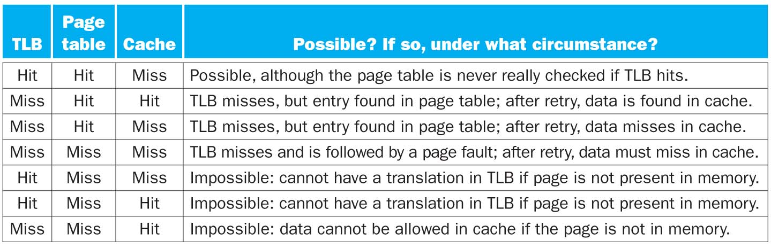
Cache, TLB, and virtual memory

Slide 23
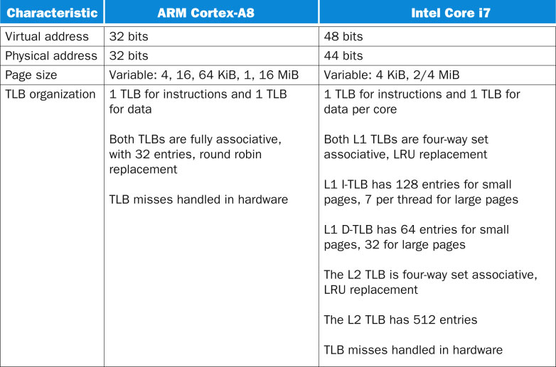
FIGURE 5.43 Address translation and TLB hardware for the ARM Cortex-A8 and Intel Core i7 920. Both processors provide support for large pages, which are used for things like the operating system or mapping a frame buffer. The large-page scheme avoids using a large number of entries to map a single object that is always present.
23
Copyright © 2014 Elsevier Inc. All rights reserved.

Slide 24
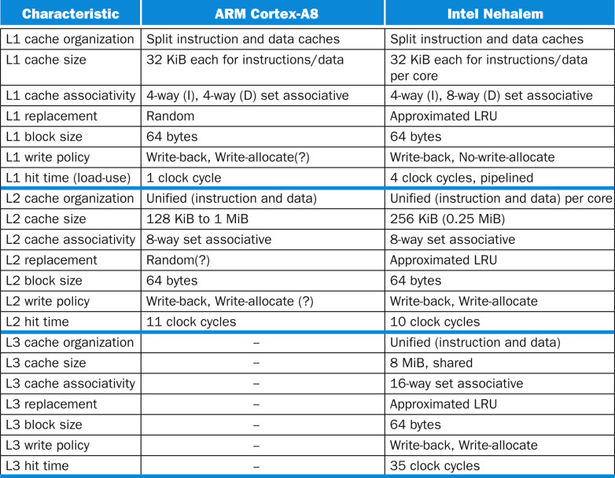
FIGURE 5.44 Caches in the ARM Cortex-A8 and Intel Core i7 920.
24
Copyright © 2014 Elsevier Inc. All rights reserved.

