Slide 1
Chapter 1
Computer Abstractions and Technology

Slide 2
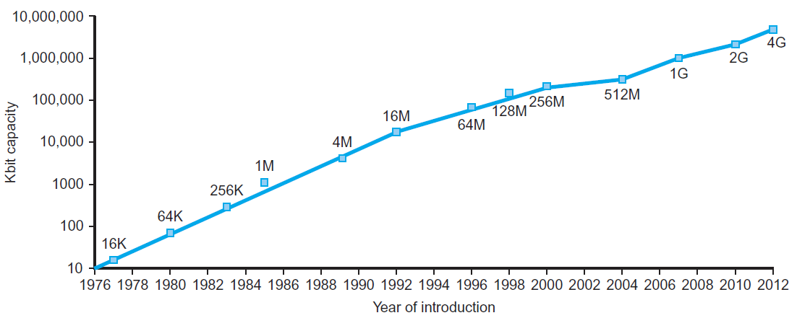
Technology Trends
Electronics technology continues to evolve
Increased capacity and performance
Reduced cost
§1.5 Technologies for Building Processors and Memory
DRAM capacity
Year | Technology | Relative performance/cost
1951 | Vacuum tube | 1
1965 | Transistor | 35
1975 | Integrated circuit (IC) | 900
1995 | Very large scale IC (VLSI) | 2,400,000
2013 | Ultra large scale IC | 250,000,000,000

Slide 3
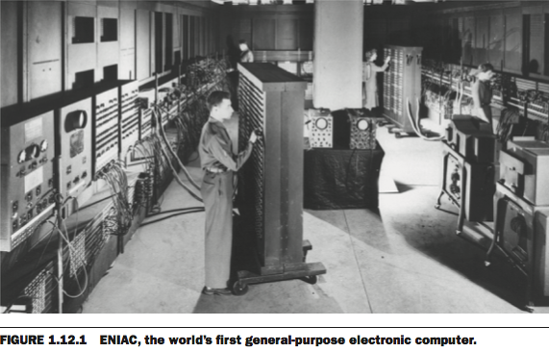
The First Electronic Computers
1946 ENIAC with 18,000 vacuum tubes, in UPenn

Slide 4
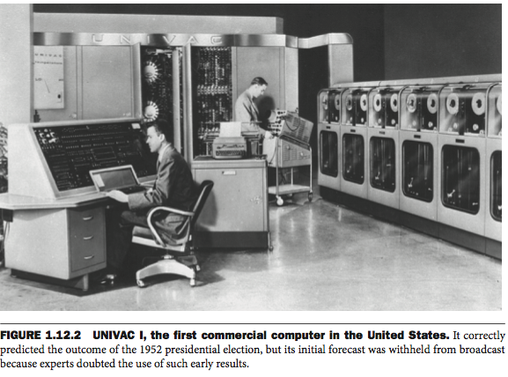
The First Commercial Computer in U.S.
in 1951, UNIVAC is sold for $1M

Slide 5
The Computer Revolution
§1.1 Introduction
Progress in computer technology
Underpinned by Moore’s Law
Makes novel applications feasible
Computers in automobiles
Cell phones
Human genome project
World Wide Web
Search Engines
Computers are pervasive : 4차 산업혁명?

Slide 6
Moore’s law
An observation made by Gordon Moore, co-founder of Intel
“The number of transistors in an IC(Integrated Circuit) doubles every year.” in1965 paper
“The number of transistors in an IC doubles every 18~24 months.” (updated in 1975)

Slide 7
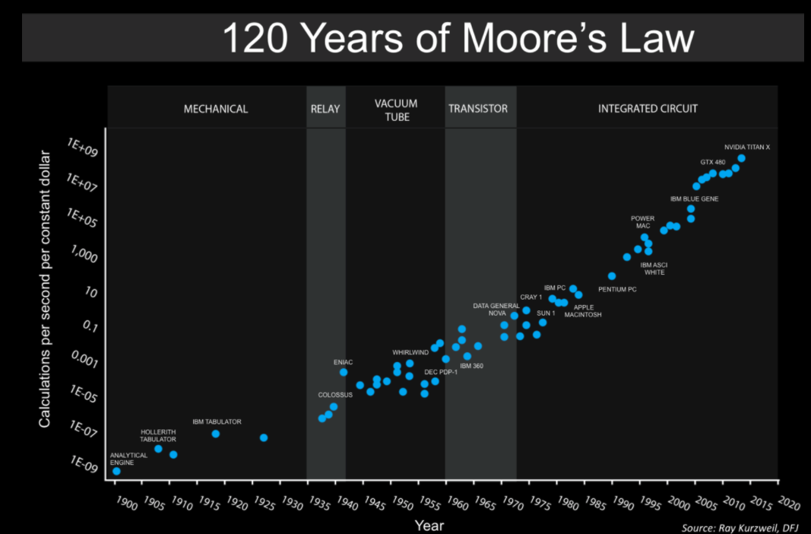
By Steve Jurvetson - https://www.flickr.com/photos/jurvetson/31409423572/, CC BY 2.0, https://commons.wikimedia.org/w/index.php?curid=55002144

Slide 8
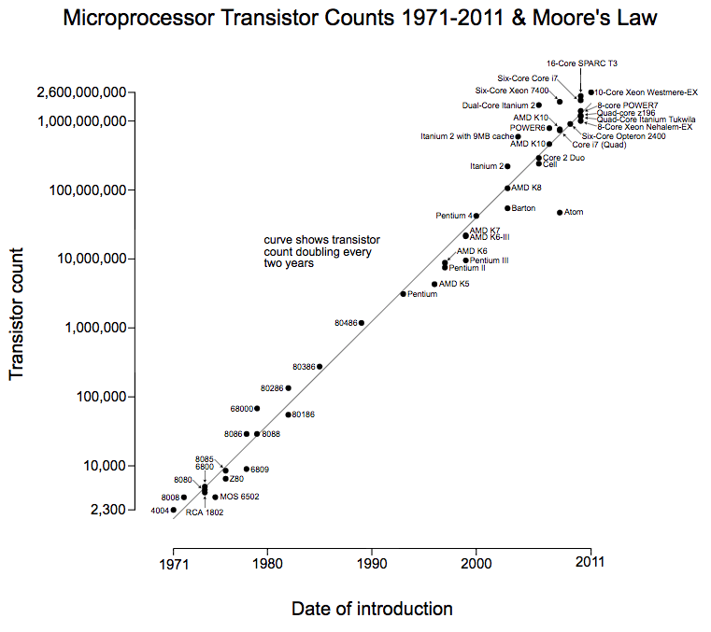
By Wgsimon - Own work, CC BY-SA 3.0, https://commons.wikimedia.org/w/index.php?curid=15193542

Slide 9
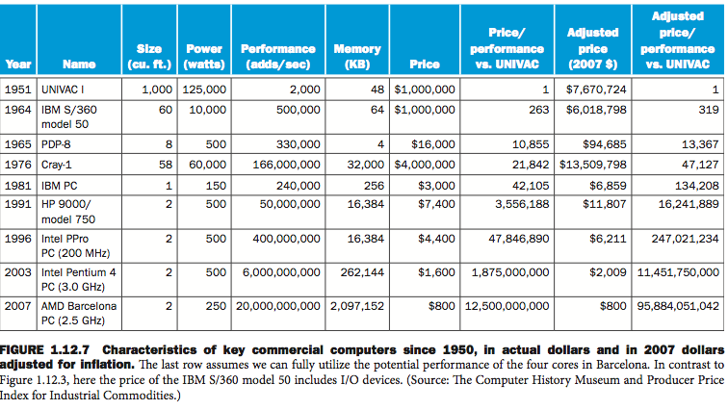

Slide 10
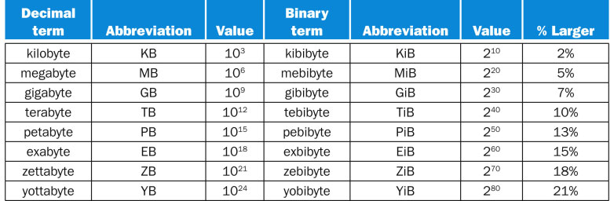
FIGURE 1.1 The 2^{X} vs. 10^{Y} bytes ambiguity was resolved by adding a binary notation for all the common size terms. In the last column we note how much larger the binary term is than its corresponding decimal term, which is compounded as we head down the chart. These prefixes work for bits as well as bytes, so gigabit (Gb) is 10⁹ bits while gibibits (Gib) is 2³⁰ bits.
Copyright © 2014 Elsevier Inc. All rights reserved.

Slide 11
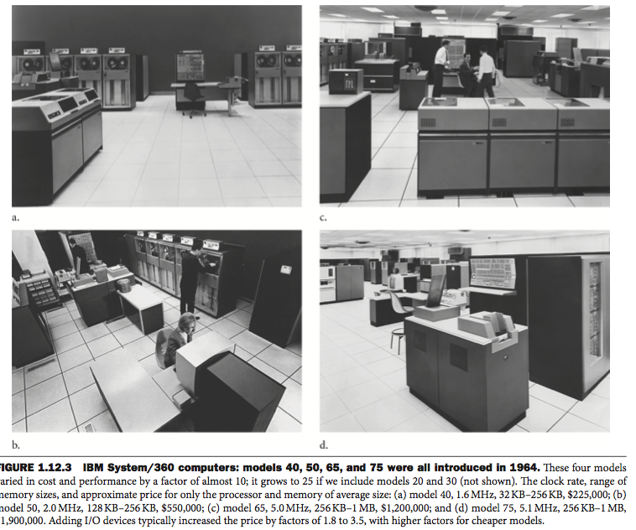

Slide 12
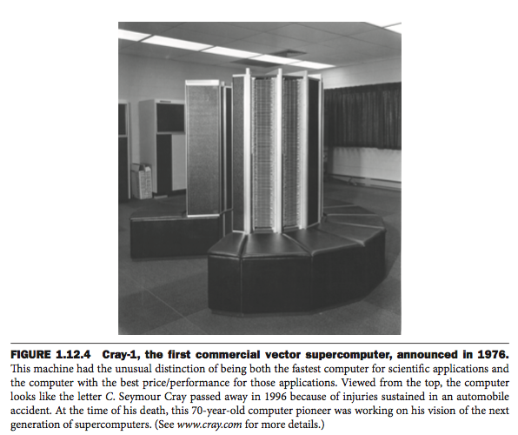

Slide 13
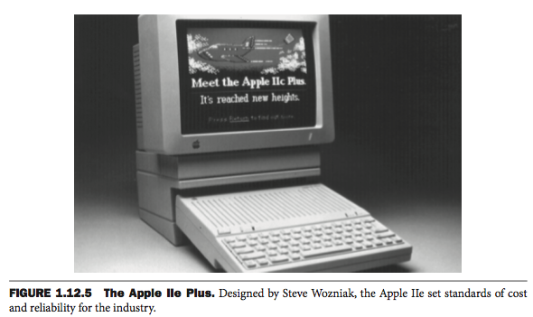

Slide 14
Classes of Computers
Personal computers
General purpose, variety of software
Subject to cost/performance tradeoff
Server computers
Network based
High capacity, performance, reliability
Range from small servers to building sized

Slide 15
Classes of Computers
Supercomputers
High-end scientific and engineering calculations
Highest capability but represent a small fraction of the overall computer market
Embedded computers
Hidden as components of systems
Stringent power/performance/cost constraints

Slide 16
The PostPC Era
Personal Mobile Device (PMD)
Battery operated
Connects to the Internet
Hundreds of dollars
Smart phones, tablets, electronic glasses
Cloud computing
Warehouse Scale Computers (WSC)
Software as a Service (SaaS)
Portion of software run on a PMD and a portion run in the Cloud
Amazon and Google

Slide 17
What is “Computer Architecture”?
Application (ex: browser)
Operating
Computer
Architecture
Compiler
System
Software
Assembler
Instruction Set
Architecture
Hardware
Processor
Memory
I/O system
Datapath & Control
Digital Design
Circuit Design
transistors
Coordination of many
levels (layers) of abstraction

Slide 18
Instruction Set Architecture
A very important abstraction
interface between hardware and low-level software
standardizes set of instructions, their operations and machine language representations.
advantage: different implementations of the same architecture
disadvantage: sometimes prevents using new innovations (Compatibility issue)
RISC (Reduced Instruction Set Computer) vs. CISC (Complex Instruction Set Computer)

Slide 19
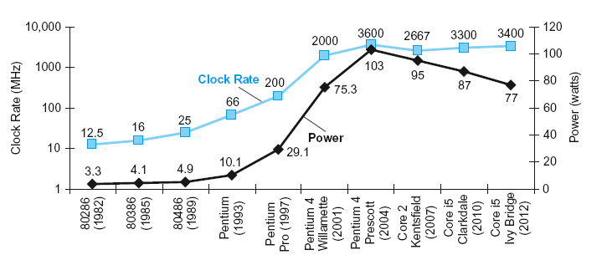
Power Trends
§1.7 The Power Wall
In CMOS IC technology
×30
5V → 1V
×1000

Slide 20
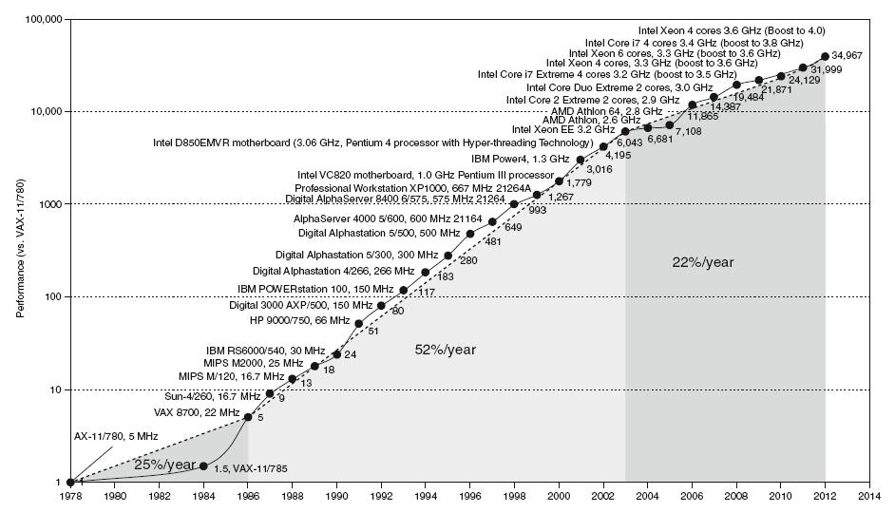
Uniprocessor Performance
§1.8 The Sea Change: The Switch to Multiprocessors
Constrained by power, instruction-level parallelism, memory latency

Slide 21
Multiprocessors
Multicore microprocessors
More than one processor per chip
Requires explicitly parallel programming
Compare with instruction level parallelism
Hardware executes multiple instructions at once
Hidden from the programmer
Hard to do
Programming for performance
Load balancing
Optimizing communication and synchronization

