Slide 1
CREDITGRAPHBENCH · GATE A
Do graphs make credit models better?
A leakage-safe test of graph features, graph neural networks and hybrids on four public credit datasets
4
public credit datasets
26
graph models vs XGBoost
5
seeds, paired bootstrap CIs
One dataset gave a large, clean win. Three gave nothing. This talk is about why.
Notes:
Every few months someone tells a bank that graph neural networks will transform credit risk. Borrowers are connected, so a model that sees the connections should see more. Today I want to test that claim properly. CreditGraphBench takes four public credit datasets, builds graphs over them, and asks whether anything built on those graphs beats a well-tuned XGBoost under a protocol a model-risk team would accept. The short answer, which I will earn over the next twenty minutes: graphs help a lot, but only when the edges are real relationships. When we invent the edges ourselves, they add nothing. Let me take you through how we got there.

Slide 2
What a credit desk actually asks
THE QUESTION
Not “is the AUC higher?” but “does the lift survive a fair test, well enough to justify a pilot?”
Ranking
Calibration
Pre-registered pass mark
Test AUC and PR-AUC on a frozen split, against the same XGBoost on the same rows.
Probabilities recalibrated on validation (isotonic) and checked on test.
A model family counts as lift only if AUC and PR-AUC both beat XGBoost with a 95% CI that excludes zero, on at least two datasets, without losing calibration or stability.
Stability
Business
Population stability index across cohorts. A score that drifts is a score you cannot use.
Approval rate at a fixed bad rate: how many more people can we lend to at the same risk?
We wrote the pass mark down before running anything. That is what makes a negative result worth hearing.
02
Notes:
Before any models, the yardstick. A production credit engine is not judged on a single AUC from a random split. It is judged on four things: ranking, calibration, stability over time, and what the score does to lending decisions. So every model in this benchmark is compared with XGBoost on exactly the same test rows, with a paired bootstrap, over five seeds. And on the right is the rule we committed to before running anything: lift has to show up in both AUC and PR-AUC, with a confidence interval that excludes zero, on at least two of the four datasets. One lucky dataset is not enough to take to a bank. Keep that rule in mind, because it decides the verdict at the end.

Slide 3
Five tiers, from a SQL query to a neural network
THE LADDER
Each tier asks more of the graph, and more of the serving stack that has to run it.
Needs at scoring time
Notebook
0
Tabular
Logistic regression, XGBoost, MLP
No graph
02
1
Graph features → XGBoost
Degree, neighbour default rate, neighbour means
Precomputed lookups
04
2
Graph neural network
GraphSAGE, GAT, RGCN
Graph at inference
05
3
Hybrid
GNN embedding appended to XGBoost features
Cached embeddings
06
4
Distilled student
XGBoost trained on a graph teacher's soft labels
Tabular only
07
Today: notebook 03 builds the graphs, then 04, 05 and 06 try three ways to use them.
03
Notes:
Here is the ladder of models. Tier zero is the baseline everything is measured against: tabular models, with XGBoost as the reference. Tier one is the cheapest way to use a graph: compute neighbourhood statistics, the kind of thing a bank can do with a database join, and hand them to the same XGBoost. Tier two is a real graph neural network, which needs the graph at scoring time. Tier three is the hybrid: take the GNN's internal embedding and feed it to XGBoost. That is the shape most banks would actually deploy, because the decision engine stays a tree model they already know how to govern. Tier four, distillation, is in the benchmark but not in this talk. Today is the highlighted middle: how we build the graphs, then tiers one, two and three.

Slide 4
Four datasets, one real graph
03 · BUILD THE GRAPH
Only DGraph-Fin arrives with borrower-to-borrower edges. For the other three, we decide what an edge is.
OBSERVED
INVENTED BY US
DGraph-Fin
Home Credit
Lending Club
Taiwan
1.2M
307K
1.35M
30K
labelled users
loans
loans
card holders
Real contact graph
Own credit records
Invented edges
Invented edges
3.7M people, 4.3M emergency-contact links they listed themselves
Each customer linked to their own bureau history. No customer touches another
Same zip or employer, and nearest neighbours. Tested on 2017–18 loans
Nearest neighbours only. No real structure exists
Whether the edges are observed or invented turns out to be the variable that matters.
DGraph-Fin: Huang et al., NeurIPS 2022 Datasets & Benchmarks · Home Credit and Lending Club via Kaggle · Taiwan via UCI
04
Notes:
Four datasets, chosen to span the range, and I have grouped them by the one thing that ends up mattering. On the left, observed structure. DGraph-Fin is the only dataset that arrives with a real graph: Finvolution's users and the emergency contacts they listed, almost four million people. Home Credit has real relational data, each customer's own credit bureau history and past applications, but those links never connect two customers. On the right, Lending Club and Taiwan have no graph at all, so we invent one, from shared zip code and employer, or from nearest neighbours. Lending Club is also tested out of time, on 2017 and 2018 loans, the way a bank deploys. Keep the colours in mind: green observed, gold invented. Every chart uses them.

Slide 5
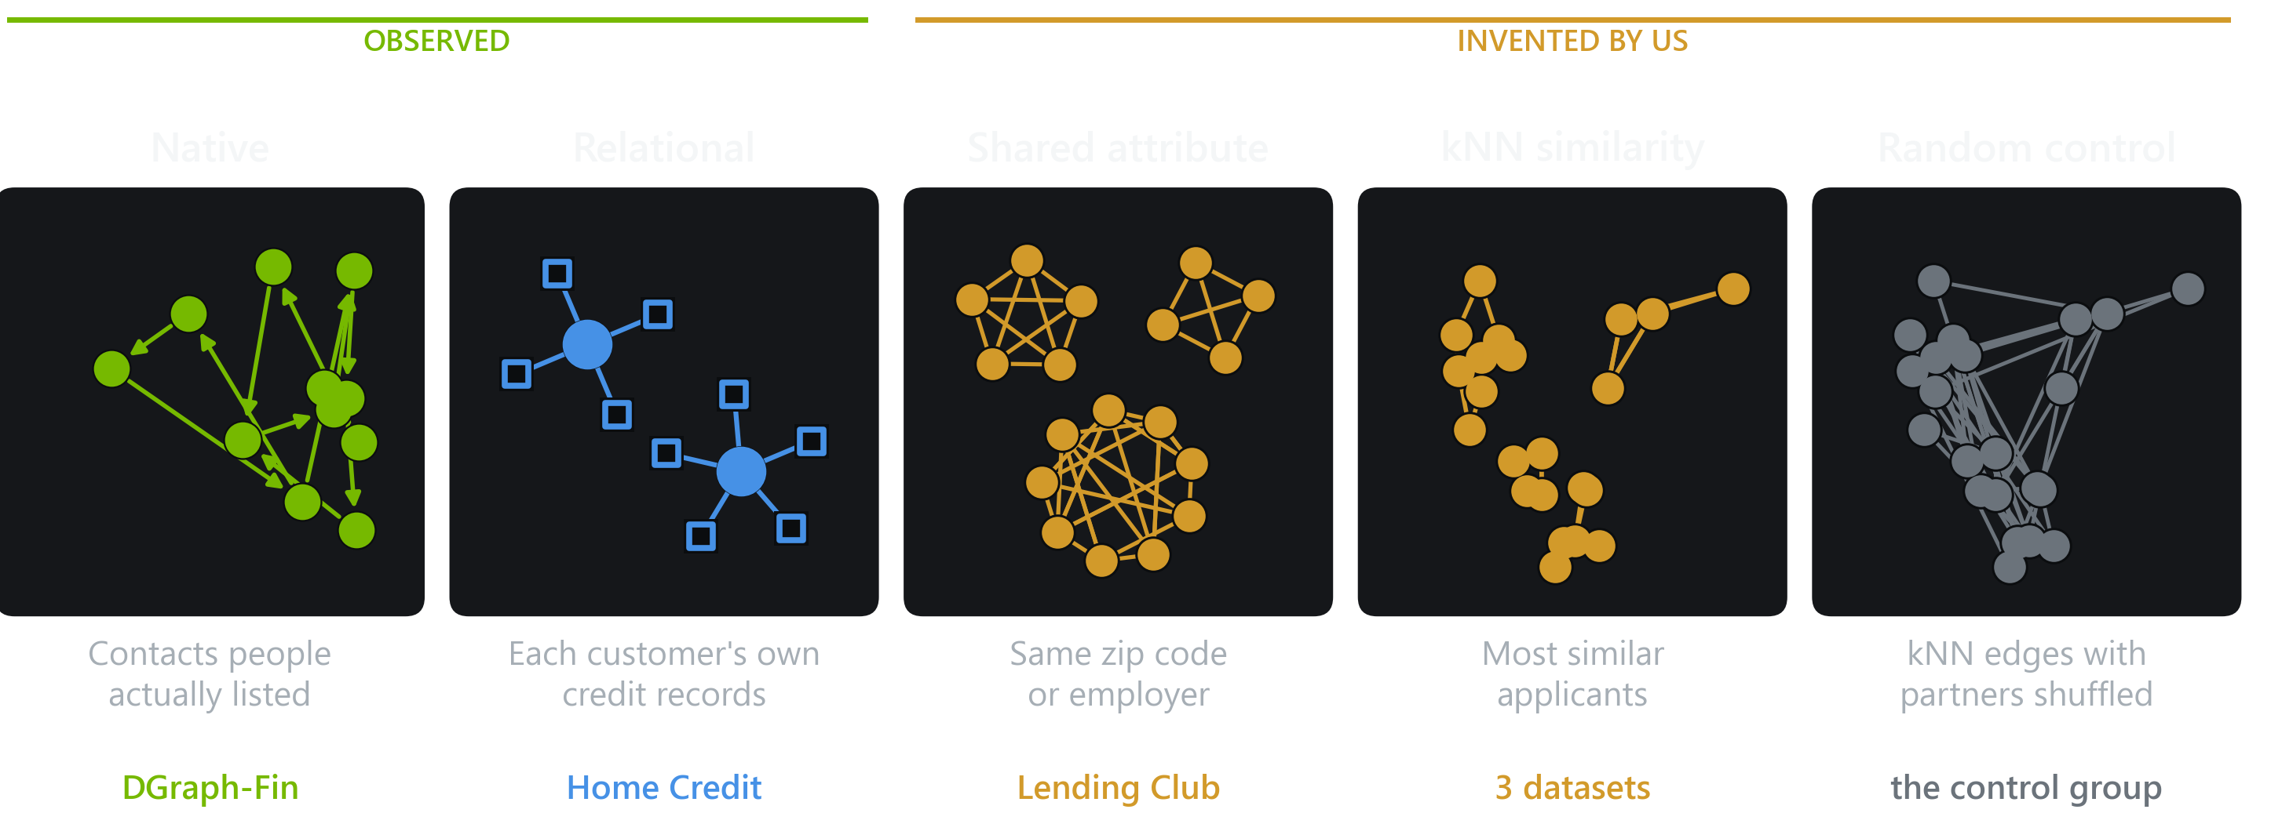
Five ways to give a credit model a graph
03 · BUILD THE GRAPH
Panels three to five are drawn by running the repository's own graph builders on toy data.
The fifth builder is not a model input. It is the experiment's control group.
05
Notes:
These are the five builders in notebook 03. The first two use structure that exists in the data: real contacts on DGraph-Fin, and each customer's own records on Home Credit. The next three are invented by us. Shared attribute links applicants in the same zip code or with the same employer. kNN links each applicant to the applicants most similar to them. And the last one is the most important for the science: take the kNN graph and shuffle who every edge points to. Same number of links per person, but now they mean nothing. If a graph model cannot beat that shuffled graph, it has not learned anything from structure.

Slide 6
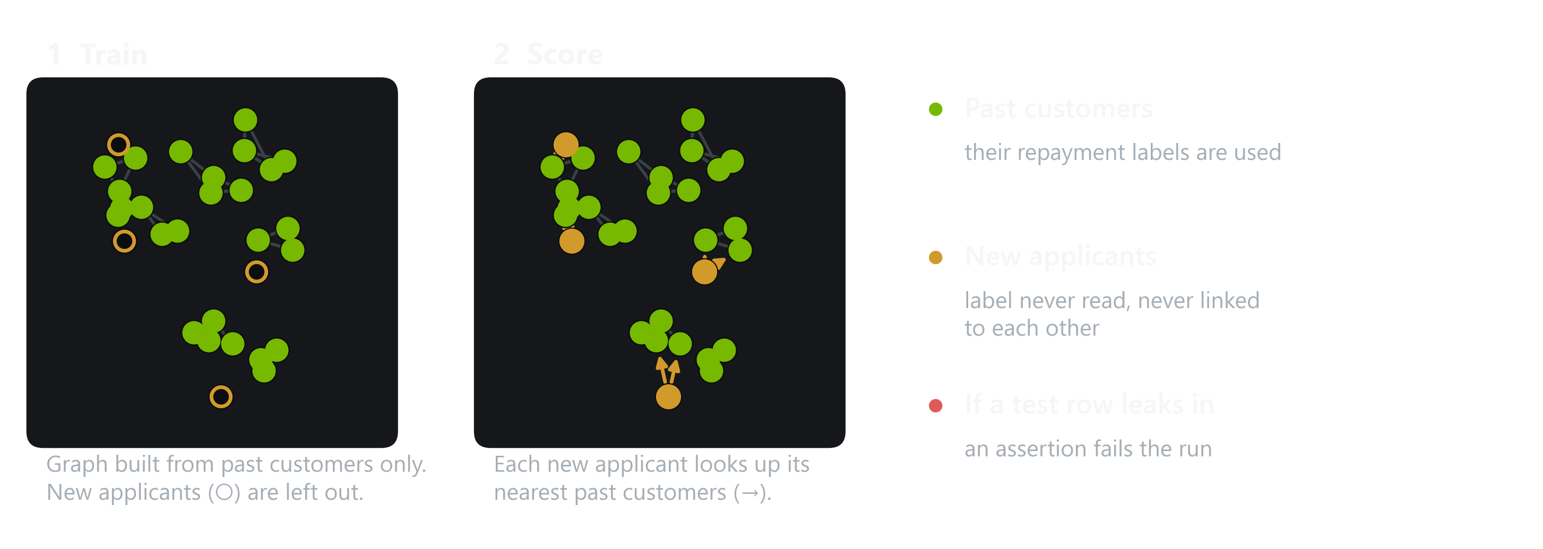
The clean-room rule
03 · BUILD THE GRAPH
A graph can smuggle test answers into training. So new applicants only join the graph at scoring time.
A new applicant is treated exactly as a bank would treat one: looked up, never trained on.
06
Notes:
This is the slide I would defend hardest in a model-risk review. Graphs leak in ways tabular models do not: if a test applicant sits in the graph during training, message passing can carry its outcome into its neighbours. So, step one on the left: the graph is built from past customers only, and the new applicants, the gold rings, are simply not in it. Step two on the right: at scoring time each new applicant looks up its nearest past customers, the arrows. That is exactly what a bank does with a real new application. New applicants never link to each other, their labels are never read, and if a single training edge ever touches a test row, an assertion fails the run.

Slide 7
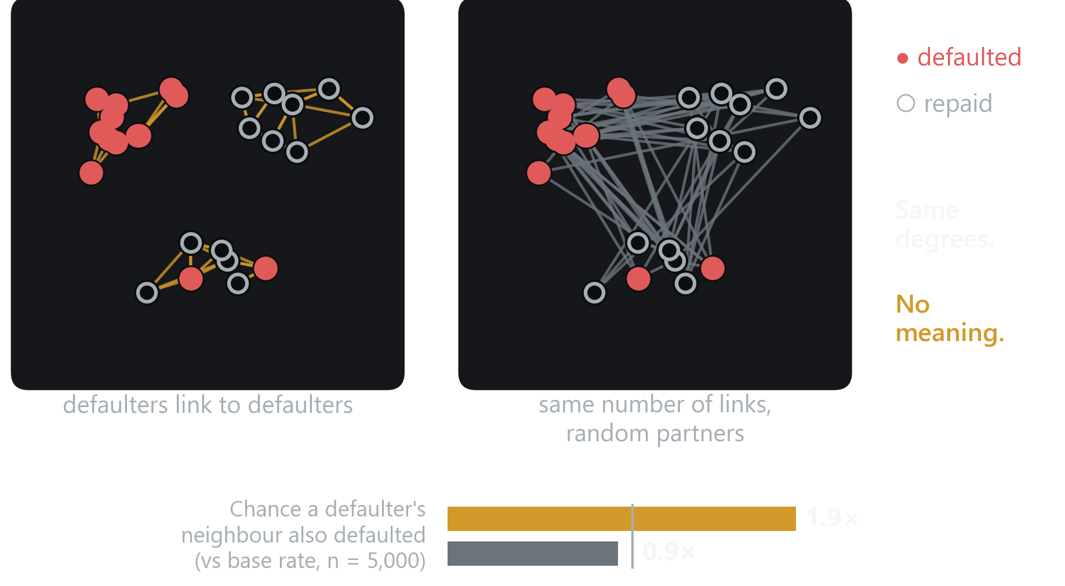
Keep the wiring, destroy the meaning
03 · BUILD THE GRAPH
The random control shuffles every edge's partner. If a model does as well on that, structure was never the reason.
What it keeps
Every applicant keeps the same number of links. Same graph size, same density.
What it destroys
Who is linked to whom. Defaulters stop clustering: 1.9× the base rate falls to 0.9×.
One honest caveat
Models read links both ways. Shuffling breaks mutual pairs, so the control is about a third denser.
Every kNN result in this talk is reported next to its shuffled twin.
Illustration on synthetic data built with the repository's KnnIndex and rewire(). Not a benchmark result.
07
Notes:
Why a random control? Because a graph model can improve a score for reasons that have nothing to do with relationships, for example just by averaging over neighbours, which smooths out noise. Look at the left graph: red dots are defaulters, and in a similarity graph they link to each other. On the right, the same graph with every partner shuffled. Same number of links per person, but the red dots no longer cluster. The bar at the bottom puts a number on it: in the kNN graph a defaulter's neighbour is almost twice as likely to default as average. After shuffling, it is chance. One caveat I want to be upfront about: the models read links in both directions, and shuffling breaks mutual pairs, so the control graph ends up about a third denser. It does not change any conclusion.

Slide 8
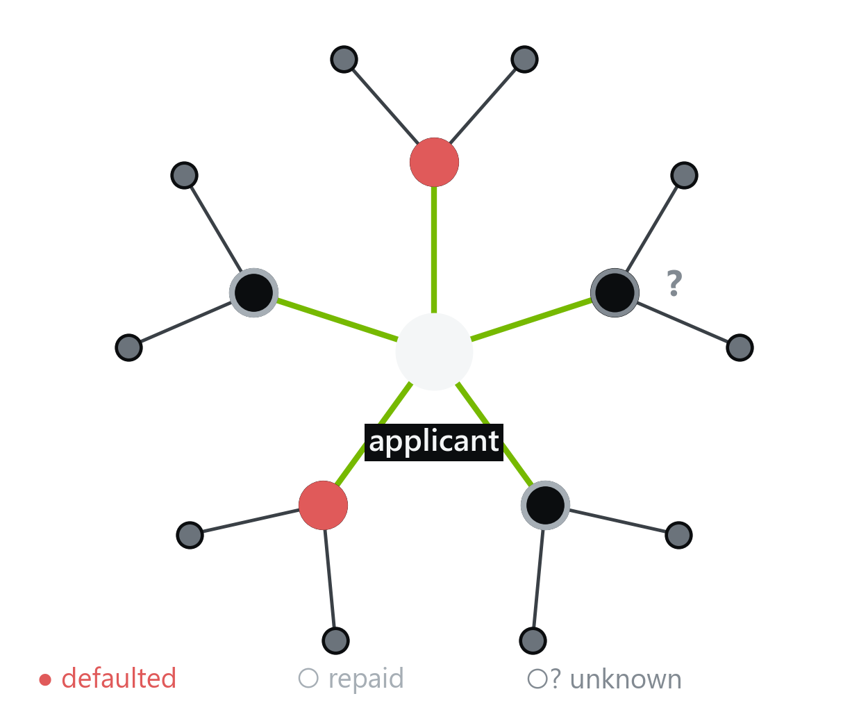
Graph features a bank can compute in SQL
04 · TIER 1 · GRAPH FEATURES
Summarise each applicant's contacts into a few extra columns, then train the same XGBoost.
Neighbour default rate
2 of 4 known contacts defaulted → 50%
Degree
5 contacts listed
Contact-type counts
how many of each of 12 relationship types
Two-hop reach
how many people the contacts know
Applicant vs contacts
own income minus the contacts' average, and so on
The unknown contact (?) is ignored: default rates only ever use outcomes from the training period.
08
Notes:
Tier one is the version of 'use the graph' a bank could ship next quarter. Take this applicant. They listed five contacts. Two of them defaulted, two repaid, and one is new, so we do not know yet. The strongest feature is the first one on the right: of the contacts whose outcome we know, what fraction defaulted. Here, two of four, fifty percent. The unknown contact is ignored, because we only ever use outcomes from the training period. Then simpler things: how many contacts, what kinds, how far the network reaches, and how the applicant differs from the people around them. Every one of these is a join and a group-by in SQL. We add them as columns and retrain the exact same XGBoost.

Slide 9
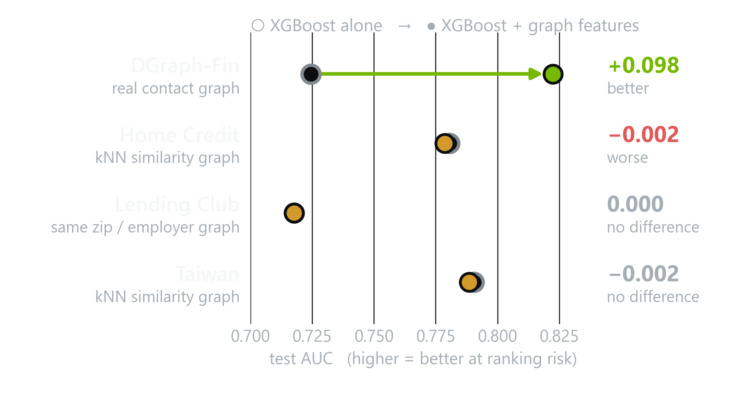
Real edges: a large win. Invented edges: nothing
04 · TIER 1 · GRAPH FEATURES
Each row: XGBoost alone, then the same XGBoost with graph features added. Same test rows, five seeds.
Real contacts
AUC 0.725 → 0.822 on DGraph-Fin. Significant on all five seeds, the largest gain in the study.
Invented edges
On the other three datasets the dots sit on top of each other: within 0.002 of XGBoost.
The control agrees
kNN features never beat the same features computed on the shuffled graph.
Hand-built graph features add almost ten AUC points, but only where the relationships are real.
09
Notes:
Here is how to read this chart, because the same chart comes back twice more. Each row is a dataset. The grey ring is XGBoost on its own. The coloured dot is the same XGBoost after we add graph features. The arrow shows the change. On DGraph-Fin, with real contacts, the arrow is long: AUC goes from 0.725 to 0.822, almost ten points, and it is significant on every seed. On the other three datasets there is no arrow at all. The dots sit on top of each other, within two thousandths of an AUC point. And when we compute the same features on the shuffled control graph, they do just as well as kNN, which tells us the kNN graph was carrying no real signal.

Slide 10
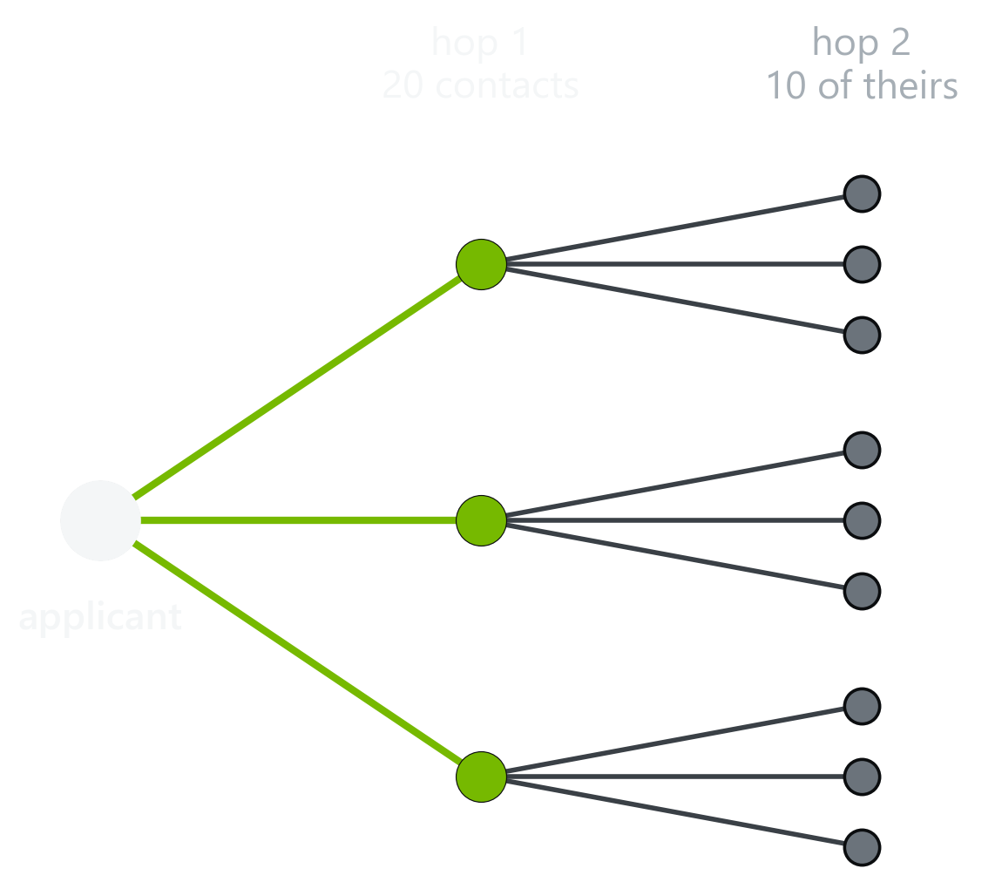
A GNN on 3.7 million people
05 · TIER 2 · GRAPH NEURAL NETWORKS
Each layer reaches one hop further. After two, an applicant has seen its contacts' contacts.
Applicant + sampled contacts
Scale
Sample 20 contacts, then 10 of theirs, so memory stays flat on the full graph.
GraphSAGE layer 1 · 128
Imbalance
About 1.3% defaulters. Weighted loss, early stopping on validation AUC.
GraphSAGE layer 2 · 64 = embedding
Reused later
Probability of default
The 64-number embedding is saved per applicant and fed to the hybrid.
The embedding is a 64-number summary of everything within two hops of the applicant.
10
Notes:
Tier two is a real graph neural network. On the left is how one applicant is processed: we sample twenty of their contacts, then ten contacts of each of those, so a training batch never needs the whole 3.7 million person graph in memory. In the middle are the layers. Two GraphSAGE layers, each averaging information from neighbours, produce a 64-number summary of the applicant's neighbourhood, and a final layer turns that into a probability of default. Defaulters are about one percent, so the loss is weighted. And that 64-number embedding is saved for every applicant, because Tier three reuses it.

Slide 11
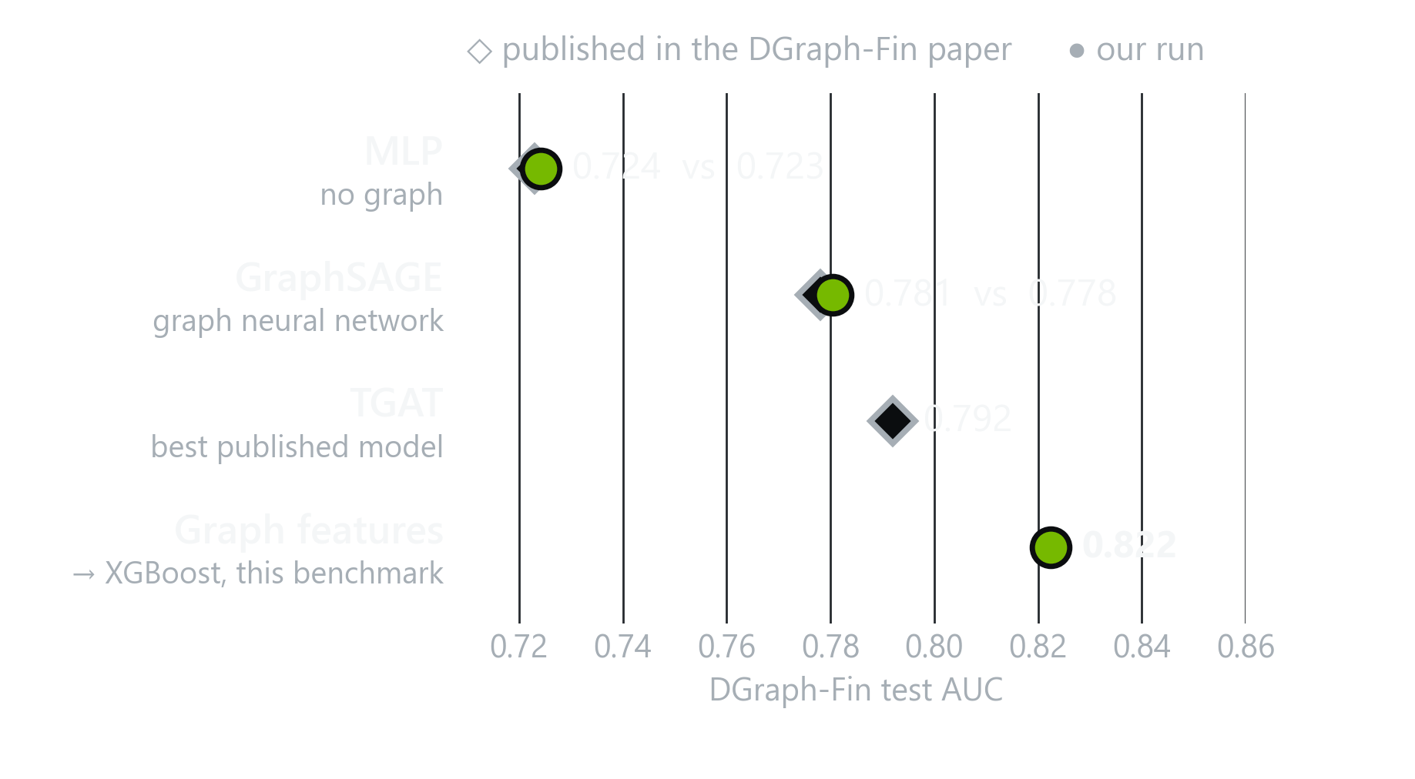
First, prove the harness is honest
05 · TIER 2 · GRAPH NEURAL NETWORKS
Before showing GNNs losing, we reproduced the published DGraph-Fin results on the official split.
Reproduced
Our MLP and GraphSAGE land within 0.003 AUC of the paper. The pre-registered check passes.
Then beaten
Plain graph features into XGBoost score 0.822, above the best published model, TGAT, at 0.792.
Why it matters
When the GNNs lose on other datasets, it is not because the training code is broken.
A benchmark that cannot reproduce the paper cannot be trusted to contradict it.
11
Notes:
Before I show you GNNs losing, you need to trust that they were trained properly. DGraph-Fin has published results, so we reproduced them. The diamonds are the paper's numbers, the green dots are ours. The MLP: 0.723 published, 0.724 ours. GraphSAGE: 0.778 published, 0.781 ours. The dots sit right on the diamonds. Then the surprise at the bottom: the simple graph features from Tier one score 0.822, above the best model in the paper, the temporal TGAT at 0.792. We did not re-run TGAT ourselves, so I hold that comparison loosely, but the ordering is striking.

Slide 12
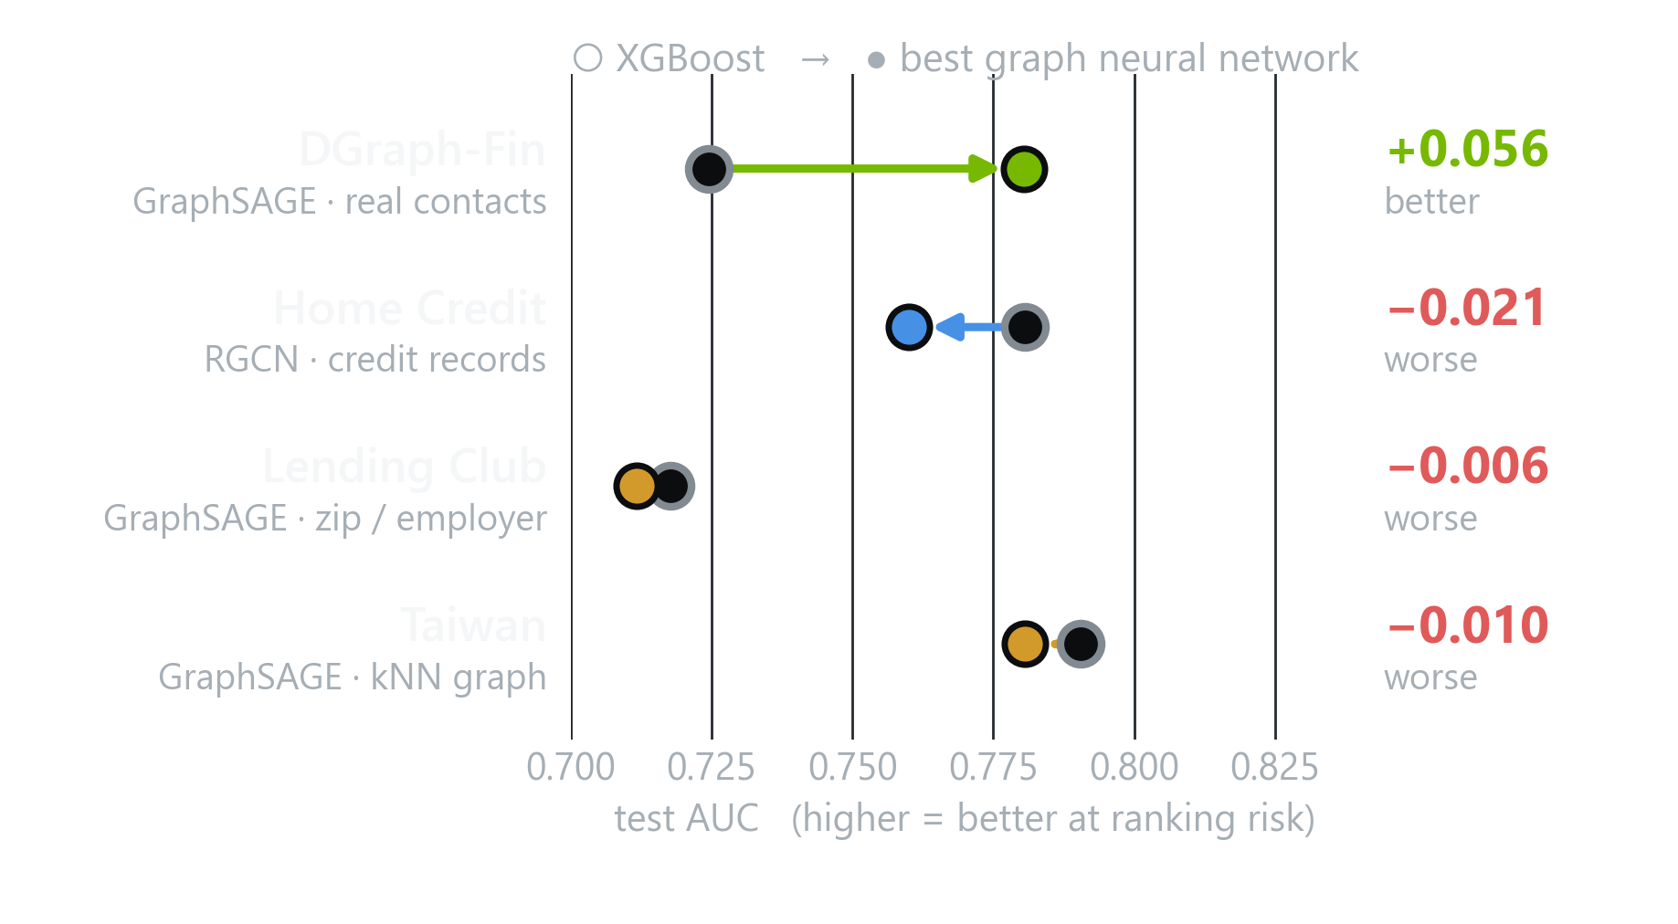
GNNs win on real edges and lose everywhere else
05 · TIER 2 · GRAPH NEURAL NETWORKS
Same chart as before: XGBoost, then the best graph neural network for each dataset.
Real contacts
GraphSAGE adds 0.056 AUC on DGraph-Fin. Better on every seed.
Real records
On Home Credit the RGCN loses 0.021. XGBoost already sees that history through engineered columns.
Invented edges
Even the best GNN loses on Lending Club and Taiwan. The arrows point backwards.
Every result here is significant: reliably better on real edges, reliably worse on everything else.
12
Notes:
Same chart as two slides ago, now with the best graph neural network for each dataset. On DGraph-Fin the arrow points forward: GraphSAGE adds 5.6 AUC points over XGBoost. On every other dataset, the arrow points backwards. Home Credit is instructive: the relational data is real, but XGBoost already gets that history through engineered bureau aggregates, and the RGCN does worse than those columns. On Lending Club and Taiwan, even the best GNN on our invented graphs is worse than XGBoost. And these are not noise: every one of these differences is statistically significant.

Slide 13
Two ways to put a graph into XGBoost
06 · TIER 3 · THE HYBRID
In both, the decision engine stays a gradient-boosted tree. What differs is who builds the graph columns.
TIER 1 · NOTEBOOK 04
+0.098
Graph
SQL aggregates
+ tabular
XGBoost
who knows whom
degree, neighbour default rate, ...
same as Tier 0
Tier 0 recipe
AUC on DGraph-Fin · +13 pts approvals
No neural network. Scoring needs only a neighbour lookup.
TIER 3 · NOTEBOOK 06
+0.061
Graph
GNN
Embedding
+ tabular
XGBoost
who knows whom
trained, then frozen
64 numbers per applicant
same as Tier 0
Tier 0 recipe
AUC on DGraph-Fin · +11 pts approvals
The graph is needed only to refresh embeddings, in batch.
The hybrid is the commercial candidate: the graph enters as a feature block, the governance stays the same.
13
Notes:
Tier three is the shape a bank would actually deploy. You keep XGBoost as the decision engine, the model your validators, reason codes and monitoring already understand. The graph enters as a block of columns. In Tier one, the top lane, those columns are hand-built SQL aggregates. In Tier three, the bottom lane, they are the 64-number embedding from the GNN, cached per applicant and refreshed in batch. On DGraph-Fin the top lane gives plus 0.098 AUC. The bottom lane, with a neural network in it, gives plus 0.061. Let me put every DGraph-Fin model side by side.

Slide 14
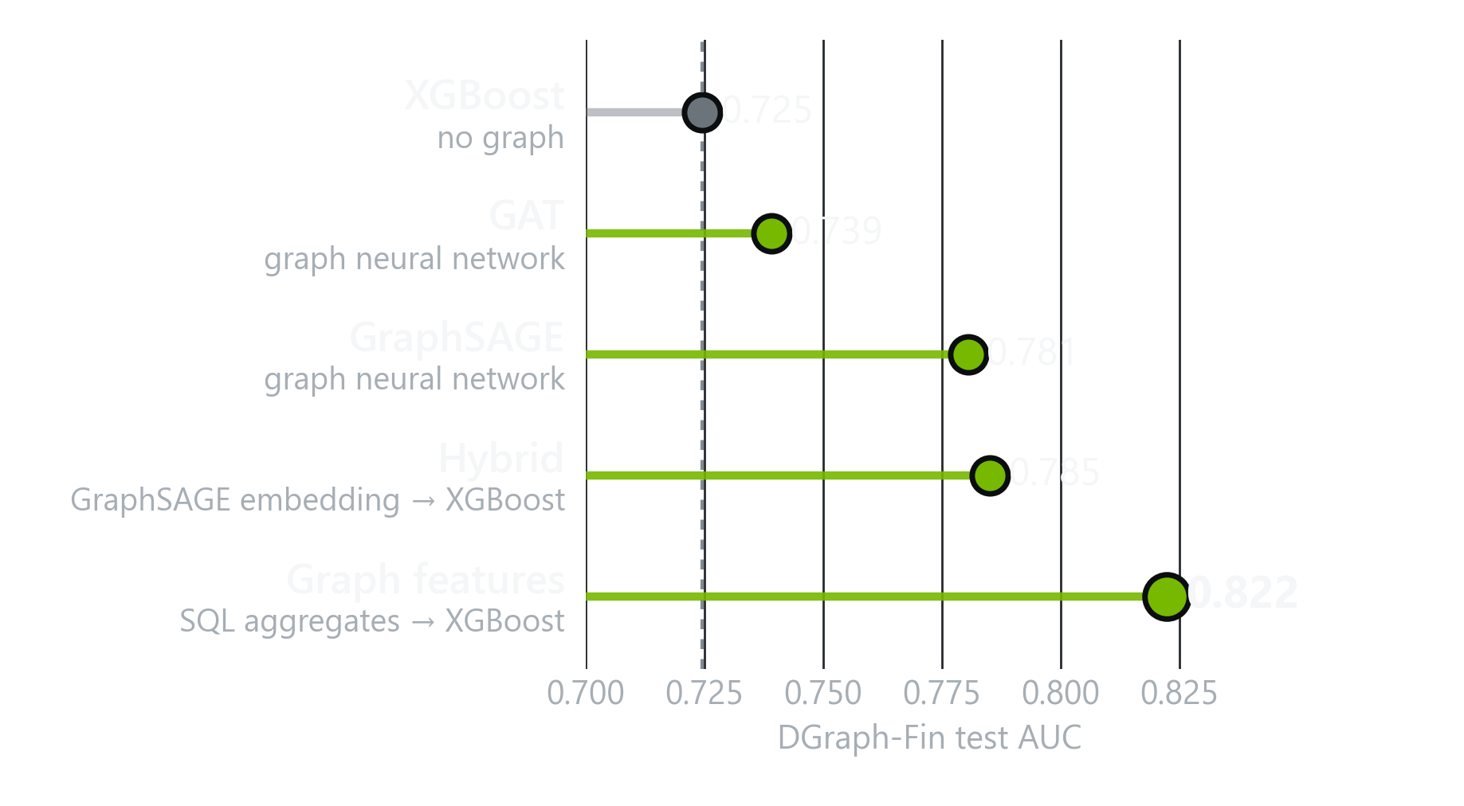
The hybrid helps, but SQL features go further
06 · TIER 3 · THE HYBRID
Every model on DGraph-Fin, the one dataset with real edges. Test AUC, mean of five seeds.
The hybrid helps the GNN
Feeding the embedding to XGBoost lifts GAT 0.739 → 0.773 and GraphSAGE 0.781 → 0.785.
SQL features go further
0.822 with no neural network anywhere, and nothing new to serve.
Elsewhere
On the other three datasets the hybrid never gets above XGBoost.
Does the lift need a neural network? On this evidence, no.
14
Notes:
Here is every model on DGraph-Fin, the one dataset where graphs work, ordered from worst to best. The dashed line is XGBoost at 0.725. The graph neural networks help: GAT to 0.739, GraphSAGE to 0.781, and the hybrid, which feeds the GraphSAGE embedding into XGBoost, edges up to 0.785. But the winner, by a clear margin, is the bottom row: plain graph features, the SQL aggregates from Tier one, at 0.822. No neural network, nothing new to serve. So the honest answer to 'does the lift need a neural network?' is no. Most of the value is in a handful of neighbourhood statistics, above all the neighbour default rate.

Slide 15
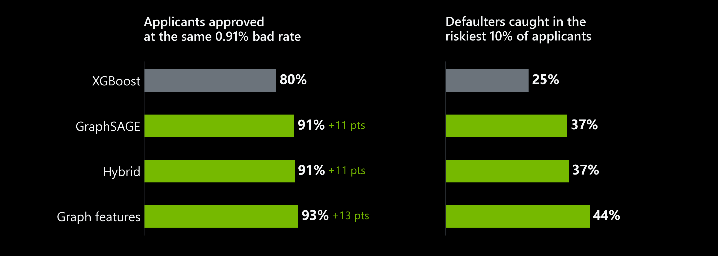
What the lift is worth at the credit desk
06 · TIER 3 · THE HYBRID
Hold XGBoost's 0.91% bad rate fixed and ask: how many applicants can each model approve?
13 more applicants in every 100 approved, at the same risk, from features you can compute in SQL.
Stage 08, DGraph-Fin test split, mean of 5 seeds. Labels are a public repayment proxy, not a calibrated PD for a real portfolio.
15
Notes:
AUC is not a business case, so here is the translation a credit officer cares about. XGBoost approving 80 percent of applicants gives a bad rate of 0.91 percent. Hold that bad rate fixed, and ask each model how many people it could approve. Graph features approve 93 percent: thirteen more people in every hundred, at exactly the same risk. On the right, the collections view: the riskiest ten percent of applicants now contains 44 percent of all defaulters, up from 25. Calibration and stability held too: after recalibration every model is well calibrated, and the population stability index stays below 0.02. The footnote matters: these are public proxy labels, so this is the argument for a pilot, not a production PD.

Slide 16
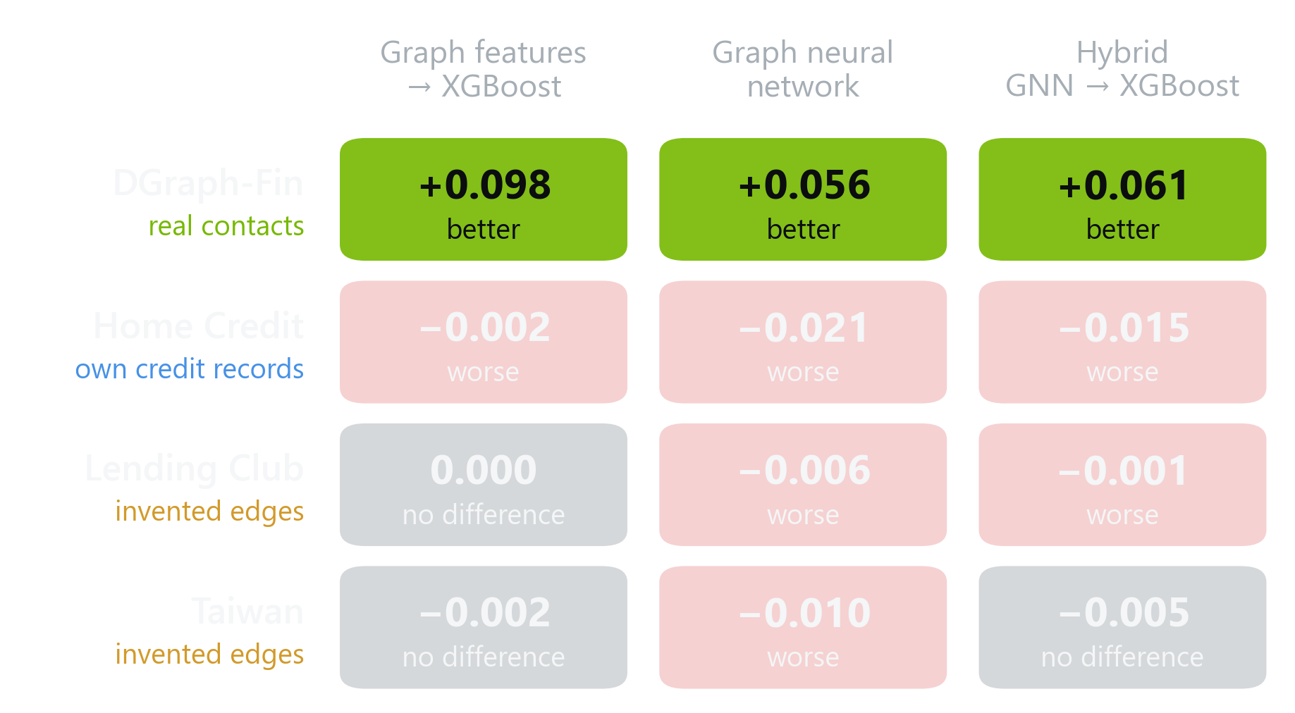
Graphs only help where the edges are real
THE WHOLE PICTURE
The best model of each kind, minus XGBoost, on each dataset.
3 / 3
families beat XGBoost on real contacts
0 / 9
beat it anywhere else
1 of 4
datasets show lift; the pass mark was 2
The signal is in relationships you observe, not relationships you infer.
16
Notes:
Here is the whole study on one slide. Rows are datasets, columns are the three ways of using a graph, and each cell is the best model of that kind minus XGBoost. The top row is green across the board: on real contacts, every approach beats XGBoost. Every other cell is either no difference or worse. Nine out of nine. So back to the rule we wrote down at the start: lift on at least two datasets. We have it on one. By our own pass mark, all three graph approaches fail Gate A. I think that is the most useful thing this benchmark produced: a clear map of where graphs are worth the engineering, and where they are not.

Slide 17
Four rules before you build a credit GNN
WHAT WE WOULD TELL A BANK
1
Find the real edges first
2
Start with SQL features
Contacts, guarantors, shared devices, payment flows. Observed relationships carried all of the lift here.
Neighbour default rate and degree beat every GNN: +0.098 AUC against +0.061, with nothing new to serve.
3
Always run a random control
4
Build graphs in a clean room
kNN graphs never beat their shuffled twins. Without the control, smoothing looks like structure.
Test rows attach by lookup, labels come from training only, and an assertion enforces it.
Gate A verdict: pilot graph features only where real relationship data exists, and start with Tier 1.
17
Notes:
If you take four things away, take these. One: before anyone builds a GNN, find out whether you have real relationship data: emergency contacts, guarantors, shared devices, payment flows. That is where all the lift came from. Two: start with features you can compute in SQL. They beat every neural network we trained, and they add nothing new to the serving path. Three: always run a random control. Without it, the smoothing a GNN does looks exactly like learned structure. Four: build graphs in a clean room, because graphs leak in ways that will not show up until production. So the verdict for Gate A: no general case for graph models in credit, but a strong, specific case for graph features wherever real relationships exist. Thank you, I am happy to take questions.

