Slide 1

Better ask ERNI
1
The Lifecycle of Butterflies
An exploration of the transformative journey of butterflies.

Slide 2
Better ask ERNI
2
Agenda
This presentation will cover the four main stages of a butterfly's lifecycle: Egg, Larva, Pupa, and Adult. We will explore each stage in detail to understand the transformation process.

Slide 3
The beginning of a butterfly's life.
Stage 1: Egg

Slide 4

Better ask ERNI
4
Egg Stage
Butterfly eggs are laid on the leaves of host plants. These eggs are tiny, often resembling small dots. The duration of this stage varies, but it typically lasts a few days to a week. During this time, the embryo develops inside the egg, preparing for the next stage.

Slide 5
The growth phase of the caterpillar.
Stage 2: Larva (Caterpillar)

Slide 6

Better ask ERNI
6
Larva Growth
Once hatched, the caterpillar begins its life by consuming the eggshell. It then starts feeding on leaves, growing rapidly. This stage is characterized by several molts, as the caterpillar sheds its skin to accommodate its increasing size.

Slide 7
The transformation phase.
Stage 3: Pupa (Chrysalis)

Slide 8
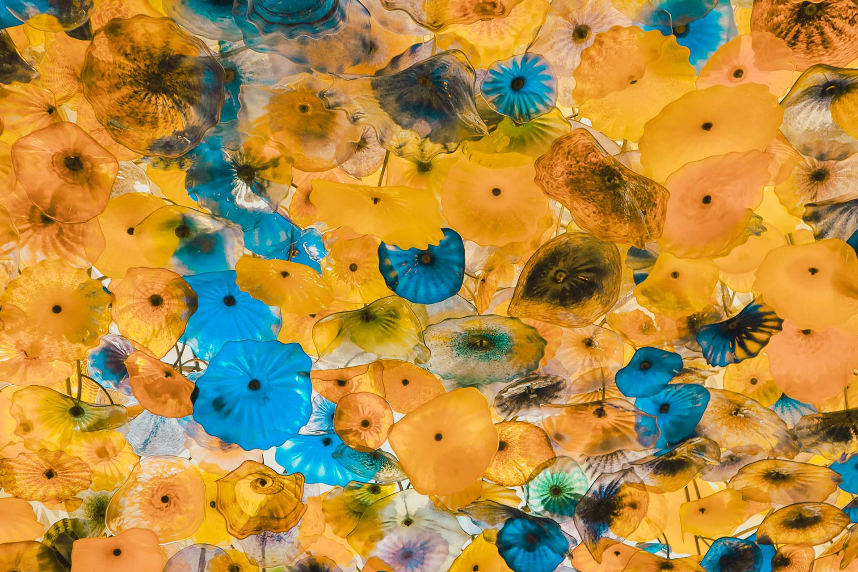
Better ask ERNI
8
Metamorphosis
During the pupal stage, the caterpillar forms a protective casing around itself, known as a chrysalis. Inside, it undergoes a remarkable transformation called metamorphosis, where its body structure is reorganized to emerge as an adult butterfly.

Slide 9
The final, beautiful stage of the lifecycle.
Stage 4: Adult Butterfly

Slide 10
Conclusion
Understanding the lifecycle of butterflies provides insight into the complexity and beauty of nature. Each stage plays a crucial role in the development of the butterfly, showcasing the wonders of biological transformation.

