Slide 1
NTRS
Neural Thickets × Randomized Smoothing
Certified Geometry of the LLM Post-Training Weight Space
H1 Universal Adaptation Scale
H2 Forgetting Budget
H3 Model Merging
Kina Kim | SFU | June 2026

Slide 2
Post-training has no formal guarantees
→ LoRA, RLHF, and SFT adapt LLMs — but none answer: how far can we move θ before quality degrades?
→ Practitioners tune learning rate by trial and error; there is no principled safe budget
→ Sequential fine-tuning causes catastrophic forgetting — but when, and by how much?
→ Model merging works empirically but has no geometric sufficient condition for success
What a certificate would buy
→ Predict a safe LR and step count before running any fine-tuning
→ Know when sequential FT will cause forgetting — without running it
→ Certify that a model merge will succeed — from geometry alone

Slide 3
We bring Randomized Smoothing into weight space
Cohen et al. (2019) — original RS
NTRS — weight-space RS (this work)
→ Perturb the INPUT x with Gaussian noise
→ Certify robustness to adversarial input changes
→ Radius in input space: r* = σ · Φ⁻¹(p_A)
→ Perturb the WEIGHTS θ with Gaussian noise
→ Certify robustness to post-training weight changes
→ Same Binomial CI machinery — new domain, new meaning
C(θ, σ) = P_{ε ~ N(0, σ²I)}[ s(θ + ε) ≥ m ]
s(θ) = quality score (e.g. neg. WikiText-2 NLL) m = quality threshold
→ C → 1.0: model survives ALL perturbations of scale σ (deep inside the basin)
→ C → 0.0: model is at the edge — small noise degrades quality

Slide 4
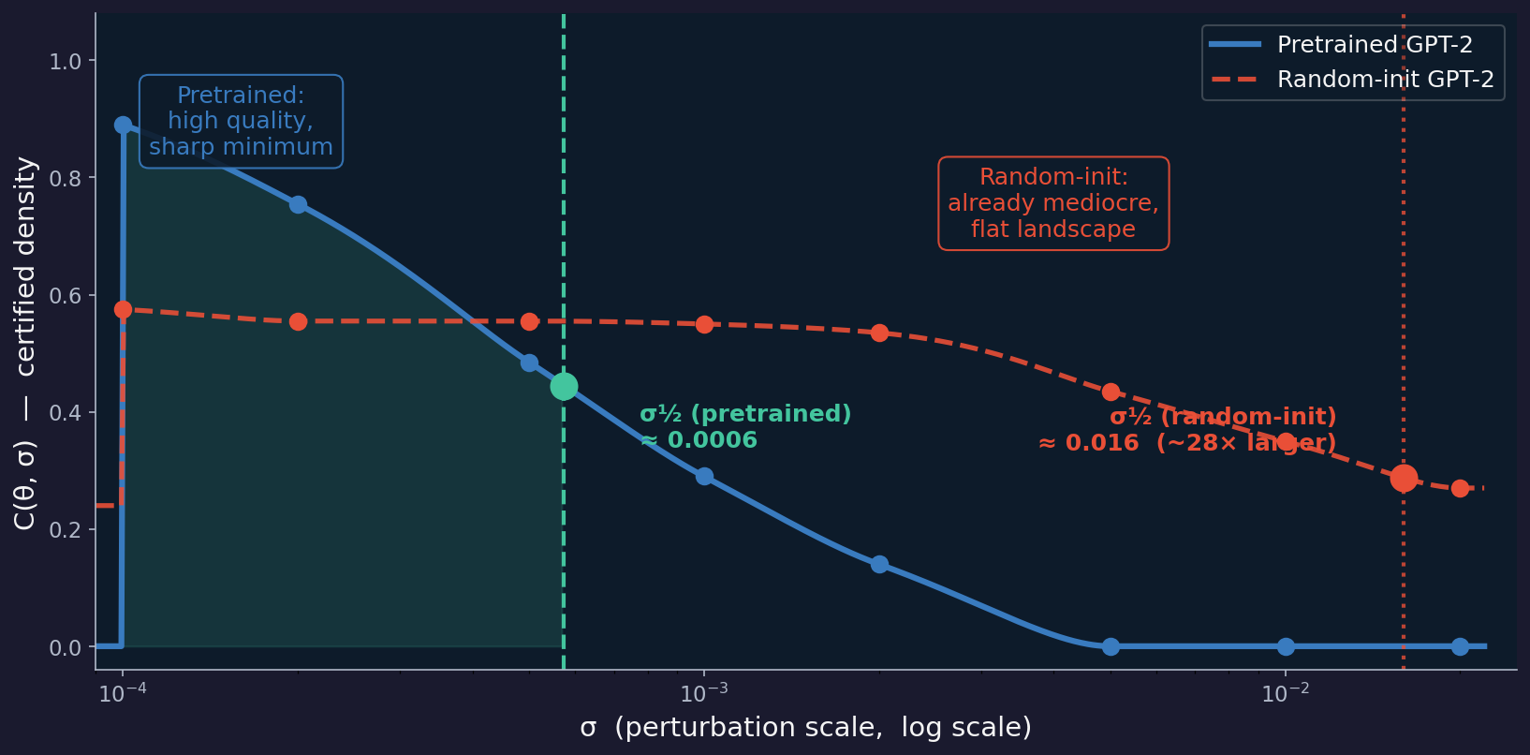
C(θ, σ): How it looks on a real model
What the curves show
→ Pretrained (blue): peaks near 0.90, drops sharply — σ½ ≈ 0.001
→ Random-init (red): peaks at only 0.58, decreases very slowly — σ½ ≈ 0.020
→ Random-init σ½ is ~20× larger — not because it is more robust, but because its loss landscape is flat and undifferentiated
→ σ½ measures minimum SHARPNESS, not quality
The key insight
Smaller σ½ = sharper, better-organised minimum = better-trained model
→ Pretrained GPT-2 is HARDER to perturb away from quality than random-init
→ Computed in ~2 min on GPU with N = 200 perturbations — no labels needed

Slide 5
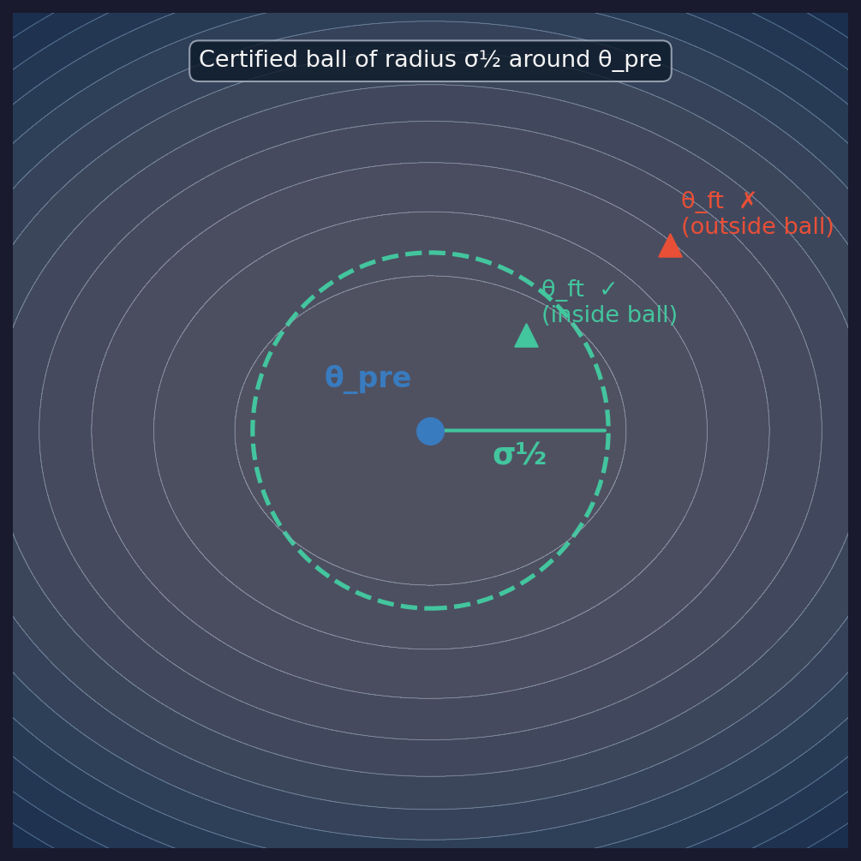
σ½ is the radius of the safe zone in weight space
Inside the ball ✓
→ ‖ε‖ < σ½ → s(θ+ε) ≥ m with high probability
→ Fine-tuned model stays near pretrained quality
→ WikiText-2 PPL ratio stays ≈ 1.0
Outside the ball ✗
→ ‖ε‖ > σ½ → quality degrades in expectation
→ Fine-tuned model drifts off the pretrained loss surface
→ WikiText-2 PPL ratio rises above 1.02
Perturbations are isotropic Gaussian — random direction, fixed scale σ

Slide 6
Why σ½ is the right unit for all three hypotheses
Model-agnostic
Measurable before fine-tuning
→ σ½ absorbs differences in scale, arch, and pretraining quality
→ ‖Δθ‖ / σ½ is dimensionless — comparable across GPT-2, Llama, etc.
→ Without σ½, each model needs its own threshold
→ Computed on θ_pre in ~2 min (no task labels, no fine-tuning)
→ Gives a predictive budget BEFORE the experiment starts
→ σ½_pre is reused across H1, H2, and H3 without re-running
Interpretable geometry
Connects to Neural Thickets
→ R_A > 1 means 'you have left the certified basin of Task A'
→ d < σ½_A + σ½_B means 'the two basins overlap — merge is safe'
→ Geometric picture is intuitive and falsifiable
→ Larger / better-trained models → smaller σ½ (tighter basin)
→ Consistent with NT solution-density scaling law
→ σ½ is the empirical correlate of 'thicket density'

Slide 7
H1 · Universal Adaptation Scale
One normalised number predicts stability across any model, task, or LR
R = ‖Δθ‖ / σ½_pre ≈ 1 is a universal stability boundary
Normalising by σ½ collapses all PPL-degradation curves onto one trajectory
→ R < 1 → update inside the certified ball → pretraining quality preserved
→ R > 1 → update outside the ball → WikiText-2 PPL degrades
→ σ½ is the natural unit that makes fine-tuning scale comparable across architectures
Analogies to known scaling laws
Chinchilla
μP
H1 (claim)
N_tokens / N_params ≈ 20 collapses loss across model sizes
lr / √width collapses training curves across widths
‖Δθ‖ / σ½ collapses PPL curves across tasks, models, LRs

Slide 8
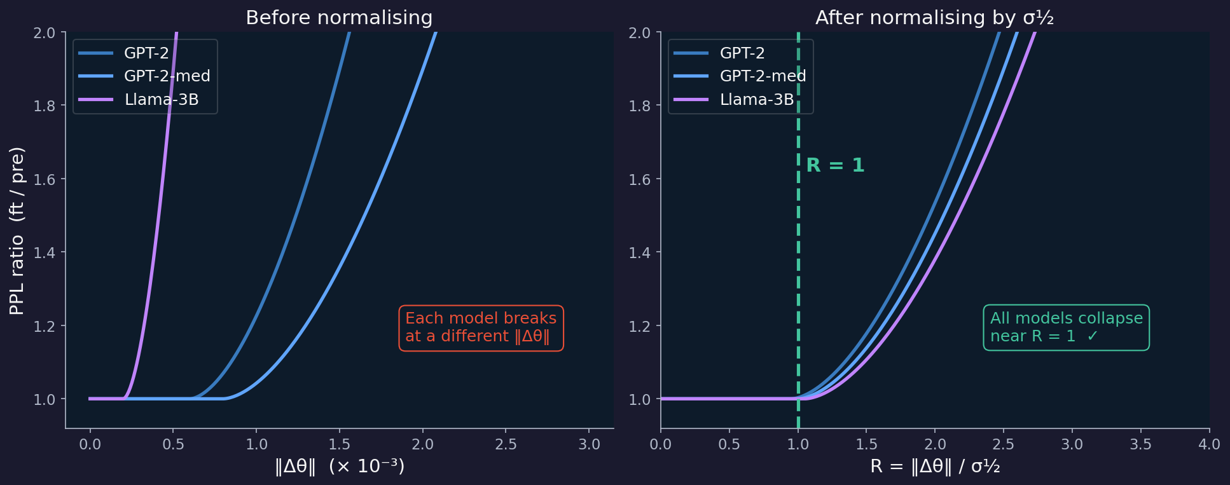
H1 — Visualised: before and after σ½ normalisation
Illustrative. If H1 holds, the right panel collapses to a single curve with a kink at R = 1.

Slide 9
H1 · Experiment Scope
5 models × 5 tasks × 6 LRs = 150 fine-tuning runs
Model
Params
Architecture
σ½_pre
GPT-2
124 M
GPT-2 decoder
~0.00060
GPT-2-medium
354 M
GPT-2 decoder
~0.00081
GPT-2-large
774 M
GPT-2 decoder
~0.00060
GPT-2-xl
1.5 B
GPT-2 decoder
~0.00067
Llama-3.2-3B
3 B
Llama decoder
~0.00020
Tasks
SST-2
MNLI
Yahoo
DBPedia
AG News
Binary sentiment — novel format
Textual inference — moderate familiarity
Q&A classification — partial overlap
Entity classification — encyclopedic
News classification — WebText familiar
→ LoRA rank = 8 (primary) · 500 steps per condition · eval on WikiText-2 NLL

Slide 10
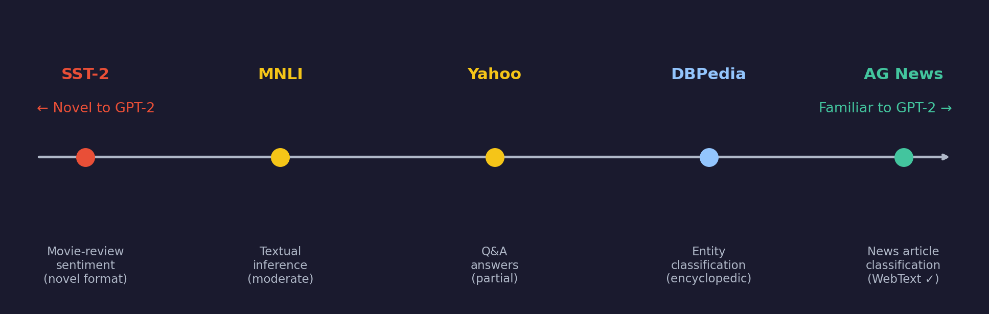
H1 · Why These Tasks? Controlling for Pretraining Familiarity
Familiar tasks (AG News, DBPedia)
Novel tasks (SST-2, MNLI)
→ GPT-2 was pretrained on WebText — news and encyclopedic text is heavily represented
→ Model needs only tiny parameter movement to classify these → R stays small even at high LR
→ Risk: if we only used familiar tasks, R≈1 might hold trivially and mean nothing
→ Short-form sentiment and textual inference are NOT dominant patterns in WebText
→ Model must learn a genuinely new signal → large parameter movement required → R grows
→ Including these tests whether R≈1 holds even when the model has to move far
Both extremes are required — without novel tasks, universality claim is untestable

Slide 11
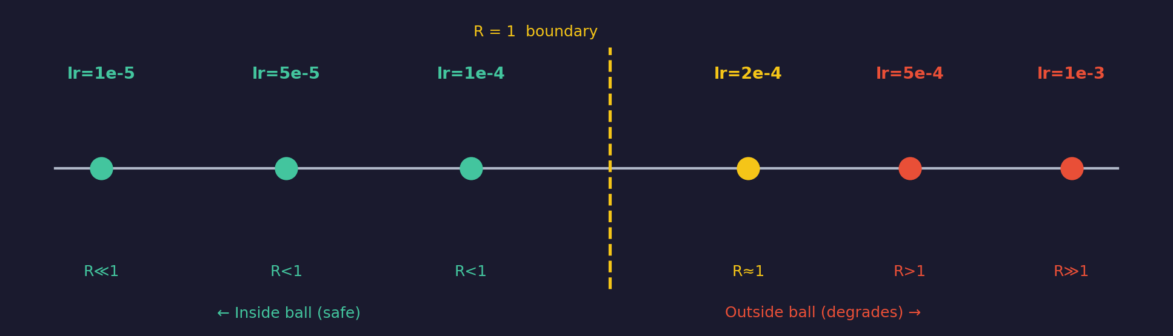
H1 · Why These LRs and Models?
Learning rates: span both sides of R = 1
Models: architecture + scale diversity
→ lr = 1e-5 → R ≪ 1: the safe control condition (model barely moves)
→ lr = 1e-4 / 2e-4 → R ≈ 0.4–0.9: expected neighbourhood of the boundary
→ lr = 5e-4 / 1e-3 → R > 1: deliberate overshoot — confirms degradation side
→ Without overshooting the boundary we cannot verify that σ½ predicts failure
→ GPT-2 family (124M → 1.5B): same architecture, clean parameter scaling — isolates size effect
→ Llama-3.2-3B: different architecture AND training recipe (RLHF, instruction tuning)
→ Without Llama, 'universal' only means 'works for GPT-2 decoder-only stack'
→ GPT-2-xl + Llama-3B bracket the Neural Thickets 'thicket threshold' (~1.5B)

Slide 12
H2 · Forgetting Budget
The certified ball of θ_A is a forgetting budget for Task B training
R_A = ‖θ_B − θ_A‖ / σ½_A > 1 predicts Task A forgetting
Whenever Phase 2 weights exit the certified ball around θ_A, Task A accuracy drops
→ Continual learning: R_A = 1 is a hard budget — train on Task B until this, then stop
→ RLHF analogy: σ½_SFT is the weight-space KL penalty radius — bounds safe RLHF movement
→ Practical: compute σ½_A once, then predict forgetting without running Phase 2
Stronger claim
→ Forgetting curve F(t) aligns across model sizes, task pairs, and LRs when plotted vs R_A(t)
→ The transition at R_A = 1 is sharp — a step function, not a gradual drift

Slide 13
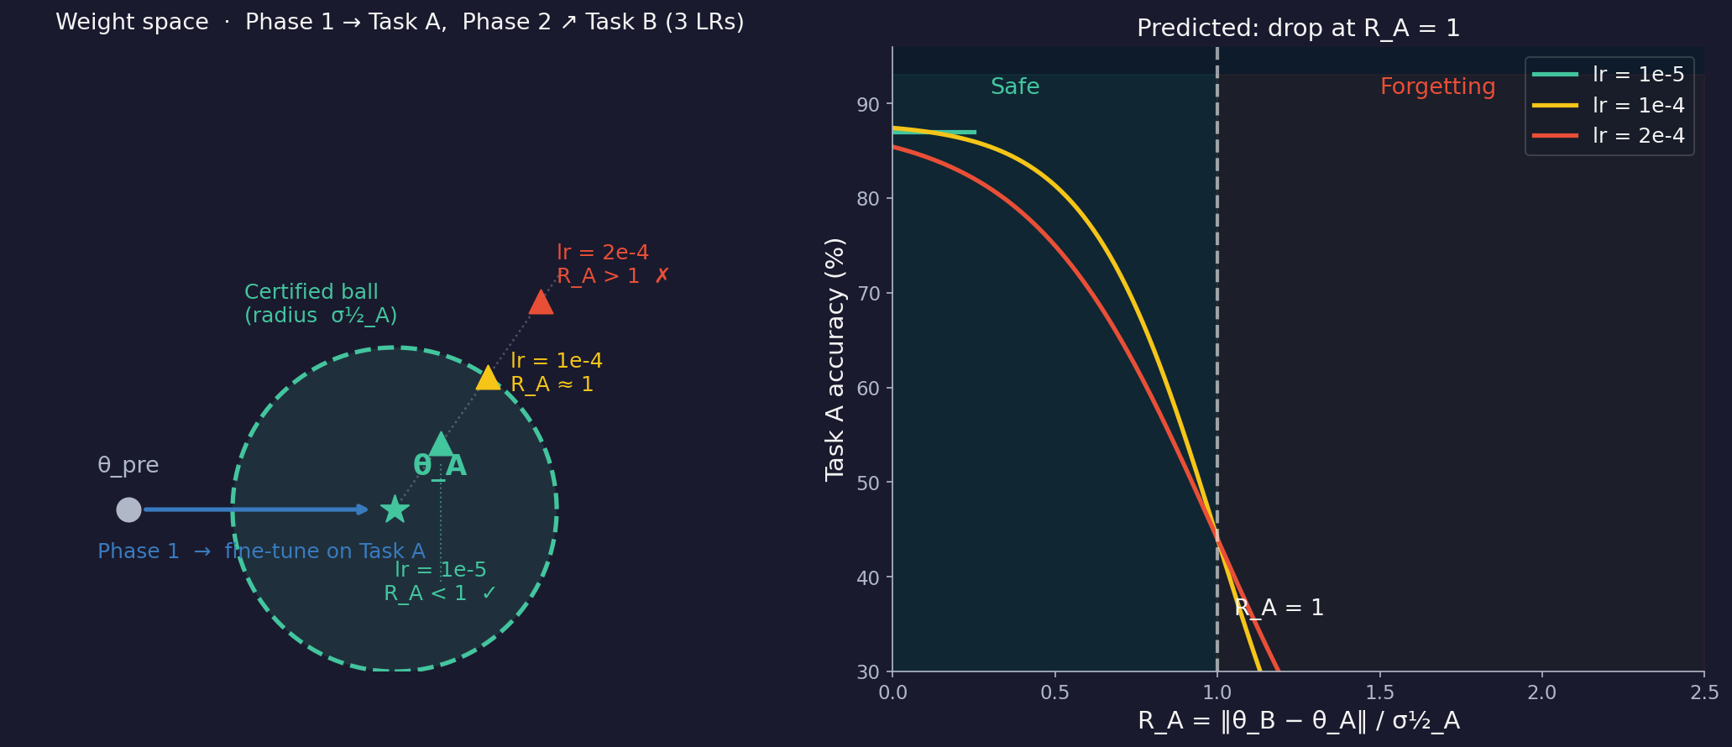
H2 — Visualised: weight-space trajectory and Task A accuracy
Left: Phase 2 trajectory in weight space — low LR stays inside σ½_A ball, high LR exits. Right: predicted Task A accuracy vs R_A — drop at R_A = 1.

Slide 14
H2 · Task Pair Design — Two Requirements in Tension
Task A — must converge cleanly
Task B — must require real parameter movement
→ If Task A never converges, σ½_A reflects a pretrained (not fine-tuned) basin — the H2 formula becomes meaningless
→ Choose a familiar task: AG News for GPT-2 (WebText = news text) → model reaches >80 % accuracy at lr = 1e-4 in 2000 steps
→ Convergence guard: raise an error if Phase 1 accuracy < 70 %
→ σ½_A is measured on the FINE-TUNED θ_A (not pretrained) — it reflects the Task A optimum basin
→ If Task B is also familiar (e.g. another news dataset), R_A stays tiny throughout Phase 2 → no forgetting → H2 is untestable
→ Choose a novel task: SST-2 for GPT-2 (short-form sentiment ≠ WebText distribution) → model must move θ significantly to learn it
→ This ensures R_A grows across the LR range 1e-5 → 2e-4, giving data both inside and outside the ball
→ Reverse for Llama-3B (SST-2 → AG News): tests whether task direction matters

Slide 15
H2 · Why These LRs, Steps, and Ranks?
Phase 1 — lr_a = 1e-4, 2000 steps
→ lr = 1e-5 does NOT converge on AG News in 2000 steps — σ½_A stays pretrained-like and inflates R_A to nonsense values
→ lr = 1e-4 produces ~4× basin widening on GPT-2 (verified in lora_density_experiment) — gives a well-characterised σ½_A
→ 2000 steps: enough for >80 % accuracy on AG News with rank = 8 (confirmed empirically)
Phase 2 — three LRs, each targeting a different R_A regime
→ lr = 1e-5 → R_A stays < 1 throughout 2000 steps → control: Task A should be preserved
→ lr = 1e-4 → R_A crosses 1 around step 800–1000 → tests the transition; sharpest signal for H2
→ lr = 2e-4 → R_A > 1 early → confirms the failure side; large forgetting expected
Ranks 8 and 32 — why both?
→ rank = 32 moves faster in norm for the same LR (more directions updated per step)
→ So at rank 32, R_A > 1 is reached at a lower LR — stress-tests whether rank shifts the boundary
→ If the boundary moves with rank: the ball is not isotropic in LoRA-update space — important nuance
50-step eval cadence during Phase 2: fine enough to catch the R_A = 1 crossing without excessive compute

Slide 16
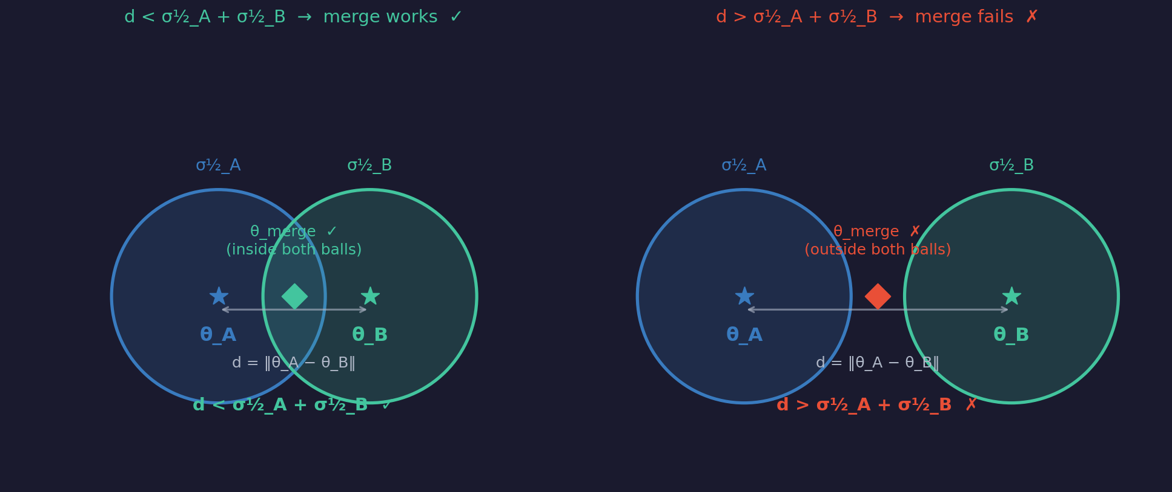
H3 · Model Merging
If the certified balls overlap, the midpoint is safe
d(θ_A, θ_B) < σ½_A + σ½_B → merging θ_A and θ_B preserves both tasks
Geometric sufficient condition: if both models lie inside each other's certified ball, their midpoint does too
Why this is novel
→ All prior merge methods (TIES, DARE, task arithmetic) are empirical — no geometric certificate
→ H3 predicts success BEFORE running the merge — from σ½_A, σ½_B, and ‖θ_A − θ_B‖ alone
→ If H1 holds, keeping ‖Δθ_A‖ < σ½ during training guarantees d < σ½_A + σ½_B
→ The certificate is conservative: gap > 0 is sufficient, not necessary

Slide 17
H3 · Why These Tasks, Model, and Merge Method?
Why GPT-2-medium?
Why AG News + SST-2?
Why simple averaging?
→ GPT-2 (124M) is capacity-limited — multi-task performance saturates at low accuracy, masking the merge signal
→ GPT-2-medium (354M) has enough capacity to hold two tasks simultaneously — we can actually measure success
→ σ½_pre ≈ 0.00081 already characterised from H1; baseline well-established
→ Cheap enough to run 9 (LR_A, LR_B) conditions + merge evals in one A40 session
→ Different label spaces (4-class vs binary) + different text formats → genuinely conflicting weight updates
→ AG News is familiar → θ_A stays close to θ_pre → σ½_A stays large → easier for condition to be satisfied
→ SST-2 is novel → θ_B must move further → harder to satisfy condition → tests the boundary
→ If both tasks were familiar, d would always be small → certificate always satisfied → H3 untestable
→ A 'boring' pair never produces failures — we NEED gap < 0 cells to falsify H3
→ θ_merge = (θ_A + θ_B) / 2 is the midpoint in weight space — exactly what the ball-overlap condition predicts
→ If the condition works for the simplest merge method, it is the strongest claim
→ Exotic methods (TIES, DARE) re-weight parameters in ways that obscure the geometry
→ If simple averaging FAILS where gap > 0, H3 is cleanly falsified
→ If simple averaging SUCCEEDS where gap > 0, H3 is confirmed by the most skeptical test

Slide 18
H3 · The 3×3 LR Grid — Tracing the Merge Boundary
We need cells where the certificate is satisfied AND violated — otherwise we cannot falsify H3
lr_B = 1e-5
lr_B = 1e-4
lr_B = 2e-4
d ≪ σ½_A + σ½_B gap >> 0 H3 predicts ✓ SUCCESS (control cell)
d moderate gap > 0 H3 predicts ✓ SUCCESS
d grows gap ≈ 0 near-boundary case
lr_A = 1e-5
d moderate gap > 0 H3 predicts ✓ SUCCESS
d large gap ≈ 0 most interesting cell
d very large gap < 0 H3 predicts ✗ FAILURE
lr_A = 1e-4
d grows gap ≈ 0 asymmetric boundary
d large gap < 0 H3 predicts ✗ FAILURE
d ≫ σ½_A + σ½_B gap ≪ 0 H3 predicts ✗ FAILURE (stress-test cell)
lr_A = 2e-4
Green = H3 predicts success · Yellow = near boundary · Red = H3 predicts failure · Key test: does the merge success map align with the gap sign?

Slide 19
Three Geometric Bets on σ½
H1 Adaptation Scale
If confirmed →
R = ‖Δθ‖/σ½ ≈ 1 is a universal stability boundary
A model-agnostic LR / step budget rule, pre-hoc, no fine-tuning needed
H2 Forgetting Budget
If confirmed →
R_A > 1 predicts Task A forgetting after sequential FT
σ½_A is a certified continual-learning budget; direct weight-space analog of KL penalty
H3 Model Merging
If confirmed →
d(θ_A, θ_B) < σ½_A + σ½_B predicts merge success
First geometry-based certificate for safe model merging — predict before running
Shared infrastructure: same σ½ estimator · same GPU pipeline · density sweeps reused across all three hypotheses

