Slide 1
Certified Basin Geometry at Scale
How Fine-Tuning Method and Model Scale Determine Weight-Space Robustness
Neural Thickets × Randomized Smoothing | Follow-up
Kina Kim | SFU | June 2026

Slide 2
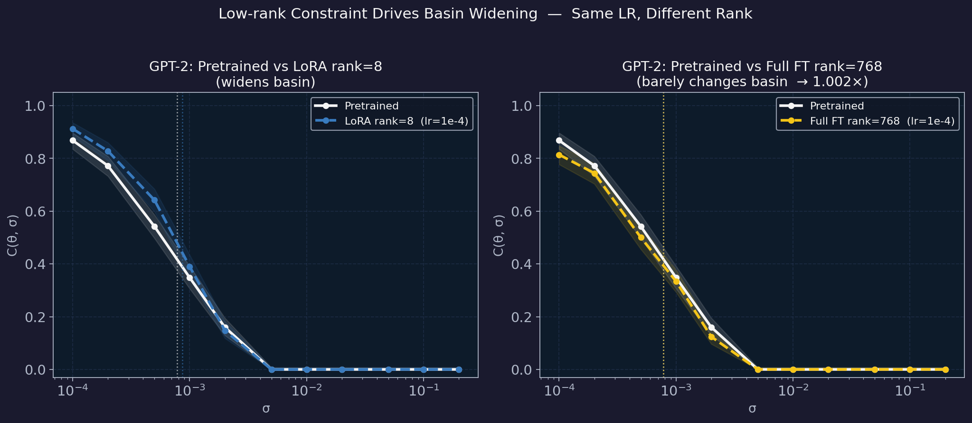
Quick Recap — Framework & Key Definitions
What we measure and why
Framework
C(θ, σ) = P[NLL(θ+ε) ≤ NLL(θ) + slack]
ε ~ N(0, σ²I)
σ½ = σ where C drops to peak / 2
→ certified basin WIDTH
norm/σ½ = ‖θ_ft − θ_pre‖ / σ½_pre
→ update relative to basin
Previous (GPT-2 only):
→ norm/σ½ < 1 → PPL stable, basin widens 1.1–1.75×
→ Full FT (rank=768): barely widens (1.002×) — low-rank constraint drives effect
New question:
Does the certified ball boundary hold across GPT-2, Qwen2.5-3B, Llama-3.2-3B, and Llama-3.1-8B?
Does LoRA basin widening persist at 3B and 8B parameter scale?

Slide 3
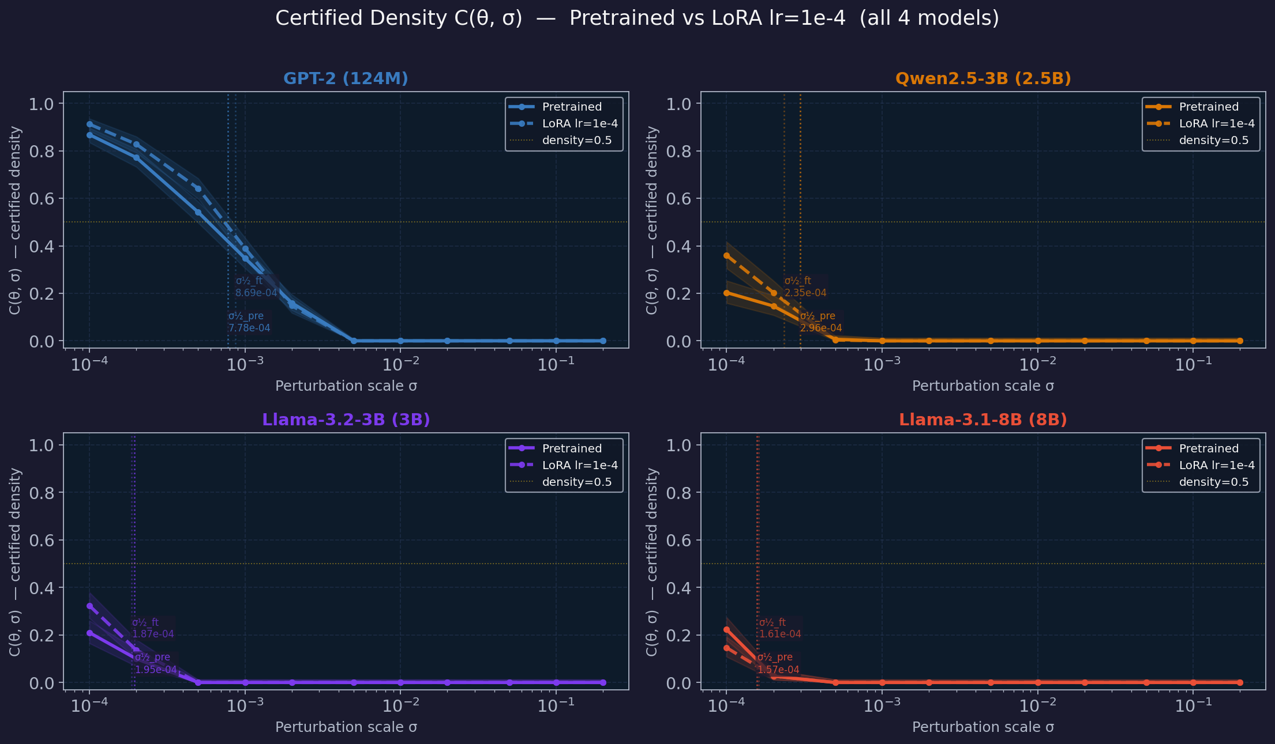
Experiment Verification — Density Curves Across 4 Models
C(θ, σ) before and after LoRA fine-tuning (lr=1e-4, rank=8)
Each panel: black=pretrained, dashed=LoRA lr=1e-4. Dotted vertical = σ½ (50% density point). Note: σ½_pre shrinks 5× from GPT-2 → 8B. Near-identical pretrained vs LoRA curves at large scale = tight ball with little room to widen.

Slide 4
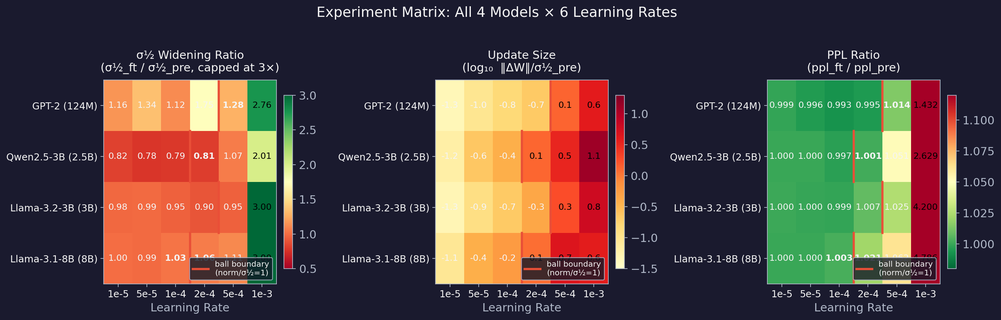
Complete Experiment Matrix — All 4 Models × 6 LRs
Widening ratio / update size / PPL ratio at a glance | Red line = certified ball boundary
→ Left panel: σ½ widening ratio — green >1 (widening), yellow ≈1 (flat), red <1 (narrowing)
→ Center panel: log₁₀(norm/σ½) — red line marks certified ball boundary (norm/σ½=1)
→ Right panel: PPL ratio — strongly tracks ball position: inside ball → PPL ≈ 1.0, outside → degrades
→ lr=1e-3: catastrophic collapse across all models (PPL +160% to +380%, norm/σ½ 4×–13×)

Slide 5
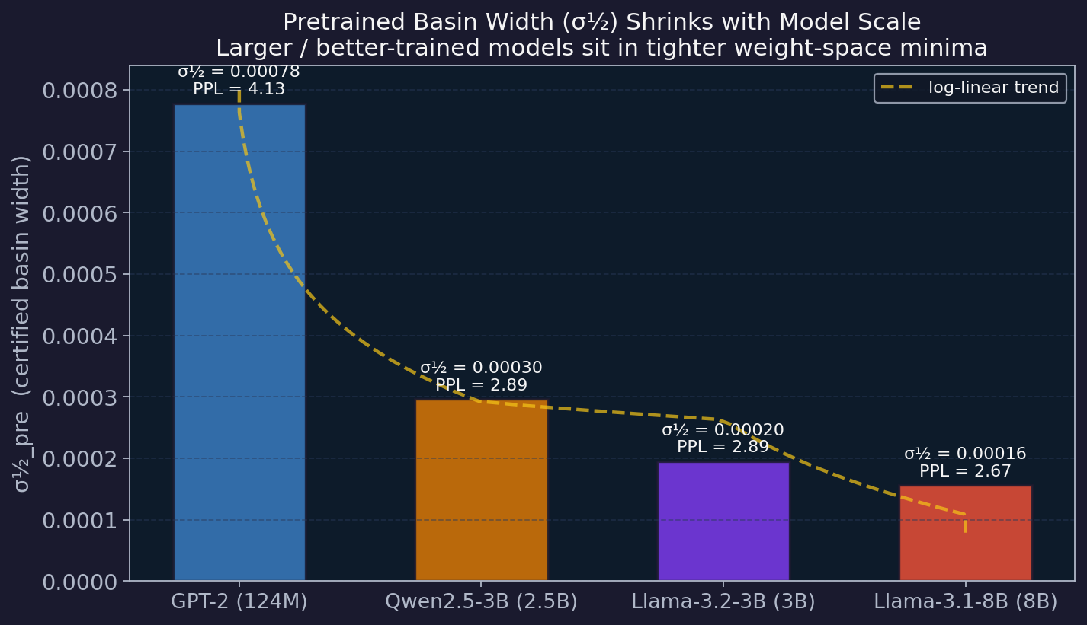
Finding 1 — σ½ Shrinks with Model Capability
Better models sit in tighter weight-space minima
Key numbers
GPT-2 (124M): σ½=7.78e-4
Qwen (2.5B): σ½=2.96e-4 (2.6×)
Llama (3.0B): σ½=1.95e-4 (4.0×)
Llama (8.0B): σ½=1.57e-4 (5.0×)
Interpretation
→ σ½ tracks pretrained PPL — smaller basin = better model
→ Consistent with Neural Thickets: denser solution clusters at larger scale
→ Tighter σ½ → safe LR budget shrinks with scale
→ Predicts: thicket emergence (~1.5B) should show a kink in this curve
σ½_pre measured on pretrained model only — no fine-tuning. Dashed line = log-linear trend. GPT-2 is 5× wider than Llama-3.1-8B.

Slide 6
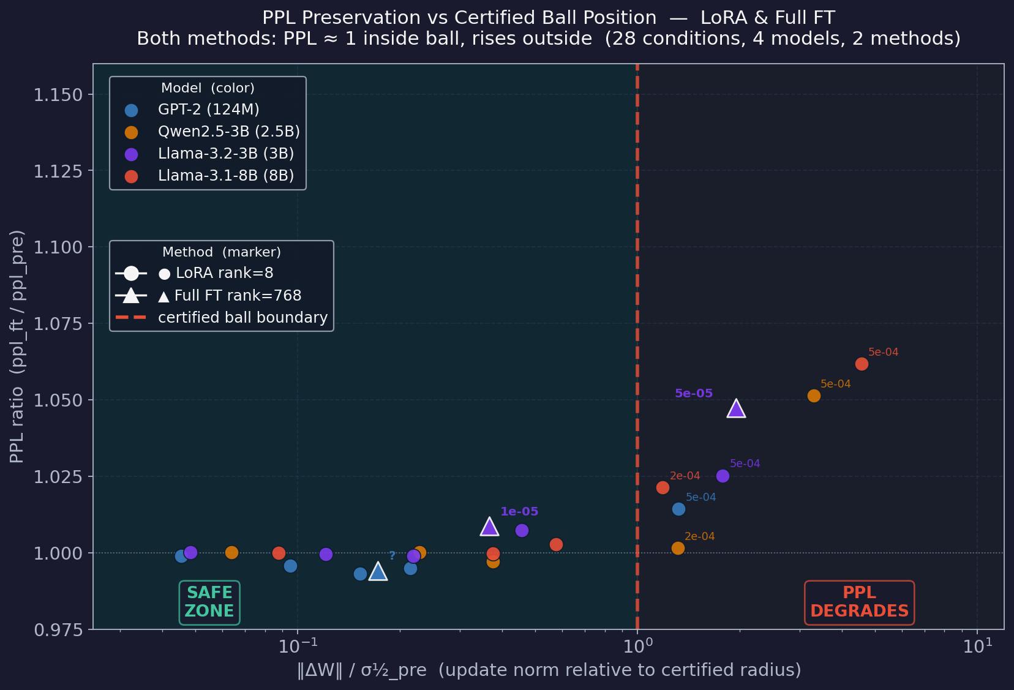
Finding 2 — Universal PPL Safety Boundary (Method-Agnostic)
norm/σ½ < 1 → PPL stable LoRA rank=8 AND Full FT rank=768 | 4 models | 28+ conditions
The rule
norm/σ½ < 1
→ PPL ratio ≈ 1.000 ✓
norm/σ½ > 1
→ PPL ratio > 1.02 ✗
Evidence
→ 28+ data points across 4 models, 2 methods, zero exceptions
→ ● LoRA rank=8 (24 pts, 4 models × 6 LRs)
→ ▲ Full FT rank=768 (4 pts, GPT-2 + Llama-3B LR sweep)
→ Boundary is σ½-normalized — absolute LR is irrelevant
→ Method doesn't matter — only norm/σ½ matters
Circles = LoRA rank=8. Triangles = Full FT rank=768. Both methods: PPL ≈ 1 inside the ball, rises outside. Green = safe zone. Pink = PPL-degraded zone.

Slide 7
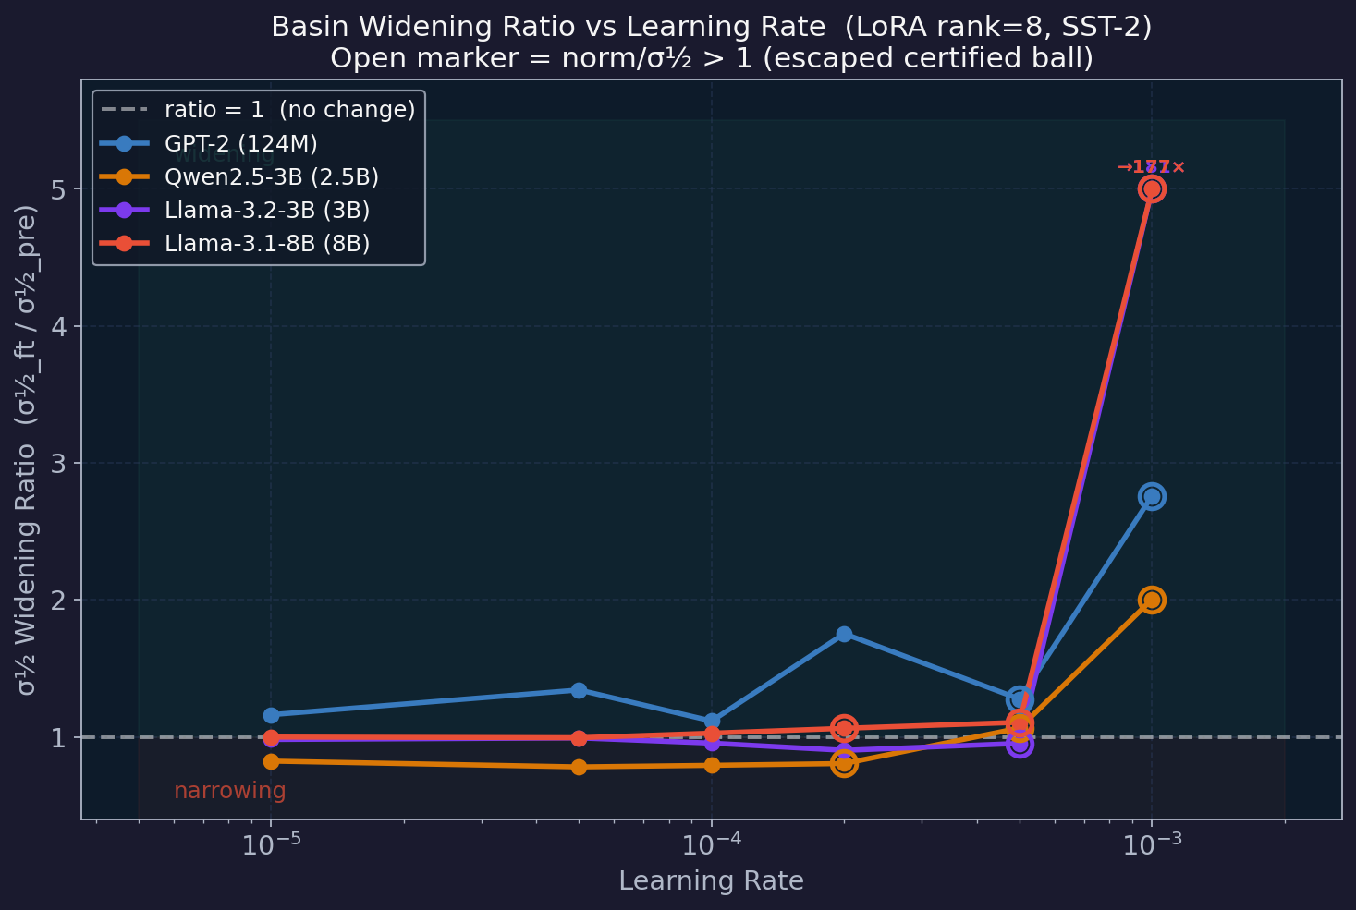
Finding 3 — Widening Is a Small-Model Phenomenon
GPT-2 widens 1.1–1.75× inside the ball; 3B+ models show flat or narrowing
Best safe widening
GPT-2 (124M): 1.75×
(lr=2e-4, norm/σ½=0.21)
Qwen (2.5B): 0.82×
(lr=1e-5, norm/σ½=0.06)
Llama (3.0B): 0.99×
(lr=5e-5, norm/σ½=0.12)
Llama (8.0B): 1.03×
(lr=1e-4, norm/σ½=0.58)
Why?
→ Tighter σ½ at scale → less room to widen inside ball
→ Llama-8B: norm/σ½=0.58 already at lr=1e-4 — little space left
→ LoRA rank=8 may not have the capacity to reshape a tighter basin
Open markers = norm/σ½ > 1 (escaped certified ball). Widening above the dashed line = basin expanded after fine-tuning. Clipped at 5× for readability.

Slide 8
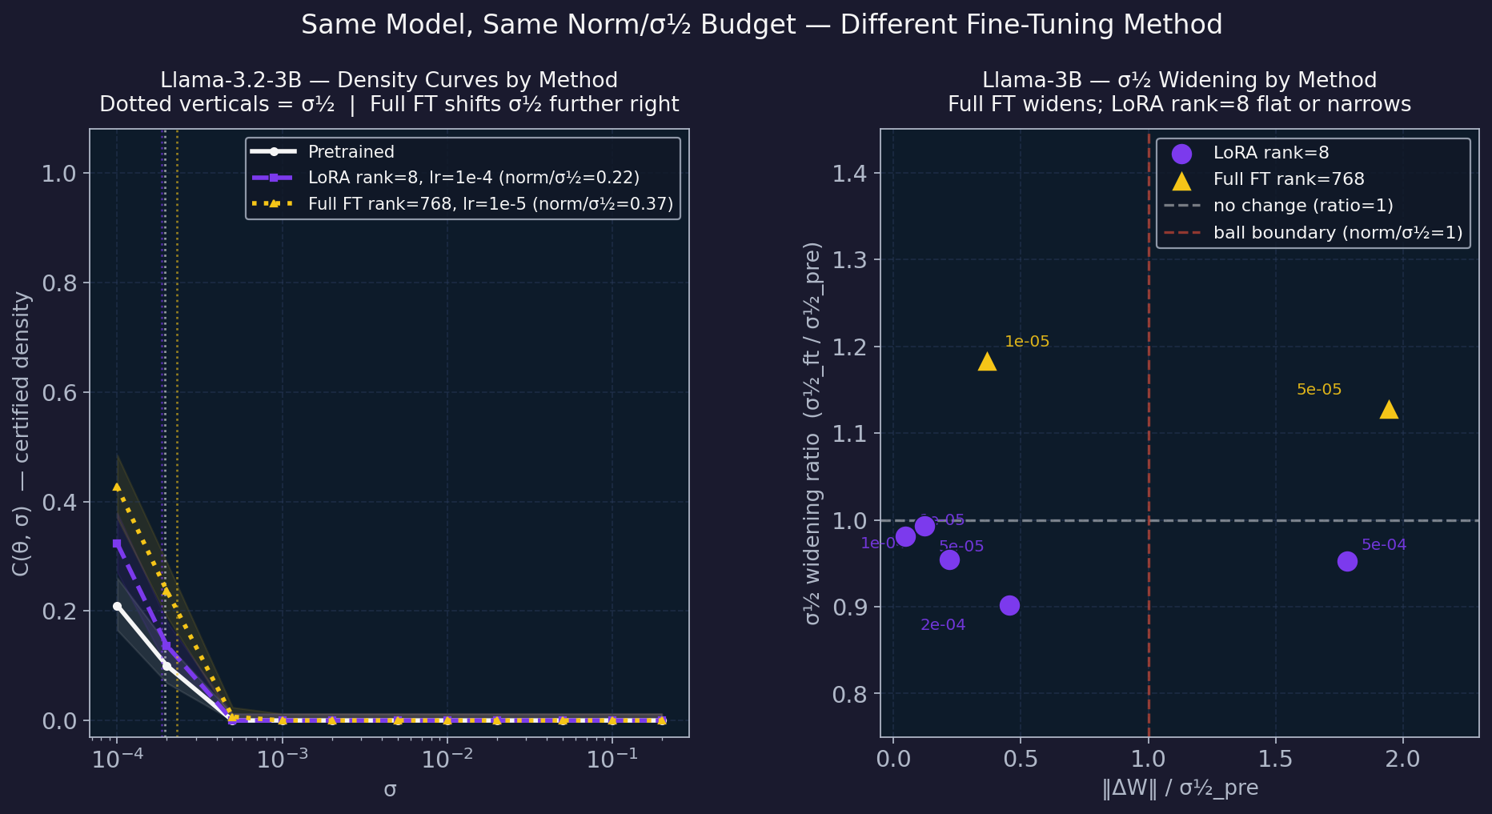
Method Comparison — Same Model, Same Norm Budget, Different Method
Llama-3.2-3B: LoRA rank=8 vs Full FT rank=768 | F2 confirmed method-agnostic
Llama-3B results
LoRA rank=8:
lr=1e-4, norm/σ½=0.22
ratio=0.955× (narrows)
PPL=1.007 ✓
Full FT rank=768:
lr=1e-5, norm/σ½=0.37
ratio=1.184× (widens!)
PPL=1.009 ✓
Both inside ball →
both PPL-stable
Key insight
→ F2 holds for both methods
→ Widening reversal: at 3B scale, full FT widens, LoRA narrows
→ Low-rank claim holds for GPT-2, but reverses at 3B
Left: density curves — full FT shifts σ½ right more than LoRA. Right: widening scatter — full FT widens (▲) while LoRA (●) is flat. Both at Llama-3B, SST-2, 500 steps.

Slide 9
RandOpt Exploration — Negative Result
Random perturbation selection fails without a meaningful task scoring signal
Setup (GPT-2, N=500, K=10)
NT paper context
→ Sample N=500 Gaussian weight perturbations at each σ
→ Score each by SST-2 zero-shot accuracy
→ Keep top-K=10 deltas, average them → θ_ft
→ Measure σ½ before and after; compare to LoRA
→ Gan & Isola used 7B+ models on math (GSM8K) — tasks where the base model already scores meaningfully (30%+ vs 5% random)
→ Selection signal is what makes RandOpt work
Two paths forward
What happened
→ Option A: Use supervised scoring (cross-entropy on labeled examples) — gives RandOpt the same task signal as LoRA. Fair comparison.
→ Option B: Focus on Claim 1 (ball boundary as universal LR rule) as primary contribution. Treat RandOpt as future work.
GPT-2 SST-2 zero-shot accuracy: 0.60 (near random)
Top-K mean accuracy: 0.60 (no improvement)
σ½ appears to 'widen' (1.4×–2.2×) — but meaningless.
We averaged random noise, not selected good solutions.
Root cause: no scoring signal
Recommended: Option B for now — Claim 1 is the stronger, cleaner result across 4 models.
GPT-2 base can't do SST-2 zero-shot reliably → all perturbations score identically → selection is random → RandOpt degenerates to noise averaging.

Slide 10
Summary & Open Questions
What we have
Open Questions
F1 σ½ Scaling Law
→ Why does GPT-2 widen but 3B doesn't? Architecture, scale, or pretraining data diversity?
→ Does a wider σ½ after FT improve downstream generalization — or is it a geometric artifact?
→ Thicket threshold (~1.5B, per NT paper): should σ½ show a kink there?
→ RandOpt with supervised scoring — does it naturally stay inside the certified ball?
→ Can σ½ serve as an overfitting diagnostic during training (per professor's suggestion)?
σ½_pre shrinks 5× from GPT-2 → 8B. Better models = tighter basins. Aligns with Neural Thickets.
F2 Universal Safety Boundary (method-agnostic)
norm/σ½ < 1 predicts PPL stability. Confirmed for LoRA rank=8 (24 pts) AND full FT rank=768 (4 pts). Zero exceptions across 28+ conditions, 4 models, 2 methods.
F3 Scale + Method Dependent Widening
GPT-2 LoRA: widens 1.1–1.75×. 3B LoRA: flat/narrows (0.95×). 3B full FT: widens (1.18×). Widening depends on both scale and method.
F4 Low-Rank Effect (GPT-2 scale observation)
At GPT-2 scale: full FT rank=768 barely widens (1.002×), LoRA rank=8 widens (1.12–1.29×). Pattern reverses at 3B — full FT widens, LoRA narrows.
For professor: Is 'certified ball as universal LR budget rule' the right paper framing? Worth pursuing supervised RandOpt for Claim 2?

