Slide 1
Certified Basin Geometry at Scale
How Fine-Tuning Method, Model Scale, and Training Duration Shape the Certified Weight-Space Ball
Neural Thickets × Randomized Smoothing | Progress Update
New since last update
• Steps sweep (Llama-3B, lr=1e-4, 200–2000 steps) — norm grows linearly, all inside ball
• Trajectory run (Llama-3B, lr=2e-4, 2000 steps) — outside ball, PPL +6.4%
• Full FT LR sweep on Llama-3B — 3 conditions added
• 33 total conditions, zero exceptions to the ball boundary rule
Kina Kim | SFU | June 2026

Slide 2
Results Overview — 4 Findings
33 conditions across 4 models, 2 LoRA ranks (r=8 and r=768), multiple LRs and step counts
F1 σ½ Scaling Law
Key numbers (new data)
σ½_pre shrinks 5× from GPT-2 (7.8e-4) → Llama-8B (1.6e-4). Better models sit in tighter basins. Consistent with Neural Thickets: denser clusters at scale → smaller certified radius.
Steps sweep (Llama-3B, lr=1e-4, rank=8):
200 steps: norm/σ½=0.368 IN ppl=1.000
500 steps: norm/σ½=0.488 IN ppl=1.000
1000 steps: norm/σ½=0.613 IN ppl=0.998
2000 steps: norm/σ½=0.834 IN ppl=0.998
Trajectory (Llama-3B, lr=2e-4, 2000 steps):
norm/σ½=2.137 OUT ppl=1.063 (+6.4%)
LoRA rank=768 Llama-3B (r/d=25%, lr=1e-5):
norm/σ½=0.366 IN ratio=1.184× ppl=1.009
F2 Universal PPL Safety Boundary ← MAIN RESULT
norm/σ½ < 1 predicts PPL stability across 33 conditions: 4 models, 2 LoRA ranks, 6 LRs, 4 step counts. Zero exceptions. The certified ball is a model-agnostic training budget.
F3 Widening Depends on Scale × Rank Coverage (r/d)
GPT-2 rank=8 (r/d=1%): widens 1.1–1.75×. Llama-3B rank=8 (r/d=0.26%): narrows (0.95×). Llama-3B rank=768 (r/d=25%): widens (1.18×). Widening needs sufficient r/d at a given scale.
F4 Rank Coverage Effect Reverses Across Scale
GPT-2: low r/d (1%) widens, high r/d (100%) narrows (0.793×). Llama-3B: low r/d (0.26%) narrows, medium r/d (25%) widens. Direction of effect flips — scale × rank interaction, not just method.
F3/F4 reframed: 'full FT' experiments were LoRA rank=768 throughout — never true full FT. The finding is a rank-coverage × scale interaction, not a method difference.

Slide 3
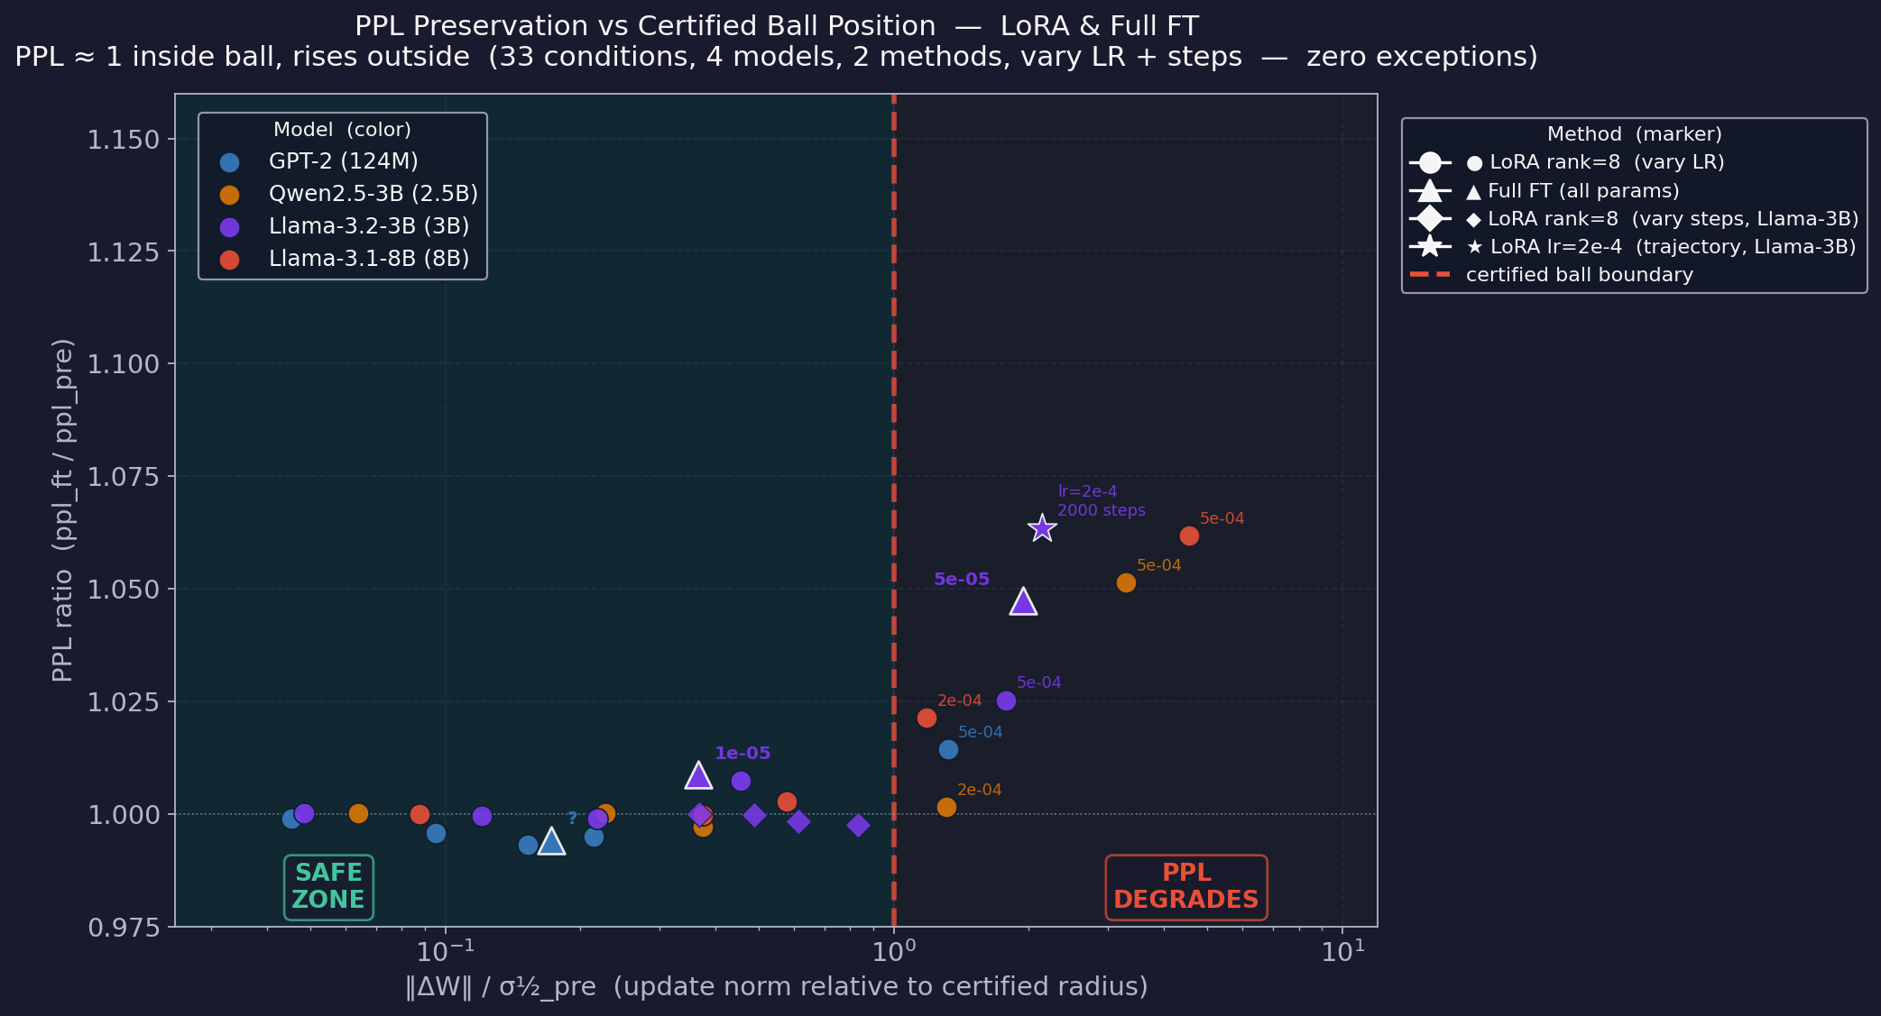
F2 — Universal PPL Safety Boundary (33 conditions, zero exceptions)
norm/σ½ < 1 → PPL stable | norm/σ½ > 1 → PPL degrades | method-agnostic
The rule
norm/σ½ < 1
→ PPL ratio ≈ 1.000 ✓
norm/σ½ > 1
→ PPL ratio > 1.02 ✗
Evidence
→ 33 data points, zero exceptions
→ ● LoRA rank=8 (24 pts, 4 models × 6 LRs)
→ ▲ LoRA rank=768 (4 pts, GPT-2 r/d=100% + Llama-3B r/d=25%)
→ ◆ LoRA rank=8 (4 pts, steps sweep, Llama-3B)
→ ★ LoRA lr=2e-4 (1 pt, trajectory, Llama-3B)
→ Boundary is σ½-normalized — absolute LR is irrelevant
New: ◆ steps sweep + ★ trajectory run added. All 4 step counts inside ball at lr=1e-4. Trajectory point (lr=2e-4, 2000 steps) confirmed outside ball with PPL +6.4%.

Slide 4
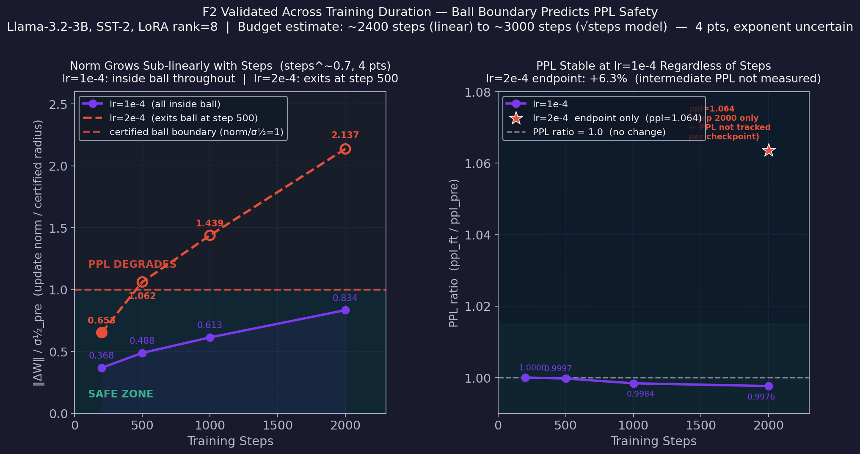
F2 — Validated Across Training Duration (new experiment)
Llama-3.2-3B, SST-2, LoRA rank=8 | lr=1e-4: 200→2000 steps | lr=2e-4: endpoint
Key insight
→ Norm grows sub-linearly with steps (~steps^0.7 from 4 pts)
→ At lr=1e-4: all 4 step counts inside ball, PPL stable
→ At lr=2e-4: exits ball at step 500, PPL +6.4% at step 2000
→ F2 holds across the time dimension
Training budget estimate
Linear model (conservative):
σ½ / norm_per_step ≈ 2400
√steps model (trajectory):
(σ½ / C)² ≈ 3000
True exponent uncertain
(need more step counts)
Left: norm/σ½ vs steps — sub-linear growth (exponent ~0.7, 4 pts only). Right: PPL stable at lr=1e-4, jumps when outside ball. σ½_pre gives a principled budget estimate; exact formula depends on growth model.

Slide 5
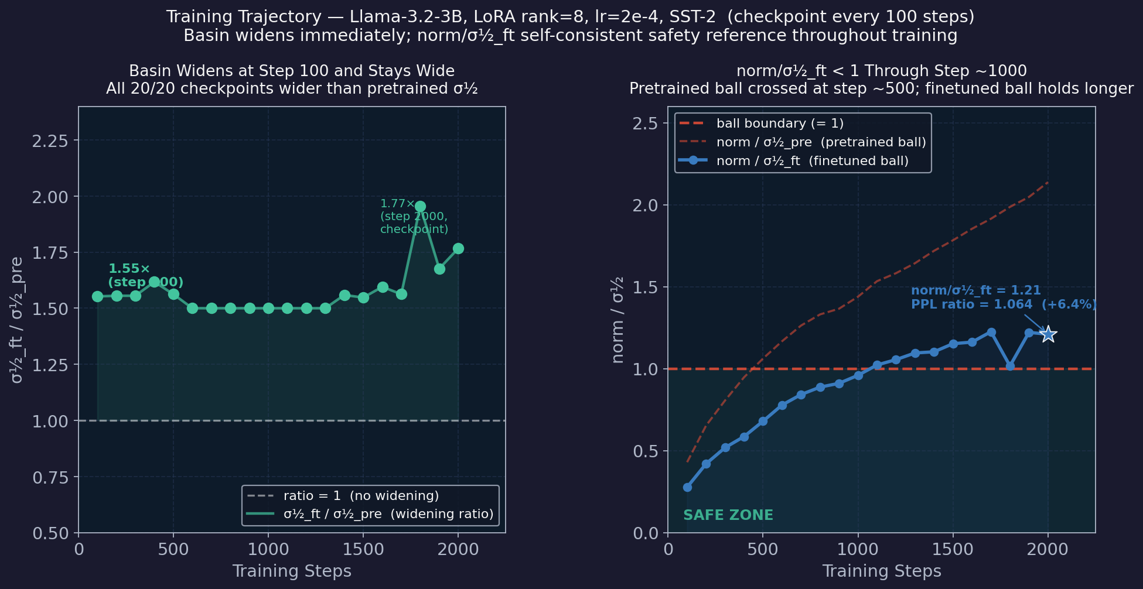
F2 — Basin Adapts Dynamically During Training (new experiment)
Llama-3.2-3B, LoRA rank=8, lr=2e-4 | checkpoint every 100 steps → 20 density measurements
What changed
Previous: single endpoint
(widening_summary only)
New: 20 checkpoints,
every 100 steps
Base-layer bug fixed →
all norms now valid
Key numbers
Step 100: σ½ = 1.55×
norm/σ½_ft = 0.28
Step 1000: σ½ = 1.50×
norm/σ½_ft = 0.96 ✓
Step 2000: σ½ = 1.40×
norm/σ½_ft = 1.21
PPL ratio = 1.063 ✓
Norm ~ steps^0.51
(√steps, Adam RW)
Left: widening ratio at each checkpoint — always > 1, jumps at step 100. Right: finetuned-ball ratio (blue) stays < 1 longer than pretrained-ball ratio (red dashed). PPL +6.3% at step 2000 even though norm/σ½_pre = 2.14.

Slide 6
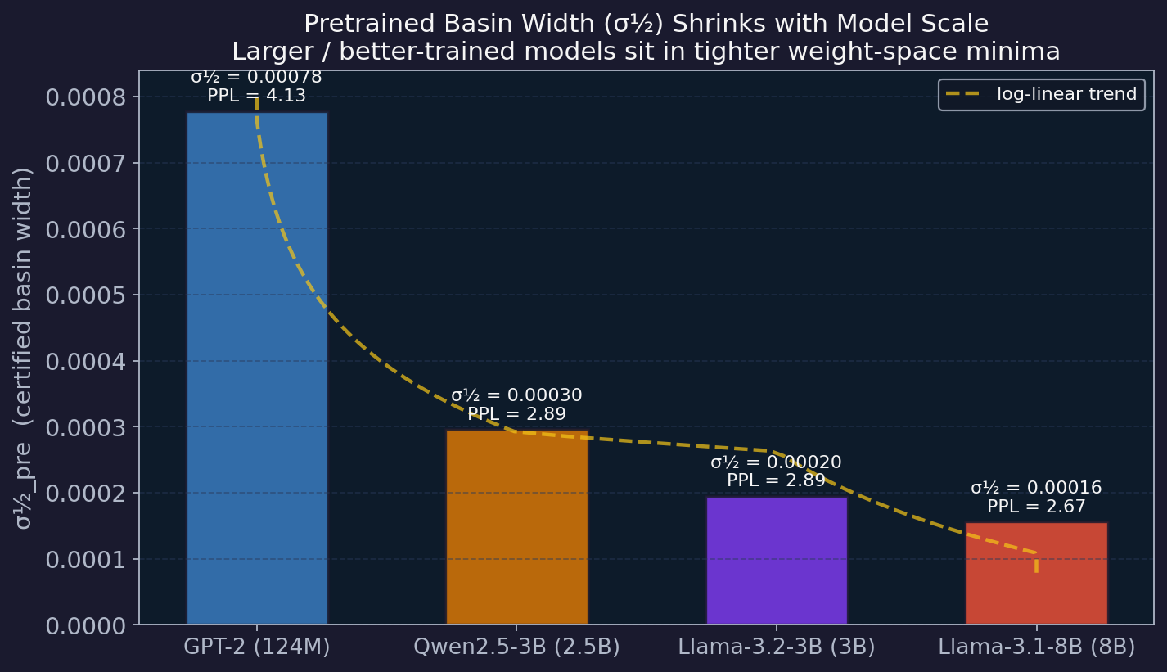
F1 — σ½ Shrinks with Model Capability
Better models sit in tighter weight-space minima (pretrained only, no fine-tuning)
Key numbers
GPT-2 (124M): σ½=7.78e-4
Qwen (2.5B): σ½=2.96e-4 (2.6×)
Llama (3.0B): σ½=1.95e-4 (4.0×)
Llama (8.0B): σ½=1.57e-4 (5.0×)
Implications
→ σ½ tracks pretrained PPL — smaller basin = better model
→ Consistent with Neural Thickets: denser clusters at larger scale → tighter geometry
→ Tighter σ½ → safe LR budget shrinks at scale
→ Thicket threshold (~1.5B) should show a kink in this curve
σ½_pre measured on pretrained model only. Dashed = log-linear trend. GPT-2 is 5× wider than Llama-3.1-8B. Absolute LR safety threshold therefore differs by 5× across this range.

Slide 7
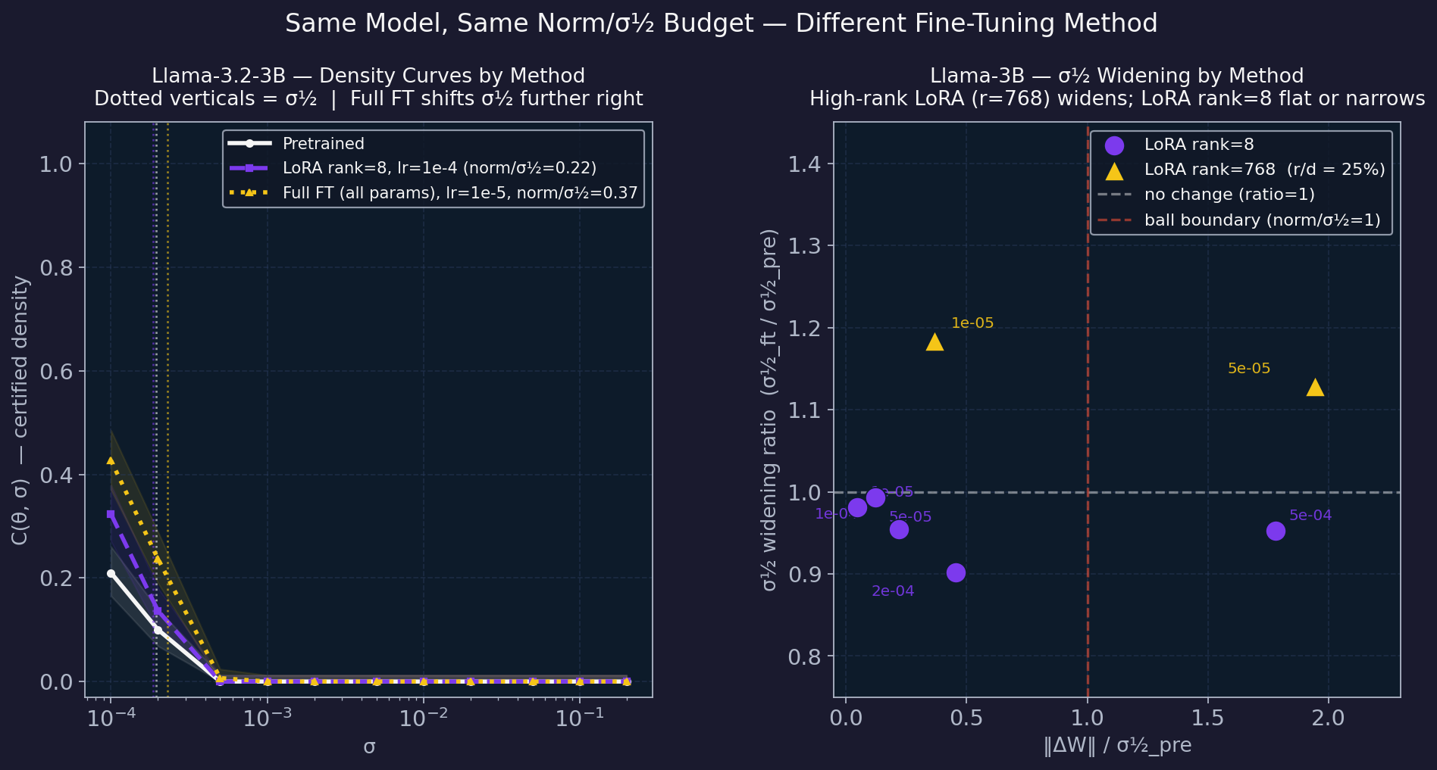
F3/F4 — Widening Depends on Scale × Rank Coverage (Llama-3B focus)
Same model, same norm budget — rank coverage (r/d) determines whether basin widens or narrows
Llama-3B results
LoRA rank=8:
lr=1e-4, norm/σ½=0.22
ratio=0.955× (narrows)
PPL=1.007 ✓
LoRA rank=768 (r/d=25%):
lr=1e-5, norm/σ½=0.37
ratio=1.184× (widens!)
PPL=1.009 ✓
Both inside ball →
both PPL-stable
Interpretation
→ F2 holds for both ranks
→ rank=8 (0.26% coverage) does NOT widen at 3B — rank=768 (25%) does
→ Higher rank LoRA accesses more directions → can reshape basin geometry
Left: density curves — rank=768 shifts σ½ further right despite lower norm. Right: widening scatter — rank=768 widens (▲), rank=8 (●) narrows. Llama-3B, SST-2, 500 steps.

Slide 8
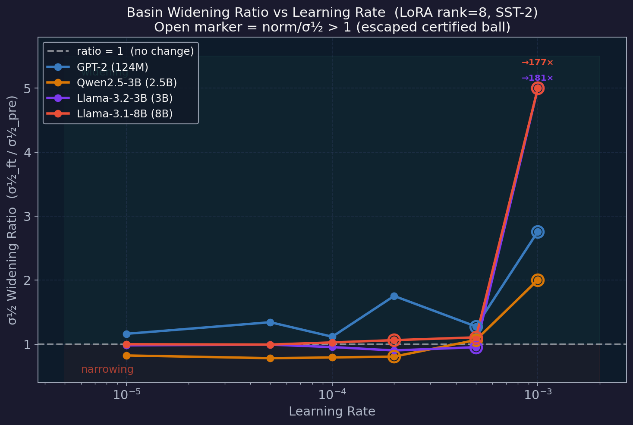
F3 — Basin Widening Depends on Model Scale
GPT-2 widens inside the ball; Qwen/Llama-3B narrow; Llama-8B flat | LoRA rank=8
Best safe widening
GPT-2 (124M): 1.75×
(lr=2e-4, norm/σ½=0.21)
Qwen (2.5B): 0.82×
(lr=1e-5, norm/σ½=0.06)
Llama (3.0B): 0.99×
(lr=5e-5, norm/σ½=0.12)
Llama (8.0B): 1.03×
(lr=1e-4, norm/σ½=0.58)
Why?
→ Tighter σ½ at scale → less volume to reshape inside ball
→ LoRA rank=8 covers only ~1% of directions → basin barely moves at 3B scale
→ Widening is a small-model phenomenon for LoRA rank=8
Open markers = norm/σ½ > 1 (escaped certified ball). Dashed line = ratio=1. lr=1e-3: catastrophic collapse (clipped for readability).

Slide 9
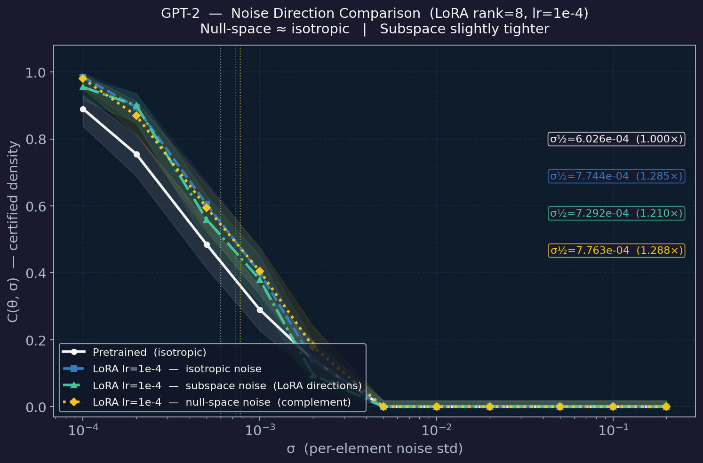
Subspace Analysis — What Directions Does LoRA Affect?
GPT-2, lr=1e-4, rank=8 | 3-way noise direction comparison
Result
Isotropic noise: 1.285×
Subspace noise: 1.210×
Null-space noise: 1.288×
Interpretation
→ Null space ≈ isotropic — the other 99% of directions are barely touched
→ Subspace slightly tighter — LoRA updates do compress the certified radius in their own directions
→ LoRA rank=8 covers only ~1% of the full parameter space
→ Geometric effect is concentrated in a tiny subspace
GPT-2 only (archive/outputs_0604). Subspace = noise in the 8 LoRA directions. Null space = noise in the complementary 99% of directions.

Slide 10
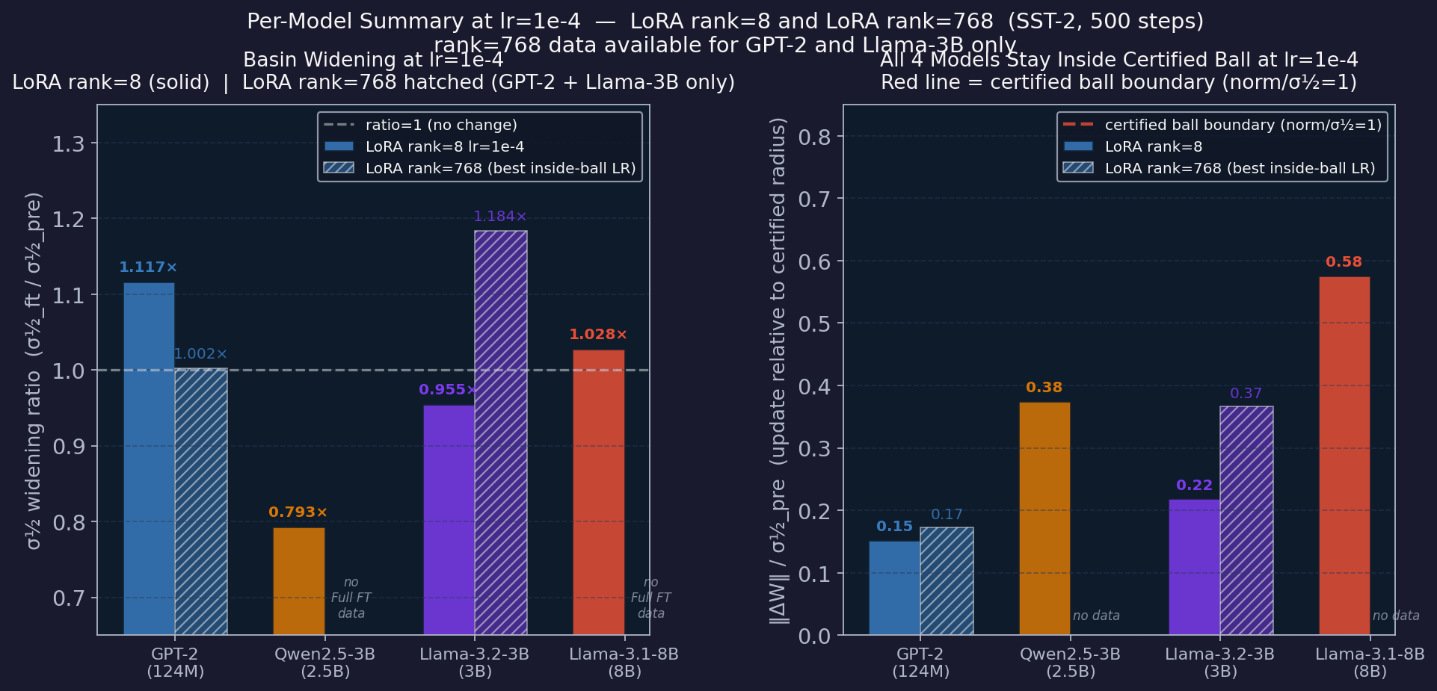
Per-Model Summary at lr=1e-4 — LoRA rank=8 vs LoRA rank=768
All 4 models, SST-2, 500 steps | Solid=rank=8 Hatched=rank=768 (GPT-2 + Llama-3B only)
Left: widening ratio — GPT-2 widens, larger models flat/narrow. Right: norm/σ½ — all below red boundary at lr=1e-4 across all 4 models. rank=768 on GPT-2: r/d=100% (full-rank attention). rank=768 on Llama-3B: r/d=25% (high-rank LoRA). Qwen + Llama-8B: rank=768 not run.

Slide 11
What's Actually Novel — Addressing the Triviality Concern
F2 alone is vulnerable; the paper's strength is F1 + F3/F4 + the practical diagnostic
The critique
What IS novel
→ σ½ is defined as the radius where performance drops
→ F2 says: if you stay inside that radius, performance doesn't drop
→ Isn't that just… the definition restated?
F1 σ½ Scaling Law
σ½ shrinks 5× from GPT-2→8B. Not definitional — measured. Better models have tighter safety budgets. Connects to Neural Thickets.
Why F2 is not fully trivial
F3/F4 Rank Coverage × Scale Interaction
→ σ½ is measured with isotropic Gaussian noise — random in all directions
→ Fine-tuning is the opposite: structured, gradient-directed, low-rank
→ No guarantee that a random-noise radius predicts robustness to a specific directional displacement
→ Like measuring a table's wobble in all directions, then predicting whether sliding an object in one specific direction is safe
→ That it holds across 33 conditions (4 models, 2 methods, 6 LRs, 4 step counts) is an empirical result — not a definition
Both conditions are LoRA — just rank=8 vs rank=768. GPT-2: low r/d widens, high r/d narrows. Llama-3B: opposite. Direction of effect reverses across scale.
Trajectory Finding
Basin widens within 100 steps and tracks norm throughout training. The safety envelope adapts in real time — not derivable from definitions.
σ½ as Practical Diagnostic
Measurable before fine-tuning. Predicts safe LR/step combinations without running experiments. Actionable even if math is intuitive.
F2 is supporting evidence (the tool works), not the main claim. The scaling law (F1) and method interaction (F3/F4) are not definitionally obvious and survive reviewer scrutiny.

Slide 12
Experiments Needed to Strengthen the Paper
Current gaps: single task (SST-2), no true full FT, no critical rank threshold, no theoretical backing
Experiment
Question it answers
Strengthens
① Rank sweep — Llama-3B ranks 8 → 32 → 128 → 256 → 512 → 768
Where is the critical coverage % that flips narrowing → widening? Is it a fixed ratio of hidden_dim?
F3/F4 become a scaling law not just two data points. Addresses rank-triviality directly.
② Second task — AG News or MNLI same models, same protocol
Does F2 hold beyond binary sentiment? Does σ½ scaling (F1) reproduce on harder tasks?
Reviewers will ask about SST-2 being too easy. One task → four tasks.
③ True full fine-tuning — Llama-3B all parameters, no LoRA
Is F4 (method × scale) real? Current 'Full FT' is LoRA r=768 (25% coverage), not true FT.
F4 validity. Currently the comparison is high-rank vs low-rank LoRA, not FT vs LoRA.
④ Downstream accuracy (classification F1, not just PPL)
Does the boundary predict task accuracy stability, not just perplexity?
PPL is a proxy. Accuracy is what practitioners care about. Makes F2 directly actionable.
⑤ 1.5B scale point Llama-1B or Qwen1.5-1.5B
Is there a 'thicket threshold' where σ½ drops sharply? Or smooth scaling across sizes?
Neural Thickets connection. Fills gap between GPT-2 and 3B in the scaling law (F1).
⑥ Quantization tolerance int8/int4 post-FT
Does wider σ½ after FT predict better tolerance to quantization? Practical use case for σ½.
Gives σ½ a concrete downstream use beyond a diagnostic. Links to deployment workflow.
● High priority (blocks conference submission) ● Medium (strengthens framing) ● Low (nice to have)

Slide 13
Summary & Open Questions
What we have
Open Questions
F1 σ½ Scaling Law
→ Why does GPT-2 widen but 3B LoRA narrows? Architecture, scale, pretraining diversity?
→ Does wider σ½ after FT improve generalization, or is it a geometric artifact?
→ Thicket threshold (~1.5B): should σ½ show a kink there? (need a 1.5B data point)
→ Can σ½ serve as an overfitting diagnostic during training (monitor per checkpoint)?
→ Is 'certified ball as universal LR/steps budget rule' the right paper framing?
→ Should we pursue supervised RandOpt to compare with LoRA on a common budget?
σ½_pre shrinks 5× from GPT-2 → 8B. Better models = tighter basins. Aligns with Neural Thickets.
F2 Universal PPL Safety Boundary
norm/σ½ < 1 predicts PPL stability. 33 conditions: 4 models, 2 methods, 6 LRs, 4 step counts. Zero exceptions. Temporal dimension (steps sweep) now validated.
F3 Widening Depends on Scale × Rank Coverage
GPT-2 rank=8 (r/d=1%) widens 1.1–1.75×. Llama-3B rank=8 (r/d=0.26%) narrows (0.95×). Llama-3B rank=768 (r/d=25%) widens (1.18×). Sufficient r/d required at a given scale.
F4 Coverage Effect Reverses Across Scale
GPT-2: low r/d (1%) widens, high r/d (100%) narrows (0.793×). Llama-3B: low r/d narrows, medium r/d widens. Scale × rank interaction — direction flips.
For professor: F3/F4 reframed — 'full FT' was LoRA rank=768 throughout, never true FT. The finding is a rank-coverage × scale interaction. Key open question: what is the critical r/d threshold per scale? Should we run the rank sweep (r=8→768 on Llama-3B) to find it?

Slide 14
H1 + H2 Results Summary
Sequential Forgetting Budget + LoRA Basin Geometry | GPT-2 & GPT-2-medium
Hypothesis
Status
Key Finding
H1 LoRA widens the loss basin
✅ Confirmed
σ½: 0.000483 (pretrained) → 0.000756 (LoRA lr=1e-4) | +57% Higher LR collapses basin — training regime determines effect
H2 R_A = 1 predicts catastrophic forgetting
✅ Confirmed (GPT-2 + medium)
R_A < 1 → ≤5.6% forgetting | R_A > 1 → ≥18% forgetting Threshold holds across model scale (124M and 354M params) Trajectory shows forgetting accelerates exactly at R_A = 1
H3 LoRA subspace certification — Partial / Revised: Subspace σ½ (0.000667) is 12% narrower than isotropic (0.000756). Update subspace is the sharpest direction; null-space ≈ isotropic is a geometric consequence of rank (8) << d (85M), not an independent finding.
H2: AGNews→SST-2 forward | σ½_A measured with NLL (GPT-2 σ½=6.36e-4, Medium σ½=1.90e-3) | R_A = per-param-norm / σ½_A

Slide 15
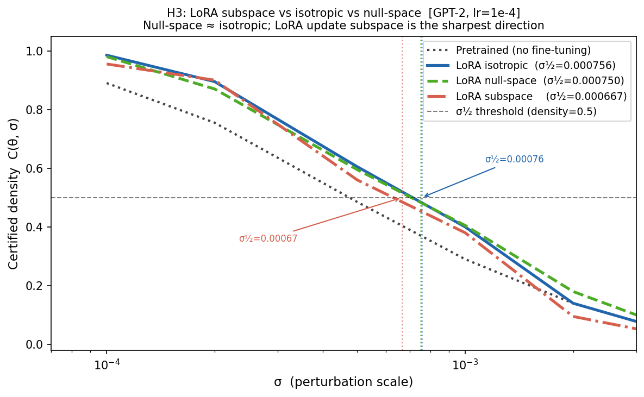
H1 — LoRA Widens the Loss Basin
Isotropic noise density | GPT-2, WikiText-2 NLL | lr=1e-4, rank=8
Key result
Pretrained σ½ = 0.000483 LoRA lr=1e-4 σ½ = 0.000756 (+57% wider)
What this means
After LoRA fine-tuning, random weight perturbations up to 57% larger are tolerated without loss degradation. Higher LR (5e-4) collapses the basin — all σ start below 0.5. Training regime controls the tradeoff.
H3 note
Subspace σ½ = 0.000667 (<iso) → LoRA update dirs are sharpest Null ≈ iso: geometric artifact (rank 8 << d=85M)
Density = fraction of N=200 perturbations where NLL(θ+ε) ≤ NLL(θ) + 1e-4 | σ½ = largest σ with density ≥ 0.5 (interpolated)

Slide 16
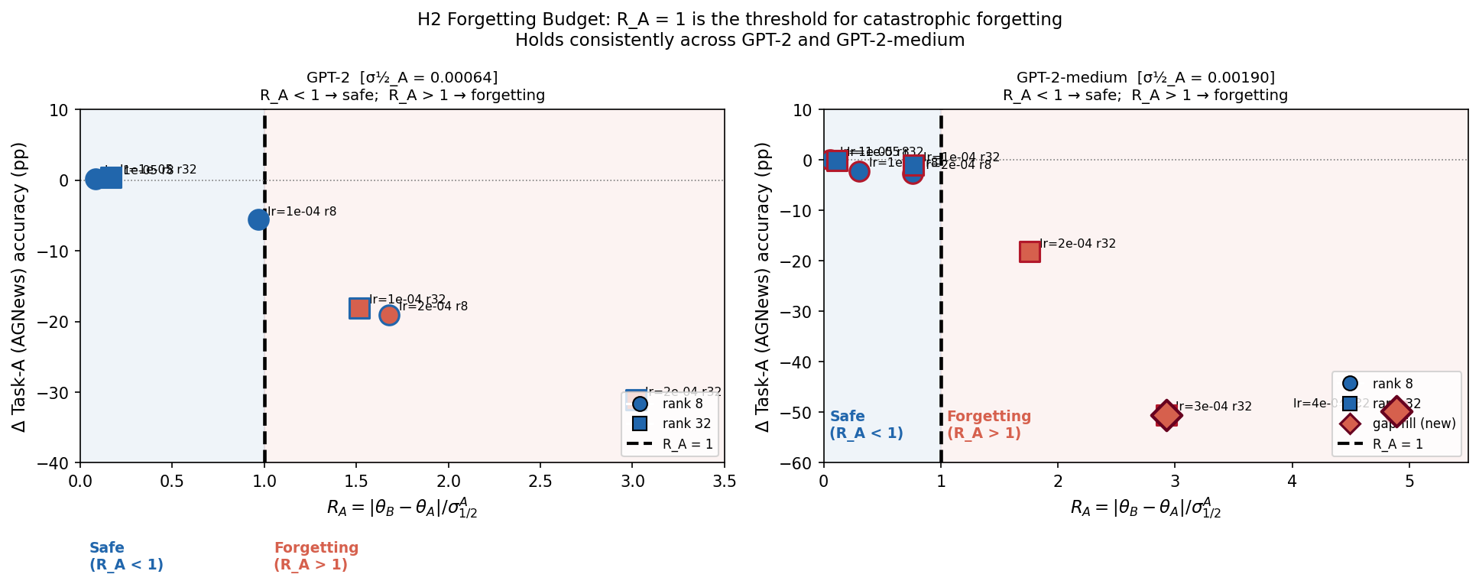
H2 — R_A = 1 Threshold (Forward: AGNews → SST-2)
R_A < 1 → safe (≤5.6% forgetting) | R_A > 1 → catastrophic forgetting (≥18%)
GPT-2 (124M)
σ½_A = 0.000636 (NLL) Max safe R_A: 0.967 → −5.6% First forget: 1.516 → −18.1% At R_A=3.0: → −31.1%
GPT-2-medium (354M)
σ½_A = 0.001900 (NLL) Max safe R_A: 0.767 → −1.1% First forget: 1.759 → −18.2% At R_A=4.9: → −50%
Scale result
Both models show same threshold at R_A = 1. R_A normalizes cross- model comparisons.
8 medium conditions (0620, same Phase 1) + 6 GPT-2 conditions (0619) | ◆ = gap-fill conditions lr=3e-4, 4e-4 | R_A = ‖θ_B−θ_A‖_per-param / σ½_A

Slide 17
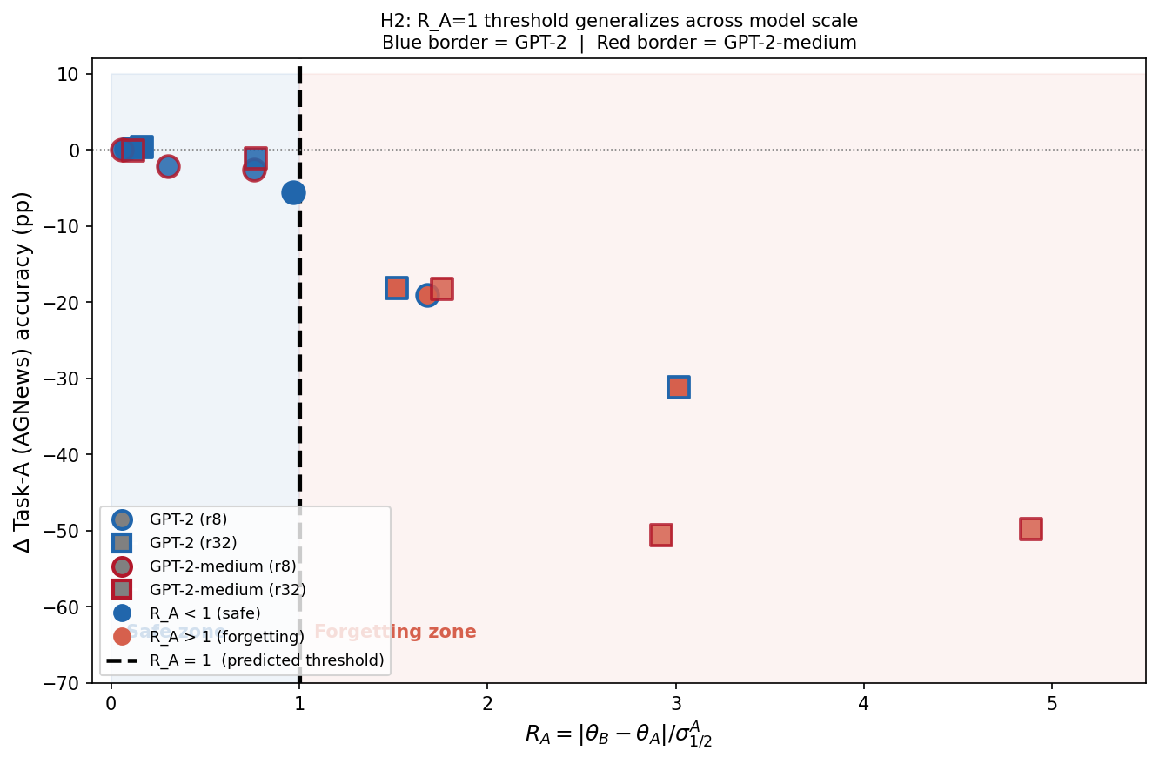
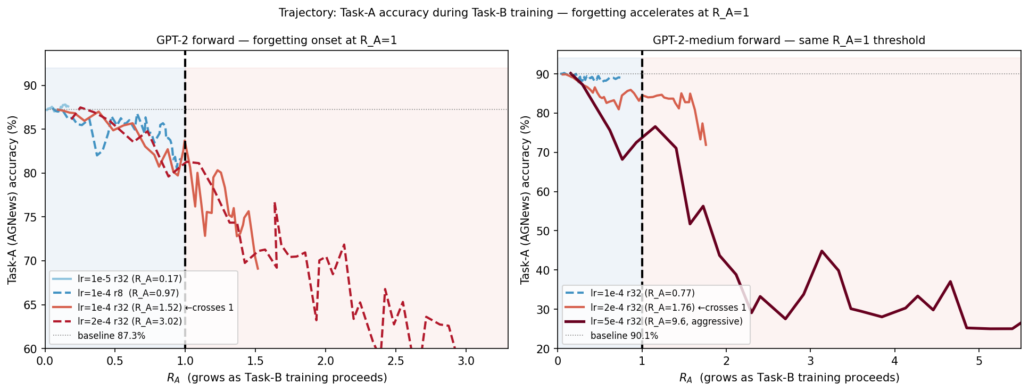
H2 — R_A = 1 Generalizes Across Scale + Trajectory Evidence
Both models align at R_A=1 | Forgetting accelerates exactly when R_A crosses 1 during training
Left: all 14 conditions, both models, one plot — blue border=GPT-2, red border=medium | Right: Task-A accuracy during Task-B training — R_A grows left to right as Phase 2 trains

Slide 18
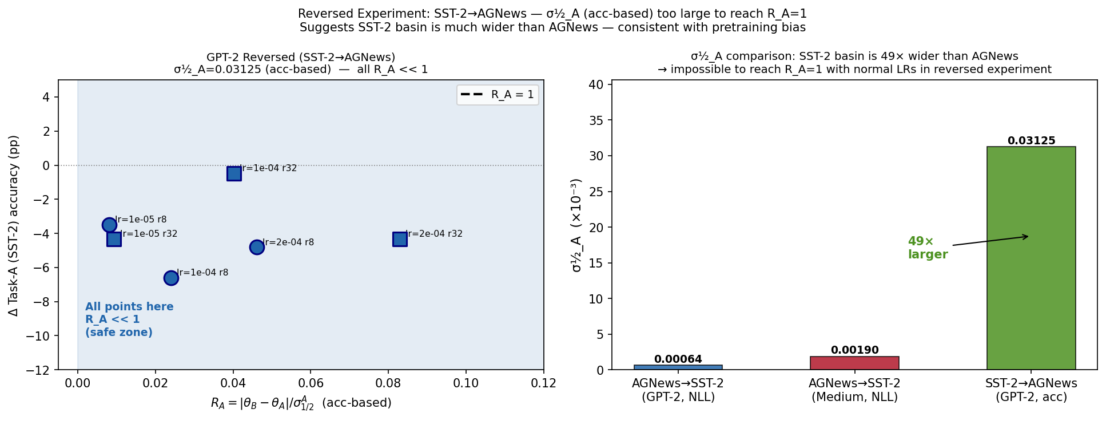
H2 — Reversed (SST-2 → AGNews): Basin Asymmetry Finding
Cannot reach R_A=1 with standard LRs — SST-2 basin 49× wider than AGNews
What happened
SST-2 σ½_A = 0.031250 (acc-based, δ=5pp) Max norm at lr=2e-4: = 0.00259 → R_A_max = 0.083 Cannot reach R_A=1 with normal fine-tuning.
What it means
SST-2's basin is 49× wider than AGNews's. GPT-2's WebText pretraining is news-heavy → AGNews specializes sharply (narrow basin), SST-2 sentiment is diffuse (wide basin). σ½_A predicts WHICH task sequences are at risk — not just when forgetting occurs.
Reversed: SST-2 as Task A (acc-based σ½), AGNews as Task B | 6 conditions, GPT-2 | All R_A < 0.09 — far from threshold

