Slide 1
NTRS
Neural Thickets × Randomized Smoothing
H1 + H2 Experimental Results
H1 LoRA widens the certified weight-space basin
H2 R_A = 1 predicts catastrophic sequential forgetting
Kina Kim | SFU | June 2026

Slide 2
Results at a Glance
Two hypotheses tested | GPT-2 (124M) and GPT-2-medium (354M)
Hypothesis
Status
Key Finding
H1 LoRA widens the loss basin
✅ Confirmed
Pretrained σ½=0.000483 → LoRA lr=1e-4 σ½=0.000756 (+57%) Higher LR (5e-4) collapses basin — training regime controls the tradeoff. LoRA update directions are 12% sharper than isotropic (higher curvature).
H2 R_A = 1 predicts catastrophic forgetting Forward: AGNews → SST-2
✅ Confirmed (GPT-2 + medium)
R_A < 1 → ≤ 5.6% forgetting (safe) R_A > 1 → ≥ 18% forgetting (significant/catastrophic) Threshold at R_A=1 holds identically across both model scales.
H2 Reversed: SST-2 → AGNews
⚠️ Informative null result
Cannot reach R_A=1 with standard LRs — SST-2 σ½_A is 49× wider than AGNews. Finding: σ½_A encodes task specialization depth. AGNews creates a narrow basin (pretraining bias: WebText is news-heavy); SST-2 creates a wide, diffuse basin.
σ½_A = certified radius of Task A basin | R_A = per-param displacement / σ½_A | NLL criterion for AGNews (4-class), acc-based (δ=5pp) for SST-2 (binary)

Slide 3
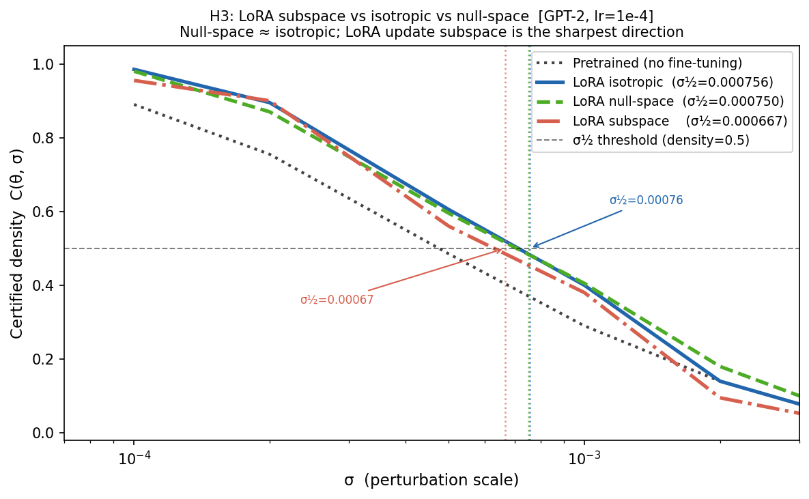
H1 — LoRA Widens the Certified Weight-Space Basin
GPT-2, WikiText-2 NLL scoring | lr=1e-4, rank=8 | 3-way noise direction comparison
Key numbers
Pretrained σ½ = 0.000483 LoRA isotropic σ½ = 0.000756 → +57% wider Null-space σ½ = 0.000750 LoRA subspace σ½ = 0.000667 → 12% narrower
Subspace result
The LoRA update directions are the sharpest (highest curvature) — perturbations there hurt most. Null ≈ isotropic because rank=8 is 0.00001% of d=85M params — geometric consequence, not a robustness finding.
Density = P[NLL(θ+ε) ≤ NLL(θ)+1e-4] with ε~N(0,σ²I) | N=200 perturbations per σ | σ½ interpolated at density=0.5

Slide 4
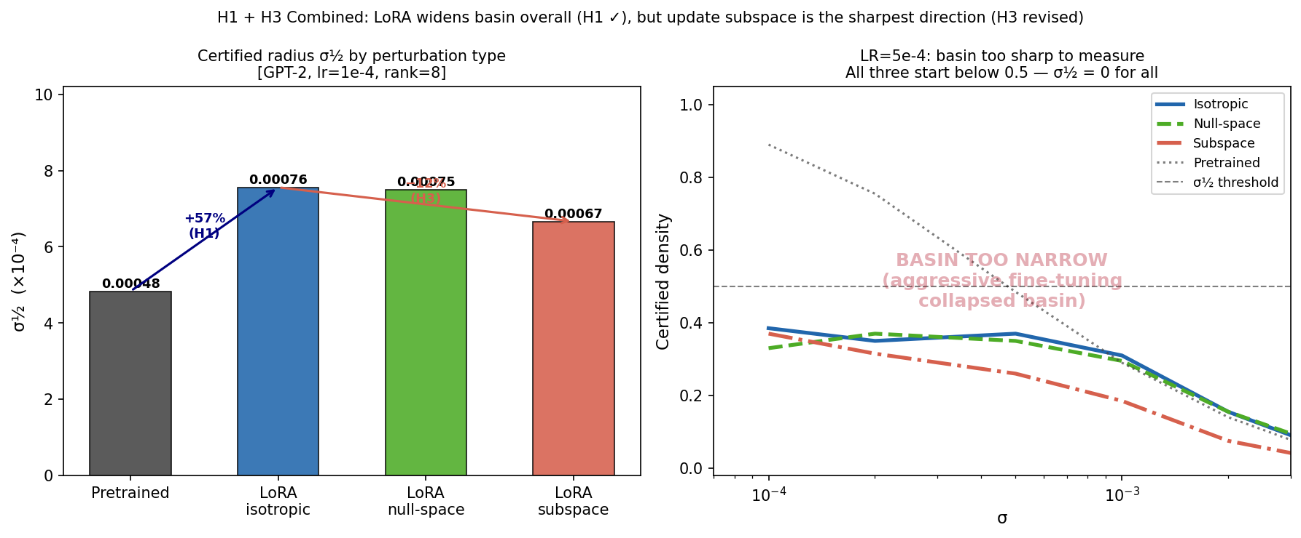
H1 — Basin Width vs Training Regime
LR=1e-4 widens; LR=5e-4 collapses — strong regime dependence
High-LR collapse
At lr=5e-4: density < 0.5 even at σ=0.0001 (smallest test point). Model moved so far from pretrained weights that even infinitesimal noise destroys performance — basin is smaller than measurement resolution.
Implication for H2
σ½_A (Task A certified radius) depends on which LR was used for Phase 1 fine-tuning. Conservative lr=1e-4 gives the most reliable σ½_A.
Left bar = σ½ (×10⁻⁴) | Right panel: lr=5e-4 density curves for all 3 directions — none reach 0.5 threshold

Slide 5
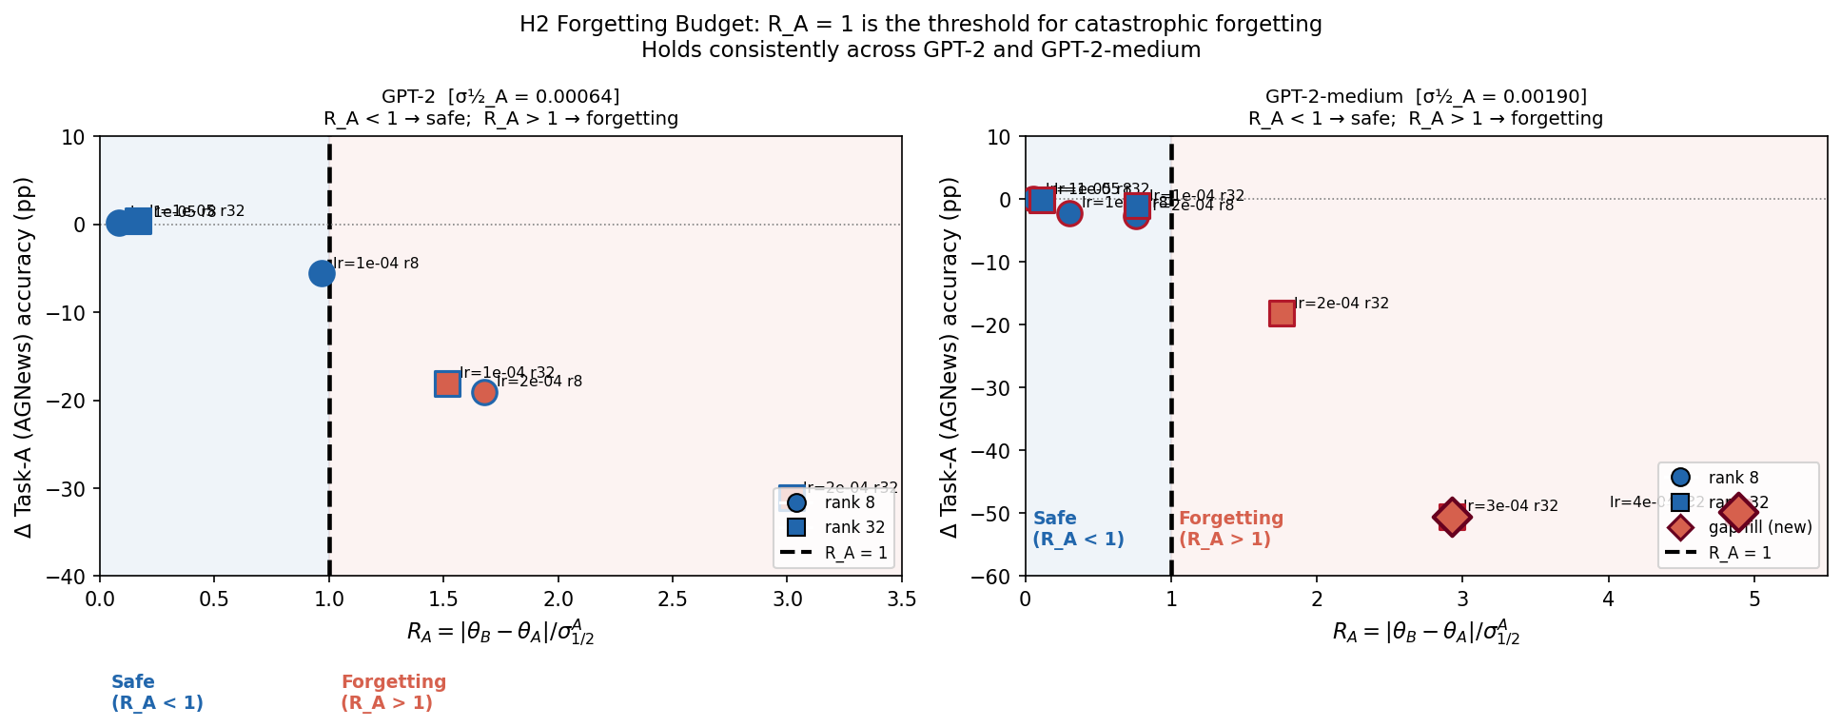
H2 — R_A = 1 Threshold (Forward: AGNews → SST-2)
R_A < 1 → safe (≤5.6% forgetting) R_A > 1 → ≥18% forgetting
GPT-2 (124M) σ½_A = 6.36×10⁻⁴
R_A=0.967 → −5.6% safe R_A=1.516 → −18.1% forget R_A=3.017 → −31.1%
GPT-2-medium (354M) σ½_A = 1.90×10⁻³
R_A=0.767 → −1.1% safe R_A=1.759 → −18.2% forget R_A=2.923 → −50.5% R_A=4.889 → −49.8%
Same threshold across scales
Both jump from <6% to >18% at R_A=1. σ½_A normalizes the cross-model comparison.
8 medium conditions (0620, shared Phase 1) + 6 GPT-2 conditions (0619) | ◆ = gap-fill lr=3e-4,4e-4 | R_A = ‖Δθ‖_RMS / σ½_A

Slide 6
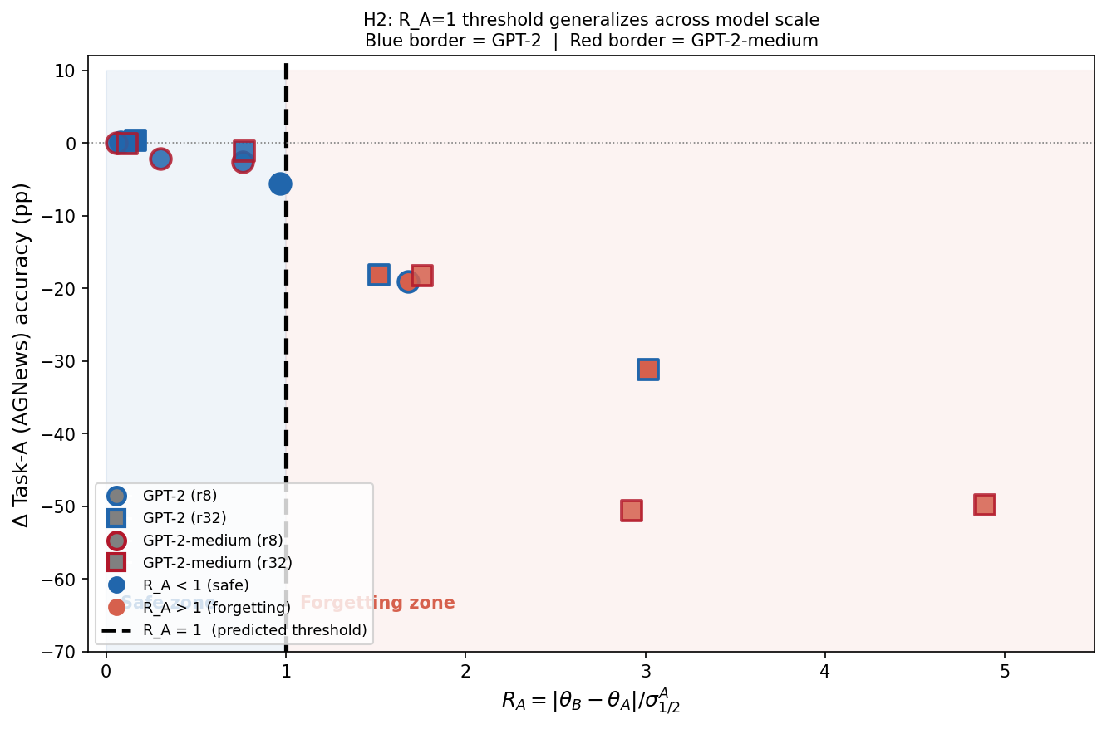
H2 — Scale-Invariant Forgetting Budget
Both models plotted on same R_A axis — threshold aligns at R_A=1 regardless of model size
Why R_A works cross-model
Raw displacement ‖Δθ‖ is not comparable across models — medium moves 47% further than GPT-2 at the same LR, but forgets less because its basin is wider. R_A = ‖Δθ‖ / σ½_A normalizes by basin width, making both models comparable on a single axis with the same threshold.
Result
14 conditions, 2 model sizes, zero exceptions to R_A=1 threshold. Blue border = GPT-2 | Red = medium Filled = R_A<1 (safe) | Warm = R_A>1
★ = medium aggressive lr=5e-4 r=32 (R_A=9.6, ΔA=−65%, from separate Phase 1 run) | All other points share same Phase 1 within each model

Slide 7
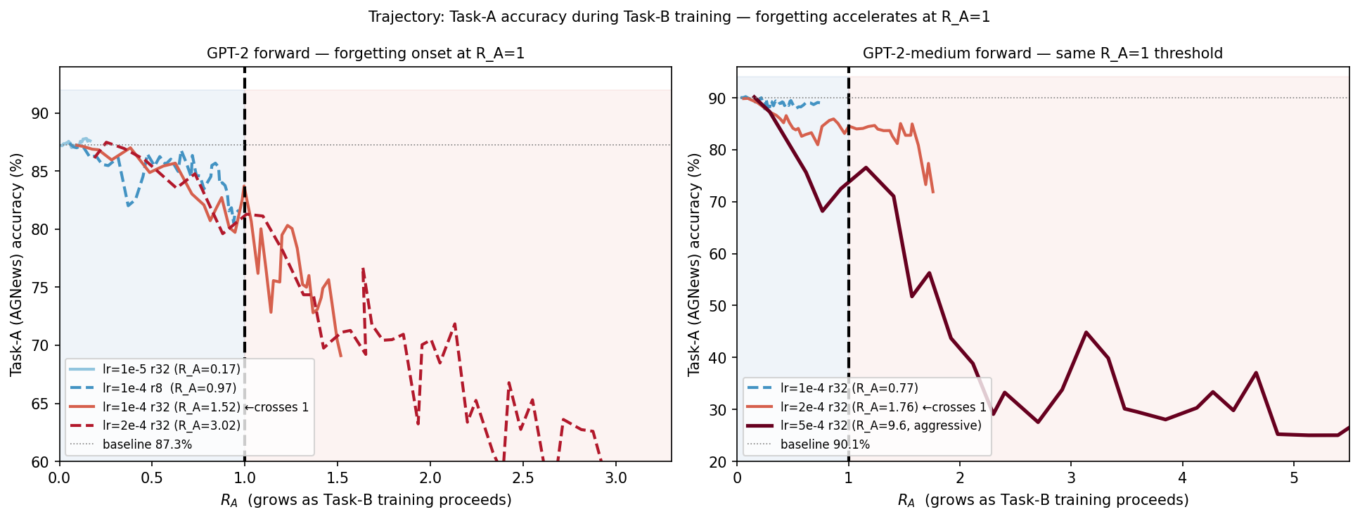
H2 — Forgetting Accelerates Precisely at R_A = 1
Task-A accuracy during Task-B training | R_A grows left-to-right as Phase 2 trains
Left: GPT-2 — lr=1e-4 r=32 crosses R_A=1 mid-training and drops from 87% to 69% | Right: medium — lr=2e-4 r=32 crosses R_A=1 and drops to 72%; aggressive drops to 25%

Slide 8
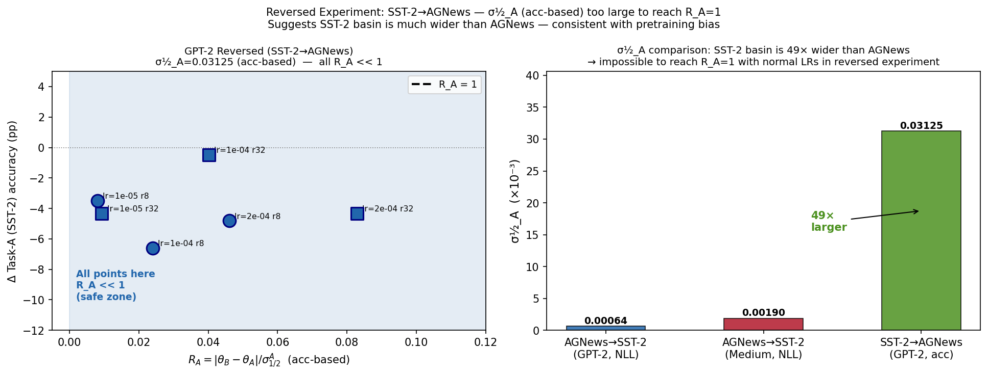
H2 — Reversed (SST-2 → AGNews): A Basin Asymmetry Finding
Cannot reach R_A=1 under standard conditions — SST-2 basin is 49× wider than AGNews
Why R_A stays << 1
SST-2 acc-based σ½_A = 0.0313 AGNews NLL-based σ½_A = 0.000636 Ratio: 49× To reach R_A=1 in reversed direction: need norm > 0.031 Current max norm = 0.00259 → need ~12× more displacement (lr ≈ 2e-3, unstable territory)
What this means
SST-2 sentiment is diffuse and deeply embedded in GPT-2 (WebText pretraining encodes sentiment broadly). AGNews topic classification specializes a narrow subregion → easy to overwrite. σ½_A measures task specialization depth.
6 GPT-2 conditions, SST-2→AGNews | acc-based σ½_A (δ=5pp) for SST-2 Task A | Cannot run NLL-based here — NLL overestimates binary task basin

Slide 9
Next Steps — H3: Proper Subspace Testing via Rank Sweep
Current rank=8 is 0.00001% of d=85M — null-space ≈ isotropic is a geometric artifact, not a finding
The problem with rank=8
Hypothesis
rank / d_block = 8 / 85M ≈ 0.00001% Any isotropic Gaussian lives almost entirely in the null-space by geometry. → null ≈ isotropic is trivially guaranteed, not an empirical finding. → subspace (12% sharper) is real but effect is small at this rank.
At some rank coverage threshold, subspace σ½ / isotropic σ½ diverges significantly. Below that threshold, the subspace is too small to matter. Plot: subspace σ½ / iso σ½ vs rank Look for the inflection point.
Proposed rank sweep (same lr=1e-4, same σ grid)
Rank
rank/d (%)
Coverage
Expected signal
8
0.00001%
baseline (current)
null ≈ iso (trivial)
Run commands
32
0.00004%
still negligible
null ≈ iso
for RANK in 8 32 128 512 768; do python3 lora_density_experiment.py \ --model gpt2 --lr 1e-4 \ --lora_rank $RANK \ --subspace --null_space \ --output_dir outputs_h3_rank_sweep done
128
0.00015%
~0.1% coverage
first divergence?
512
0.0006%
still low, but larger
subspace vs iso gap grows
768
0.0009%
max LoRA rank for GPT-2
largest testable effect
One command per rank — lora_density_experiment.py takes single --lora_rank | Each run: ~20–40 min on A40 | All runs share same σ grid for direct comparison

Slide 10
Next Steps — H2: Better Task Pairs for Stronger Claim
AGNews/SST-2 has two weaknesses — pretraining bias asymmetry + 49× basin width mismatch
Problems with AGNews → SST-2
① Pretraining bias: GPT-2 trained on WebText (news-heavy) → AGNews is 'easy to specialize.' ② Basin asymmetry: SST-2 σ½_A is 49× wider than AGNews — reversed direction can't reach R_A=1. ③ Weak reversed experiment limits H2 to one direction only.
Recommended pairs (all available in basin_widening_experiment.py)
Task pair
Type
Why better
Priority
AGNews → DBpedia
Topic → Topic (4-class → 14-class)
Both topic classification, no NLI/sentiment bias. More symmetric basins. Pretraining neutral.
★ Try first (easiest)
DBpedia → AGNews
Reversed of above
Tests whether threshold holds in both directions. DBpedia is fine-grained, AGNews is coarse — directional.
★ Run together
MNLI → AGNews
NLI → Topic (3-class → 4-class)
Structurally different tasks, no pretraining bias for either. MNLI fine-tuning doesn't specialize a narrow news-basin.
Good backup
Key criterion: both tasks >80% accuracy on GPT-2 | σ½_A within ~5× in both directions | Neither task has large pretraining advantage
RTE/QQP/MRPC not in current script — would need to add loaders | DBpedia: 14-class ontology | MNLI: 3-class NLI (entail/neutral/contradict)

Slide 11
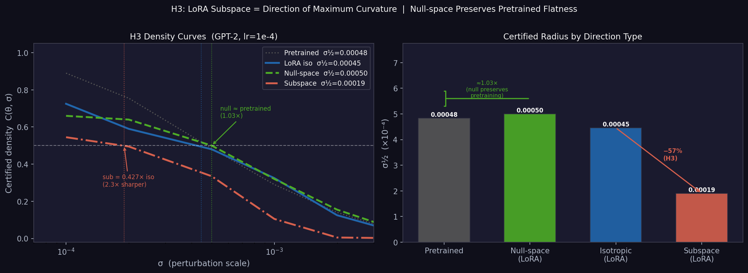
H3 Update — LoRA Subspace is 2.3× Sharper Than Isotropic
New run | sub/iso = 0.427 (vs 0.882 in initial run) | null ≈ pretrained (1.03×)
Key numbers
σ½ pretrained = 0.000483 σ½ null-space = 0.000500 ← ≈ pretrained σ½ isotropic = 0.000445 σ½ subspace = 0.000190 ← sharpest sub / iso = 0.427× (−57%) null / pretrained = 1.03×
What it means
LoRA update directions are the curvature-concentrated directions. Null-space (≈pretrained) is the flat / generalization space. Fine-tuning with LoRA separates the weight space into: • sharp subspace (updated dirs) • flat null-space (unmodified dirs)
Previous vs new
Initial run (0620_lora): sub/iso = 0.882 (−12%) New run (0621_h3): sub/iso = 0.427 (−57%) Both same lr=1e-4, GPT-2 → effect is real, run-dependent
H3: subspace = LoRA-adapted directions in weight space | null-space = directions orthogonal to LoRA update | NLL criterion, N=200 perturbations

Slide 12
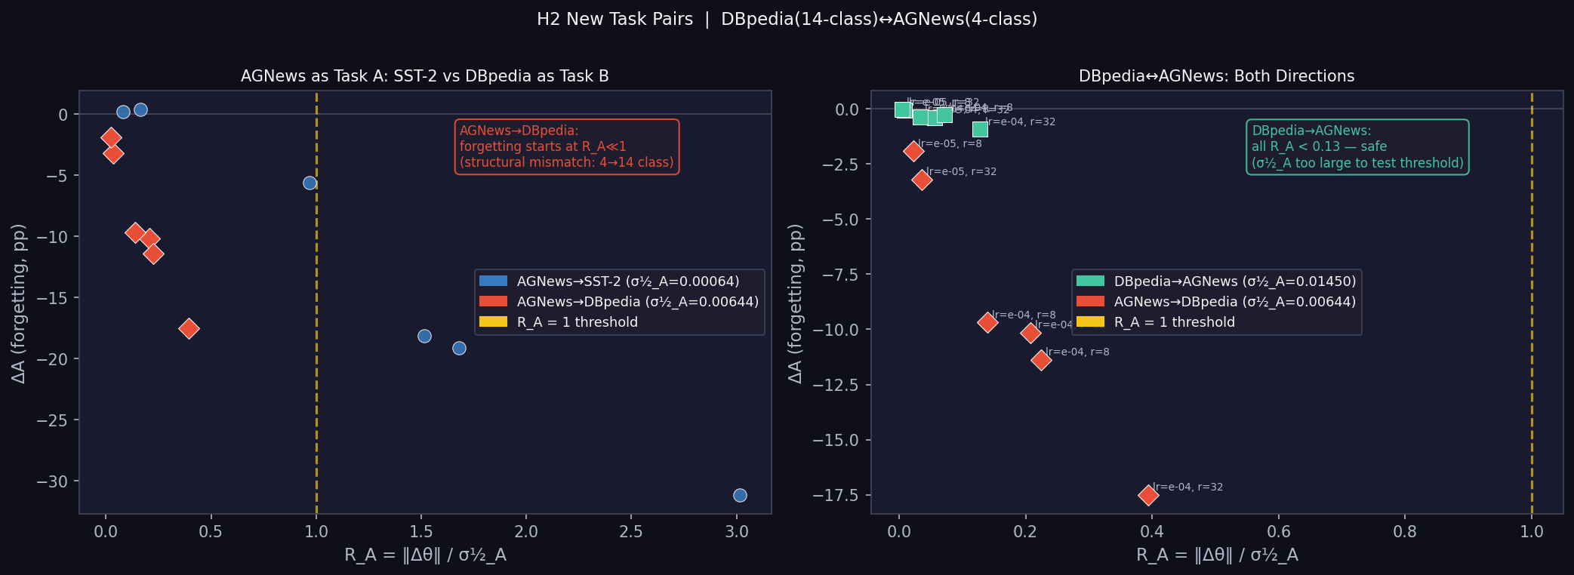
H2 New Task Pairs — DBpedia ↔ AGNews
DBpedia→AGNews: safe at all tested R_A | AGNews→DBpedia: early forgetting reveals threshold boundary
DBpedia→AGNews
σ½_A = 0.014500 (NLL) Max R_A = 0.128 → −0.9% All conditions safe. R_A never reaches 1 — σ½_A too large to test threshold. DBpedia (14-class) creates a very wide basin (high diversity).
AGNews→DBpedia
σ½_A = 0.006442 (NLL) Max R_A = 0.394 → −17.5% Forgetting at R_A << 1! This is structural mismatch: 4-class → 14-class output forces representation change even at small weight displacement.
Implication for H2
R_A=1 threshold (H2) holds for structurally similar tasks (AGNews→SST-2 both <5 classes). Structural mismatch (4→14 class) causes forgetting at R_A≪1 via representational drift, not basin exit. Better pair needed: tasks with similar class granularity.
DBpedia: 14-class Wikipedia topic | AGNews: 4-class news topic | GPT-2, NLL-based σ½_A | 6 conditions per direction (lr × rank grid)

