Slide 1
NTRS
Neural Thickets × Randomized Smoothing
Certified Geometry of the LLM Post-Training Weight Space
H1 Universal Adaptation Scale
H2 Forgetting Budget
H3 Model Merging
Kina Kim | SFU | June 2026

Slide 2
Post-training has no formal guarantees
→ LoRA, RLHF, and SFT adapt LLMs — but none answer: how far can we move θ before quality degrades?
→ Practitioners tune learning rate by trial and error; there is no principled safe budget
→ Sequential fine-tuning causes catastrophic forgetting — but when, and by how much?
→ Model merging works empirically but has no geometric sufficient condition for success
What a certificate could buy
→ Predict a safe LR and step count before running any fine-tuning
→ Know when sequential FT will cause forgetting without running it
→ Certify that a model merge will succeed from geometry alone

Slide 3
We bring Randomized Smoothing (RS) into weight space
Original RS
NTRS — weight-space RS (this work)
→ Perturb the INPUT x with Gaussian noise
→ Certify robustness to adversarial input changes
→ Radius in input space: r* = σ · Φ⁻¹(p_A)
→ Perturb the WEIGHTS θ with Gaussian noise
→ Certify robustness to post-training weight changes
→ Same Binomial CI machinery
=> new domain, new meaning
C(θ, σ) = P_{ε ~ N(0, σ²I)}[ s(θ + ε) ≥ m ]
s(θ) = quality score (e.g. WikiText-2 NLL) m = quality threshold
(GPT2 models trained on WebText; WikiText-2 for validation as a benchmark)
=> C → 1.0: model survives ALL perturbations of scale σ (deep inside the basin)
=> C → 0.0: model is at the edge — small noise degrades quality

Slide 4
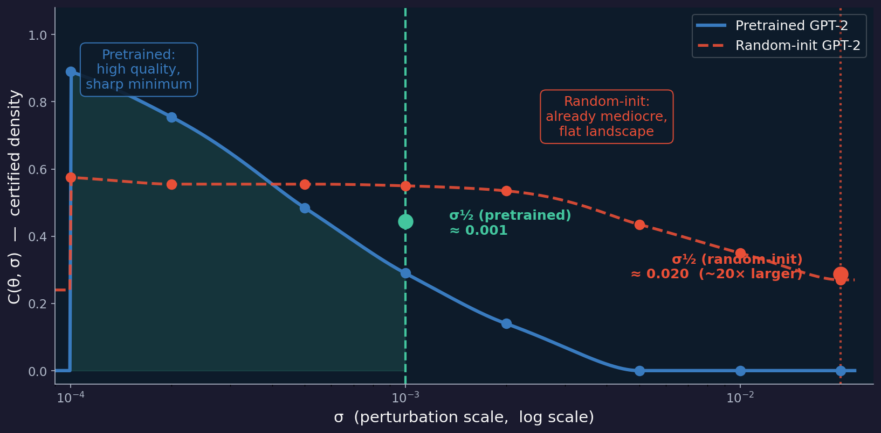
C(θ, σ) → σ½ visualization
Reading the curve
Left of σ½: model is robust — nearly all perturbations preserve quality
σ½: the half-way point — 50 % of perturbations now degrade quality
Right of σ½: model is fragile at this noise scale
Pretrained model has a MUCH wider safe zone than random-init
σ½ in one sentence
σ½ is the certified radius of the pretrained model's weight-space basin
→ Smaller σ½ = sharper minimum = better-trained model

Slide 5
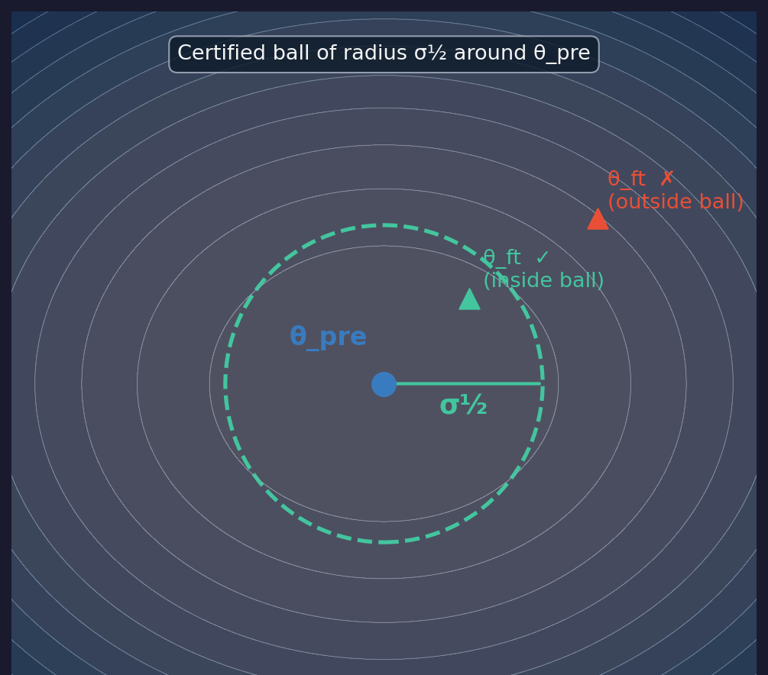
σ½ is the radius of the safe zone in weight space
Inside the ball ✓
‖ε‖ < σ½ → s(θ+ε) ≥ m with high probability
Fine-tuned model stays near pretrained quality
WikiText-2 PPL ratio stays ≈ 1.0
Outside the ball ✗
‖ε‖ > σ½ → quality degrades in expectation
Fine-tuned model drifts off the pretrained loss surface
WikiText-2 PPL ratio rises above 1.02
Perturbations are isotropic Gaussian — random direction, fixed scale σ

Slide 6
Motivation behind σ½ for three hypotheses
Model-agnostic
Measurable before fine-tuning
σ½ absorbs differences in scale, arch, and pre-training quality
‖Δθ‖ / σ½ is dimensionless → Comparable across GPT-2, Llama, etc.
→ Without, each model needs its own threshold
Computed on θ_pre in ~2 min → no task labels, no fine-tuning
Gives a predictive budget BEFORE the experiment starts
Interpretable geometry
Connects to Neural Thickets
R_A > 1: “you have left the certified basin of Task A”
d < (σ½_A + σ½_B): “the two basins overlap — merge is safe”
Geometric picture is intuitive and falsifiable
Larger / better-trained models → smaller σ½ (tighter basin)
Consistent with NT solution-density scaling law
σ½ is the empirical correlate of 'thicket density'

Slide 7
H1 · Universal Adaptation Scale
One normalised number for stability prediction
R = ‖Δθ‖ / σ½_pre ≈ 1 is a universal stability boundary
Normalising by σ½ collapses all PPL-degradation curves onto one trajectory
R < 1 → update inside the certified ball → pretraining quality preserved
R > 1 → update outside the ball → WikiText-2 PPL degrades
σ½ is the natural unit that makes fine-tuning scale comparable across architectures
Analogies to known scaling laws
Chinchilla
μP
H1 (claim)
N_tokens / N_params ≈ 20 collapses loss across model sizes
lr / √width collapses training curves across widths
‖Δθ‖ / σ½ collapses PPL curves across tasks, models, LRs

Slide 8
H1 · Literature Review & State of the Art
Flatness & sharpness literature
Scaling-law analogies
SAM / flat-minima line: Foret et al. (2021); Flat-LoRA (ICML 2025) shows a flat LoRA-subspace minimum can still be sharp in full parameter space
Sharpness predicts forgetting: Li et al. (2024) found forgetting correlates with loss-landscape sharpness
Gap we fill: we measure basin width directly as a certified radius (σ½), not a qualitative sharpness proxy
Chinchilla (Hoffmann et al., 2022): N_tokens / N_params collapses loss curves across model sizes
μP (Yang et al., 2021): lr / √width collapses training dynamics across widths
Gap we fill: no normalized quantity collapses fine-tuning curves across architectures — R = ‖Δθ‖/σ½ is untested
Weight-space randomized smoothing
Where H1 sits
Closest prior work: Darzi et al. (2025), RS-style Gaussian weight noise for federated-learning privacy/robustness
Cohen et al. (2019): the canonical input-space RS certificate, transplanted here into weight space
Gap we fill: no prior weight-space RS work targets a fine-tuning safe-budget certificate
Adjacent to flatness/SAM literature, but sharper: a single falsifiable ratio, not “flatter is better”
Open question we address: is R ≈ 1 a universal transition, or does it vary by architecture / task / optimizer?

Slide 9
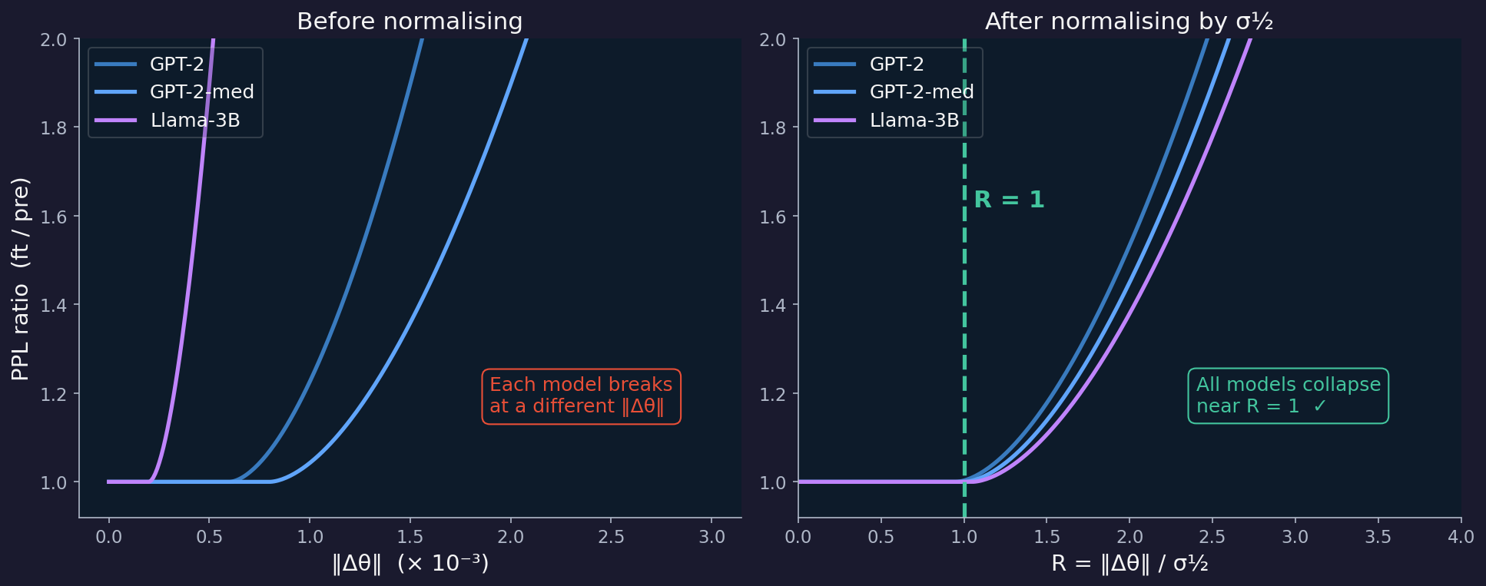
H1 — Visualised: before and after σ½ normalisation
Illustrative. If H1 holds, the right panel collapses to a single curve with a kink at R = 1.

Slide 10
H1 · Experiment Scope
5 models × 5 tasks × 6 LRs = 150 fine-tuning runs
Model
Params
σ½_pre
GPT-2
124 M
~0.00060
GPT-2-medium
354 M
~0.00081
GPT-2-large
774 M
~0.00060
GPT-2-xl
1.5 B
~0.00067
Llama-3.2-3B
3 B
~0.00020
Tasks
SST-2
MNLI
Yahoo
DBPedia
AG News
Binary sentiment: novel format
Textual inference: moderate familiarity
Q&A classification: partial overlap
Entity classification: encyclopedic
News classification : WebText familiar
→ LoRA rank = 8 (primary) · 500 steps per condition · eval on WikiText-2 NLL

Slide 11
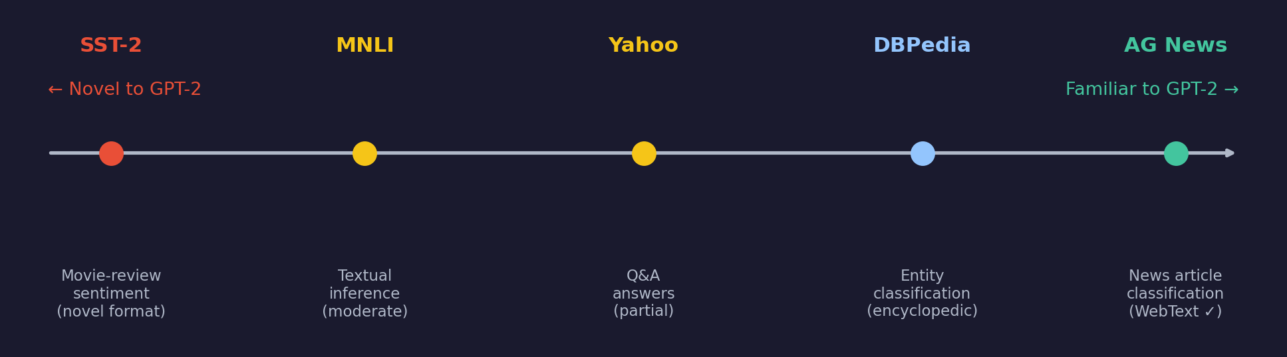
H1 · Why These Tasks? Controlling for Pretraining Familiarity
Familiar tasks (AG News, DBPedia)
Novel tasks (SST-2, MNLI)
GPT-2 was pretrained on WebText; news and encyclopedic text is heavily represented
Model needs only tiny parameter movement to classify these → R stays small even at high LR
Risk: if we only used familiar tasks, R≈1 might hold trivially and mean nothing
Short-form sentiment and textual inference are NOT dominant patterns in WebText
Model must learn a genuinely new signal → large parameter movement required → R grows
Including these tests whether R≈1 holds even when the model has to move far
Both extremes are required — without novel tasks, universality claim is untestable

Slide 12
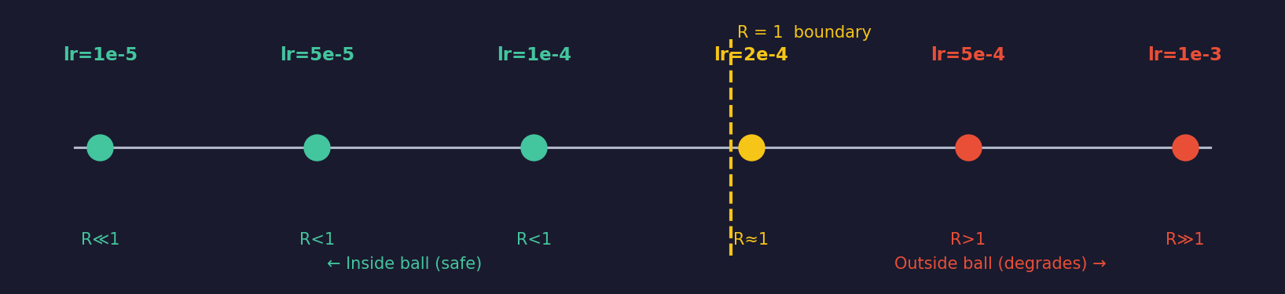
H1 · Why These LRs and Models?
Learning rates: span both sides of R = 1
Models: architecture + scale diversity
lr = 1e-5 → R ≪ 1: the safe control condition (model barely moves)
lr = 1e-4 / 2e-4 → R ≈ 0.4–0.9: expected neighbourhood of the boundary
lr = 5e-4 / 1e-3 → R > 1: deliberate overshoot — confirms degradation side
→ Without overshooting the boundary we cannot verify that σ½ predicts failure
GPT-2 family (124M → 1.5B) : isolates size effect
Llama-3.2-3B: different architecture AND training recipe (RLHF, instruction tuning)
→ Without Llama, 'universal' only means 'works for GPT-2 decoder-only stack'

Slide 13
H2 · Forgetting Budget
The certified ball of θ_A to a forgetting budget for Task B training
R_A = ‖θ_B − θ_A‖ / σ½_A > 1 predicts Task A forgetting
Whenever Phase 2 weights exit the certified ball around θ_A, Task A accuracy drops
Continual learning: R_A = 1 is a hard budget — train on Task B until this, then stop
RLHF analogy: σ½_SFT is the weight-space KL penalty radius — bounds safe RLHF movement
→Practical: compute σ½_A once, then predict forgetting without running Phase 2
Extending claim
Forgetting curve F(t) aligns across model sizes, task pairs, and LRs when plotted vs R_A(t)
The transition at R_A = 1 is sharp — a step function, not a gradual drift

Slide 14
H2 · Literature Review & State of the Art
Catastrophic forgetting literature
RLHF & KL-penalty analogy
Mechanistic view: Imanov (2026) attributes forgetting to gradient interference, representational drift, and landscape flattening
PEFT is not immune: 2025–26 work shows LoRA still causes real forgetting in continual settings
Gap we fill: existing diagnoses are post-hoc; none give a predictive budget computed before Phase 2
Standard practice: PPO/RLHF penalizes KL divergence in output space vs. the SFT reference (Ouyang et al., 2022)
Known limitation: output-space KL restricts the optimization landscape; 2025 work proposes χ² / energy-based alternatives
Gap we fill: no method defines the safe-movement radius in weight space — σ½_SFT is proposed as that analog
Continual learning & LMC view
Where H2 sits
I-LoRA (Ren et al., 2024): stability–plasticity frontier reached via low-loss valleys — hints at geometry
EWC-LoRA (Xiang et al., 2024): Fisher-matrix importance weighting — functional, not geometric, and costly
Gap we fill: one certified radius replaces per-parameter importance estimation
If confirmed, sharper than sharpness-correlation papers: predicts a hard crossing (R_A = 1), not just a directional trend
Open question we address: is the R_A = 1 transition genuinely sharp across model sizes and task pairs, or gradual?

Slide 15
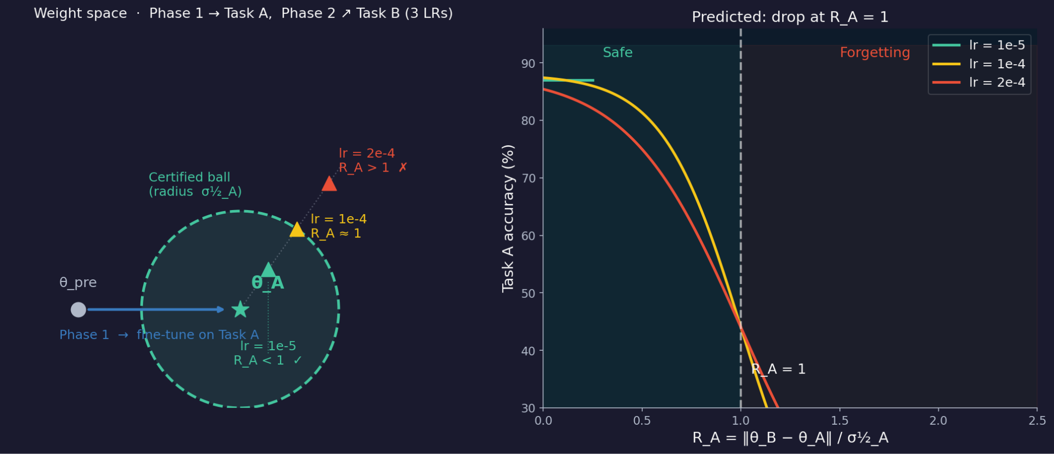
H2 — Visualised: weight-space trajectory and Task A accuracy
Left: Phase 2 trajectory in weight space — low LR stays inside σ½_A ball, high LR exits. Right: predicted Task A accuracy vs R_A — drop at R_A = 1.

Slide 16
H2 · Task Pair Design — Two Requirements in Tension
Task A — must converge cleanly
Task B — must require real parameter movement
If Task A never converges, σ½_A reflects a pretrained (not fine-tuned) basin
→ H2 formula becomes meaningless
Choose a familiar task: AG News for GPT-2 (WebText = news text) → model reaches >80 % accuracy at lr = 1e-4 in 2000 steps
Convergence guard: raise an error if Phase 1 accuracy < 70 %
σ½_A is measured on the FINE-TUNED θ_A (not pretrained) — it reflects the Task A optimum basin
If Task B is also familiar (e.g. another news dataset), R_A stays tiny throughout Phase 2 → no forgetting → H2 is untestable
Choose a novel task: SST-2 for GPT-2 (short-form sentiment ≠ WebText distribution) → model must move θ significantly to learn it
This ensures R_A grows across the LR range 1e-5 → 2e-4, giving data both inside and outside the ball
Reverse for Llama-3B (SST-2 → AG News): tests whether task direction matters

Slide 17
H2 · Why These LRs, Steps, and Ranks?
Phase 1 — lr_a = 1e-4, 2000 steps
→ lr = 1e-5 does NOT converge on AG News in 2000 steps — σ½_A stays pretrained-like and inflates R_A to nonsense values
→ lr = 1e-4 produces ~4× basin widening on GPT-2 (verified in lora_density_experiment) — gives a well-characterised σ½_A
→ 2000 steps: enough for >80 % accuracy on AG News with rank = 8 (confirmed empirically)
Phase 2 — three LRs, each targeting a different R_A regime
→ lr = 1e-5 → R_A stays < 1 throughout 2000 steps → control: Task A should be preserved
→ lr = 1e-4 → R_A crosses 1 around step 800–1000 → tests the transition; sharpest signal for H2
→ lr = 2e-4 → R_A > 1 early → confirms the failure side; large forgetting expected
Ranks 8 and 32 — why both?
→ rank = 32 moves faster in norm for the same LR (more directions updated per step)
→ So at rank 32, R_A > 1 is reached at a lower LR — stress-tests whether rank shifts the boundary
→ If the boundary moves with rank: the ball is not isotropic in LoRA-update space — important nuance
50-step eval cadence during Phase 2: fine enough to catch the R_A = 1 crossing without excessive compute

Slide 18
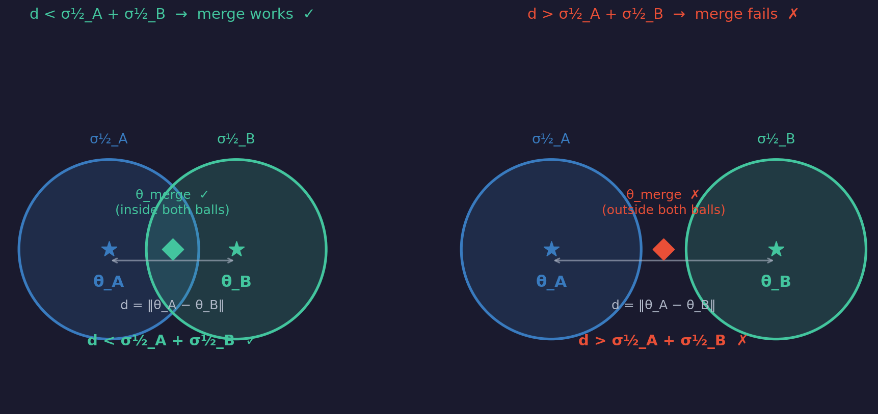
H3 · Model Merging
If the certified balls overlap, the midpoint is safe
d(θ_A, θ_B) < σ½_A + σ½_B → merging θ_A and θ_B preserves both tasks
Geometric sufficient condition: if both models lie inside each other's certified ball, their midpoint does too
Why this is novel
→ All prior merge methods (TIES, DARE, task arithmetic) are empirical — no geometric certificate
→ H3 predicts success BEFORE running the merge — from σ½_A, σ½_B, and ‖θ_A − θ_B‖ alone
→ If H1 holds, keeping ‖Δθ_A‖ < σ½ during training guarantees d < σ½_A + σ½_B
→ The certificate is conservative: gap > 0 is sufficient, not necessary

Slide 19
H3 · Literature Review & State of the Art
Linear mode connectivity (LMC)
Empirical merge methods
Foundational: Frankle et al. (2020) define LMC: loss stays low along the linear path if barrier ε ≈ 0
Gap we fill: shared pretrained init drives strong LMC (2026 survey), but predicting capability preservation during merging still “remains incomplete” — our target
Task arithmetic, TIES, DARE: combine/prune/sign-align task vectors empirically, no geometric pre-check
Basin width matters: Wortsman et al. (2022): wider, flatter basins support more robust weight averaging — descriptive, not certified
Gap we fill: a certified sufficient condition (ball overlap) computable before merging, not after
Why barriers appear
Where H3 sits
Feature mismatch, not geometry: Nobari et al. (2025): many LMC failures are fixable via activation renorm
Task interference: complementary updates merge cleanly; conflicting updates create barriers — still empirical
Gap we fill: σ½-ball overlap gives one falsifiable geometric quantity, not post-hoc diagnosis
A certifiable special case of LMC: “overlapping balls → midpoint is safe” is falsifiable where LMC is descriptive
Open question we address: does σ½-ball overlap predict simple-averaging merge success — the most skeptical test

Slide 20
H3 · Why These Tasks, Model, and Merge Method?
Why GPT-2-medium?
Why AG News + SST-2?
Why simple averaging?
→ GPT-2 (124M) is capacity-limited — multi-task performance saturates at low accuracy, masking the merge signal
→ GPT-2-medium (354M) has enough capacity to hold two tasks simultaneously — we can actually measure success
→ σ½_pre ≈ 0.00081 already characterised from H1; baseline well-established
→ Cheap enough to run 9 (LR_A, LR_B) conditions + merge evals in one A40 session
→ Different label spaces (4-class vs binary) + different text formats → genuinely conflicting weight updates
→ AG News is familiar → θ_A stays close to θ_pre → σ½_A stays large → easier for condition to be satisfied
→ SST-2 is novel → θ_B must move further → harder to satisfy condition → tests the boundary
→ If both tasks were familiar, d would always be small → certificate always satisfied → H3 untestable
→ A 'boring' pair never produces failures — we NEED gap < 0 cells to falsify H3
→ θ_merge = (θ_A + θ_B) / 2 is the midpoint in weight space — exactly what the ball-overlap condition predicts
→ If the condition works for the simplest merge method, it is the strongest claim
→ Exotic methods (TIES, DARE) re-weight parameters in ways that obscure the geometry
→ If simple averaging FAILS where gap > 0, H3 is cleanly falsified
→ If simple averaging SUCCEEDS where gap > 0, H3 is confirmed by the most skeptical test

Slide 21
H3 · The 3×3 LR Grid — Tracing the Merge Boundary
We need cells where the certificate is satisfied AND violated — otherwise we cannot falsify H3
lr_B = 1e-5
lr_B = 1e-4
lr_B = 2e-4
d ≪ σ½_A + σ½_B gap >> 0 H3 predicts ✓ SUCCESS (control cell)
d moderate gap > 0 H3 predicts ✓ SUCCESS
d grows gap ≈ 0 near-boundary case
lr_A = 1e-5
d moderate gap > 0 H3 predicts ✓ SUCCESS
d large gap ≈ 0 most interesting cell
d very large gap < 0 H3 predicts ✗ FAILURE
lr_A = 1e-4
d grows gap ≈ 0 asymmetric boundary
d large gap < 0 H3 predicts ✗ FAILURE
d ≫ σ½_A + σ½_B gap ≪ 0 H3 predicts ✗ FAILURE (stress-test cell)
lr_A = 2e-4
Green = H3 predicts success · Yellow = near boundary · Red = H3 predicts failure · Key test: does the merge success map align with the gap sign?

Slide 22
Three Geometric Bets on σ½
H1 Adaptation Scale
If confirmed →
R = ‖Δθ‖/σ½ ≈ 1 is a universal stability boundary
A model-agnostic LR / step budget rule, pre-hoc, no fine-tuning needed
H2 Forgetting Budget
If confirmed →
R_A > 1 predicts Task A forgetting after sequential FT
σ½_A is a certified continual-learning budget; direct weight-space analog of KL penalty
H3 Model Merging
If confirmed →
d(θ_A, θ_B) < (σ½_A + σ½_B) predicts merge success
First geometry-based certificate for safe model merging; predict before running

