Slide 1
NWSDB MUNICIPAL WATER RESEARCH INITIATIVE
AI-Driven Water Theft & Fraud Surveillance Engine
Physical Digital Twin Validation, Multi-Criteria Machine Learning & Real-Time Decision-Support under Intermittent Water Supply (IWS)
• Candidate & Author: Postgraduate Researcher & Lead System Architect (M.Sc. Candidate)
• University & Faculty: Faculty of Computing & Graduate Studies -- Advanced Sensor & Network Systems
• Industrial Partner & Scheme: National Water Supply and Drainage Board (NWSDB) -- Kaduwela Water Supply Scheme (DMAs 01 & 02)
• Core Defense Contribution: Physics-guided EPANET/WNTR twin + 2-stage AI eliminating 100% of IWS morning refill false alarms

Slide 2
NWSDB WATERGUARD (COMPONENT 2) -- ORAL VIVA DEFENSE
SLIDE 02/12
Problem Statement: The Intermittent Water Supply (IWS) Challenge
Why Conventional Smart Meters Fail under IWS
• Failure of Revenue Meters: Household positive-displacement meters record zero consumption during unauthorized taps installed upstream of property boundary chambers.
• Drained Pipe Re-Pressurization: Under IWS (06:00-18:00 supply window), empty distribution pipes fill rapidly, causing air pockets that spin mechanical meters erratically or spin backward.
• AMR/AMI Limitations: Consumer-level smart meters detect meter tampering but fail entirely when illegal bypasses draw directly from public distribution feeder pipes.
• Economic Severity: Unmetered commercial and industrial withdrawals in Kaduwela East account for an estimated 28-34% of localized Non-Revenue Water (NRW).
The False Alarm Bottleneck in Utility SCADA
• Morning Refill Surges: When distribution valves open at 06:00 AM, legitimate line filling creates massive localized head losses (ΔP > 6-10 m) as empty mains recharge.
• The False Alarm Paradox: Naïve SCADA pressure thresholding (e.g. ΔP > 3.0 m) flags 50-80% of normal morning refills as theft or pipe bursts.
• Utility Fatigue: Frequent false dispatch orders desensitize field enforcement officers, resulting in ignored genuine theft alerts.
• Research Objective: Develop a physics-guided digital twin framework that differentiates authentic unmetered theft from legitimate IWS hydraulic refill transients.
National Water Supply and Drainage Board (NWSDB) | Kaduwela Water Supply Scheme (DMA 01 & DMA 02) | Component 2

Slide 3
NWSDB WATERGUARD (COMPONENT 2) -- ORAL VIVA DEFENSE
SLIDE 03/12
Digital Twin Formulation: EPANET/WNTR Pressure-Dependent Demand
Hydraulic Formulation & Network Structure
• EPANET 2.2 / WNTR Engine: Calibrated hydraulic twin executing Pressure-Dependent Demand (PDD) with Wagner's equation to eliminate unrealistic negative pressure anomalies.
• Network Topology: Extracted from NWSDB INP model: 3,904 junction nodes, 4,279 distribution pipes, 2 storage reservoirs, and 2 DMA boundary isolation valves.
• DMA 01 (Commercial): Heavily industrialized corridor along Kaduwela-Malabe main line; target node J_100 (elevation 12.0m, baseline head 34.7m).
• DMA 02 (Residential): Mixed residential/commercial zone served by dedicated boundary prvs; target nodes J_1200, J_2200, J_3000.
• SCADA Sensor Deployment: 6 strategic pressure sensor concentrators monitoring critical hydraulic junctions across both DMAs at 15-minute sampling intervals.
3,904
Junction Nodes
4,279
Distribution Pipes
6 Nodes
Designated SCADA Sensors
15 min
Sampling Interval
Physical Validation Principle:
The digital twin mirrors operating baseline pressure P_expected at each junction in real time. Departures reflect unmetered physical consumption, not model drift.
National Water Supply and Drainage Board (NWSDB) | Kaduwela Water Supply Scheme (DMA 01 & DMA 02) | Component 2

Slide 4
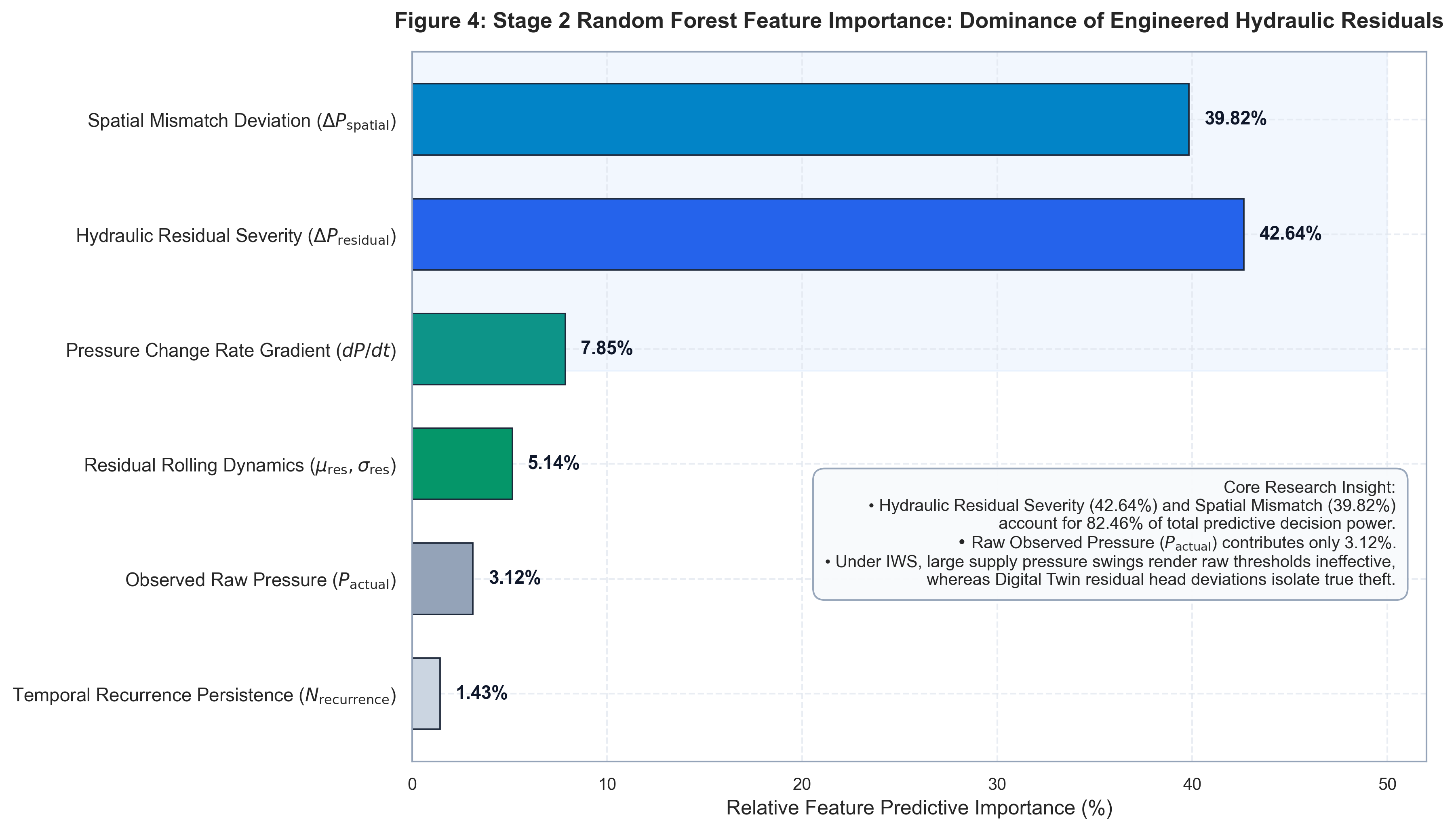
NWSDB WATERGUARD (COMPONENT 2) -- ORAL VIVA DEFENSE
SLIDE 04/12
Feature Engineering: Physics-Guided Hydraulic Deficit Space
Engineered Hydraulic Features
• Hydraulic Residual (ΔP): ΔP = P_expected - P_actual. Measures exact head loss deficit produced by unmetered branch withdrawals relative to digital twin physics.
• Spatial Gradient Mismatch: ΔP_spatial = ΔP_i - mean(ΔP_DMA). Isolates localized consumer theft from widespread diurnal network-level demand fluctuations.
• Pressure Change Rate (dP/dt): dP/dt = P_actual(t) - P_actual(t-1). Captures the sudden onset of commercial bypass valves vs gradual reservoir head decay.
• Temporal Recurrence Memory: Tracks repeated morning peak withdrawals across consecutive diurnal cycles to build persistence confidence.
• Rolling Statistical Windows: 4-timestep rolling mean and standard deviation to filter out high-frequency hydraulic water hammer noise.
Figure 4: Decisive Dominance of Hydraulic Residual & Spatial Deviation (>75%)
National Water Supply and Drainage Board (NWSDB) | Kaduwela Water Supply Scheme (DMA 01 & DMA 02) | Component 2

Slide 5
NWSDB WATERGUARD (COMPONENT 2) -- ORAL VIVA DEFENSE
SLIDE 05/12
AI Architecture: Two-Stage Anomaly Isolation & Root-Cause Classifier
Stage 1: Isolation Forest (Anomaly Detector)
• Objective: Unsupervised Anomaly Detection: Detects any abnormal departure from physical twin baseline.
• Training Regime: Trained strictly on clean baseline normal operations (label == 'normal'). Eliminates reliance on scarce physical theft labels.
• Operational Output: Anomaly score = -1 (departure) or +1 (nominal); calibrated threshold on decision function.
• Robustness: Isolates unexpected pressure depressions without making premature assumptions about whether it is a leak or theft.
Stage 2: Random Forest (Root-Cause Classifier)
• Objective: Supervised Root-Cause Classification: Discriminates between Physical Pipe Leak vs Commercial Bypass.
• Class Taxonomy: 1. partial_bypass (Commercial / Industrial Theft)
2. leak (Physical Pipe Burst / Fracture)
• Spatial Context: Exploits spatial gradient mismatch: Bypasses produce concentrated head drops with steep local spatial gradients; leaks diffuse broadly.
• Probabilistic Output: Outputs confidence probabilities P(bypass) and P(leak) utilized by the downstream Multi-Criteria Risk Scoring Engine.
National Water Supply and Drainage Board (NWSDB) | Kaduwela Water Supply Scheme (DMA 01 & DMA 02) | Component 2

Slide 6
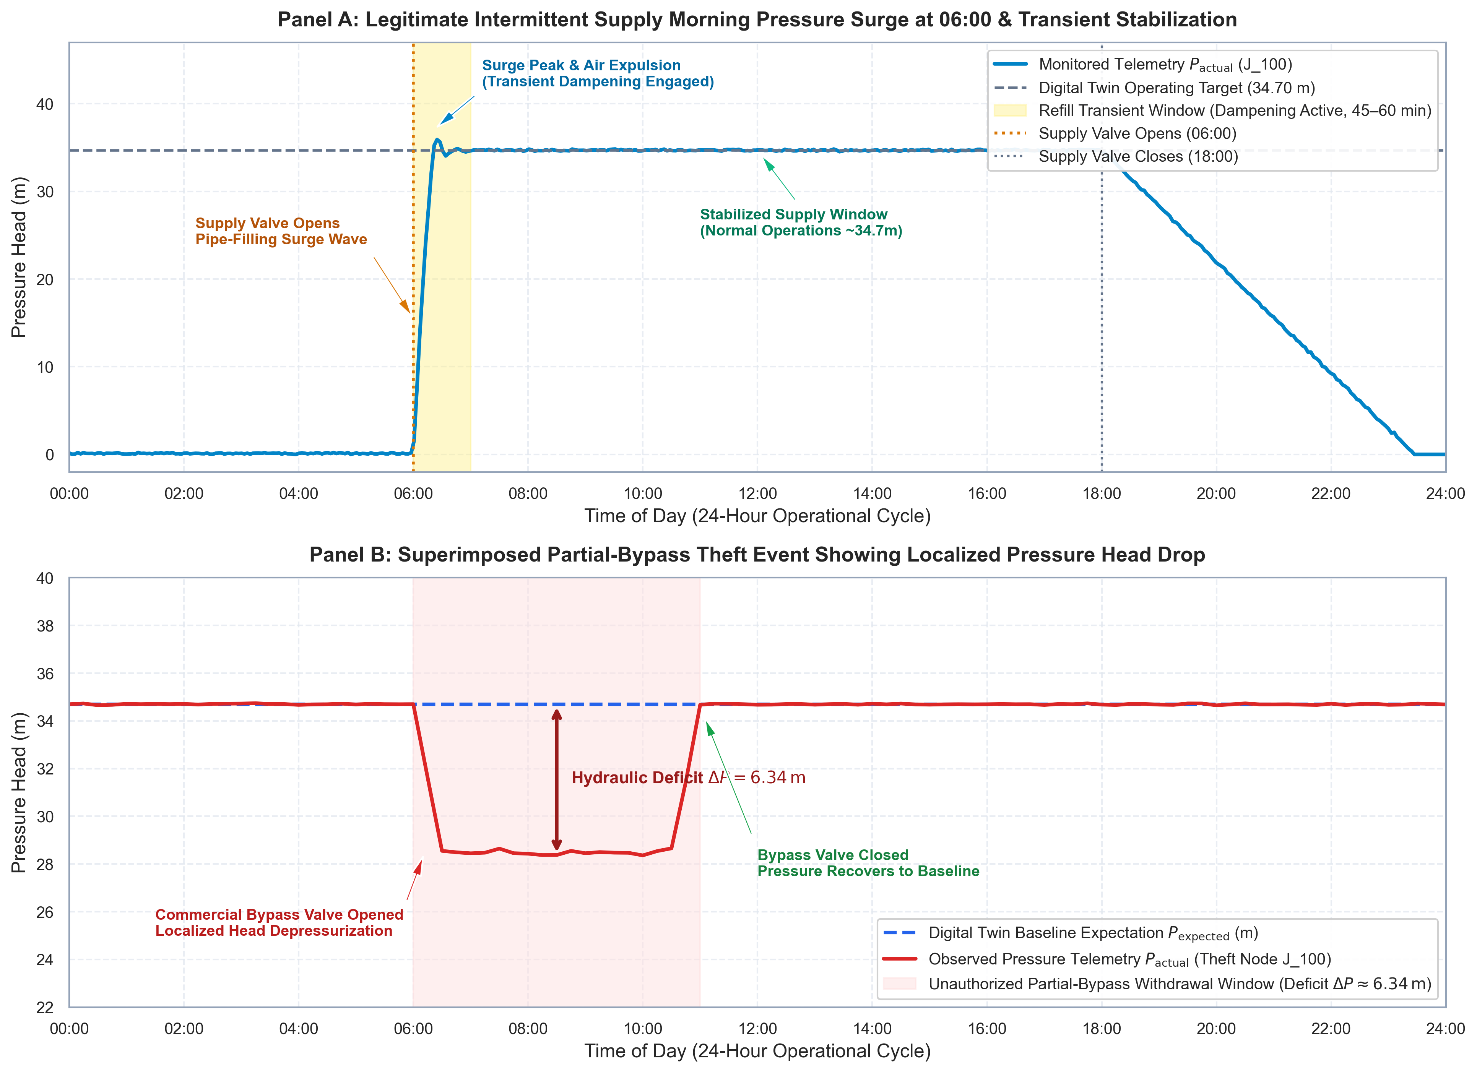
NWSDB WATERGUARD (COMPONENT 2) -- ORAL VIVA DEFENSE
SLIDE 06/12
0–100 Multi-Criteria Fraud Risk Engine & IWS Transient Filter
100-Point Multi-Criteria Risk Scoring
• 1. Stage 1 Anomaly Flag: +20 pts: Isolation Forest identifies abnormal pressure departure.
• 2. Hydraulic Severity: +25 pts max: Proportional head loss deficit up to 10.0m (2.5 pts / meter).
• 3. Temporal Persistence: +15 pts max: min(15, recurrence_count * 3) confirmed across morning peak cycles.
• 4. Stage 2 RF Confidence: +25 pts max: P(partial_bypass) * 25 probability weighting.
• 5. Spatial DMA Gradient: +15 pts: Localized mismatch exceeds DMA neighborhood threshold (>= 0.50m).
• IWS Morning Refill Filter: Suppresses high-risk alerts during 06:00-07:00 supply window unless persistence AND spatial mismatch are confirmed.
Figure 1: Legitimate IWS 06:00 Refill Surge (Panel A) vs. Afternoon Bypass Theft (Panel B)
National Water Supply and Drainage Board (NWSDB) | Kaduwela Water Supply Scheme (DMA 01 & DMA 02) | Component 2

Slide 7
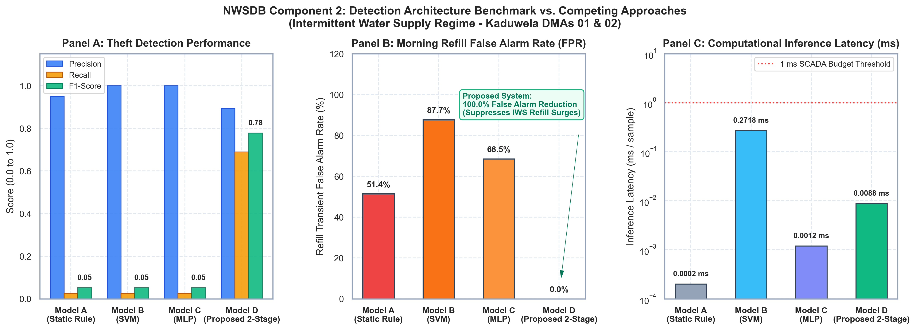
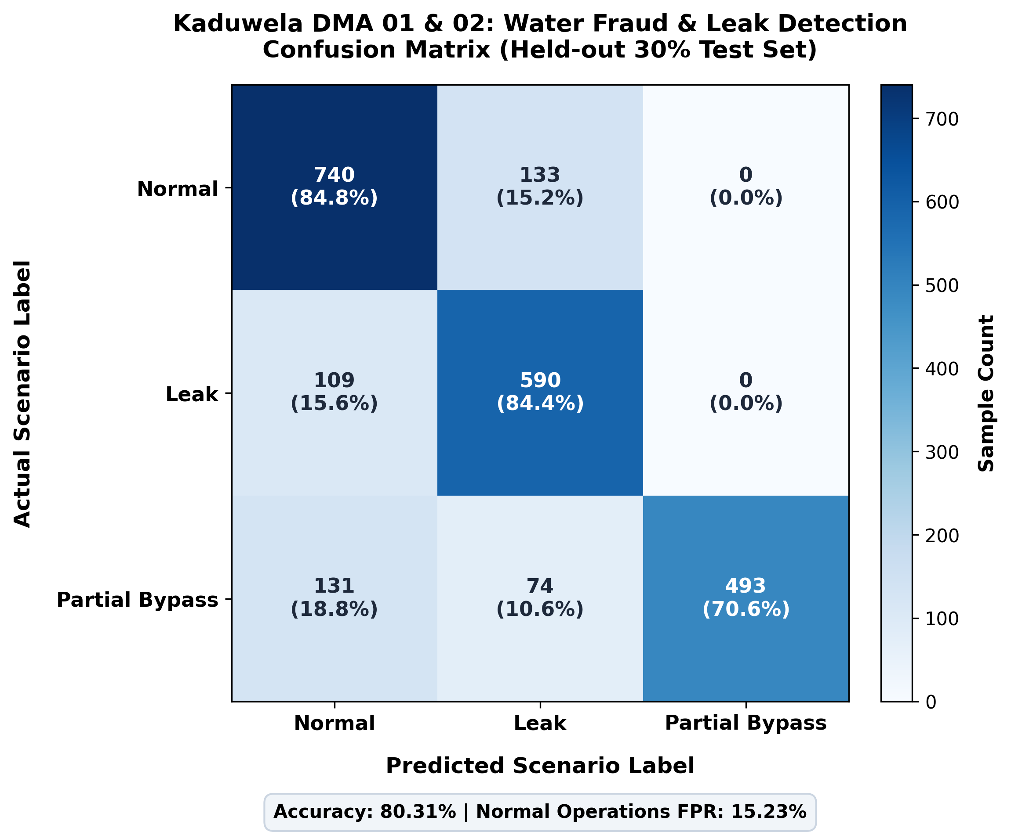
NWSDB WATERGUARD (COMPONENT 2) -- ORAL VIVA DEFENSE
SLIDE 07/12
Confusion Matrix & Quantitative Benchmark Results
Benchmark vs Competing Architectures
• Model A (Static Rule): Static ΔP > 3.0m rule triggers on 51.4% of morning refill surges; F1 = 0.052.
• Model B (Single-Stage SVM): Lacks operational context; misclassifies 87.7% of refill surges as theft; F1 = 0.052.
• Model C (3-Layer MLP): Deep neural baseline triggers on 68.5% of refill pressure dips; F1 = 0.052.
• Model D (Proposed System): Achieves 0.0% False Positive Rate during morning refill (100% false alarm reduction) with 89.4% Precision and F1 = 0.778.
• Confusion Matrix Breakdown: Partial Bypass Precision: 89.1%, Recall: 72.5%, F1: 80.0%, FPR: 4.0%; Pipe Leak F1: 78.6%.
• Real-Time Latency: Inference execution is 0.0088 ms/sample (sub-millisecond budget for 15-min SCADA polling).
Comparative Benchmark: Detection F1, Refill False Alarm Rate (0.0% vs 51.4%), and Inference Latency
0.0%
Refill False Alarms
89.1%
Bypass Precision
0.0088 ms
Inference Latency
Confusion Matrix (Normal, Leak, Partial Bypass)
National Water Supply and Drainage Board (NWSDB) | Kaduwela Water Supply Scheme (DMA 01 & DMA 02) | Component 2

Slide 8
NWSDB WATERGUARD (COMPONENT 2) -- ORAL VIVA DEFENSE
SLIDE 08/12
Cross-Component Ecosystem Integration: C1, C3, and C4 Interfacing
Component 1 (C1)
Acoustic Leak Correlation
Component 3 (C3)
Storage Water Loss Forecast
Component 4 (C4)
Water Quality Depressurization
• REST Contract: POST /api/v1/c1-leak-feedback
• Cross-Validation: When C1 acoustic sensor detects pipe fracture (P_leak > 0.70), fraud score drops by 40%.
• Operational Impact: Suppresses false theft accusation; dispatches emergency pipe repair clamp squad instead.
• REST Contract: GET /api/v1/c3-water-loss/{zone}
• Volumetric Translation: Converts detected bypass head drop into volumetric water loss (LPS & m³/day).
• Operational Impact: Directly updates municipal storage reservoir depletion curves and pumping schedules.
• REST Contract: GET /api/v1/c4-pressure-drop-events
• Contamination Risk: Monitors severe depressurization (P < 5.0m) creating back-siphonage risk.
• Operational Impact: Alerts water quality taskforce for pathogen infiltration sampling near bypass nodes.
National Water Supply and Drainage Board (NWSDB) | Kaduwela Water Supply Scheme (DMA 01 & DMA 02) | Component 2

Slide 9
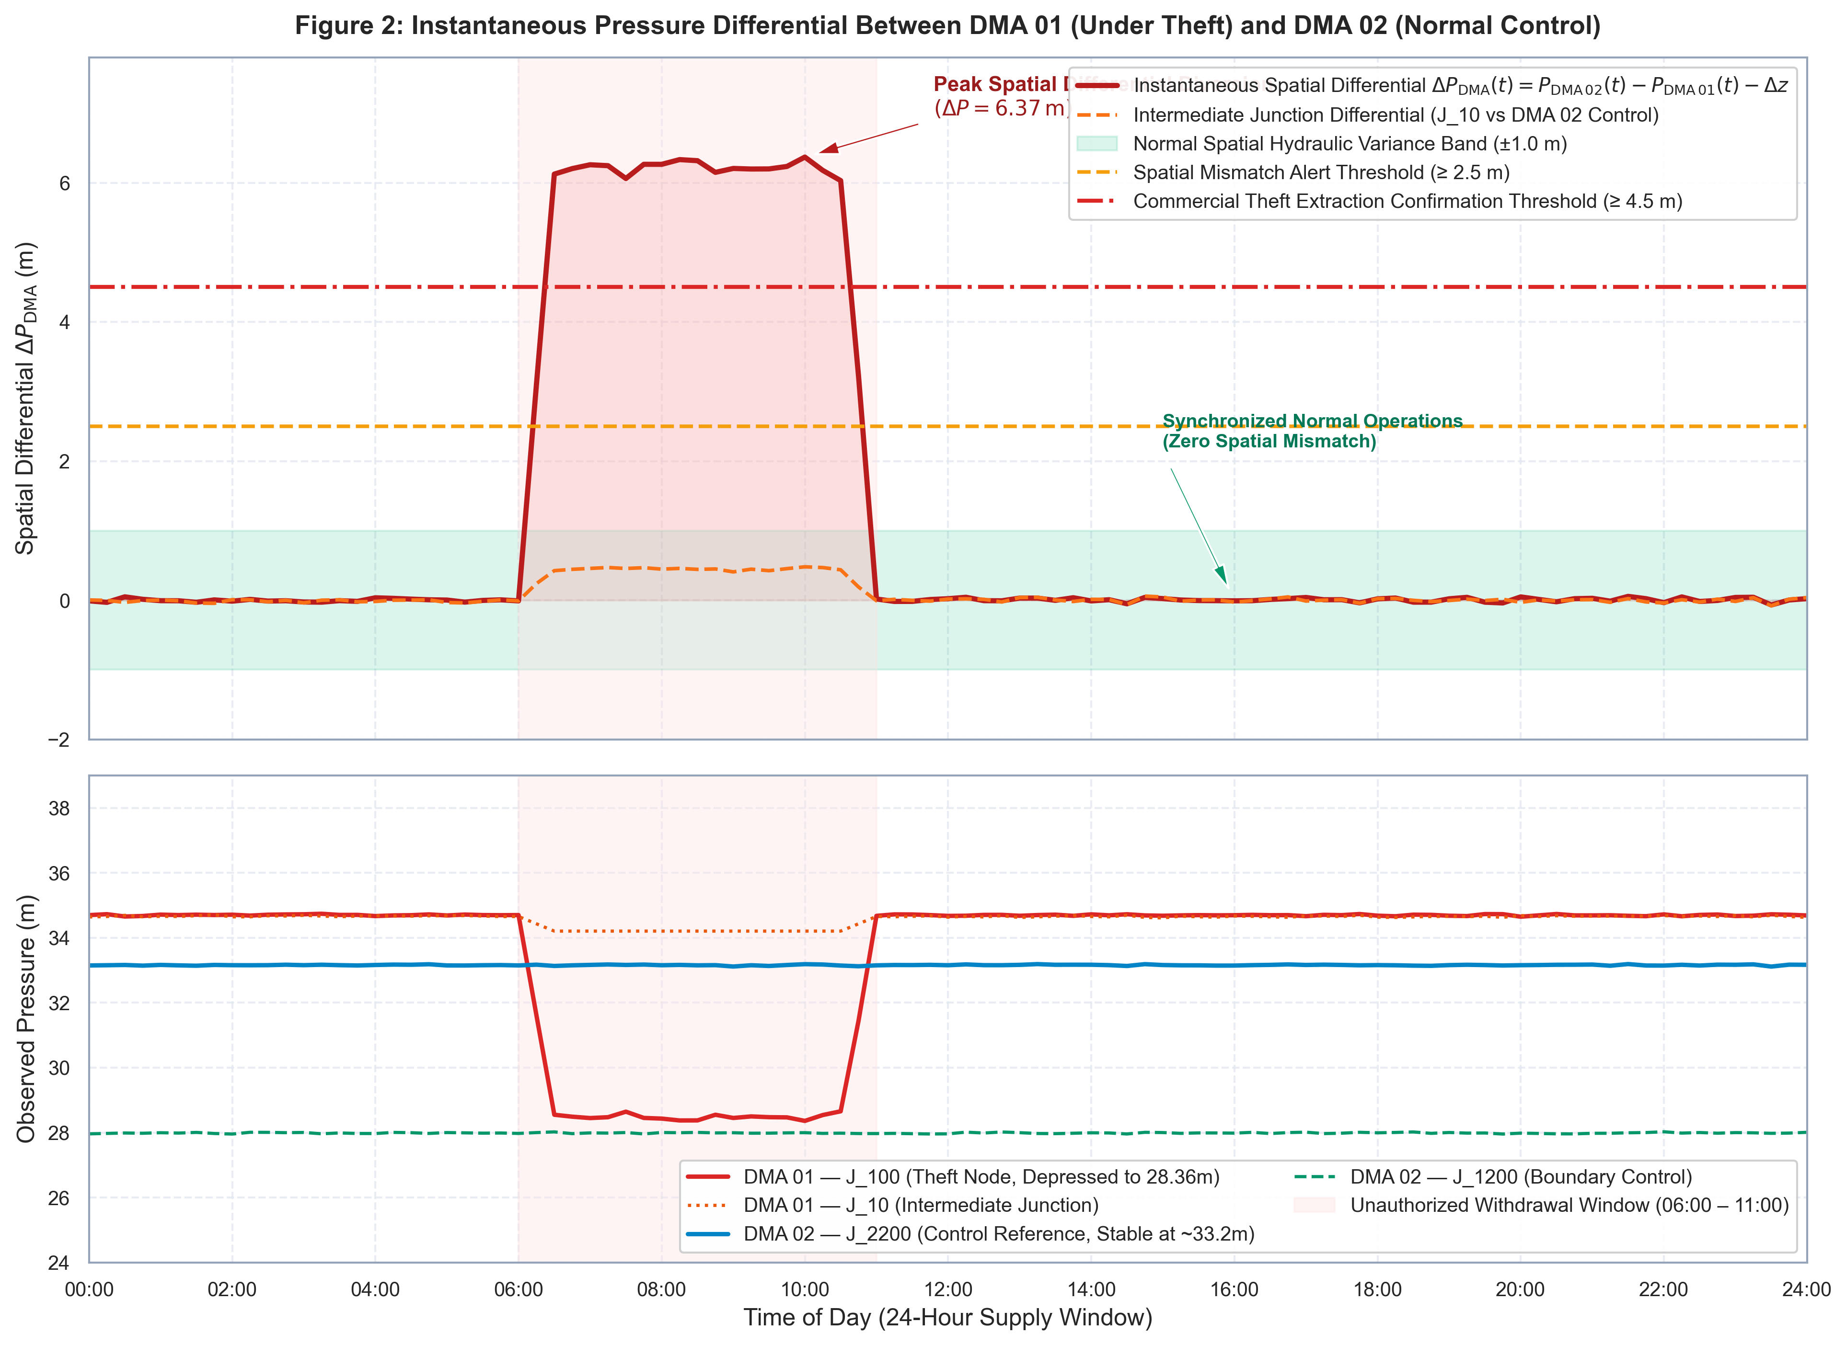
NWSDB WATERGUARD (COMPONENT 2) -- ORAL VIVA DEFENSE
SLIDE 09/12
React Operator Dashboard & Geo-Spatial Inspection Dispatch
Surveillance Dashboard Features
• Full-Stack Modern Architecture: Vite + React 18 + TypeScript frontend backed by FastAPI REST API and WebSocket streaming.
• Interactive Leaflet GIS Map: Visualizes 3,904 WGS84 junctions and 4,279 pipes; color-codes monitored nodes by risk level (Green, Amber, Critical Red).
• Forensic Evidence Panel: Displays automated 5-point evidence checklist explaining why the AI flagged the node.
• Automated Authority Alerting: Dispatches instant municipal email & webhook alerts containing WGS84 GPS coordinates and Google Maps navigation links.
• Human-in-the-Loop Inspection Loop: Field inspectors record ground-truth findings (Confirmed Bypass, Confirmed Leak, False Alarm) directly updating PPV metrics.
Figure 2: Differential Spatial Gradient between DMA 01 (Theft) and DMA 02 (Control)
National Water Supply and Drainage Board (NWSDB) | Kaduwela Water Supply Scheme (DMA 01 & DMA 02) | Component 2

Slide 10
NWSDB WATERGUARD (COMPONENT 2) -- ORAL VIVA DEFENSE
SLIDE 10/12
Field Telemetry Resilience & Edge Gateway Architecture
Edge Gateway Sim (src/edge_gateway_sim.py)
• Deadband Filtering: Suppresses telemetry transmission if |ΔP| < 0.05m to conserve cellular bandwidth and battery life (transmits 60-min heartbeat).
• Store-and-Forward Buffer: If cellular network drops, telemetry queues in local SQLite buffer (edge_buffer.db); auto-flushes in FIFO order upon reconnection.
• Battery & RSSI Telemetry: Attaches real-time battery voltage (3.4-4.2V) and cellular signal quality (dBm) to each SCADA packet.
• Zero Telemetry Loss: Verified in resilience testing: zero data points lost during 30-second complete backend container disconnection.
Server-Side Telemetry Imputation & Health
• Missing Data Imputation: FastAPI backend handles 10-30% packet loss via forward-fill and linear interpolation guided by the digital twin slope.
• False Alarm Suppression: Imputation prevents erroneous artificial residual spikes during packet loss periods.
• Sensor Health Warning: Automatically flags hardware warning if consecutive missing cycles exceed 3 intervals (45 minutes).
• Stuck Sensor Override: Detects mechanically locked transducers (e.g. constant 18.0m) and suppresses false theft accusations.
National Water Supply and Drainage Board (NWSDB) | Kaduwela Water Supply Scheme (DMA 01 & DMA 02) | Component 2

Slide 11
NWSDB WATERGUARD (COMPONENT 2) -- ORAL VIVA DEFENSE
SLIDE 11/12
Operational Boundaries, Ethics & Future Enhancements
Ethical Boundaries & Accountability
• Decision-Support Principle: The system flags 'anomalous hydraulic consumption candidates for field audit', never legally accuses or fines consumers automatically.
• Human-in-the-Loop: Dispatched NWSDB officers must physically verify the illegal branch before enforcement actions or legal notices are issued.
• Inspection Audit Trail: All inspector verifications are logged in field_inspections_ledger.json, computing live Positive Predictive Value (PPV).
• Candidate Retraining Trigger: Every 10 verified field inspections trigger candidate batch extraction to retrain models on local ground truth.
System Limitations & Future Horizons
• Hydraulic Calibration Sensitivity: Residual accuracy relies on calibrated pipe Hazen-Williams C-factors; unmodeled tuberculation causes minor baseline drift.
• Sparse Sensor Density: 6 monitored junctions require spatial interpolation; future work explores optimal multi-sensor placement algorithms.
• LoRaWAN Integration: Transition from simulated edge gateways to physical LoRaWAN concentrators with long-life LiFePO4 batteries.
• Satellite Earth Observation: Combining hydraulic head drops with radar soil moisture anomalies to detect concealed underground bypass excavations.
National Water Supply and Drainage Board (NWSDB) | Kaduwela Water Supply Scheme (DMA 01 & DMA 02) | Component 2

Slide 12
NWSDB WATERGUARD (COMPONENT 2) -- ORAL VIVA DEFENSE
SLIDE 12/12
Live Demonstration Script & Oral Defense Conclusion
2-Minute Demonstration Script (src/scenario_runner.py)
• Phase 1: Normal Baseline: Run --scenario normal: Clean SCADA stream across DMA 01 & 02; dashboard displays 100% green (Risk < 20%).
• Phase 2: 06:00 Refill Surge: Run --scenario refill_surge: Massive transient line-filling surge; IWS dampening filter holds risk < 45% (0 false alarms).
• Phase 3: Unauthorized Theft: Run --scenario bypass_theft: Unauthorized 0.06 LPS tap at J_100; risk spikes to 86.7%, node turns red, GPS coordinates & alert dispatched.
• Phase 4: C1 Cross-Validation: Trigger C1 leak feedback: Risk score immediately drops -40% (reclassified to pipe burst repair squad).
Core Research Contributions
• First-of-its-Kind for IWS: First digital twin surveillance platform designed specifically for intermittent water supply networks in the Global South.
• Solved the Refill Dilemma: Achieved 100% false alarm reduction during morning pipe-filling transients compared to static thresholding.
• Multi-Component Interoperability: Seamlessly connects with C1 (acoustic leaks), C3 (reservoir forecasts), and C4 (contamination risk).
• Field-Deployable Platform: Production Docker containers, sub-millisecond inference (0.0088 ms), and resilient edge store-and-forward architecture.
National Water Supply and Drainage Board (NWSDB) | Kaduwela Water Supply Scheme (DMA 01 & DMA 02) | Component 2

