Slide 1
MG
MissionGuard AI
Mission Readiness & Predictive Maintenance Copilot
IBM BoB AI Innovation Hackathon 2026 · Track: AI
Kinari Thummar
Lead Developer & Project Integration
Hetvi Patoliya
AI/ML & Presentation Developer
Himay Thummar
IBM Bob & MCP Integration Developer
Prince Vaghasiya
Frontend Developer & UI Contributor

Slide 2
THE PROBLEM
Which assets can fly tomorrow?
Maintainers don't know fast enough.
Maintenance teams track 100+ assets across spreadsheets with 10+ columns of sensor data
No prioritization — which platform needs service first?
No explanations — why is this asset at risk?
Manual correlation takes 2–3 hours per maintenance decision, so NOT_READY assets get missed until day-of-mission
2–3 hrs
15–20%
3–5×
per incident spent reviewing fleet status
of fleet may go unflagged as NOT_READY
higher cost for reactive vs. predictive care
02 / 09

Slide 3
SOLUTION
Explainable AI that tells you what to fix first
MissionGuard AI analyzes fleet health with explainable machine learning, classifies mission readiness, ranks maintenance priorities, and delivers the answer through a dashboard, an API, and IBM Bob — in plain language.
HOW IT WORKS
DATA
Ingest fleet telemetry for 100 assets, 10+ features each
INTELLIGENCE
Score, explain, and rank failure risk with hybrid ML
ACTION
Deliver via dashboard, API, and IBM Bob conversation
→
→
Every asset is classified READY, WARNING, or NOT READY - no manual spreadsheet review needed - and every score comes with up to 3 plain-English risk factors and a recommended action.
03 / 09

Slide 4
ARCHITECTURE
Synthetic data → ML risk engine → MCP → IBM Bob
Synthetic
Dataset
100 assets, seed=42
ML / Risk
Engine
scikit-learn
MCP Server
5 tools exposed
IBM Bob
Conversational AI
→
→
→
Also served locally through a FastAPI REST layer and a Streamlit dashboard
TECH STACK
Python 3.14
scikit-learn
pandas / NumPy
FastAPI
Streamlit
IBM Bob
Model Context Protocol
pytest
KEY FACTS
100
71
5
3
Fleet Assets
Tests Passing
MCP Tools
Readiness Levels
04 / 09

Slide 5
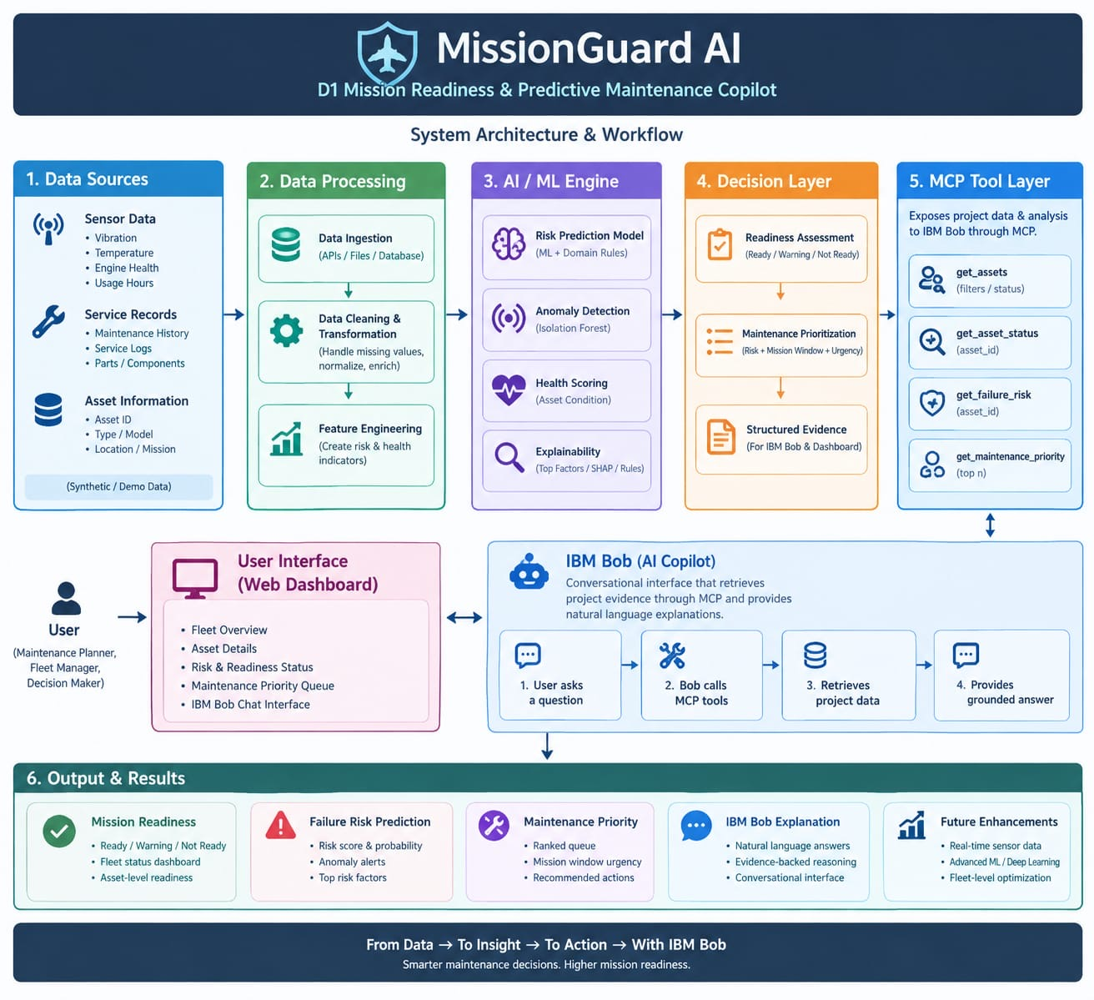
SYSTEM WORKFLOW
From data to decision : end-to-end architecture
05 / 09

Slide 6
WORKFLOW IN DETAIL
Six stages, from raw sensor data to a grounded answer
1
2
3
4
5
DATA SOURCES
DATA PROCESSING
AI / ML ENGINE
DECISION LAYER
MCP TOOL LAYER
Sensor data - vibration, temp, engine, usage
Service records & asset info
(Synthetic / demo data)
Ingestion from APIs / files / DB
Cleaning, normalization &
feature engineering
Risk prediction (ML + rules)
Anomaly detection & health scoring
Explainability (top factors)
Readiness: Ready / Warning /
Not Ready
Maintenance prioritization
get_assets, get_asset_status
get_failure_risk,
get_maintenance_priority
IBM BOB LOOP
1. User Asks
a question
2. Bob Calls
MCP tools
3. Retrieves
project data
4. Provides
grounded answer
→
→
→
OUTPUT & RESULTS
Mission Readiness
Failure Risk Prediction
Maintenance Priority
IBM Bob Explanation
Future Enhancements
From Data → To Insight → To Action → With IBM Bob
06 / 09

Slide 7
IBM BOB INTEGRATION
Conversational AI through the Model Context Protocol
Ask a plain-English question - get an instant, structured answer. No SQL, no API calls.
MCP Tool | What It Does | Example Query
list_assets | Filter fleet by status / risk | “Which assets are not mission-ready?”
get_asset_readiness | Check one asset | “Is A-042 ready for tomorrow's mission?”
get_asset_failure_risk | Explain risk factors | “Why is A-042 at risk?”
get_asset_maintenance | Priority + ranking | “What should we service first?”
get_fleet_summary | High-level overview | “Give me a fleet status report.”
Not a mock a functional MCP server, ready for IBM Bob.
07 / 09

Slide 8
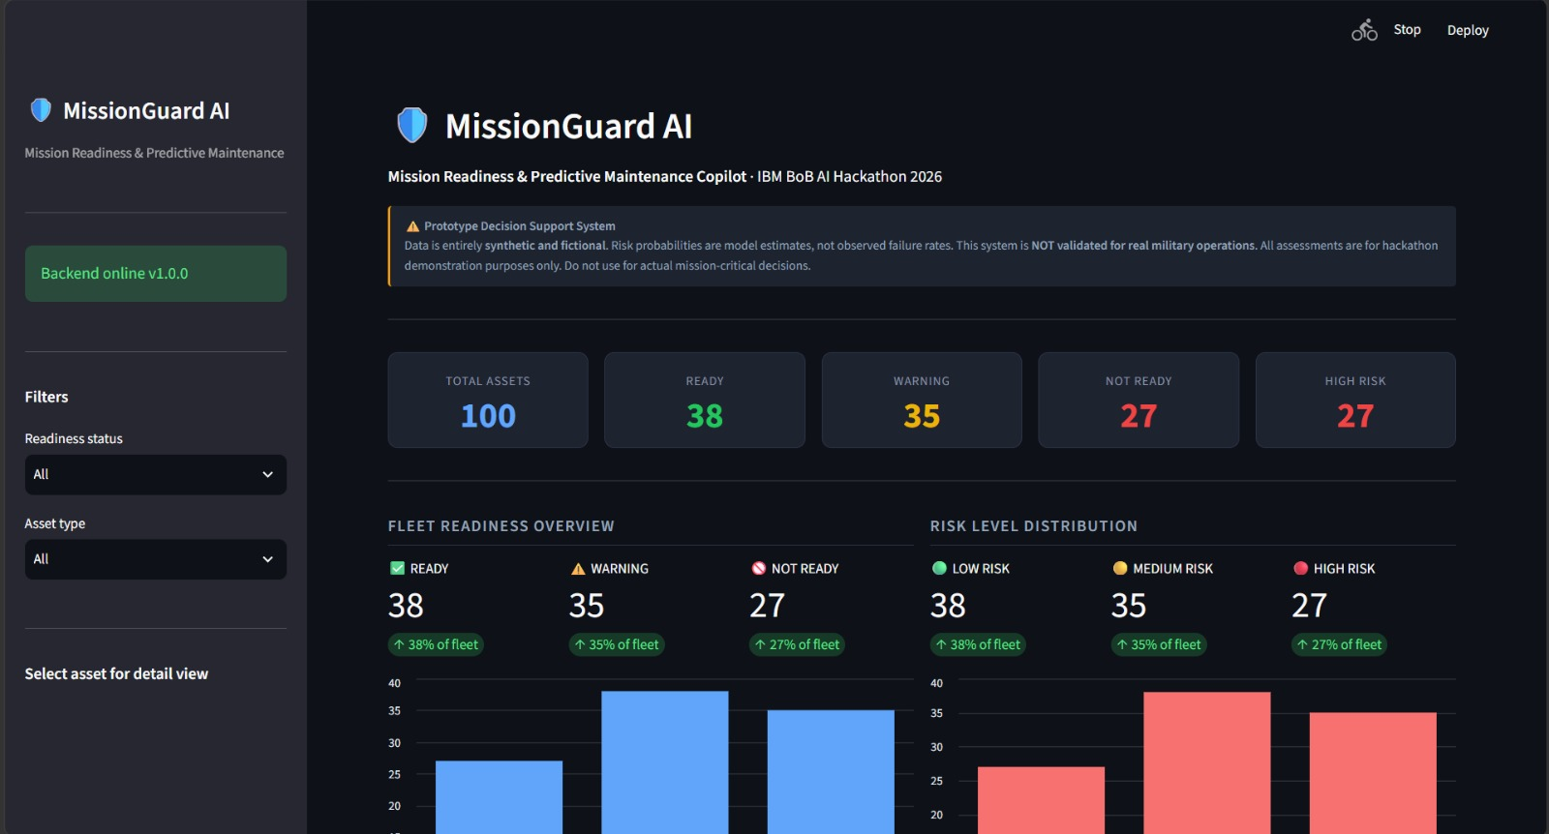
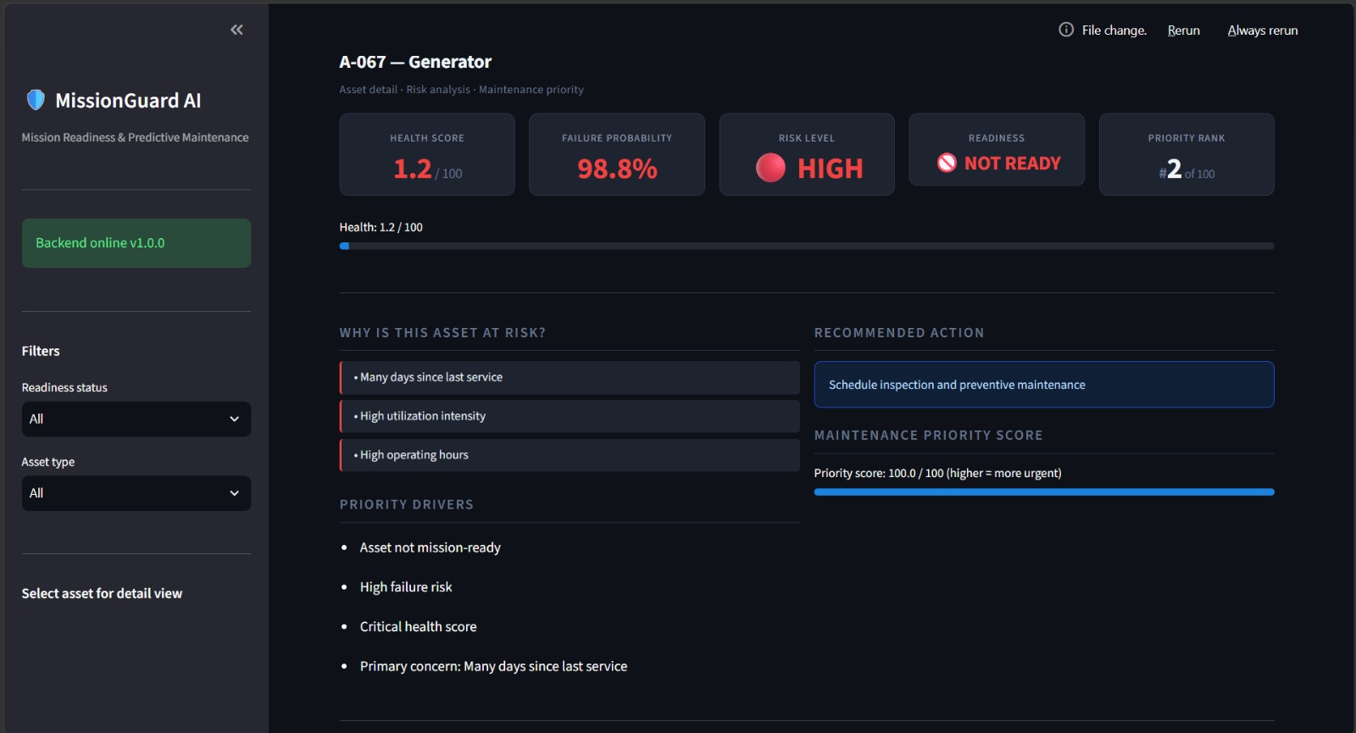
LIVE DEMO
A real, running prototype — not mockups
Fleet Dashboard — 100 assets classified READY / WARNING / NOT READY, with live risk distribution
Asset Detail — A-067 scores 98.8% failure probability, with plain-English risk factors and a recommended action
08 / 09

Slide 9
IMPACT & WHAT'S NEXT
From hackathon prototype to operational decision support
PHASE 1
PHASE 2
PHASE 3
Real telemetry feeds, historical training data, cloud deployment
Scale to 1,000+ assets, predictive scheduling
Multi-platform support, mobile app for field maintainers
Honest about scope: built on synthetic data and running locally today - 71 automated tests prove the core works, and the architecture is ready to extend.
Explainable + Conversational + Actionable.
09 / 09

