Slide 1
Math-Java Project
Fast Fourier Transform
Herrenschmidt Félix - Desrumaux Guillaume

Slide 2
Summary
Requirements
Program Architecture
Versioning
Demonstration
Conclusion

Slide 3
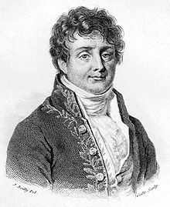
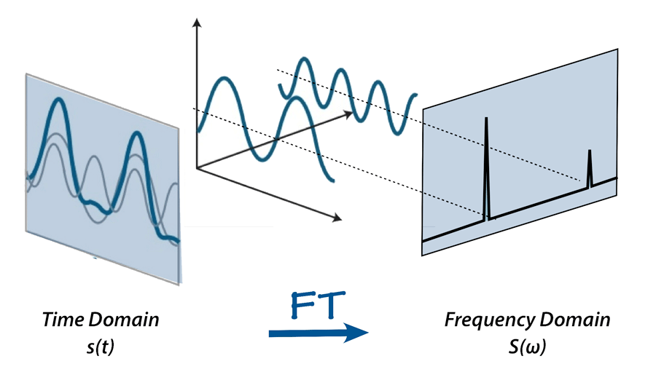
Introduction
Jean Baptiste Joseph Fourier
Fast Fourier Transform
James Cooley / John Tukey (1965)
http://mriquestions.com/fourier-transform-ft.html

Slide 4
Requirements
HMI
Real Signal
FFT
Data Series
FFT
Inverse
Complex Signal
FFT

Slide 5
Progr am Architecture
Human Machine Interface
Computation
Computed data
Computed data
Signal
User choice
Controller

Slide 6

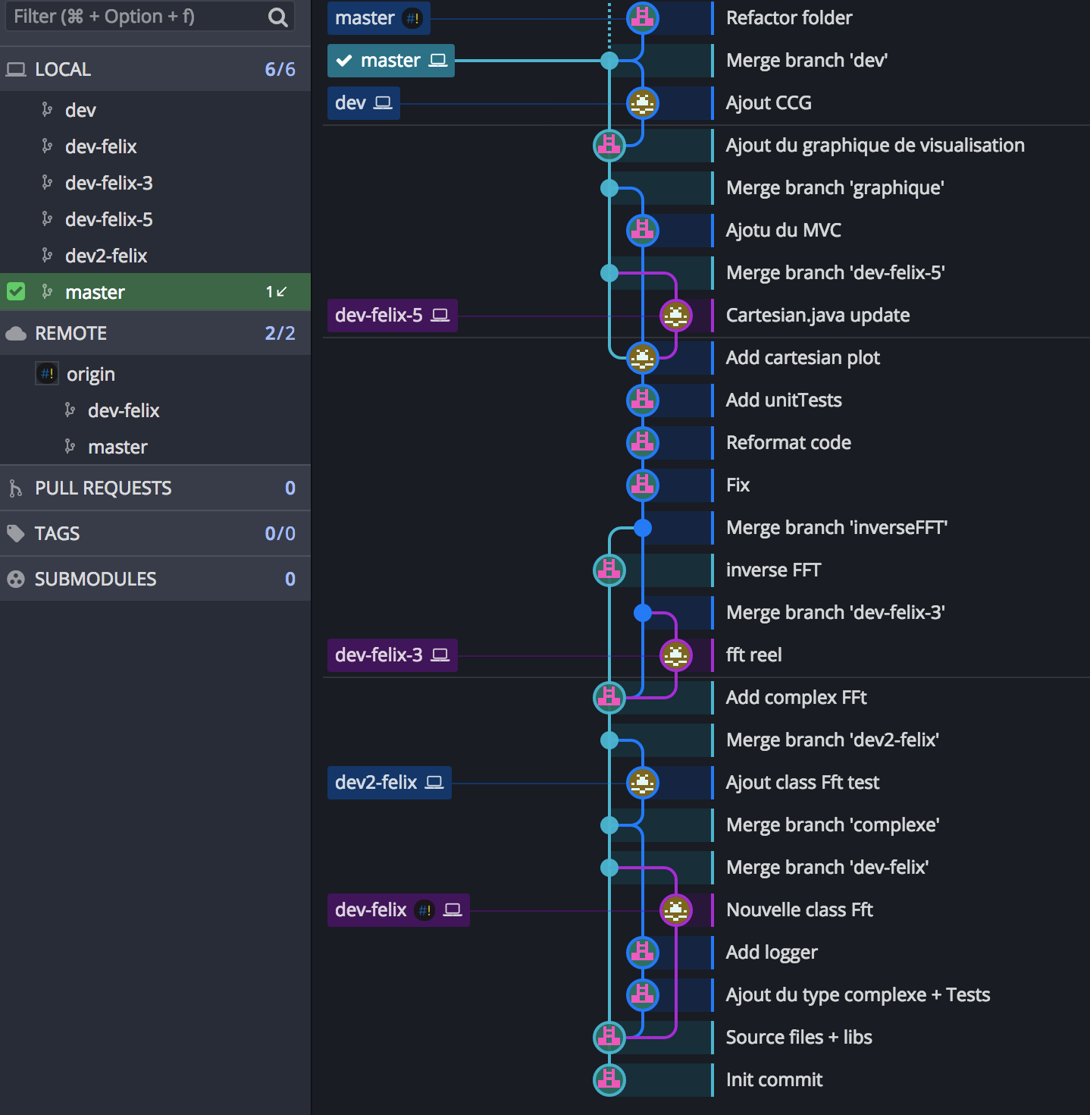
Versioning

Slide 7
Demonstration

Slide 8
Conclusion

