Slide 1
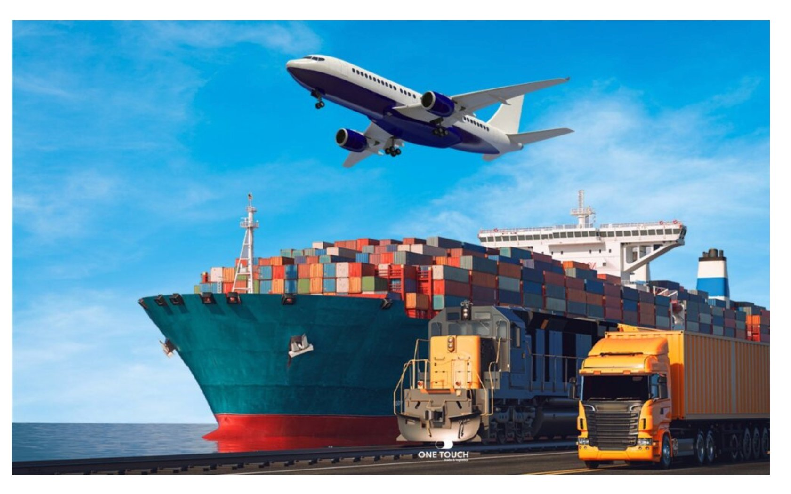
ShipmentDoc Compliance AI
Dangerous Goods & Customs Clearance Automation · German Freight
Kinda Faisal — Freelance AI Consultant | AI Consulting Bootcamp | April 2026
github.com/kindafaisal-ui/final-project-dg-customs-compliance | Portals live — see slides 5 & 6

Slide 2
Introduction — Kinda Faisal
2
NAME
Kinda Faisal — Freelance AI Consultant
BACKGROUND
6 years hands-on in international logistics operations
EXPERIENCE
Daily work with DG documents, customs clearance, ADR / IMDG / IATA compliance
PAIN I KNOW
Operations staff spend 70–80% of their day managing compliance documents
NOW
AI Consulting Bootcamp — building real solutions for real logistics problems
ShipmentDoc Compliance AI | Kinda Faisal AI Consulting | 2026

Slide 3




The Problem
3
From my 6 years in logistics — operations staff spend 70–80% of their working day on compliance documents. They must verify every document manually for customs clearance AND dangerous goods regulations. One mistake: €50,000 fine or a truck stopped at the border for 2 days.
9–12 min
5–10%
500 docs
6 Regs
Per document
manually checked
Industry error rate
on compliance docs
Per day = 83+ hours
of manual work daily
ADR · IMDG · IATA
UCC · CMR · EUR.1
ADR violations → fines up to €50,000 · Missing HS codes / EORI numbers → 1–2 day customs hold · All 6 regulations checked manually — every shipment, every day
ShipmentDoc Compliance AI | Kinda Faisal AI Consulting | 2026

Slide 4





The Solution — ShipmentDoc Compliance AI
4
AI-powered compliance checking against ADR, IMDG, IATA, EU UCC, CMR and EUR.1 — from 9–12 minutes to 0.44 seconds per document, freeing 83 hours of staff time every day. The AI flags. The human decides.
Speed & Efficiency
Green Tech
Human in the Loop
9–12 min → 0.44 seconds per document
GPT-4o: efficient serverless deployment, no always-on servers
AI flags issues — Human decides. Always.
83 hours/day freed for operations staff
Runs at midnight on off-peak energy
Every flagged document reviewed before dispatch
500 documents processed overnight automatically
80% fewer customs holds → less CO₂ emissions
Full LangSmith audit trail for every AI decision
Shipper Portal: https://final-project-dg-customs-compliance-3djmsuecztvsuux7jgpyai.streamlit.app/ | Freight Forwarder: https://final-project-dg-customs-compliance-mffpsnzkusr6pmhcb6e8xv.streamlit.app/
ShipmentDoc Compliance AI | Kinda Faisal AI Consulting | 2026

Slide 5
Live Demo — The System in Action
5
n8n Workflow
1
Runs automatically
at midnight
Gmail Alert
▶
2
Consolidated email
to management
Portal
3
Staff review
flagged docs
VIDEO DEMO
Open portal live — enter shipment details and generate checklist
https://final-project-dg-customs-compliance-3djmsuecztvsuux7jgpyai.streamlit.app/ (Shipper) · https://final-project-dg-customs-compliance-mffpsnzkusr6pmhcb6e8xv.streamlit.app/ (FF)
LangSmith
4
Full AI audit
trail visible
ShipmentDoc Compliance AI | Kinda Faisal AI Consulting | 2026

Slide 6
System Pipeline — How It Works
6
Shipment
Documents
n8n
Trigger
AI Agent
GPT-4o
DG Check
ADR·IMDG·IATA
Customs
UCC·CMR·EUR.1
LangSmith
Audit Log
Gmail
Report
Streamlit
Portal
Human
Decision ✓
500/day · 7 types
Every night 00:00
LangChain
Dangerous Goods
EU Customs
Full trace
Management
Operations staff
Final approval
TWO AI AGENTS — HOW EACH WORKS
Agent 1 — Freight Forwarder Portal
Agent 2 — Shipper Portal
https://final-project-dg-customs-compliance-mffpsnzkusr6pmhcb6e8xv.streamlit.app/
https://final-project-dg-customs-compliance-3djmsuecztvsuux7jgpyai.streamlit.app/
Operations team enters shipment details via n8n workflow
Shipper enters shipment details directly in the portal
Checks DG compliance: ADR tunnel codes, UN numbers, packing groups
AI agent generates full document checklist in real time
Checks customs: HS codes, EORI numbers, CMR fields, EUR.1
Checks which documents are required per route & cargo type
Flags issues in plain language — emails management at 06:00
Validates dangerous goods classification against IATA/ADR/IMDG
Every decision logged in LangSmith with full audit trail
Human compliance officer reviews and approves before dispatch
ShipmentDoc Compliance AI | Kinda Faisal AI Consulting | 2026

Slide 7
Choose Your Level
7
A
Start Smart
B
Go Deeper
C
Full System ★
AI Email Alert Only
AI Compliance Portal
Complete Automation
€1,500–€3,000
€3,500–€6,000
€5,750–€10,900
€100–€200/month
€200–€400/month
€264–€810/month
AI agent checks all documents overnight
Everything in Option A
Email + Portal combined
Against ADR · IMDG · IATA · EU UCC
Streamlit portal for operations team
AI agent + n8n + LangSmith
One email to management daily
Plain-language actions per document
TMS integration ready
Fastest — 2 weeks to deploy
Full LangSmith audit trail
ROI: 1,589% · Break-even < 1 month
Best for: Management overview · Low budget
Best for: Operations team · Detailed review
Best for: Full automation · Maximum ROI
ShipmentDoc Compliance AI | Kinda Faisal AI Consulting | 2026

Slide 8


Performance & Compliance
8
0.44s
8.7/10
90.7%
1.2%
Per document
(was 9–12 min)
AI quality score
(LLM-as-judge)
AI confidence
average
Error rate
(vs 5–10% manual)
EU AI Act — LIMITED RISK
Green Tech
Human in the Loop
› Private company — not a border authority
› GPT-4o on serverless cloud — no always-on servers
› AI flags — Human makes every final decision
› Human-in-the-loop — no autonomous decisions
› Runs at midnight on off-peak energy
› 8.7/10 before every decision: AI is evaluated
› LangSmith audit trail for every AI decision
› 80% fewer customs holds → less trucks idling → less CO₂
› Human responsibility stays exactly where it is today
GDPR: shipper names, EORI numbers, driver names · Legal basis: Contract + Legal obligation (EU UCC + ADR 2023) · EU servers (Frankfurt) · 90-day retention
ShipmentDoc Compliance AI | Kinda Faisal AI Consulting | 2026

Slide 9

9
Thank You
Questions & Discussion
The AI flags. The human decides.
Transparent · Affordable · Compliant · Green · Fast.
kindafaisal@hotmail.com
github.com/kindafaisal-ui/final-project-dg-customs-compliance
Freight Forwarder Portal: https://final-project-dg-customs-compliance-mffpsnzkusr6pmhcb6e8xv.streamlit.app/
Shipper Portal: https://final-project-dg-customs-compliance-3djmsuecztvsuux7jgpyai.streamlit.app/
Next Step: 60-day pilot with real shipment data — validate, refine, deploy at scale
ShipmentDoc Compliance AI | Kinda Faisal AI Consulting | AI Consulting Bootcamp | 2026

