Slide 1
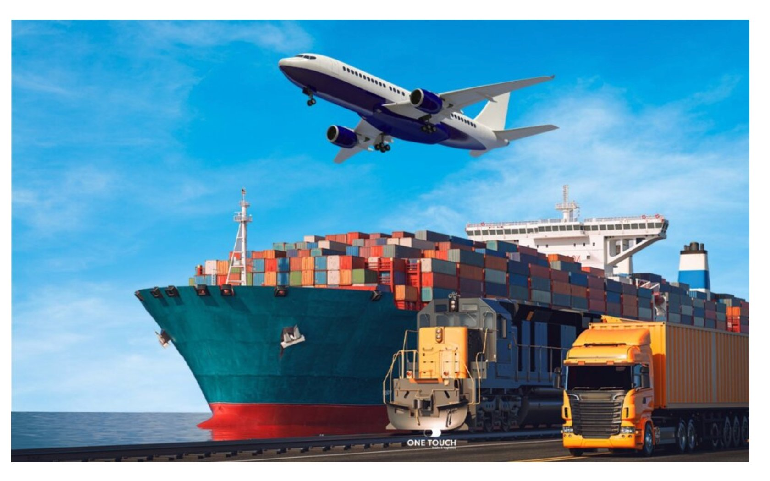
Chleo Logistics GmbH · Germany
🚛 Road freight
✈ Air cargo
Smart Document
Automation
🚢 Sea freight
📦 Customs & DG
Dangerous Goods &
Customs Clearance Compliance
AI Consulting Bootcamp — Week 7 | Kinda Faisal | 2026

Slide 2
The Problem — What Chleo Faces Daily
Client Profile
9–12 min
€50,000+
🏢 Medium freight forwarder — 50–200 employees
per document manually
vs 44s with AI
ADR fine per DG
compliance violation
📍 Based in Germany — international shipments
🚛 50–300 shipments per day to 10+ countries
5–10%
60–70%
📄 7 document types per shipment on average
industry error rate
on compliance docs
of staff time on
manual data entry
⚠ Daily exposure to ADR, IMDG, IATA, EU customs

Slide 3
System Architecture — How It All Connects
1
2
3
Dataset
AI Agent
LangSmith
500 records · 7 doc types · generate_dataset.py
LangChain · DG + Customs compliance tools
Every AI decision traced · EU server · Transparent
▼ main.py triggers all components automatically ▼
4
5
6
n8n Workflow
Tableau
main.py
Midnight schedule + webhook trigger · Email alerts
2 dashboards · Live KPIs · DG & Customs views
Orchestrator — one command connects all 5 above
python main.py → runs all 6 components → saves results → triggers n8n → email sent

Slide 4
Our Solution — What We Built
1
LangChain AI Agent
Checks DG declarations (ADR/IMDG/IATA) AND customs documents (UCC/CMR/EUR.1/HS codes) automatically
2
LangSmith Monitoring
Every AI decision logged and traceable — Chleo can see exactly what was checked and why. Full transparency
3
n8n Automation Workflow
Runs at midnight automatically, analyzes documents, sends email alert if compliance issues are found
4
Tableau Dashboard
Two dashboards: overview of all docs + dedicated customs clearance view with routes, processing times, KPIs

Slide 5
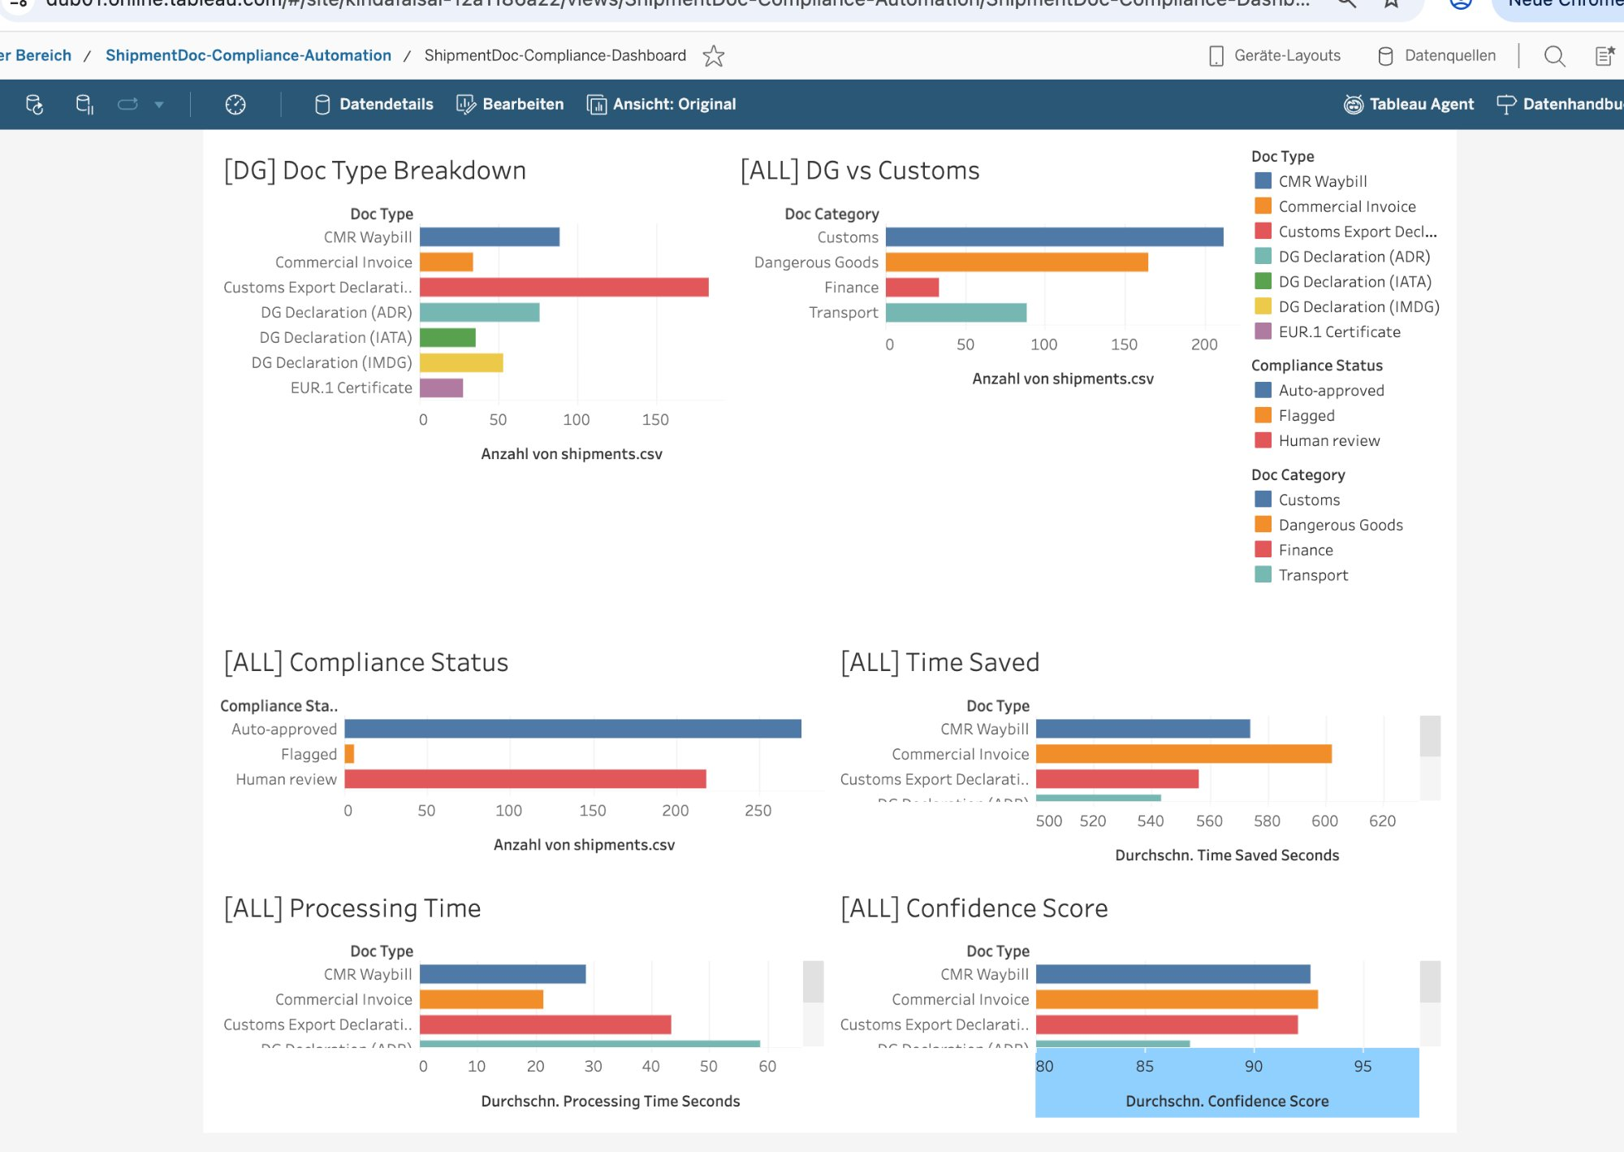
Live Dashboard — Tableau Cloud (Real Screenshot)
500
Documents
analyzed
90.7%
Avg AI
confidence
559s
Saved per
document
1.2%
Error rate
vs 5–10% avg

Slide 6
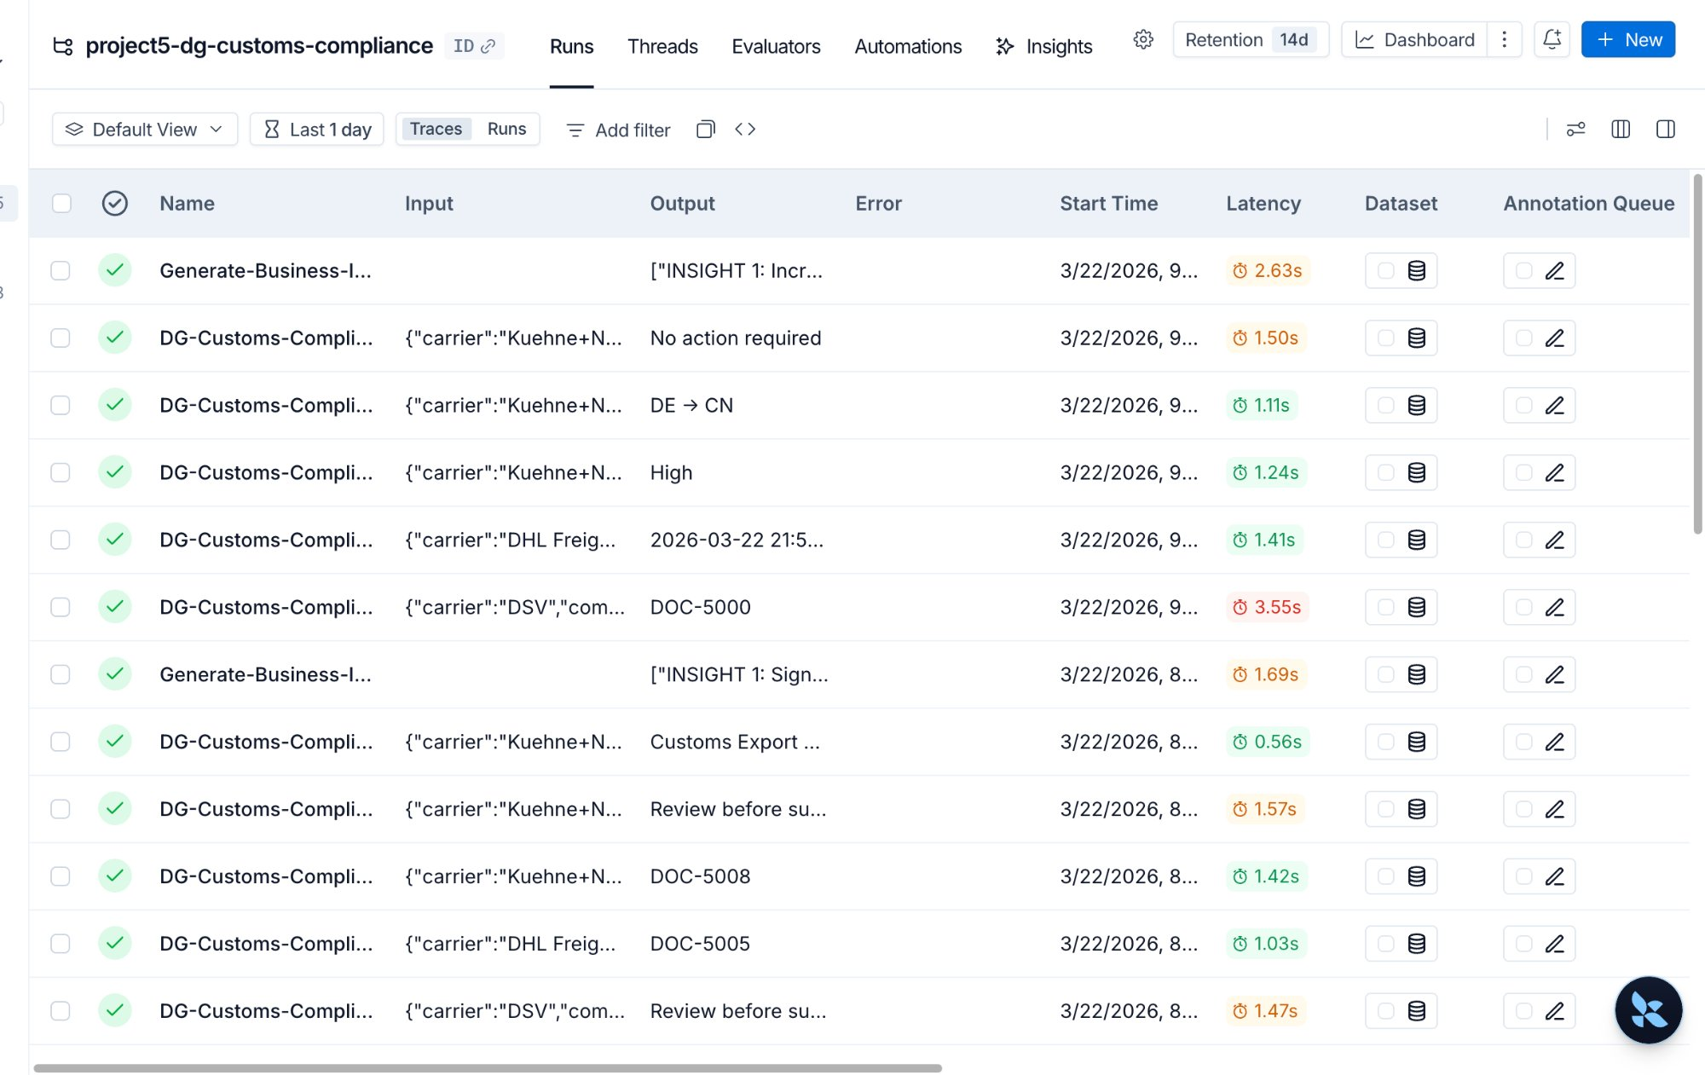
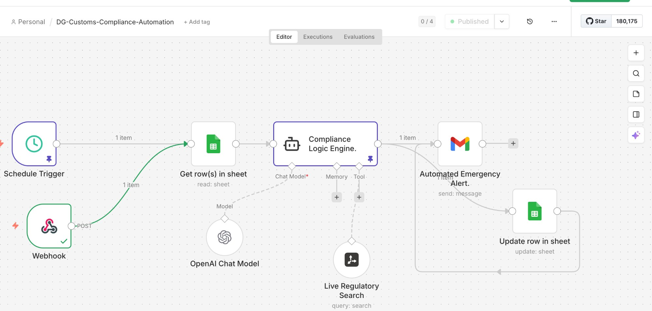
AI Transparency (LangSmith) + Automation (n8n)
LangSmith — Every AI decision traced
n8n — Automated daily workflow
All green = zero errors · 0.5–3.5s per doc · Full audit trail
Published · Schedule + Webhook · Email alert on compliance issues

Slide 7
AI Evaluation — LLM-as-Judge Results
A second AI (the judge) evaluates the quality of our AI's insights on 4 criteria: Relevance · Accuracy · Actionability · Clarity (scored 1–10)
9.1/10
9.3/10
8.1/10
8.9/10
Relevance
Accuracy
Actionability
Clarity
Insights directly address DG & customs pain points
All numbers backed by real dataset calculations
CEO can act on most insights immediately
Plain language, minimal jargon for non-technical CEO
Overall Average
Key findings
8.7 / 10
Best: INS-003 Error Rate insight (9.5/10)
Weakest: INS-002 Confidence (8.0/10) — needs clearer CEO language
7 insights evaluated by GPT-3.5-Turbo judge
Bias noted: LLM may score own outputs higher than human reviewers would

Slide 8
Investment, ROI & Timeline
Investment
83h
94%
Phase 1: Setup & Data
Weeks 1–2
€1,000–€2,000
Saved per day
500 docs × 10 min
Error reduction
10% → 1.2%
Phase 2: AI Agent
Weeks 3–4
€1,500–€2,500
Phase 3: Dashboard + n8n
Weeks 5–6
€1,000–€2,000
Phase 4: Monitoring
Weeks 7–8
€800–€1,500
€80K+
< 6mo
TOTAL UPFRONT
8 weeks
€4,300–€8,000
Annual staff
cost savings
Full return on
investment
Monthly running cost
Ongoing
€200–€500/mo

Slide 9
Next Steps
1
Phase 1 — 2 weeks
Connect to the existing TMS, configure all document types and routes (DE→TR, DE→GB, DE→US, DE→CN)
2
Phase 2 — AI agent live
The AI agent processes real shipment documents with full LangSmith tracing for management transparency
3
Phase 3 — Full automation
Automated daily compliance reports via n8n, Tableau dashboard connected to live data
4
Phase 4 — Scale
Expands to all document types, predictive analytics, full integration with carrier and customs APIs
Every day without automation = 83 hours of staff time lost and ongoing compliance risk

Slide 10
Thank You
for Listening
Smart Document Automation — Dangerous Goods & Customs Clearance
Project
Sector
Company
Bootcamp
DG & Customs Automation
Logistics / Supply Chain
Medium freight forwarder, DE
AI Consulting — Week 7
Kinda Faisal · AI Consulting Bootcamp · 2026

