Slide 1
Detecting Memory Leaks in C/C++ Applications using Visual Studio
Presented by Umar Lone
www.poash.com
learning.poash.com

Slide 2

learning@poash

Slide 3

learning@poash

Slide 4

learning@poash

Slide 5
Objectives
Understand C/C++ memory management in depth
Identify issues with memory management
Detect and isolate memory leaks
Create a custom leak detector

Slide 6
Process
When a program is started, virtual memory is allocated and is called address space
Virtual address space provides an environment for the executable to run
Size depends on the platform
Some parts of the process are used for storing data
  global, static, local & runtime

Slide 7
Process
Section | Purpose
Code Segment | Program executable code
Data Segment | Global & static variables
Heap | Dynamically allocated memory
Stack | Local variables
Stack
Heap
Data Segment
Code Segment
0x00000000
Virtual Address Space

Slide 8
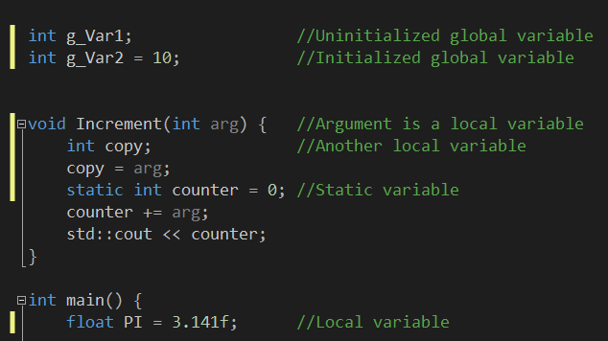
Variables
Stack
Heap
Data Segment
Code Segment
Virtual Address Space

Slide 9
Pointer
A pointer is like a variable, except that it holds address instead of the value
Syntax is different than a variable
int *p = &<variable> or dynamic memory
A pointer can hold address of
  variable
  pointer
  object
  function

Slide 10
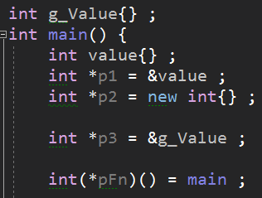
Pointer
Stack
Heap
Data Segment
Code Segment
Virtual Address Space

Slide 11
Byte Ordering
Specifies the order in which a sequence of bytes is stored in the memory
Big Endian : most significant byte is stored first (the first byte in the data)
Little Endian : least significant byte is stored first (the last byte in the data)

Slide 12
Example
MSB
LSB
3456
;
int value =
12
78
0
1
2
3
0x100
0x200
0x300
0x400
Big Endian
12
34
56
78
0x100
0x200
0x300
0x400
Little Endian
78
56
34
12

Slide 13
What is a bug?
Defect that breaks the intended behavior of the program
Shows up as wrong result, crash, leak, slow execution, etc.
Introduced due to unclear requirements, logic mistakes or environment differences
Hard to avoid in software development process, but need to be minimized as much as possible

Slide 14
What is debugging?
Process of locating, tracking & reducing the bugs in software
Common process: reproduce -> isolate -> fix -> verify
Key techniques: breakpoints, stepping, reading call stacks & logging values

Slide 15
Debugging Tools
Several tools exist for debugging
Called symbolic debuggers
  Point to the faulting code in the source
Provide functionality to ease debugging
Some debuggers are command-line based; other provide IDE

Slide 16
Windows Debuggers
Two main categories of debuggers- User mode & Kernel mode debuggers
User mode debuggers are used for debugging user applications.
  Visual Studio debugger, NTSD, CDB, etc
Kernel mode debuggers are used to debug the OS kernel and are mostly used for debugging device drivers.
  WinDBG & Kernel Debugger (KD)

Slide 17
Debugging Without Debuggers
Defensive coding can minimize debugging
Logging can provide information about program during execution
In C++,
  Prefer strong types over raw types
  Use RAII
  If unavoidable, use runtime checks
  Validate inputs at boundaries
Treat warnings as errors
Use sanitizers

Slide 18
Tracing/Logging
Technique to output debugging information during program execution
  Terminal
  Output window
  File
Can help identify source through line numbers, function or file names
Some IDEs provide tracing support

Slide 19
Function Tracing (MSVC)
MSVC provides several macros that are useful for function level tracing
  __FUNCDNAME__ : expands to the decorated name of the function
  __FUNCTION__ : expands to the undecorated name of the function without parameter list
  __FUNCSIG__ :expands to the undecorated name of the function along with the parameter list
  __func__ : ISO C99 standard macro that expands to undecorated name of the function without parameter list
Notes:
Simplest form of logging/tracing.

Slide 20
Example
template<typename T>
class Array {
public:
void resize(size_t new_size) {
std::cout << "__func__:" << __func__ << '\n';
std::cout << "__FUNCDNAME__:" << __FUNCDNAME__ << '\n';
std::cout << "__FUNCTION__:" << __FUNCTION__ << '\n';
std::cout << "__FUNCSIG__:" << __FUNCSIG__ << '\n';
std::cout << __FILE__ << ':' << __LINE__ << '\n';
}
};
__func__:resize
__FUNCDNAME__:?resize@?$Array@H@@QAEXI@Z
__FUNCTION__:Array<int>::resize
__FUNCSIG__:void __thiscall Array<int>::resize(unsigned int)
E:\VS Debugging\vscode\main.cpp:20

Slide 21
C++20 std::source_location
Alternatively, use std::source_location class from C++20
Typesafe with well structured members
Can be passed around in code, stored or formatted
Less macro boilerplate code
Standardized

Slide 22
Example
void Log(std::source_location loc = std::source_location::current()) {
std::cout << std::format("File: {}, Line: {}, Function: {}\n",
loc.file_name(),
loc.line(),
loc.function_name());
}
File: E:\VS Debugging\vscode\main.cpp, Line: 21, Function: int __cdecl main(void)
File: E:\VS Debugging\vscode\main.cpp, Line: 15, Function: void __thiscall Array<int>::resize(unsigned int)

Slide 23
Reporting Macros
Macros provided by debug C/C++ runtime
Display debug messages as debugger output in VS
The macros end with a number signifying number of arguments they accept
Multiple versions (including wchar_t) of these macros are provided
  _RPTn – only shows the message
  _RPTFn – shows message along with file & line number
Require <crtdbg.h> header
Notes:
Automatically removed in release builds

Slide 24
Macros
#define _RPT0(rptno, msg) _RPT_BASE(rptno, NULL, 0, NULL, "%s", msg)
#define _RPTN(rptno, msg, ...) _RPT_BASE(rptno, NULL, 0, NULL, msg, __VA_ARGS__)
#define _RPTW0(rptno, msg) _RPT_BASE_W(rptno, NULL, 0, NULL, L"%ls", msg)
#define _RPTWN(rptno, msg, ...) _RPT_BASE_W(rptno, NULL, 0, NULL, msg, __VA_ARGS__)
#define _RPTF0(rptno, msg) _RPT_BASE(rptno, __FILE__, __LINE__, NULL, "%s", msg)
#define _RPTFN(rptno, msg, ...) _RPT_BASE(rptno, __FILE__, __LINE__, NULL, msg, __VA_ARGS__)
#define _RPT1 - 5 _RPTN
#define _RPTW1 - 5 _RPTWN
#define _RPTF1 - 5 _RPTFN
#define _RPTFW1 - 5 _RPTFWN
Note : Only useful in Visual Studio where the debugger output is displayed in the output window

Slide 25
#include <crtdbg.h>
template<typename T>
class Array {
public:
void resize(size_t new_size) {
_RPTF0(0, "Resizing array\n");
}
};
int main() {
_RPT0(0, "Starting program\n");
Array<int> s;
s.resize(10);
}
Starting program
E:\vstudio\codeprep\Examples\main.cpp(7) : Resizing array

Slide 26
Format Specifiers
C++ Type | _RPTn / MSVC Debug Macros | printf / std::printf
int | %d | %d
unsigned int | %u | %u
long | %ld | %ld
unsigned long | %lu | %lu
long long | %I64d | %lld
unsigned long long | %I64u | %llu
float | %f | %f
double | %f or %lf | %f or %lf
char | %c | %c
char* (C-string) | %s | %s
wchar_t | %C | %lc
wchar_t* | %S | %ls
void* (pointer) | %p | %p
size_t | %Iu | %zu
ptrdiff_t | %Id | %td

Slide 27
ANSI C Assertion
ANSI C defines a macro called assert(exp) defined in <assert.h>
On failure, assert terminates the program
  sends its output to stderr, if the application is a console application
  it shows the assertion failure in a dialog box along with the expression for GUI applications
Assertion checking can be turned off by defining NDEBUG macro before including <assert.h>
Helps surface programmer mistakes at the exact location, not later as a vague crash

Slide 28
Usage
Preconditions – guard expectations about inputs from trusted callers
Postconditions – verify results after a function executes
Invariants – enforce rules that should always hold across operations

Slide 29
Visual C++ Asserts
Visual C++ supports following types of assertions:
  ANSI assert() macro
  CRT assertions
  MFC Assertions
  ATL Assertions through ATLASSERT
C++11 added a compile-time assertion through static_assert

Slide 30
Preconditions
void Copy(const char *pStr) {
assert(pStr != nullptr) ;
assert(strlen(pStr) != 0) ;
//...
const char &NString::operator [](int index) const {
//check if index is valid
assert(index < m_Length) ;
return m_pBuffer[index] ;
}
void List::Partition(size_t first, size_t last) {
assert(first >= MIN) ;
assert(last <= MAX) ;
//...

Slide 31
Post Conditions
int pop(std::stack<int>& commands) {
//Precondition
assert(!commands.empty() && "pre: stack should not be empty");
const auto old_size = commands.size();
const int top = commands.top();
commands.pop();
assert(commands.size() == old_size - 1 && "post: size decreased by one");
return top;
}
void start_and_join() {
assert(!thr_.joinable() && "pre: thread must not already be running");
work_done_ = false;
thr_ = std::thread{[this]{
do_work();
work_done_ = true;
}};
thr_.join();
assert(!thr_.joinable() && "post: thread still running");
assert(work_done_ && "post: work in progress");
}

Slide 32
Invariants
void Validate() const {
assert(m_Balance >= 0 && "invariant: Negative balance");
assert(currency.size() == 3 && "invariant: Currency must be 3 letters");
}
void deposit(long long amt) {
assert(amt >= 0 && "pre: deposit negative");
m_Balance += amt;
Validate();
}
bool withdraw(long long amt) {
assert(amt >= 0 && "pre: withdraw negative");
if (amt > m_Balance) return false;
m_Balance -= amt;
Validate();
return true;
}

Slide 33
Guidelines
Use to catch programmer errors, not user errors
Don’t use for untrusted data (files, network, user input)
Avoid multiple expressions in one assert statement.
Avoid using function calls inside assert
Don’t use assertions as a substitute for error handling

Slide 34
Guidelines
Asserts are useful to check for errors that should never occur
Use when the program should stop immediately instead of continuing in inconsistent state
Possibility of cascading failures due to inconsistent or irrecoverable states
Detecting bugs during debugging
Remember, assertions can be turned off
Prefer exceptions for recoverable errors

Slide 35
Asserting User Input
int read_port_from_config(std::string_view s) {
int port = parse_int(s);
//Bad: user/config error, not a programmer bug
assert(port > 0 && port < 65536);
return port;
}
Avoid asserting external inputs
int read_port_from_config(std::string_view s) {
int port = parse_int(s);
if (port <= 0 || port >= 65536) {
throw std::runtime_error("invalid port");
}
return port;
}

Slide 36
Asserting With Side Effects
char *buff{} ;
assert((buff = (char*)malloc(bytes)) != nullptr) ;
Calls to assert are removed when NDEBUG is defined
char *buff{} ;
buff = (char*)malloc(bytes);
if (buff == nullptr) {
//Handle null condition
}

Slide 37
Asserting Business Logic
double ApplyDiscount(double percentage) {
//Removed in Release build
assert(percentage >= 0 && percentage <= 10);
// ... continues assuming percentage is in range
// may use discount outside range here
//...
return price;
}
In Release build, the check vanishes
double ApplyDiscount(double percentage) {
if (!WithinRange(percentage)) {
return price;
}
//Rest of the code
}

Slide 38
Complex Expressions
HWND CreateChildWindow(
HWND hWndParent,
LPCSTR pszClassName,
LPCSTR pszTitle)
{
assert(
(hWndParent != nullptr)
&& (pszClassName != nullptr)
&& (pszTitle != nullptr)
);
Assertion failed: (hWndParent != nullptr) && (pszClassName != nullptr) && (pszTitle != nullptr)
Notes:
In case of assertion, the diagnostic message will contain the entire expression,

Slide 39
Complex Expressions
HWND CreateChildWindow(
HWND hWndParent,
LPCSTR pszClassName,
LPCSTR pszTitle)
{
assert(hWndParent != nullptr);
assert(pszClassName != nullptr);
assert (pszTitle != nullptr);
Assertion failed: hWndParent != nullptr

Slide 40
Messages
void Foo(void *p) {
assert(p != nullptr && "Pointer is null") ;
//Rest of the code
}
Assertion failed: p != nullptr && "Pointer is null"

Slide 41
Compile-Time Assertion
C++11 provides static_assert to assert expressions at compile-time
Accepts an expression & a text message (optional in C++17)
The expression must be a compile-time expression convertible to constant bool
The expression is not evaluated
If the expression returns false, a compile-time error is issued along with the text message

Slide 42
Example
template<typename T, size_t size>
void Evaluate(const T (&arr)[size]) {
  static_assert(size < 128) ;
template<typename T>
void Serialize(const T &obj) {
static_assert(std::is_trivial_v<T>) ;
Notes:
Example: Imagine writing a serialize function to write an object into a file . Instead of checking for the type at runtime, check at compile-time.

Slide 43
Visual Studio Debugger
Powerful debugger best suited for debugging user mode applications
Supports a wide array of features including
  Watch windows
  Breakpoints
  Memory windows
  Function call stack tracing
  Disassembly window
  Registers windows
  Threads window
Most are accessible only during debugging

Slide 44
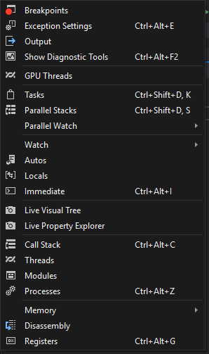
Debug Windows

Slide 45
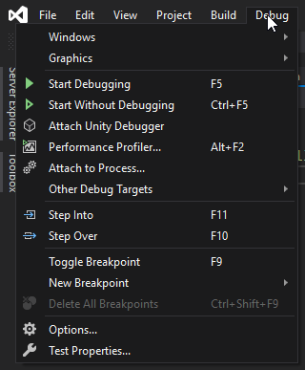
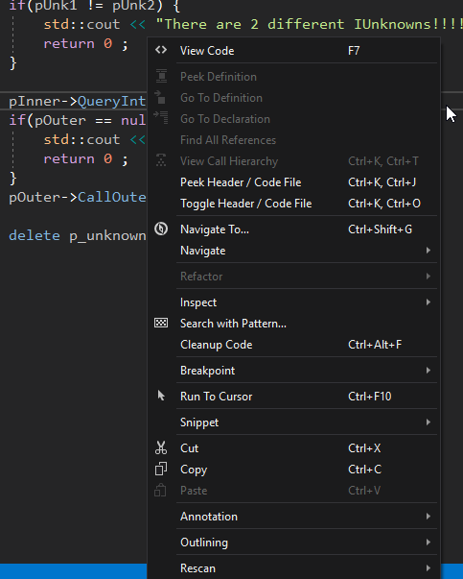
Starting Debugging
Run the program through debugger
Jumps into a function during debugging
Steps over a function during debugging
Start debugging and pause at this line

Slide 46
Start & Stop Debugging
Won’t step into standard library code by default
The default can be changed in case you want to step into standard library code
If some source is not available during debugging, disassembly is displayed

Slide 47
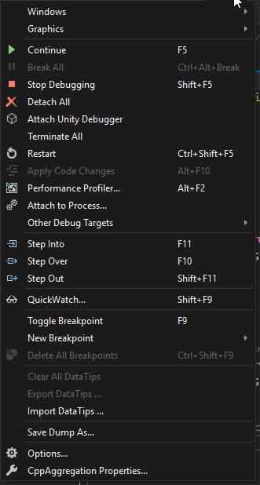
Debugging Commands
Continue debugging if paused
Stop debugging
Restart debugging
Step out of a function quickly during debugging

Slide 48

More Commands
During debugging, you have the following options
  execute code line by line
  restart debugging
  stop debugging
  continue program execution

Slide 49
Datatips
A convenient way to view variable information
Can be set only in debug mode
Hovering over a variable displays a data tip that contains the name & current value
Can be pinned and dragged anywhere afterwards

Slide 50
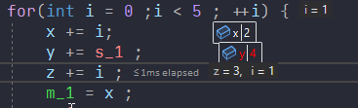
Datatips

Slide 51
Locals & Autos Window
Locals displays values of all variables declared in the current local scope
In member functions, doesn’t show member variables, only this pointer & local variables
Autos is similar except it shows all enclosing scope variables, including class members
  Only the variables on the last three lines are shown
Global & static variables are not displayed; Autos window only displays them if they’re used

Slide 52
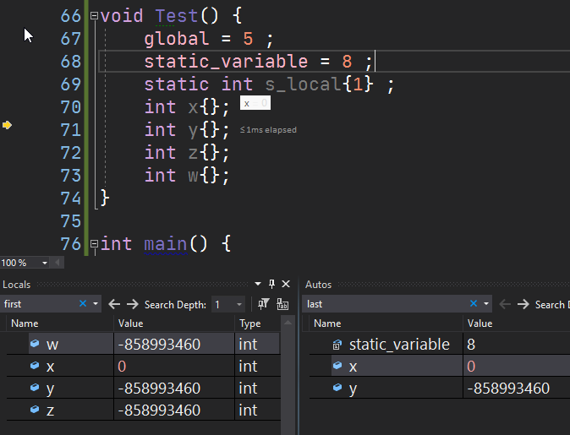
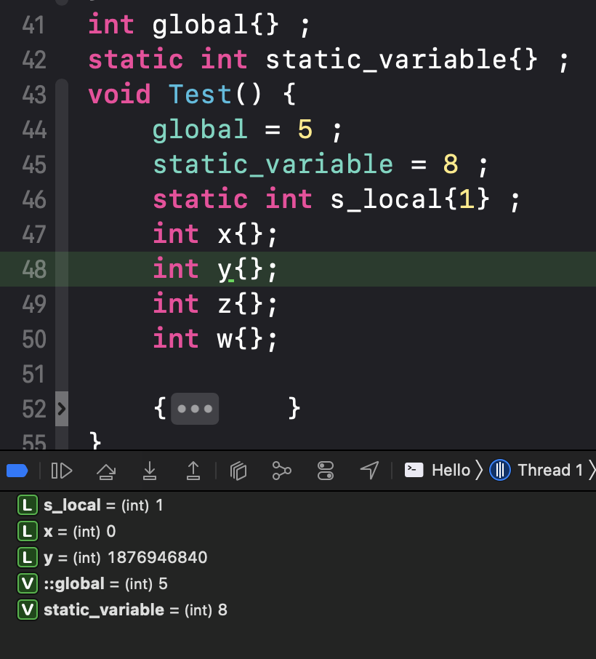

Slide 53
Watches
Visual Studio provide four types of variable windows:
  Quickwatch (Datatip)
  Locals
  Autos
  Watch

Slide 54
Watch
A persistent, customizable window that displays values of variables & expressions
Unlike Autos & Locals, the variables stick and remain visible across frames
Can accept any valid expression; even nested members of objects

Slide 55
Watch Window
In addition to displaying value of a variable, a watch window provides a lot of features
During debugging, it can
  evaluate expressions
  invoke simple C functions
  accept format specifiers
  change the value of variables at runtime

Slide 56
Expression Evaluation
You can invoke C functions & debugger intrinsic functions in watch (string functions)
May not support all types of expressions e.g., expressions that require calls to constructors/destructors, conversions, etc.

Slide 57
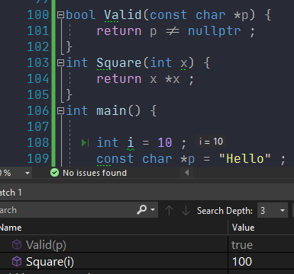

Slide 58
Breakpoints
Breakpoints are special markers that pause the program while debugging
Work only during debugging
The program is said to be in break mode
Helps to inspect variables, memory, call stack, etc., and then step or continue
Additionally, you can run to current line & break instead of setting a breakpoint
Can be of various types

Slide 59
Breakpoint Types
Simple
Address
Conditional
Hit Count
Function
Data
Temporary
Actions & Tracepoints

Slide 60
Tracepoints
Tracepoints are special kind of breakpoints that perform a custom action when the breakpoint is hit in addition to breaking program execution
There are two options that decide the action when the breakpoint is hit
  Print a message and/or
  Execute a macro

Slide 61
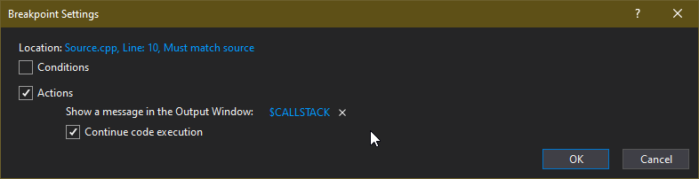
Tracepoints

Slide 62
Important Windows
Debuggers can provide lot of information during debugging
More debug information can be displayed in the following windows
  Call Stack
  Disassembly
  Expressions
  Threads
  Memory
  etc...

Slide 63
Call Stack
This window is only visible during debugging
Displays the active chain of function calls on the current thread
  most recent frame are at the top and callers below
Helps reconstruct the execution path during debugging
Double‑click a frame to navigate and make it the active frame; Autos/Locals update to that scope

Slide 64
Disassembly
Shows the generated assembly code during debugging
It can be used to understand the code generated by the compiler
e.g., virtual function call, optimized code, etc.
It is possible to step through the disassembly during debugging
Available through Debug menu in Visual Studio

Slide 65
Memory Window
Shows the raw view of the process memory during debugging
The data can be viewed in different formats and columns
Useful to confirm member offsets or endianness
Available only during debugging

Slide 66
Dynamic Memory Allocation
Refers to memory allocation on heap
This memory is allocated at runtime
Dynamic memory can be accessed throughout the program (as long as you have the address)
Dynamic memory has to be released manually by the programmer

Slide 67
Why Dynamic Memory
Required size of memory may be unknown at compile time
  loading information from external source
  build data structures without fixed size
More control over lifetime of data
  lifetime of stack based data has limited by scope
  creating big objects

Slide 68
Dynamic Memory Allocation in C
C provides the following functions to allocate memory at runtime
  malloc : allocates raw memory on the heap
  calloc : allocates raw memory and initializes to zero
  realloc : can change the size of memory block
  free : releases the memory allocated by other functions

Slide 69
C Allocation Functions
Not very useful in C++
Cannot initialize memory
Constructors cannot be invoked during allocation
Destructor cannot be invoked during deallocation
Cannot be customized
Return NULL on failure

Slide 70
C++ Allocation Operators
C++ provides only two operators for allocating dynamic memory
The operators have several forms
  new : allocates memory and optionally initializes it (by calling constructor)
  delete : releases memory after optionally calling a destructor
  new[] : allocates memory for an array
  delete[] : releases memory for an array

Slide 71
How new works
0xc001
Number *ptr = new Number{5} ;
Intialize/Invoke ctor
Invoke
void *operator new(size_t size){
//Allocate memory
new expression
Memory address

Slide 72
delete
delete expression
  invokes destructor if one is present
  invokes operator delete that releases the memory

Slide 73
How new works
A new expression invokes operator new function
operator new function will try to allocate memory
On failure
  it throws an exception of type bad_alloc( default behavior)
  it calls a function set by set_new_handler function
  it returns NULL (if nothrow version of new is used)
On success
  the constructor is invoked
  memory address is returned

Slide 74
Non-throwing new
This new does not throw an exception if it fails, but returns nullptr
It is useful when it may not be possible to catch the exception
For example, you may be calling C++ code from C code. In such case, the exception if thrown, cannot be caught
Or an application & library compiled with different compilers call each others’ code that may throw exceptions. There is no guarantee that such exceptions can be caught by either application or the library

Slide 75
Syntax
Object *pObj = new (std::nothrow) Object{} ;
//Check the value of pObj for nullptr

Slide 76
Placement new
The form of new allocates memory at the address specified by the user
Useful for creating objects at designated memory locations
  useful in embedded devices where objects may be stored at known locations
  memory pooling
You may need to call the destructor explicitly for objects that have been created by placement new
Standard library uses placement new in allocators

Slide 77
Syntax
Type *ptr = new (<memory address>) Type{} ;

Slide 78
operator new functions
Expression | Function
T *p = new T ; | void *operator new(std::size_t)
T *p = new (std::nothrow)T ; | void *operator new(std::size_t, const std::nothrow_t &)
T *p = new (address)T ; | void *operator new(std::size_t, void *)
T *p = new (args…)T ; | void* operator new (std::size_t count, args... );
T *p = new T[n] ; | void *operator new[](std::size_t)
T *p = new (std::nothrow)T[n] ; | void *operator new[](std::size_t, const std::nothrow_t &)
T *p = new (address)T[n] ; | void *operator new[](std::size_t, void *)
T *p = new (args…)T[n] ; | void* operator new[] (std::size_t count, args... );

Slide 79
operator delete functions
Expression | Function
delete p ; | void operator delete(void *)
 | void operator delete (void *, const std::nothrow &)
 | void operator delete (void *, void *)
 | void operator delete(void *, args…)
delete[] p; | void operator delete [](void *)
 | void operator delete [](void *, const std::nothrow &)
 | void operator delete [](void *, void *)
 | void operator delete[](void *, args…)

Slide 80
malloc vs new
malloc
new
Function
Requires size during allocation
Cannot initialize memory
Cannot call constructors
Returns void pointer that needs to be type casted
Cannot be customized
malloc, calloc & realloc
Return NULL on failure
Operator
Size is ascertained from the type
Can initialize memory
Can call constructors
Returns correct type of pointer
Can be customized through overloading
Has different forms
Throws exception on failure

Slide 81
Issues
Manual memory management can lead to various issues if not done correctly
These issues arise due to various reasons
  Failing to allocate memory for a pointer before using it
  Allocating insufficient memory that leads to overwrites
  Accessing memory after it has been freed
  Freeing same memory twice
  Not freeing memory after it is no longer required

Slide 82
Uninitialized Pointers
A pointer holds a memory address
If not initialized, it will contain an unknown value
  possibly a valid memory address
  invalid memory address
  difficult to validate the pointer
Accessing such memory address may lead to disastrous consequences
Most compilers warn about uninitialized variables
Always initialize pointers

Slide 83
Memory Overwrite
Caused when insufficient memory is allocated
Data stored in this memory may overflow into surrounding area
Leads to loss of data, or worse, program crash
Common in dynamic arrays, strings, etc.
Use standard library containers instead

Slide 84
Dangling Pointer
After deleting memory, its address still remains in the pointer
Consequently, the pointer continues pointing to the memory (which is no longer valid)
Such a pointer is said to be dangling
This can cause two problems
  the same memory may be deleted again unknowingly (called double-delete)
  pointer may be used without knowing it’s dangling

Slide 85
Avoiding Dangling Pointer
To avoid dangling pointer, assign nullptr immediately after deleting it
If the pointer is accessed again, it will cause an access violation
Deleting a null pointer is not an error; delete treats it like a no-op

Slide 86
Memory Leak
Caused when memory is allocated, but not released afterwards
The address may be lost and the memory can never be reclaimed
If this happens with large allocations and/or repeatedly while the programming is running, the heap memory will run out
  may cause the OS to increase the pagefile size
  will drastically reduce the performance of the system
  in worst case, your program will be killed by the OS

Slide 87
Avoid Memory Issues
Use correct coding practices
Use standard library components instead of rolling your own implementation
Use tools to detect memory related issues
  Insure++
  Valgrind
  Visual Studio

Slide 88
Detecting Heap Buffer Overflows
Visual Studio heap manager provides a function called _CrtCheckMemory that checks for heap consistency
If the heap memory is consistent it returns a non-zero value
If it detects an overwrite in a memory block, it
  returns 0
  dumps basic information in the output window
By default, free() & delete automatically call this function before releasing the memory

Slide 89
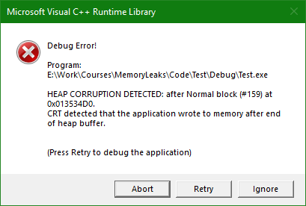
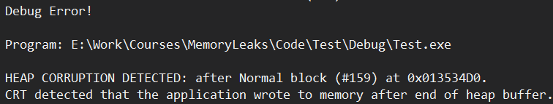
Example
char *p = (char *)malloc(5) ;
strcpy(p, "Hello") ;
free(p) ;
char *p = new char[5] ;
strcpy(p, "Hello") ;
delete []p ;

Slide 90
Detecting Memory Leaks
Visual Studio CRT library provides a function called _CrtDumpMemoryLeaks()
Just like other CRT debug functions, it works only in debug build
Once invoked, it goes through all allocated memory blocks
Any block that is not marked as free is a leaked block
  it dumps diagnostic message in the output window
  returns 1

Slide 91
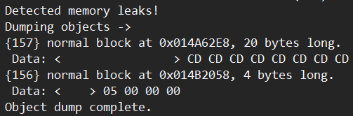
Diagnostic Dump
Leaked Memory Address
Block Size
Allocation Index
Block Data
Block Type
NORMAL
CLIENT
CRT
IGNORE
FREE

Slide 92
Memory Checkpoints
Debug heap manager provides functions to capture the state of the heap
  also called as checkpoint
Different states can be captured and compared
If there is a difference between the older & newer heap state, that indicates a possibility of a leak
Any number of states can be saved & compared; the application can keep on running

Slide 93
Debug Heap Functions
Name | Description
_CrtMemState | Structure to hold the memory state
_CrtMemCheckpoint() | Captures the current state of the heap in _CrtMemState structure
_CrtMemDifference() | Compares two checkpoints & returns 1 if they’re different
_CrtMemDumpAllObjectsSince() | Dumps the blocks that have been allocated since an earlier checkpoint
_CrtMemDumpStatistics() | Dumps the difference between the block types

Slide 94
Report Mode & Type
The heap reporting _Crt functions display different kinds of messages
Some messages are displayed in Visual Studio output window and some in a separate Window
The type of messages that are displayed can be controlled by report type
Report mode can be used to decide where to display the messages

Slide 95
Report Type
There are three report types that can be set by the user
  _CRT_WARN – represents warnings & other information that do not need immediate attention e.g. memory leaks
  _CRT_ERROR – unrecoverable problems that require immediate attention e.g. calling abort()
  _CRT_ASSERT – assertion failures e.g. heap corruption messages

Slide 96
Report Mode
Following report modes are supported
  _CRTDBG_MODE_DEBUG – message is written to debugger output window
  _CRTDBG_MODE_FILE – message is written to a user-defined file
  _CRTDBG_MODE_WNDW – message is displayed in a message box with Abort, Retry & Ignore buttons
  _CRTDBG_REPORT_MODE – returns the current mode for a specific report

Slide 97
Implementation
VS debug heap library detects leaks by storing extra information when memory is requested
Allocates a bigger memory block that contains the following information
  line number
  file name
  type of block
  size of requested memory
  pointer to previous & next block
Essentially, multiple blocks form a two-way linked list

Slide 98
Implementation
int *ptr = new int{6} ;
ptr
Memory Block
Memory Block
Block Header
Guard Bytes

Slide 99
Memory Block
allocated_mem
user_mem
struct ptMemoryBlockHeader
User Memory

Slide 100
Implementation
The user only gets a portion of this memory block
When the user releases the memory, the block is removed from the list
Any memory that is not released will still have corresponding blocks in the list
These blocks are dumped as leaks through _CrtDumpMemoryLeaks()
The information about the leak is picked from the block header

Slide 101
Implementation (Detecting Memory Overwrites)
Various ways to implement
  surround allocated memory with known values
  memory surrounding allocated memory is put in read-only pages
Visual Studio & other tools use these approaches to detect memory overwrites
The user’s allocated memory is surrounded by known values (0xFDFDFDFD)
This area is called NoMansLand
If the values in NoMansLand change, that indicates heap corruption

Slide 102
Memory Block
NoMansLand
allocated_mem
0XFDFDFDFD
0XFDFDFDFD
Block Header
User Memory

Slide 103
Visual Studio Implementation
Visual Studio provides a function called _CrtCheckMemory to check for overwrites
The heap manager allocates extra memory
The user’s allocated memory is surrounded by NoMansLand
This area contains known values (0xFDFDFDFD)
The function checks for these known values

Slide 104
Implementation
0xFDFDFDFD
Header
User memory
int *p = new int{100} ;
0xFDFDFDFD
Footer

