Slide 1


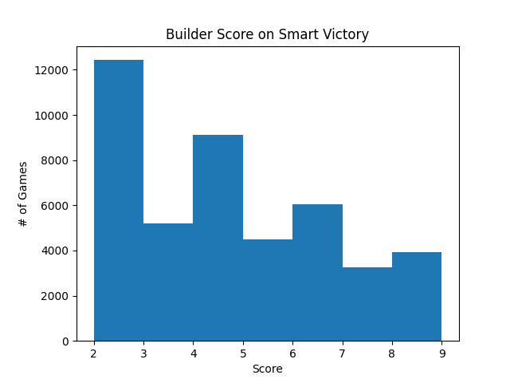
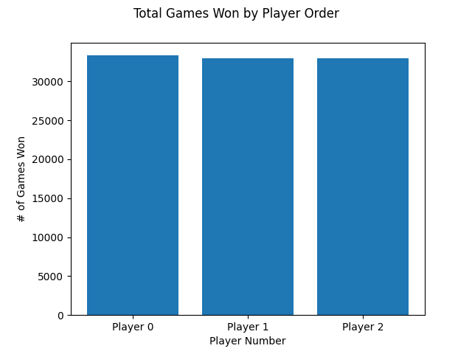
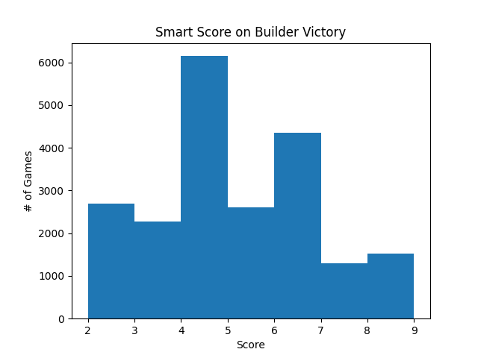
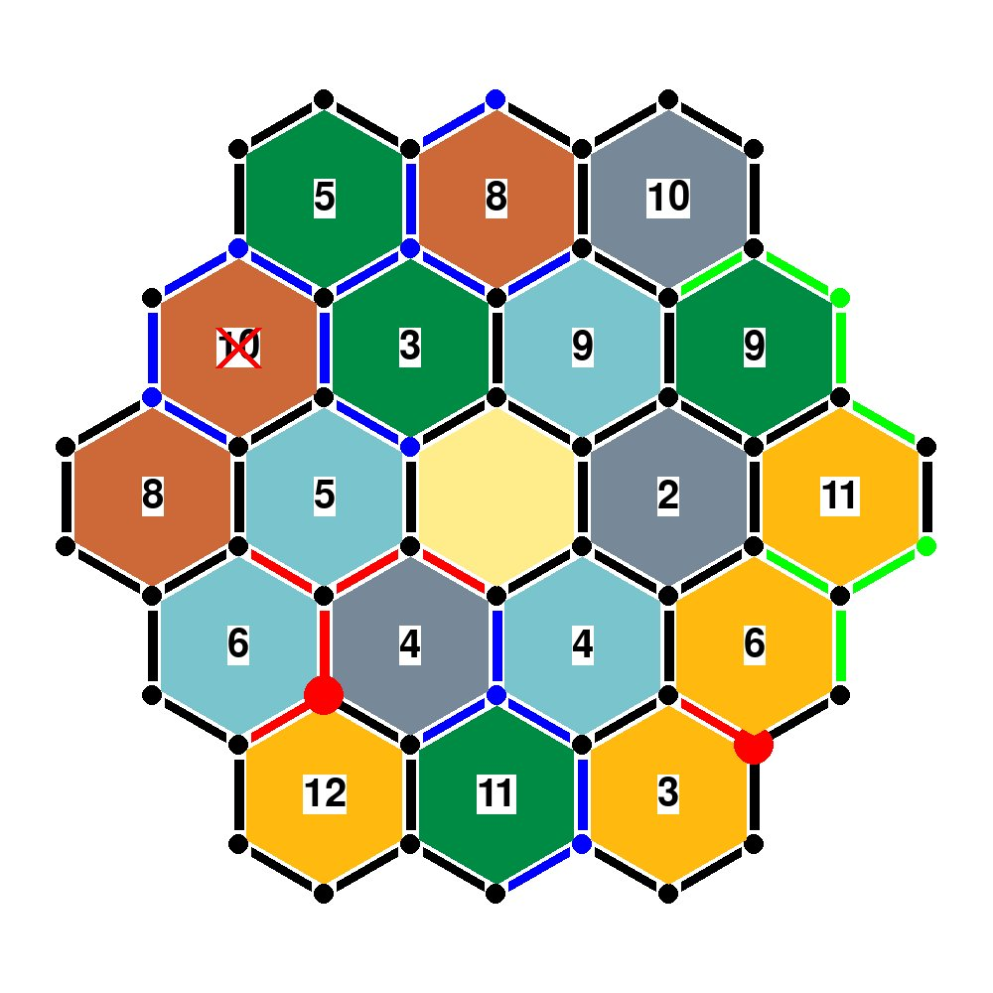
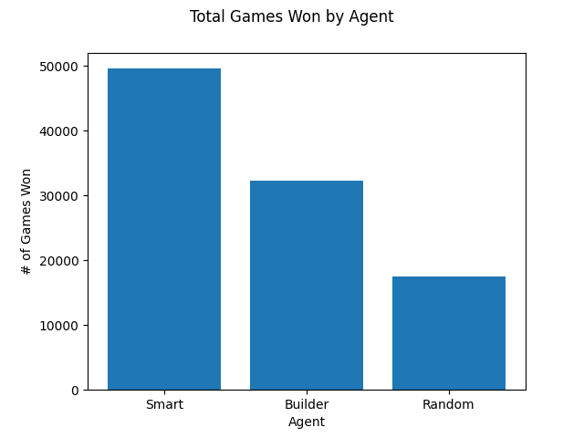
Heuristics Testing for Settlers of Catan
Daniel Kim, Department of Computer Science, James Glenn, Department of Computer Science, Yale University
DESCRIPTION
KEY FINDINGS
> Strategies that take a holistic approach to Settlers of Catan (including the use of development cards, going for longest road, etc.) perform better than strategies that utilize infrastructure as the primary basis for point generation.
> Player order does not matter too much when playing Catan; all player order placements had around the same % of victories.
The development of heuristics for Catan policies can take a number of different directions, including but not limited to:
- What resources to prioritize for initial settlement placing
- What resources to prioritize for later settlement placing
- Whether to prioritize upgrading settlements to cities or placing new settlements first
- Where to place new roads, and whether to build new roads or prioritize other infrastructure, such as development cards.
To start with heuristic development, a random policy and a human policy (so interested researchers can play against the policies directly) was created, and the "smart heuristic player" from Ashraf and Kim's 2018 work into my own Catan package was adapted.¹ Then, a "builder" heuristic was created loosely based on the "smart heuristic player" mentioned above and the author's own personal playstyle, which eschews building the longest road, development cards, or the largest army in favor of building up a large base of resource generation infrastructure (settlements and cities) and gaining the required 10 VPs from settlement and city building. Lastly, various parameters of both heuristics were tweaked through the hill-climbing method, in order to ascertain possible optimal hyperparameters.
A testing framework was also created, in order to effectively play the different heuristics against each other; this tester measures victories for each heuristic after a specified number of games, as well as the points won by the losing heuristics.
INTRODUCTION
Settlers of Catan is a three or four-player turn-based stochastic/Markov game with limited information that tasks players with colonizing the island of Catan. The goal of the game is to earn 10 "Victory Points", which can be done in these ways:
- 1 VP from building a settlement
- 1 VP from upgrading a settlement to a city
- 2 VP from having the longest road
- 1 VP from development cards, which may give VPs or confer a variety of other effects.
- 2 VP from having the largest army (built from dev cards)
To gain these VPs, players must generate resources from settlements and, later, cities in order to build settlements, cities, roads, and development cards.
RESULTS
Testing 100,000 Catan games with the unoptimized Smart, Builder, and Random agents in a scenario where all three of these agents faced off against each other in a three-person game of Catan showed that the Smart agent performed the greatest, implying that a balanced focus that incorporates development cards into a strategy may perform better than a strategy focused more on infrastructure above all else. Interestingly enough, the graphs showing the builder score on smart victory (and vice-versa) on the right have a {insert skew here}, even showing a large number of games with only 2 points. This implies that the agents failed to gain any points at all during the entire game, something that implies the need for a more focused strategy; the agents may have oscillated between multiple aims (such as gathering resources for building a settlement and building a city) instead of trading and building towards one exclusively. Player order also was not very important when determining victory; as shown above, the first, second, and third players had around the same number of victories.
REFERENCES
An example of a completed game of Catan using three different policies - the "builder", Ashraf and Kim's "smart player", and a random policy. The "smart player" in blue has won the game.
[1] Omar Ashraf and Christopher Kim. CPSC 490 Project Proposal: Computational Intelligence for Settlers of Catan. Undergraduate thesis, 2018.

