Slide 1
Javascript Operating System
Tomas Re, Logan Figgins, Matt Kindblad, Edwin Young, Darrel Daquigan

Slide 2
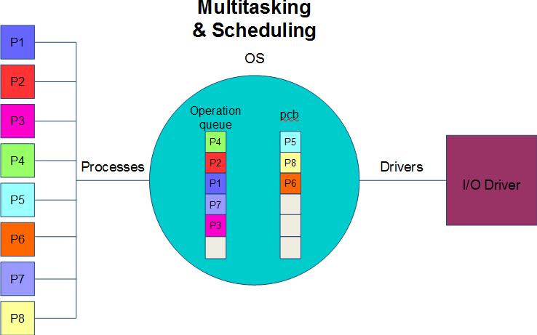

Slide 3
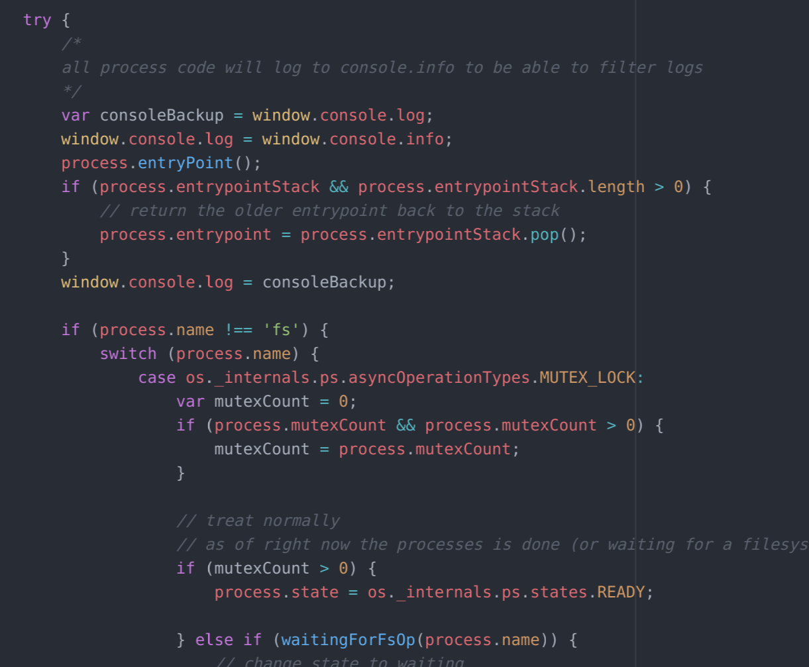
Scheduler Overview: pseudocode
find a process which is valid to be scheduled
// userspace logs to info to filter os from userspace logs
set console.log to be console.info
// the processes entrypoint is a closure (function) on how to continue running
// the process can have multiple of these if leaving for fs calls inside mutex locks etc
// try catch no guarantee a userspace process wont throw an exception
run the outermost entrypoint (syncronous function)
restore normal console.log
// scheduler sets all process states - all user process switches go through the scheduler (even streams)

Slide 4
Assignment 2:
Device Drivers and CLI
P1
OS
Keyboard Device
P2
Operation
queue
pcb
P3
P8
P5
P4
P2
CLI
I/O Driver
Processes
Drivers
P1
P6
P5
P7
P3
P6
CLI
P7
Display Device
P8

Slide 5
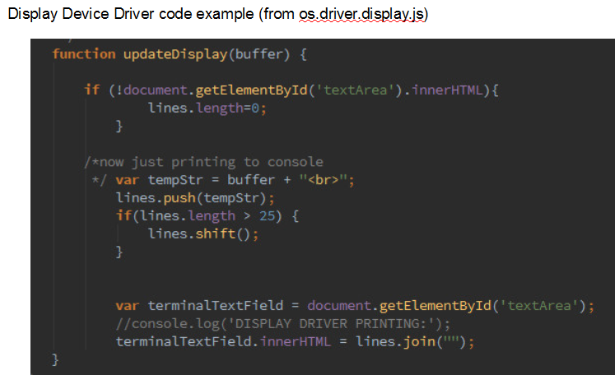

Slide 6
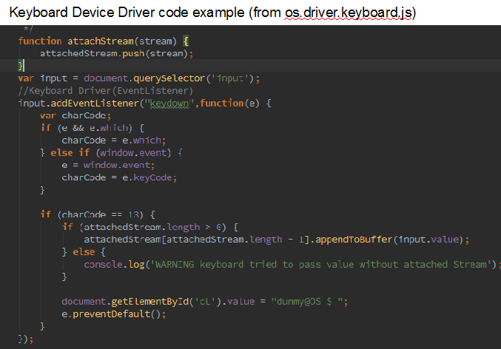

Slide 7
CLI Code Example From Bash.js
case "copy": //copy is finished
var sourcePath = convertToAbsolute(command[1]);
var destinationPath = convertToAbsolute(command[2]);
if(validPath(path)) {
os._internals.ps.copyProcessTableEntryToPCB('copy', null, [sourcePath, destinationPath]);
//os.ps.register('copy',os.bin.copy(command[1],command[2]));
stdout.appendToBuffer('Copying' + command[1] + ' to destination ' + command[2]);
}
break;
case "rm":
var path = convertToAbsolute(command[1]);
if(validPath(path)) {
os._internals.ps.copyProcessTableEntryToPCB('remove', null, [path]);
}
stdout.appendToBuffer("removing " +command[1]);
break;
case "vectorcalculator":
os._internals.ps.copyProcessTableEntryToPCB('vectorcalculator');
//os.ps.register('vectorcalculator', os.bin.vectorcalculator);
stdout.appendToBuffer('Running VectorCalculator.js');
break;
case "countchars":
os.internals.ps.copyProcessTableEntryToPCB('countchars');
stdout.appendToBuffer('Running CountChars.js');
break;

Slide 8
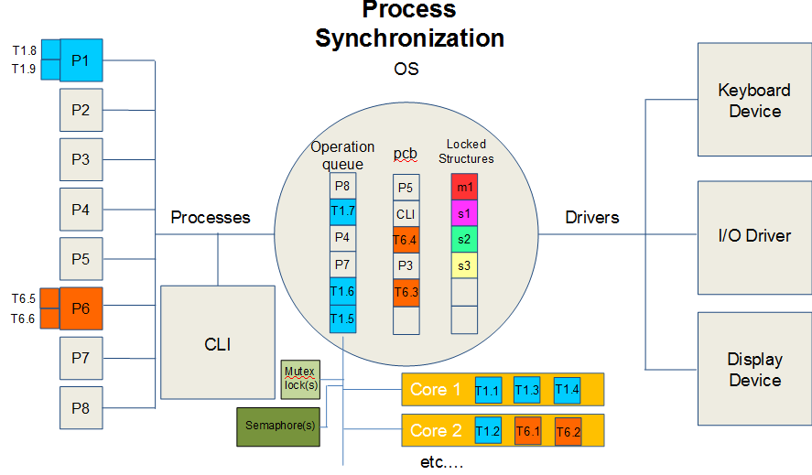

Slide 9
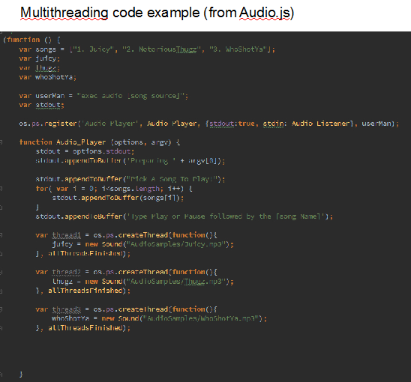

Slide 10
var threadsDoneCalc = 0;
for (var i = 0; i < 5; i++){
(function(i) {
os.ps.createThread(
function (){
console.log("thread " + i + " created");
os.ps.pthread_semaphore_lock(
'meanLock',
function (){
console.log("thread " + i + " lock");
for (var j = 0; j < stats.range; j++){
if (i < 4 || j < stats.n%stats.range){
//console.log("counting pos " + ((i*stats.range)+j) + ": " + stats.samples[(i*stats.range)+j]);
stats.sum += stats.samples[(i*stats.range)+j];
}
}
threadsDoneCalc++;
os.ps.pthread_semaphore_unlock(
'meanLock',
function(){
console.log("Thread " + i + " unlock");
stats.mean = stats.sum/stats.n;
stats.print();
callback(null, stats, threadsDoneCalc, fh);
}
);
}
);
},
threadsDone
);
})(i)
}
},
Thread and Semaphore Example from StatsCalc.js

Slide 11
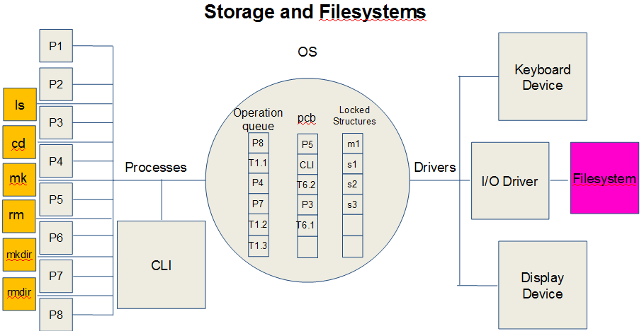

Slide 12
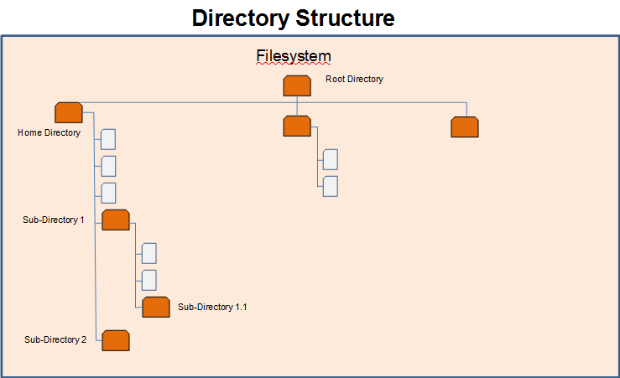

Slide 13
Filesystem Example from os.fs.disk
os._internals.fs.disk.root.home['Stats_Data.csv'] = {
// the actual data
data: '1,2,3,4,5,6\n4,5,6,7,8,9\n1,2,3,4,5,6\n4,5,6,7,8,9\n1,2,3,4,5,6\n4,5,6,7,8,9\n1,2,3,4,5,6\n4,5,6,7,8,9\n' +
'1,2,3,4,5,6\n4,5,6,7,8,9\n1,2,3,4,5,6\n4,5,6,7,8,9\n1,2,3,4,5,6\n4,5,6,7,8,9\n1,2,3,4,5,6\n4,5,6,7,8,9\n' +
'1,2,3,4,5,6\n4,5,6,7,8,9\n1,2,3,4,5,6\n4,5,6,7,8,9\n1,2,3,4,5,6\n4,5,6,7,8,9\n1,2,3,4,5,6\n4,5,6,7,8,9\n' +
'1,2,3,4,5,6\n4,5,6,7,8,9\n1,2,3,4,5,6\n4,5,6,7,8,9\n1,2,3,4,5,6\n4,5,6,7,8,9\n' +
'1,2,3,4,5,6\n4,5,6,7,8,9\n1,2,3,4,5,6\n4,5,6,7,8,9\n1,2,3,4,5,6\n4,5,6,7,8,9\n1,2,3,4,5,6\n4,5,6,7,8,9\n' +
'1,2,3,4,5,6\n4,5,6,7,8,9\n1,2,3,4,5,6\n4,5,6,7,8,9\n1,2,3,4,5,6\n4,5,6,7,8,9\n',
// metadata ie simulated file handle
meta: {}
};
os._internals.fs.disk.root.home['integers.csv']={
data: "1,2,3,4,5,6,7,8,9,10,11,12,13,14,15,16,17,18,19,20,21,22,23,24,25,26,27,28,29,30,31,32,33,34,35,36,37",
meta:{}
};

Slide 14
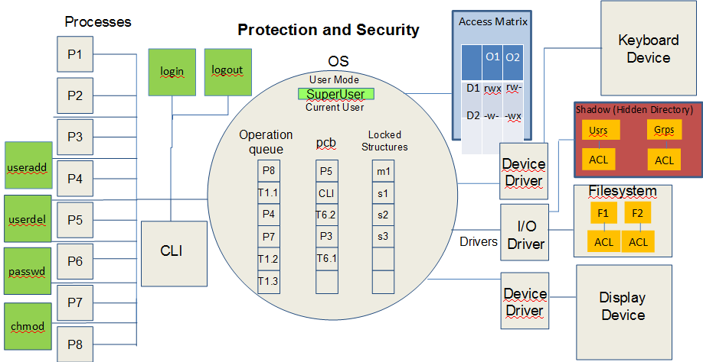

Slide 15
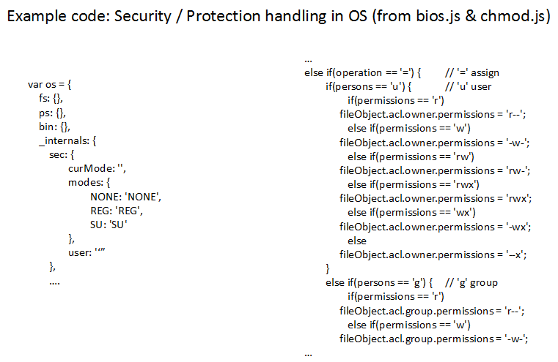

Slide 16
