Slide 1
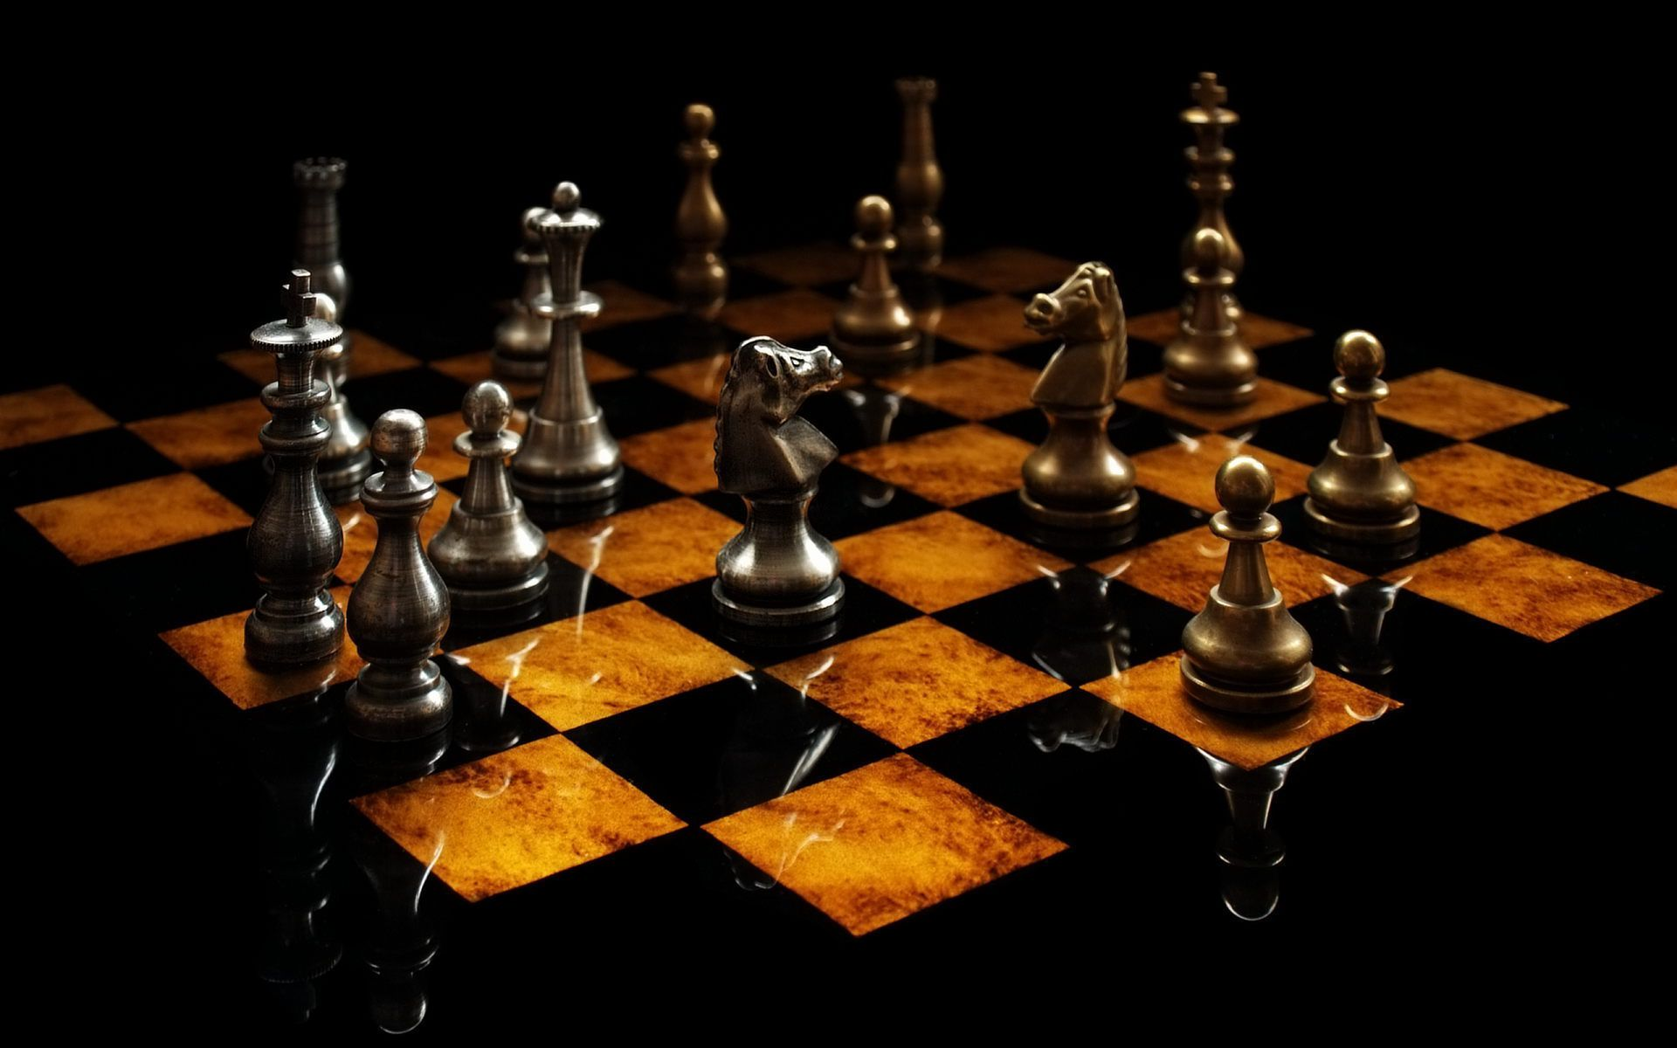
CHESSTONE
Group 1. 서정현 임우섭 정석우 한태균
SW Project – Team Project
Free PowerPoint Templates
Free PowerPoint Templates

Slide 2
Index
Use of Git
UI Design
Game Logic Explanation
Class UML
State Author
Q&A
Free PowerPoint Templates
Free PowerPoint Templates

Slide 3
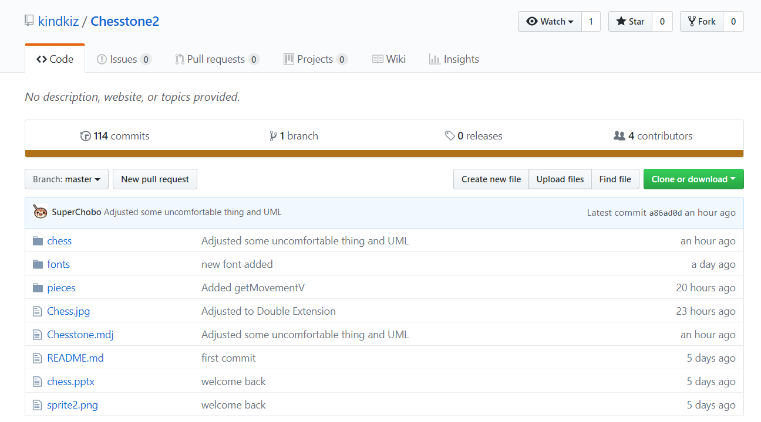
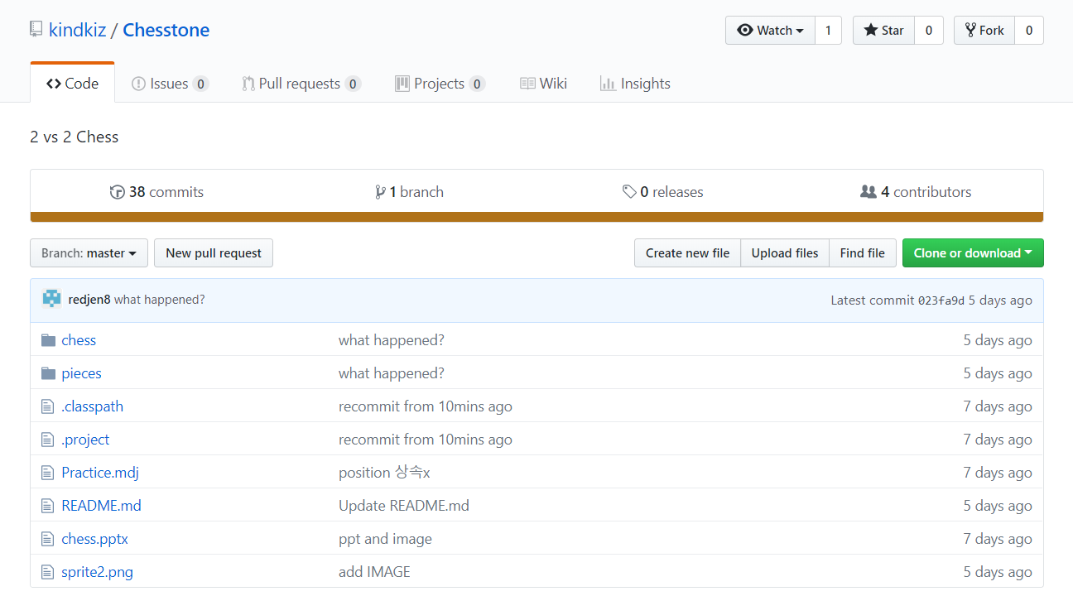
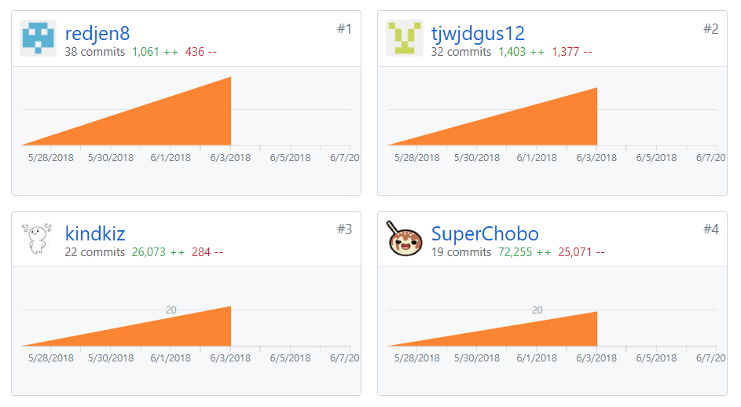
Use of Git
+150
Commits
Free PowerPoint Templates

Slide 4
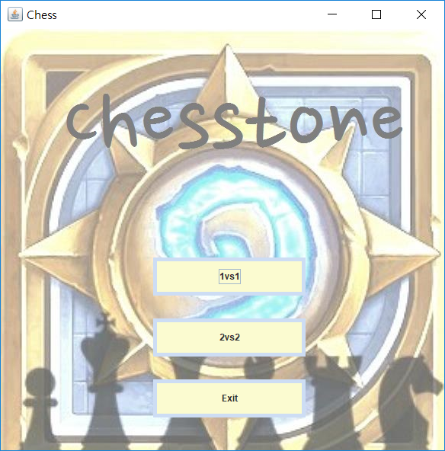
UI Design
Main
Free PowerPoint Templates
Free PowerPoint Templates

Slide 5
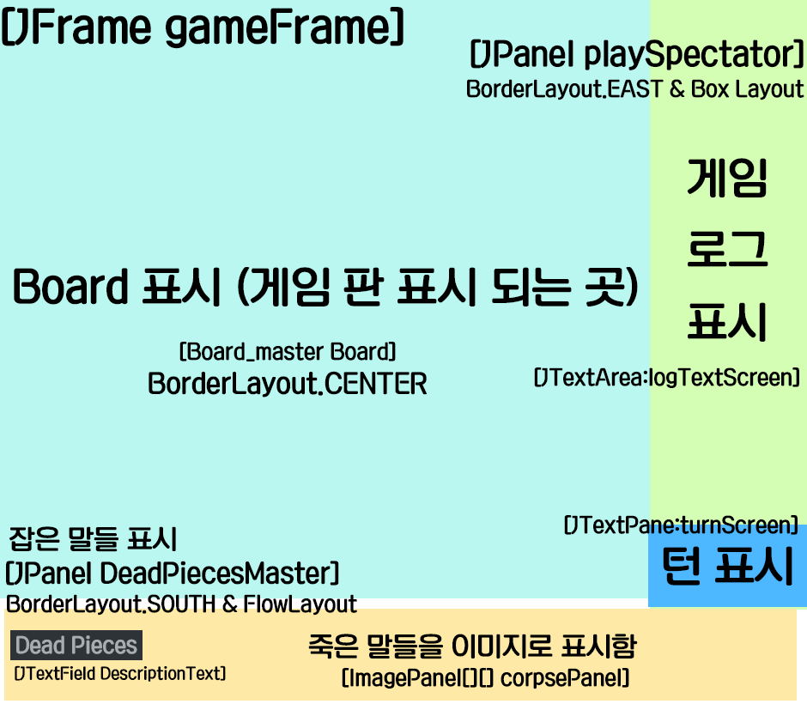
UI Design
Game
Free PowerPoint Templates
Free PowerPoint Templates

Slide 6
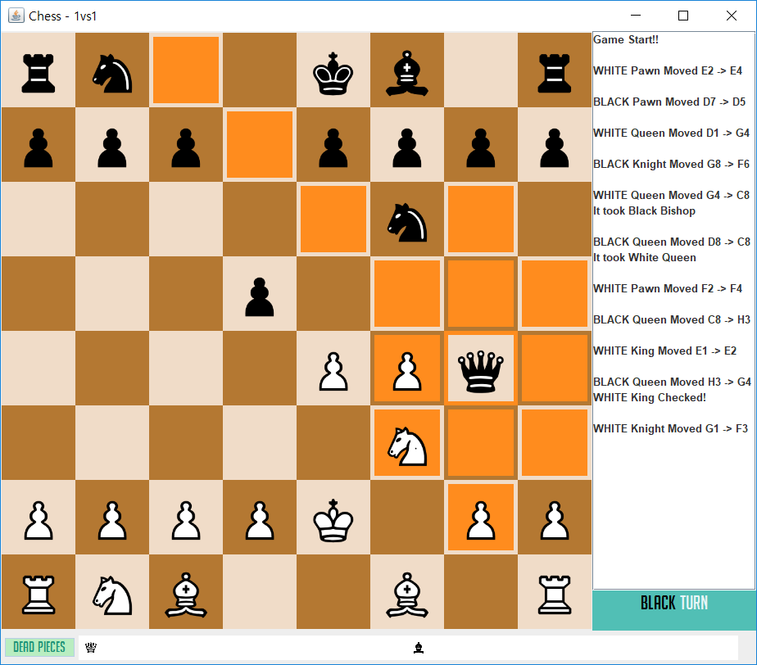
UI Design
Chess Board
Log
1vs1
Turn
Dead Pieces
Free PowerPoint Templates
Free PowerPoint Templates

Slide 7
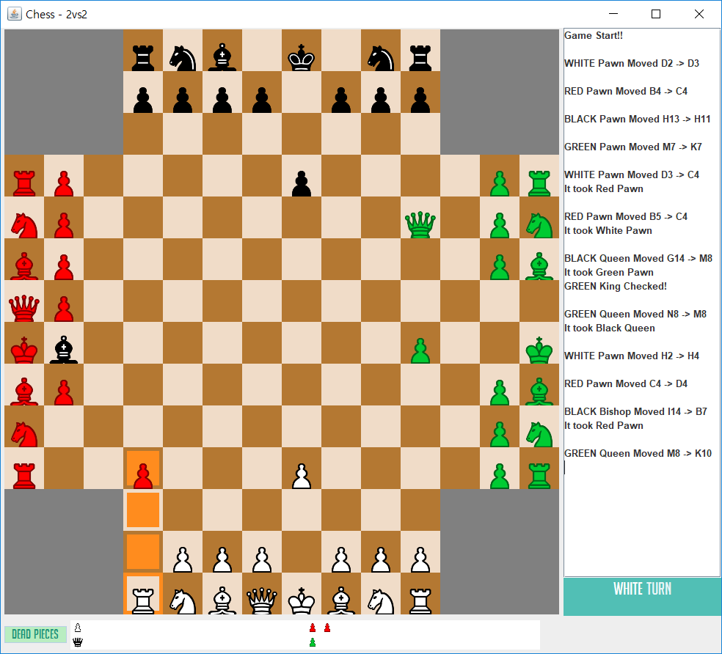
UI Design
Chess Board
Log
2vs2
Turn
Dead Pieces
Free PowerPoint Templates
Free PowerPoint Templates

Slide 8
Game Logic
this panel is movable panel
Selected piece exists
this panel contains my piece
Jpanel clicked
else
Selected not exists
Select this piece
Free PowerPoint Templates

Slide 9
Game Logic
illegal Move? -> add illegal move log, cancel
add move log
enemy Caught? -> add catch log, add dead pieces
Move!
change turn
Am I Checked?
Am I Checkmated? -> win pop-up
Stalemate? -> draw pop-up
board renew
this panel is movable panel
this panel contains my piece
Select this piece
else
Cancel the selected piece
Free PowerPoint Templates

Slide 10
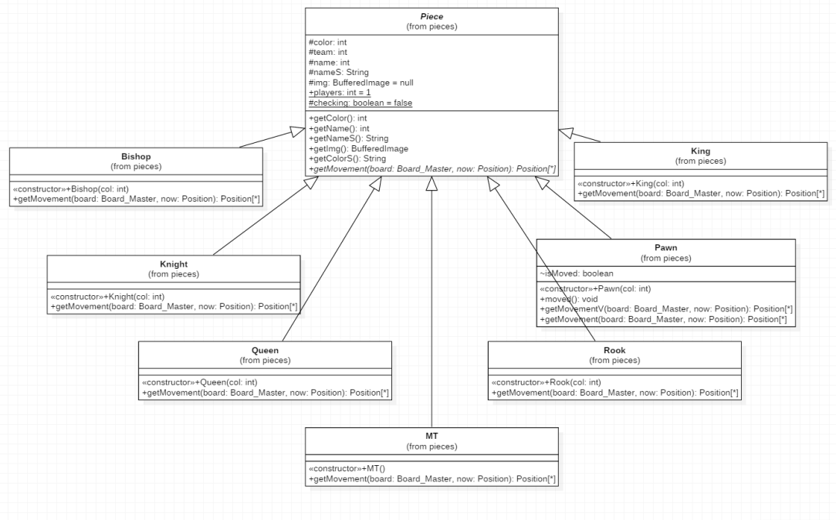
Class UML
Free PowerPoint Templates

Slide 11
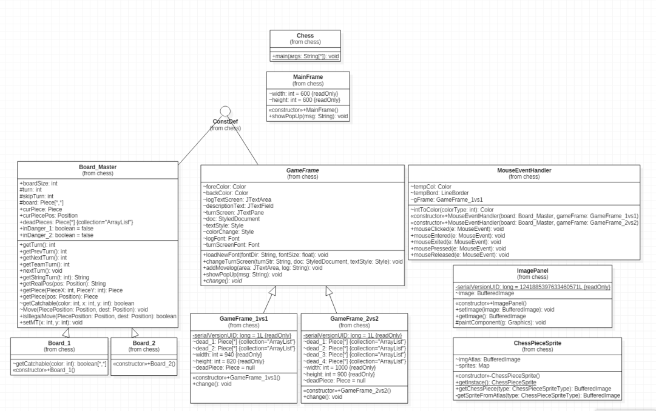
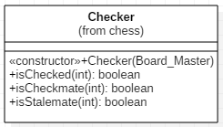
Class UML
Free PowerPoint Templates

Slide 12
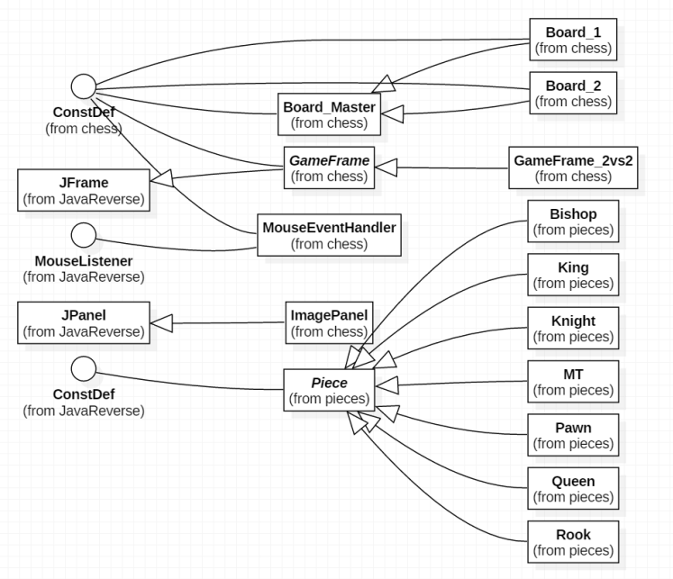
Class UML
Free PowerPoint Templates

Slide 13
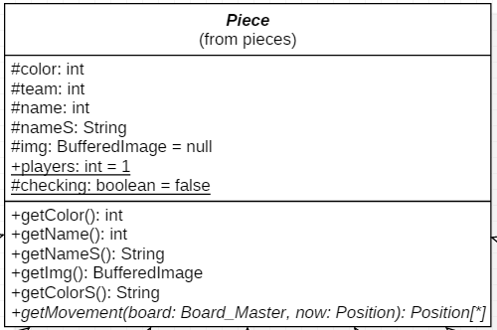
Class UML
Free PowerPoint Templates

Slide 14
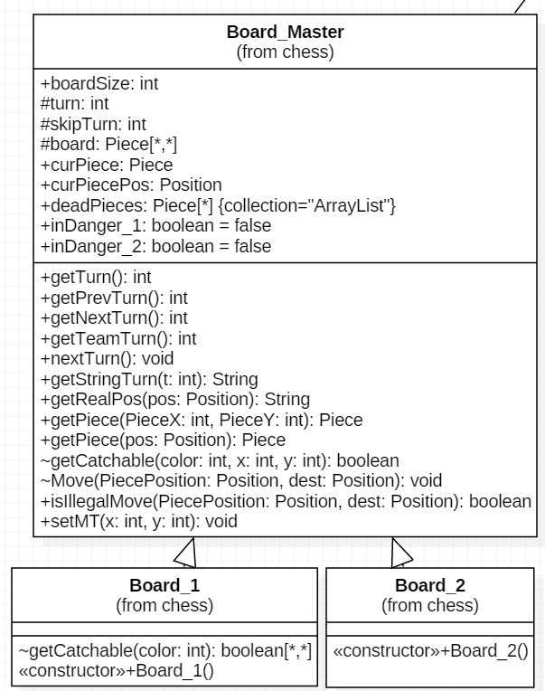
Class UML
Free PowerPoint Templates

Slide 15
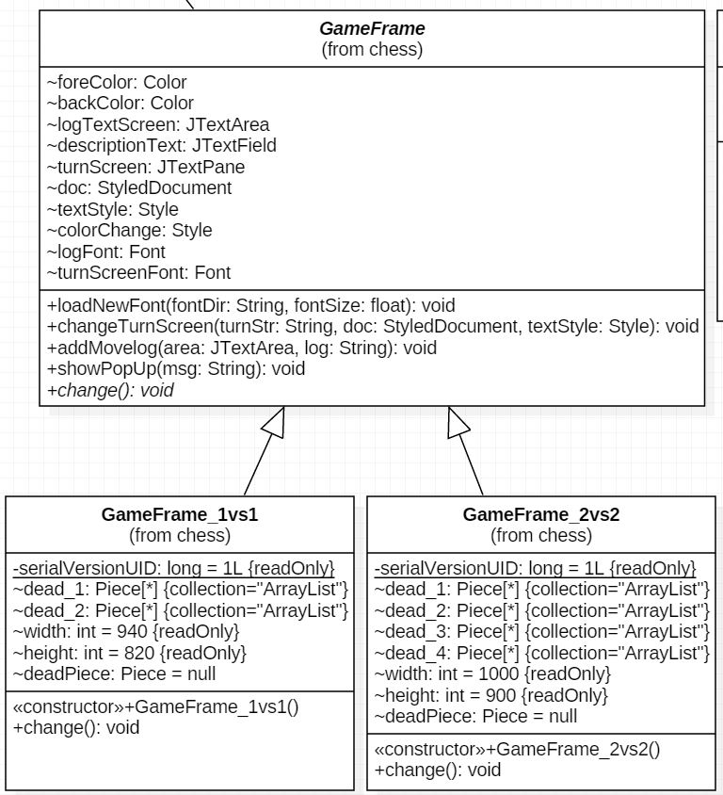
Class UML
Free PowerPoint Templates

Slide 16
Class UML
Free PowerPoint Templates

Slide 17
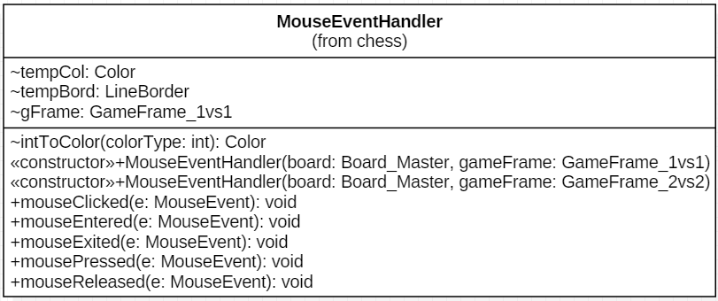
Class UML
Free PowerPoint Templates

Slide 18
Class Author
한태균
임우섭
kindkiz
SuperChobo
Checker
Rook
Bishop
Chess
Piece
Pawn
Knight
King
Queen
MT
Position
ConstDef
정석우
서정현
Redjen8
tjwjdgus12
mainFrame
Board_Master
Board_1
Board_2
GameFrame
GameFrame_1vs1
GameFrame_2vs2
MouseEventHandler
Free PowerPoint Templates

Slide 19
Q&A
체-바
Free PowerPoint Templates

