Slide 1
CHESS
1vs1
2vs2
Exit

Slide 2
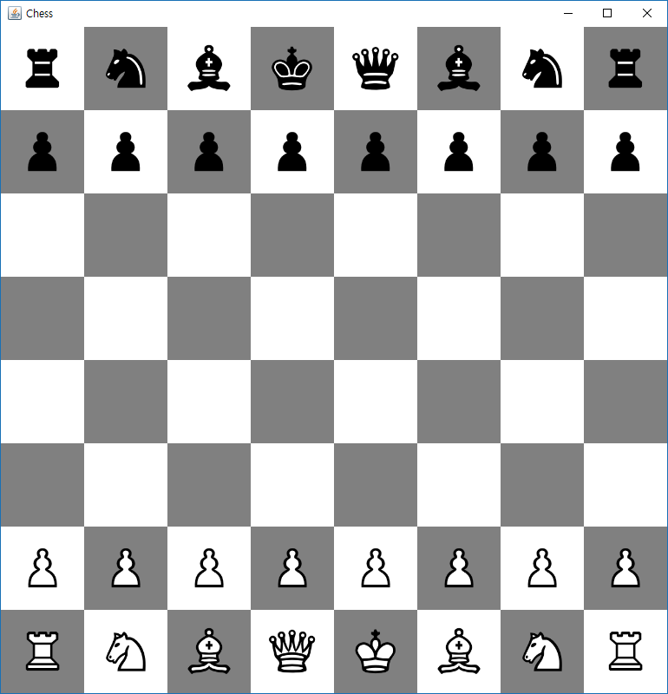

Slide 3
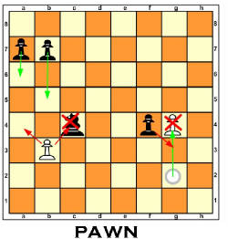
Chess pieces
Pawn
Pawn can move forward one square if that square is empty
Pawn can move forward two square if pawn is in initial position
Pawn can attack diagonally forward one square away

Slide 4
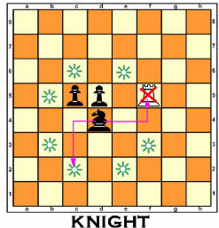
Chess pieces
Knight
Knight can move or attack two squares horizontal then one square vertical or two squares vertical then one square horizontal.(L shape)
Knight can jump over other pieces

Slide 5
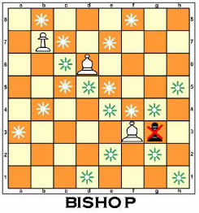
Chess pieces
Bishop
Bishop can move or attack any number of squares diagonally
Cannot jump over other pieces.

Slide 6
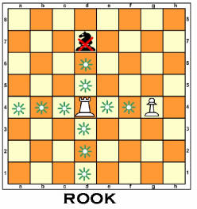
Chess pieces
Rook
Rook can move or attack any number of squares horizontally or vertically
Cannot jump over other pieces.

Slide 7
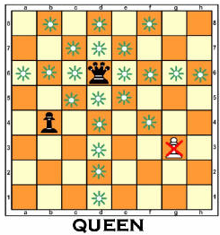
Chess pieces
Queen
Queen can move or attack any number of squares diagonally or horizontally or vertically
Cannot jump over other pieces.

Slide 8
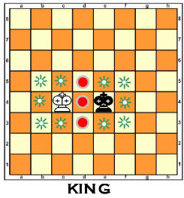
Chess pieces
King
King can move or attack one square diagonally or horizontally or vertically
Cannot jump over other pieces
Cannot move to square that can be attacked by enemy

Slide 9
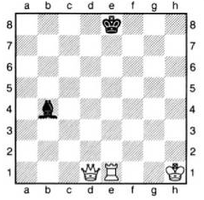
Chess rules
Check
If king is under attack by at least one enemy piece(ie. King will captured next turn)

Slide 10
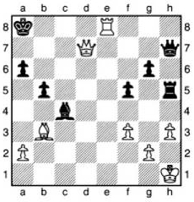
Chess rules
Checkmate
When in check, no legal move left to resolve check.
When happen, game is over. And checkmated side loses.

Slide 11
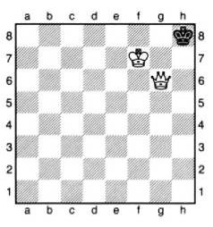
Chess rules
Stalemate
When in not check, no legal move left.
When happened, game is a draw.

Slide 12
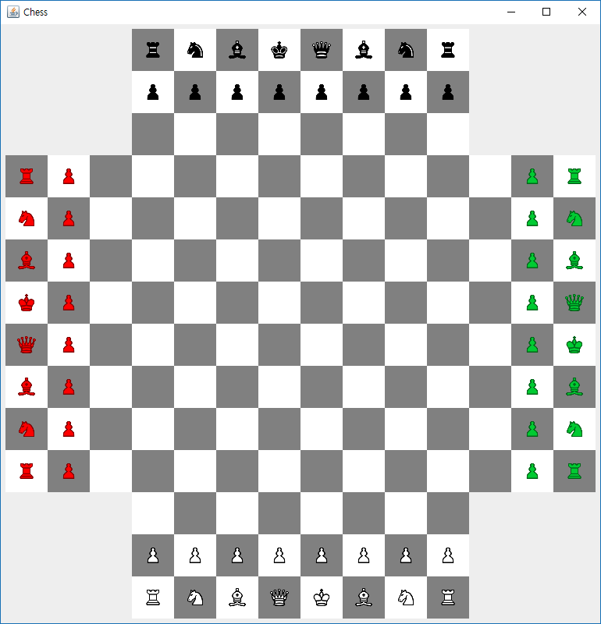

Slide 13
Chess rules(4Way, 2vs2)
In 4Way chess, turn goes White->Red->Black->Green
White, Black vs Red, Green
Cannot attack own team
Winning condition is when both enemy(ie. Red, Green) is under checkmate
All other rules are same.

Slide 14
ImagePanel
/**
* ImagePanel is JPanel variant for displaying BufferedImage
* <p>
* to maintain alpha channel in image, ImagePanel is transparent, by default.
*
* @see JPanel
* @see BufferedImage
* @author LeNerd
* @since 2018-05-23
*/
public class ImagePanel extends JPanel {
private static final long serialVersionUID = 1241885397633460571L;
BufferedImage image;
public ImagePanel() {
setOpaque(false);
}
/**
* set Image to draw
*
* @param image
* image to set.
*/
public void setImage(BufferedImage image) {
this.image = image;
}
/**
* get current Image
*
* @return BufferedImage
*/
public BufferedImage getImage() {
return image;
}

Slide 15
ImagePanel
protected void paintComponent(Graphics g) {
super.paintComponent(g);
/*
* inform render to use bilinear interpolation
*/
((Graphics2D) g).setRenderingHint(RenderingHints.KEY_INTERPOLATION,
RenderingHints.VALUE_INTERPOLATION_BILINEAR);
if (image != null) {
/*
* if image is set, draw to fill.
* with aspect ratio
*/
float wr = (float)getWidth() / (float)image.getWidth();
float hr = (float)getHeight() / (float)image.getHeight();
float r = Math.min(wr, hr);
int w = (int)(image.getWidth()*r);
int h = (int)(image.getHeight()*r);
g.drawImage(image, (getWidth()-w)/2,(getHeight()-h)/2,w,h, this);
}
}
}

Slide 16
ImagePanel
JPanel variant for showing image.
Transparent images are supported
setImage() to set images(BufferedImage) to draw.
If stop want to show image, pass null.
getImage() returns currently showing image.

Slide 17
ChessPieceSprite
/**
* A class to maintain ChessPiece Images.
* <p>
* this class load Sprite atlas and generate BufferedImage for each chess piece
*
* @see ChessPieceSpriteType
* @see BufferedImage
* @author LeNerd
* @since 2018-05-23
*/
public class ChessPieceSprite {
/**
* This represents possible chess pieces.
*
* @author LeNerd
*
*/
public enum ChessPieceSpriteType {
BLACK_KING(5, 0), BLACK_QUEEN(4, 0), BLACK_LOOK(3, 0), BLACK_KNIGHT(1, 0), BLACK_BISHOP(2, 0), BLACK_PAWN(0, 0),
WHITE_KING(5, 1), WHITE_QUEEN(4, 1), WHITE_LOOK(3, 1), WHITE_KNIGHT(1, 1), WHITE_BISHOP(2, 1), WHITE_PAWN(0, 1),
RED_KING(5, 5), RED_QUEEN(4, 5), RED_LOOK(3, 5), RED_KNIGHT(1, 5), RED_BISHOP(2, 5), RED_PAWN(0, 5),
GREEN_KING(5, 8), GREEN_QUEEN(4, 8), GREEN_LOOK(3, 8), GREEN_KNIGHT(1, 8), GREEN_BISHOP(2, 8), GREEN_PAWN(0, 8);
int x;
int y;
private ChessPieceSpriteType(int x, int y) {
this.x = x;
this.y = y;
}
public String getKey() {
return x + "," + y;
}
}

Slide 18
ChessPieceSprite
private static ChessPieceSprite instance = new ChessPieceSprite();
BufferedImage imgAtlas;
Map<String, BufferedImage> sprites;
private ChessPieceSprite() {
try {
imgAtlas = ImageIO.read(new File("sprite2.png"));
} catch (IOException e) {
// TODO Auto-generated catch block
e.printStackTrace();
}
sprites = new HashMap<>();
}
/**
* returns current instance of ChessPieceSprite
*
* @return instance of ChessPieceSprite
*/
public static ChessPieceSprite getInstace() {
return instance;
}
/**
* returns BufferedImage for given ChessPieceSpriteType
* <p>
* this function generates BufferedImage for first time for each
* ChessPieceSpriteType. any subsequent call is cached.
*
* @param type
* type of chess piece
*
* @return BufferedImage for given ChessPieceSpriteType.
*/
public BufferedImage getChessPiece(ChessPieceSpriteType type) {
if (sprites.get(type.getKey()) == null) {
sprites.put(type.getKey(), getSpriteFromAtlas(type));
}
return sprites.get(type.getKey());
}

Slide 19
ChessPieceSprite
private BufferedImage getSpriteFromAtlas(ChessPieceSpriteType type) {
int w = imgAtlas.getWidth() / 6;
int h = imgAtlas.getHeight() / 12;
BufferedImage img = new BufferedImage(w, h, imgAtlas.getType());
Graphics g = img.getGraphics();
g.drawImage(imgAtlas, 0, 0, w, h, type.x * w, type.y * h, type.x * w + w, type.y * h + h, null);
// g.dispose();
return img;
}
}

Slide 20
ChessPieceSprite
ChessPieceSprite class is for management of Images of chess pieces
This class cannot be created manually(ie. with new keyword)
This class is Singleton class. Only one class instance is exists and created when class is loaded by Java
To use this class, call getInstance() to get current instance.
getChessPiece() has parameter of ChessPieceSpriteType.
Pass desired color and piece variant.
Every variant is enumerated in ChessPieceSpriteType.
Example: but black bishop image to variable img
BufferedImage img = ChessPieceSprite.getInstace().getChessPiece(ChessPieceSpriteType.BLACK_BISHOP);

Slide 21
Requirements
Chess pieces
Use given ChessPieceSprite Class to get chess piece images.
Use given ImagePanel Class to show chess piece.
Any extra elements(background, buttons, etc) must inherits JPanel directly or indirectly.
Class
One or more use of double inheritance.
One or more use of Interface and implement.
Class must be at least 9
Excluding ChessPieceSprite, ImagePanel classes.
State author on every classes.
Only one author per classes.
If Copy/Code sharing between other teams are found beyond reasonable doubt, author of related code are given 0 point

Slide 22
Midterm presentation(June 1st)
10 Minute presentation per team
Presentation must includes
Project architecture/design
UI design
Game logic explanation
Class architecture/design
With UML
State author for each class
Project schedule and progress report

Slide 23
Final presentation(June 8th)
10 minute presentation per each tea
Presenter must be different from midterm presenter
Presentation must includes
Finalized Project architecture/design
UI design
Game logic explanation
Finalized Class architecture/design
With UML
State author for each class
Project implementation report
Project Demo

