Slide 1
Exploring the Immune Microenvironment and Prognostic Role of BTK in Lung Adenocarcinoma A reproducibility study based on TCGA data mining
Kindle Zhang qz2527
advisor: Zhonghua Liu

Slide 2
Background/Introduction
Background
LUAD is the most common subtype of lung cancer, and BTK is a tyrosine kinase increasingly recognized for its role in tumor immunity.
This is a simulation study, analyzed using the following steps to explore the immune microenvironment and prognostic role of BTK in Lung Adenocarcinoma.
Outline
Lung Adenocarcinoma(LUAD) data from TCGA and get gene expression profile (counts and tpms)
Perform EstimateScore and Plot Survival Curves
Analyze Correlation Between Clinical Features and EstimateScore
DEGs and Enrichment Analysis with GO and KEGG function
PPI and Cox regression on gene expression
Focus on BTK gene
GSEA Enrichment Analysis on BTK gene
CIBERSORT analysis

Slide 3
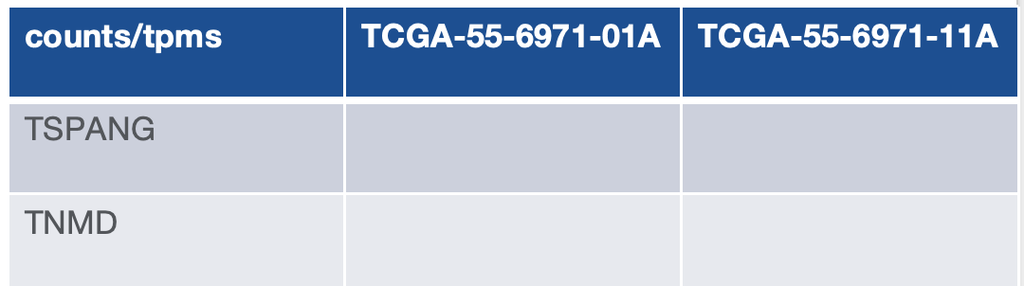
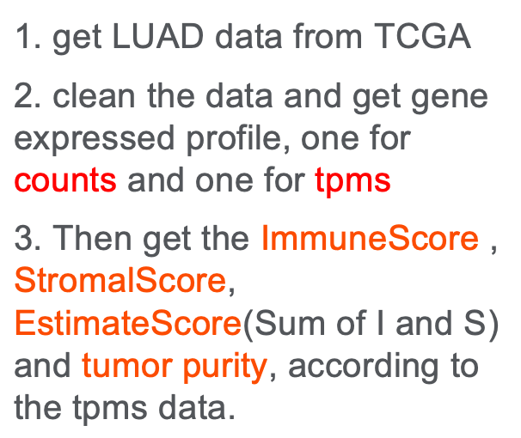
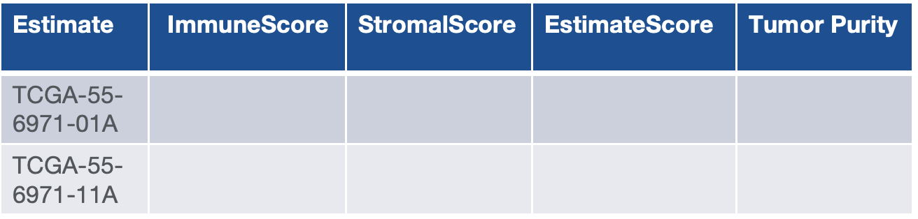
Data
gene expressed profile

Slide 4
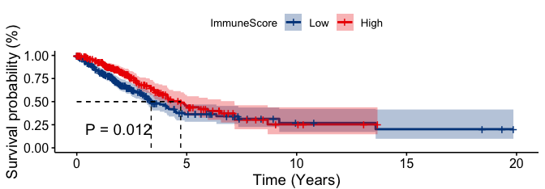
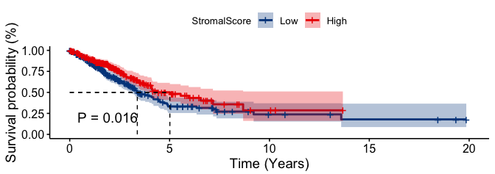

cox model
Survival curve
Combined with survival information,
plot survival curve in tumor samples.
Estimate score larger, less death risk.

Slide 5
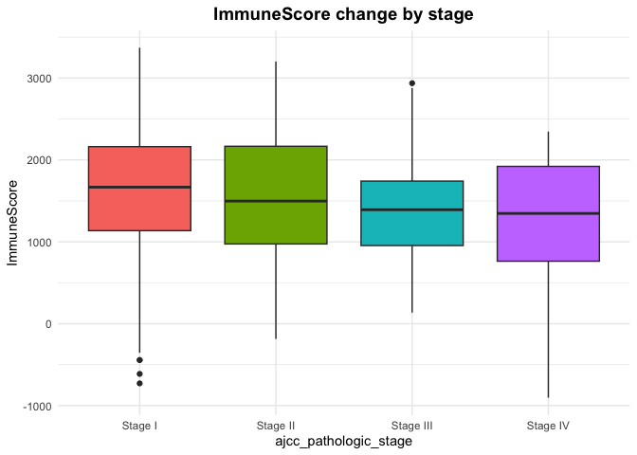
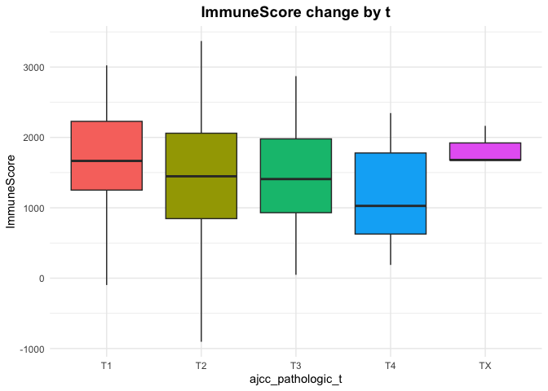
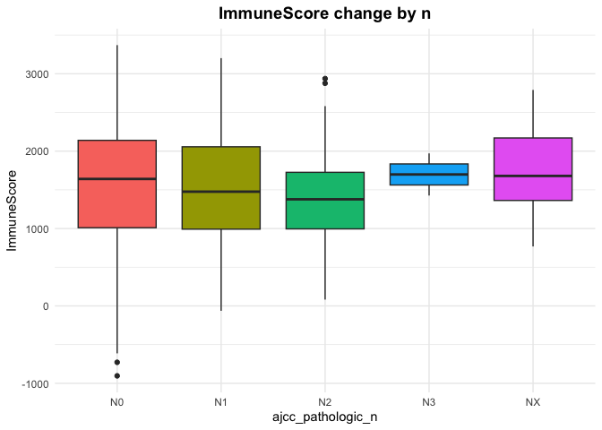
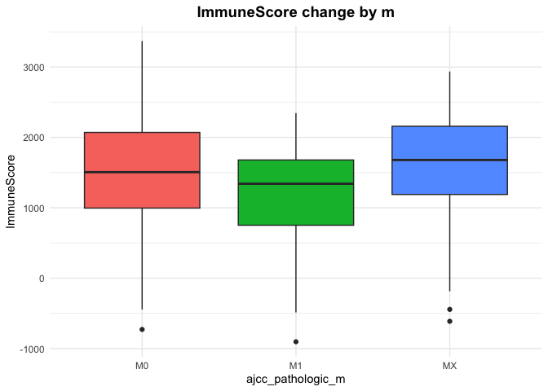
Box Plot
Combined with clinical data,
plot boxplot in tumor samples.
Here are the ImmuneScore
performance in different clinical
stages.
stage: Cancer Stage
t: Size and extent of invasion of
the primary tumor
n: Regional Lymph Nodes
m: Distant Metastasis

Slide 6
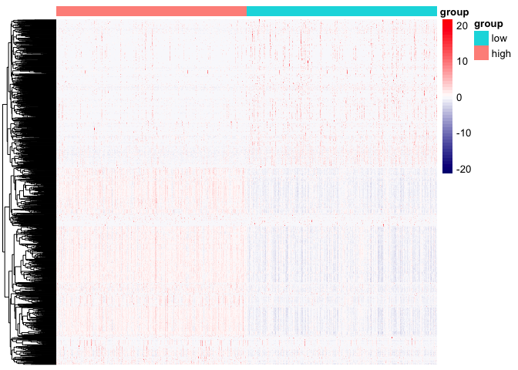
DEG
in this part, divide counts data
(with tumor sample) in to two groups,
one is high in StromalScore/Immune
Score, one is low. Then make a DEG
analysis.
get a heatmap like this:
ImmuneSocre for example
immune score high vs low
gene | basemean | log2foldchange | statistics | padj
BTK |  | red positive
mnda |  | blue negative

Slide 7
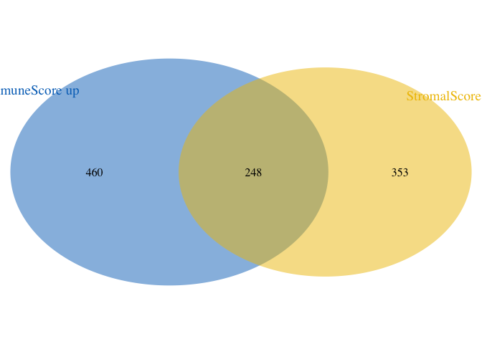
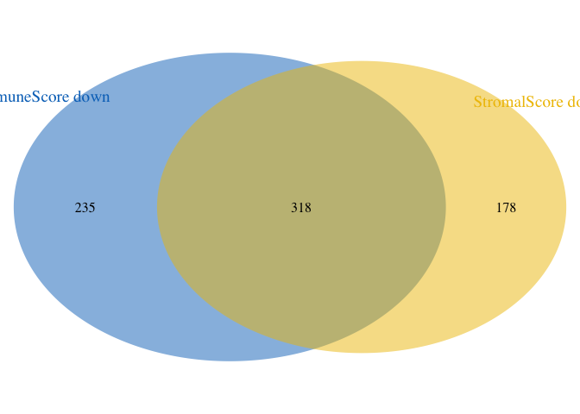
Enrichment analysis
find the intersect gene by using
Venn Diagram
we get 248+318 = 566 genes that
are either simultaneously upregulated
in both the Immune and Stromal scores,
or simultaneously downregulated in
both scores.

Slide 8
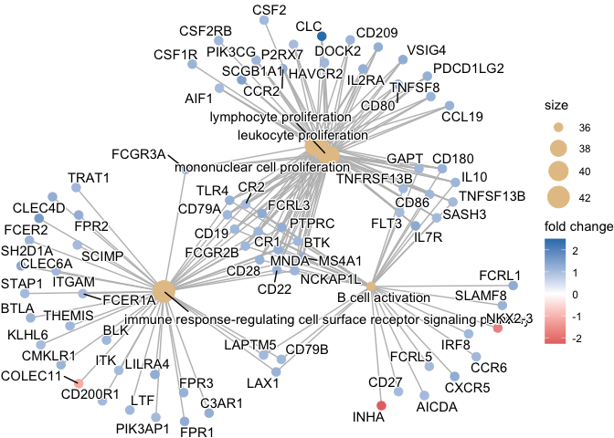
Enrichment analysis
1. GO function, according
to different functions, showing
like this:
2. KEGG function, according
to different paths

Slide 9
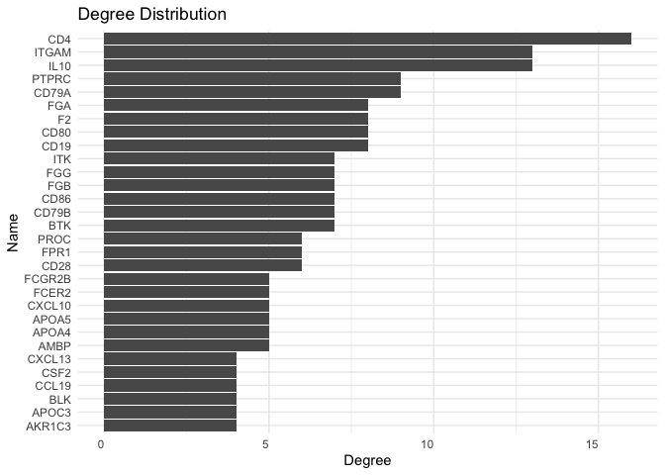
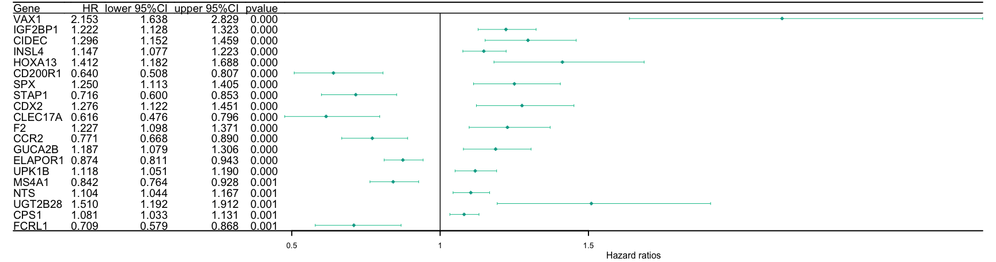
PPI analysis
make a protein and protein interaction
analysis according to those 566 genes,
get a table like this: CD4 is the hub gene
make a survival analysis again with 566
genes’ expression(tpms)
There’re 4 gene are both significant
in PPI and COX:
"F2" "CD19" "BTK" "CD79A"

Slide 10
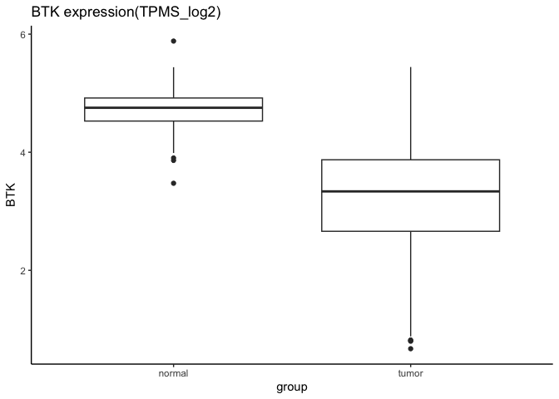
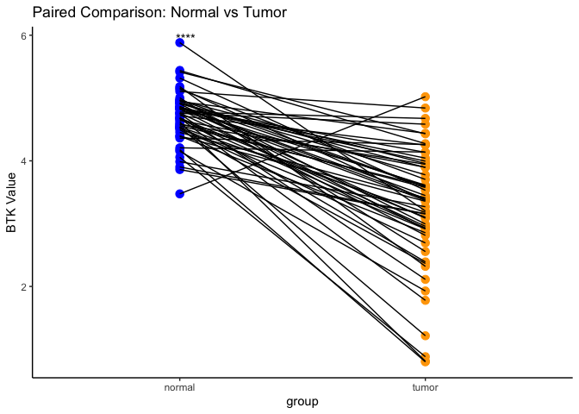
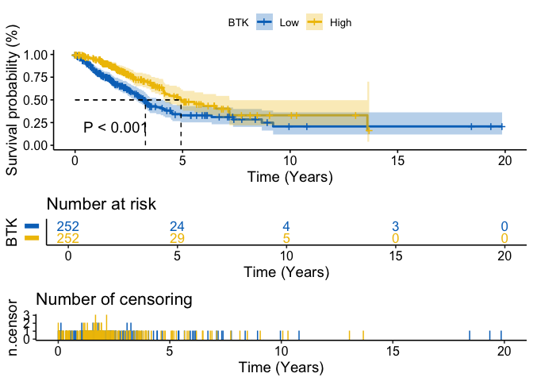
Analysis univariate gene: BTK
BTK expression in tumor and
non tumor group:
box plot, paired box plot,
survival curve and BTK expression
along different stage.

Slide 11
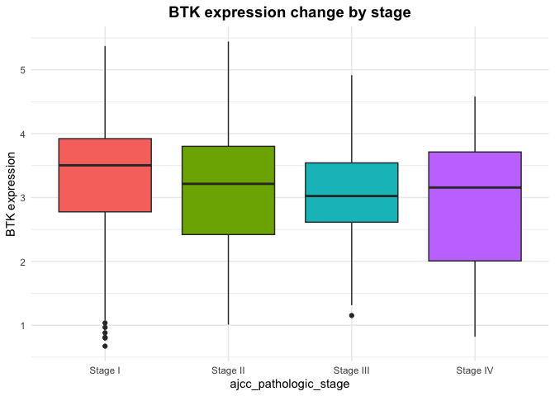
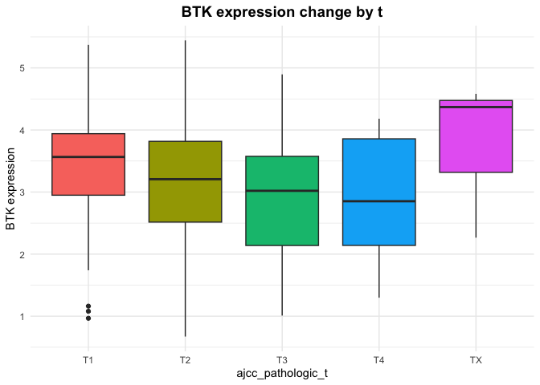
Analysis univariate gene: BTK
for example: stage and t

Slide 12
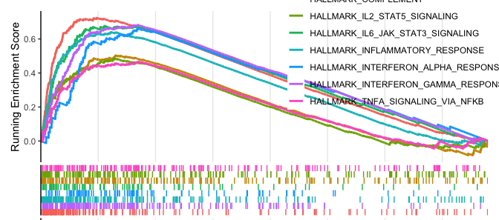
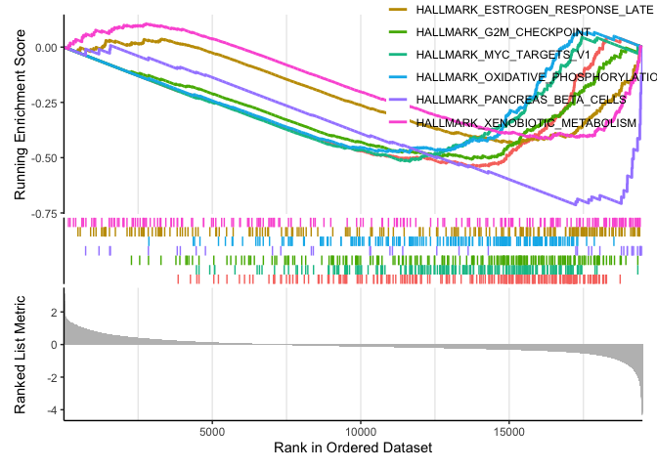
DEG again and GSEA
In tumor samples, divide sample
into two groups. one is high in BTK
expression, one is low. Make a DEG again.
Then make a GSEA(Gene Set Enrichment
Analysis). It has advantage on GO and KEGG.
HALL set example:
BTK expression high vs low
gene | basemean | log2foldchange | statistics | padj
BTK |  | red positive
mnda |  | blue negative

Slide 13
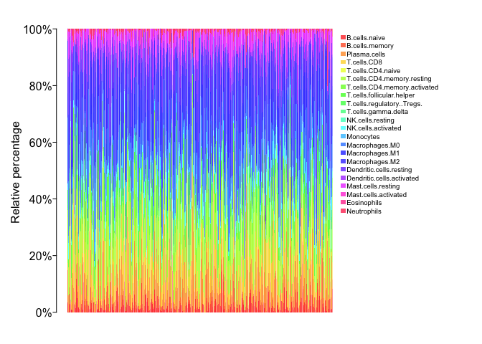
Cibersort
Cell-type Identification By
Estimating Relative Subsets
Of RNA Transcripts
According to tumor sample’s
tpms data,we can get:
rainbow plot: Proportions of
22 immune cell types across
all samples

Slide 14
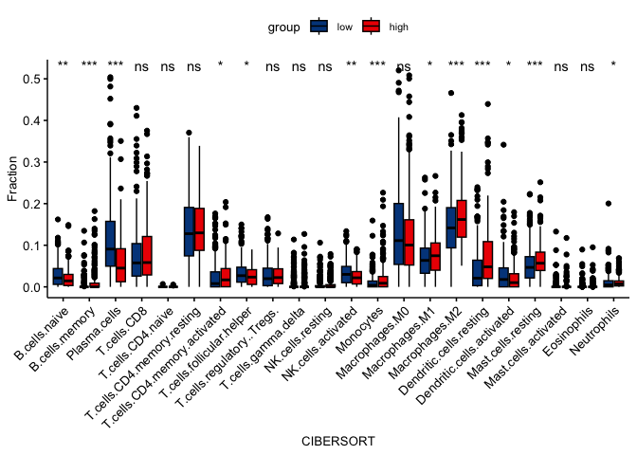
Cibersort
different test:
different immune cells
performance in different
BTK expression groups

Slide 15
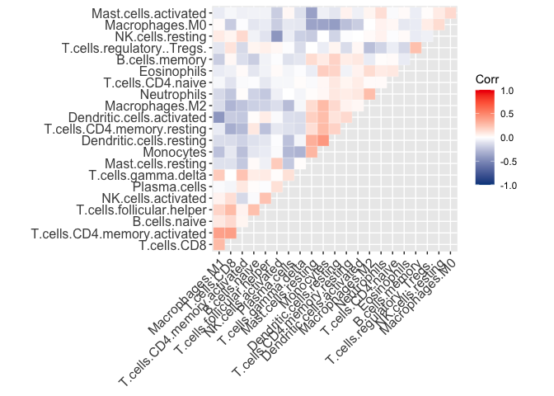
Cibersort
correlation analysis among cell types:
different immune cell proportion’s
correlation plot

Slide 16
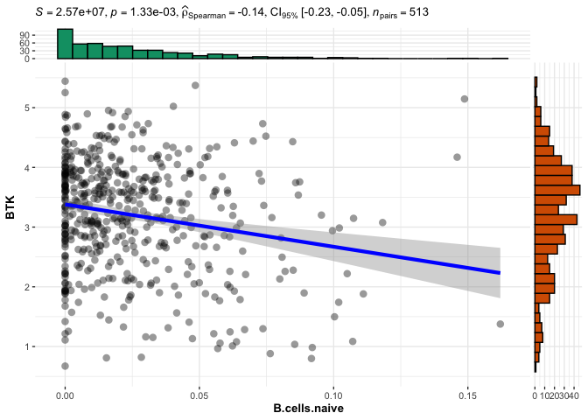
Cibersort
correlation test between BTK
gene and cell types:
B.celles.naive for example:

Slide 17
Result
1. Immune and ESTIMATE Scores Correlate with Overall Survival
2. TME Scores Are Associated with Clinical Staging
3. BTK Identified as a Prognostic Biomarker. ("F2", "CD19", "CD79A" also influence)
Through intersection analysis of PPI network and univariate Cox regression, BTK was identified as a key gene.
4. BTK Expression Reflects TME Functional State
GSEA showed that high BTK expression was enriched in immune-related pathways, while low expression was linked to metabolic pathways, suggesting BTK as an indicator of TME shift from immune-dominant to metabolism-dominant.
5. BTK Correlates with Tumor-Infiltrating Immune Cells (TICs)
BTK expression was positively correlated with memory B cells, CD8+ T cells, monocytes, resting dendritic cells, and resting mast cells; and negatively correlated with activated NK cells, M0 macrophages, and activated mast cells.

Slide 18
Discussion
1. The entire workflow can be packaged into an R package (or software package) to improve productivity. So that we can analyze other genes more easily.
2. Can BTK serve not only as a prognostic marker, but also as an indicator of TME status and potential immunotherapy responsiveness.

Slide 19
Thanks for listening
Reference:
Chen, L., Liu, D., & Lv, Z. (2021). BTK has potential to be a prognostic factor for lung adenocarcinoma and an indicator for tumor microenvironment remodeling: A study based on TCGA data mining. Frontiers in Cell and Developmental Biology, 9, 668592. https://doi.org/10.3389/fcell.2021.668592
Contact：
my github: https://github.com/kindlezhang/bioinformatics
my email: zhangqiduo462@gmail.com

