Slide 1

Hotel
Reservation
Analysis
with SQL
Presented by Tufan Kundu

Slide 2
Overview:
The hotel industry relies on data to make informed decisions and enhance the overall guest experience. In this project, we delve into a comprehensive hotel reservation dataset to extract meaningful insights. Our goal is to uncover guest preferences, Identify booking trends and discover key factors influencing how the hotel operates.

Slide 3

Objective :
Our objective is to leverage SQL for in-depth exploration and analysis of the dataset.
By addressing specific queries related to the dataset , our goal is to reveal patterns
that will guide strategic decisions and optimize the overall performance of the hotel.
Tool Used :

Slide 4
Dataset Overview :
Booking_ID: A unique identifier for each hotel reservation.
no_of_adults: The number of adults in the reservation.
no_of_children: The number of children in the reservation.
no_of_weekend_nights: The number of nights in the reservation that fall on weekends.
no_of_week_nights: The number of nights in the reservation that fall on weekdays.
type_of_meal_plan: The meal plan chosen by the guests.
room_type_reserved: The type of room reserved by the guests.
lead_time: The number of days between booking and arrival.
arrival_date: The date of arrival.
market_segment_type: The market segment to which the reservation belongs.
avg_price_per_room: The average price per room in the reservation.
booking_status: The status of the booking.

Slide 5
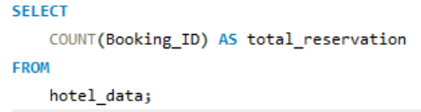

Q1. What is the total number of reservations in the dataset?
Query:
SELECT COUNT(Booking_ID) AS total_reservationFROM hotel_data;
Output:
Insight: there are 700 reservations in the dataset

Slide 6
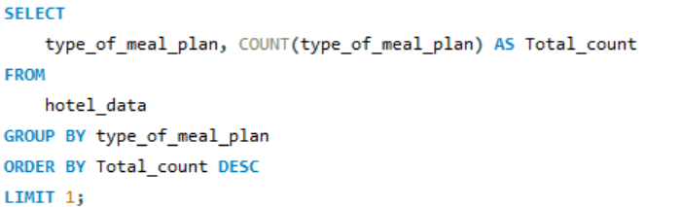
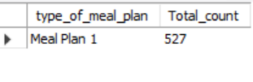
Q2. Which meal plan is the most popular among guests?
Query:
Output:
Insight: Meal plan 1 is the most popular meal among the guest with the total count of 527

Slide 7
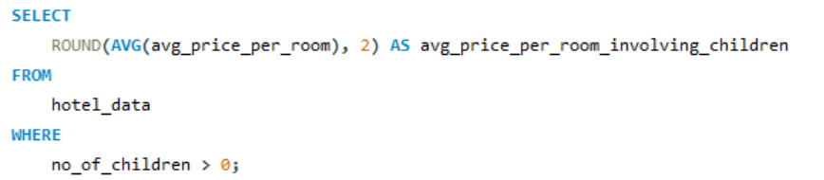

Q3.What is the average price per room for reservations involving children?
Query:
Output:
Insight: average price per room for reservations involving children is ₹144.57

Slide 8
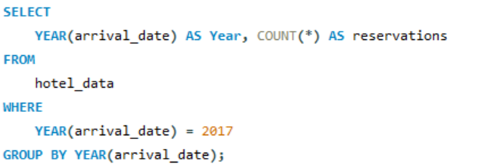

Q4. How many reservations were made for the year 2017 ?
Query:
Output:
Insight: 123 reservations were made for the year 2017

Slide 9
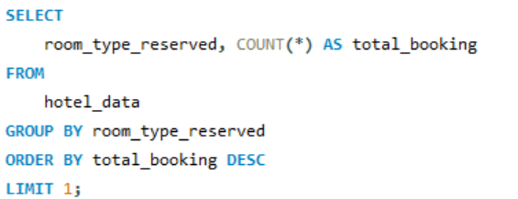

Q5. What is the most commonly booked room type?
Query:
Output:
Insight: Room_type_1 is the most commonly booked room type with total_booking of 534

Slide 10
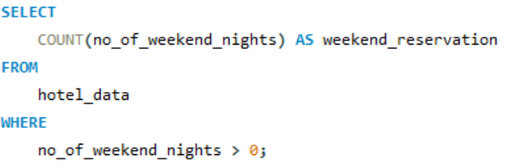

Q6. How many reservations fall on a weekend (no_of_weekend_nights > 0)?
Query:
Output:
Insight: There are 383 weekend reservations

Slide 11
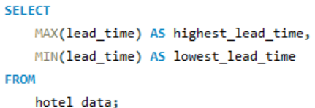

Q7. What is the highest and lowest lead time for reservations?
Query:
Output:
Insight: The range of lead times, from 0 to 443 days, suggests diverse booking behaviors among guests. Some prefer last-minute reservations, while others plan well in advance.

Slide 12
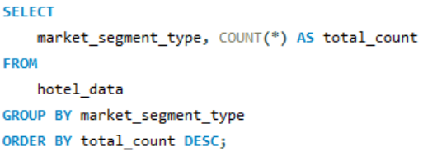
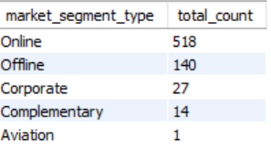
Q8. What is the most common market segment type for reservations?
Query:
Output:
Insight: Online is the most common market segment type for reservations

Slide 13
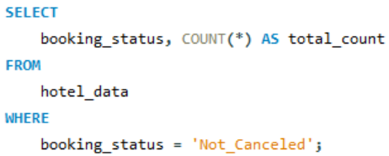

Q9. How many reservations have a booking status of "Confirmed"?
Query:
Output:
Insight: 493 reservations have a booking status of "Confirmed"

Slide 14
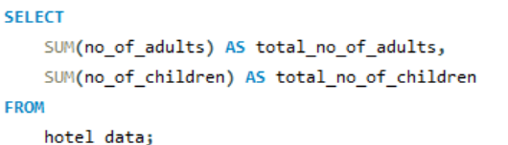

Q10. What is the total number of adults and children across all reservations?
Query:
Output:
Insight: The majority of reservations, totaling 1,316, involve adult guests, while a smaller number, 69, include children.

Slide 15
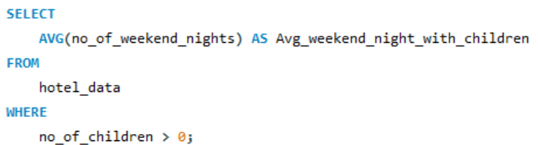

Q11. What is the average number of weekend nights for reservations involving children?
Query:
Output:
Insight: On average, reservations with children involve a one-night stay on weekends.

Slide 16
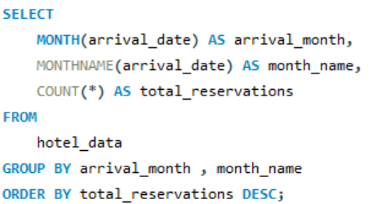
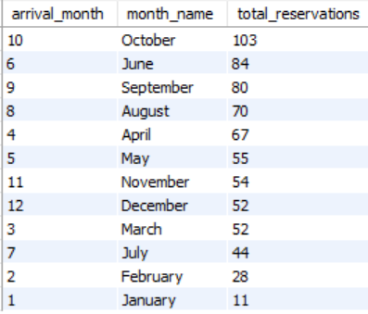
Q12. How many reservations were made in each month of the year?
Query:
Output:
Insight: October stands out as the peak reservation month (103 total_reservations)followed by June and September . In contrast, January records the lowest number of reservations (11 total_reservations), indicating a quieter period.

Slide 17
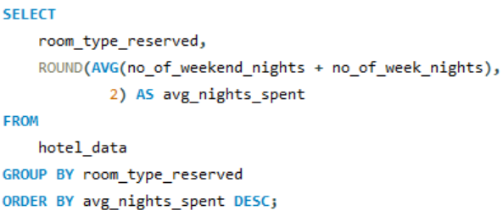
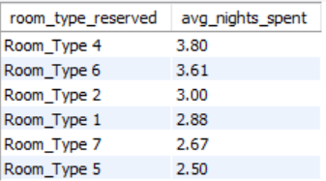
Q13. What is the average number of nights (both weekend and weekday) spent by guests for each room type?
Query:
Output:
Insight: Guests staying in Room Type 4 tend to spend the most nights on average (3.80), while those in Room Type 5 have the lowest average stay duration (2.50).

Slide 18
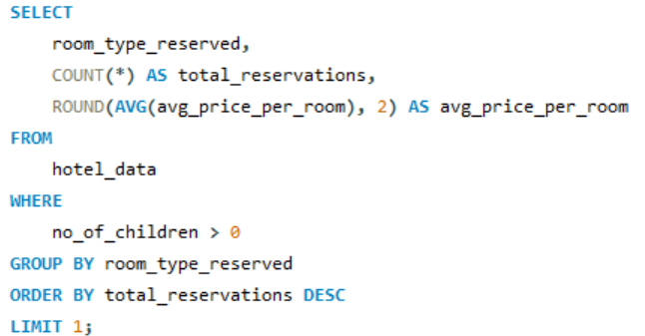

Q14. For reservations involving children, what is the most common room type, and what is the average price for that room type?
Query:
Output:
Insight: For reservations involving children, Room Type 1 is the preferred choice, with an average room price of 123.12.

Slide 19
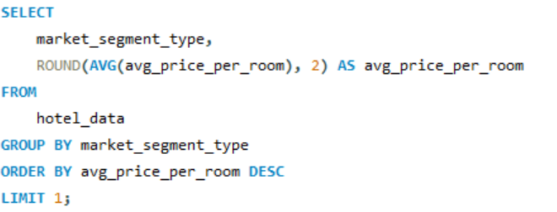

Q15. Find the market segment type that generates the highest average price per room.
Query:
Output:
Insight: Online bookings generate the highest average room price, reaching 112.46

Slide 20
Recommendations
Implement targeted promotions for Room Type 1 to capitalize on its popularity.
Tailor marketing strategies to attract online bookings, the most prevalent segment.
Explore partnerships or promotions to boost reservations during quieter months like January.
Enhance confirmation and booking processes to maintain the high success rate of reservations.
Focus on enhancing services and promotions during weekdays to meet the strong demand for reservations on weekday nights (656), creating an opportunity to attract a larger number of guests.
Continue monitoring and adapting strategies based on changing guest preferences and market trends.

Slide 21

Thank
You

