Slide 1


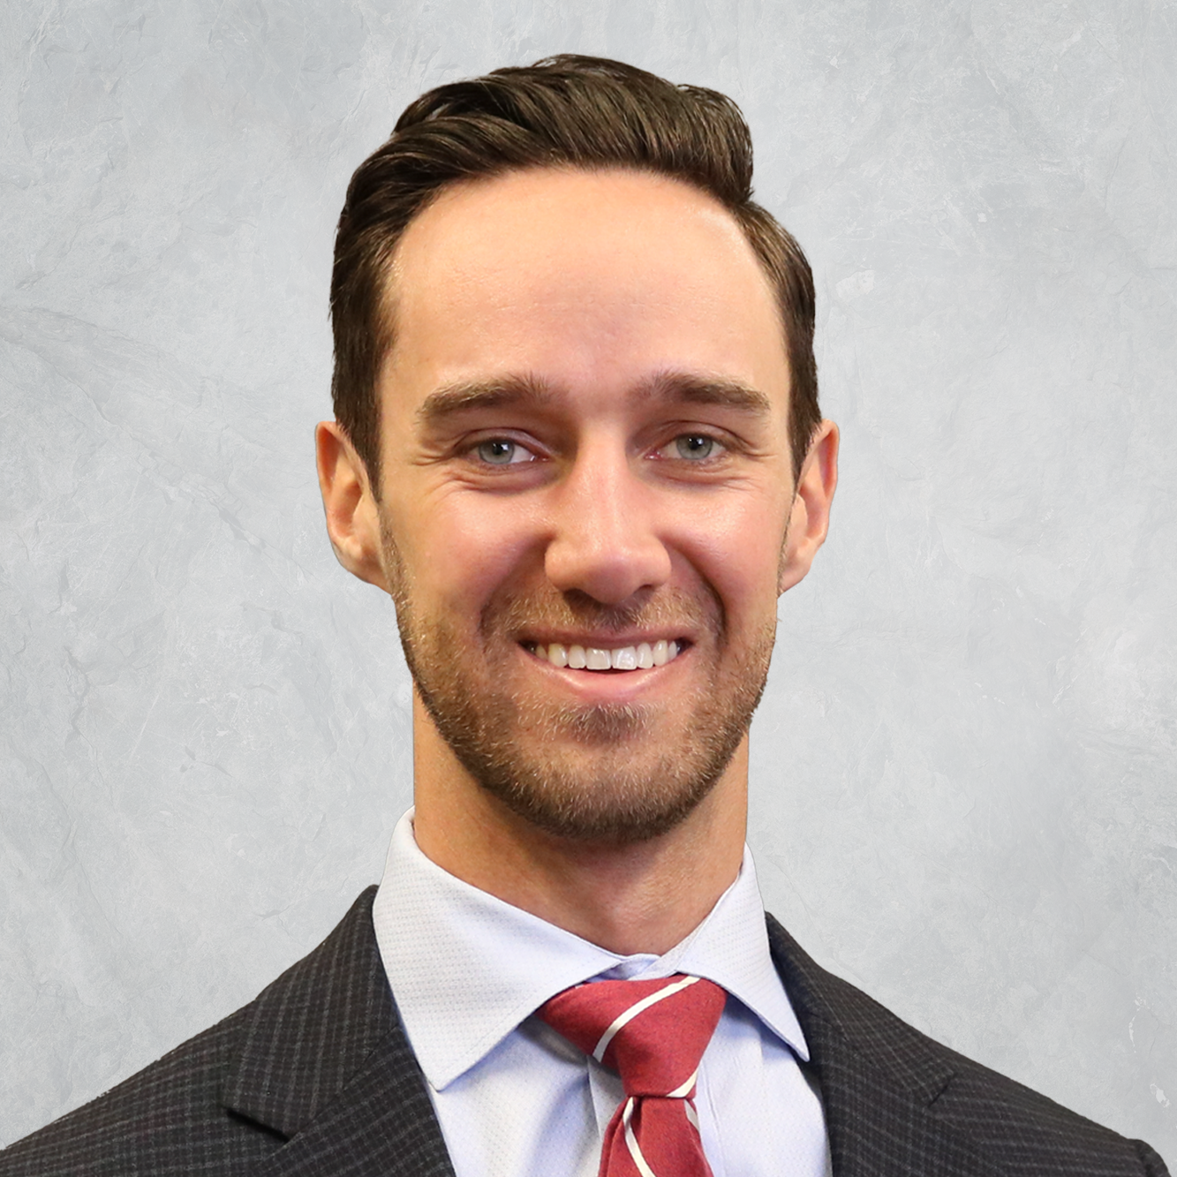

Insurance & Risk Management
Real Estate Development & Property Management
Empowering Your Future with Tailored Risk Management Solutions
Kevin Shafer is a Senior Advisor at CCIG who specializes in building data-informed insurance programs tailored to each client’s unique needs. With a focus on real estate, he takes a highly methodical approach to understanding each client’s risk appetite and long-term goals.
Since joining CCIG in 2021, he has advanced through roles in account service, marketing analysis, and advisory, building hands-on experience across renewals, carrier strategy, proposal development, claims trend analysis, and client communications. In his current role, he works closely with clients, internal teams, and carrier partners to identify coverage gaps and implement risk strategy initiatives designed to strengthen overall program performance.
Kevin Shafer
Senior Insurance Advisor
(720)-330-7924
kevin.shafer@thinkccig.com
INSURANCE FOR SMALL AND MID-SIZED BUSINESSES
Risk Assessment
Identify operational and financial exposures
Analyze coverage gaps and overlaps
Review contracts and insurance requirements
Benchmark risk against industry trends
Loss Prevention
Develop proactive safety initiatives
Implement loss control recommendations
Provide OSHA and compliance resources
Strengthen fleet and driver safety
Ongoing Risk Management
Monitor claims and loss trends
Review experience modification factors
Refine renewal and coverage strategies
Support business continuity planning
Claims Advocacy
Guidance through the claims process
Coordinate directly with insurance carriers
Advocate during complex loss situations
Provide updates through resolution
LEARN MORE
Visit resources.thinkccig.com/capabilities/smb
thinkCCIG.com

Slide 2

Insurance & Risk Management
Hotels, Restaurants & Hospitality Businesses
Empowering Your Future with Tailored Risk Management Solutions
Kevin Shafer is a Senior Advisor at CCIG who specializes in building data-informed insurance programs tailored to each client’s unique needs. With a focus on hospitality, he takes a highly methodical approach to understanding each client’s risk appetite and long-term goals.
Since joining CCIG in 2021, he has advanced through roles in account service, marketing analysis, and advisory, building hands-on experience across renewals, carrier strategy, proposal development, claims trend analysis, and client communications. In his current role, he works closely with clients, internal teams, and carrier partners to identify coverage gaps and implement risk strategy initiatives designed to strengthen overall program performance.
Kevin Shafer
Senior Insurance Advisor
(720)-330-7924
kevin.shafer@thinkccig.com
INSURANCE FOR SMALL AND MID-SIZED BUSINESSES
Risk Assessment
Identify operational and financial exposures
Analyze coverage gaps and overlaps
Review contracts and insurance requirements
Benchmark risk against industry trends
Loss Prevention
Develop proactive safety initiatives
Implement loss control recommendations
Provide OSHA and compliance resources
Strengthen fleet and driver safety
Ongoing Risk Management
Monitor claims and loss trends
Review experience modification factors
Refine renewal and coverage strategies
Support business continuity planning
Claims Advocacy
Guidance through the claims process
Coordinate directly with insurance carriers
Advocate during complex loss situations
Provide updates through resolution
LEARN MORE
Visit resources.thinkccig.com/capabilities/smb
thinkCCIG.com

Slide 3

Insurance & Risk Management
Distribution, Warehousing & Logistics
Empowering Your Future with Tailored Risk Management Solutions
Kevin Shafer is a Senior Advisor at CCIG who specializes in building data-informed insurance programs tailored to each client’s unique needs. With a focus on distribution, he takes a highly methodical approach to understanding each client’s risk appetite and long-term goals.
Since joining CCIG in 2021, he has advanced through roles in account service, marketing analysis, and advisory, building hands-on experience across renewals, carrier strategy, proposal development, claims trend analysis, and client communications. In his current role, he works closely with clients, internal teams, and carrier partners to identify coverage gaps and implement risk strategy initiatives designed to strengthen overall program performance.
Kevin Shafer
Senior Insurance Advisor
(720)-330-7924
kevin.shafer@thinkccig.com
INSURANCE FOR SMALL AND MID-SIZED BUSINESSES
Risk Assessment
Identify operational and financial exposures
Analyze coverage gaps and overlaps
Review contracts and insurance requirements
Benchmark risk against industry trends
Loss Prevention
Develop proactive safety initiatives
Implement loss control recommendations
Provide OSHA and compliance resources
Strengthen fleet and driver safety
Ongoing Risk Management
Monitor claims and loss trends
Review experience modification factors
Refine renewal and coverage strategies
Support business continuity planning
Claims Advocacy
Guidance through the claims process
Coordinate directly with insurance carriers
Advocate during complex loss situations
Provide updates through resolution
LEARN MORE
Visit resources.thinkccig.com/capabilities/smb
thinkCCIG.com

