Slide 1
Real vs Fake
Image Identification
Paul, Kate, Sean

Slide 2
Background

Slide 3
Image generation
With the recent advancements in AI models and web interfaces, the average person is now able to create hyper-realistic images with only a simple prompt
This will be extremely useful, but always raises questions of security and integrity of images

Slide 4
Faces
Human faces are one example which can now be easily generated.
It has now become fairly easy to falsify or create images of people doing things they have never done, or videos people saying things they have never said
This obviously may have serious implications
The legal system is quickly trying to catch up

Slide 5
Problem statement

Slide 6
Our goal
“In an attempt to catch up to this ever changing space, we will attempt to create a model which will be able to identify real vs fake images of human faces”

Slide 7
Data

Slide 8
Real and Fake Face Detection dataset
This dataset was found on Kaggle and was create by dataset contains expert-generated high-quality photoshopped face images.
Computational Intelligence and Photography Lab Department of Computer Science, Yonsei University
The images are composite of different faces, separated by eyes, nose, mouth, or whole face.

Slide 9
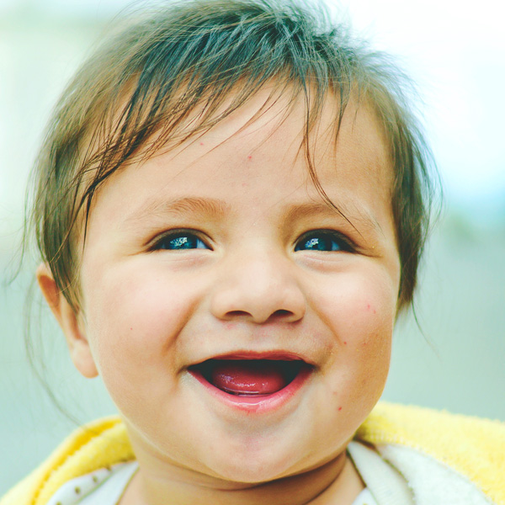
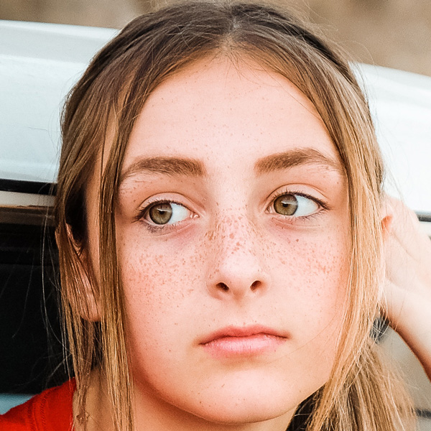


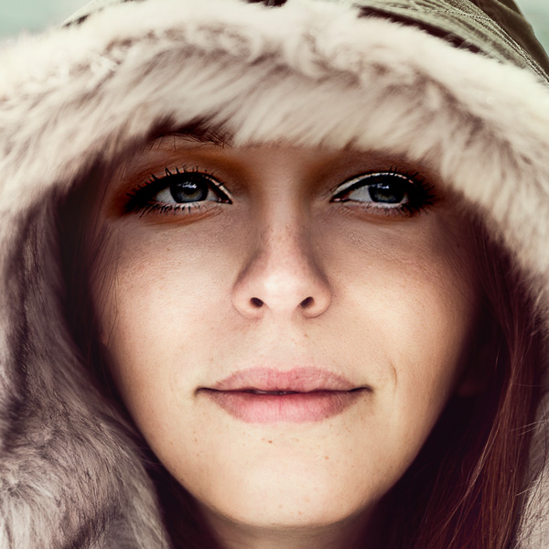
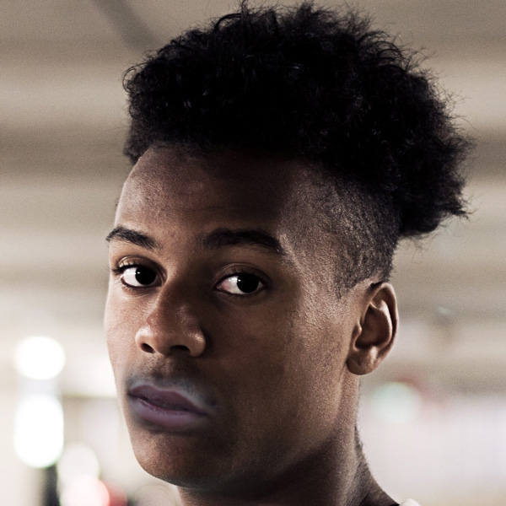
Data Visualization
Real Images:
Fake Images:

Slide 10
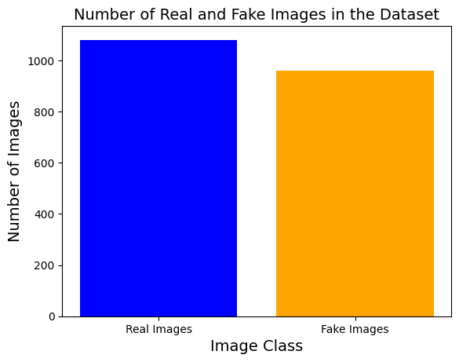
Dataset Distribution
Real images: 1,081 (53%)
Fake images: 960 (47%)
A relatively balanced dataset

Slide 11
Framework

Slide 12
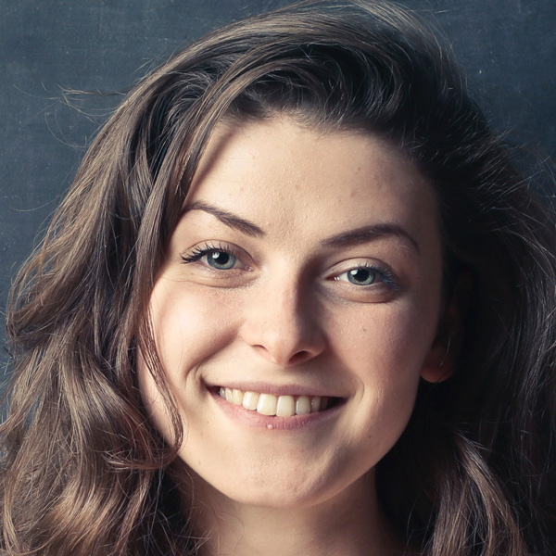
Workflow Diagram of Fake Detection Algorithm
Image Processing
Feature Extraction
Binary Classification
ResNet50
Fake or Real
Inception
VGG16

Slide 13
Data Preprocessing

Slide 14
Image Resizing
For VGG16 & Resnet- 50 , resize all the image data into 224 x 224
For GoogLeNet (Inception v3), resize all the images into 299 x 299

Slide 15
Pre-processing and splitting
Pixel normalization : To scale the pixel values into a range of [0, 1]:
Regardless of the image size = (224, 224) or (299 x 299), we divide the images by 255 in the case of 8-bit images
Labels: Positive Class (1) → Fake images Negative Class (0) → Real images
Data splitting: Even though our dataset is considered as relatively balanced, we still want to apply stratification on the labels when splitting the images and labels into the training/validation and test sets, this can ensure that the proportions of different classes in the original image dataset are preserved in each of these 3 subsets.
→ To avoid potential biases in the data distribution across different subsets.

Slide 16
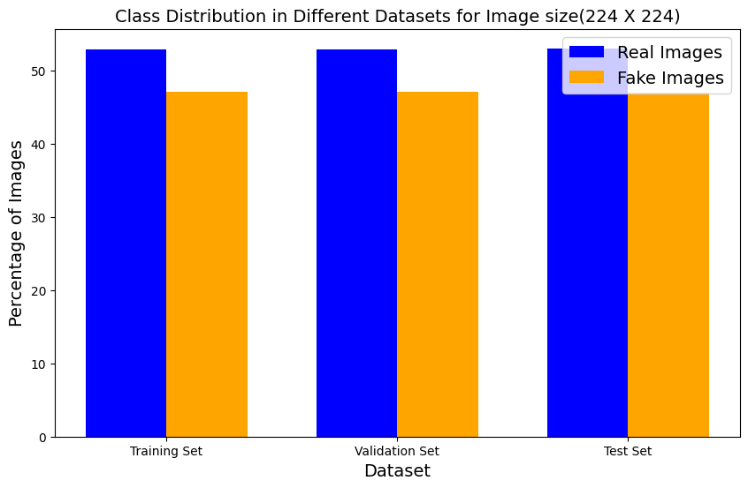
Class Distribution after Data Splitting

Slide 17
Model Selection

Slide 18
ResNet50
ResNet50 is a deep convolutional neural network with 50 layers, featuring skip connections and residual blocks.
Advantages:
Its depth (50 layers) allows it to capture complex features and patterns in the data.
Uses residual(skip) connections, which can help deal with the vanishing gradient problem.
Disadvantages:
The ResNet50’s depth make it computationally expensive and memory consuming.
It has a tendency towards overfitting

Slide 19
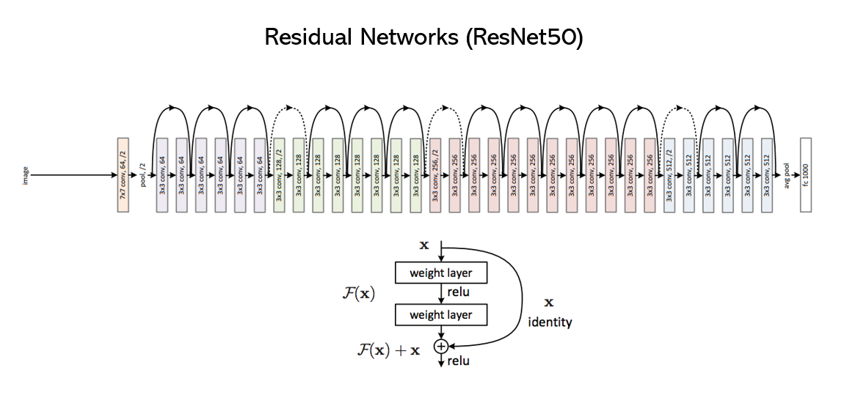
ResNet 50

Slide 20
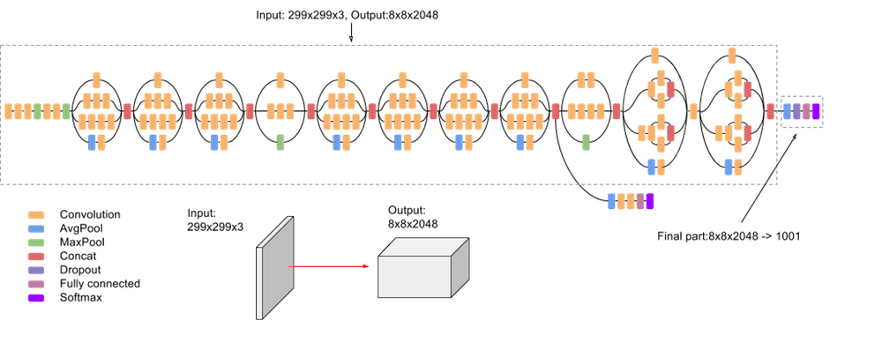
Inception v3 (GoogLeNet)

Slide 21
Inception v3 (GoogLeNet)
It has already trained on more than millions of images from the “ImageNet” database.
Total Number of layers: 48 (including the fully connected networks) [ individual operational layers: 311 layers ]
The concept of Inception Module: the term "Mixed" refers to the Inception modules In Inception v3, there are a total of 11 "Mixed" layers (Inception modules)
Instead of using a single filter size, the module uses filters of different sizes (1x1, 3x3, and 5x5) within the same layer. By using multiple filter sizes, this can capture features at various scales effectively, leading to higher feature extraction efficiency.
It requires less memory and computational power during training.

Slide 22
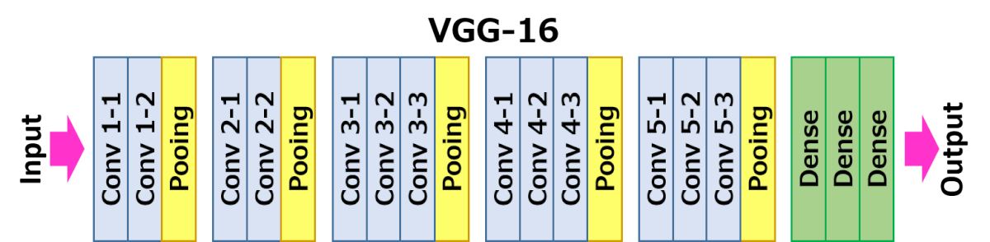
VGG16
VGG16 (Visual Geometry Group 16) is a convolutional neural network (CNN) architecture for computer vision tasks.
Architecture: 13 Convolutional Layers, 5 Max-Pooling Layers, 3 Fully Connected Layers, and 1 Output Layer.
Input: Fixed-size RGB image (224x224 pixels).
Activation: ReLU after each convolutional layer.
Max-Pooling: 2x2 window with a stride of 2 to reduce spatial dimensions.

Slide 23
VGG16 - Model Framework
Testing Hyperamaters on base model
Unfreeze last layer
Unfreeze all layers
Using best hyperparamters
Using best hyperparamters

Slide 24
Results

Slide 25
ResNet 50
 | All Layers Frozen | Last layer unfrozen | First and last layer unfrozen | All layers unfrozen
Training Accuracy | 85 | 85 | 85 | 86
Testing Accuracy | 62 | 64 | 66 | 70
AUC (from ROC) | 65 | 71 | 69 | 75

Slide 26
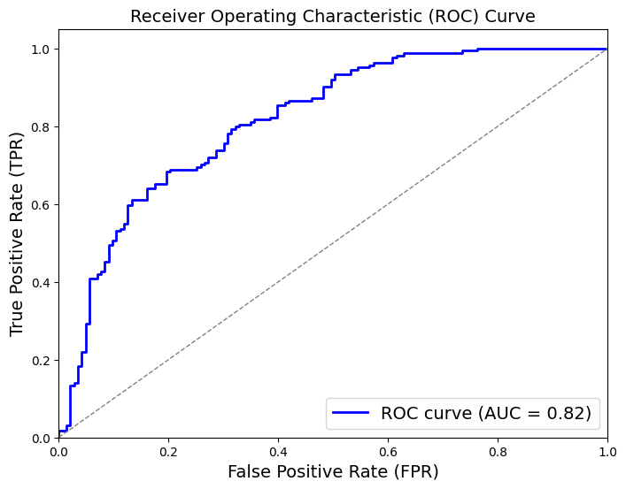
Inception v3 (GoogLeNet)
With a relatively balanced dataset and by considering the trade off between “Overfitting” and “Better Probability Prediction” , the best model we choose for Inception is to unfreeze all the layers.
 | All layers frozen | Unfreezing till “Mixed 4” layers (using 40% of the total layers) | All layers unfrozen
Training Accuracy | 67% | 88% | 96%
Testing Accuracy | 58% | 72% | 73%
AUC (from ROC) | 0.62 | 0.76 | 0.82
Notes:
With a relatively balanced dataset prioritize "Better Probability Prediction" . A high AUC indicates that our model is better at distinguishing between the positive and negative classes, and its predicted probabilities are more accurate and reliable.

Slide 27
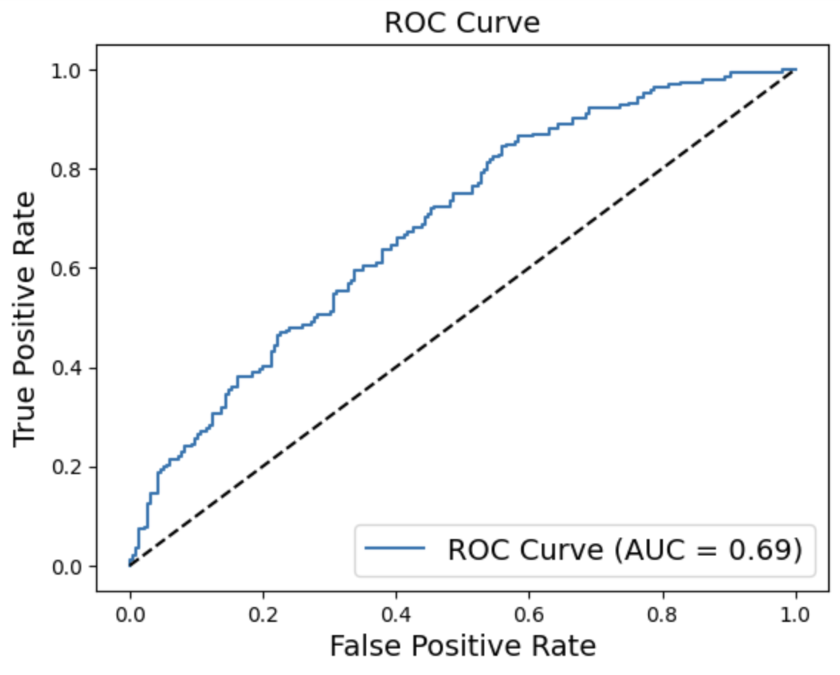
VGG16
The model which fared the best in terms of accuracy was the model with all layers frozen
 | All layers frozen | Last layer unfrozen | All layers unfrozen
Training Accuracy | 79% | 87% | 78%
Testing Accuracy | 63% | 62% | 60%

Slide 28
Overall Results : Model Analysis
 | ReNet-50 | Inception v3 | VGG16
Training Accuracy | 85% | 96% | 79%
Validation Accuracy | 65% | 71.2% | 72%
Training loss | 6.7 | 5.3 | 0.53
Validation loss | 3.4 | 6.02
Testing accuracy (Accuracy Score) | 70% | 73% | 63%
AUC (from ROC ) | .75 | 0.82 | 0.69

Slide 29
Conclusions

Slide 30
Model Selected
Pick the best model
Essential Considerations: “Overfitting” - A wide discrepancy between training and testing accuracies AUC (Area Under the Curve) if we have a balanced dataset
It is essential to strike a balance between overfitting and better probability prediction.
A high AUC indicates that our model is better at distinguishing between the positive and negative classes, and its predicted probabilities are more accurate and reliable.

