Slide 1
Hashing functions and their applications
A presentation by Freddie Zaragoza for CS 131

Slide 2
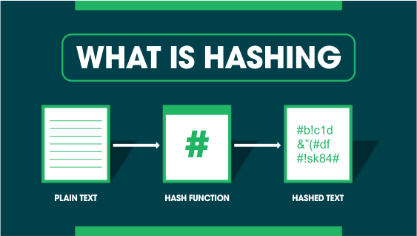
What are Hashing functions?
Hashing describes the process of converting a key to a different value.
A hash function is a function that is used to generate a new value based on a given algorithm
The resulting value is known as a hash value or hash

Slide 3
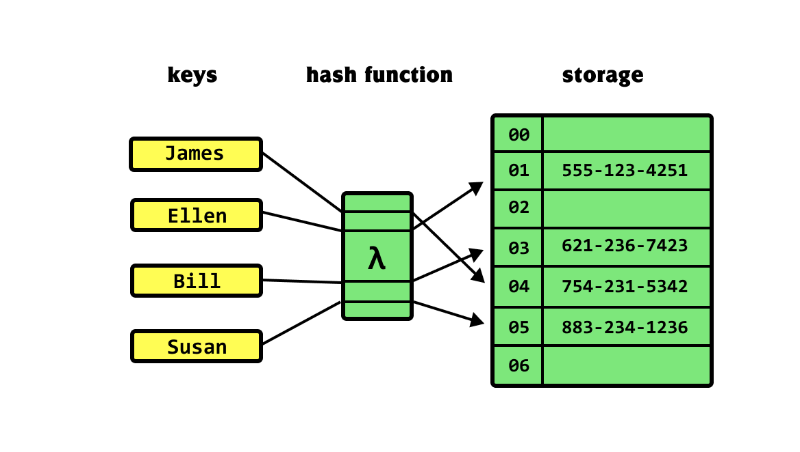
What are the attributes of a hashing algorithm?
It accepts a message of any length
It produces a fixed length message digest
It is fast and easy to compute the message digest for any given message
The hash is irreversible
A small change in initial message should result in large changes in the message digest
The hash is collision free

Slide 4
What are the purposes of hashing functions?
To compare large amounts of data
To index data
To generate pseudo random strings
Cryptographic functions like passwords and digital signatures

Slide 5
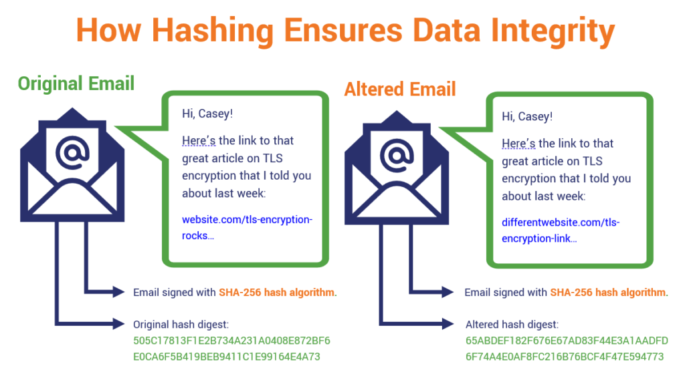
How do hashing functions help compare large amounts of data?
Hashing functions help compare large amounts of data by making it faster to determine if two large pieces of data are the same by comparing the smaller hash that is generated for the two of them
For example:
Input1= 1,2,3,4,5,...,5892,5893,...,10000
Input2=1,2,4,4,5,...,5892,5892,...,10000
Hash1=A32654
Hash2=HC4596

Slide 6
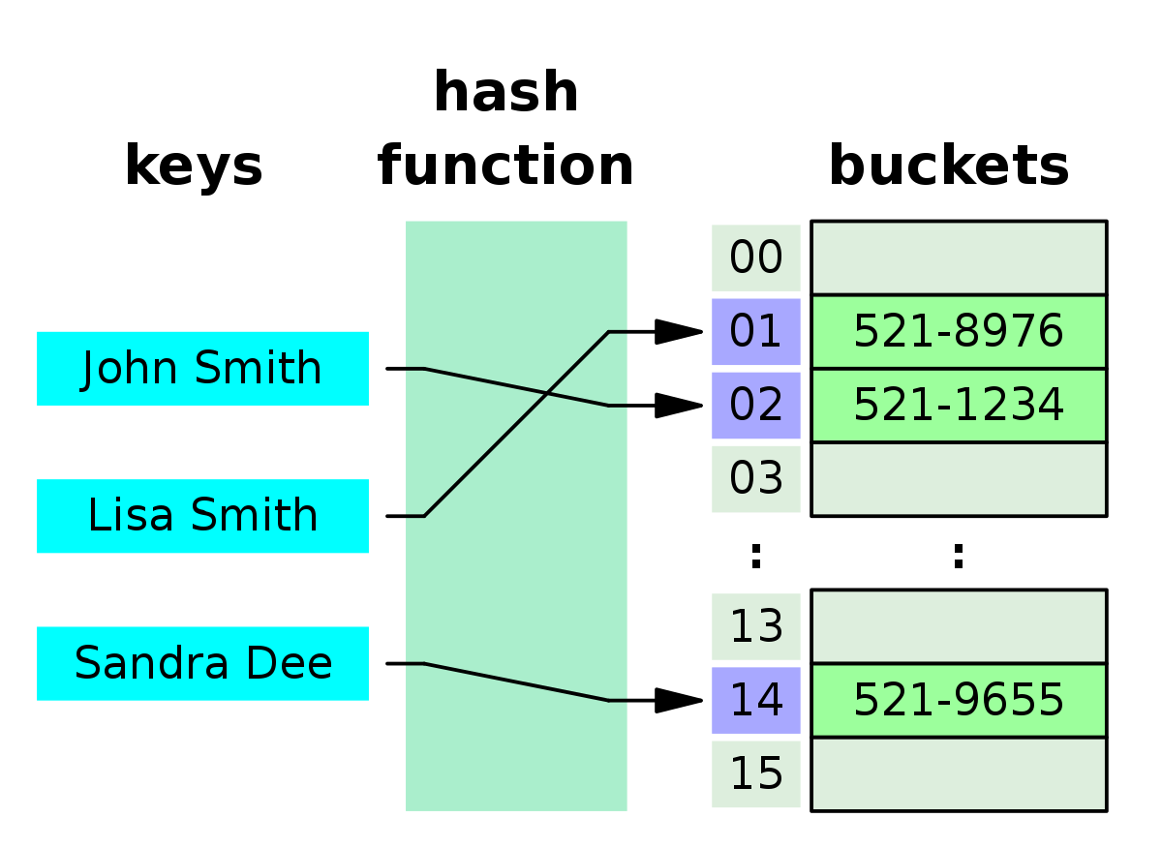
How do hashing functions help to index data?
Hashing functions can be used to index data by creating a mapping between the input data and its corresponding hash. This allows for efficient lookup of the data, since once the hash is known, it can be used to quickly retrieve the corresponding data from the index.

Slide 7
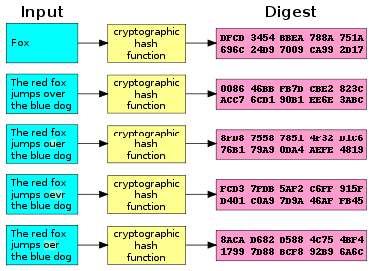
Why and how do hashing functions generate pseudo random strings?
Hashing functions create pseudo random strings because the strings they generate differ greatly depending on input, the strings are not easily reversible into their original input and if the hashing function is good the hash is always unique.
This is a great feature of hashing functions as it means they can be effectively used in cryptography and the generation of digital signatures

Slide 8
Here is a basic overview of how a real cryptographic hash function works:
The input message is "Hello, world!"
The message is broken up into small blocks of data, each with a size of 512 bits. In this case, the message can be represented as two blocks: "Hello, worl" and "d!".
The SHA-256 algorithm performs a series of mathematical operations on these blocks to produce a fixed-size output, known as the "hash value" or "digest."
The output of the SHA-256 algorithm in this case would be a hash value of 64 hexadecimal characters, such as "315f5bdb76d078c43b8ac0064e4a0164612b1fce77c869345bfc94c75894edd3"

Slide 9
In conclusion:
Hashing functions are used to store data for quicker access, compare large quantities of data and to perform cryptographic functions.

