Slide 1
Number Theory and Cryptography
Naweid Hassanzadeh
CS 131
West Los Angeles College

Slide 2
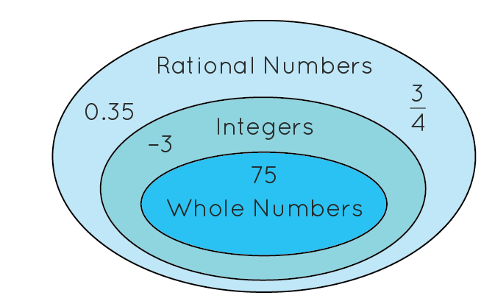
What is Number Theory
Number theory is the branch of mathematics that deals with the properties of numbers and the ways in which they can be manipulated and used to solve problems.
Examples of topics in number theory include prime numbers, divisibility rules, and number bases.
Number theory is used in cryptography to encode and decode messages.
It is also used in coding theory to design efficient ways of storing and transmitting data

Slide 3
History
Number theory has its origins in ancient civilizations, such as the Babylonians and the Egyptians, who used numbers for practical purposes such as counting and measuring.
Over time, number theory has developed into a sophisticated branch of mathematics, with many important contributions from mathematicians such as Euclid and Carl Friedrich Gauss.

Slide 4
Congruence
Suppose we want to determine whether the number 17 is a prime number.
We can then compute the congruence "2^(17-1) ≡ 1 (mod 17)".
To do this, we first compute 2^16 = 65536.
We then find the remainder when 65536 is divided by 17, which is 15.
This means that 2^16 ≡ 15 (mod 17).
Finally, we multiply both sides of the congruence by 2 to get 2^(17-1) ≡ 2 * 15 = 30 (mod 17).
Since 30 is congruent to 1 modulo 17, we can conclude that the number 17 is a prime number.
Notes:
Congruence is a mathematical relationship between two numbers that means they have the same remainder when divided by a given number. For example, the numbers 4 and 13 are congruent modulo 3, because they both have a remainder of 1 when divided by 3.

Slide 5
Modular Arithmetic
Mod: in the modulus 12 system, the numbers 7 and 9 can be added together to get 16. But since 16 is not within the modulus 12, we must take the modulus of the result to find the true sum: 16 % 12 = 4. This means that the sum of 7 and 9 in the modulus 12 system is 4.
Mod Inverse: in the modular arithmetic system with a modulus of 12, the inverse of 7 is 11, because 7 x 11 = 77, which is equivalent to 1 (mod 12). This means that we can write 7 x 11 = 1 (mod 12).
Notes:
One of the key benefits of modular arithmetic is that it allows us to work with large numbers in a more manageable way. For example, in the modulus 12 system, the number 13 is equivalent to the number 1, because 13 - 12 = 1. This is known as taking the modulus, or finding the remainder after division. Modular arithmetic has a number of useful properties that make it a powerful tool for solving problems.
One concept that is closely related to modular arithmetic is the concept of modular inverses. In modular arithmetic, the inverse of a number is a number that, when multiplied by the original number, gives a result of 1 (mod m), where m is the modulus. This can be written as a x a^-1 = 1 (mod m).

Slide 6
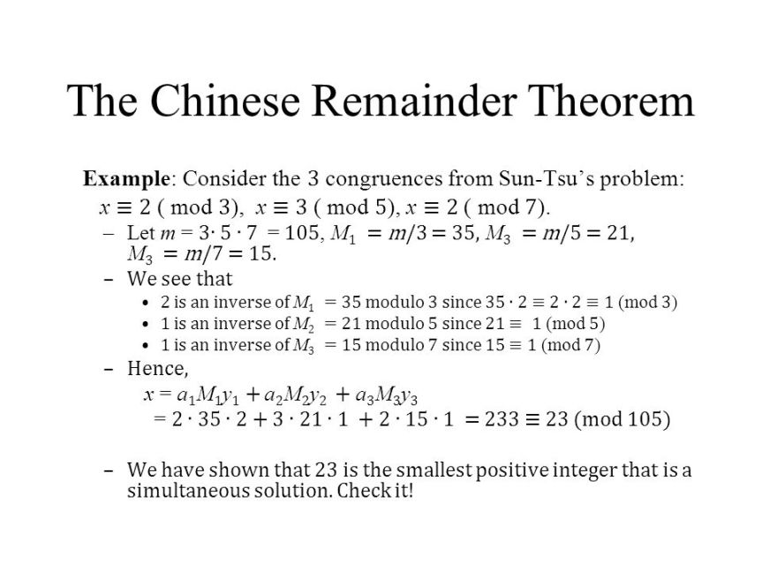
Chinese Remainder Theorem
Notes:
Chinese Remainder Theorem involves working with remainders when numbers are divided by other integers. It allows one to find the solution to a system of simultaneous congruences. It states that if two integers a and b are relatively prime (i.e., their greatest common divisor is 1), then for any set of integers {x1, x2, ..., xn}, there exists an integer x such that x is congruent to x1 modulo a, and x is congruent to x2 modulo b. In other words, if we know the remainder when a number is divided by two or more integers, then we can use the Chinese Remainder Theorem to figure out what the number itself is.
One example of how the Chinese Remainder Theorem can be used is in cryptography, where it is used to encrypt and decrypt messages. Another example is in computer science, where it is used to solve problems involving modular arithmetic, such as in scheduling algorithms and other computational tasks.

Slide 7
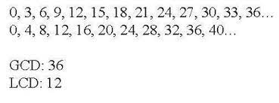
LCD and GCD
LCD-Least common denominator
GCD-Greatest common divisors

Slide 8
Euclidean Algorithm
-Suppose we want to find the gcd of the numbers 24 and 60.
Divide the larger number (60) by the smaller number (24) to get the quotient (2) and the remainder (12).
Divide the smaller number (24) by the remainder (12) to get the quotient (2) and the remainder (0).
Since the remainder is 0, the gcd is the previous remainder (12).
Therefore, the gcd of 24 and 60 is 12.
Notes:
In general, the Euclidean algorithm works by repeatedly dividing the larger number by the smaller number and using the remainders to compute the gcd of the original numbers. This algorithm is an efficient way of computing the gcd of two numbers, and it has many applications in number theory and other areas of mathematics.

Slide 9
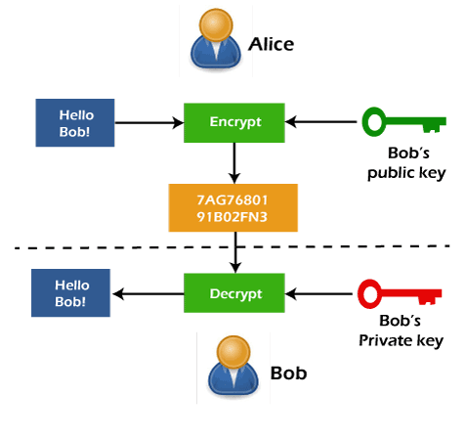
Uses in Cryptology:
Here is how the RSA algorithm works:
The sender and receiver agree on two large prime numbers, p and q.
They then compute the product of these two prime numbers, which is the number n = p * q.
The receiver then chooses a number e that is relatively prime to (p-1) * (q-1), and computes the corresponding value of d such that e * d = 1 mod (p-1) * (q-1).
The receiver then sends the values of n and e to the sender. These values form the public key that can be used by anyone to encrypt messages for the receiver.
To encrypt a message, the sender first represents the message as a number m. They then compute the encrypted message c as c = m^e mod n.
To decrypt the message, the receiver uses their private key d to compute the decrypted message m as m = c^d mod n.
Notes:
One of the most well-known cryptographic algorithms is the RSA algorithm, which is widely used for secure communication over the internet. The RSA algorithm is based on the fact that it is computationally infeasible to factorize large composite numbers into their prime factors.As you can see, the RSA algorithm relies heavily on number theory, specifically the properties of prime numbers and modular arithmetic. This is just one example of how number theory is used in cryptography. There are many other algorithms and protocols that use number theory in similar ways to provide secure communication.

Slide 10
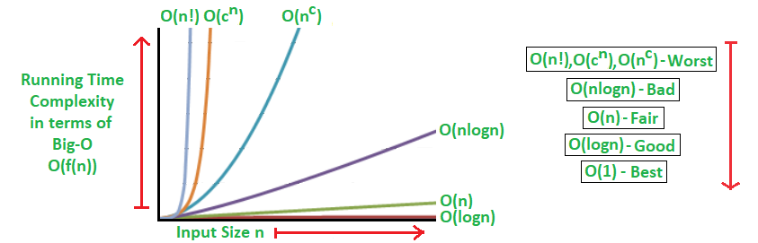
Time complexity
-One way in which number theory is used to analyze the complexity of algorithms is by studying the growth rate of the number of steps required to solve a problem as the size of the input data increases.
- if an algorithm has a time complexity of O(n^2), this means that the number of steps required to solve the problem grows at most quadratically with the size of the input data.
Notes:
Number theory is useful for finding the complexity of algorithms because it provides a mathematical framework for analyzing the performance of algorithms. The study of the computational complexity of algorithms is concerned with how the performance of an algorithm depends on the size of the input data. By using number-theoretic techniques, it is possible to analyze the complexity of algorithms and determine whether they are efficient for solving a given problem.

Slide 11
Conclusion
Number theory consists of many different topics and is useful many different fields:
-Congruence and Modular Arithmetic
-Cryptology
-Time complexity
-Computer Science and Algorithms

