Slide 1

Permutations and Combinations
Miriam Pastrana
CS 131 Fall 2022
Notes:
Hello, Im Miriam Pastrana and my presentation will be on permutations and combinations. Which was introduced to this class in Chapter 6: Counting.

Slide 2
Applications of Permutations and Combinations in Computer Science
Particular areas that have extensive applications of combinatorics such as permutations and combinations include: communication networks, cryptography and network security; computer architecture; electrical engineering; computational molecular biology; languages both natural and computer; pattern analysis; scientific discovery; databases and data mining; scheduling problems in operations research; and simulation.

Slide 3

What are Permutations?
Permutation relates to the act of arranging all the members of a set into some sequence or order. In other words, if the set is already ordered, then the rearranging of its elements is called the process of permuting. Permutation is the choice of r things from a set of n things without replacement and where the order matters.
Permutation Formula
Permutation with Repetition Formula P(n,r)=

Slide 4
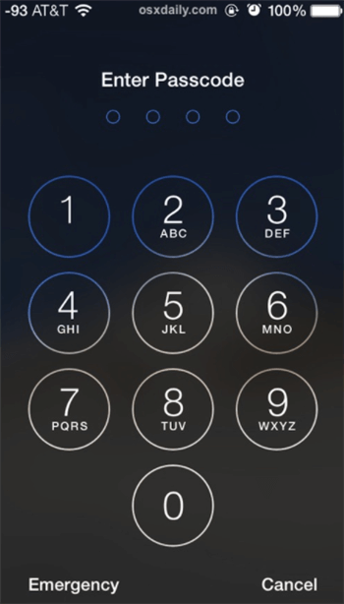

Passcodes
First passcode allows for repetition
P(10,4) = 10x10x10x10
= 10,000 possible passcodes
Second passcode doesn't allow for repetition
P(10,4) = 10!/(10-4)!
= 10x9x8x7
= 5040 possible passcodes

Slide 5


What are Combinations?
Combination is a way of selecting items from a collection, such that the order of selection does not matter. In other words, combination is the choice of r things from a set of n things without replacement and where order doesn't matter.
Combination formula
Combination Formula with Repetition C(n,r) =

Slide 6

Packing
C(20,5) = 20!/[5!(20-5)!]
= 20!/(5!15!)
= 15,504 possible combinations
C(5,5) = [(5+5-1)!]/[5!(5-1)!]
= 9!/(5!4!)
= 126 possible combinations

Slide 7
Permutations used for the list of data (where the order of the data matters) Combinations used for a group of data (where the order of data doesn’t matter)

