Slide 1





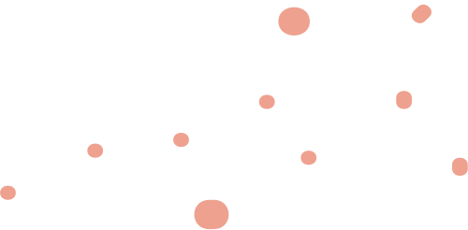



Tom’s Maze Chase
Comp 4303 Group Presentation

Slide 2


our team
Sahil Mahey
201964327
Harsh Sharma
201961844

Slide 3
Abstract
Tom's Maze Chase is an engaging game where players control Tom the cat, navigating through a dynamic maze environment to catch Jerry and friends while evading Spike. With strategic gameplay, character variety, and unique features like power-up tiles and random respawns, it offers thrilling challenges and endless fun. Built using Three.js, it showcases technical prowess in UI and logic development.

Slide 4
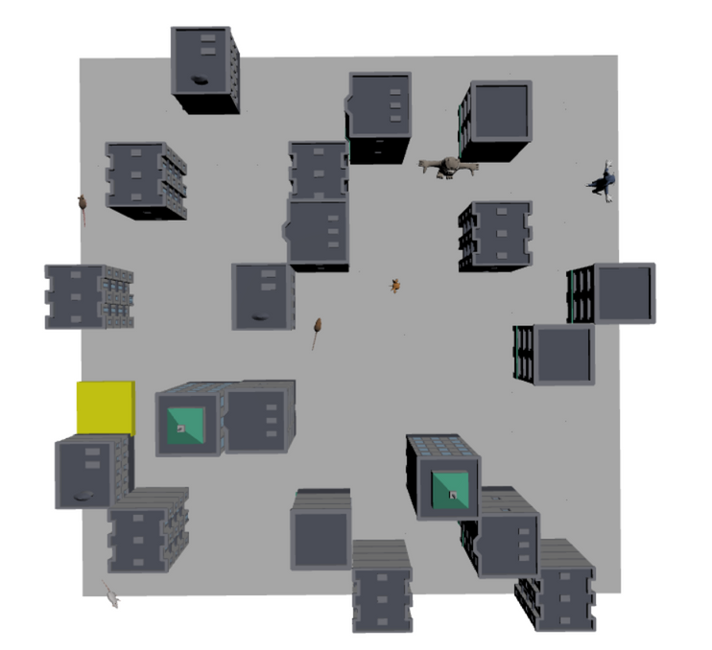
Introduction
Tom's Maze Chase is an exciting game where players take control of Tom, the cat, in a challenging maze environment. The objective is to catch all the mice, led by Jerry, while avoiding obstacles and evading Spike, who is also on the hunt. Players must strategically navigate the maze, collect the power-up tile to gain temporary advantage, and outwit Spike to emerge victorious.

Slide 5
Goals
1.
Players must strategically navigate the maze to catch Jerry and his friends while avoiding obstacles and outsmarting Spike.
2.
Collect the power-up tile to gain temporary advantages such as increased speed for Tom, invisibility for Jerry and friends, and enhanced pursuit abilities for Spike.

Slide 6


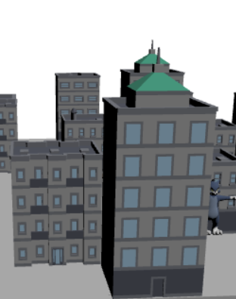
The grey color represents ground tiles.
The yellow color represents a power up tile, which provide temporary advantages to the characters. The tile turns green after a character obtain a power up and come back to its normal state (yellow) after certain period of time.
The obstacles in the maze are represented by different buildings structures appearing on random locations in the maze using Halton Sequence.

Slide 7

Characters
tom
Help Tom catch Jerry and his friends! Navigate a tile-based world, collect power-ups for speed boosts, and avoid Spike the Bulldog to win!
TOP SPEED: 5
POWER UP TIME: 6 SECONDS
POWER-UP ABILITY: 2X SPEED

Slide 8
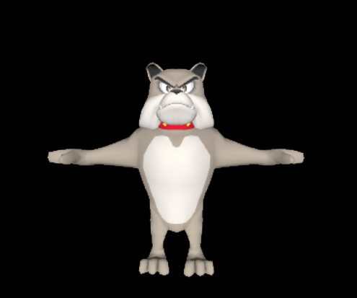
Spike
watch out for Spike, who hunts you down with an A* algorithm after obtaining a power-up while avoiding collisions with obstacles, turning the tables!
TOP SPEED: 4
POWER UP TIME: 10 SECONDS
POWER-UP ABILITY: 2X SPEED

Slide 9
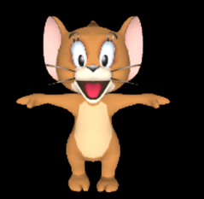
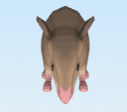
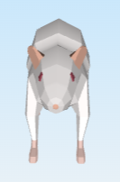
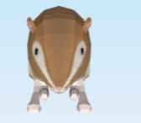
Jerry and his friends
Classic Chase gets an upgrade! Jerry and his friends hide and seek with invisible power-ups to avoid collision with obstacles while Tom hunts them down strategically.
TOP SPEED: 10
POWER UP TIME: 10 SECONDS
POWER-UP ABILITY: INVISIBILITY AND RANDOM RESPAWN

Slide 10
concept covered
Complex Movement Algorithms | Wander Collision Avoidance
Pathfinding | A*
Decision Making | State machine
Procedural content generation | Perlin noise
Other topic learned in the class | Halton sequence

Slide 11
Rules
The player wins the game upon successfully capturing all the mice while avoiding being caught by Spike. Conversely, the game is lost if Spike catches Tom before all the mice are captured. Players have the option to restart the game after either winning or losing.
Players control Tom using arrow keys to navigate the maze's pathways. Tom can move up, down, left, or right but cannot move through walls or obstacles.
When Tom collects the power-up tile, he gains a temporary speed boost. Meanwhile, Jerry and his friends become invisible, making them harder to catch, and Spike gains enhanced pursuit abilities using an A* algorithm to see Tom.
Jerry and his friends can respawn at random locations within the maze after exhausting their power BOOSTER, increasing the challenge and unpredictability of gameplay.

Slide 12
Project structure
code/
js/
Game/
Behaviour/
World/
Util/
public/
Models/
index.html
Documents/
Video/
README.md

Slide 13
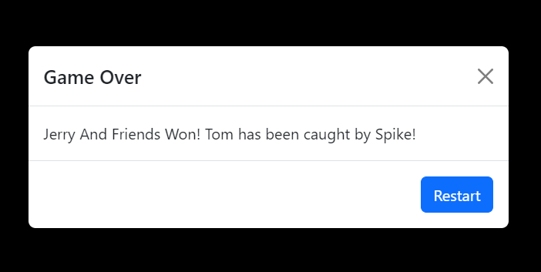
The END
You want to play again or you lost!!!! Don't worry! You can always restart the game after the results.

