Slide 1
Questions these slides attempts to answer…
Data source and Data quality issues.
Revenue trends over the years.
Which CATEGORY of products has the best / worst REVENUE ?
What are the TOP three (3) PRODUCTS by REVENUE ?
What are the TOP three (3) PRODUCTS by VOLUME ?
Pandas vs Polars benchmark which is more efficient and faster ?

Slide 2
Data source and Data quality issues
The dataset used was pulled directly from Kaggle
It contains over 1 million rows of Apple Retail Sales data.
It also includes information on products, stores, sales transactions, and warranty claims.
The data set had littlr to no quality issues and it was clean. The only cleaning done was formatting of the dates.
NOTE: This dataset is not based on real Apple Inc. data.
It was created using Python and LLM-generated insights to simulate realistic sales patterns and business metrics.

Slide 3
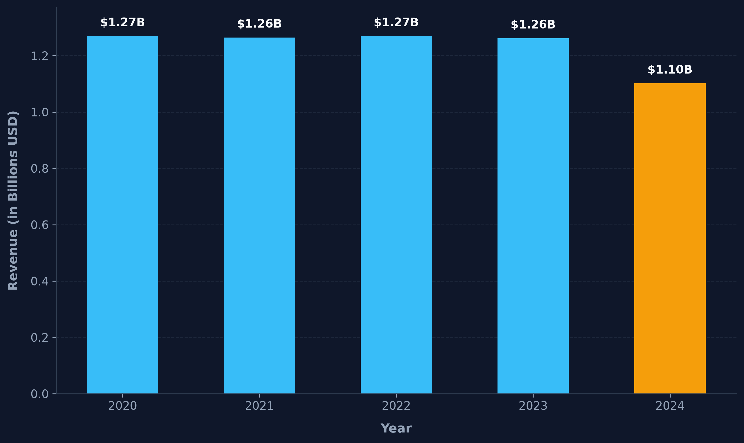
Revenue Trends over the years
Revenue held remarkably flat at roughly $1.26B – 1.27B every year from 2020 to 2023, then dropped sharply to $1.10B in 2024, a clear break from five years of stability.

Slide 4
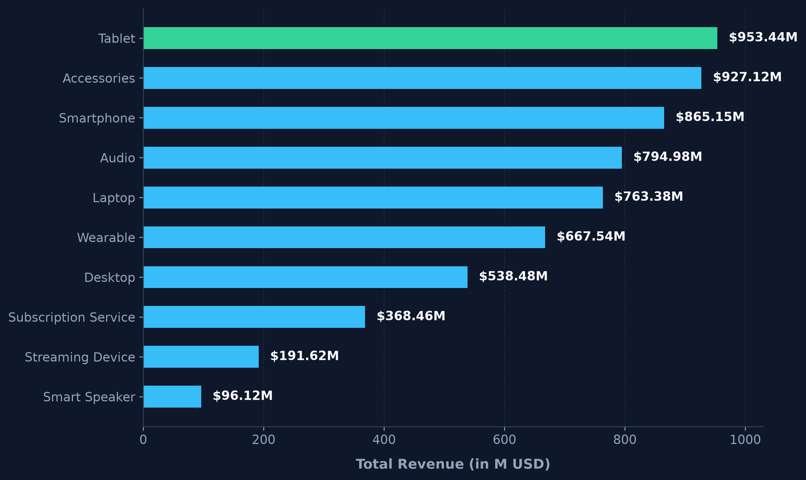
CATEGORY of products and their REVENUE …
Tablets and Accessories lead all ten categories, while Smart Speakers trail far behind, showing a steep drop-off after the top five categories.

Slide 5
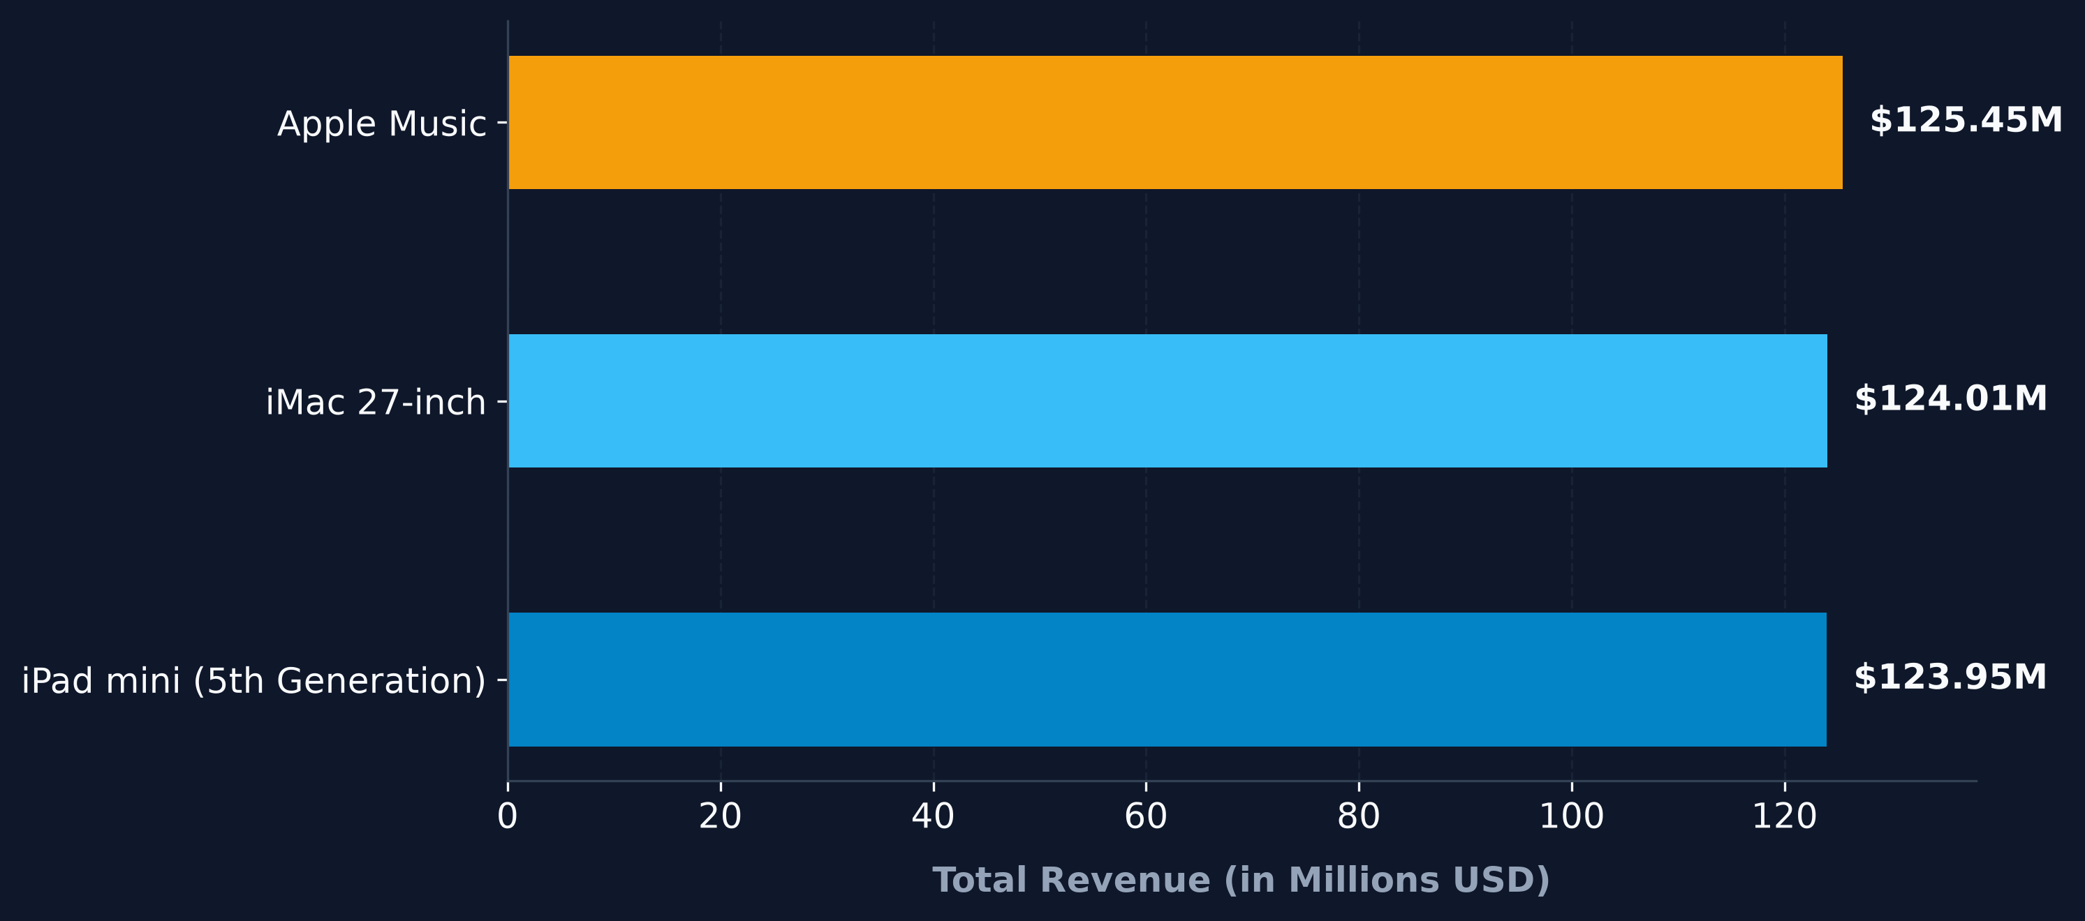
TOP three (3) PRODUCTS by REVENUE…
Apple Music narrowly edges out iMac 27-inch and iPad mini 5th Gen, showing that subscription revenue now rivals the best-selling hardware.

Slide 6
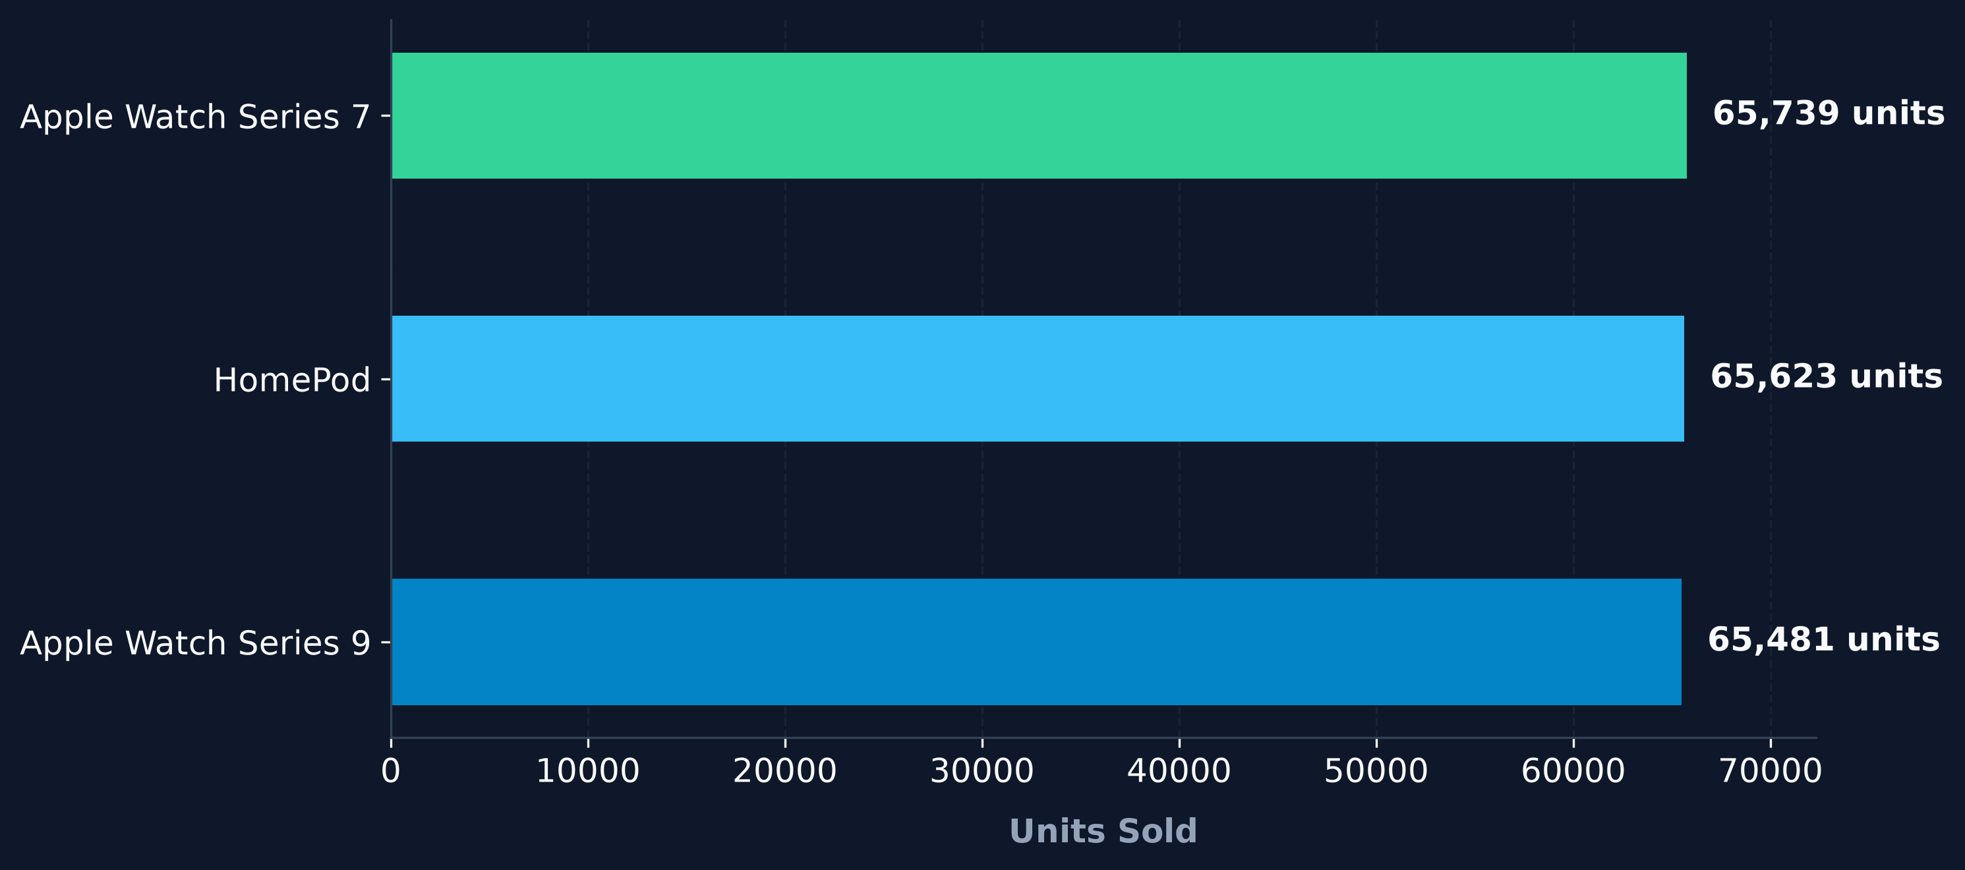
TOP three (3) PRODUCTS by VOLUME…
Apple Watch Series 7 leads a very tightly clustered pack with HomePod and Apple Watch Series 9, all within about 260 units of each other.

Slide 7
Benchmarks…
Dataset Rows: 1,040,200
Tool | Read Time | Peak Memory
Pandas | 311.76 ms | 19.92 MB
Polars | 181.68 ms | 0.00 MB
Tool | Exec Time | Peak Memory
Pandas | 283.67 ms | 72.94 MB
Polars | 51.39 ms | 0.01 MB
After 3 runs, Polars loaded the Parquet file 1.72x faster.
After 5 runs, Polars completed aggregation 5.52x faster.

Slide 8
Summary & Recommendations…
The 2024 "decline" (-12.7%) is not a business trend. Recording stops on November 11, 2024, so December is fully absent and November itself is missing 19 of its 30 days. A backfill of the missing days is highly recommended. However, Tablets and Accessories anchor revenue, and Apple Music now rivals flagship hardware. 4
The recommended near-term focus is to protect and scale these proven drivers.
On tooling: Polars loaded the source data 1.72x faster and ran aggregations 5.52x faster than Pandas. Standardizing the pipeline on Polars makes fast, frequent reconciliation checks cheap

