Slide 1

SOFTWARE DESIGN AND ARCHITECTURE
Instructor: M Faizan Khan

Slide 2
Review
Distributed Architectures
  Service Oriented Architecture

Slide 3
Outline
Data Flow Architectures
  Batch Sequential
  Pipe and Filter

Slide 4
Data flow Software Architecture

Slide 5
Data Flow Architectures
The data flow software architecture style views the entire software system as a series of transformations on successive sets of data, where data and operations on it are independent of each other.
The software system is decomposed into data processing elements where data directs and controls the order of data computation processing.

Slide 6
Data Flow Architectures
Each component in this architecture transforms its input data into corresponding output data.
The connection between the subsystem components may be implemented as I/O streams, I/O files, buffers, piped streams, or other types of connections.

Slide 7
Data Flow Architectures
Regardless of the type of topology, the data moves from one subsystem to another.
In general, there is no interaction between the modules except for the output and the input data connections between subsystems.

Slide 8
Data Flow Architectures
One subsystem can be substituted by another without affecting the rest of the system
Since each subsystem does not need to know the identity of any other subsystem, modifiability and reusability are important property attributes of the data flow architecture.

Slide 9
Batch sequential

Slide 10
Batch – Sequential
In batch sequential architecture, each data transformation subsystem or module cannot start its process until its previous subsystem completes its computation.
Data flow carries a batch of data as a whole from one subsystem to another.

Slide 11
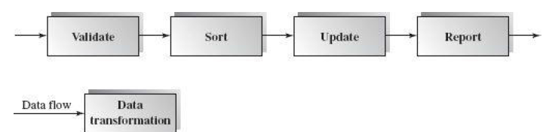
First subsystem validates the transaction requests (insert, delete, and update) in their totality.
Next, the second subsystem sorts all transaction records in an ascending order on the primary key of data records
The transaction update module updates the master file with the sorted transaction requests, and then
the report module generates a new list.
The architecture is in a linear data flow order.

Slide 12
Applicable domains of batch sequential architecture:
• Data are batched.
• Intermediate file is a sequential access file.
• Each subsystem reads related input files and writes output files.

Slide 13
Benefits:
• Simple divisions on subsystems.
• Each subsystem can be a stand-alone program working on input data and producing output data.

Slide 14
Limitations:
• Implementation requires external control.
• It does not provide interactive interface.
• Concurrency is not supported and hence throughput remains low
• High latency.

Slide 15
Pipes-and-Filters Style

Slide 16
Pipe and Filter
This architecture decomposes the whole system into components of data source, filters, pipes, and data sinks.
The connections between components are data streams.
The particular property attribute of the pipe and filter architecture is its concurrent and incremented execution.

Slide 17
Pipes-and-Filters Style
Suitable for applications that require a defined series of independent computations to be performed on data.
Each component has a set of inputs and set of outputs.
A component reads a stream of data on its input and produces stream of data at its output.

Slide 18
Filter
Each filter is an independent data stream transformer;
  it reads data from its input data stream, transforms and processes it, and then
  writes the transformed data stream over a pipe for the next filter to process.

Slide 19
Filter
A filter does not need to wait for batched data as a whole.
  As soon as the data arrives through the connected pipe, the filter can start working right away.
A filter does not even know the identity of data upstream or data downstream.
  A filter is just working in a local incremental mode.

Slide 20
Active and Passive filters
An active filter pulls in data and pushes out the transformed data (pull/push);
A passive filter lets connected pipes push data in and pull data out.

Slide 21
Pipes
The connectors serve as channels for the streams, transmitting outputs of one filter to inputs of the other.
  This makes connectors act as Pipes.

Slide 22
Pipes
A pipe moves a data stream from one filter to another.
A pipe can carry binary or character streams.
A pipe is placed between two filters; these filters can run in separate threads of the same process.

Slide 23

Structure

Slide 24
There are three ways to make the data flow:
Push only (Write only)
  A data source may push data in a downstream.
  A filter may push data in a downstream.
Pull only (Read only)
  A data sink may pull data from an upstream.
  A filter may pull data from an upstream.
Pull/Push (Read/Write)
  A filter may pull data from an upstream and push transformed data in a downstream.

Slide 25
Examples
Traditional Compilers:
Compilation phases are pipelined, though the phases are not always incremental. The phases in the pipeline include:
  lexical analysis + syntax analysis (parsing) + semantic analysis + code optimization + code generation

Slide 26
Example:
Architecture of a Compiler
Compilation is regarded as a sequential (pipeline) process.
Every phase is dependent on some data on the preceding phase.
text
Lex
Syn
Sem
Opt
CGen
code

Slide 27
Compiler
The system might consist of a pipeline of processing elements similar to the following:
  A source element reads the program text (i.e., source code) from a file (or perhaps a sequence of files) as a stream of characters.
  A lexical analyzer converts the stream of characters into a stream of lexical tokens for the language--keywords, identifier symbols, operator symbols, etc.
  A parser recognizes a sequence of tokens that conforms to the language grammar and translates the sequence to an abstract syntax tree.

Slide 28
Compiler
  A "semantic" analyzer reads the abstract syntax tree and writes an appropriately augmented abstract syntax tree.
  A global optimizer (usually optionally invoked) reads an augmented syntax tree and outputs one that is equivalent but corresponds to program that is more efficient in space and time resource usage.
  An intermediate code generator translates the augmented syntax tree to a sequence of instructions for a virtual machine.

Slide 29
Compiler
  A local optimizer converts the sequence of intermediate code (i.e., virtual machine) instructions into a more efficient sequence.
  A backend code generator translates the sequence of virtual machine instructions into a sequence of instructions for some real machine platform (i.e., for some particular hardware processor augmented by operating system calls and a runtime library).

Slide 30
Compiler
If the previous step generated symbolic assembly code, then an assembler is needed to translate the sequence of symbolic instructions into a relocatable binary module.
If the previous steps of the pipeline generated a sequence of separate binary modules, then a linker might be needed to bind the separate modules with library modules to form a single executable (i.e., object code) module.
A sink element outputs the resulting binary module into a file.

Slide 31
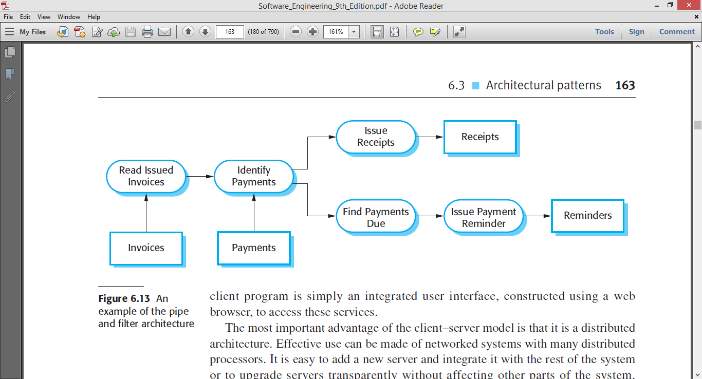
Sales System

Slide 32
Applicable domains of pipe and filter architecture:
The system can be broken into a series of processing steps over data streams, and at each step filters consume and move data incrementally.
The data format on the data streams is simple, stable, and adaptable if necessary.
Significant work can be pipelined to gain increased performance.
Producer or consumer-related problems are being addressed.

Slide 33
Benefits:
Concurrency: It provides high overall throughput for excessive data processing.
Reusability: Encapsulation of filters makes it easy to plug and play, and to substitute.
Flexibility: It supports both sequential and parallel execution.

Slide 34
Benefits:
Modifiability: It features low coupling between filters, less impact from adding new filters, and modifying the implementation of any existing filters as long as the I/O interfaces are unchanged.
Simplicity: It offers clear division between any two filters connected by a pipe.

Slide 35
Disadvantages
Not good choice for interactive systems, because of their transformational characteristic.

Slide 36
Summary
Data flow architectures
  Batch Sequential
  Pipe and Filter

