Slide 1

SOFTWARE DESIGN AND ARCHITECTURE
INSTRUCTOR : M FAIZAN KHAN

Slide 2
Review
Data Flow Architectures
  Batch Sequential
  Pipe and Filter

Slide 3
Outline
Shared Data Software Architectures
  Central Repository Architecture

Slide 4
Shared data Software Architecture

Slide 5
Shared Data Software Architecture
Data-centered software architecture is characterized by a centralized data store that is shared by all surrounding software components.
The software system is decomposed into two major partitions: data store and independent software component or agents.

Slide 6
Shared Data Software Architecture
The connections between the data module and the software components are implemented either by explicit method invocation or by implicit method invocation.

Slide 7
Shared Data Software Architecture
In pure data-centered software architecture, the software components don't communicate with each other directly; instead, all the communication is conducted via the data store.
The shared data module provides all mechanisms for software components to access it, such as insertion, deletion, update, and retrieval.

Slide 8
Shared Data:
The high level design solution is based on a shared data-store which acts as the “central command” with 2 variations:
Blackboard style
Repository style

Slide 9
Repository architecture

Slide 10
Repository Architecture
The repository architecture style is a data-centered architecture that supports user interaction for data processing.
The software component agents of the data store control the computation and flow of logic of the system.

Slide 11
Repository architecture
All data in a system is managed in a central repository that is accessible to all system components.
Components do not interact directly, only through the repository.
Lab testing
physician
diagnosis
Patient
database
accounting
& administration
pharmacy &
drug processing

Slide 12
Repository architecture
Organizing tools around a repository is an efficient way to share large amounts of data.
  There is no need to transmit data explicitly from one component to another.

Slide 13
Repository architecture
However, components must operate around an agreed repository data model.
  Inevitably, this is a compromise between the specific needs of each tool and it may be difficult or impossible to integrate new components if their data models do not fit the agreed schema.

Slide 14
Repository architecture
Although it is possible to distribute a logically centralized repository, there may be problems with data redundancy and inconsistency.
  In practice, it may be difficult to distribute the repository over a number of machines.

Slide 15
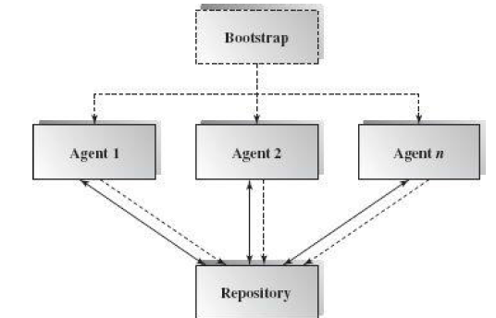
Repository Architecture
A general picture of the repository architecture.
The dashed lines pointing toward repository indicate that repository clients have full control over the logic flow.

Slide 16
Repository Architecture
Clients can get data from the data store and put data in the data store.
Different clients may have different interfaces and different data access privileges.

Slide 17
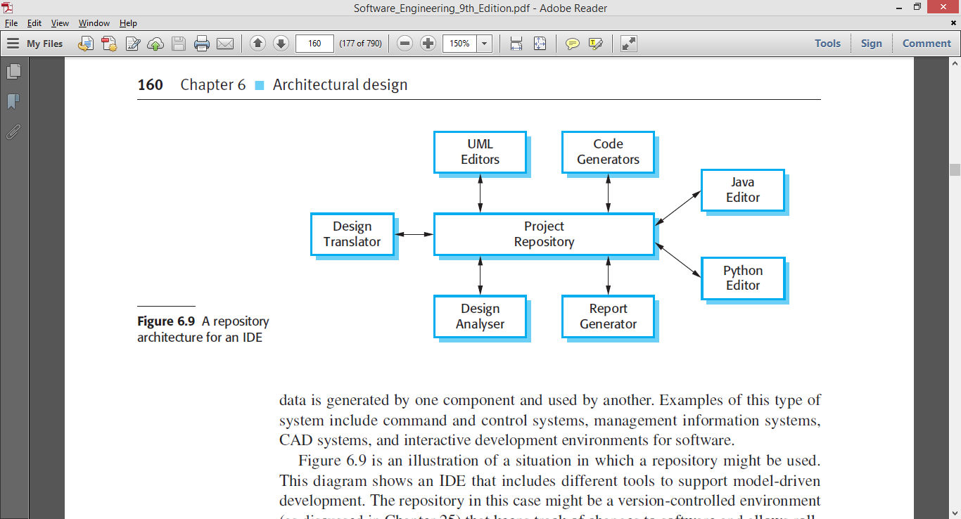
Example: Integrated Development Environment

Slide 18
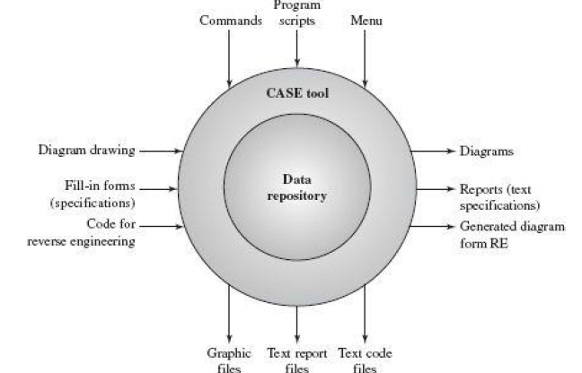
CASE Tools
There are many CASE tools surrounding the data store

Slide 19
CASE tools
A user of CASE tools can draw a UML design diagram such as a class diagram, collaboration diagram, or sequence diagram, and store the design blueprints in the CASE data store.
The biggest advantage of CASE tools is its centralized data with many supporting software tools which can generate different products for different purposes based on the same set of data.

Slide 20
Applicable domains of repository architecture:
Suitable for large, complex information systems where many software component clients need to access them in different ways
Requires data transactions to drive the control flow of computation

Slide 21
Advantages
Components can be independent—they do not need to know of the existence of other components.
Changes made by one component can be propagated to all components.
  All data can be managed consistently (e.g., backups done at the same time) as it is all in one place.

Slide 22
Disadvantages
The repository is a single point of failure so problems in the repository affect the whole system.
May be inefficiencies in organizing all communication through the repository.
Distributing the repository across several computers may be difficult.

Slide 23
Summary
Shared Data Software Architectures
  Central Repository Architecture

