Slide 1

SOFTWARE DESIGN AND ARCHITECTURE
Instructor: M FAIZAN KHAN

Slide 2
Review
Shared Data Software Architectures
  Central Repository Architecture

Slide 3
Outline
Shared Data Software Architectures
  Black board Style architecture

Slide 4
Shared data Software Architecture

Slide 5
Shared Data Software Architecture
Data-centered software architecture is characterized by a centralized data store that is shared by all surrounding software components.
The software system is decomposed into two major partitions: data store and independent software component or agents.

Slide 6
Shared Data Software Architecture
The connections between the data module and the software components are implemented either by explicit method invocation or by implicit method invocation.

Slide 7
Shared Data Software Architecture
In pure data-centered software architecture, the software components don't communicate with each other directly; instead, all the communication is conducted via the data store.
The shared data module provides all mechanisms for software components to access it, such as insertion, deletion, update, and retrieval.

Slide 8
Shared Data:
The high level design solution is based on a shared data-store which acts as the “central command” with 2 variations:
Blackboard style
Repository style

Slide 9
Blackboard architecture

Slide 10
Blackboard architecture
The blackboard architecture was developed for speech recognition applications in the 1970s.
Other applications for this architecture are image pattern recognition and weather broadcast systems.

Slide 11
Blackboard architecture
The word blackboard comes from classroom teaching and learning.
Teachers and students can share data in solving classroom problems via a blackboard.
Students and teachers play the role of agents to contribute to the problem solving.
They can all work in parallel, and independently, trying to find the best solution.

Slide 12
Blackboard architecture
It is a data- directed and a partially data-driven architecture.

Slide 13
Blackboard architecture
The entire system is decomposed into two major partitions.
  One partition, called the blackboard, is used to store data (hypotheses and facts)
  while the other partition, called knowledge sources, stores domain specific knowledge.
  There also may be a third partition, called the controller, that is used to initiate the blackboard and knowledge sources and that takes a bootstrap role and overall supervision control.

Slide 14
Blackboard architecture - Connections
The connections between the blackboard subsystem and knowledge sources are basically
  implicit invocations from the blackboard to specific knowledge sources,
which are registered with the blackboard in advance.

Slide 15
Blackboard architecture - Connections
Data changes in the blackboard trigger one or more matched knowledge source to continue processing.
Data changes may be caused by new deduced information or hypotheses results by some knowledge sources.
This connection can be implemented in publish/subscribe mode.

Slide 16
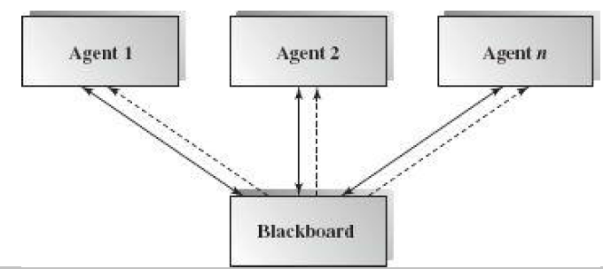
A block diagram - blackboard architecture
The solid lines indicate data links,
  while dashed lines represent the flow logic control,
which is controlled by any data changes in the data store.
The data in the blackboard store directs the flow of the computation.

Slide 17
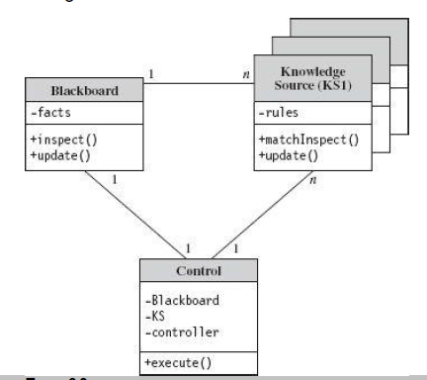
Rule-based blackboard software architecture
Figure shows a UML class diagram of a rule-based blackboard software architecture.
One blackboard may have many knowledge sources associated with it, working on given data and deduced data available in the blackboard subsystem.

Slide 18
Rule-based blackboard software architecture
Each knowledge source helps to solve problems in its expertise area.
Knowledge can be stored in different knowledge representation formats depending on the reasoning strategy.
For example, a knowledge source stores all related rules and provides activation mechanisms for the blackboard to trigger in rule-based expert system.

Slide 19
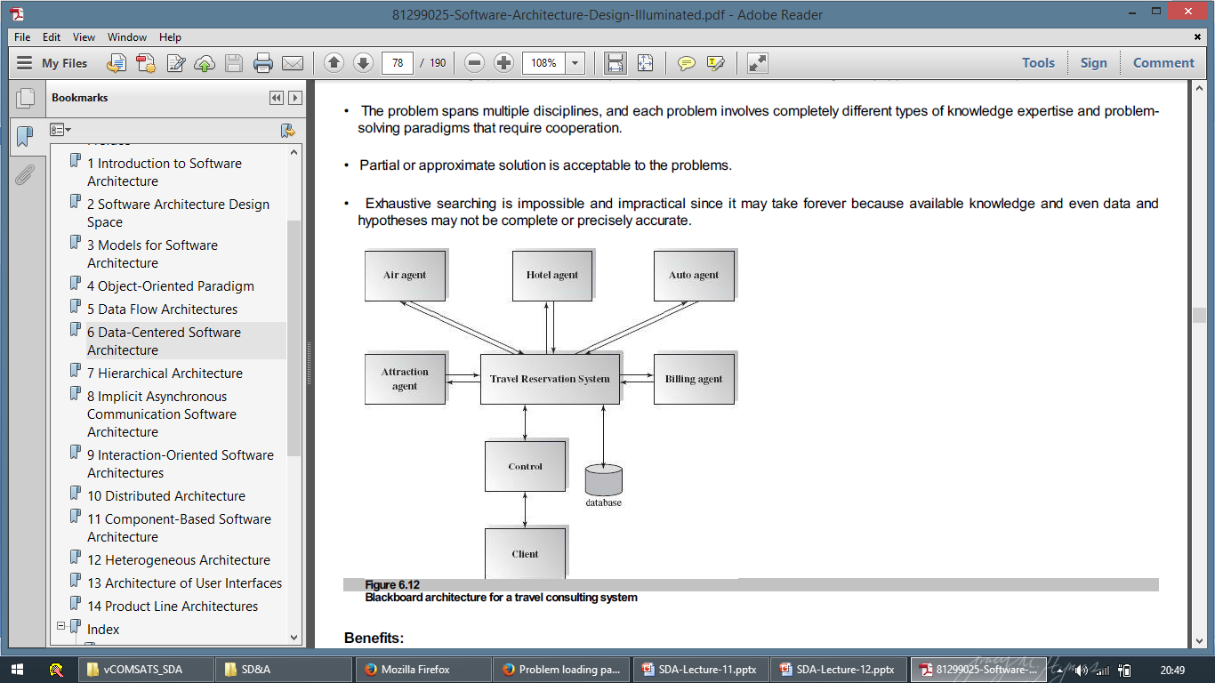
Example - Travel Consulting System
There may be many air travel agencies, hotel reservation systems, car rental companies, or attraction reservation systems to subscribe to or register with through this travel planning system.

Slide 20
Example - Travel Consulting System
Once the system receives a client request, it publishes the request to all related agents and composes plan options for clients to choose from.

Slide 21
Example - Travel Consulting System
The system also stores all necessary data in the database.
After the system receives a confirmation from the client, it invokes the financial billing system to verify credit background and to issue invoices.

Slide 22
Example - Travel Consulting System
The data in the data store plays an active role in this system.
It does not require much user interaction after the system receives client requests since the request data will direct the computation and activate all related knowledge sources to solve the problem.

Slide 23
Applicable domain:
Suitable for solving open-ended and complex problems such as artificial intelligence (AI) problems where no preset solutions exist.
The problem spans multiple disciplines, and each problem involves completely different types of knowledge expertise and problem solving paradigms that require cooperation.

Slide 24
Applicable domain:
Partial or approximate solution is acceptable to the problems.
Exhaustive searching is impossible and impractical since it may take forever because available knowledge and even data and hypotheses may not be complete or precisely accurate.

Slide 25
Benefits:
Scalability: easy to add or update knowledge source.
Concurrency: all knowledge sources can work in parallel since they are independent of each other.
Supports experimentation for hypotheses.
Reusability of knowledge source agents.

Slide 26
Limitations:
Due to the close dependency between the blackboard and knowledge source, the structure change of the blackboard may have a significant impact on all of its agents.
Since only partial or approximate solutions are expected, it can be difficult to decide when to terminate reasoning.

Slide 27
Limitations:
Synchronization of multiple agents is an issue. Since multiple agents are working and updating the shared data in the blackboard simultaneously, the preference or priority of executions of multiple agents must be coordinated.
Debugging and testing of the system is a challenge.

Slide 28
Summary
Shared Data Software Architectures
  Black board style Architecture

