Slide 1

20H58665– Software Design and Architecture
Instructor: M Faizan Khan

Slide 2
Revision
Introduction to design
Importance of design

Slide 3
Outline
Design phase in SDLC – architecture and detailed design
Factors that affect design
Quality Models

Slide 4
Software Development Activities
Requirements Elicitation
Requirements Analysis (e.g., Structured Analysis, OO Analysis)
– analyzing requirements and working towards a conceptual model without taking the target implementation technology into account
Design
  coming up with solution models taking the target implementation technology into account
Implementation
Testing

Slide 5
Software Design in SDLC
In SDLC (Software Development Life Cycle), Design phase is one of the most important phases.
In the software engineering context, design focuses on four major areas of concern: data, architecture, interfaces and components.

Slide 6
Design Process Activities
Architectural design
  Modules, inter-relationships etc
Abstract specification
  Services of each sub-system, constraints etc

Slide 7
Design Process Activities
Interface design
  Interface to other sub-system or outside enviornment
Component design
  Services allocated to components and their interfaces designed
Data structure design
Algorithm design

Slide 8
The Software Design Process

Slide 9
Levels of Software Design
Architectural design (high-level design)
  architecture - the overall structure, main modules and their connections
  addresses the main non-functional requirements (e.g., reliability, performance)
  hard to change
Detailed design (low-level design)
  the inner structure of the main modules
  detailed enough to be implemented in the programming language

Slide 10
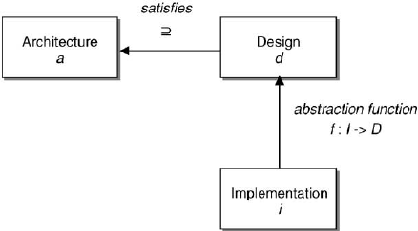

Slide 11
Design vs. Architecture
Architecture is concerned with the selection of architectural elements, their interaction, and the constraints on those elements and their interactions
Design is concerned with the modularization and detailed interfaces of the design elements, their algorithms and procedures, and the data types needed to support the architecture and to satisfy the requirements.
Architecture…is specifically not about…details of implementations (e.g., algorithms and data structures.)

Slide 12
Factors that affect Design

Slide 13
FACTORS THAT AFFECT DESIGNS
There is a set of general laws of design that characterize the nature of design:
The Principle of Totality:
  All design requirements are always interrelated and must always be treated as such throughout a design task
    Requirement conflicts
    Requirement prioritization
    Design decisions

Slide 14
FACTORS THAT AFFECT DESIGNS
The Principle of Time:
  The features and characteristics of all products change as time passes.
    User friendliness
    Resource intensive

Slide 15
FACTORS THAT AFFECT DESIGNS
The Principle of Value:
  The characteristics of all products have different relative values depending upon the different circumstances and times in which they may be used.
  Changes with time
  Changes with circumstances
  Adaptability for a wide range of user types should be considered.

Slide 16
FACTORS THAT AFFECT DESIGNS
The Principle of Resources:
  The design, manufacture and life of all products and systems depend upon the materials, tools and skills upon which we can call.
    development tools,
    run time support systems,
    human resource
    application domain-specific tools and equipment,

Slide 17
FACTORS THAT AFFECT DESIGNS
The Principle of Synthesis:
  All features of a product must combine to satisfy all the characteristics we expect it to possess with an acceptable relative importance for as long as we wish, bearing in mind the resources available to make and use it.
    trade-offs between desirable features and functions

Slide 18
FACTORS THAT AFFECT DESIGNS
The Principle of Iteration:
  Design requires processes of evaluation that begin with the first intentions to explore the need for a product or system.
  designs have to be changed to correct errors and to improve quality.

Slide 19
FACTORS THAT AFFECT DESIGNS
The Principle of Change:
  Design is a process of change, an activity undertaken not only to meet changing circumstance, but also to bring about changes to those circumstances by the nature of the product it creates.
  The design of a software system must take into consideration how it changes the way that we will work and live as the consequence of using the system.

Slide 20
FACTORS THAT AFFECT DESIGNS
The Principle of Relationships:
  Design work cannot be undertaken effectively without established working relationships with all stakeholders
  Customers, Users, System administrator, Project managers, Developers, Requirements analysts, Designers, Programmers, Testers:

Slide 21
FACTORS THAT AFFECT DESIGNS
The Principle of Competence:
  Design competence is the ability to create a synthesis of features that achieves all desired characteristics in terms of their required life and relative value, using available effective information
  competence of the designer.

Slide 22
FACTORS THAT AFFECT DESIGNS
The Principle of Service:
  Design must satisfy everybody, and not just those for whom its products are directly intended.
  it must be easy to maintain,
  easy to reuse,
  easy to transport to other operation environments and to
  be inter-operable to other software systems, etc.

Slide 23
Software Quality Models

Slide 24
SOFTWARE QUALITY MODELS
Quality is the excellence of the product or service.
  From a user’s point of view, quality is ‘fitness for purpose’.
  The value-based view of quality is concerned with the ability to provide what the customer requires at a price that they can afford.
  From the manufacturing point of view, the quality of a product is the conformance to specification.
  the product view sees the quality of a product as tied to inherent characteristics of the product.

Slide 25
Hierarchical models
McCall divided software quality attributes into 3 groups
Each group represents the quality with respect to one aspect of the software system while the attributes in the group contribute to that aspect.
Each quality attribute is defined by a question so that the quality of the software system can be assessed by answering the question.

Slide 26
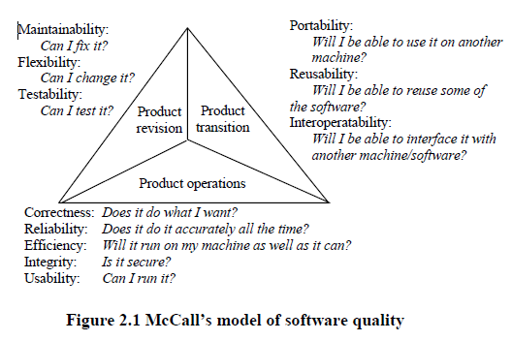

Slide 27
Relational models
Perry’s model contains three types of relationship between the quality attributes.
  The direct relationship
  The inverse relationship
  The neutral relationship

Slide 28
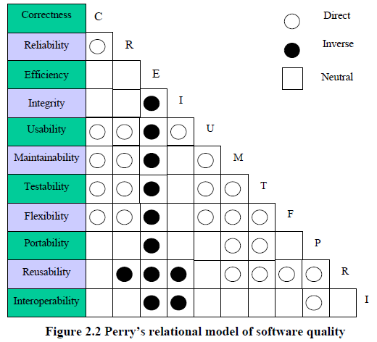

Slide 29
Summary
Design phase in SDLC – architecture and detailed design
Factors that affect design
Quality Models

Slide 30
Integrity vs. efficiency (inverse): The control of data access will need additional
code, leading to a longer runtime and more storage requirement.
• Usability vs. efficiency (inverse): Improvement of HCI will need more code
and data, hence the system will be less efficient.

Slide 31
Maintainability and testability vs. efficiency (inverse): Compact and optimised
code is not easy to maintain and test, and well-commented code is less
efficient.
• Flexibility, reusability vs. integrity (inverse): Flexible data structures required
for flexible and reusable software increase the data security problem.
• Flexibility and reusability vs. maintainability (direct): Maintainable code arises
from the code that is well structured; meantime, well-structured maintainable
code is easy to reuse in other programs.
• Portability vs. reusability (direct): Portable code is likely to be easily used in
other environments. The code is likely well-structured and easier to be reused.
• Correctness vs. efficiency (neutral): The correctness of code has no relation
with its efficiency. Correct code may be efficient or inefficient in operation.

