Slide 1

20H58665– Software Design and Architecture
LECTURE 3/4

Slide 2
Previous Lecture
Good design
Quality attributes of software design
Software design principles
Concepts in design

Slide 3
Outline
Software design methods
Design Paradigms
Typical Design Trade-offs

Slide 4
Software Design Methods

Slide 5
Software Design Methods
In a Software development process, the Software Design Methodology (SDM) refers to specific set of procedures used to manage and control the SDLC (Software Development Life Cycle).

Slide 6
Software Design Methods
The choice of the SDM primarily depends upon several factors, namely,
  the type of the software (such as standalone or distributed and networked; Strategic or operational etc.)
  the scope of the development project (such as revamp of the existing system or new system, the number of modules involved, underlying complexity of the coding, system testing and implementation etc),
  the resources constraints (such as time, money, expertise)

Slide 7
Software Design Methods
Systematic approaches to developing a software design.
  Structured (Function-Oriented)
  Object-Oriented
  Data-Oriented (Data-structure-centered)
  Component-based
  Formal Methods

Slide 8
Software Design Methods
Structured Methods
  Process functions are identified
Object-Oriented
  develop an object model of a system
Data-Oriented
  Entities are determined for each sub-system, then entity inter-relationships are examined to develop the additional entities needed to support the relationships.

Slide 9
Software Design Methods
Component-based
  Divide the system into components
Formal Methods
  Requirements and programs are translated into mathematical notation

Slide 10
Which method to choose?
Data oriented design is useful for systems that process lots of data, e.g. database and banking applications
Structured design is useful for process intensive systems that will be programmed using a procedural language such as C.
OO methods are useful for any system that will be programmed using an object oriented language such as C++.

Slide 11
Component-based Methods are used for the large systems that can be modularized.
Formal methods are considered to be an alternative to OO and classical design methods,
  but their use is expensive and claims of reduced errors remain unproven.
  However, the ability to formally validate the correctness of a software artifact is appealing and research on formal methods is ongoing.

Slide 12
Design Paradigms

Slide 13
Software Design Paradigms
Structured Design/Function Oriented Design
Object-Oriented Design

Slide 14
Structured/Procedural Paradigm
Focus on procedures and functions.
Design the system by decomposing it based on the processes and functions.
Top-down algorithmic decomposition.
This approach separates data from procedures.

Slide 15
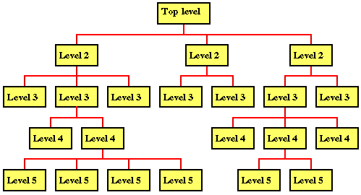
Structured/Procedural Paradigm

Slide 16
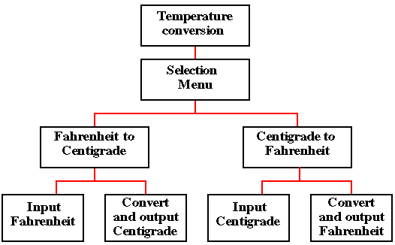
Example:

Slide 17
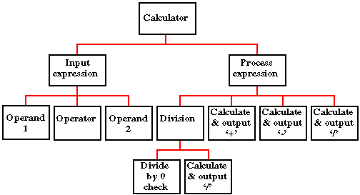
Example:

Slide 18
Drawbacks
Interdependencies between various functions and processes.
Cannot be reused easily.
Data related to each function is not attached.

Slide 19
Object-Oriented Paradigm
Describing the software solution in terms of collaborating objects, with responsibilities.
  Objects,
  classes,
  encapsulation,
  States,
  inheritance,
  composition,
  polymorphism

Slide 20
Object-Oriented Design
Bottom-up
  Encapsulate data and procedures in objects and classes.
  Refinement in classes lead to a composed larger system.

Slide 21
Benefits
Enjoys all the benefits of Modular approach
Dependencies can be handled by finding the commonalities through inheritance and polymorphism.
Naturalness
  OO paradigm models the real world better because everything in real world is an object.
Reusability
  Using the existing classes or components in future design, without much effort.

Slide 22
If OO design is incorrect, the implementation derived from the design in an OOP language would be very complex.

Slide 23
Case Study : Fire Alarm
The owner of a large multi-stored building wants to have a computerized fire alarm system for his building.
Smoke detectors and fire alarms would be placed in each room of the building.
The fire alarm system would monitor the status of these smoke detectors.

Slide 24
Case Study : Fire Alarm
Whenever a fire condition is reported by any of the smoke detectors, the fire alarm system should determine the location at which the fire condition is reported by any of the smoke detectors, the fire alarm system should determine the location at which the fire condition has occurred and then sound the alarms only in the neighbouring locations.

Slide 25
Case Study : Fire Alarm
The fire alarm system should also flash an alarm message on the computer console. Fire fighting personnel man the console round the clock.
After a fire condition has been successfully handled, the fire alarm system should support resetting the alarms by the fire fighting personnel.

Slide 26
Function-Oriented Approach
/* Global data (system state) accessible by various functions */
BOOL detector_status[MAX_ROOMS];
int detector_locs[MAX_ROOMS];
BOOL alarm_status[MAX_ROOMS];
  /* alarm activated when status is set */
int alarm_locs[MAX_ROOMS];
  /* room number where alarm is located */
int neighbor-alarm[MAX_ROOMS][10];
  /* each detector has atmost 10 neighboring locations */

Slide 27
Function-Oriented Approach
The functions which operate on the system state are:
  interrogate_detectors();
  get_detector_location();
  report_fire_location();
  determine_neighbor();
  ring_alarm();
  reset_alarm();

Slide 28
Object-Oriented Approach
class detector
  attributes
    status, location, neighbors
  operations
    create, sense-status, get-location, find-neighbors
class alarm
  attributes
    location, status
  operations
    create, ring-alarm, get_location, reset-alarm

Slide 29
Structured vs. OO Paradigm
In structured design, data and functions are kept separately.
Usually all of the data are placed before any of the functions are written.
Sometimes, it is not intuitively known which data works with which function.

Slide 30
Structured vs. OO Paradigm
In OO design, the related data and functions of an object are placed together within one unit.
In Structured approach abstraction exists in functions unlike OO approach where abstraction is in terms of objects

Slide 31
Design Goals and trade-offs

Slide 32
List of Design Goals
Reliability
Modifiability
Maintainability
Understandability
Adaptability
Reusability
Efficiency
Portability
Traceability of requirements
Fault tolerance
Backward-compatibility
Cost-effectiveness
Robustness
High-performance
Good documentation
Well-defined interfaces
User-friendliness
Reuse of components
Rapid development
Minimum # of errors
Readability
Ease of learning
Ease of remembering
Ease of use
Increased productivity
Low-cost
Flexibility

Slide 33
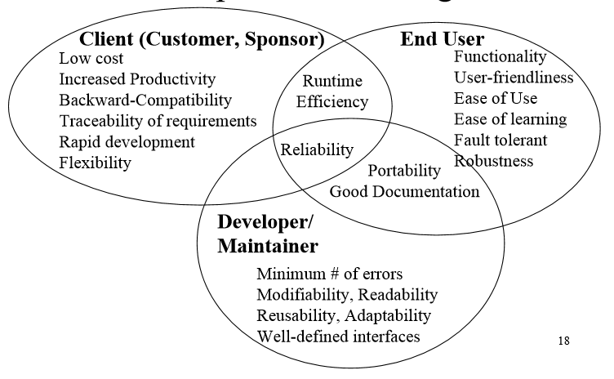
Relationship Between Design Goals

Slide 34
Typical Design Trade-offs
Functionality vs. Usability
Cost vs. Robustness
Efficiency vs. Portability
Rapid development vs. Functionality
Cost vs. Reusability
Backward Compatibility vs. Readability

Slide 35
Summary
Software design methods
Design Paradigms
Typical Design Trade-offs

