Slide 1

20H58665– Software Architecture
Instructor: M Faizan Khan

Slide 2
Review
Software design methods
Design Paradigms
Typical Design Trade-offs

Slide 3
Outline
Introduction to software architecture
Architecture vs Design
Architect’s responsibilities
Architecture Business Cycle

Slide 4
Software Architecture

Slide 5
Software Architecture
is the description of elements from which system is built, interactions among those elements, patterns that guide their composition, and constraints on the patterns.
Considers system as a collection of components and their interactions.

Slide 6
Components & their Interactions
Components are such things as clients and servers, databases, layers, etc.
Interactions among components can be procedure calls, shared variable access, etc.
At the architectural level, we also consider system-level issues such as capacity, consistency, performance, etc.

Slide 7
Software Architecture
The fundamental organization of a system embodied in its components, their relationships to each other, and to the environment, and the principles guiding its design and evolution [IEEE standard 1471–2000 ].

Slide 8
Software Architecture
Architecture serves as a blueprint for a system. It provides an abstraction to manage the system complexity and establish a communication and coordination mechanism among components.
It defines a structured solution to meet all the technical and operational requirements, while optimizing the common quality attributes like performance and security.
Further, it involves a set of significant decisions about the organization related to software development and each of these decisions can have a considerable impact on quality, maintainability, performance, and the overall success of the final product. These decisions comprise of −
  Selection of structural elements and their interfaces by which the system is composed.
  Behavior as specified in collaborations among those elements.
  Composition of these structural and behavioral elements into large subsystem.
  Architectural decisions align with business objectives.
  Architectural styles guide the organization.

Slide 9
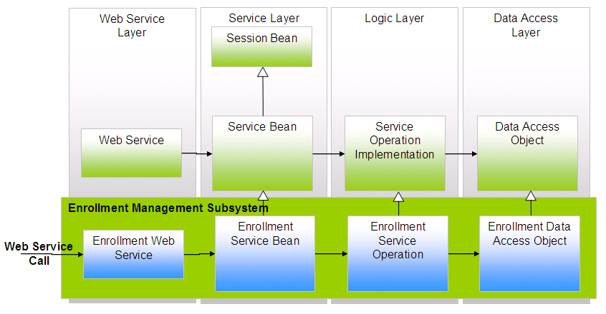
Software Architecture
What is the nature of the elements?
What are the responsibilities of the elements?
What is the significance of the connections?
What is the significance of the layout?

Slide 10
Where does architecture design come from?
The architecture design representation is derived from the system requirement specification and the analysis model.

Slide 11
Who is responsible for developing the architecture design?
Software architects and designers are involved in this process by translating (mapping) the software system requirements into architecture design.

Slide 12
Why is software architecture design so important?
A poor design may result in a deficient product that
  does not meet system requirements,
  is not adaptive to future requirement changes,
  is not reusable,
  exhibits unpredictable behavior, or
  performs badly.

Slide 13
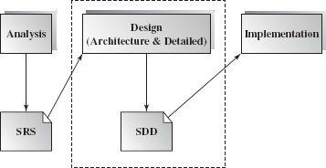
When is software design conducted?
Software design is an early phase of the Software Development Life Cycle (SDLC).

Slide 14
What is the outcome of the software architecture design?
Simply put, it is an overall representation of the software to be built.
A complete software architecture specification must describe not only
  the elements and connectors between elements, but also the
  constraints and runtime behaviors
so that developers know what and how the design should be implemented.

Slide 15
Architecture and Design

Slide 16
Architecture vs. Design
“All architecture is design, not all design is architecture”.
Architectural design is outward looking
    Focus on stakeholders, not technology
Architecture doesn't describe the complete characteristics of components – Design does.

Slide 17
Architecture vs. Design
architecture
design
implementation
CODE

Slide 18
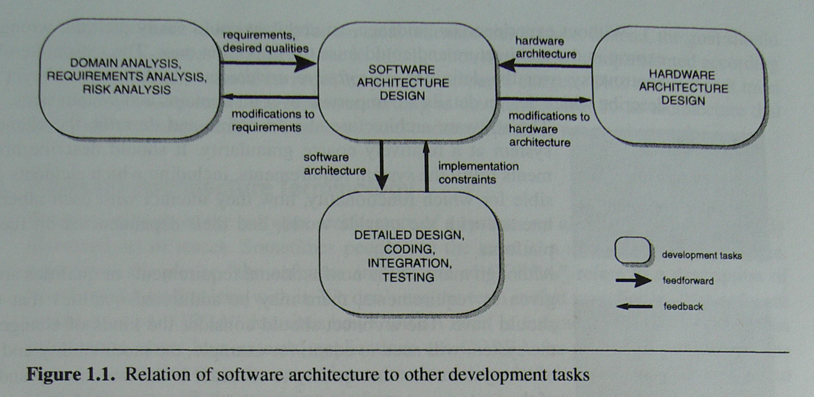
Software Architecture in Context

Slide 19
Architect’s tasks

Slide 20
Role of Software Architect
  A Software Architect provides a solution that the technical team can create and design for the entire application. A software architect should have expertise in the following areas
Design Expertise
Expert in software design, including diverse methods and approaches such as object-oriented design, event-driven design, etc.
Lead the development team and coordinate the development efforts for the integrity of the design.
Should be able to review design proposals and tradeoff among themselves.

Slide 21
Role of Software Architect
Domain Expertise
Expert on the system being developed and plan for software evolution.
Assist in the requirement investigation process, assuring completeness and consistency.
Coordinate the definition of domain model for the system being developed.
Technology Expertise
Expert on available technologies that helps in the implementation of the system.
Coordinate the selection of programming language, framework, platforms, databases, etc.

Slide 22
Role of Software Architect
Methodological Expertise
Expert on software development methodologies that may be adopted during SDLC (Software Development Life Cycle).
Choose the appropriate approaches for development that helps the entire team.
Hidden Role of Software Architect
Facilitates the technical work among team members and reinforcing the trust relationship in the team.
Information specialist who shares knowledge and has vast experience.
Protect the team members from external forces that would distract them and bring less value to the project.

Slide 23
Role of Software Architect
Deliverables of the Architect
A clear, complete, consistent, and achievable set of functional goals
A functional description of the system, with at least two layers of decomposition
A concept for the system
A design in the form of the system, with at least two layers of decomposition
A notion of the timing, operator attributes, and the implementation and operation plans
A document or process which ensures functional decomposition is followed, and the form of interfaces is controlled

Slide 24
Architectural influences
Influences
  System Stakeholders
  Developing organization
  Architects’ background and experience
  Technical environment
Precautionary measures
  Know your constraints
  Early engagement of stakeholders

Slide 25
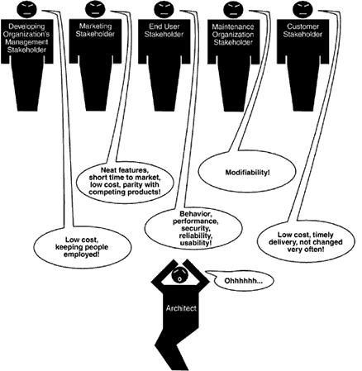

Slide 26
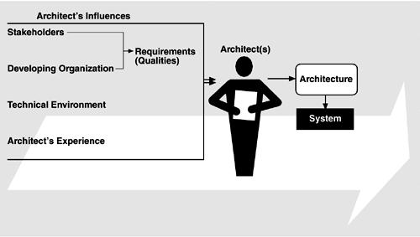
Influences on the architecture

Slide 27
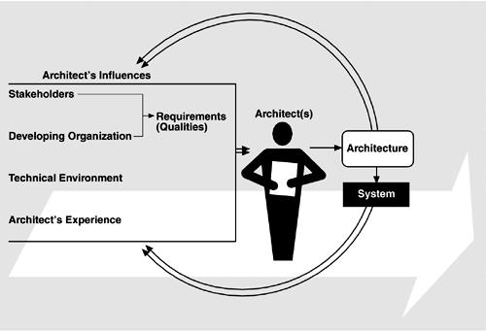
The Architecture Business Cycle

Slide 28
AN ARCHITECT’S TASKS
Perform static partition and decomposition of a system into subsystems and communications among subsystems.
  A software element can be configured, delivered, developed, and deployed, and is replaceable in the future.
  Each element's interface encapsulates details and provides loose coupling with other elements or subsystems.

Slide 29
AN ARCHITECT’S TASKS
Establish dynamic control relationships among different subsystems in terms of data flow, control flow orchestration, or message dispatching.
Consider and evaluate alternative architecture styles that suit the problem domain at hand.

Slide 30
AN ARCHITECT’S TASKS
Perform tradeoff analysis on quality attributes and other nonfunctional requirements during the selection of architecture styles.
  For example, in order to increase a distributed system's extensibility, portability, or maintainability, software components and Web services may be the best choice of element types, and a loose connection among these elements may be most appropriate.

Slide 31
Architecture Business Cycle

Slide 32
Architecture Business Cycle (ABC)
Software architecture is a result of technical, business and social influences.
These are in turn affected by the software architecture itself.
This cycle of influences from the environment to the architecture and back to the environment is called the Architecture Business Cycle (ABC).

Slide 33
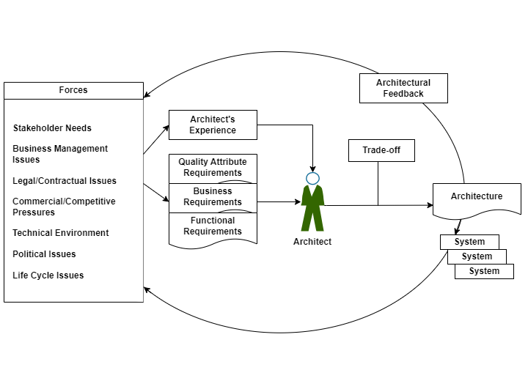
Architecture Business Cycle

Slide 34
ABC Activities
Creating the business case for the system
  Why we need a new system, what will be its cost? Time to market, integration with existing systems?
Understanding the Requirements
  Various approaches for requirements elicitation i.e., object-oriented approach, prototyping etc.
  The desired qualities of a system shape the architectural decisions – architecture defines the tradeoffs among requirements
Creating/selecting the architecture

Slide 35
ABC Activities …
Communicating the architecture
  Inform all stakeholders (i.e., developers, testers, managers, etc.)
  Architecture’s documentation should be unambiguous
Analysing or evaluating the architecture
  Evaluate candidate designs
  Architecture maps the stakeholders’ requirements/needs
Implementation based on architecture
Ensuring conformance to an architecture

Slide 36
Summary
Introduction to software architecture
Architecture vs Design
Architect’s responsibilities
Architecture Business Cycle

