Slide 1

20H58665– Architectural Representation
M Faizan Khan

Slide 2
Review
Introduction to software architecture
Architecture vs Design
Architect’s responsibilities
Architecture Business Cycle

Slide 3
Outline
Architectural Representation
  Using UML
  Using ADL

Slide 4
Architectural Representations
Software architecture specifies a high level of software system abstraction by employing decomposition, composition, architecture styles, and quality attributes.

Slide 5
Architectural Representations
Every software architecture must describe its collection of components and the connections and interactions among these components.
It must also specify the deployment configuration of all components and connections.
Additionally, a software architecture design must conform to the project's functional and nonfunctional requirements.

Slide 6
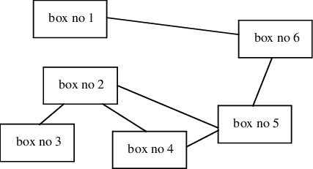
Architectural Representations – Box Diagram

Slide 7
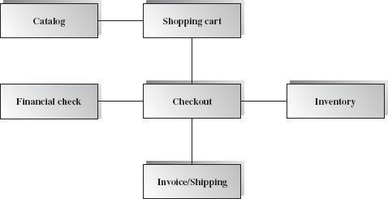
Architectural Representations – Box Diagrams
Box-and-line diagrams are often used to describe the business concepts and processes during the analysis phase of the software development lifecycle.

Slide 8
Box diagrams
These diagrams come with descriptions of components and connectors, as well as other descriptions that provide common intuitive interpretations.

Slide 9
Unified Modeling Language

Slide 10
UML for Software Architecture
The Unified Modeling Language (UML) is a graphical language for
  visualizing,
  specifying,
  constructing, and
  documenting
the artifacts of a software-intensive system.
UML offers a standard way to draw a system's blueprints.

Slide 11
Architecture View Models
a model is a complete, simplified description of a system from a particular perspective or viewpoint.
There is no single view that can present all aspects of complex software to stakeholders!!!

Slide 12
View Model
View models provide partial representations of the software architecture to specific stakeholders such as
  the system users,
  the analyst/designer,
  the developer/programmer,
  the system integrator, and
  the system engineer.

Slide 13
View Model
Software designers can organize the description of their architectural decisions in different views.

Slide 14
The 4 +1 View Model
The 4+1 view model was originally introduced by Philippe Kruchten (Kruchten, 1995).
The model provides four essential views:
  the logical view,
  the process view,
  the physical view, and
  the development view
and fifth is the scenario view

Slide 15
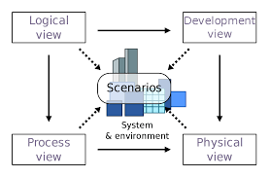
The 4 +1 View Model

Slide 16
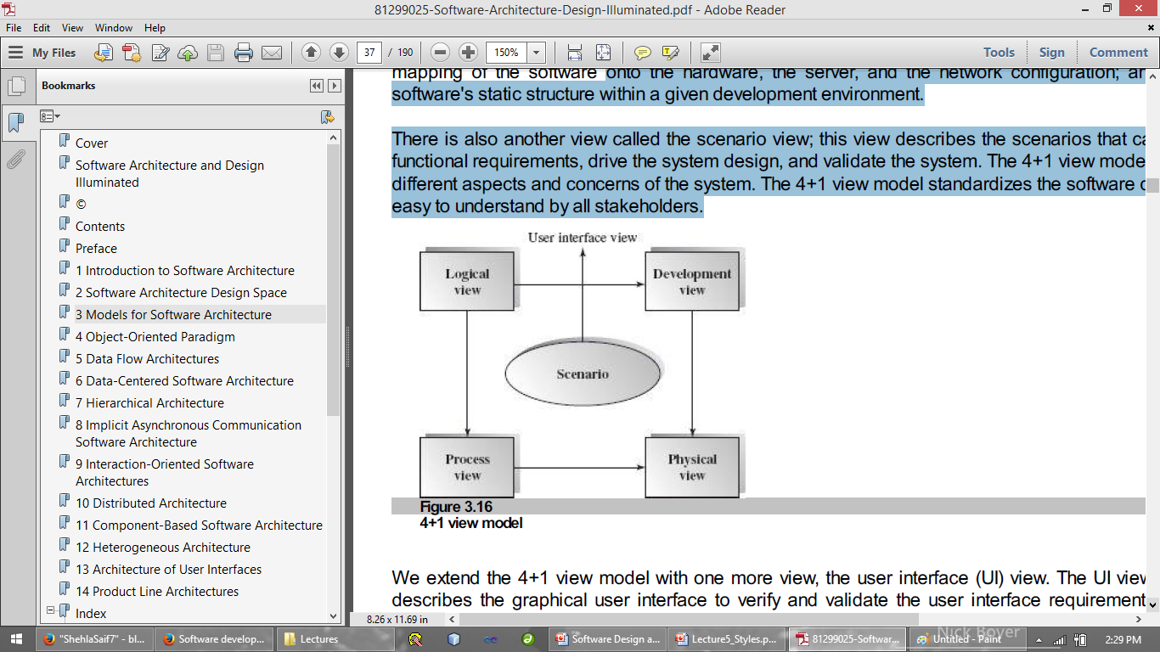
The 4+1 view model
Multiple-view model that addresses different aspects and concerns of the system.
Standardizes the software design documents and makes the design easy to understand by all stakeholders.

Slide 17
The Scenario View
The scenario view describes the functionality of the system, i.e., how the user employs the system and how the system provides services to the users.
It helps designers to discover architecture elements during the design process and to validate the architecture design afterward.
  The UML use case diagram and other verbal documents

Slide 18
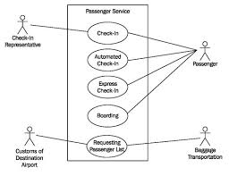
USE- CASE Diagram

Slide 19
The Logical or Conceptual View
The logical view is based on application domain entities necessary to implement the functional requirements.
The logical view specifies system decomposition into conceptual entities (such as objects) and connections between them (such as associations).

Slide 20
The logical view
The logical view is typically supported by
  UML static diagrams including class/object diagrams and
  UML dynamic diagrams such as the interaction overall diagram, sequence diagram, communication diagram, state diagram, and activity diagram.

Slide 21
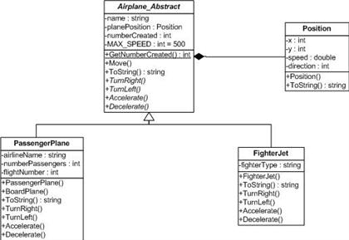
Class Diagram

Slide 22
The Development or Module View
The development view derives from the logical view and describes the static organization of the system modules.
Modules such as namespaces, class library, subsystem, or packages are building blocks that group classes for further development and implementation.
UML diagrams such as package diagrams and component diagrams are often used to support this view.

Slide 23
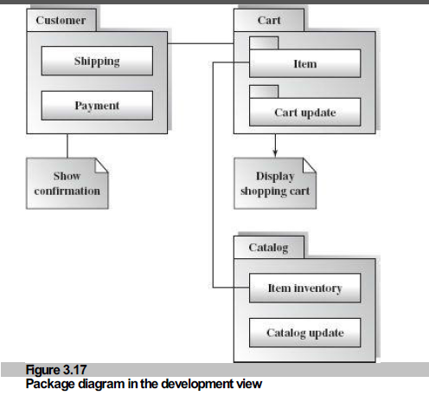
Package Diagram

Slide 24
The Process View
The process view focuses on the dynamic aspects of the system, i.e., its execution time behavior.
This view maps functions, activities, and interactions onto runtime implementation.
The process view takes care of the concurrency and synchronization issues between subsystems.
The UML activity diagram and interaction overview diagram support this view.

Slide 25
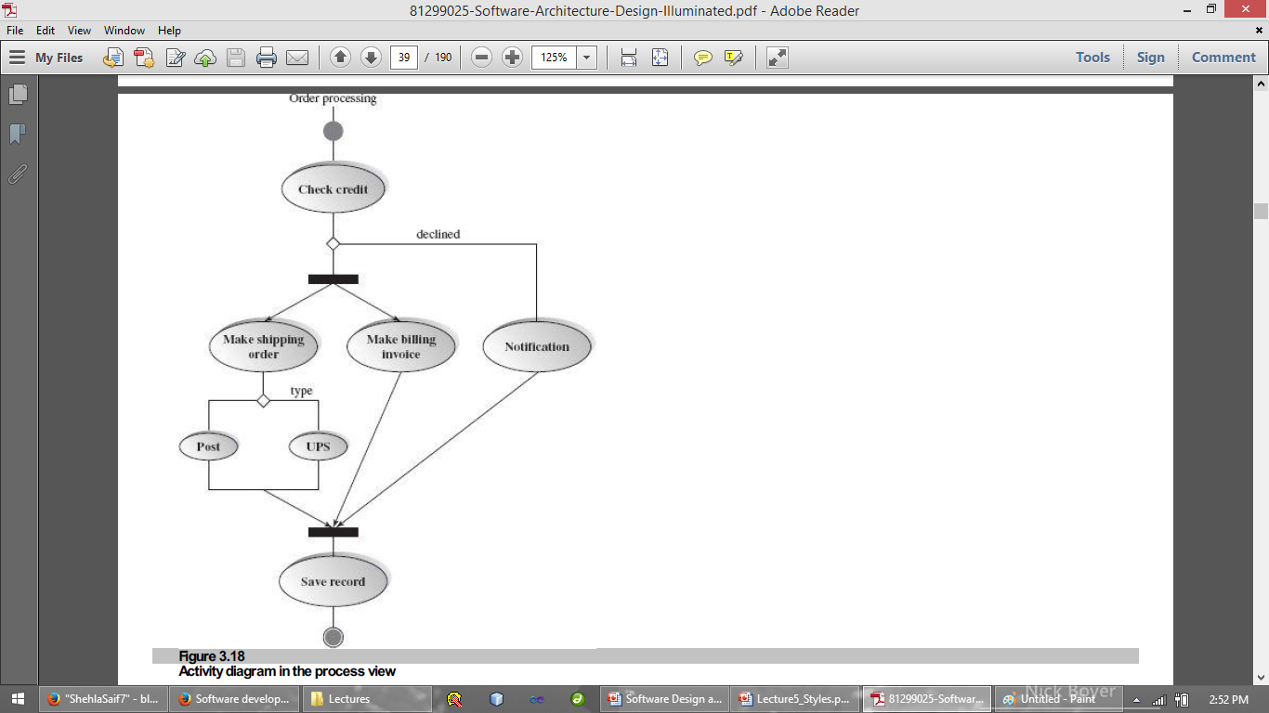
Activity Diagram

Slide 26
The Physical View
The physical view describes installation, configuration, and deployment of the software application.
It concerns itself with how to deliver the deploy-able system.
The physical view shows the mapping of software onto hardware.
  It is particularly of interest in distributed or parallel systems.
The UML deployment diagrams and other documentation are often used to support this view.

Slide 27
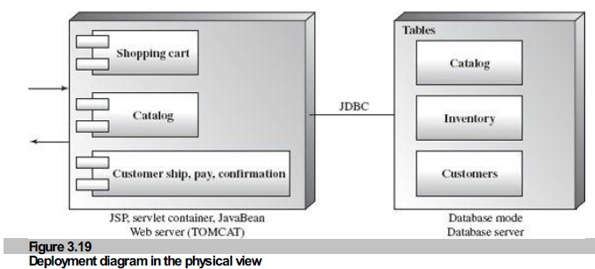
Deployment Diagram

Slide 28
The User Interface View
The User Interface (UI) view is an extended view that provides a clear user-computer interface view and hides implementation details.
This view may be provided as a series of screen snapshots or a dynamic, interactive prototype demo.
Any modification on this view will have direct impact on the scenarios view.

Slide 29
The 4 +1 View Model
The 4+1 view model was originally introduced by Philippe Kruchten (Kruchten, 1995).
The model provides four essential views:
  the logical view,
  the process view,
  the physical view, and
  the development view
and fifth is the scenario view

Slide 30
4+1 view model
The 4+1 view is an architecture verification technique for studying and documenting software architecture design.

Slide 31
Architecture Description language

Slide 32
What is an Architecture Description Language?
It is a modelling notation to support architecture-based development
  used to define and model system architecture prior to detailed design and implementation

Slide 33
Many ADLs
Architecture Description Languages (ADLs) can be used to specify an architecture
UML (OMG) - general-purpose
SADL (SRI)
Aesop (Carnegie Mellon University)
Acme (CMU) – and interchange format
Rapide (Stanford University)
Wright (CMU)
Darwin (Imperial College London)

Slide 34
Parts of an ADL
Architecture Style =
  {Component/Connector Vocabulary, Topology,Semantic Constraints}
Components (locus of computation),
  filter, data store, object, process, server
Connectors (interactions between components),
  procedure call, RPC, pipe, TCP/IP
Key issue - tool support

Slide 35
Acme: a generic ADL
n Developed by David Garlan and others (CMU) and David Wile (USC)
  Simple, generic language for describing software architectures and families of architectures
  Intended to be standard representation for tools

Slide 36
Tools – ACME Studio
ACME Studio - a viewer and editor for ACME descriptions.
Text and graphical views supported.

Slide 37
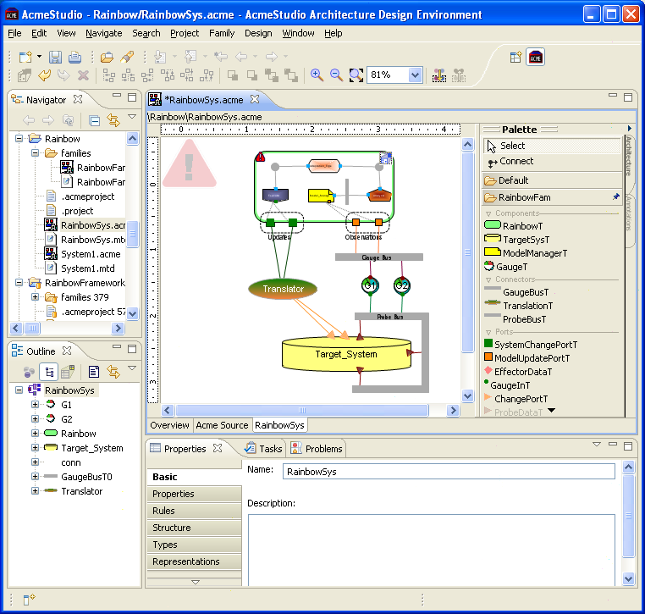

Slide 38
Elements of Components and Connectors view
Components model principal run-time elements that have a set of ports
Ports model component’s interfaces through which component interacts with other components via connectors
Connectors model the pathways of communication between components and have a set of roles
Roles model the specifications of behavior requires of the components that use a given connector

Slide 39
Example of Component and Connector (C&C) Model in Acme ADL
Simple-cs system consist of a single client and a single server, interacting through rpc based connector
In this representation we can analyze our C&C model to see if there are any unattached roles or ports, name collisions and etc.

Slide 40
Modeling Architectural Properties in Acme ADL
Properties are name-value pairs that can be associated with any architectural element: component, port, connector
Sync-request port property indicates if rpc-request port is synchronous or asynchronous, max-transactions-per-second and max-clients-supported component properties indicate maximum properties of server component and protocol property of rpc connector indicates the name of the communication protocol

Slide 41
Summary
Architectural Representation
  Using UML
  Using ADL

