Slide 1

Introduction and Categorizations to Architectural Styles
M Faizan KHAN

Slide 2
Review
Architectural Representation
  Using UML
  Using ADL

Slide 3
Outline
Introduction to architectural styles
Categorizations of architectural styles
Hierarchical architectures
  Layered Architecture

Slide 4
Architectural Styles
An architecture style (also known as an “architecture pattern”) abstracts the common properties of a family of similar designs.
Define a family of systems in terms of a pattern of its structural organization.

Slide 5
Components of a style
The key components of an architecture style are:
Elements/components
  that perform functions required by a system
Connectors
  that enable communication, coordination, and cooperation among elements
Constraints
  that define how elements can be integrated to form the system
Attributes
  that describe the advantages and disadvantages of the chosen structure

Slide 6
Categories of Architectural Styles
Hierarchal Software Architecture
  Layered
Distributed Software Architecture
  Client Server
  SOA
Data Flow Software Architecture
  Pipe n Filter
  Batch Sequential
Event Based Software Architecture
Data Centered Software Architecture
  Black board
  Shared Repository
Interaction-Oriented Software Architectures
  Model View Controller
Component-Based Software Architecture

Slide 7
Hierarchal Software Architecture

Slide 8
Hierarchal Style
The hierarchical software architecture is characterized by viewing the entire system as a hierarchy structure.
The software system is decomposed into logical modules (subsystems) at different levels in the hierarchy.

Slide 9
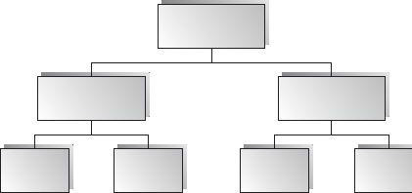
Hierarchal Style
Modules at different levels are connected by explicit or implicit method invocations.
  a lower-level module provides services to its adjacent upper-level modules, which invokes the methods or procedures in the lower level.

Slide 10
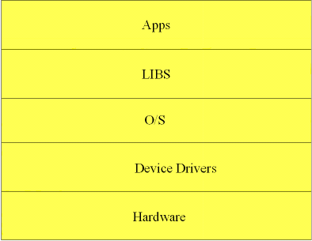
Hierarchal Style
System software is typically designed using the hierarchical architecture style;
  examples include Microsoft .NET, Unix operating system, TCP/IP, etc.

Slide 11
Hierarchal Style
Lower levels provide more specific functionality down to fundamental utility services
  such as I/O services, transaction, scheduling, and security services, etc.
Middle layers, in an application setting, provide more domain- dependent functions
  such as business logic or core processing services.
Upper layers provide more abstract functionality in the form of user interfaces
  such as command line interpreters, GUIs, Shell programming facilities, etc.

Slide 12
Layered Architecture

Slide 13
Layered Style
Organized hierarchically into layers.
Each layer provides service to the layer above it and serves as a client to the layer below.
The connectors are defined by the protocols that determine how the layers will interact.

Slide 14
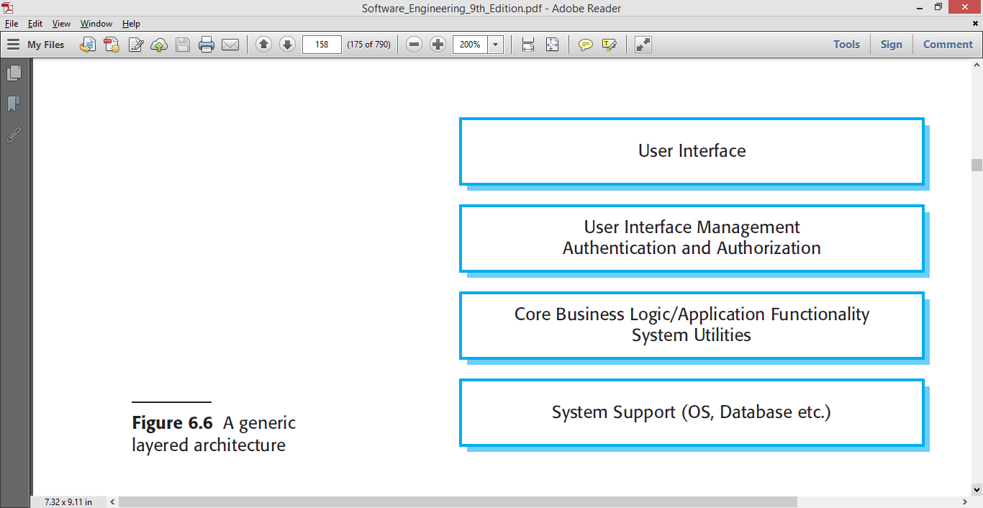
A generic Layered Architecture

Slide 15
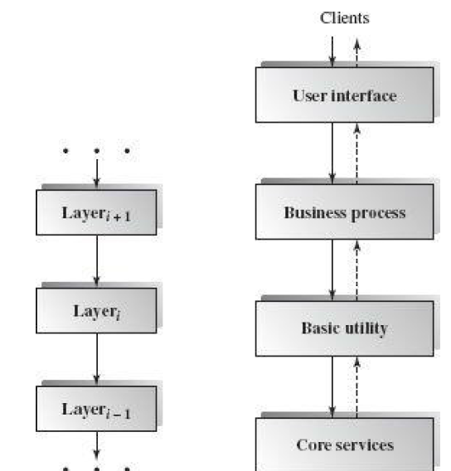
A partial layered architecture example

Slide 16
Specializations
Often exceptions are made to permit non-adjacent layers to communicate directly.
  This is usually done for efficiency reasons.

Slide 17
Example:
Library system
Allows controlled electronic access to copyright material from a group of university libraries.
Bottom layer being the individual database in each library.
Components?

Slide 18
Components:
  UI
  Authentication and forms
  Search engine
  Document retrieval
  Rights manager
  Accounts management
  databases

Slide 19
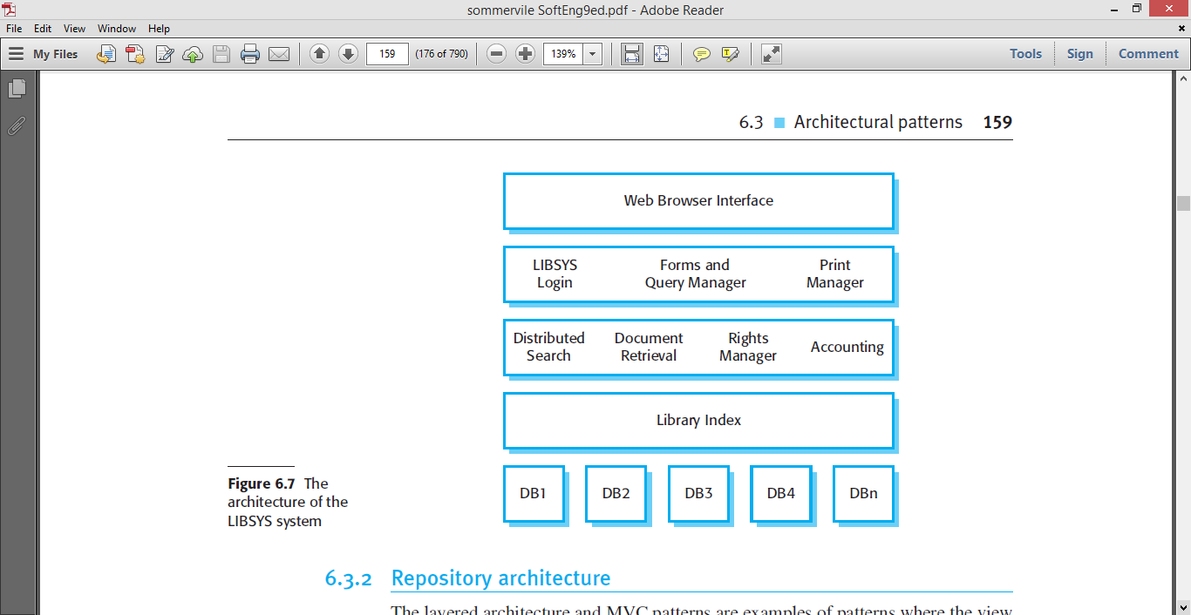
Example: Library System
Ref: Software Engineering - Sommerville

Slide 20
Applicable domains of layered architecture:
Any system that can be divided between the application-specific portions and platform-specific portions which provide generic services to the application of the system.

Slide 21
Applicable domains of layered architecture:
Applications that have clean divisions between core services, critical services, user interface services, etc.
Applications that have a number of classes that are closely related to each other so that they can be grouped together into a package to provide the services to others.

Slide 22
Benefits:
Incremental software development based on increasing levels of abstraction.
Enhanced independence of upper layer to lower layer since there is no impact from the changes of lower layer services as long as their interfaces remain unchanged.

Slide 23
Benefits:
Enhanced flexibility: interchangeability and reusability are enhanced due to the separation of the standard interface and its implementation.

Slide 24
Benefits:
Component-based technology is a suitable technology to implement layered architecture; this makes it much easier for the system to allow for plug-and-play of new components.
Promotion of portability: each layer can be an abstract machine deployed independently.

Slide 25
Limitations:
Lower runtime performance since a client's request or a response to a client must go through potentially several layers.
There are also performance concerns of overhead on the data processing and buffering by each layer.

Slide 26
Limitations:
Many applications cannot fit this architecture design.
Breach of interlayer communication may cause deadlocks, and “bridging” may cause tight coupling.
Exceptions and error handling are issues in the layered architecture, since faults in one layer must propagate upward to all calling layers.

Slide 27
Summary
Introduction to architectural styles
Categorizations of architectural styles
Hierarchical architectures
  Layered Architecture

