Slide 1

SOFTWARE DESIGN AND ARCHITECTURE
M FAIZAN KHAN

Slide 2
Review
Introduction to architectural styles
Distributed architectures
  Client Server Architecture
  Multi-tier Architecture

Slide 3
Outline
Distributed Architectures
  Service Oriented Architecture

Slide 4
Distributed Software Architecture

Slide 5
Distributed Software Architecture
A distributed system is a collection of computational and storage devices connected through a communications network.
Communication occurs using a number of methods including message passing, remote procedure calls, and remote method invocation.

Slide 6
Service Oriented Architecture

Slide 7
Service
A service is a business functionality that is
  well-defined,
  self-contained,
  Independent from other services,
and published and available to be used via a standard programming interface.

Slide 8
Service Oriented Architecture (SOA)
Service Oriented Architecture (SOA) is a business centric IT architectural approach that supports integrating your business as linked, repeatable business tasks, or services.

Slide 9
Service orientation
Service orientation is a particular strategy for separating concerns and dividing a system into components.
Its fundamental characteristic is that every component provides a distinct service that can be used by multiple consumers.

Slide 10
Banking example
Imagine that several areas of banking applications will deal with the current balance of an existing customer.
More than often, the “get current balance” functionality is repeated in various applications within a banking environment.
This gives rise to a redundant programming scenario.
The focus should be toward finding this sort of common, reusable functionality and implement it as a service, so
  that all banking applications can reuse the service as and when necessary.

Slide 11
SOA Defined
SOA is a software architecture model
  in which business functionality are logically grouped and encapsulated into
    self contained, distinct and reusable units
    called services that
    represent a high level business concept
    can be distributed over a network
    can be reused to create new business applications
    contain contract with specification of the purpose, functionality, interfaces (coarse grained), constraints, usage
        ... of the business functionality

Slide 12
Service Discovery
A service can only be used if potential clients are aware of its existence, and have information about how to use it.
This is achieved through service description.
  A service description contains at least the name of the service, the location of the service, and the data exchange requirements.

Slide 13
Key aspects of services
Loose coupling
  the inherently unreliable communication over the internet must not lead to a blocked system.
Service contract
  A service contract is a communications agreement, and specifies the details of the service that the service provider is performing
Autonomy
  Services should have control over the logic they encapsulate.

Slide 14
Key aspects of services
Abstraction
Reusability
Composability
Statelessness
  services should minimize retaining information specific to an activity
Discoverability

Slide 15
What is Service Architecture?
services
A collection of services
type
type
type
classified into types
arranged into layers
Governed by architectural
patterns and policies
identification
granularity
dependency
source:TietoEnator AB, Kurts Bilder

Slide 16
Need for SOA
Isolating business logic
  The biggest problem in programming is often it is very difficult to keep the business logic separated from the so called “computer logic”.
  Non-IT folks can change the business logic any time, without understanding how a small change could result in possibly disproportionate amount of work required by the IT folks to implement the change.

Slide 17
Need for SOA
Interoperability
Redundancies
  There are many similar yet slightly different applications that are used throughout the organization.
  Each department usually comes out with its own version of software components.

Slide 18
Types of Services
There are several types of services used in SOA systems.
  Business services
  Entity services
  Functional services
  Utility services

Slide 19
Types of Services
Business services
  Business service can be defined as the logical encapsulation of business functions. It has to be relevant to the business the organization is running.
Entity services
  An entity service usually represents business entities (e.g. Employee, Customer, Product, Invoice etc.). Such entity service usually expose CRUD (create, read, update, delete) operations.

Slide 20
Types of Services
Functional services
  It is usually a technology-oriented service and not a business oriented one. Task services can be thought of as controller of composition of services and hence its reusability is usually lower.
Utility services
  Utility services offers common and reusable services that are usually not business centric. They might include event logging, notifications exception handling etc.

Slide 21
Service Architecture Organized by Layers
Reasons for Layering
Flexible composition.
Reuse.
Functional standardization in lower levels
Customization in higher layers
Separation of Concerns.
Policies may vary by Layer
Example Layers
Presentation
& workflow
Composed Services
Basic Services
Underlying
API
according to:TietoEnator AB, Kurts Bilder
Notes:
Flexible composition. Services are
composed from many Services in
lower layers
Reuse. Services are used by
many Services in higher layers
Functional standardization and
commoditization in lower levels
Customization in higher layers
Separation of Concerns. Each layer
may reflect different
Purpose and role of Service
Provider of services in that layer
Appropriate Technology or
implementation approach for the
layer
Policies may vary by Layer. E.g.
Different Sourcing permitted
Degree of Standardization/
Differentiation allowed

Slide 22
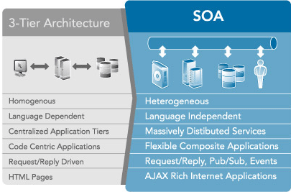
SOA is an evolutionary step
for architecture

Slide 23
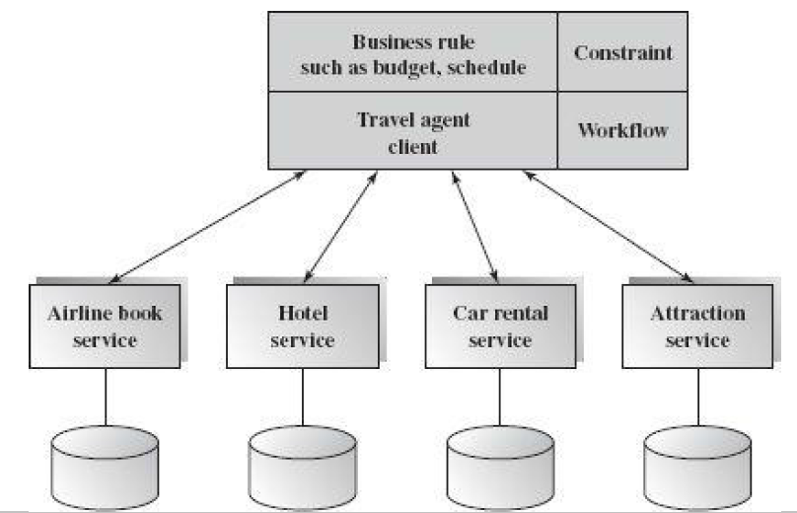
Another example
An online travel agency system
It consists of four existing web services:
  airline reservation,
  car rental,
  hotel reservation,
  and attraction reservation.

Slide 24
SOA Benefits
Ability to build business applications faster and more easily
Easier maintenance / update
Business agility and extensibility
Lower total cost of ownership

Slide 25
Summary
Distributed architectures
  Service Oriented Architecture

