Slide 1

SOFTWARE DESIGN AND ARCHITECTURE
M Faizan KHan

Slide 2
Review
Interaction-Oriented Software Architectures
  MVC

Slide 3
Outline
Component Based Architecture

Slide 4
Component based software architecture

Slide 5
Component Based Software Architecture
Component-based software architecture divides a problem into sub-problems each associated with component partitions.
The interfaces of the components play important roles in the component-based design.
The main motivation behind component-based design is component reusability.

Slide 6
Component Based Software Architecture
Designs can make use of existing reusable commercial off-the-shelf (COTS) components or ones developed in-house, and they may produce reusable components for future reuse.
This increases overall system reliability since the reliability of each individual component enhances the reliability of the whole system via reuse.

Slide 7
Component
A component is a deployable software package that can provide services to its clients;
  it may also itself require services from other components.
A component remains self-contained and substitutable as long as its interface is unchanged.

Slide 8
Component
Component is a higher level of abstract concept than class.
A component may consist of many related classes stored and deployed in the same binary assembly.

Slide 9
Component
The interface of a component plays the role of contract between its implementation and its clients; hence the approach is also called a contract-oriented software architecture.
The first step in component-based software design is to identify first cut components and specify all necessary connections among these components.
The connections are conducted via the interfaces of components.

Slide 10
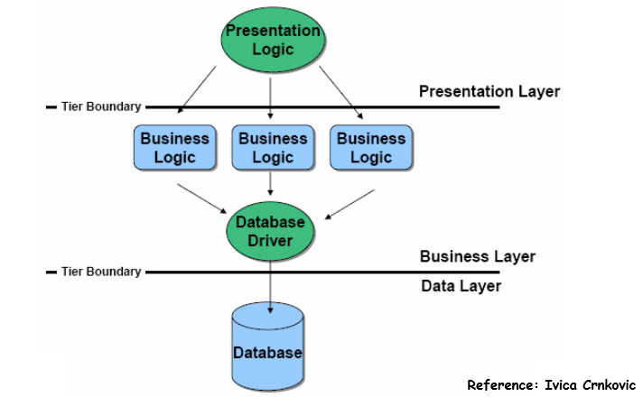
N tier Architecture

Slide 11
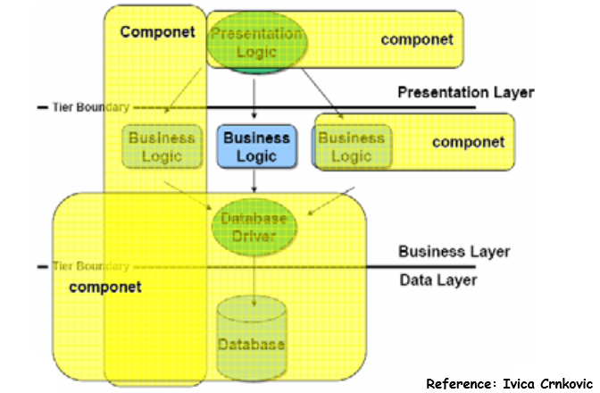

Slide 12
Components can be made of
Source code
  Classes – one or more, possibly related
Executable code
  Object code
  Virtual object code
Other files
  Images, text, indices

Slide 13
Connectors
Connectors connect components, specifying and ruling their interaction.
Component interaction can take the form of
  method invocations,
  asynchronous invocations such as
    event listener and registrations,
    broadcasting,
  message-driven interactions,
  data stream communications, and
  other protocol specific interactions.
The interaction type is specified by the interfaces of the components.

Slide 14
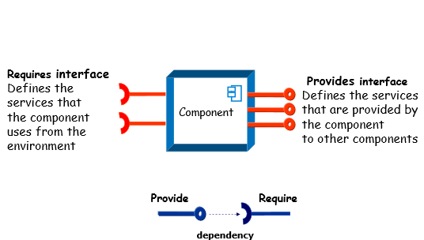

Slide 15
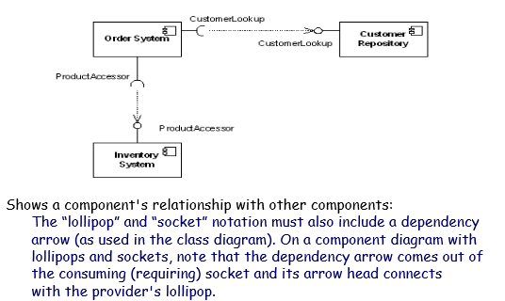

Slide 16
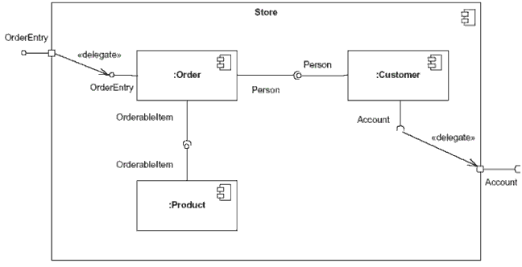

Component Diagram
Figure: This component's inner structure is composed of other components

Slide 17
Contractual interfaces
A specification attached to an interface that mutually binds the clients and providers of the components
Functional Aspects (API)
Pre- and post-conditions for the operations specified by API
  Preconditions denoting the constraints which need to be met by the client
  Postconditions denoting the constraints which the component promises to fulfill in return
  A component may also additionally satisfy global constraints called invariants
Non-functional aspects (different constrains, environment requirements, etc.)

Slide 18
Component Model
A component model is a definition of standards for component implementation, documentation and deployment
  Examples of component models
    EJB model (Enterprise Java Beans)
    .NET model
    Corba Component Model
The component model specifies how interfaces should be defined and the elements that should be included in an interface definition
Different application domains have different needs for component-based systems
  Different non-functional properties: performance, security, reliability, scalability, etc.

Slide 19
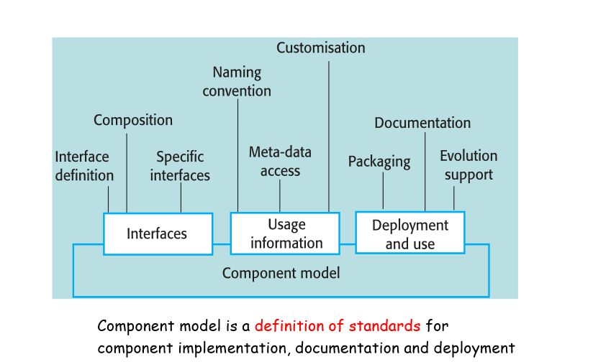
Elements of a component model

Slide 20
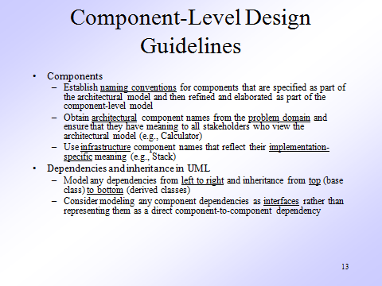

Slide 21
Applicable domains of component-based architecture
Applications where the interface contracts between subsystems are clear
Applications that require loose coupling between the components and where many reusable components are available
Suitable for the class library system organization (.NET class library and Java API are built in component architecture)

Slide 22
Benefits
Reusability of components.
System maintenance and evolution; easy to change and update the implementation without affecting the rest of the system.
Independency and flexible connectivity of components.

Slide 23
Benefits
Independent development of components by different groups in parallel.
Productivity for the current and future software development.
Many OO design tools can also be used for component-based software development.

Slide 24
Limitations
It can be difficult to find suitable available components to reuse.
Adaptation of components is an issue.
Few component-oriented dedicated design tools are available.

Slide 25
Summary
Component oriented Software Architecture

